Slide 1
Masaryk University School of Medicine and Brno University Hospital Department of Obstetrics and Gynecology
Head: doc. MUDr. Vít Weinberger, PhD.
Uterine tumors
Eliška Gazárková
Gynecology and Obstetrics
2020

Slide 2
Uterine tumors
Tumors of the uterine body
Cervical tumors
Benign (leiomyoma, polyp)
Malignant (sarcoma, endometrial cancer)

Slide 3
Uterine tumors
Benign tumors of the uterine body
Leiomyoma
Endometrial polyp

Slide 4
Uterine tumors
Leiomyoma
Body (cervix, Fallopian tubes, ovary, vagina, vulva, ligament, GIT)
20-50% of women
Most common diagnosis
35-45 years; after menopause occurs involution

Slide 5
Uterine tumors
Leiomyoma
Classification according to localization:
Subkumosal (ev. nascent)
Intramurals
Subserous (ev. stopwatch)
Intraligamentous
Degenerative changes
Hyalinization, mukoid degeneration, cystic degeneation, kacification

Slide 6
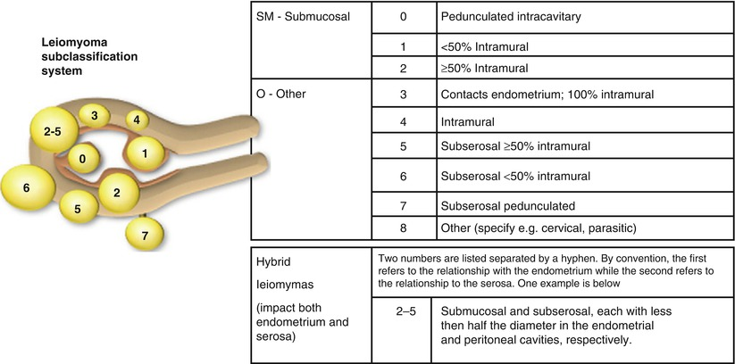
Uterine tumors
Leiomyoma
Classification according to localization:

Slide 7
Uterine tumors
Leiomyoma
Symptomatology
60-90% asymptomatic
Irregular uterine bleeding, hypermenorrhoea, anemization
Lower abdominal pain
Urinary symptoms (pressure on the bladder, urine retention)
Obstipation
Sterility / infertility

Slide 8
Uterine tumors
Leiomyoma
Etiology
Hormonal dysregulation (hyperestrogenismus)
Genetic causes
Antropometric influences (BMI)
Diagnosis
Palpation, gynecological examination
Ultrasound
Complementary methods – CT, MR
Invasive methods – LSK, HSK
Histology – final diagnosis

Slide 9
Uterine tumors
Leiomyoma
Therapy – conservative approach
Elimination of the symptoms / myoma volume reduction
Non steroid anflogistics
HAK, depot gestogens – reduction of blood loss, dysmenorrhoea
GnRh analogs – arteficial menopause – reduction of blood loss + myoma volume reduction

Slide 10
Uterine tumors
Leiomyoma
Therapy – sugical
Myoma enucleation - laparotomic, laparoskopic, hysterosocpic
younger women, intrests in fertility
Hysterectomy - abdominal, vaginal, laparoscopic
(preoperative preparation – 3 month aplication of GnRh analogs)

Slide 11
Uterine tumors
Corporal polyp
Grows out of the pars basalis
Most frequent localisation – uterine fundus
Hyperplastic, atrofic, functional
Mostly asymptomatic X irregular uterine bleeding, pain
Dignosis: ultrasound, hysteroscopy
Therapy: surgical – curretage, HSK

Slide 12
Uterine tumors
Malignant tumors of the uterine body​ –
uterine cancer – endometrial carcinoma
3.-4. most common malignancy in the world (breast, colorectal, lung)
the most common gynecological malignancy in developed coutries
absence of screening (ultrasound, hysteroscopy, cytology)
relatively good prognosis, 75 - 88% of patients in IA a IB stages survive more than 5 years following diagnosis
low incidence in African countries
two times higher incidence in white race

Slide 13
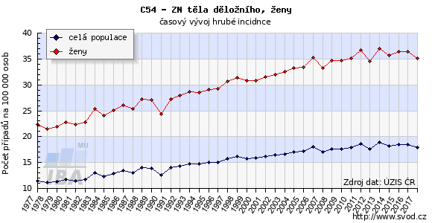
Uterine cancer

Slide 14
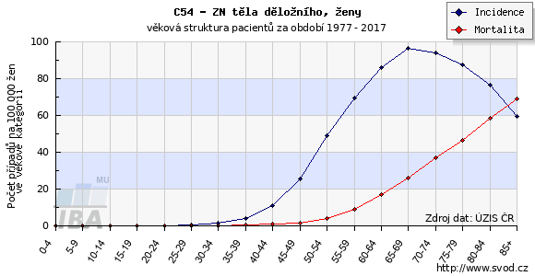
Uterine cancer

Slide 15
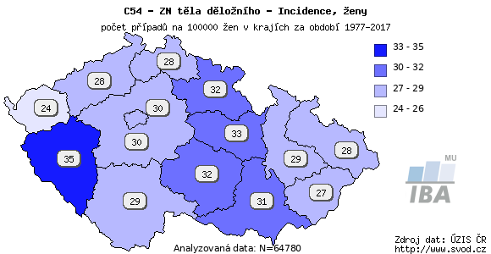
Uterine cancer

Slide 16
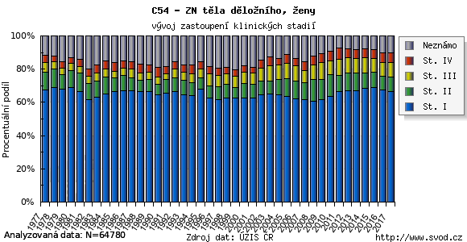
Uterine cancer

Slide 17
Histologic types of uterine tumors
Uterine cancer
Epithelial tumors (98%)
- endometrioid adenocarcinoma (squamous component., viloglandular comp., secreting, sertoliform, microglandular) (78-80%)
- mucinous (1-9%)
- clear cell (2%)
- uterine papillary serous (<10%)
- spinocelular (<1%)
- Neuroendocrine Carcinoma of the Endometrium (NECa): LG -carcinoid,
HG –small cell and large cell neuroendocrine carcinoma
- mixed (I.+ II. type)
- malignant mixed müllerian tumor: carcinosarcoma
Mesenchymal tumors
- leiomyosarcoma
- endometrial stromal sarcoma (low i high grade)
- undifferentiated uterine sarcoma (high grade)
- Rare types (rhabdomyosarcoma…)

Slide 18
Etiopathogenesis
Uterine cancer
Type I
- 80 - 85 % off all cases
- based on endometrial hyperplasia
- the most common somatic abnormalities: microsatellite instability (asociated with
Lynch syndrome), mutation: PTEN, PIK3CA, PIK3R1, K-ras, β-catenin (squamouse differentiation of endometrial carcinoma)
- typical histologic types: low grade endometrial carcinoma, mucinous adenocarcinoma
- better prognosis
Type II
- 15-20 % of all cases
- unclear ethiopatogenesis, frequently appeared on a background of an atrophic endometrium, not connected with hyperestrinism and endometrial hyperplasia, absence of risk factors typical for I. Type, in most cases hormonaly independent (ER-, PR-)
- worse prognosis than I type, older patients (60 y.o. and older)
- the most frequent somatic abnormalitie: mutation in p53, chromosomal instability, approximately 25% HER-2 amplification
- ussaul histological types: serous carcinoma, high grade endometrioid carcinoma , clear cell

Slide 19
Uterine cancer
Risk factors
Type I:
women at age 55 and above (the risk of cancer increases with age)
obesity (BMI ˃ 30 incresing risk 3-4x)
early menarche, late menopause, nulliparity, anovulation, polycystic ovary syndrome, long-term tamoxifen use
hypertension
diabetes mellitus
Genetic risk factors: approx. 5 % of endometrial carcinoma cases are hereditary
The manifestation of cancer is 10-20 years earlier thant in non-hereditary (sporadic) forms
In case of Lynch syndrome II (HNPCC = Hereditary nonpolyposis colorectal cancer) – the risk of endometrial cancer is 30-60 %
Endometrial cancer is typically manifested prior to colorectal carcinoma
Type II:
uncertain ethiopatogenesis

Slide 20
Uterine cancer
Protective factors
multiparity RR 0,5 (after 1st. delivery only 50% risk compared to nulliparous women)
vegetarian lifestyle, sufficient intake of vitamin A and C
combined oral contraceptive use more than 5 years RR 0,5 (lasting effect for 10-15 years)
smoking RR 0,5-0,7
IUS (intrauterine system) – Mirena, RR 0,6
physical activity

Slide 21
Uterine cancer
Endometrial hyperplasia – risk of carcinoma progression
simplex endometrial hyperplasia…………………….1 %
complex endometrial hyperplasia ……………………3 %
precancerous condition
simplex atypical endometrial hyperplasia ………….. 8 %
complex atypical endometrial hyperplasia……...29-40 %
serous intraepithelial carcinoma (serous and clear cell carcinoma type II)

Slide 22
TNM | FIGO stages | Surgical-pathologic findings
TX |  | Primary tumor cannot be assessed
T0 |  | No evidence of primary tumor
Tis* |  | Carcinoma in situ (preinvasive carcinoma)
T1 | I | Tumor confined to corpus uteri
T1a | IA | Tumor limited to endometrium or invades less than one half of the myometrium
T1b | IB | Tumor invades one half or more of the myometrium
T2 | II | Tumor invades stromal connective tissue of the cervix but does not extend beyond uterus**
T3a | IIIA | Tumor involves serosa and/or adnexa (direct extension or metastasis)
T3b | IIIB | Vaginal involvement (direct extension or metastasis) or parametrial involvement
 | IIIC | Metastases to pelvic and/or para-aortic lymph nodes
 | IV | Tumor invades bladder mucosa and/or bowel mucosa, and/or distant metastases
T4 | IVA | Tumor invades bladder mucosa and/or bowel mucosa (bullous edema is not sufficient to classify a tumor as T4)
M0 |  | No distant metastasis
M1 | IVB | Distant metastasis (includes metastasis to inguinal lymph nodes, intraperitoneal disease, or lung, liver, or bone metastases; it excludes metastasis to para-aortic lymph nodes, vagina, pelvic serosa, or adnexa)

Slide 23
Prognostic factors
Uterine cancer
- stage of disease (FIGO, TNM)
- quality of surgical treatement
Negative prognostic factors:
- lymph node metastatic lesion (quantity, size), extrauterine spread, the depth of myometrial invasion, cervical invasion, tumor size greater then 2cm, invasion in lymphatic vessels
- L1CAM positivity, loss of ER, PR, mutations in the p53
- Histological type: typ II (a 5 year surveillance 58 % in comparison to 83 % in type I)
- Other negative prognostics factors: age of 60 and above, radiotherapy for the primary treatment
Positive prognostic factors:
- Progesteron receptors positivity (type I), significant lymfoplasmocellular infiltration

Slide 24
Prognostic factors
Uterine cancer
According to known prognostic factors, it is possible to divide stadium I to 3 categories with different therapeutic approach (ESGO, ESMO guidelines).
Low risk: stage IA, grade 1-2, type I (endometrioid)
Intermediate risk: stage IA, grade 3, type I (endometrioid)
stage IB, grade 1-2, type I (endometrioid)
Hish risk: stage IB, grade 3, type I (endometrioid)
non-endometrioid types
In relation to extensiveness of surgery
Low risk
High riské riziko

Slide 25
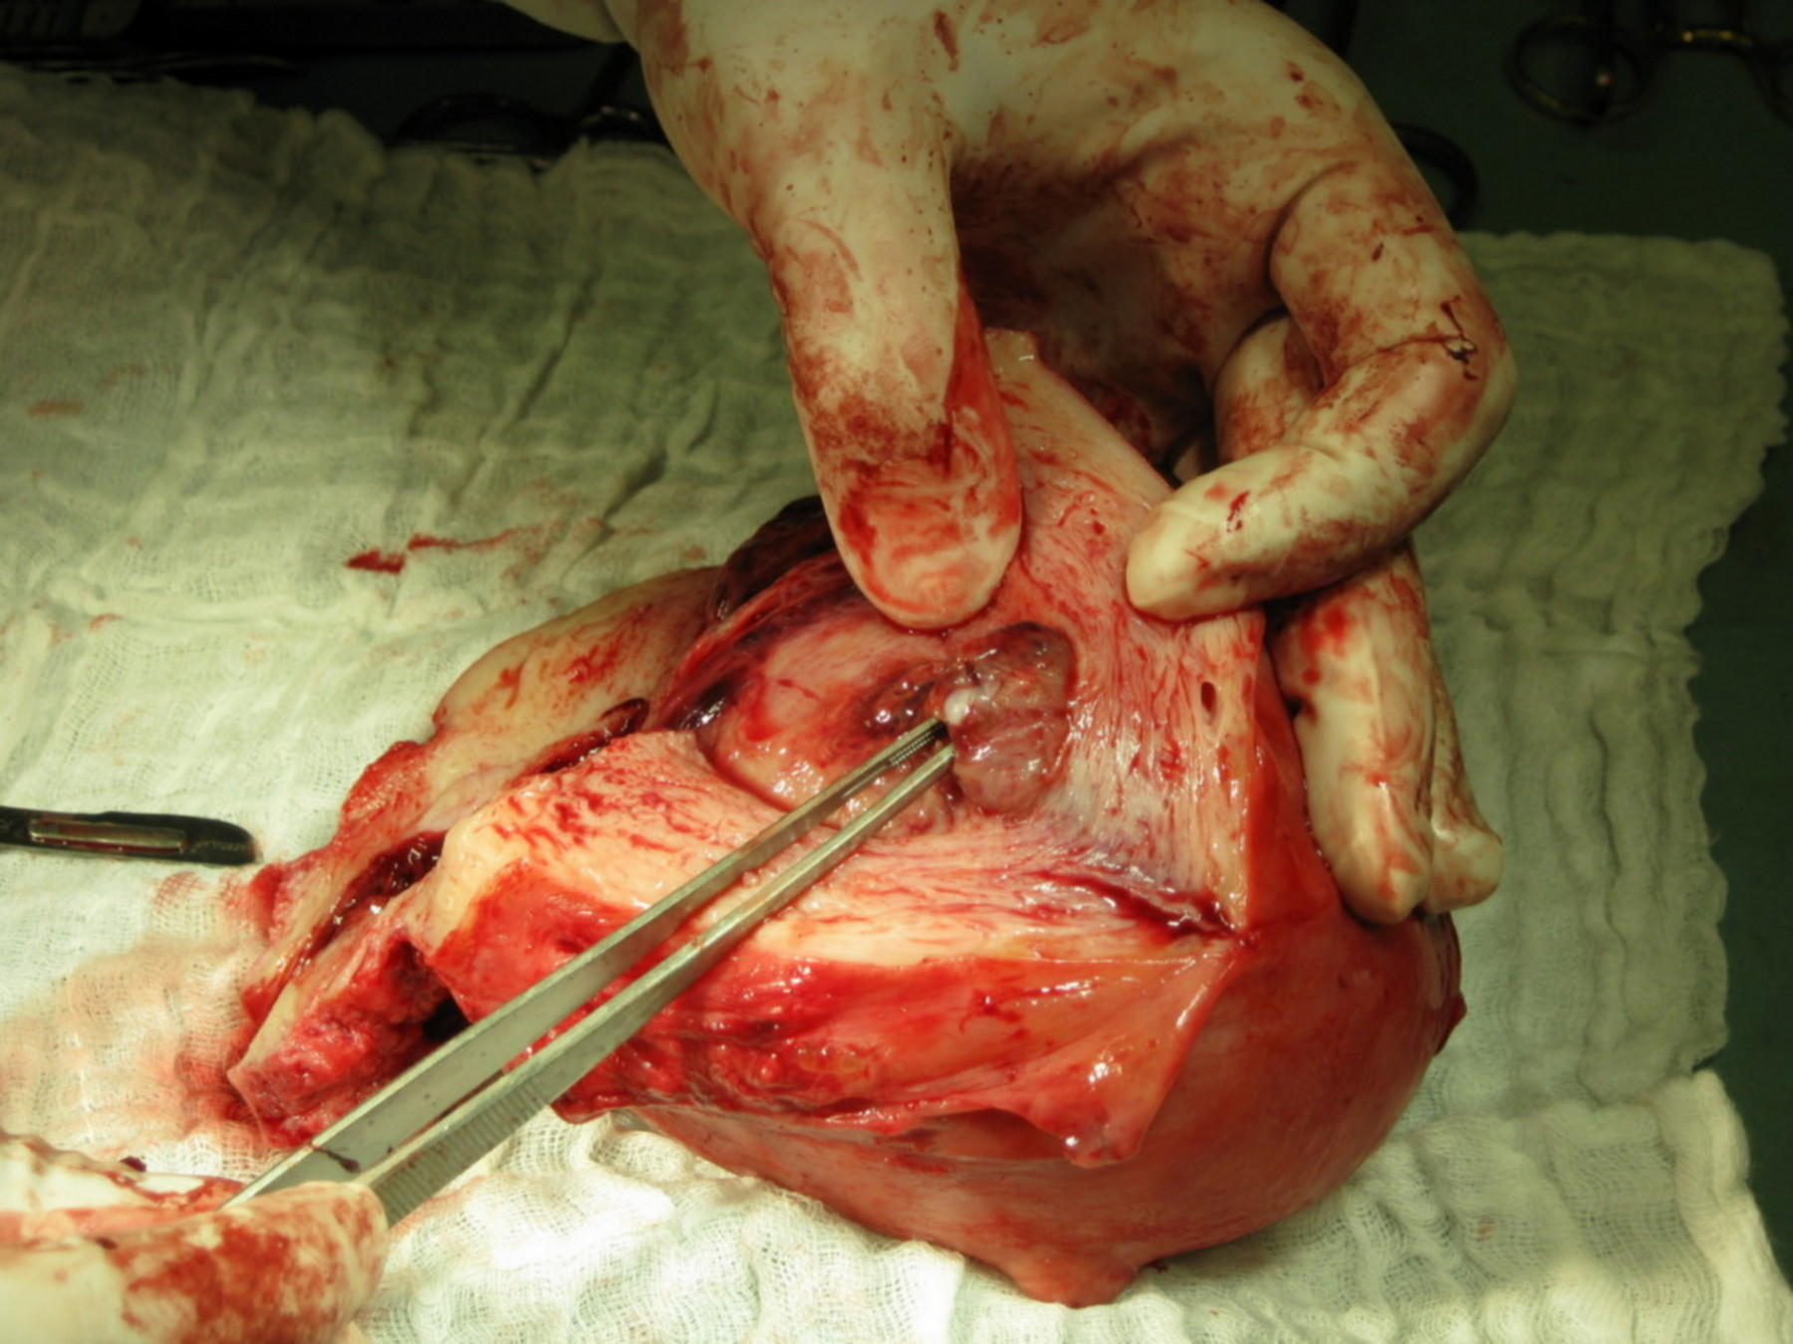
Uterine cancer
Low risk type

Slide 26
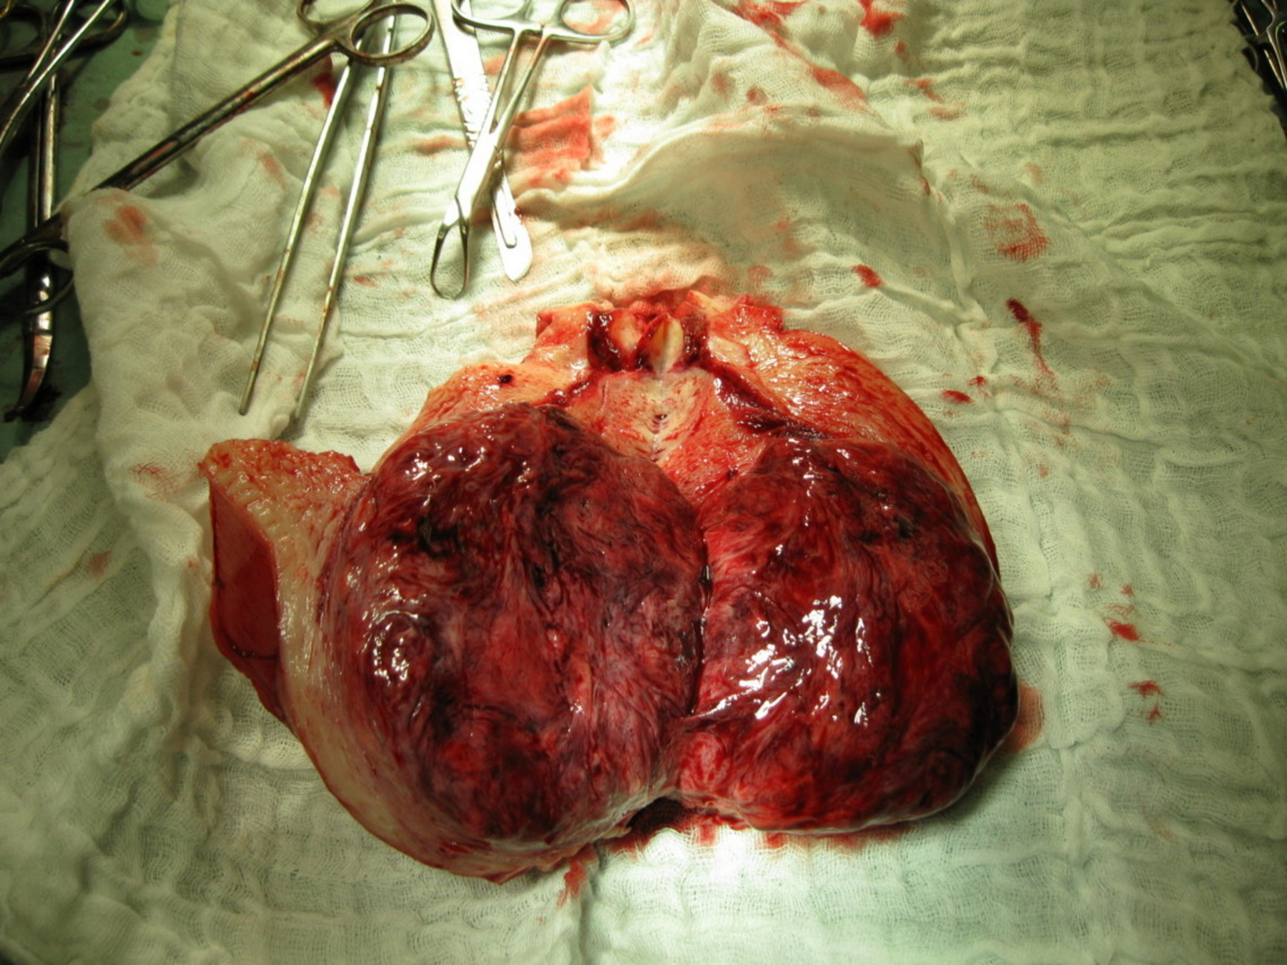
Uterine cancer
High risk type

Slide 27
Uterine cancer
Five-year disease-specific survival rates in accordance withstages
Stage | 5 year survival rates
I | 78 – 90 %
II | 74 %
III | 36 – 57 %
IV | 20 %

Slide 28
Clinical symptoms
Uterine cancer
Early stages
irregular vaginal bleeding in premenopausal women
postmenopausal vaginal bleeding
vaginal discharge
Advanced stage of cancer
pelvic pain, sacroiliac pain
hematuria
enterorrhagia
Asymptomatic patients (based on ultrasound examination)

Slide 29
Diagnosis
Uterine cancer
Absence of screening method !!!
Prebioptic methods
- ultrasound examination
- cytodiagnostic techniques
Bioptic methods
- Pipelle endometrial sampling
- dilatation & curettage
- hysteroscopy with endometrial biopsy

Slide 30
Uterine cancer
Staging
Obligatory
- Gynecologic examination
- Expert ultrasound of abdomen and pelvis
- Chest x-ray
- Laboratory tests, Internist examination
Facultative
- MR of abdomen and pelvis (ev. PET/MR, PET/CT)
- Cystoscopy
- Rectoscopy (colonoscopy)
- Tumor markers (CA125, HE4)

Slide 31
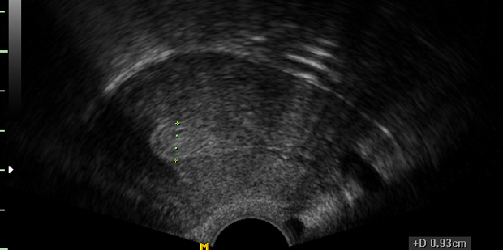
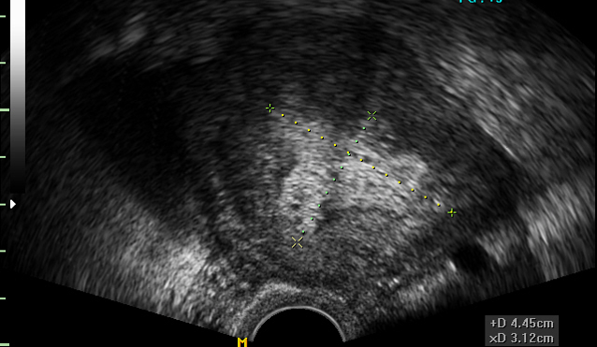
Uterine cancer
Expert ultrasound examination
Tumor in endometrial polyp limited to endometrium (without myometrium invasion)
Tumor invades less than one half of the myometrium

Slide 32
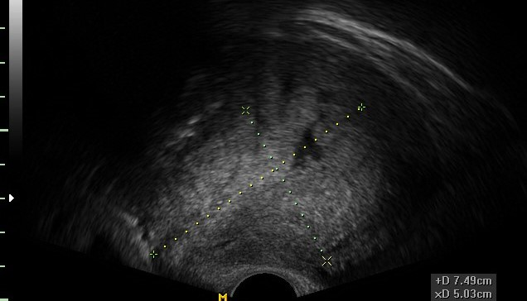
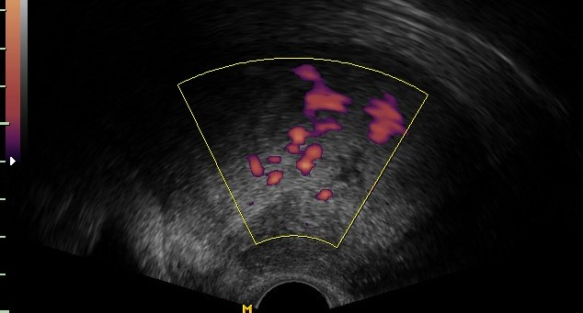
Uterine cancer
Expert ultrasound examination
Tumor invades one half or more of the myometrium
Deeply invasive tumor with high colour score in Doppler mode

Slide 33
Uterine cancer
Therapy
Surgical treatment - method of choice
Radiotherapy
Chemotherapy – advanced stages of cancer
Hormonal therapy – relapsed cancer

Slide 34
Uterine cancer
Surgical treatment
Low risk – Hysterectomy + bilateral adnexectomy
High risk - Hysterectomy + bilateral adnexectomy + aortopelvic lymphadenectomy (+ infracolic omentectomy in serous histologic type)
Advanced stages - Cytoreductive surgery, icluding pelvic exenteration in IVA stage

Slide 35
Uterine cancer
Surgical treatment
Operační léčba
Surgical approache
Miniinvasive
(laparoscopic, robotick)
low risk pacients
selected high risk patients
(without age and comorbidity
limitation due to the Trendelenburg
position)

Slide 36
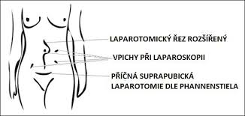
Uterine cancer
Surgical treatment
Surgical approache
Laparotomy
Patients contraindicated
to miniinvasive surgery
(comorbidity, advanced stage of disease)
- suprapubic incision - low risk
- midline laparotomy - high risk,
advanced stage of disease

Slide 37
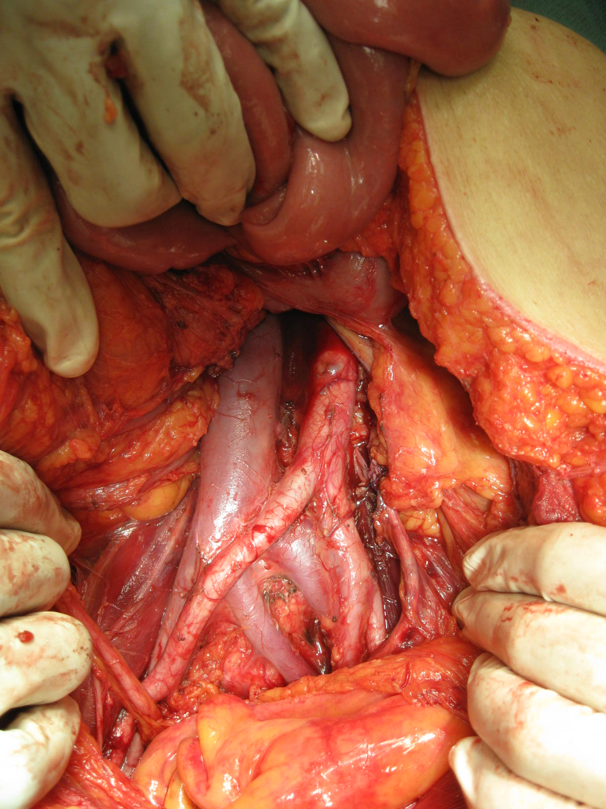
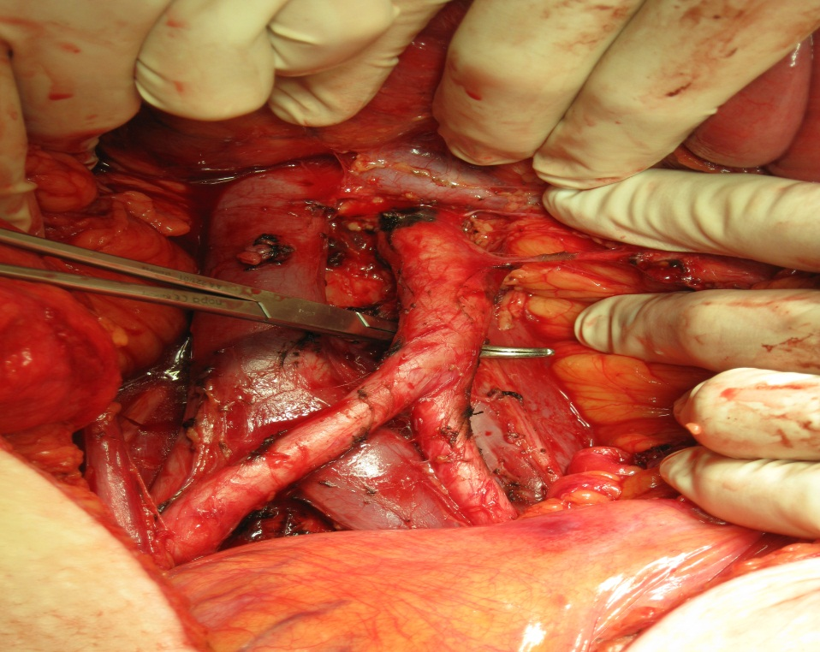
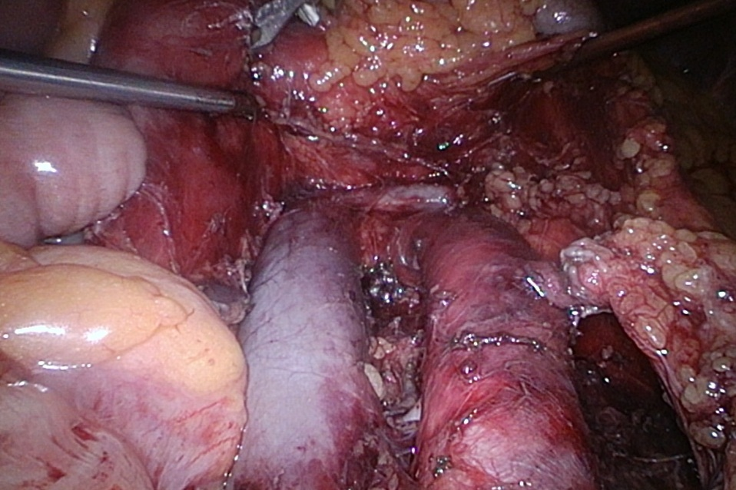
Uterine cancer

Slide 38
Uterine cancer
Surgical treatment
- high risk – in more than 50% cases with negative lymph nodes
- lymph nodes positivity
: 50% pelvic region
: 30% pelvic and paraaortic lymph nodes lesion in the same time
: 20% isolated paraaortic lymph node lesion
DEVELOPMENT OF NEW METHODS FOR SENTINEL LYMPH NODES DETECTION

Slide 39
Uterine cancer
Surgical treatment
SENTINEL NODES DETECTION METHODS
- subserous myometrial application
Hysteroscopic subendometrial application near
the tumor
- Intracervical application (PREFERENCE !)
: „double detection technique“ – radioisotope + + methylene blue dye x ICG (indocyanin green)
využití hysteroskopické aplikace radiokoloidu pravděpodobně nejlépe respektuje anatomické
souvislosti a přirozenou drenáž endometria
- metodika určena pro klinické studie

Slide 40
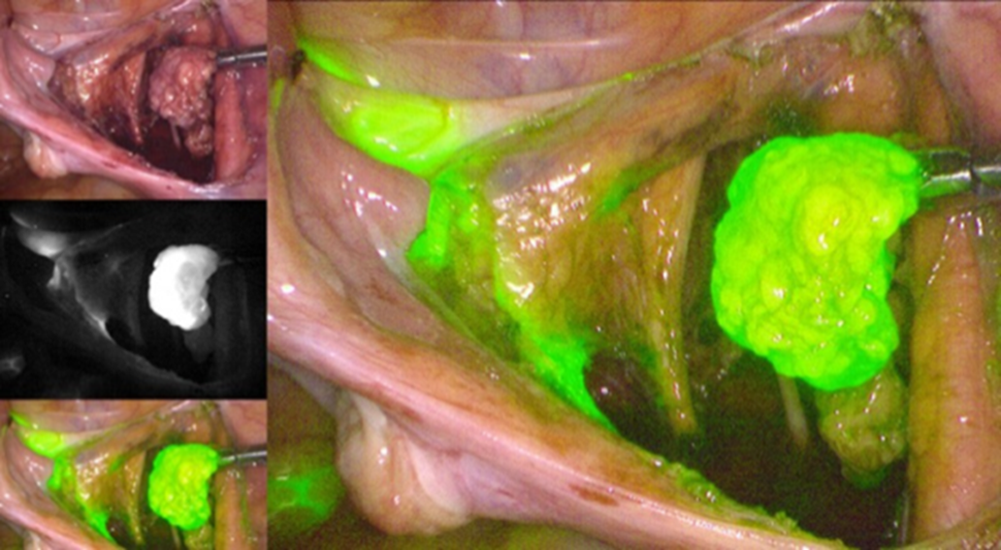
Uterine cancer

Slide 41
Thank you for your attention

