Slide 1

Preclinical dentistry I.
1.lecture
Doc. MUDr. Lenka Roubalíková, Ph.D.
lroubal@med.muni.cz
+420 607 122 064

Slide 2
Enamel
Dentin
Cementum
Dental pulp
Periodontal tisues

Slide 3
Restorative dentistry
Diseases of hard dental tisues, dental pulp and
periodontal tissues (of pulpal origin)
Aethiology, ,pathogenesis,diagnosis,therapy and
prevention.

Slide 4
Diseases of hard dental tissues
Congenital – genetic reasons
Postnatal
Before eruption
After eruption

Slide 5
Congenital
Amelogenesis imperfecta
Enamel is affected
Dentinogenesis imperfecta
Dentine is affected

Slide 6
Before eruption
Hypomineralization (white, brown spots)
Defects of enamel (hypoplasia)
Reasons
- local (inflammmation, traumatic dental injuries)
systemic (systemic diseases, antibiotics)

Slide 7
After eruption
Dental caries
Trauma
Attrition, abrasion
Erosion
V-shaped defects

Slide 8
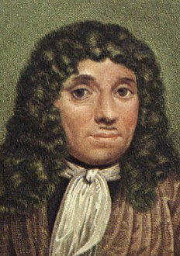
Antony van Leeuwenhoek
(1632 – 1723)
nizozemský přírodovědec a vynálezce. Obchodník v Amsterdamu a vědec samouk, byl členem královské společnosti. Zhotovil jednoduchý mikroskop s jedinou čočkou, který zvětšoval 300krát. Prostudoval řadu mikroorganismů a popsal jejich způsob života. Mj. objevil krevní kapiláry, jako první podal v roce 1683 přesný popis bakterií a prvoků, popsal příčné pruhování svalů. Popisem buněčné stavby rostlin se stal jedním ze zakladatelů rostlinné anatomie.
First observation
of microbs in oral cavity
17.century

Slide 9
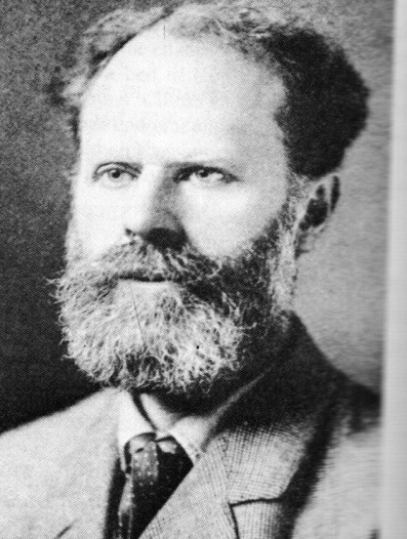
Dental caries
Willoughby Dayton Miller
(1853 -1907)
Explanation – theories
Miller´s theory: chemical – bacteriogical
explanation

Slide 10
Origin of dental caries
Dental caries originates as decalcification of hard dental tissues. This decalcification is caused by microbs that are present on tooth surfaces in the dental biofilm. These microbs utilize sugars.
After this decalcification also the decomposition of organic substances follows due to proteolytic microbs.

Slide 11
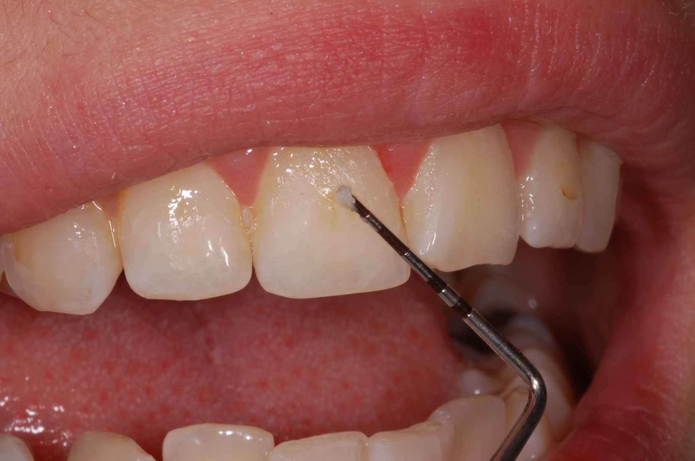
Dental biofilm – plaque.

Slide 12
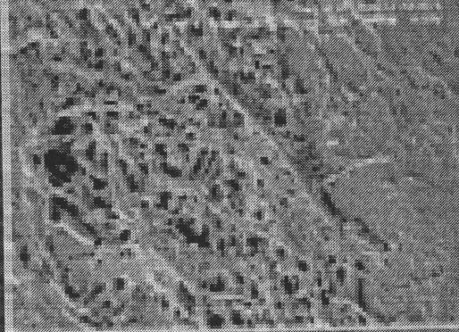
Pelicle
A layer of proteins from saliva that precipitate on the tooth

Slide 13
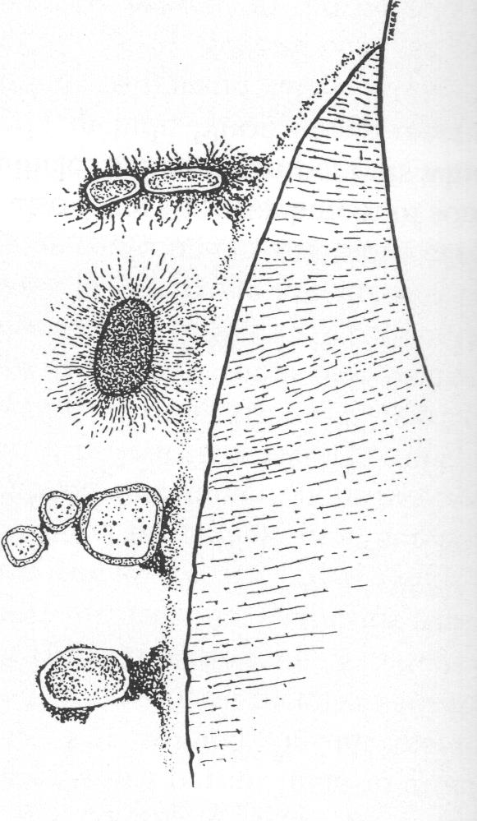
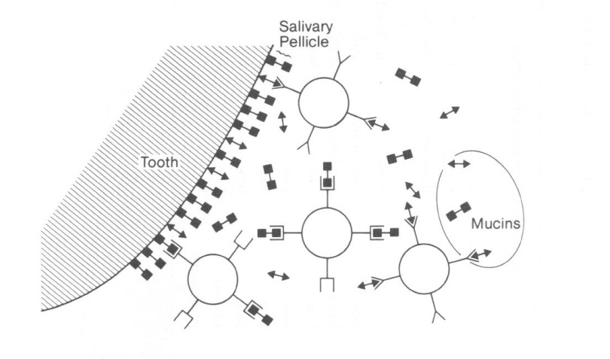
Dental biofilm
Adherence

Slide 14
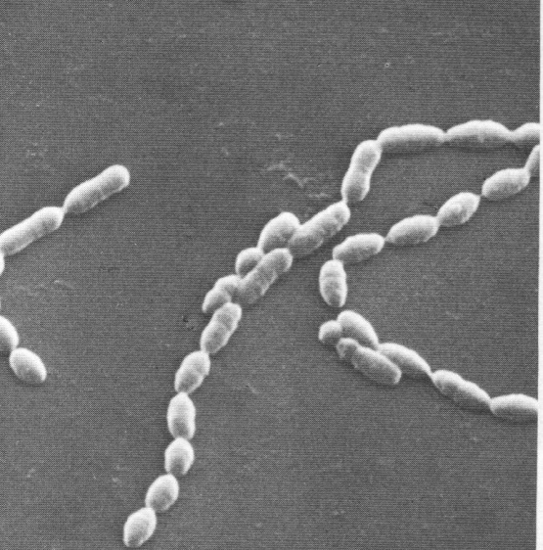
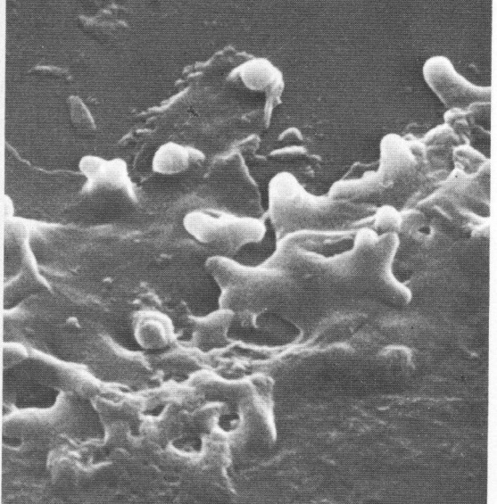
Dental biofilm
Colonization and coaggregation

Slide 15
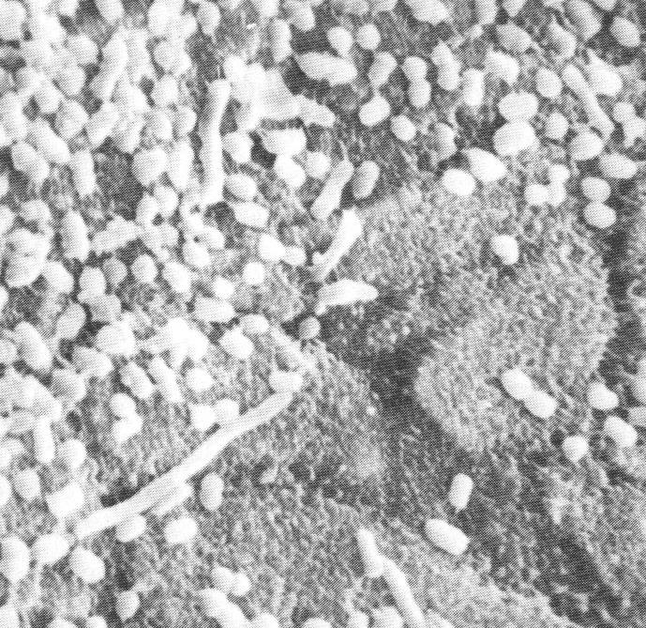
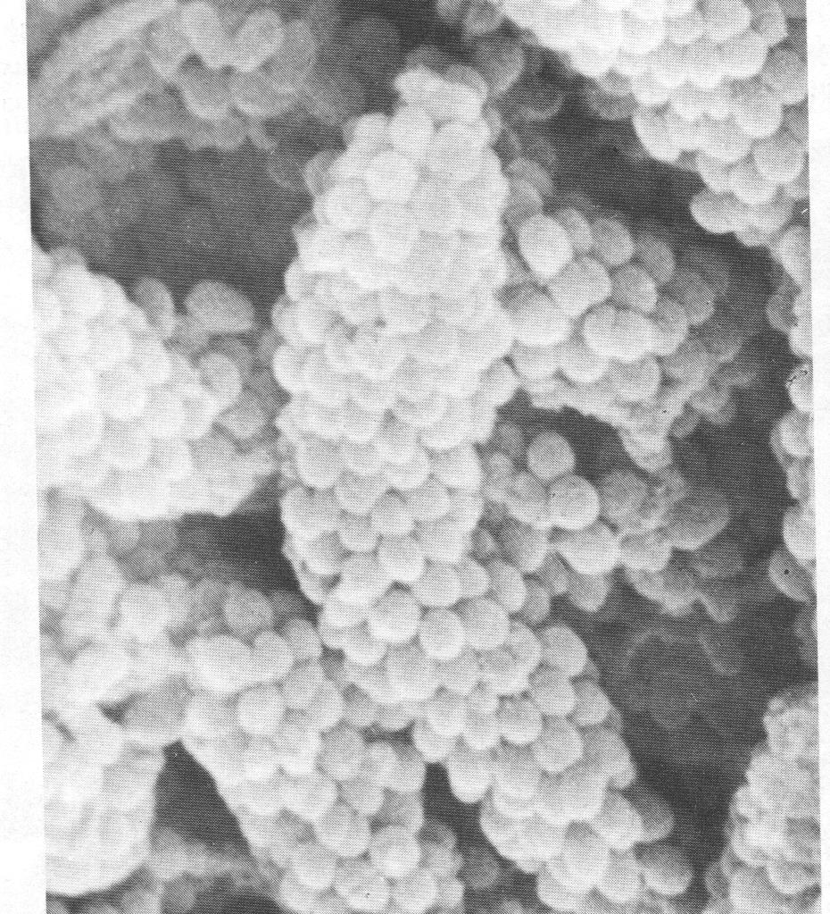
Dental biofilm
Maturation

Slide 16
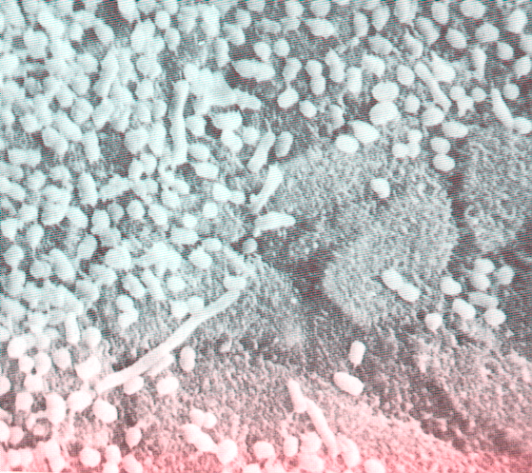
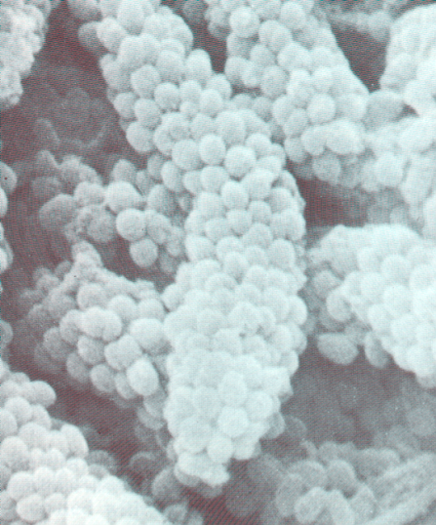
Dental bioífilm
Comunity
More species,
Better conditions for survival
Higher resistancy
Higher virulency

Slide 17
Mikrobs
Sugars
Time
Hard dental tissues

Slide 18
Metabolic activity
pH
5,0
Stephan
Dissolving of enamel
0 50
min

Slide 19
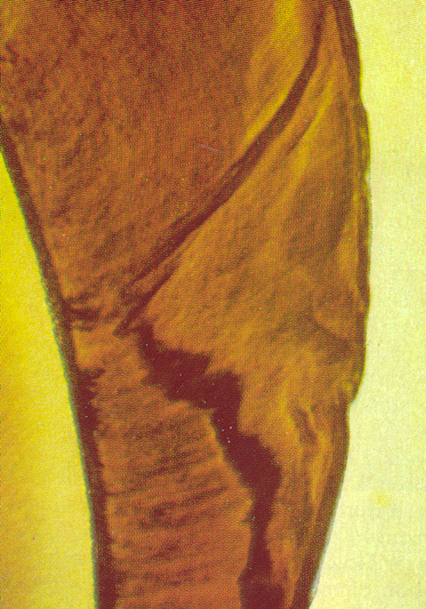
Ca₁₀(PO₄)₆(OH)₂
Ca₁₀(PO4)₆F₂
Ca²⁺
PO₄ ³⁻
Ca²⁺
PO₄³⁻
F-
OH⁻

Slide 20
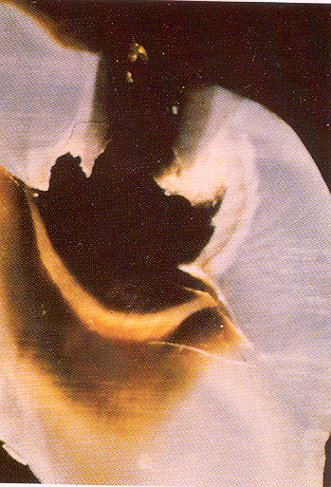
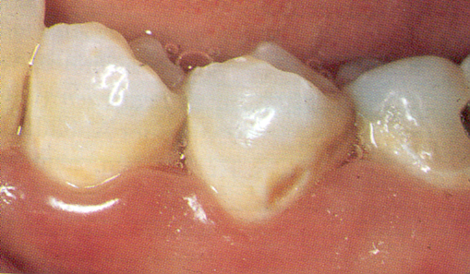
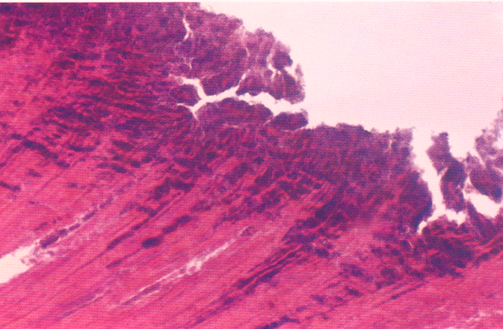
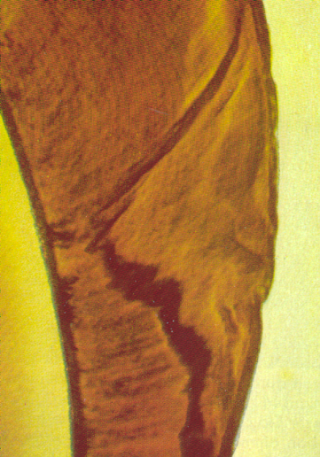
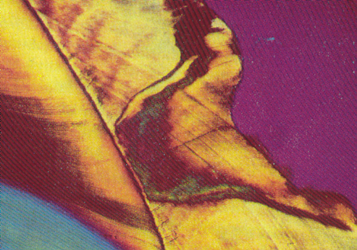
Irreversibil: non cavitated lesion
Reversibil: Initial (non cavitated) lesion
Demineralization
Non cavitated lesion can be healed
Cavitated lesion must be drilled and filled
Time

Slide 21
Dental caries is multifactorial disease
Essential factors
- necessary
Co condition factors
- not necesasary but can influence the expansion

Slide 22
Co commitans factoras
Quality of hard dental tissues and position of teeth
Food – composition and consistency
Systemic health
Age
Heredity (liking of sweetness?)
Climate

Slide 23
Caries danger areas
Pits and fissures
Proximal surfaces below the contact point
Cervical third of dental crown (area below the maximum convexity)
Exposed root
= habitually unclean areas

Slide 24
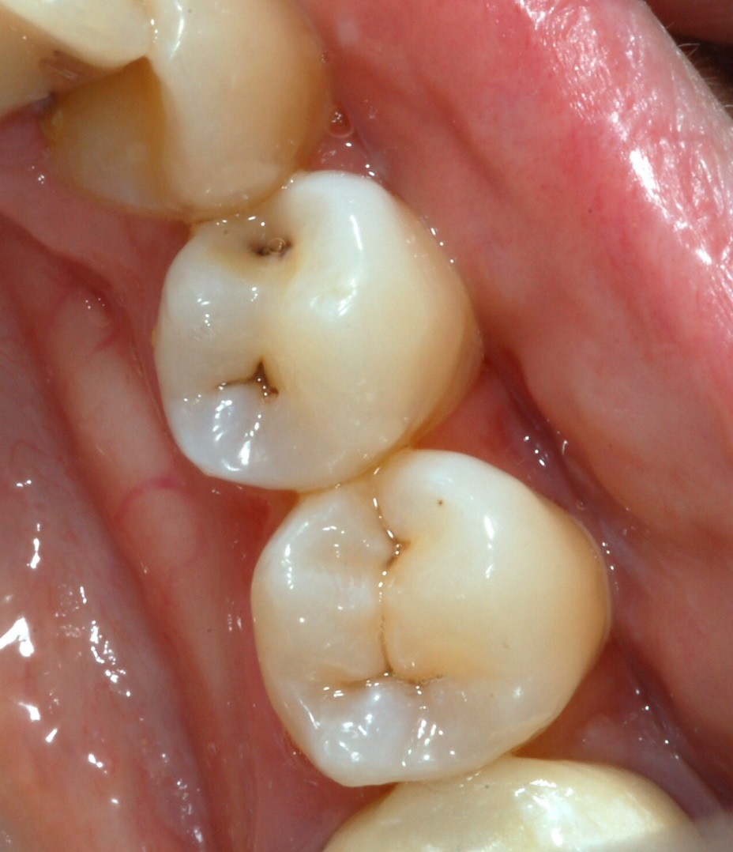
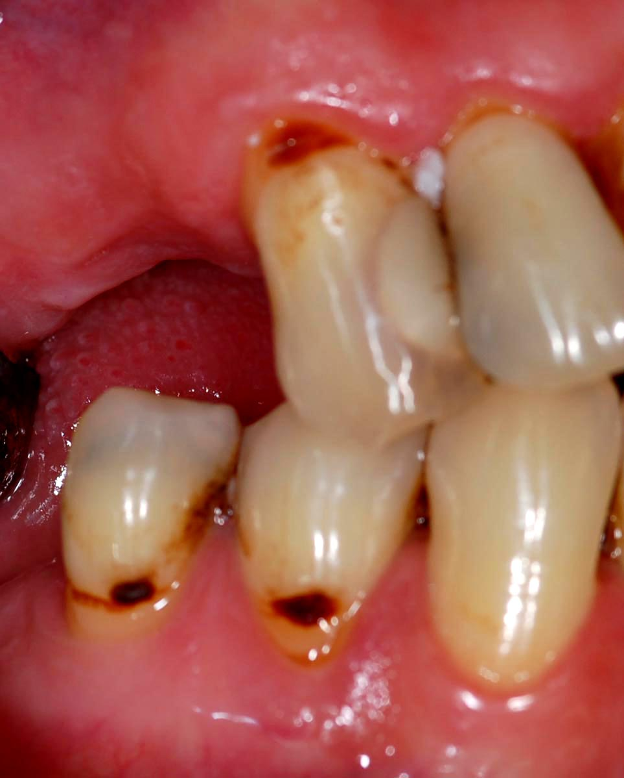


Slide 25
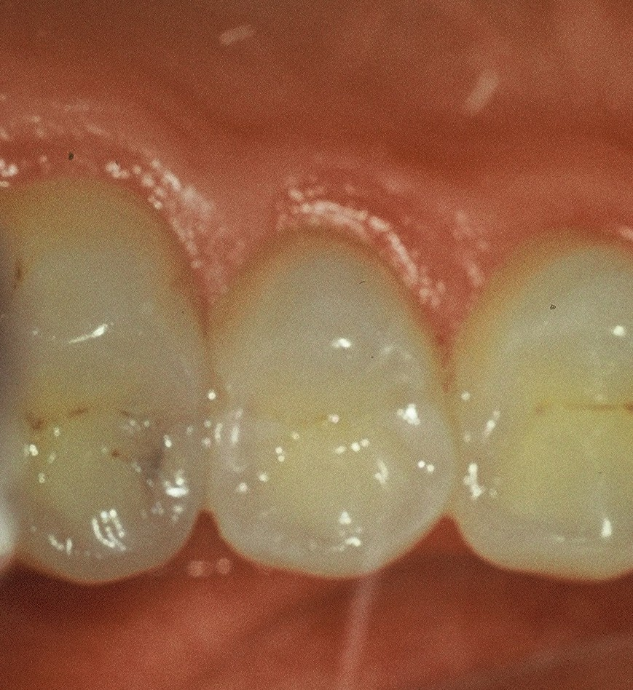

Slide 26
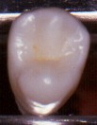
Habitually clean places
Incisal edges
Cusps and their slopes
Areas above the maximal convexity
Enamel ridges : transverse ridge,
oblique ridge

Slide 27
Classification of dental caries
Acc to topograpoy
Coronal caries
Root surface caries
According to affected surfaces
- See classification acc to Black
According to affected tissues
Caries in enamel
Caries in dentin
Caries in cementum

Slide 28
Classification of dental caries
According to its depth
Surface caries (caries superficialis)
Middle caries (caries media)
Caries next to dental pulp (caries pulpae proxima)
Caries penetrating into dental pulp (caries ad pulpam penetrans)
Deep caries

Slide 29
Surface caries

Slide 30
Middle caries

Slide 31
Caries next to dental pulp

Slide 32
Caries penetgrating into dental pulp

Slide 33
Classification of dental caries
According to history
Acute
Chronic
Arrested

Slide 34
Classification of dental caries
According to origin
Primary caries
Secondary caries
Recurrent caries

Slide 35
Primary caries

Slide 36
Secondary caries

Slide 37
Recurrent caries

Slide 38
Penetrating caries

Slide 39
Undermining caries

Slide 40
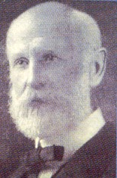
Green Vardiman Black
(1836 – 1915)
American professor
Established the scientific bases of dentistry
Formulated basic rules of preparation
of cavities
Developed the guidelines for amalgam fillings including the optimal
composition of amalgam (balanced alloy)

Slide 41
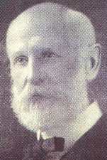
Preparation
Preparation is an instrumental treatment of the tooth that has been damaged by dental caries
in such a way that
the reconstruction of this tooth is possible
the filling does not fall out
the tooth as well as the filling can face up to occlusal forces
the risk of the caries on treated surface si minimal
(Black 1914)

Slide 42
Preparation
Preparation is an instrumental treatment of the tooth that has been damaged by dental caries
in such a way that
the reconstruction of this tooth is possible
the risk of the caries on treated surface si minimal- extention for prevention
the filling does not fall out
retention
the tooth as well as the filling can face up to occlusal forces
resistance
(Black 1914)

Slide 43
After we understand the reasons of dental caries we will be able it to heal it
(Black 1900)

Slide 44
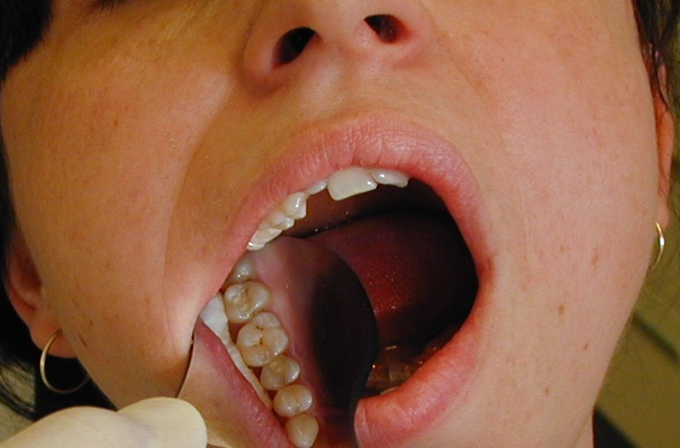
Classification acc. to Black
Class I.
Pit and fissure caries

Slide 45

Classification acc. to Black
Class II.
Proximal surfaces in premolars and molars

Slide 46
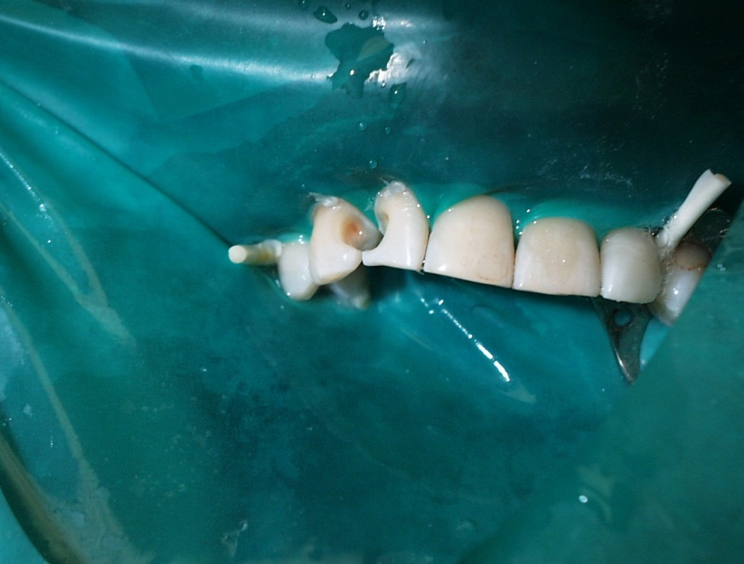
Classification acc. to Black
Class III.
Proximal surfaces of incisors and canines without
lost an incisal ridge

Slide 47
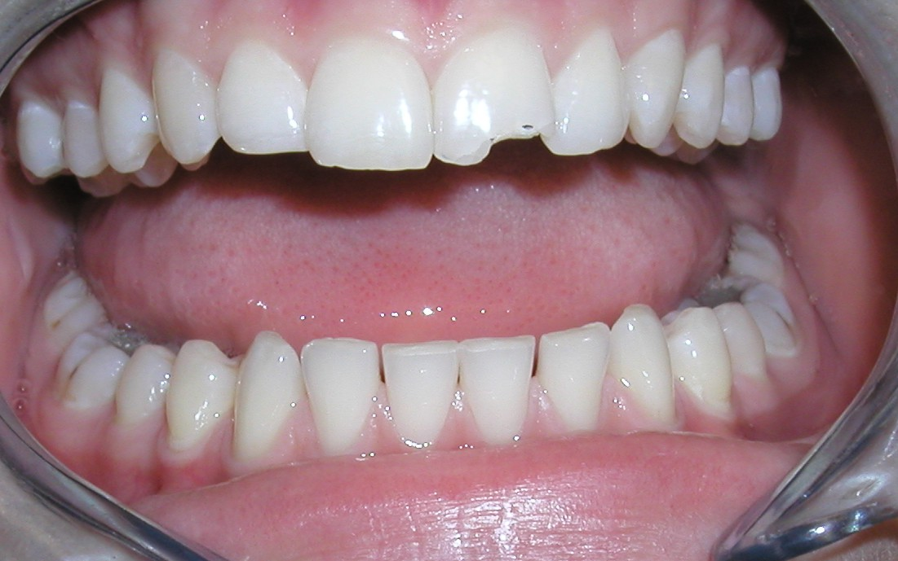
Classification acc. to Black
Class IV.
Proximal surfaces of incisors and canines with
lost an incisal ridge

Slide 48
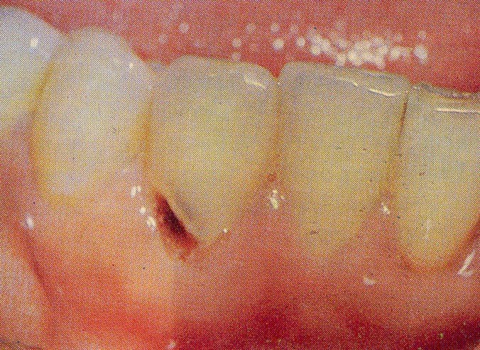
Classification acc. to Black
Class V. cervical lesions

Slide 49
Clasification acc. to black
VI. Class
Caries on incisal edges (abraded)

Slide 50
Sequence of operations
Acces to the cavity
Preparation through the hard dental tissues
Removal the undermined enamel
Separation of teeth
Separation or removal of gingiva

Slide 51
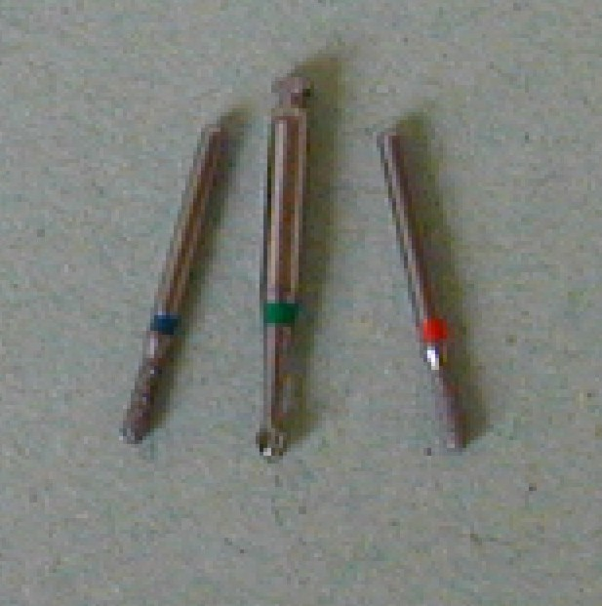
Prepration through hard dental tissues

Slide 52
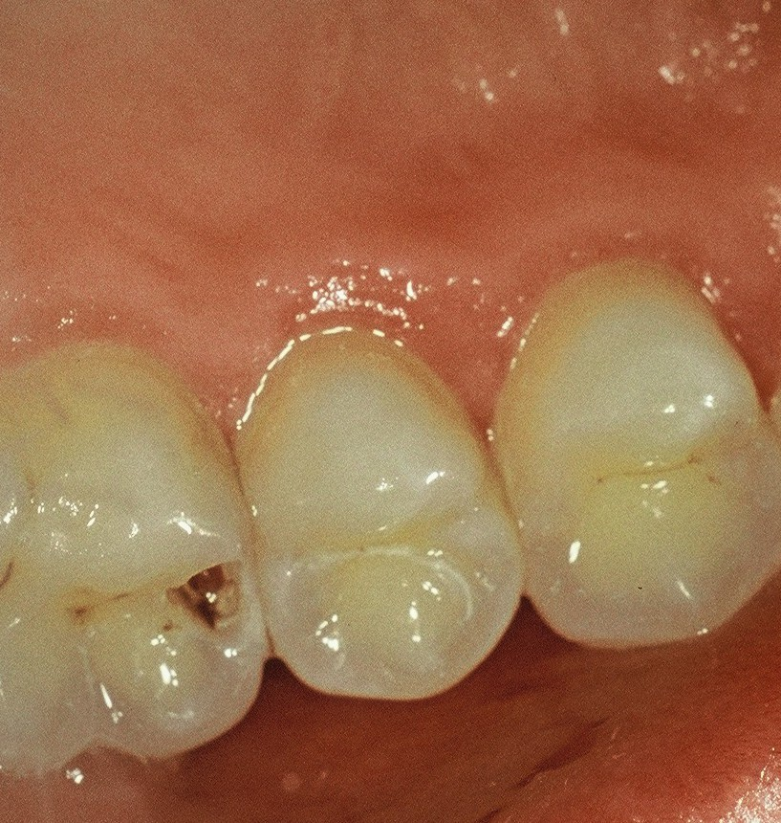
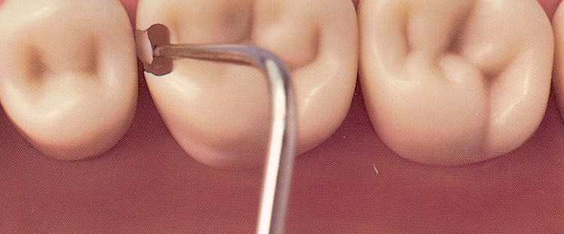
Breaking the enamel

Slide 53
Removal of the undermined enamel

Slide 54
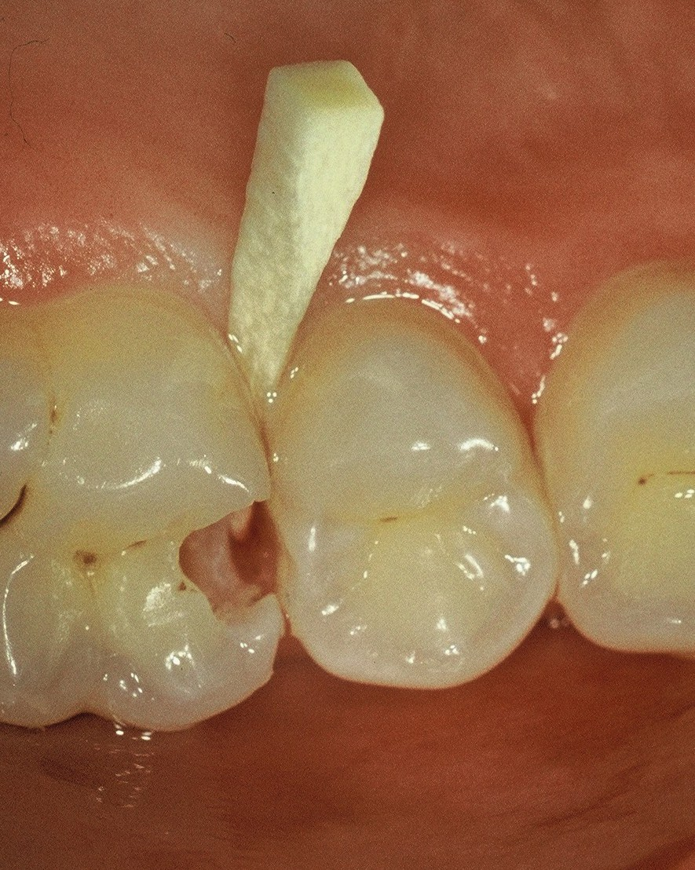
Separation with wooden wedge

Slide 55
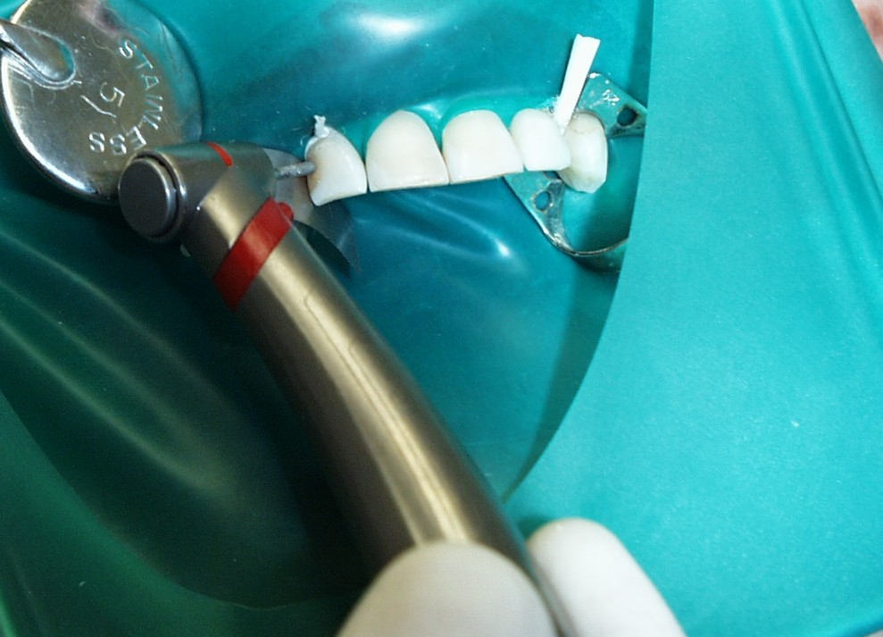
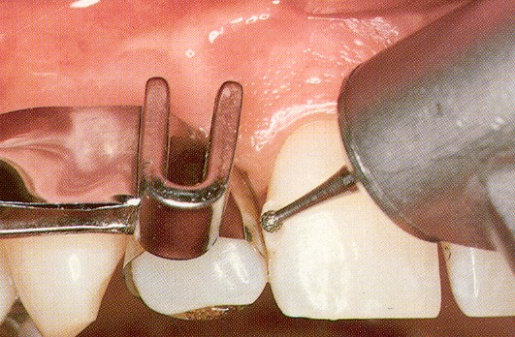
Removal of the old filling

Slide 56
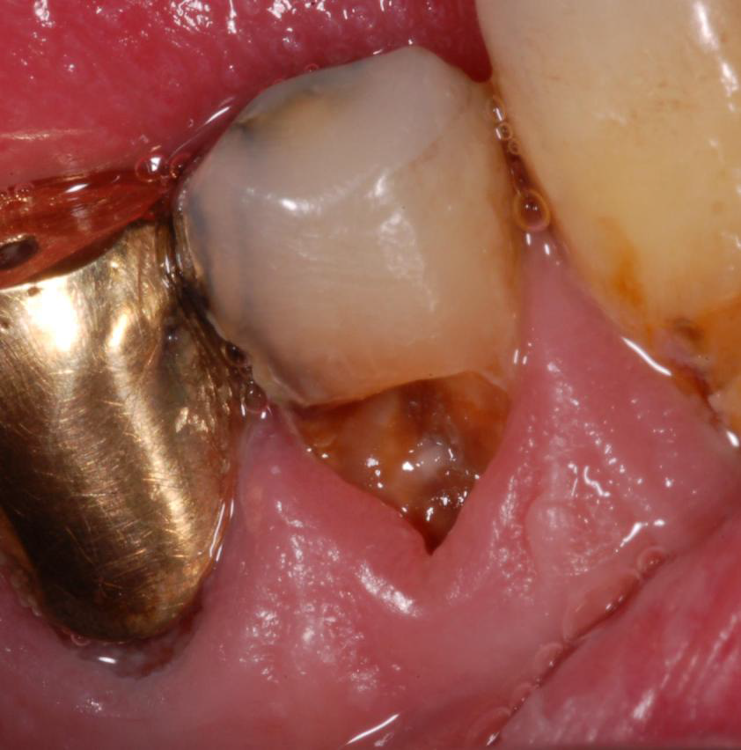
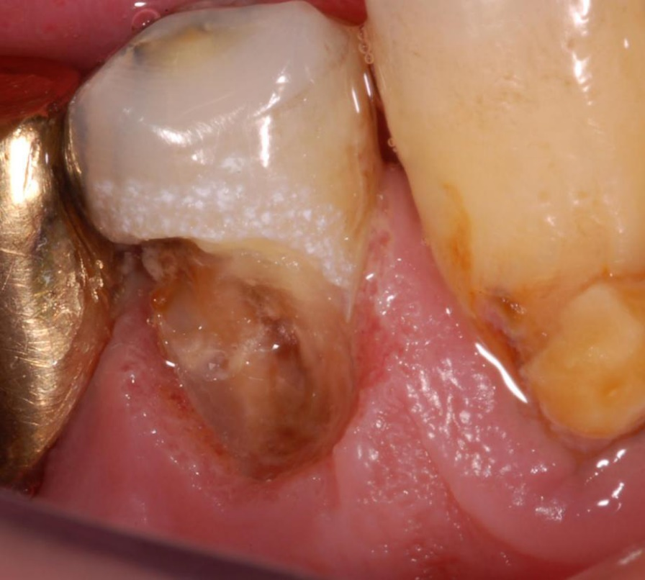
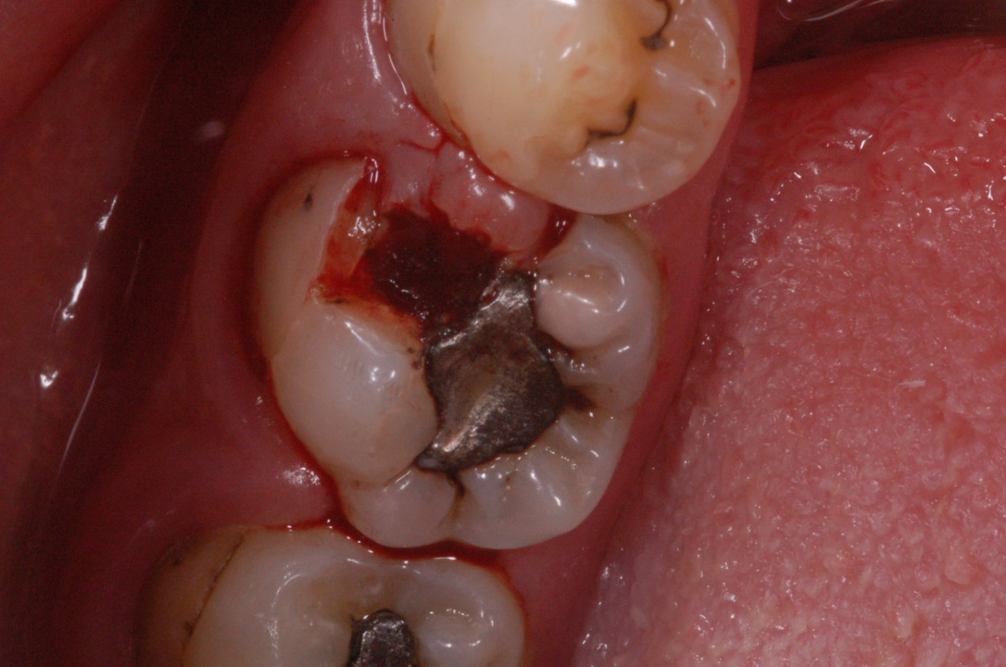
Removal of the ingrown gingiva

Slide 57
Sequence of operations
Acces to the cavity
Establishment of the cavosurface margin -
extention for prevention
Retention of the filling
Resistance of the restored tooth ( the filling
as well as the restoration)
Excavation of carious dentin
Protection of dentin wound
Finishing of the walls
Final control (light, miror, magnification)

Slide 58
Sequence of operations
Preparation of cavity borders and extention
for prevention (Cavosurface margin)
Depends on
Dental material
Oral hygiene
Precautions of secondary caries

Slide 59
Sequence of operations
Retention of the filling
Precautions of its lost
Macromechanical retention
Micromechanical retention
Chemical retention

Slide 60
Sequence of operations
Resistance of the restored tooth
Against occlusal and other forces
Depends on
Material
Individual occlusal forces

Slide 61
Sequence of operations
Excavation of carious dentin
Necessary (risk of recurrent caries)
Ball shaped (spheric) bur - slow speed (3000 rpm)
or
Excavator (hand instrument)

Slide 62
Sequence of operations
Finishing of the walls
Depends on the kind of material
Bevel or without bevel
Fine diamond bur

Slide 63
Protection of dentin wound
Filling itself
Base (below the filling – protection against thermal exposure ot toxiccity of dental materials)

Slide 64
Sequence of operations
Final control
Direct or indirect view
Good illumination
Magnification

Slide 65
Preparation
Hand
Excavator, cleaver
Power driven
Rotary
Non standard preparation
Burs, diamonds

Slide 66
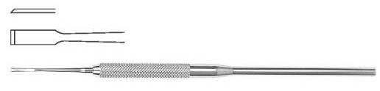
Chisel – for enamel
Cleaver

Slide 67
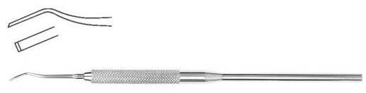
Chisel for enamel

Slide 68
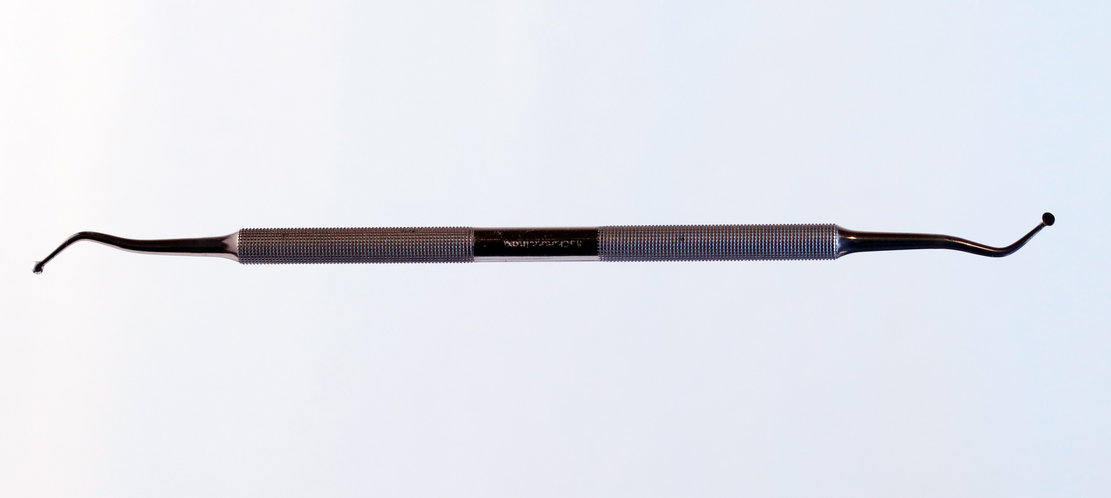
Excavator

Slide 69
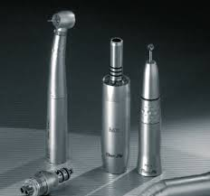
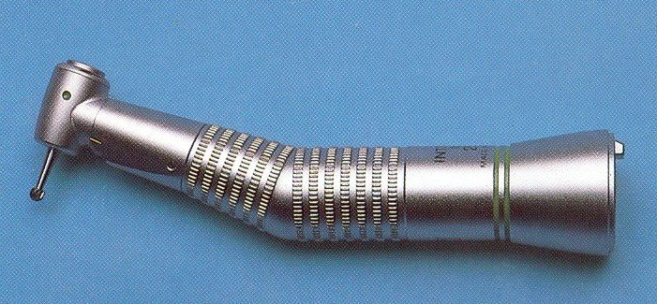
Motors and handpieces
Turbine Micromotor Handpiece

Slide 70
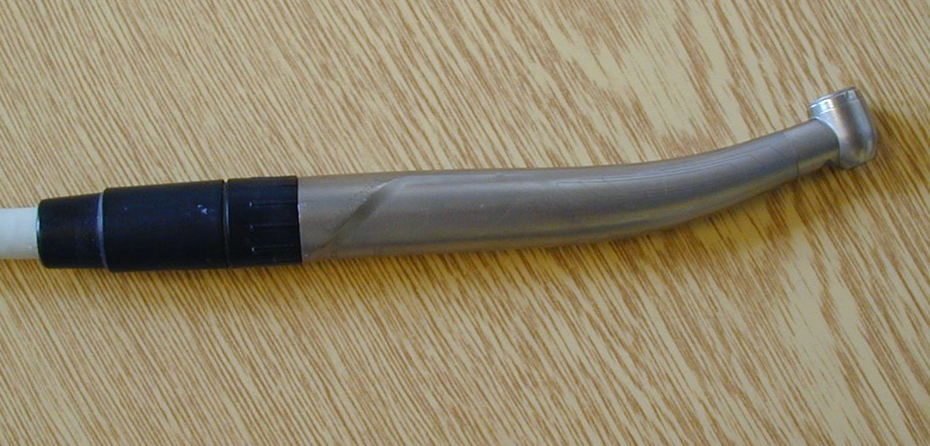
Turbine

Slide 71
Turbine
300.000 - 400.000 rpm
Big force, les control, small torque

Slide 72
Motors – micromotors
Electromotors – maximum 40.000/min
Air motors – maximum 20.000/min
Gear to fast
Gear to slow
1: 1
Blocked rotation

Slide 73
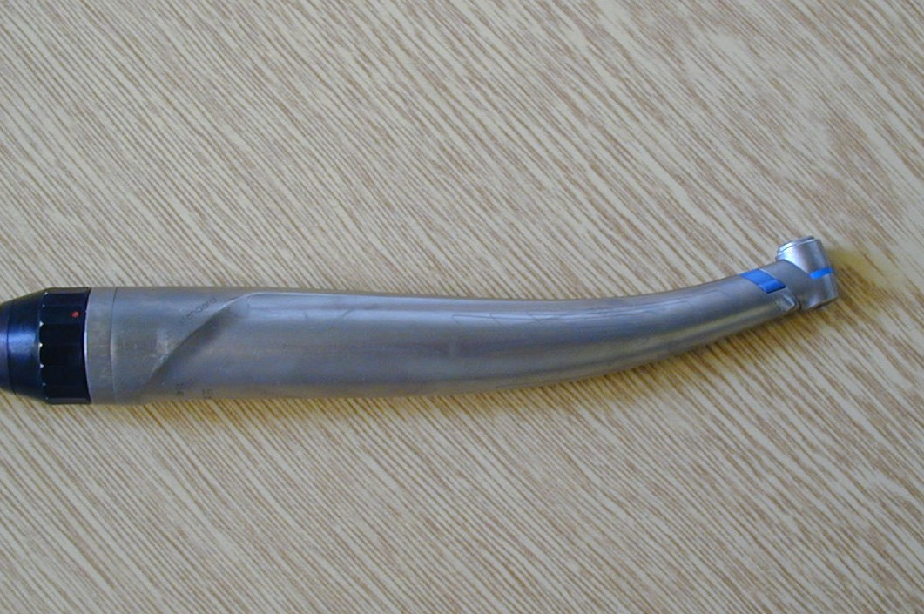
Gear
Blue coded handpiece 1:1

Slide 74
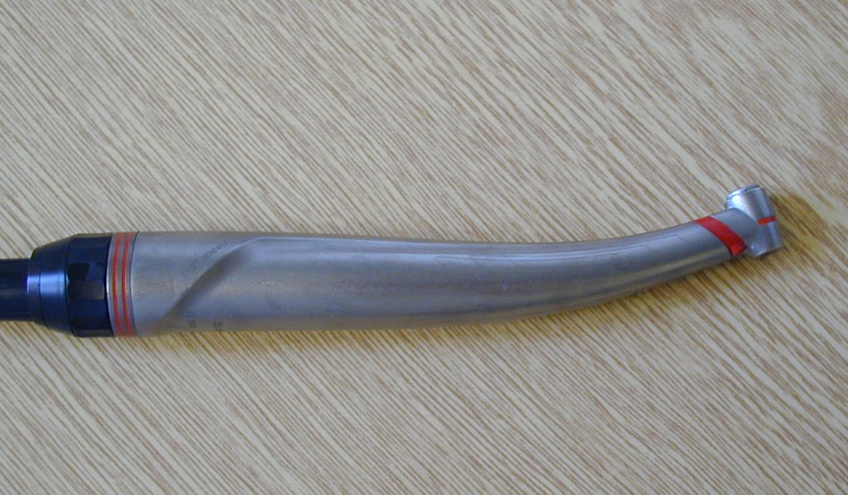
Gear
Red coded handpiece 1:5 to fast

Slide 75
Gear
Green coded handpiece – to slow
2,7 :1
7,5 :1

Slide 76

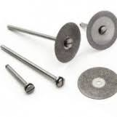

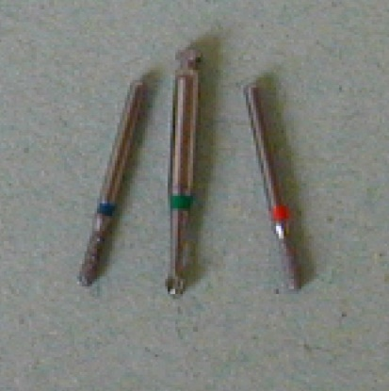
Hendpieces contraangle straight

Slide 77
Cutting instruments
Burs
Steel
Tungsten carbide
Diamonds

Slide 78
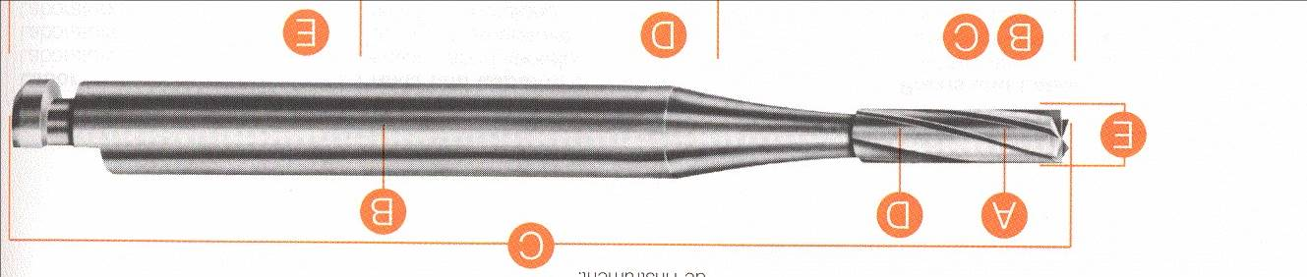
Cutting instruments
Power driven (powered) instruments for cutting
Rotary instruments
Comon design characteristics
shank
neck
Head (cutting part)

Slide 79
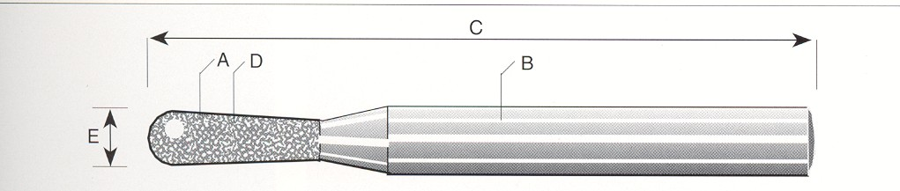
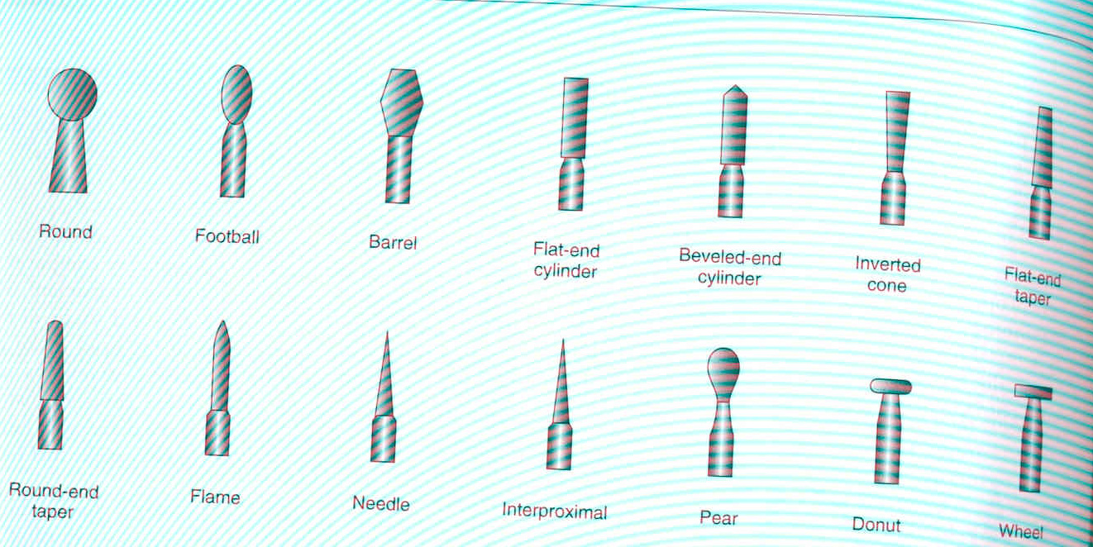
Head (cutting part) neck shank

Slide 80



Slide 81




Burs
fissure bur , round (ball) bur pear formed bur,, inverted cone bur
Notes:
Konu
81

Slide 82
Cutting instruments – diamonds head shape
Ball, pear, cylinder,taper,flame, torpedo, lens and others…..

Slide 83
Cutting instruments – diamonds
Extra coarse – black
Coarse – green
Standard – blue or without any marker
Fine - red
Extra fine - yellow
Ultrafine - white

Slide 84

Diamonds
Blue –standard (90 – 120 μm) ISO 524
Universal

Slide 85
Diamonds
Extra coarse (150 – 180 μm) ISO 544
Cutting of crowns, old fillings

Slide 86

Diamonds
Removal of old fillings, some preparations in prosthetic

Slide 87

Diamanonds
Red fine ( 20 – 40 μm) ISO 514
Finishing of borders of cavities

Slide 88

Diamanonds
Extrafine (12 – 22μm) ISO 504, finifshig of composite fillings

Slide 89

Diamonds
Ultrafine – polishing of composite fillings (6-12 μm) ISO 494

Slide 90
Thank you!

