Slide 1

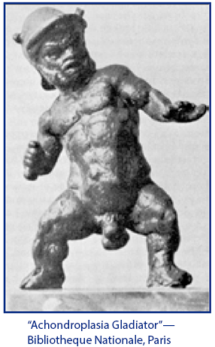
  INTRODUCTION TO TERATOLOGY
Petr Vaňhara
pvanhara@med.muni.cz

Slide 2
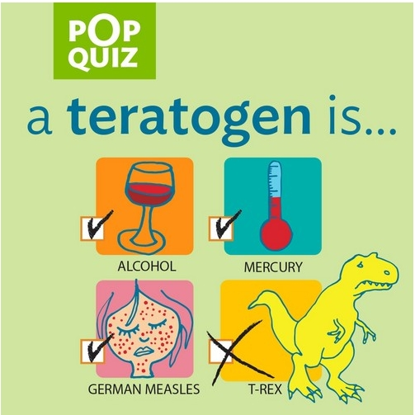
INTRODUCTION TO TERATOLOGY
Embryology is the study of normal intrauterine embryonic or fetal development.
Teratology is the study of birth defects, and a teratogen is something that either induces or amplifies abnormal embryonic or fetal development and causes birth defects.

Slide 3
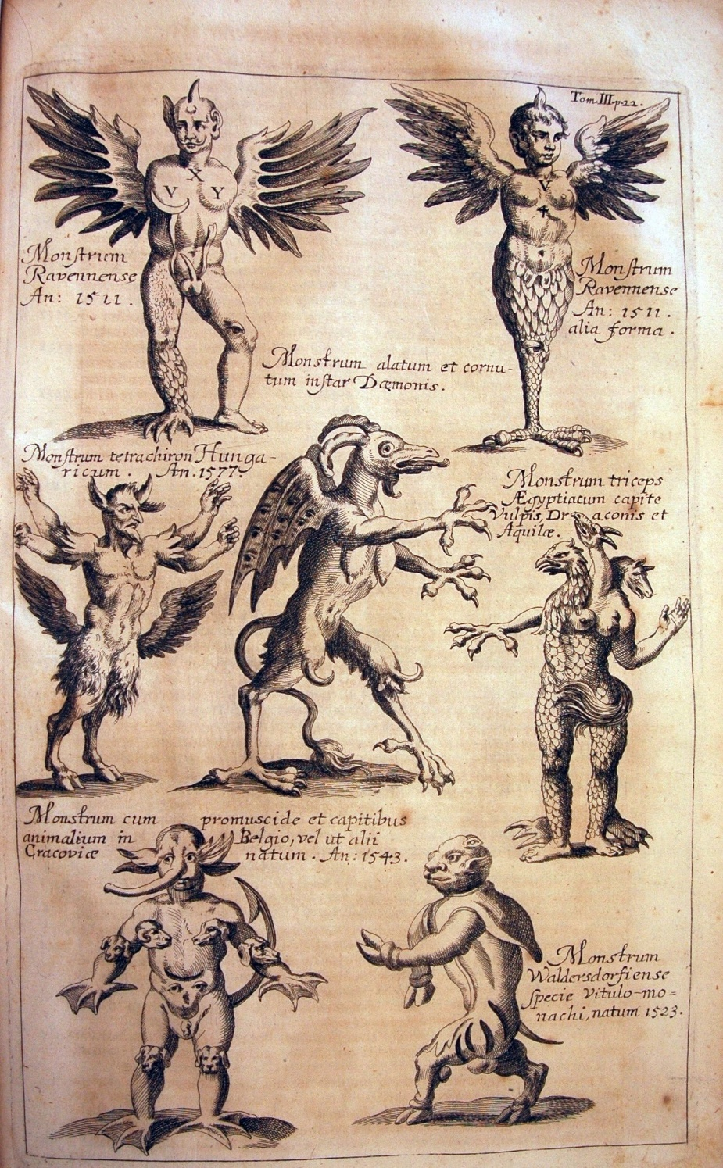
INTRODUCTION TO TERATOLOGY
Historical context
τέρας (Greek) teras = monster
Everything looking abnormal

Slide 4
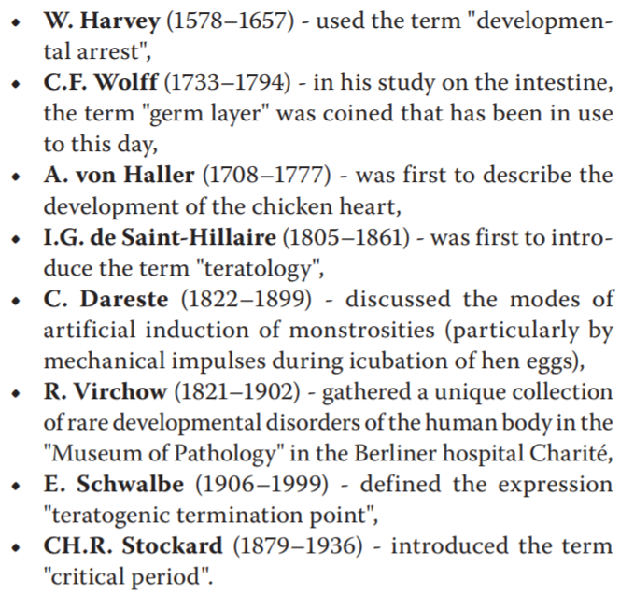
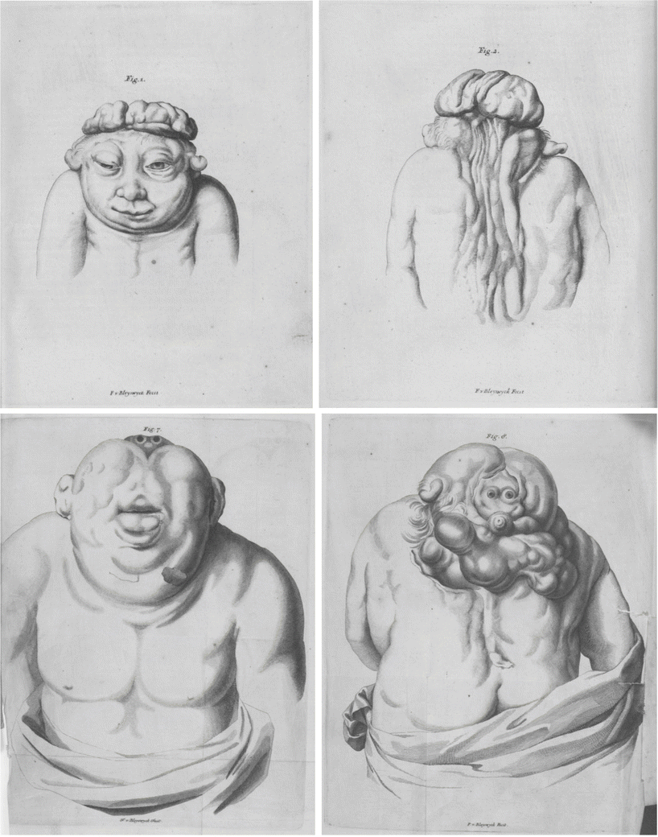
INTRODUCTION TO TERATOLOGY
Historical context
Since the 17th century related to abnormal births (development)

Slide 5
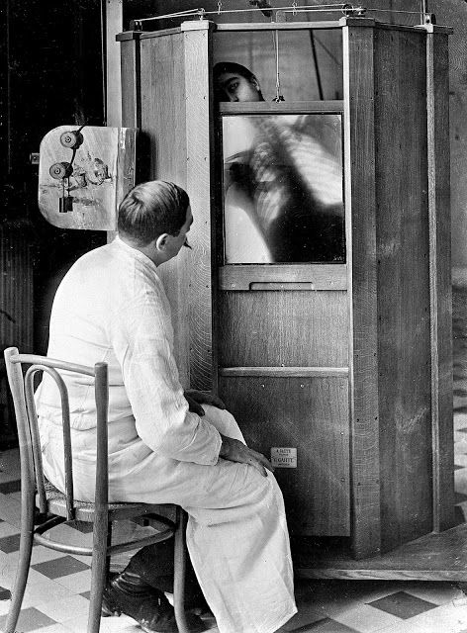
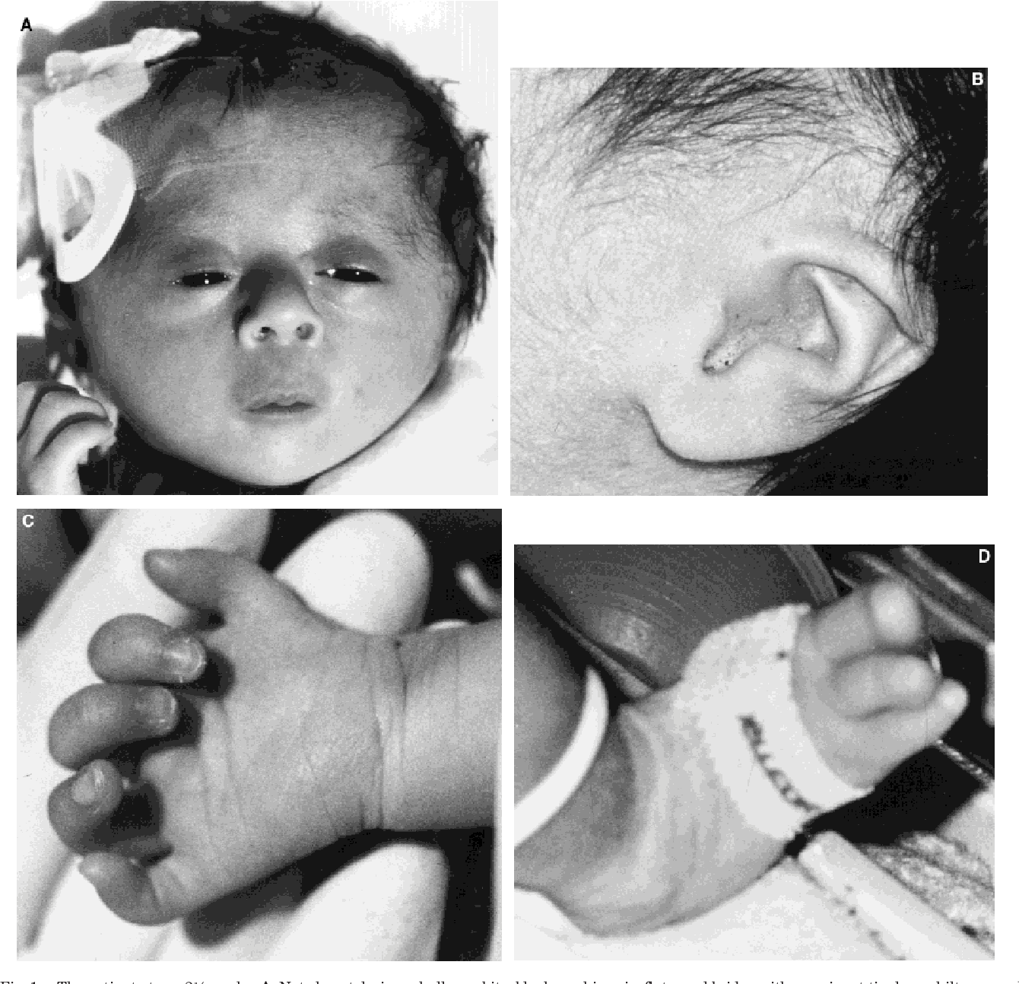
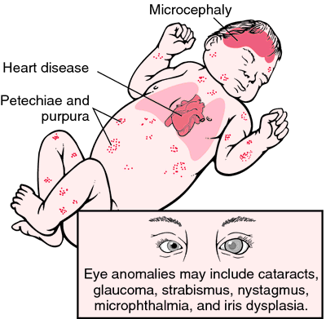
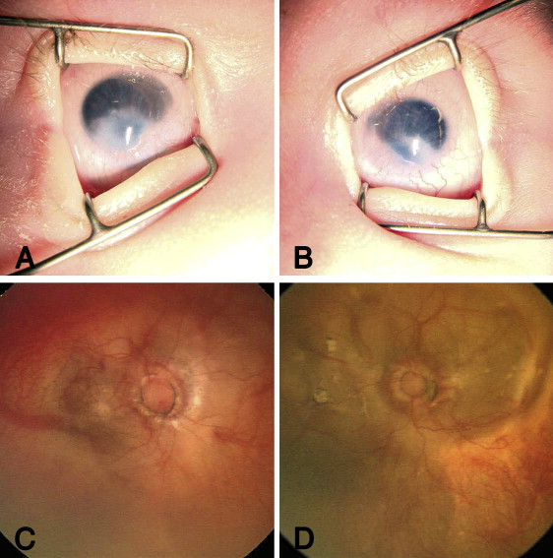
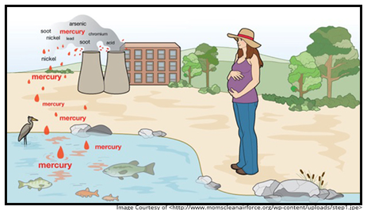
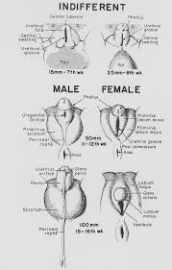
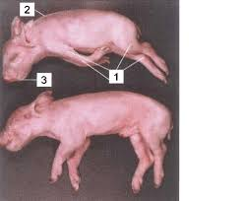
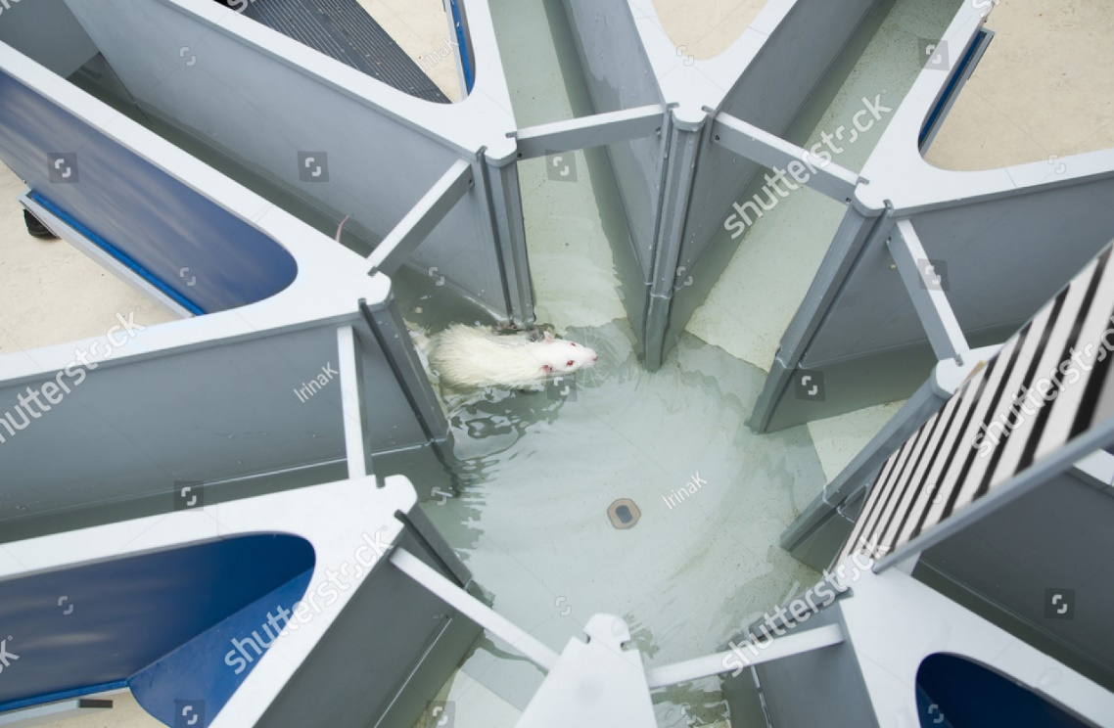
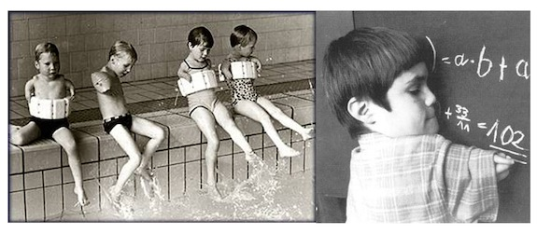
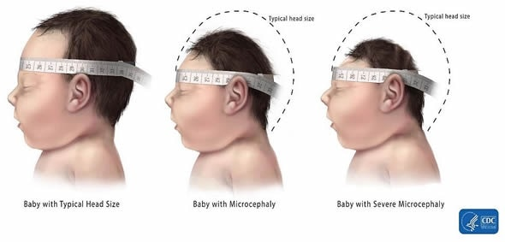
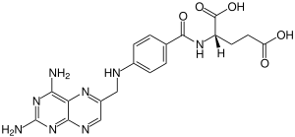

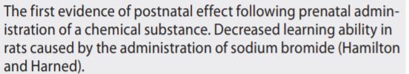








INTRODUCTION TO TERATOLOGY
1905
1921
1929
1959
1935
1937
1961
1941
1944
1948
1952

Slide 6
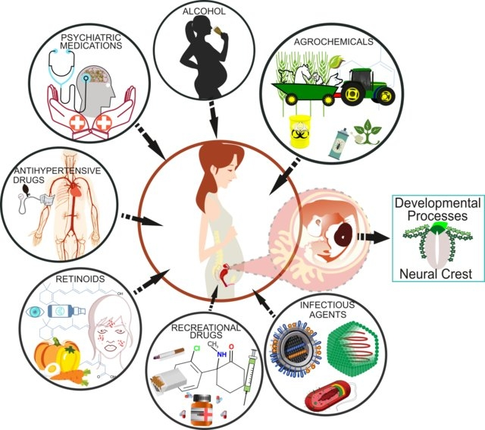
INTRODUCTION TO TERATOLOGY
What is a teratogen?
X-Rays
Lipid diet
Hypovitaminosis
Sex hormones
Virus infection
Chemical substances (NaBr, retinoids)
Drugs (aminopterins, thalidomide, medications)
Recreational drugs, alcohol
Environmental pollutant (methyl mercury, agrochemicals)

Slide 7

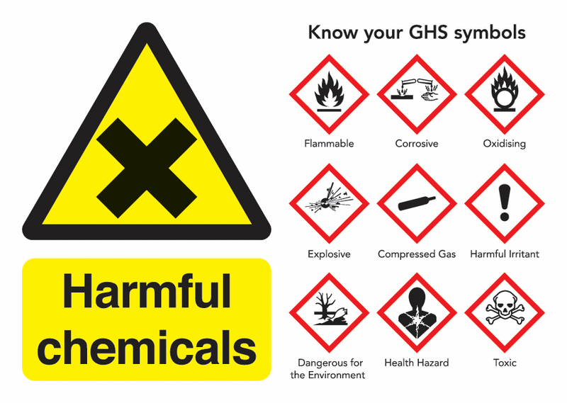

INTRODUCTION TO TERATOLOGY
Teratogens around us
physical ionizing irradiation (UV, RTG, α, β, γ), temperature, mechanical factors (amnion bands, pes equinus, ...)
chemical pharmacological drugs (antibiotics, antiepileptics, anticoagulans, cytostatics) solvents, alcohol, heavy metals, organometals, ...
biological patogens (virus), disease of mother (diabetes, myasthenia gravis, PKU)

Slide 8
INTRODUCTION TO TERATOLOGY
How to identify a teratogen?
<5%
Environmental
Intrauterine infections
Metabolic disorder of mother
Drugs and medications
Radiation
20-25% Genetical
65-75%
Multifactorial or unknown

Slide 9
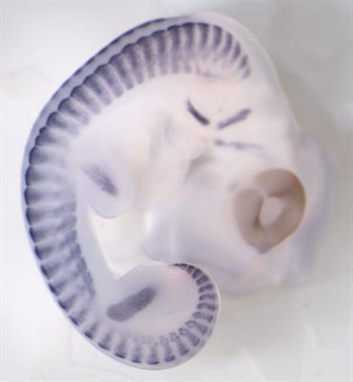
INTRODUCTION TO TERATOLOGY
What does a teratogen do?
Disrupts fine molecular or metabolic pathways
Intra uterine growth retardation
Failure of histogenesis, organogenesis
Embryonic/fetal death

Slide 10
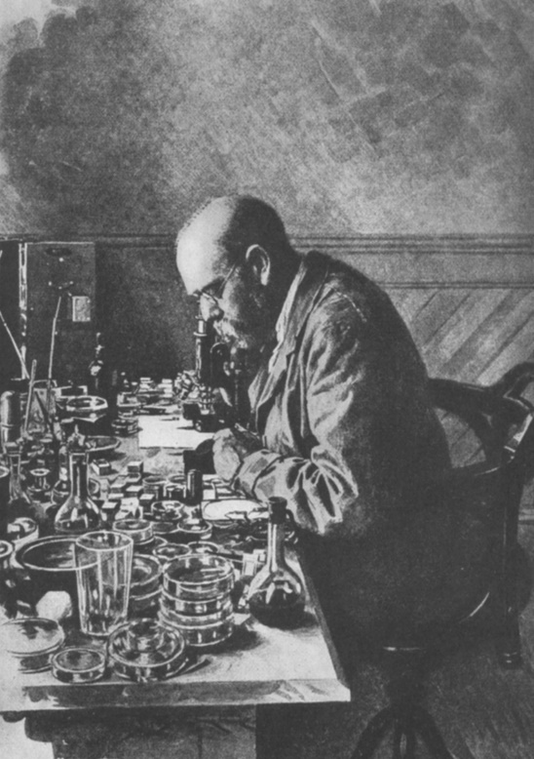
INTRODUCTION TO TERATOLOGY
How to identify a teratogen?
Animal studies
Observations from human exposure
Koch's Postulates in microbiology:
The microorganism must be found in abundance in all organisms suffering from the disease, but should not be found in healthy organisms.
The microorganism must be isolated from a diseased organism and grown in pure culture.
The cultured microorganism should cause disease when introduced into a healthy organism.
The microorganism must be reisolated from the inoculated, diseased experimental host and identified as being identical to the original specific causative agent.
"Koch's Postulates" adapted for teratology:
  The agent must be present during the critical stage of development.
  The agent produces a particular pattern of birth defects in animal studies.
  The agent crosses the placenta and there is a dose-response relationship.
  There is an abrupt increase in the frequency of a particular defect or group of defects (syndrome).
  The increase of defects is associated with the use of a new drug or the widespread exposure to a chemical or environmental change.
  There is an absence of other factors to explain the observations.
  The mechanism of teratogenesis makes biological sense.

Slide 11

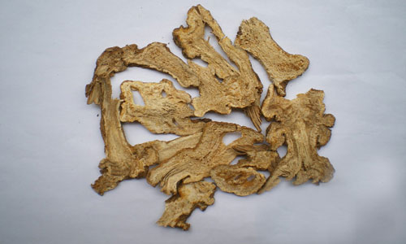
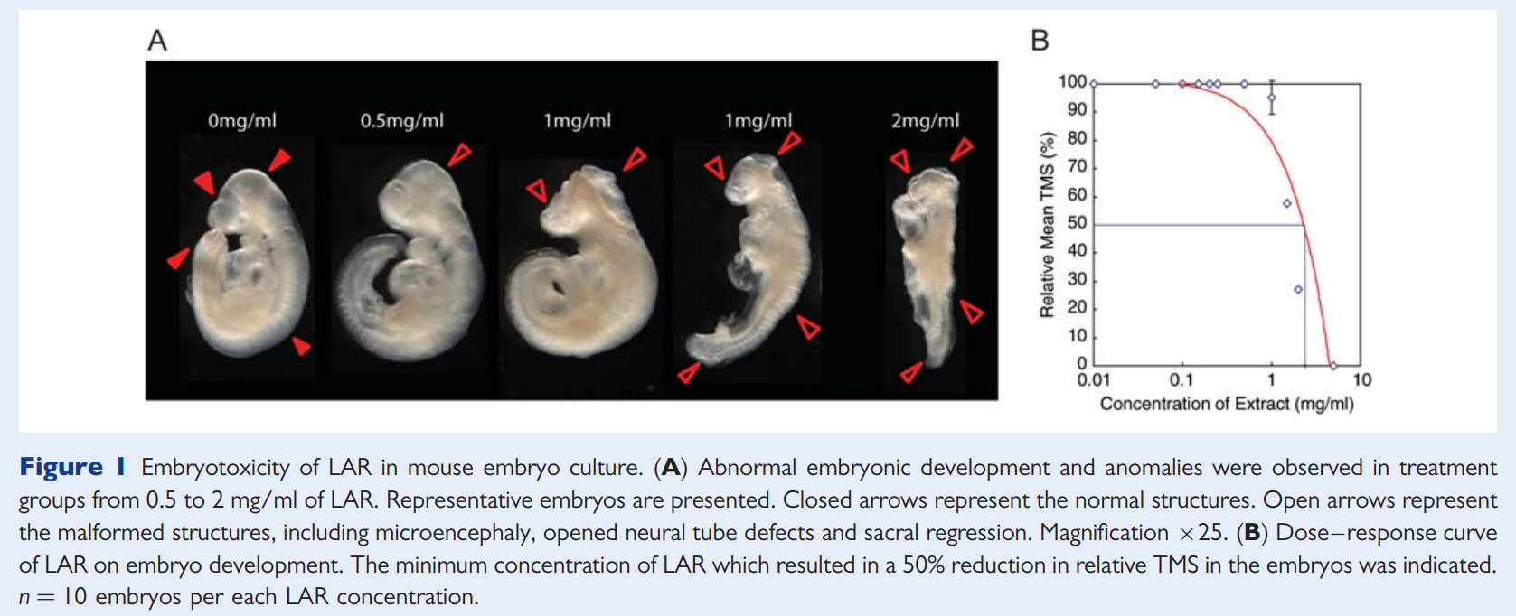
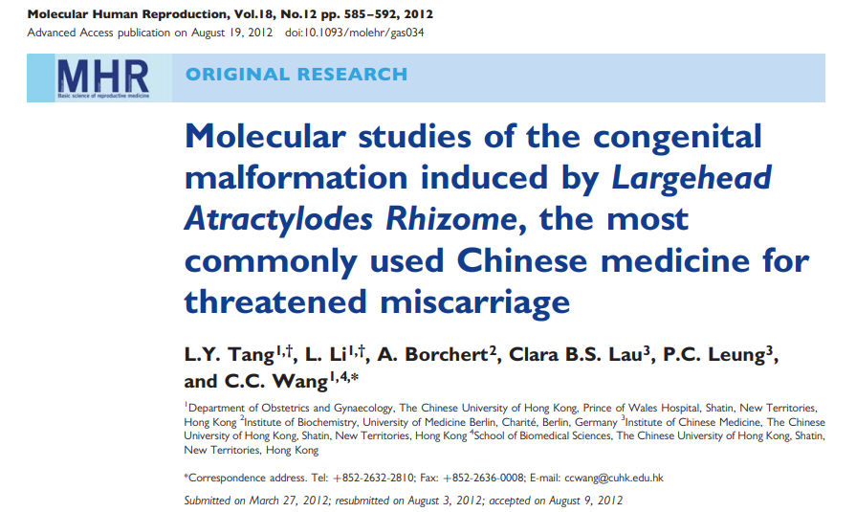
INTRODUCTION TO TERATOLOGY

Slide 12
INTRODUCTION TO TERATOLOGY
How to identify a teratogen?
Animal studies
Observations from human exposure
Understand the biological context

Slide 13
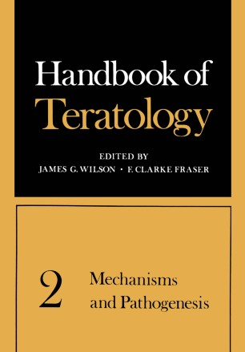
INTRODUCTION TO TERATOLOGY
Wilson’s Six Principles of Teratology (1977)
1. Susceptibility to teratogenesis depends on the genotype of the conceptus and the way in which this interacts with environmental factors.
2. Susceptibility to teratogenic agents varies with the developmental stage at the time of exposure.
3. Teratogenic agents act in specific ways (mechanisms) on developing cells and tissues to initiate abnormal embryogenesis (pathogenesis).
4. The final manifestations of abnormal development are death, malformation, growth retardation, and functional disorder.
5. The access of adverse environmental influences to developing tissues depends on the nature of the influences (agent).
6. Manifestations of deviant development increase in degree as dosage increases from the no-effect to the totally lethal level.

Slide 14
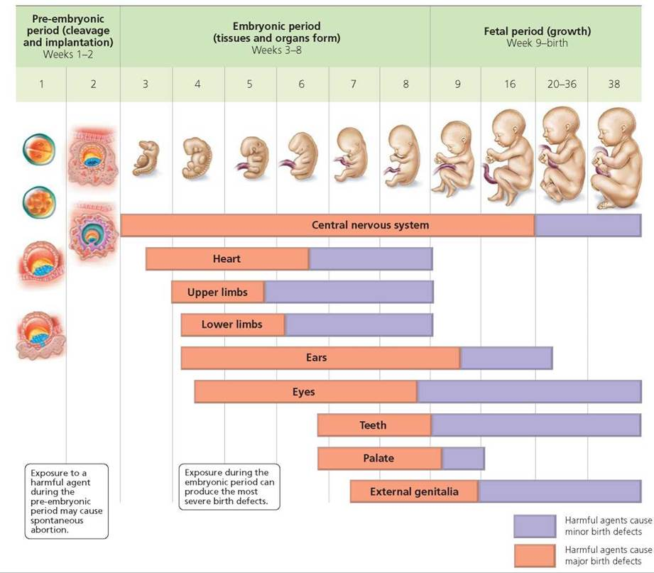
INTRODUCTION TO TERATOLOGY

Slide 15
INTRODUCTION TO TERATOLOGY
Mechanisms of action?
Mutation
Chromosomal nondisjunction and breaks Mitotic interference
Altered nucleic acid integrity or function
Lack of precursors and substrates needed for biosynthesis
Altered energy sources
Enzyme inhibitions
Osmolar imbalance
Altered membrane characteristics
1977
Epigenetic control of gene expression
The effects of small regulatory RNAs
The imbalance of gene products resulting from submicroscopic alterations of genomic structure such as copy number changes
Alterations of the cytoskeleton
Perturbations of the extracellular matrix
Effects of mechanical forces on embryogenesis
Disturbances of intracellular or intercellular signalling
Dysfunction of molecular chaperones
Effects on the distribution of molecules into subcellular compartments
Alterations of the integrity of intracellular organelles
2010

Slide 16
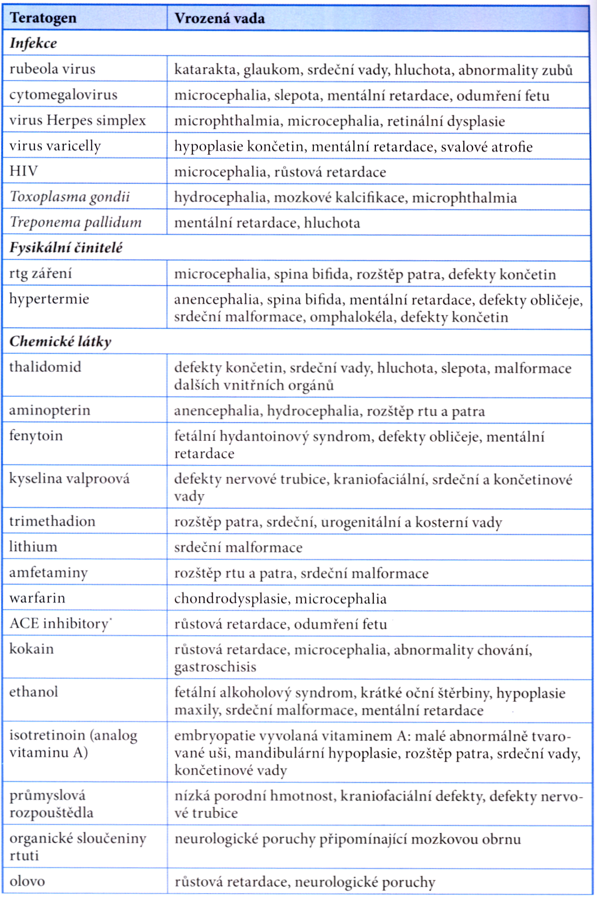
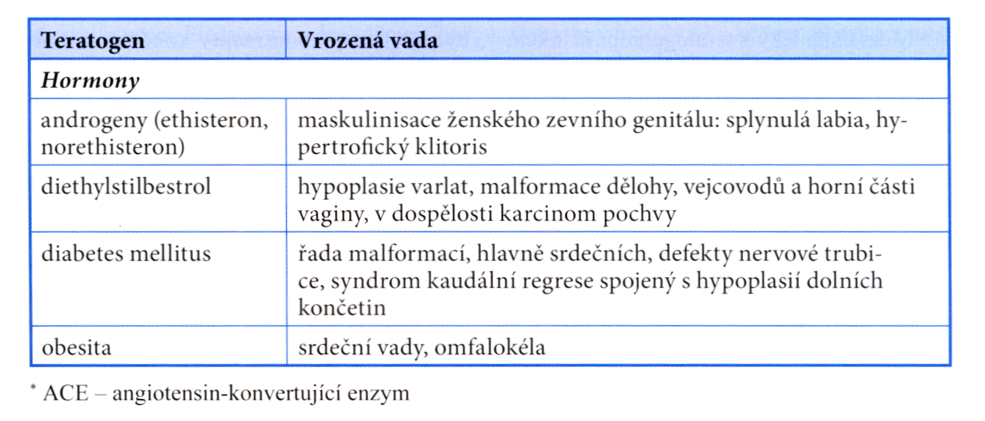
INTRODUCTION TO TERATOLOGY
Growth retardation
Failure of histogenesis, organogenesis
Embryonic/fetal death

Slide 17
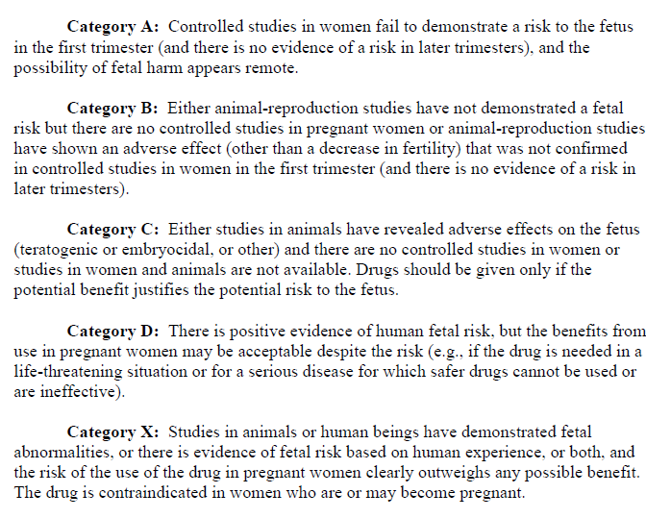


INTRODUCTION TO TERATOLOGY
How to classify a teratogen?
https://www.govinfo.gov/content/pkg/FR-2008-05-29/pdf/E8-11806.pdf
https://www.ema.europa.eu/en/documents/regulatory-procedural-guideline/guideline-exposure-medicinal-products-during-pregnancy-need-post-authorisation-data_en.pdf

Slide 18
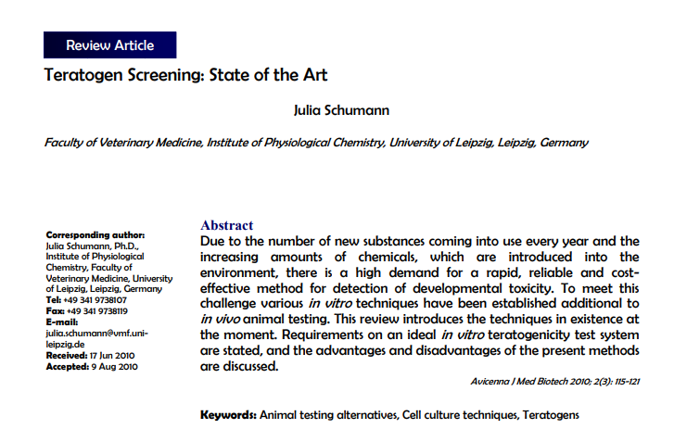
INTRODUCTION TO TERATOLOGY
Further reading

Slide 19


Slide 20

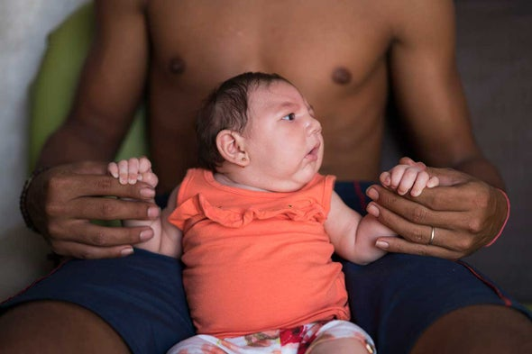

Slide 21
CASE STUDY

Slide 22
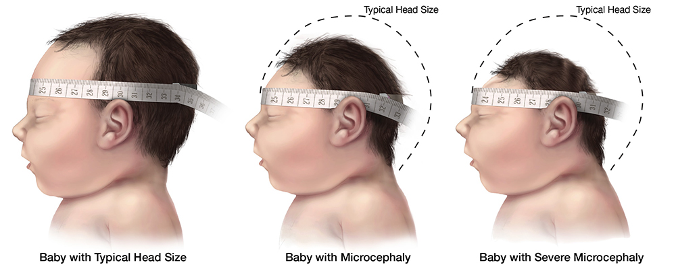
CASE STUDY
Evidence for ZIKV induced microcephaly?

Slide 23
INTRODUCTION TO TERATOLOGY
How to identify a new teratogen?
Observations from human exposure
Epidemiology – Bradford Hill criteria
Understand the biological context – transmission in ecosystem
Mechanism of action
Validate on animals

Slide 24
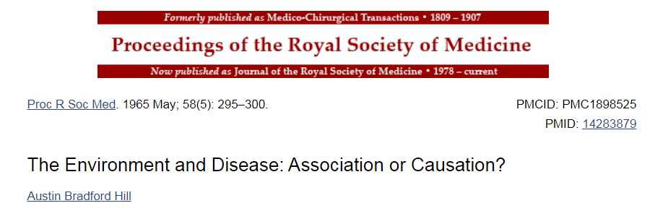

CASE STUDY
Bradford Hill criteria
Strength (effect size): A small association does not mean that there is not a causal effect, though the larger the association, the more likely that it is causal.
Consistency (reproducibility): Consistent findings observed by different persons in different places with different samples strengthens the likelihood of an effect.
Specificity: Causation is likely if there is a very specific population at a specific site and disease with no other likely explanation. The more specific an association between a factor and an effect is, the bigger the probability of a causal relationship.
Temporality: The effect has to occur after the cause (and if there is an expected delay between the cause and expected effect, then the effect must occur after that delay).
Biological gradient: Greater exposure should generally lead to greater incidence of the effect. However, in some cases, the mere presence of the factor can trigger the effect. In other cases, an inverse proportion is observed: greater exposure leads to lower incidence.
Plausibility: A plausible mechanism between cause and effect is helpful (but Hill noted that knowledge of the mechanism is limited by current knowledge).
Coherence: Coherence between epidemiological and laboratory findings increases the likelihood of an effect.
Experiment: "Occasionally it is possible to appeal to experimental evidence".
Analogy: The use of analogies or similarities between the observed association and any other associations.
Reversibility: If the cause is deleted then the effect should disappear as well.

Slide 25
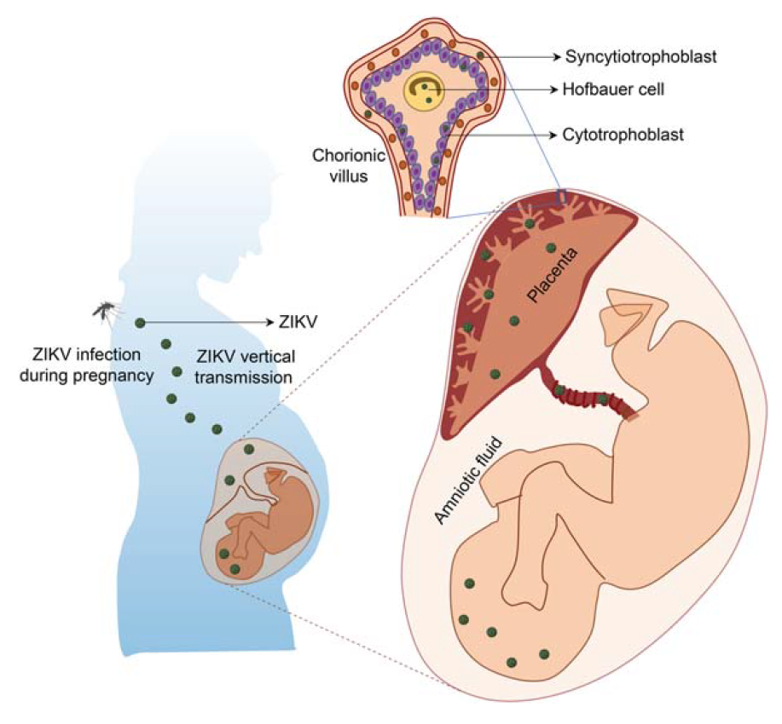
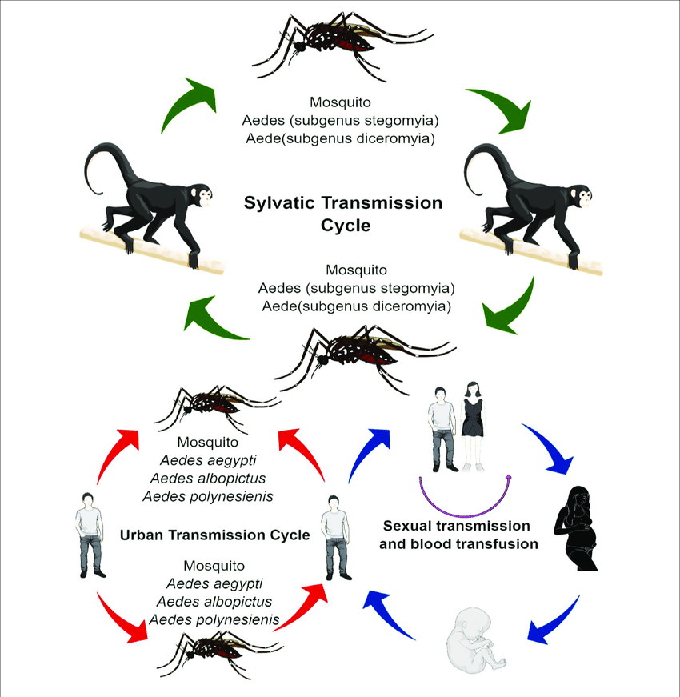
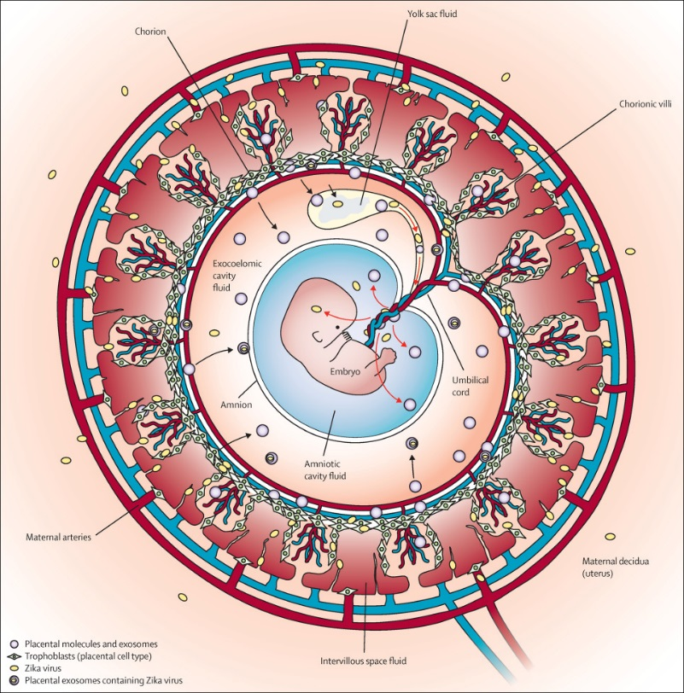
CASE STUDY
ZKV transmission

Slide 26
CASE STUDY
ZKV mechanism of action

Slide 27

CASE STUDY
Validation in animal model
Failure of placental barrier
Brain damage
https://www.cidrap.umn.edu/news-perspective/2016/05/animal-studies-detail-marked-zika-damage-developing-brains

Slide 28
INTRODUCTION TO TERATOLOGY
Take home message
Teratology, teratogens → From Koch’s postulates to Wilson’s principles
Mechanisms of action → any embryology and/or cell biology textbook
Classification & clinical examples → any embryology textbook, FDA (EU) categories
Identification, validation → ZIIKA forest virus story & Bradford Hill criteria
Further reading:
Friedman JM. The Principles of Teratology: Are They Still True? Birth Defects Research (Part A): Clinical and Molecular Teratology. 2010. 88:766–768.
Schumann J. Teratogen Screening: State of the Art. Avicenna J Med Biotechnol. 2010. 2(3): 115–121.
Varga I. Embryology Teaching: An Often-neglected Part of the Medical Curriculum. Rev Arg de Anat Clin. 2017. 9(2):47-51.
Ujhazy et al. Teratology – past, present and future. Interdiscip Toxicol. 2012. 5(4): 163–168.

Slide 29


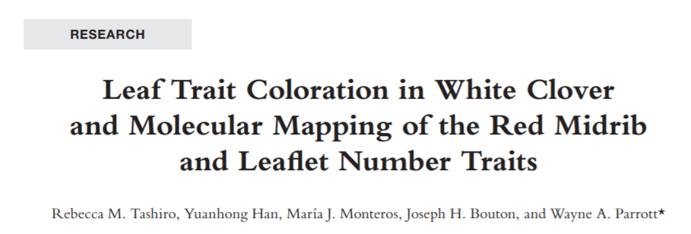
INTRODUCTION TO TERATOLOGY
Not every genetic anomaly results in a malfunction
x
Thank you for attention

