Slide 1
Magnetic therapy I
Topic 1

Slide 2
Content
History of magnetic field
A magnetic field - basic concepts
Magnetic field - physical characteristics
Types of magnetic fields
Biological mechanisms of effect
Problems of biological action of the magnetic field

Slide 3
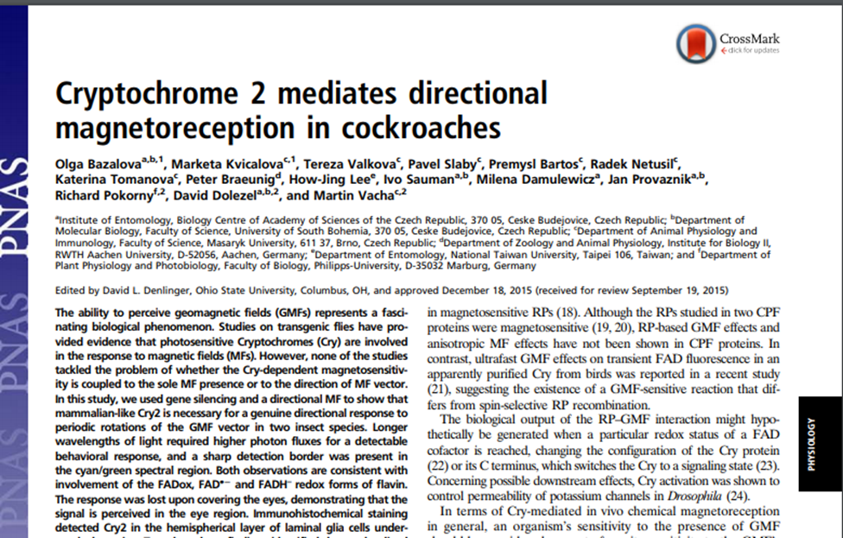
Introduction to the magnetic field
the Earth's magnetic field is known over 6 thousand years
magnetic field is used to orientation by animals – birds, fish, insect

Slide 4
Introduction to the magnetic field
Discoveries of electric energy brought knowledge of magnetic field
(18. century)
Oersted – electric current swings compass needle
Ampére – experiments with hollow cylinder = solenoid – generate induced current
Faraday – discovered electromagnetic induction
F.A.Mesmer (1774) – favorable effect on joint diseases

Slide 5
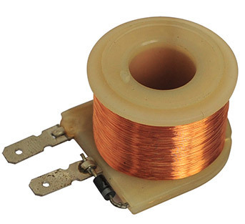
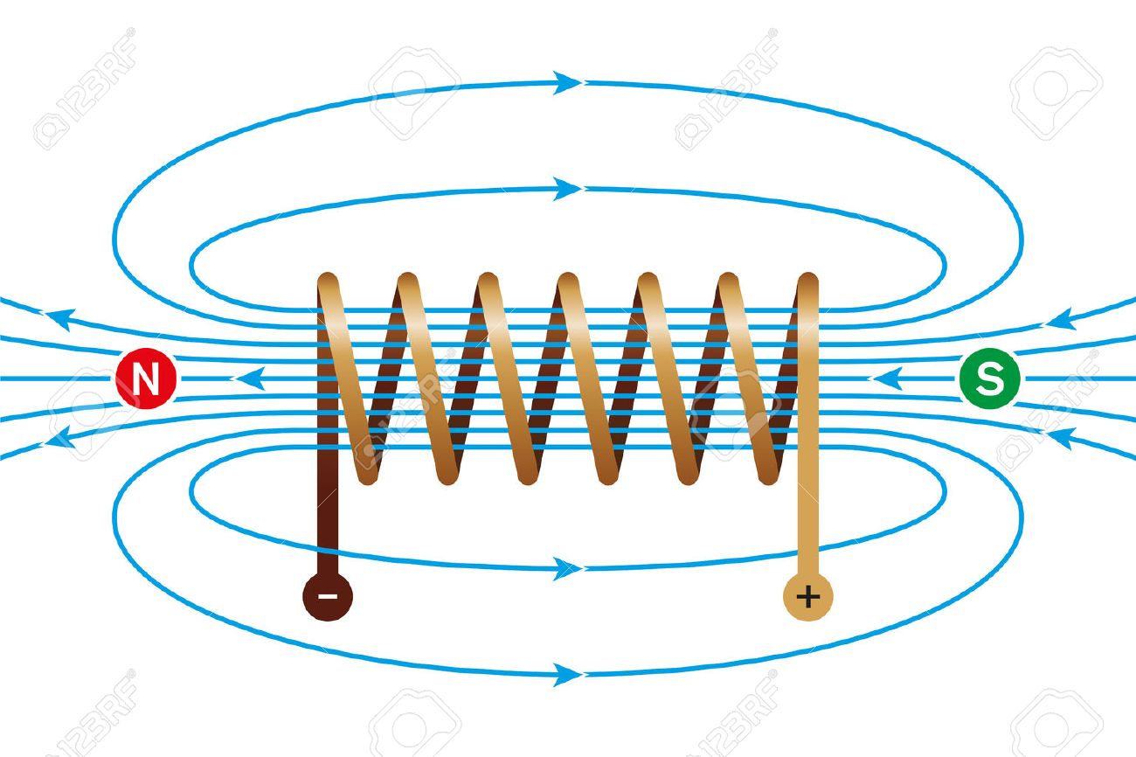
Magnetic field – basics concepts
Theory of electromagnetic field – movement of electrical charge generate induced magnetic field
Magnetic field is generated around each conductor through which the electric current flows
Physical properties depend on this electrical current
This phenomenon is called electromagnetic induction
Induction of magnetic field of the earth – approximately 10⁻⁵ T (Tesla)
https://www.google.com/url?sa=i&url=https%3A%2F%2Fdir.indiamart.com%2Fimpcat%2Felectromagnetic-coil.html&psig=AOvVaw24DdLE5E03b_hgFv3nA7Xx&ust=1602535947143000&source=images&cd=vfe&ved=0CAIQjRxqFwoTCKju5-G1rewCFQAAAAAdAAAAABAN
https://www.google.com/url?sa=i&url=https%3A%2F%2Fwww.123rf.com%2Fphoto_64054956_stock-vector-magnetic-field-of-a-current-carrying-coil-electromagnetic-coil-conductor-made-of-a-copper-wire-spira.html&psig=AOvVaw24DdLE5E03b_hgFv3nA7Xx&ust=1602535947143000&source=images&cd=vfe&ved=0CAIQjRxqFwoTCKju5-G1rewCFQAAAAAdAAAAABAI

Slide 6
Magnetic field – physical characteristics
Intensity and induction of the magnetic field - vector variables
intensity of the magnetic field – H = $\frac{I}{r}$; I – electric current; r - distance from the conductor; unit – A/m
induction of magnetic field – B – is determinated by the force applied by the magnetic field on the conductor ; unit – 1T (tesla) – in practise – mT (militesla)
Frequency – determinated by changing electric current puls magnetic field in applicator;
magnetic gradient - spatial gradient of the magnetic field; the difference of magnetic induction between two locations in magnetic field; unit – mT/cm; gradient over 0,5 mT/cm is highly risky
Diffrent magnetic fields´ characteristics for diffrent applicators

Slide 7
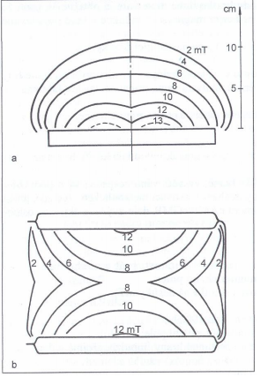
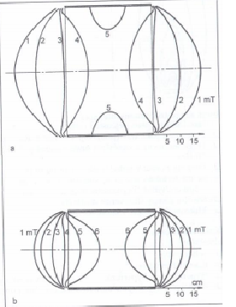
The magnetic gradient is determined by the density of the magnetic induction´s isolines of each applicator

Slide 8
Types of magnetic fields
According current and its changes over time:
Static field - unchanging intensity and direction of the field over time, this kind of field is generated around permanent magnets and around conducts flown by direct current
Alternating field (dynamic) – alternating of polarity, values of intensity is changing regularly from 0 to positive maximum and through 0 to negativ maximum and back to 0; this kind of field is generated around conducts flown by alternating current
Pulse field (dynamic) – jump changes values of intensity; this kind of field is generated around conducts flown by electrical impulses;
According frequency:
Low-frequency magnetic field
High-frequency magnetic field
According distribution of the magnetic field in surroundings
homogeneous field – has the same size and direction at all points
inhomogeneous field – has different size and direction in the considered space

Slide 9
Biological mechanisms of effect
Supposed effects through electromagnetic induction, magnetomechanic phenomena, interactions of electrones (all hypothetical)
Because of absence of demonstrable magnetic field receptors
empirical verification of effects (not according evidence-based medicine)
Only pulsed low-frequency field is more used in practise

Slide 10
General physiological effects
Vasodilatation – area of precapillary sphincter by mechanism of eflux of Ca²⁺
Analgetic effect – increase secretion of endorphin and/or reinforcement binding to specific receptors
Dispersing effect – making the background for following effects by changing rheological properties of tissues and hydration of hyaluronic acid
Myorelaxation (for hypertonic muscles or fibres) and myotonic effect (for hypotonic muscles or fibres) – enhancing perfusion of tissues and changing activity of lactate dehydrogenese
Antiedematous effect – especially in chronic post-traumatic condition; effect by changing ratio of cAMP/cGMP and improving perfusion
Accelerated healing – especially bone trauma by increasing activation of bone specific cells (osteoklast and osteoblast)
Trophotropic effect – effect by vasodilatation of capillary bed; direct effect on cells and theirs organelles (membranes – influencing influx/eflux of ionts, proteins, medicaments), increasing metabolism of tissues in exposed part

Slide 11
General physiological effects - example
Disperse and Trophotropic effect – significantly decreases the stiffness of tissues (articular capsule, muscles, scars) during fixation of joints
low-frequency pulse magnetic therapy – used in distance aplication through splint fixation from 4th day after injury, decrease stiffness and hardening of these tissues (after taking off the splint), this effect reduces time of regeneration

Slide 12
Problems of biological effects of the magnetic field
Lack of evidence-based medicine information about effect
Empirical evidence
Magnetic therapy is usually long term, some symptoms of other disease may arise during therapy
The effect can only appear after repeated application
Magnetic field can damage electronic machines like watch, computer, phone, creditcards, flashdisk and other storage media
Combination with other physical therapy modality can be inappropriate or even harmful (dose potentiation)
side effects – during aplication, after aplication;

Slide 13
What is Magnetic therapy??
Therapeutic method
Modality of the Physical therapy (kind of distance electrotherapy)
Magnetic component of electromagnetic field used for medical purposes
Modality of physical therapy that is based only on empirical evidence (lack of evidence-based medicine)

Slide 14
Take home message
Magnetic field is generated around each conductor through which the electric current flows
The properties of the magnetic field depend on the properties of the electrical current flowing through it
Magnetic field characterizes intensity, induction, magnetic gradient, field characteristics of each applicator, frequency
Many effects based on empirical evidence
Most people don´t feel it (some patients – negative feelings – nauzea, vomitus, irritation of vegetative system)
The most using magnetotherapy is low-frequency pulse magnetic therapy
Because of empirical evidence, we can´t determine exact optimum for each disease, exact specify induction, frequency, time of aplication and number of aplications.

Slide 15
Thank you for your attention

