Slide 1
Patient Safety: Protection of the Patient from Ionizing Radiation
Quality Healthcare:
Image Quality and Diagnostic Accuracy in X-Ray Imaging (XRI)

Slide 2
Ionization Radiation and Risk
Ionizing electromagnetic radiation: f > 3·10¹⁵ Hz, i.e., hard UV, X and gamma. At these frequencies, photon energies (E = hf) are high enough to ionise water molecules
Ions lead to the formation of FREE RADICALS (H, OH) and other highly chemically reactive compounds (e.g., H₂O₂) which bring about changes in biologically important molecules, e.g., DNA, leading to undesirable biological effects such as carcinogenesis.
Radiation doses lead to real risks - patient does not feel anything but the damage has been done, some of the patient’s cells have been changed!!!
The higher the amount of x-ray energy absorbed by the body - we say the higher is the radiation ‘dose’ - more free radicals etc. are produced and the higher the risk (probability) of biological effects.
Notes:
Equations for H, OH and H₂O₂formation:
H₂O⁺ H⁺ + OH
e⁻ + H₂O H₂O⁻ H + OH⁻
OH + OH H₂O₂

Slide 3
Doses: Units and Risk
Unit of dose is the Sievert (Sv). Doses in x-ray imaging practice are of the order of mSv.
Typical Doses: intra-oral less than 0.01mSv, chest X-ray: 0.1 mSv, CT mandible up to 1.2mSv, CT maxilla up to 3.3 mSv, Fluoroscopy: 5 mSv, Body CT Scan: 10 mSv, Interventional radiology – tens to hundreds of mSv.
A certain risk is associated with each mSv, e.g., a risk of 50 per million per mSv for carcinogenesis.
Radiolog. study | dose in mSv | Carcinogen risk | Number of cancer cases if each member of the EU is examined
Chest X-Ray | 0.1 | 1 in 200,000 | 3700
Fluoro. | 5 | 1 in 4000 | 185,000
CT scan | 10 | 1 in 2000 | 370,000
Intervent. radiology | 50 | 1 in 400 | 1,850,000

Slide 4
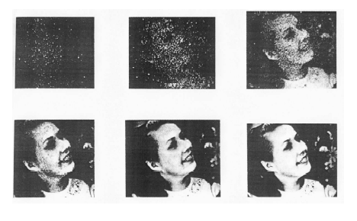
Image Quality and Patient Dose
In general, the better the image quality required the higher the dose! Too low amount of radiation - insufficient image quality, inaccurate diagnosis; too high - unnecessary patient dose and therefore risk.

Slide 5
ICRP Principles
JUSTIFICATION - Since every image carries risk before taking the image, we must ask ourselves ‘Is it justified?
  Is the x-ray image really necessary for diagnosis? (check with referral criteria)
  Is the benefit to the patient higher than the risk?
  Can we use previously taken images?
  Can we use MRI or USI which are non-ionizing?
OPTIMISATION: we must produce an image of just sufficient quality for an accurate diagnosis whilst avoiding unnecessary patient dose
  avoid repeats!
  use imaging devices which have the required performance indicators
  use device use protocols which produce images with just sufficient image quality for accurate diagnosis
Dose LIMITATION: measure patient doses regularly and check that they do not exceed recommended levels (diagnostic reference levels)
ICRP = International Commission for Radiation Protection

Slide 6
Justification : Example Referral Criteria when Imaging the Thorax
http://ec.europa.eu/energy/nuclear/radioprotection/publication/doc/118_en.pdf
(A) randomised controlled trials, meta-analyses, systematic reviews, (B) experimental or observational studies, (C) advice relies on expert opinion and has the endorsement of respected authorities.

Slide 7
Proper Perspective Regarding Risk from Ionizing Radiation
Imaging with ionising radiation is one of the most powerful tools in the doctor’s ‘toolbox’. Proper diagnosis is not possible without it.
Risks in hospital: from Physical, Chemical and Biological agents.
Physical agents: mechanical, electrical, magnetic, optical, ionising radiation
Ionising radiation is one of the least hazardous
However since millions of images are taken yearly the risk for the population as a whole (‘collective dose’) becomes high.
Moreover medical doses are increasing with ‘better safe than sorry’ medicine and the ease of use of modern imaging devices (e.g., spiral CT compared to conventional CT, digital XRI compared to film XRI).
This is why EU produced a directive regarding patient radiation protection (97/43/EURATOM).

Slide 8
Outline of Rest of Lecture
Biological hazards from ionizing radiation
Target anatomy / pathology and Image Quality Outcomes
Performance indicators of XRI devices and image quality
Optimization of patient doses in XRI
CT scanning
Dental radiology
Interventional radiology as these are techniques which carry the highest risk
Radiation detectors and their uses
The slides with PINK background contain basic knowledge obligatory for the exam!!!!

Slide 9
Risks from Ionizing Radiation

Slide 10
Effects of Radiation on Cells
Radiation bioeffects initiate at the cellular level
Cells are most radiosensitive during mitosis (cell division)
Effects of radiation on cells:
  Cell death prior to or after mitosis (not so important except in certain very high dose procedures when so many cells die that the whole tissue suffers e.g., interventional radiology)
  Delayed or prolonged mitosis
  Abnormal mitosis followed by repair
  Abnormal mitosis followed by replication - this is usually the major problem in medical imaging – leads to carcinogenesis, mutagenesis

Slide 11
Radiosensitivity of Cells
Law of Bergonie and Tribondeau: radiosensitivity of cells is proportional to rate of cell division (mitotic frequency) and inversely prop. to the level of cell specialisation (also known as cell ‘differentiation’).
  High sensitivity: bone marrow, spermatogonia, granulosa cells surrounding the ovum
  Medium sensitivity: liver, thyroid, connective tissue, vascular endothelium
  Low sensitivity: nerve cells
The younger the patient the more radiosensitive because of the high rate of cell division and incomplete differentiation, more care required in paediatrics (children 3 times more radiosensitive than adults).
The unborn child is the most sensitive.

Slide 12
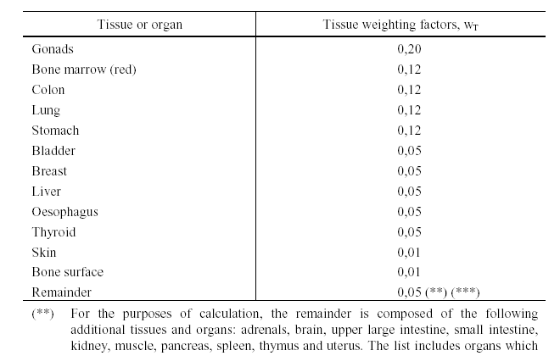
Quantifying the relative radiosensitivity for carcinogenesis and mutagenesis of various tissues: Tissue Weighting Factors
(Ref. 96/29/Euratom)

Slide 13
Some Ionizing Radiation Hazards
Carcinogenesis
Mutagenesis (change in a gene in gametes)
Eye-lens cataracts
Skin injuries
Effects on conceptus when irradiated in the uterus (e.g., death, brain damage, childhood cancer)

Slide 14
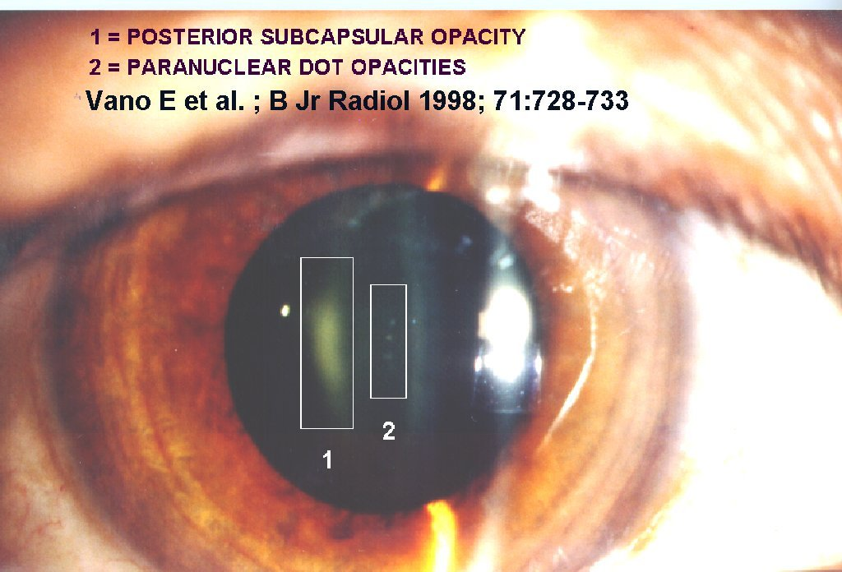
Radiation Effects: Eyes
Eye lens is highly radiosensitive, moreover, it is surrounded by highly radiosensitive cuboid cells.
lens opacities (cataracts)

Slide 15
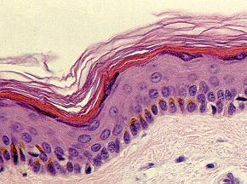
Radiation Effects on Skin
Histology of the skin
Erythema (reddening of skin): 1 to 24 hours after irradiation
Alopecia (hair loss): reversible; irreversible at high doses.
Pigmentation: Reversible, appears 8 days after irradiation.
Dry or moist desquamation (skin peeling)
Delayed effects: teleangiectasia (small red viens and arteries showing on skin), fibrosis (loss of skin elasticity).
EPIDERMIS
Increasing radiation
DERMIS
From “Atlas de Histologia...”. J. Boya
Basal stratum cells, highly mitotic, (most radiosensitive)

Slide 16
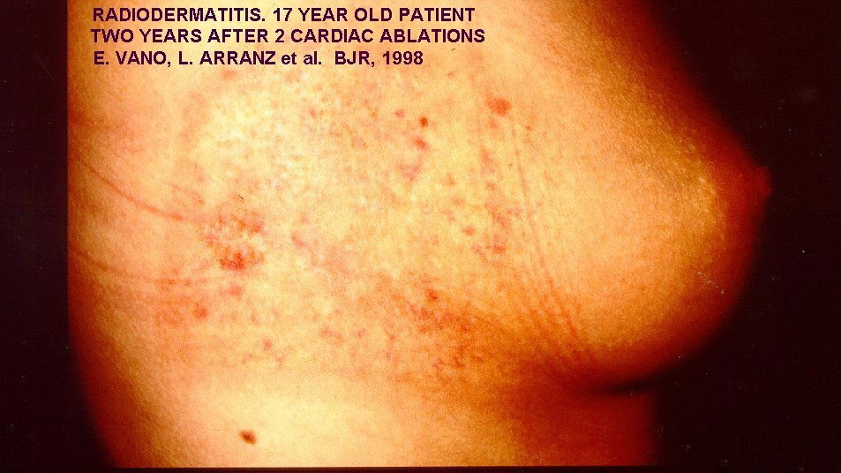
dermatitis = inflammation (pain, heat, redness) of the skin caused by an outside agent
ablation = removal of tissue by cutting, microwave radiation etc)

Slide 17
The Pregnant patient : Effects on Conceptus
There are 3 kinds of effects: lethality (i.e., death), congenital abnormalities (e.g. brain damages) and delayed effects (e.g., childhood cancer and hereditary effects noticed long after birth).
Lethality
Congenital
risk
1
2
3
Pre-implantation
Organogenesis
Time (months)
Notes:
Conceptus: unborn child from conception to birth
embryo: 0 - 8 weeks
fetus: 9th week till birth

Slide 18
Protection of the Conceptus
Women of child bearing age: protection of a possible conceptus when X-ray imaging the region from the knees to the diaphragm
Ask pregnancy question, pregnancy test, 10 day rule, 28 day rule
Except for certain very high dose procedures imaging can be done normally with some added precautions

Slide 19
Characteristics of Biological Effects
Acute (effects occur short-term, e.g., skin peeling after interventional radiology) vs. Late (effects occur long-term, e.g., carcinogenesis)
Deterministic (existence of a threshold dose, risk zero below threshold, e.g., cataracts, skin injuries, brain damage in conceptus) vs. Stochastic (no threshold, dose and risk proportional, risk never zero, e.g., carcinogenesis, mutagenesis)
risk
risk
dose of agent
dose of agent
stochastic effects
deterministic effects

Slide 20
Target Anatomy / Pathology and Image Quality Outcomes

Slide 21
Some Terminology
Target anatomy / pathology: what is present inside the patient that I want to visualize in the image?
Target Image Quality Outcomes: what qualities must the image have for me to be able to see the target anatomy and pathology clearly enough to make an accurate diagnosis?

Slide 22
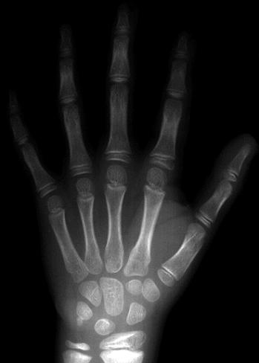

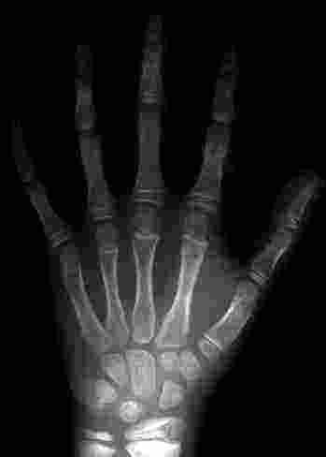
X-ray of Child’s Wrist
Target anatomy / pathology: measure gaps between the carpal bones of the wrist (in an adult, the average space less than 2mm)
Target image quality outcome: SHARP outlines

Slide 23
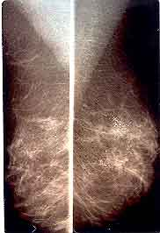
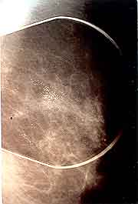
Mammography
Micro-calcifications
Target anatomy / pathology: microcalcifications in female breast
Target image quality outcome: high CONSPICUITY of very small objects
magnified view of micro-calcifications

Slide 24
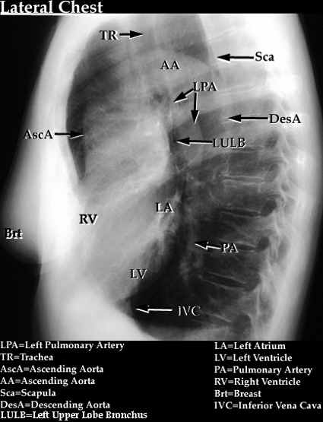
Lateral Chest X-Ray
Target anatomy / pathology: To distinguish between Ascending Aorta (AA) and Left pulmonary artery (LPA) in a lateral chest x-ray.
Target image quality outcome: High IMAGE CONTRAST (differences in grey scale level between images of different tissues)

Slide 26
Performance Indicators of XRI Devices and Image Quality

Slide 27
Performance Indicators for Image quality
Definition: A device performance indicator is:
  a physical specification of a medical device measured with a suitable test object
  provides an indication of how good a device is.
Important performance indicators for XRI devices are:
  Limiting spatial resolution (LSR)
  Contrast resolution (CR)
  Signal-to-noise-ratio (SNR)
  Geometric accuracy
  Uniformity
N.B. ‘Performance Standards’ for medical devices are recommended values of performance indicators

Slide 28
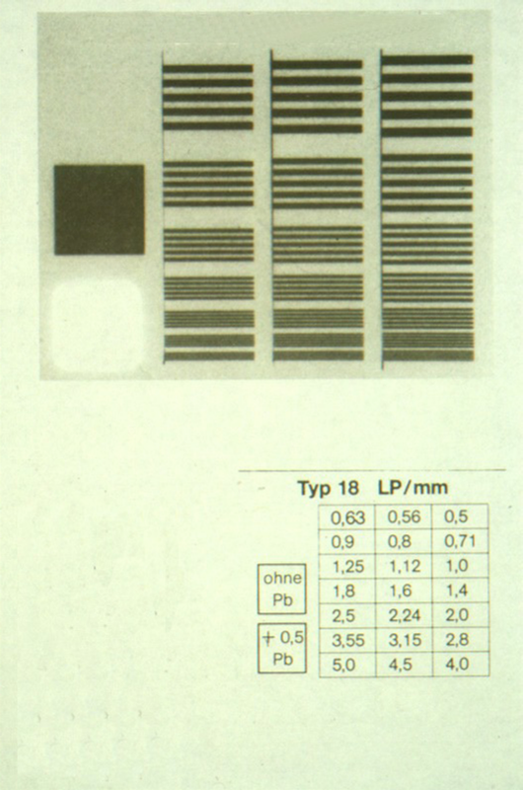
Limiting Spatial Resolution (LSR)
Put LSR test-object on the X-ray table and expose.
The LSR is the max spatial frequency which can be seen clearly.

Slide 29
Spatial Frequency Test Objects
1cm
SF=5 lp/cm
line-pair
lead plastic
SF=7 lp/cm
SPATIAL FREQUENCY = number of line-pairs per cm
SF=10 lp/cm

Slide 30
Contrast Resolution (CR)
CR test-object
Disks of materials with decreasing test-object contrast (i.e., difference in attenuation coefficient from that of the surrounding material or different thickness of the objects)

Slide 31
Contrast Resolution
The CR is the lowest test-object contrast that you can see in the image of the test-object.
Note that CR depends on the size of the discs
CR
CR
not seen

Slide 32
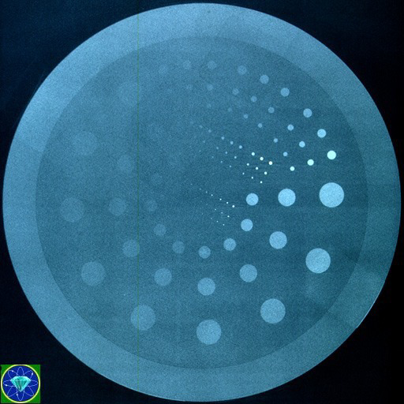
A real test object for CR testing

Slide 33


Signal-to-Noise Ratio (SNR)
Ideal x-ray tube and sensor: zero noise
In practice: Low noise
In practice: High noise
Test object: uniform thin sheet of copper
Noise occurs because of the random variability in x-ray energy fluence (energy per unit area) across the beam and detection sensitivity across x-ray sensor.

Slide 34
Measuring SNR
Plot a histogram.
SNR = mean value / standard deviation
X – axis = grey scale
Y – axis = number of pixels
Ideal x-ray tube and detector: zero noise, zero SD
Very high SNR
low noise, small SD High SNR
high noise, high SD Low SNR

Slide 35
Geometric Accuracy
To measure geometric accuracy: measure diameters and positions of images and compare with actual diameters and positions of discs in CR test object.

Slide 36
Uniformity
high uniformity
low uniformity
Checked by imaging a metal gauze and looking for areas where the image is different (darker, less sharp) than the rest of the image.

Slide 37
Use of Device Performance Indicators in Imaging

Slide 38
General Comments
You must always choose a device which has the performance indicator that would maximise visualisation of the particular anatomy / pathology under study.
Attempts to improve one performance indicator might lead to a degradation of another so one must be careful and check which performance indicator is the most important.
Attempts at improvement of performance indicators often leads to a higher patient dose (therefore one must ask whether the increased value of the performance indicator is really necessary for improved diagnostic accuracy)
Device use protocols must be designed so that these performance indicators are not degraded.

Slide 39
For High Limiting Spatial Resolution
Devices:
  X-ray tube: use the device with the smallest small focal spot available
  Digital radiography: use digital plate with the highest number of pixels sensors per unit area
Protocol:
  choose the smallest focal spot available on your device
  large SID (source image distance)
  low OID – (object image distance) use patient compression if necessary
  avoid geometric magnification if possible
  minimise motion of patient (use low exposure time, immobilise patient, give proper instructions to patient)
  Use zoom in digital

Slide 40
For High Contrast Resolution
Devices:
  use digital devices with high ADC (analog digital converter) bit-depth
Protocol:
  low kV
  minimise scatter reaching the detector (minimise field-size, minimise thickness of irradiated part, use grids, air-gap)
  use windowing

Slide 41
For High SNR
Devices:
  use low electronic noise detectors
Protocol:
  SNR is proportional to the square root of the number of photons per unit area hitting the detector. Therefore the higher the number of photons the better the SNR. Therefore use high mAs and low sensitivity detector setting (but both lead to higher patient dose).

Slide 42
For High Geometric Accuracy
ensure proper beam centring to reduce distortion
ensure proper patient positioning (object of interest parallel to detector) to reduce distortion
use large source-image distance (SID), low object-image distance (OID, including compression) to reduce magnification.

Slide 43
For High Uniformity
Devices:
  Digital: high-quality digital sensor plates and signal processors
Protocol:
  Use beam-shaping filters
  Use the heel effect

Slide 44

Always Check for Artefacts
Artefacts: features in the image which are not in the imaged object and which are brought about by damaged devices (or inappropriate use of a device)
Always check for these in every test image
no artefacts
artefacts present

Slide 45
Optimisation of Patient Doses in XRI

Slide 46
For Optimisation of Dose
Use low dose imaging devices
Use low dose protocols
Use DAP meter readings to monitor patient doses
Check that doses are below the appropriate Diagnostic Reference Levels DRLs
Ensure that the procedure is within your competence
Regular Quality Control (QC) of devices to reduce retakes (QC = regular checking of the performance indicators to ensure that they have not deteriorated)
Do regular reject analysis (to avoid making the same mistakes and hence avoid repeats)
Take advice when necessary: use the services of the Medical Physics Expert (in CZ called Medical Radiological Physicist)
Look for details in next slides!

Slide 47
Use Low Dose Devices
no grid (but CR deteriorates, avoid grid for children and small adults)
appropriate filters (removes very low energy photons which are just absorbed by the skin)
immobilisation devices with children, old people to reduce repeats
Use the Automatic Exposure Device (AED)

Slide 48
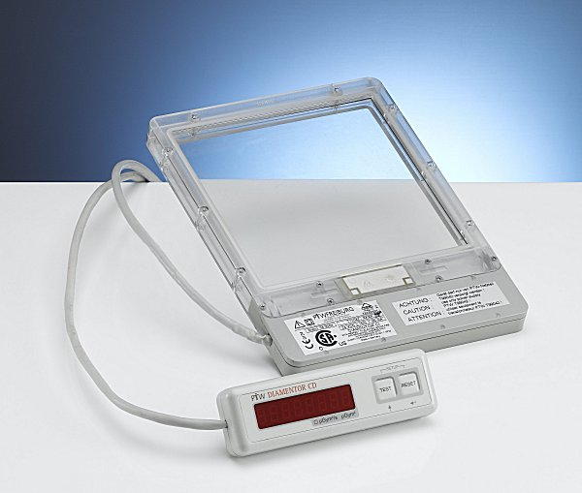
DAP meter
DAP (Dose Area Product) meter reading is a good performance indicator for the doses given by the device

Slide 49
Use Low Dose Protocols
high kV, low mAs (but lower CR)
collimate to smallest field-size (also improves CR)
never use SSD (source skin distance) less than 30 cm
protect radiosensitive organs (gonads, breast, eyes, thyroid …): exclude via collimation, right projection angle, use protective apparel, e.g., lead aprons, gonad shields
right projection e.g. PA projections best for chest and skull
use patient compression to minimise amount of tissue irradiated (improves SR, CR)
proper patient instruction to avoid repeats

Slide 50
Reducing Patient Doses in CT

Slide 51
Current Situation
CT high dose procedure
CT continues to evolve rapidly
The frequency of CT examinations is increasing rapidly!
Why increased frequency of use? 30 years ago, a standard CT of the thorax took several minutes while today with spiral-CT similar information can be accumulated in a single breath-hold making it patient & user friendly.

Slide 52
Why increased dose?
The higher the dose the better the image quality
There is a tendency to increase the volume covered in a particular examination
Modern helical CT has made volume scanning with no inter-slice gap much easier (easy just set pitch = 1)
As CT permits automatic correction of the image, high exposure factors are used even when these are not required, e.g., for thick or thin regions of the body
Same exposure factors often used for children as for adults
many radiologists believe that modern CT scanners which are very fast give lesser radiation dose, not true as mA used is higher

Slide 53
Radiosensitive Organs Needing Protection
Breast dose high in CT of thorax
Eye lens in brain CT
Thyroid in brain and in thorax CT
Gonads in pelvic CT

Slide 54
Low dose CT devices
Real-time automatic mA modulation (patient not uniform area of cross-section)
Partial rotation feature: e.g. 270 degree in Head CT (omitting the frontal 90º) saves the eyes
Gantry angulation to avoid high-sensitivity organs
Infant, small patient buttons

Slide 55
Low dose protocols
Limit the scanned volume to what is necessary only
Shielding of superficial organs such as thyroid, breast (special breast garments available), eye lens and gonads particularly in children and young adults.
Spiral CT: the higher the pitch the less the dose but the lower the axial SR
separate protocols for paediatric patients (e.g., lower mA)

Slide 56
Reducing Patient Doses in Interventional Radiology

Slide 57
RP Environment in IR
Lengthy, complex, difficult, sometimes repeated procedures - prolonged exposure times – potential for high patient doses

Slide 58
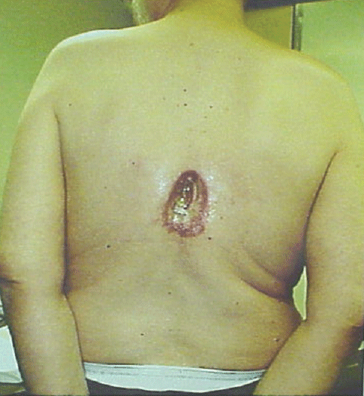
Patient: Severe Skin Injury at High Doses
Example of chronic skin injury from coronary angiography and 2x angioplasties (spine exposed)

Slide 59
Protocol Design for Patient Protection
Use low frame rates 50, 25, 12.5, 6 fps
Minimise: fluoro time, use of high image quality mode
Short intermittent exposures using pedal switch
Read dose display (total fluoro time, number of images, cumulative DAP)
Keep in mind that dose rates will be greater and dose accumulates faster in larger patients
Keep the image intensifier at minimum distance from patient
Always collimate closely to the area of interest
Prolonged procedures: reduce dose to the irradiated skin e.g. by changing beam angulation
Minimise use of zoom mode as it leads to higher patient doses

Slide 60
Units and Dose Measuring Devices

Slide 61
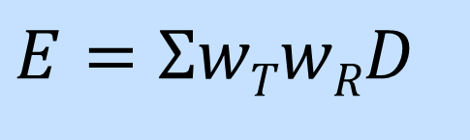
Quantities and Units for Estimating Risk
Effective Dose (units Sv):
$$E=ΣwTwRD$$
D = ABSORBED DOSE , the amount of energy absorbed per unit mass of tissue. Units J·Kg⁻¹ (Gray, Gy). The higher the absorbed dose (energy absorbed) the higher the number of ions produced and the higher the risk.
The radiation weighting factor is necessary because certain radiations are more risky than others. gamma and X (external / internal) 1, alpha (external) 0, alpha (internal) 20. The tissue weighting factor is necessary because different tissues have different radiosensitivity.
The effective dose is often referred to simply as the ‘dose’. Units of E are Sievert Sv (usually mSv used).
Notes:
Beta and X/gamma have same weighting factor (confirm) because in X / gamma it is in fact an electron that delivers the dose during absorption or scatter.

Slide 62
Old Quantities and Units (only used in USA now)
1Rad = 0.01Gy
1 Rem = 0.01Sv
Quality factor = radiation weighting factor
Roentgen (R): old measure of radiation used for X and gamma in air only

Slide 63
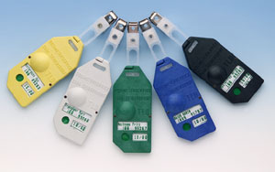
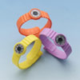
Dosimeters (dose sensors)
Types of Dosimeters used in medicine:
a) Those based on thermoluminescent materials, e.g., lithium fluoride. The ionising radiation brings some electrons into a stable higher energy excited state. After heating, the electrons fall into the ground state. This is accompanied by emission of visible light. The intensity of this light is proportional to the dose. All medical radiation badge personal dosimeters today are this type. They can also be produced as rings to measure finger doses when handling radiopharmaceuticals in nuclear medicine. They can also be put on patients' skin to measure patient entrance doses.
b) Those based on semiconductors: Ionising radiation causes movement of electrons from the valence to the conduction band in semiconductors and increases their conductivity. Semiconductor dosimeters are occasionally encountered as miniaturised probes, which can be introduced into body cavities. They directly measure the patient's dose.
c) The photographic methods are based on the ability of ionising radiation to blacken photographic emulsions (films).
d) Gas ionisation methods (ionization chamber) utilise the ability of ionising radiation to produce ions in gases and increase their electrical conductivity. The charge collected is proportional to the dose, the current to the dose rate. The ions disappear by recombination and the sensor can be then re-used.
TL personal monitors

Slide 64
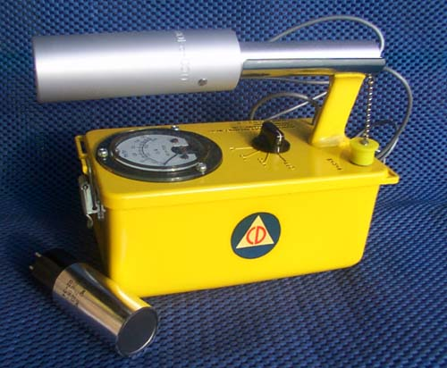
Radiation Counters
Radiation counters are radiation detectors that can detect individual photons/particles and hence make it possible for these to be counted.
The Geiger-Müller counter is based on gas ionization, however the value of voltage across the two electrodes, is such that even a single photon/particle of ionising radiation forms enough ions to be detected. The voltage between electrodes is so high that even the secondary ions can ionise neutral molecules, and the so-called multiplication or avalanche effect arises. The "avalanche" of ions hitting one of the electrodes is registered as a short voltage pulse. The number of pulses gives the number of photons / particles. However the size of the pulse is independent of the energy of the photon and therefore cannot be used as measure of that energy (it is a detector only and not a sensor).
Scintillation counters are optoelectronic devices (used for example in gamma cameras) which are both detectors and sensors - they measure both the number and the energy of the individual photon / particle.
GM tube

Slide 65
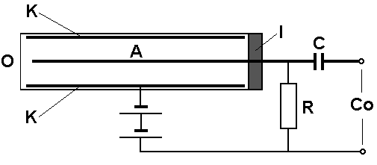
Geiger-Müller Counter
K - cylindrical cathode, A - anode central wire, O - input window, I - isolator, R - working resistor, C - condenser of the capacity coupling, Co - counter connectors.
The Geiger-Müller (GM) counter consists of a GM tube, a source of high direct voltage, and an electronic counter of impulses. The GM tube is a hollow cylinder with metallic inner surface. This metallic layer is a cathode. The central wire is the positively charged anode. The GM tube is usually filled by argon containing 10 % of the quenching agent (e.g. ethanol vapour). This agent stops (quenches) the ion multiplication process, and so prevents the formation of a stable electric discharge between the anode and cathode. The duration of avalanche ionisation is very short, about 5 ms. However, during this time the tube is not able to react to another particle of ionising radiation. This dead time is an important characteristic of GM tubes. It causes measurement error which can be corrected by calculation.

Slide 66
Scintillation counters
Scintillation counter consists of a scintillator, photomultiplier and an electronic part - the source of high voltage, and the pulse counter. The scintillator is a substance in which the scintillation (small flashes of visible light) occurs after the absorption of ionising radiation energy. The light originates in deexcitation and recombination processes. Sodium iodide crystals activated by traces of thallium are the most effective scintillators.

Slide 67
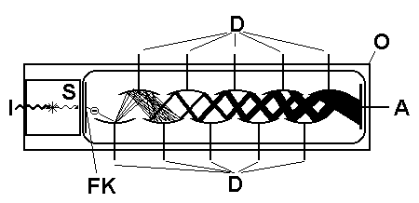
Scintillation counters
The scintillator is enclosed in a light-proof housing. One side of the housing is transparent, so that the originating photons can come to a photomultiplier, which measures low-intensity light.
The photons hit the photocathode - a very thin layer of a metal with low electron binding energy. They eject electrons from the cathode, which are attracted and accelerated by the closest positively charged electrode, the first dynode. The dynodes form an array of e.g. ten electrodes. On average, six secondary electrons are ejected by each electron impact. The secondary electrons are attracted to the next dynode, where the process is repeated. Resulting voltage pulses are counted in the electronic part of the instrument. Magnitude of this pulse is given by the energy of the ionising particle.
The scintillation detector.
I - ionising radiation, S - scintillator, FK - photocathode, D - dynodes, A - anode, O - light- and water-proof housing. There is depicted the origin of only one photon which liberates only one electron from the photocathode.

Slide 68
Websites for additional information on radiation sources and effects
European Commission (radiological protection pages): europa.eu
International Commission on Radiological Protection: www.icrp.org
World Health Organization: www.who.int
International Atomic Energy Agency: www.iaea.org
United Nations Scientific Committee on the Effects of Atomic Radiation: www.unscear.org

Slide 69
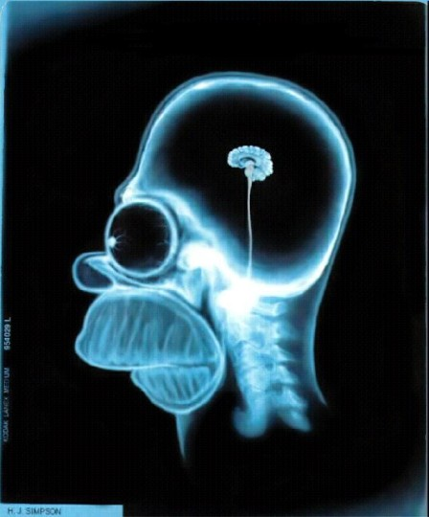
Authors:
C. J. Caruana, Biomedical Physics, Institute of Health Care, University of Malta
V. Mornstein, Dept of Biophysics, Masaryk Uni., Brno, Czech Republic
Content revision:
Ivo Hrazdira
Last revision:
January 2021

