Slide 1
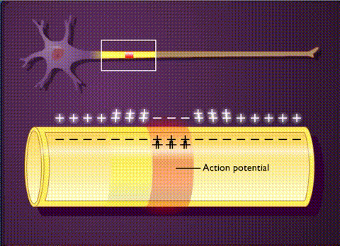
Lectures on Medical Biophysics
Biological membranes and bioelectric phenomena
A part of this lecture was prepared on the basis of a presentation kindly provided by Prof. Katarína Kozlíková from the Dept. of Medical Biophysics, Medical Faculty, Comenius University in Bratislava

Slide 2
Bioelectric phenomena
The electric signal play a key role in controlling of all vitally important organs. They ensure fast transmission of information in the organism. They propagate through nerve fibres and muscle cells where they trigger a chain of events resulting in muscle contraction. They take a part in basic function mechanisms of sensory and other body organs.
On cellular level, they originate in membrane systems, and their propagation is accompanied by production of electromagnetic field in the ambient medium.
Recording of electrical or magnetic signals from the body surface is fundamental in many important clinical diagnostic methods.

Slide 3
Biological membrane
It is not possible to understand the origin of resting and action membrane voltage (potential) without knowledge of structure and properties of biological membrane.
In principle, it is an electrically non-conducting thin bilayer (6-8 nm) of phospholipid molecules. There are also built-in macromolecules of proteins with various functions. Considering electrical phenomena, two kinds of proteins are the most important: the ion channels and pumps. In both cases these are components of transport mechanisms allowing transport of ions through the non-conducting phospholipid membrane.

Slide 4
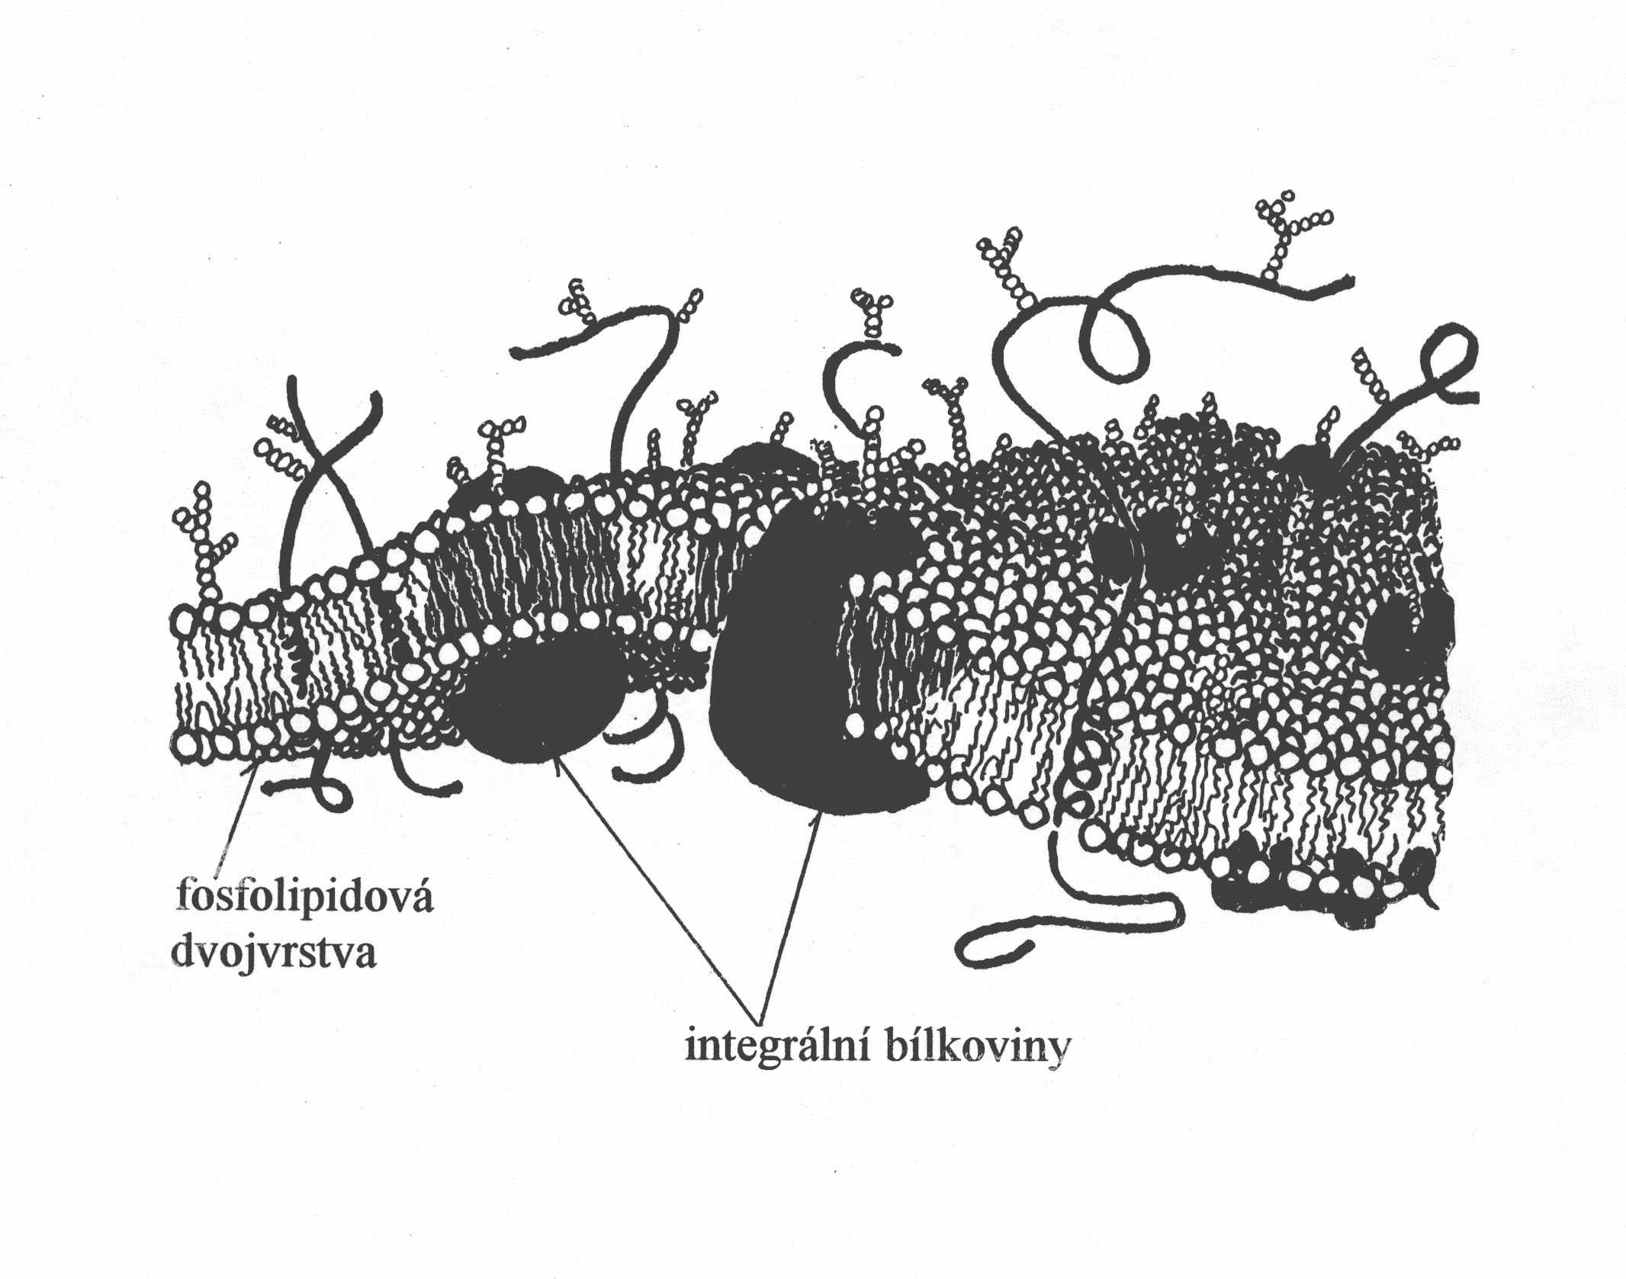
Structure of the membrane
Phospholipid bilayer
Integral proteins

Slide 5
Channels
The basic mechanism of the ion exchange between internal and external medium of the cell are the membrane channels. They are protein molecules but, contrary to the pumps with stable binding sites for the transmitted ions, they form water-permeable pores in the membrane. Opening and closing of the channels (gating) is performed in several ways. Besides the electrical gating we can encounter gating controlled by other stimuli in some channels (chemical binding of substances, mechanical tension etc.).
The passage of ions through the channel cannot be considered to be free diffusion because most channels are characterised by certain selectivity in ion permeability. Sodium, potassium, calcium or chloride channels are distinguished.
In this kind of ion transport there is no need of energy delivery.

Slide 6
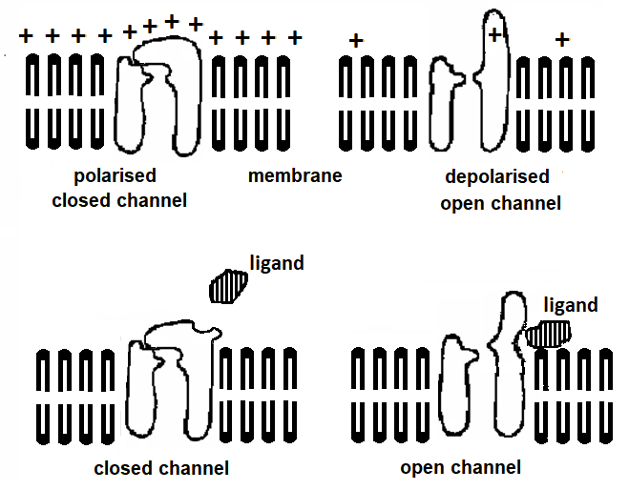
Electrical and chemical gating

Slide 7
Ion transport systems
Many ion transport systems were discovered in cell membranes. One of them, denoted as sodium-potassium pump (Na/K pump or Na⁺-K⁺-ATP-ase) has an extraordinary importance for production of membrane voltage. It removes Na-ions from the cell and interchanges them with K-ions. Thus, the concentrations of these ions in the intracellular and extracellular medium (they are denoted as [Na+], [K+] and distinguished by indexes i, e) are different. We can write:
Working Na/K pump requires constant energy supply. This energy is delivered to the transport molecules by the adenosine triphosphate (ATP) which is present in the intracellular medium.

Slide 8
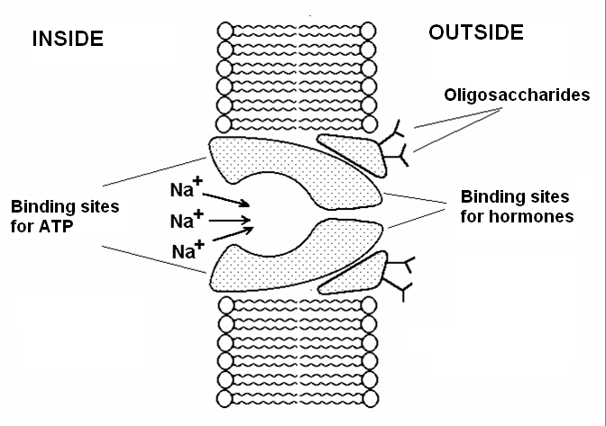
Principle of the sodium-potassium pump
The sodium ions are released on the outer side of the membrane. Following conformation change of the ion pump molecule enables binding of potassium ions which are carried inside the cell.

Slide 9
Function of biological membranes
They form the interface between the cells and also between cell compartments.
They keep constant chemical composition inside bounded areas by selective transport mechanisms.
They are medium for fast biochemical turnover done by enzyme systems.
Their specific structure and selective ion permeability is a basis of bioelectric phenomena.

Slide 10
Excitability
Characteristic feature of living systems on any level of organisation of living matter
An important condition of adaptation of living organisms to environment
An extraordinary ability of some specialised cells (or tissues – muscle cells, nerve cells)
Each kind of excitable tissue responses most easily on a certain energetic impulse (the adequate stimulus). Another energetic impulse can also evoke an excitation but much more energy is necessary (the inadequate stimulus).

Slide 11

Resting membrane potential

Slide 12
Resting membrane potential – RMP (1)
Potential difference between a microelectrode inside the cell (negative potential) and a surface electrode outside the cell (zero potential) = membrane voltage = membrane potential
„Non-polarisable“ electrodes are used
Extracellular space
membrane
Intracellular space
membrane
Extracellular space

Slide 13
Resting membrane potential – RMP (2)
Its values depend on:
- Type of the cell
- Art of the animal the cell is taken from
- For identical cells – on the composition and concentration of the ion components of the extracellular liquids
The value of RMP at normal ion composition of the IC and EC liquid: -100 mV to -50 mV
Membrane thickness ~ 10 nm
Result: Electric field intensity in the membrane ~ 10⁷ V/m
To compare: Electric field intensity on the Earth’s surface ~ 10² V/m

Slide 14
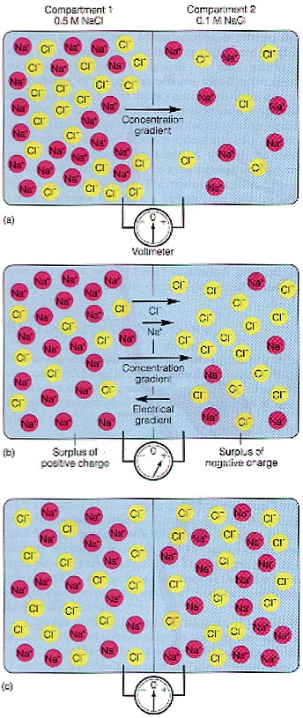
Diffusion potential DP (1)
Caused by diffusion of charged particles DP in non-living systems – solutions are separated by a membrane permeable for Na⁺ and Cl⁻.
Electric field repulses Cl⁻ from [2]
The compartments are electroneutral, but there is a concentration gradient
⇒ Diffusion of ions from [1] do [2]
Hydration envelope (water molecules are bound to ions) Na⁺ (more) a Cl⁻ (less)
⇒ faster diffusion of Cl⁻ against (!) concentration gradient
⇒ Transient voltage appears across the two compartments
⇒ Diffusion potential

Slide 15
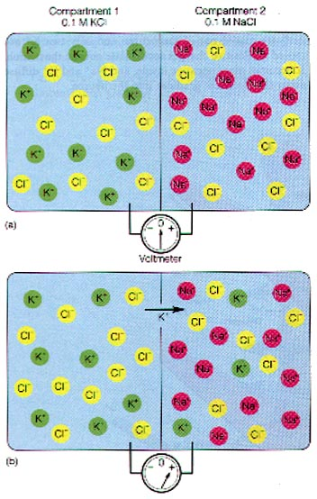
Diffusion potential DP (2)
DP in living systems – the solutions are separated by a selectively permeable membrane for K⁺, non-permeable for pro Na⁺ a Cl⁻.
⇒ Diffusion of K⁺ against its concentration gradient occurs until an electric gradient of the same magnitude, but of opposite direction arises
⇒ An equilibrium potential emerges – resulting diffusion flux is equal to zero
In such a system, an equilibrium arises if there is no resulting flux of ions.

Slide 16
A simple example of a membrane equilibrium (1)
The same electrolyte is on both sides of the membrane but of different concentrations (c_{I} > c_{II}), the membrane is permeable only for cations
membrane
Electrolyte I
Electrolyte II
Result:
Electric double layer is formed on the membrane
layer 1: anions stopped in space I
layer 2: cations attracted to the anions (II)
cations c_{C}^{I}
anions c_{A}^{II}
anions c_{A}^{I}
cations c_{C}^{II}

Slide 17
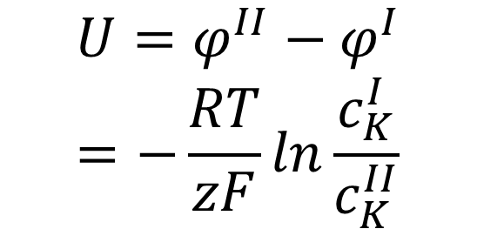
A simple example of a membrane
equilibrium (2)
The concentration difference ”drives” the cations, electric field of the bilayer “pushes them back”
In equilibrium: potential difference U arises:
membrane
Electrolyte I
Electrolyte II
-
-
-
-
-
-
-
-
-
+
+
+
+
+
+
+
+
+
$$U=φ^{II}−φ^{I}=−\frac{RT}{zF}ln\frac{c_{K}^{I}}{c_{K}^{II}}$$
ϕ^{I}
ϕ^{II}
cations c_{C}^{I}
anions c_{A}^{II}
anions c_{A}^{I}
cations c_{C}^{II}
(Nernst equation)

Slide 18
Donnan equilibrium (1)
The same electrolyte is on both sides, concentrations are different (c^{I} > c^{II}), membrane is permeable for small univalent ions C⁺ and A⁻, non-permeable for R- .
membrane
Diffusible ions: C⁺, A⁻ diffuse freely
non-diffusible ions: R⁻ i.e. big anions
Electrolyte I
Electrolyte II
anions R⁻
In presence of R⁻: Equal distribution of C⁺ and A⁻ cannot be achieved
⇒ a special case of equilibrium -
Donnan equilibrium
cations c_{C}^{I}
anions c_{A}^{II}
anions c_{A}^{I}
cations c_{C}^{II}

Slide 19

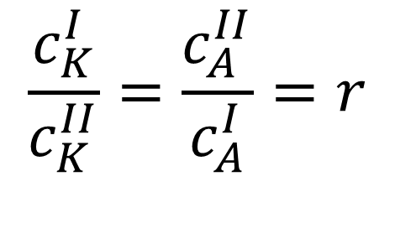
Donnan equilibrium (2)
Equilibrium concentrations:
$$c_{K}^{I}c_{A}^{I}=c_{K}^{II}c_{A}^{II}$$
membrane
Electrolyte I
Electrolyte II
Donnan ratio:
anions R⁻
$$\frac{c_{K}^{I}}{c_{K}^{II}}=\frac{c_{A}^{II}}{c_{A}^{I}}=r$$
cations c_{C}^{I}
anions c_{A}^{II}
anions c_{A}^{I}
cations c_{C}^{II}

Slide 20
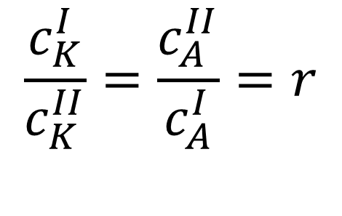
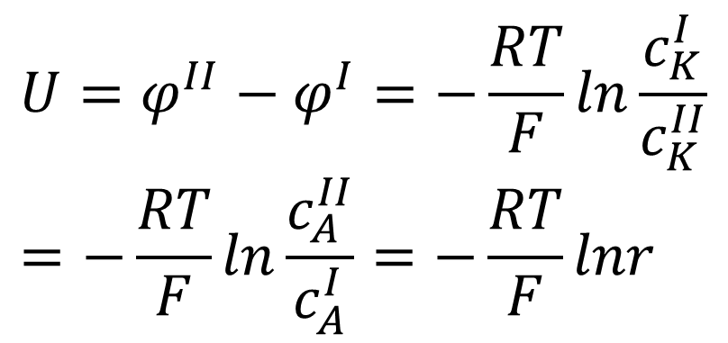
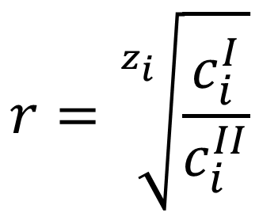
Donnan equilibrium (3)
$$r=\sqrt[z_{i}]{\frac{c_{i}^{I}}{c_{i}^{II}}}$$
$$\frac{c_{K}^{I}}{c_{K}^{II}}=\frac{c_{A}^{II}}{c_{A}^{I}}=r$$
Donnan ratio:
membrane
Electrolyte I
Electrolyte II
Donnan potential:
-
-
-
-
-
-
-
-
-
-
-
+
+
+
+
+
+
+
+
+
+
+
$$U=φ^{II}−φ^{I}=−\frac{RT}{F}ln\frac{c_{K}^{I}}{c_{K}^{II}}=−\frac{RT}{F}ln\frac{c_{A}^{II}}{c_{A}^{I}}=−\frac{RT}{F}lnr$$
anions R⁻
cations c_{C}^{I}
anions c_{A}^{II}
anions c_{A}^{I}
cations c_{C}^{II}

Slide 21
Donnan model in living cell (1)
diffuse: K+, Cl-
do not diffuse: Na+, anions,
also proteins and nucleic acids
cell membrane
intra
extra
Concentrations:
[K⁺] _{in} > [K⁺] _{ex}
[Cl⁻] _{in} < [Cl⁻] _{ex}
phosphate
anions
Na⁺
protein
anions
K⁺
Cl⁻
Cl⁻
K⁺

Slide 22
Donnan model in living cell (2)
Donnan ratio:
Cell membrane
intra
Donnan potential:
extra
-
-
-
-
-
-
-
-
-
-
-
+
+
+
+
+
+
+
+
+
+
+
phosphate
anions
Na⁺
protein
anions
K⁺
Cl⁻
Cl⁻
K⁺

Slide 23
Donnan model in living cell (3)
Donnan potential (resting potential) [mV]:
object: calculated: measured:
K⁺: Cl⁻:
cuttlefish axon - 91 - 103 - 62
frog muscle - 56 - 59 - 92
rat muscle - 95 - 86 - 92
Donnan model differs from reality:
The cell and its surroundings are regarded as closed thermodynamic systems
The diffusible ions are regarded as fully diffusible, the membrane is no barrier for the diffusible ions
The effect of ionic pumps on the concentration of ions is neglected
The interaction between membrane and ions is not considered

Slide 24
Model of ion transport (1)
Electrodiffusion model with smaller number of simplifications.
We suppose:
A constant concentration difference between outer and inner side of the membrane ⇒ constant transport rate through membrane
Migration of ions through membrane ⇒ electric bilayer on both sides of the membrane
All kinds of ions on the both sides of the membrane are considered simultaneously
Empirical fact – different ions have different non-zero permeability

Slide 25
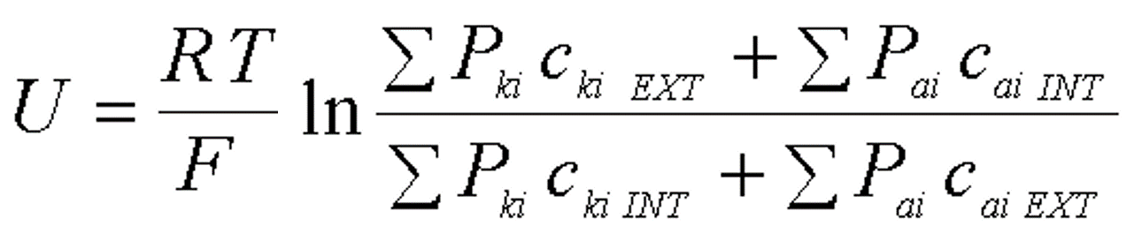
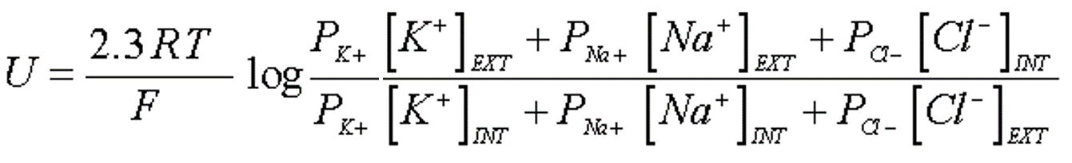
Model of ion transport (2)
Goldman - Hodgkin - Katz
k = cations, a = anions
P - permeability

Slide 26
Model of ion transport (3)
„giant“ cuttlefish axon (t = 25°C):
p_{K} : p_{Na} : p_{Cl} = 1 : 0.04 : 0.45
calculated: U = - 61 mV
measured: U = - 62 mV
frog muscle (t = 25°C):
p_{K} : p_{Na} : p_{Cl} = 1 : 0.01 : 2
calculated: U = - 90 mV
measured: U = - 92 mV

Slide 27
Action
potential

Slide 28
Action potential
The concept of action potential denotes a fast change of the resting membrane potential caused by over-threshold stimulus which propagates into the adjacent areas of the membrane.
This potential change is connected with abrupt changes in sodium and potassium ion channels permeability.
The action potential can be evoked by electrical, chemical or mechanical stimuli which cause local decrease of the resting membrane potential.

Slide 29
Mechanism of action potential triggering
U_{m}
t
U_{Na}
AP
0
Depolarization phase
Positive feedback: ↑g_{Na} ⇒ depol ⇒ ↑g_{Na}
Repolarization phase:
inactivation g_{Na} and activation g_{K}
U_{pr}
U_{mr}
t
U_{K}
hyperpolarization (deactivation g_{K})
Mechanism of the action potential triggering in the cell membrane is an analogy of a monostable flip-flop electronic circuit ☺.

Slide 30
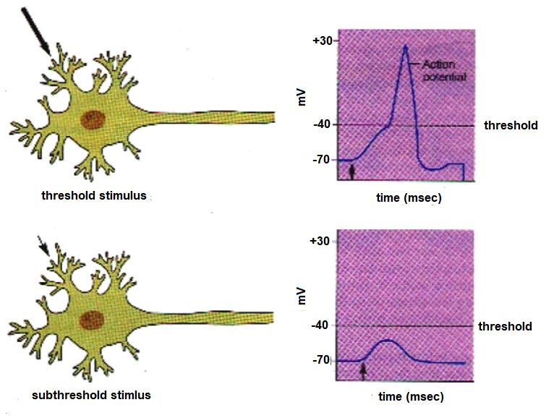
Origin of action potential

Slide 31
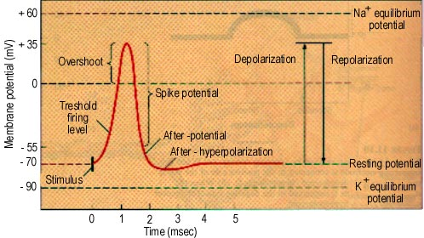
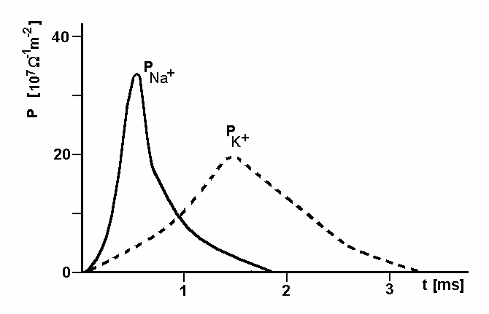
Description of action potential

Slide 32
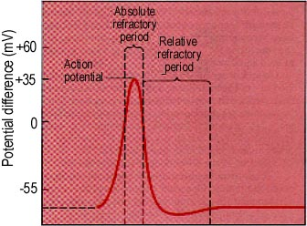
Refractory period

Slide 33
Action potential
Changes in the distribution of ions caused by action potential are balanced with activity of ion pumps (active transport).
The action potential belongs among phenomena denoted as „all or nothing“ response. Such response is always of the same size. Increasing intensity of the over-threshold stimulus thus manifests itself not as increased intensity of the action potential but as an increase in action potential frequency (rate).

Slide 34
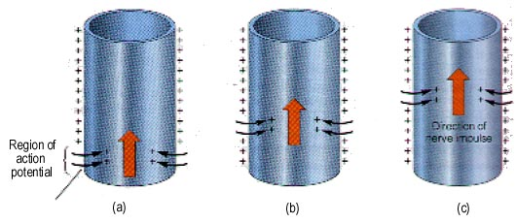
Propagation of the action potential along the membrane
AP propagation is unidirectional because the opposite side of the membrane is in the refractory period.

Slide 35
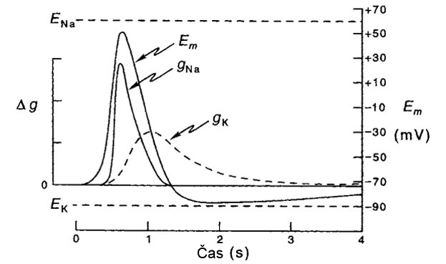
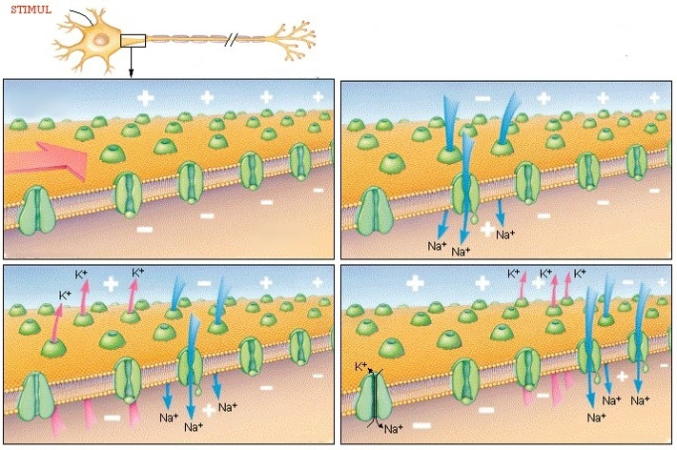
Propagation of the action potential along the neuron membrane (2)
(ms)
E – means voltage here, potential
g = electric conductivity, it can be distinguished for individual ions
cytosol

Slide 36
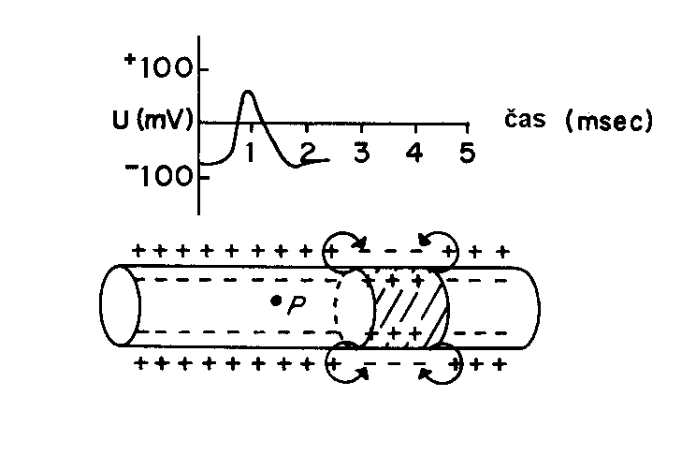
Propagation of AP and local currents
time
AP propagates along the membrane as a wave of negativity by means of local currents

Slide 37
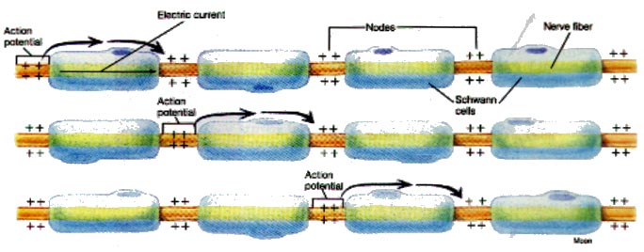
Conduction of action potential along the myelinated nerve fibre
Saltatory conduction

Slide 38
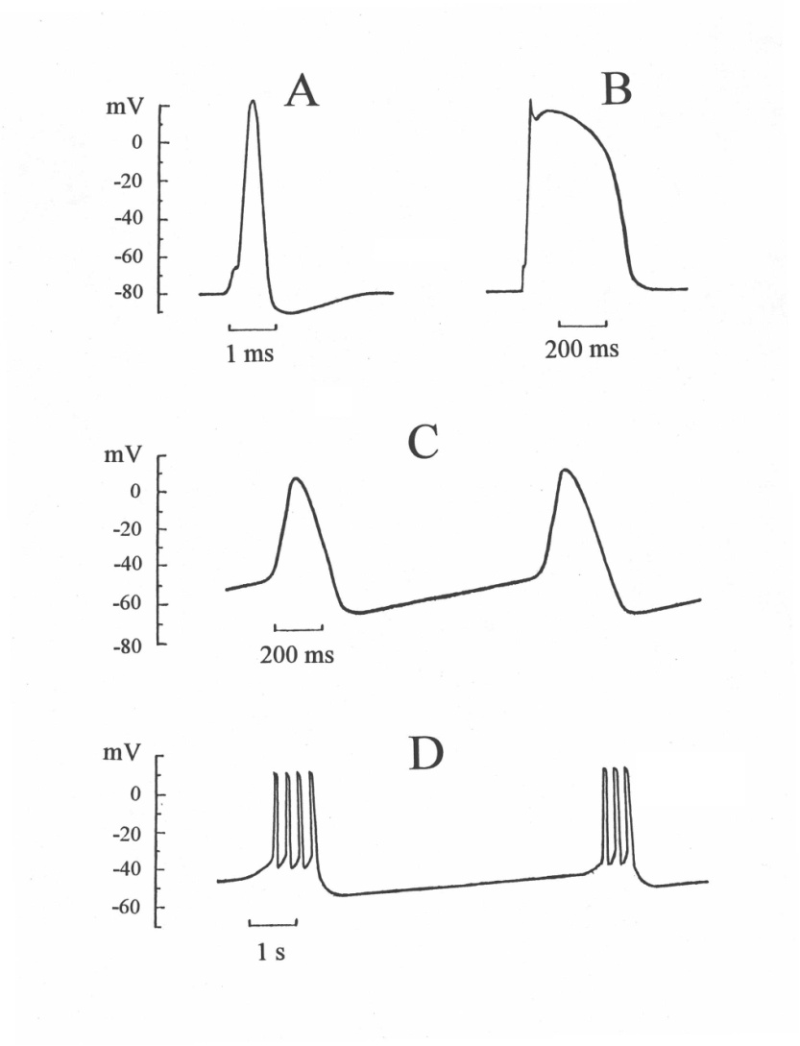
Examples of action potentials
A – nerve fibre
B – muscle cell of heart ventricle
C – cell of sinoatrial node
D – smooth muscle cell

Slide 39
Synapse

Slide 40
Definition
Synapse is a specific connection between two neurons or between neurons an other target cells (e.g. muscle cells), which makes possible transfer of action potentials.
We distinguish:
Electrical synapses (gap junctions) – close connections of two cells by means of ion channels. They enable a fast two-way transfer of action potentials.
Chemical synapses – more frequent, specific structures, they enable one-way transfer of action potentials.

Slide 41
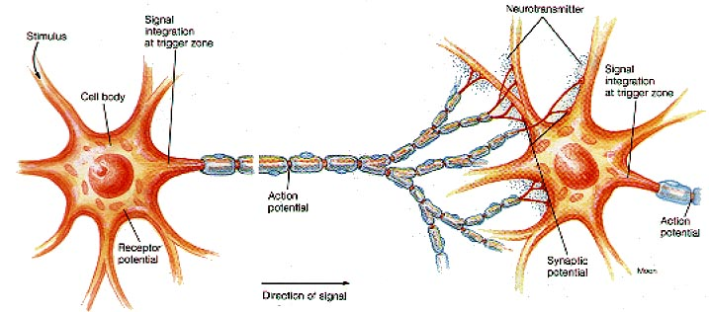
Transmission of action potentials between neurons

Slide 42
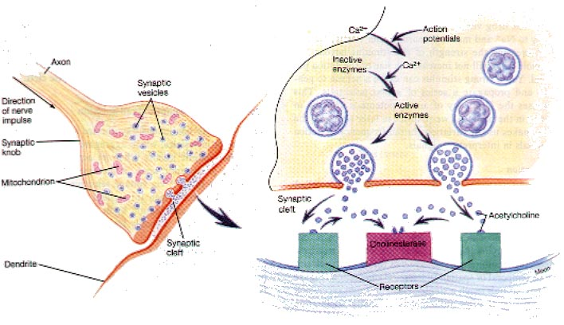
Chemical synapse

Slide 43
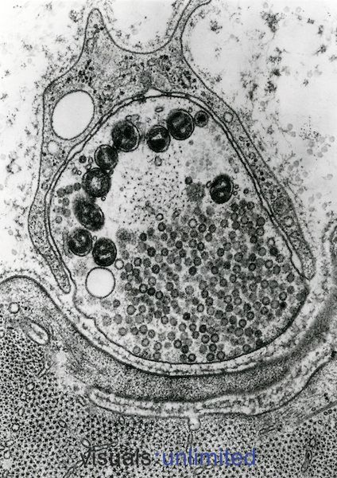
Chemical synapse – electron micrograph
Mitochondrion
Vesicles
Synaptic gap (cleft)

Slide 44
Synaptic mediators (neurotransmitters)
The most frequent mediators (neurotransmitters) of excitation synapses are acetylcholine (in neuromuscular end plates and CNS) and glutamic acid (in CNS). Both compounds act as gating ligands mainly for sodium channels. Influx of sodium ions inside the cell evokes a membrane potential change in positive sense – towards a depolarisation of the membrane (excitation postsynaptic potential).
Gamma-amino butyric acid (GABA) is a neurotransmitter of inhibitory synapses in brain. It acts as a gating ligand of chloride channels. Chloride ions enter the cell and evoke so a membrane potential change in negative sense – membrane hyperpolarization results (inhibitory postsynaptic potential).

Slide 45
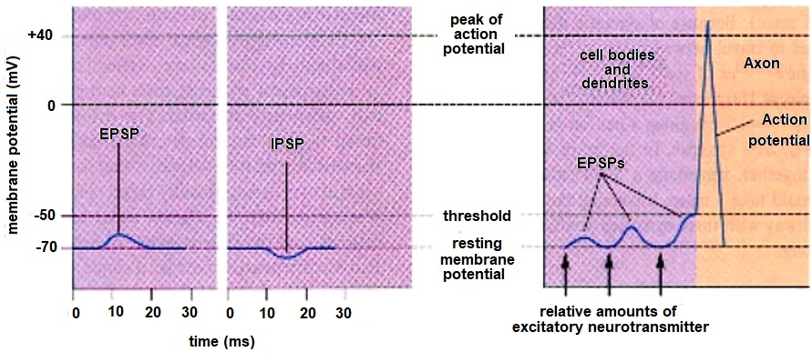
Excitation and inhibition postsynaptic potential

Slide 46
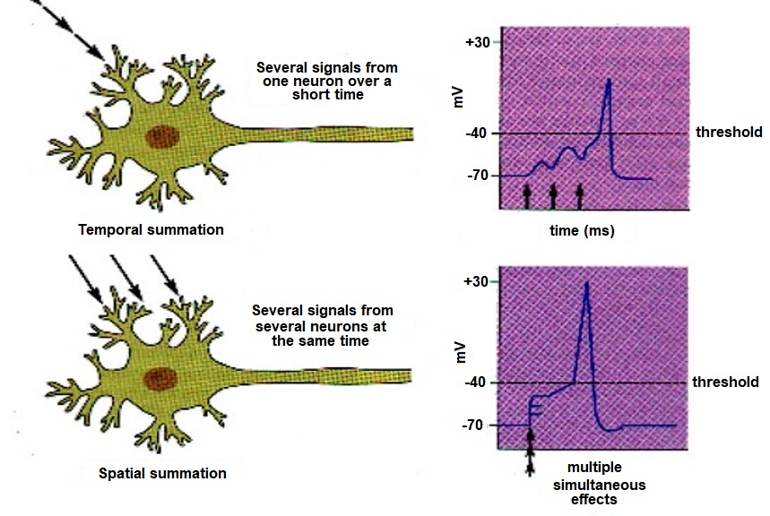
Summation of postsynaptic potentials

Slide 47
Summary
Electric phenomena on biological membranes play a key role in functioning of excitatory tissues (nerves, muscles)
Resting membrane potential (correctly: membrane voltage) is a result of a non-equal distribution of ions on both sides of the membrane.
It is maintained by two basic mechanisms: selective permeable ion channels and by transport systems – both these systems have protein character
Changes of membrane voltage after excitation are denoted as action potentials
Membrane undergoes two phases after excitation: depolarization – connected with influx of sodium ions into the cell - and subsequent repolarization – connected with efflux of potassium ions from the cell
In the refractory period, the membrane is either fully or partly insensitive to stimulation
Synapse is a connection of two cells which enables transmission of action potentials

Slide 48
Authors:
Vojtěch Mornstein, Ivo Hrazdira
Language collaboration:
Carmel J. Caruana
Last revision September 2021, addition of soundtrack October 2020

