Slide 1
Arterial stiffness.

Slide 2
Oral exam questions
Arterial elasticity – significance
Arterial pulse, pulse wave

Slide 3
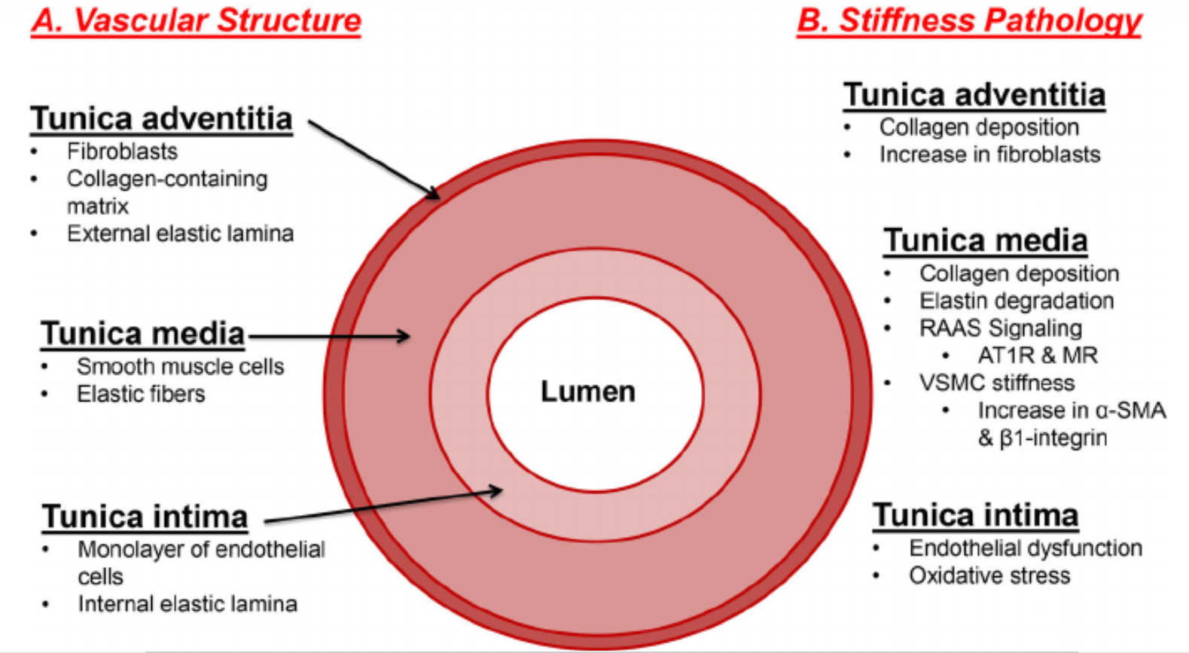
Factors of arterial stiffness changes
!
Elastin degradation
Collagen deposition
Endothelial dysfunction

Slide 4
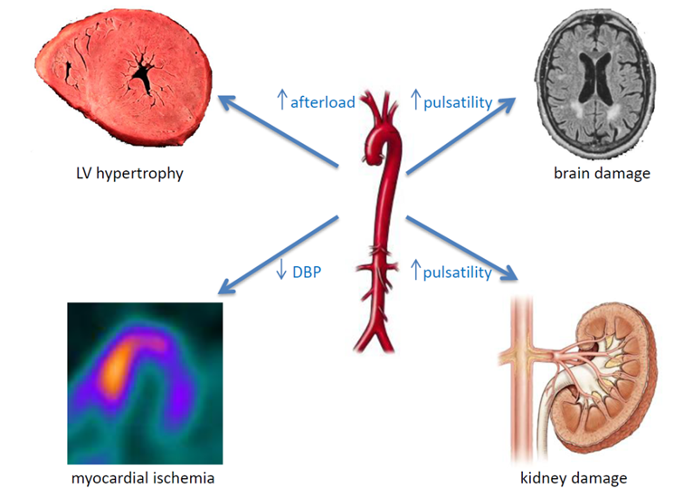
Complications of the higher arterial stiffness

Slide 5
Pulse wave
P[mmHg]
Forward systolic wave
t [s]
Reflected wave

Slide 6
Pulse wave
P[mmHg]
P[mmHg]
SBP/P₁
P₂
DBP
t [s]
t [s]
Forward systolic wave
PP=SBP – DBP
mBP=DBP+1/3PP
AP=P₂ – P₁
Reflected wave
SBP – systolic blood pressure, DBP – diastolic blood pressure, P₁ – pressure at peak of systolic flow, P₂ – pressure of the reflected wave, PP – pulse pressure, mBP – mean blood pressure, AP – augmented pressure

Slide 7
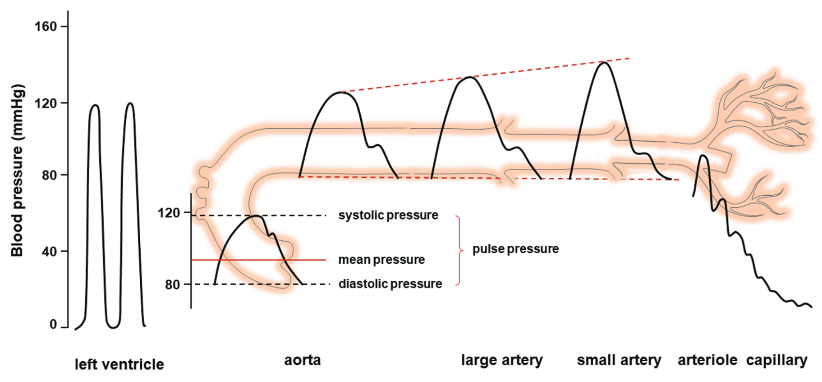
Pulse wave at different vascular segments

Slide 8
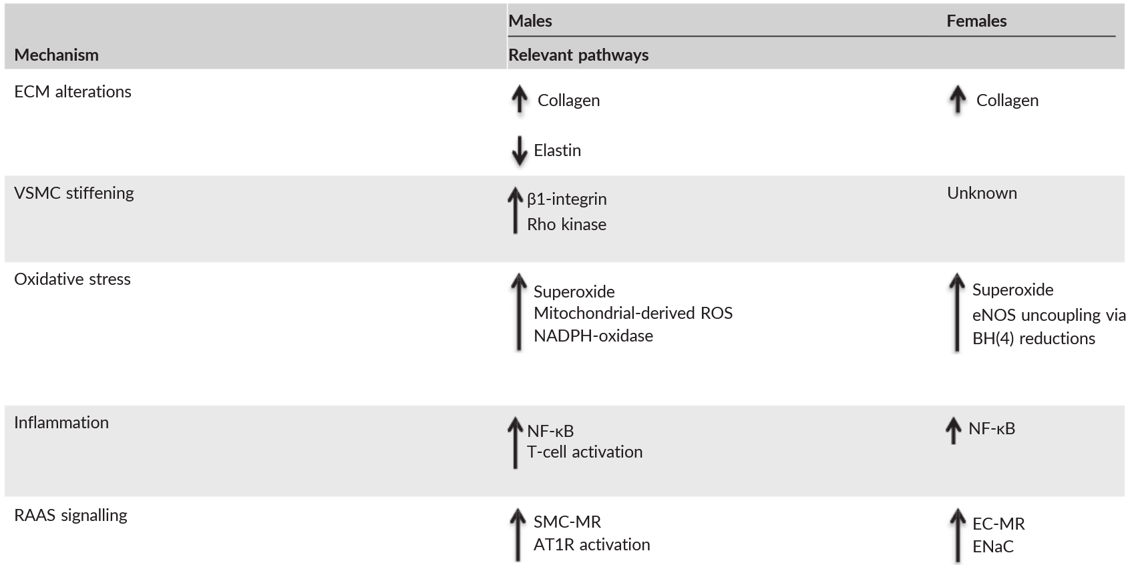
Sex differences in mechanisms of arterial stiffness
ECM - extracellular matrix; VSMC - vascular smooth muscle cell; eNOS - endothelial NOS; NADPH - NAD phosphate oxidase; BH(4) - tetrahydrobiopterin; SMC‐MR - smooth muscle cell mineralocorticoid receptor; AT1R - angiotensin II type 1 receptor; EC‐MR - endothelial cell mineralocorticoid receptor; ENaC - epithelial sodium channel.

Slide 9
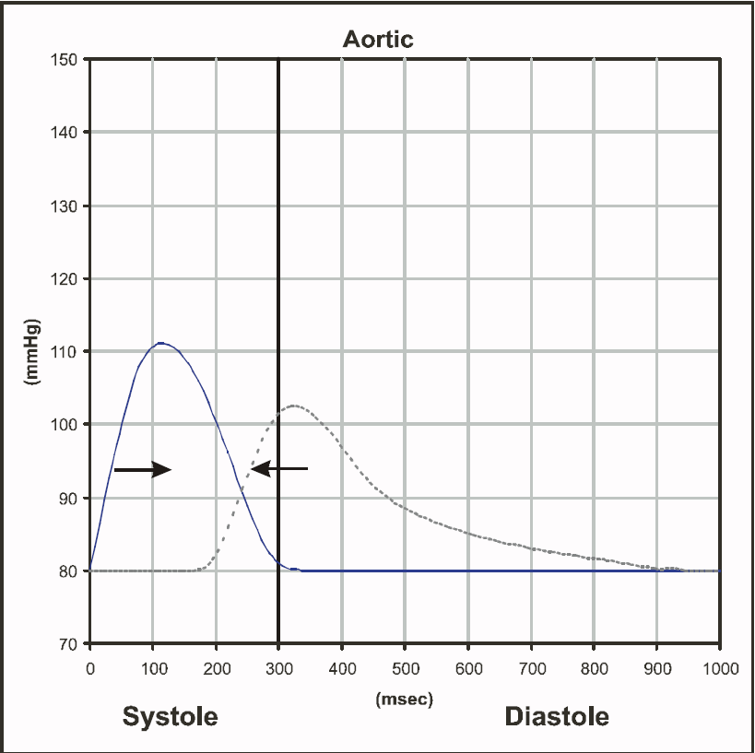
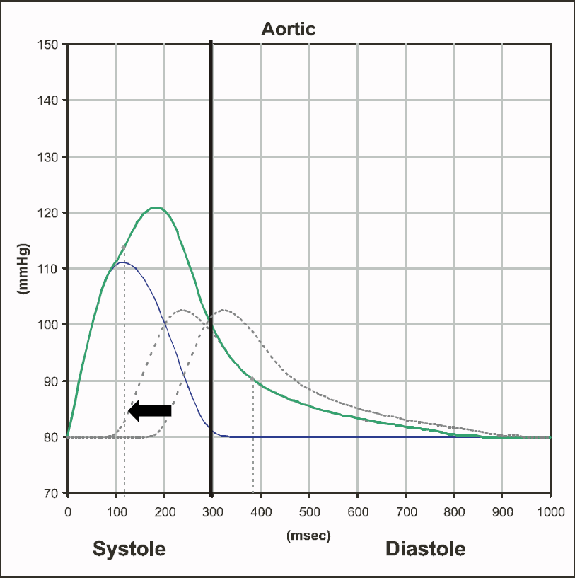
Pressure wave reflection

Slide 10
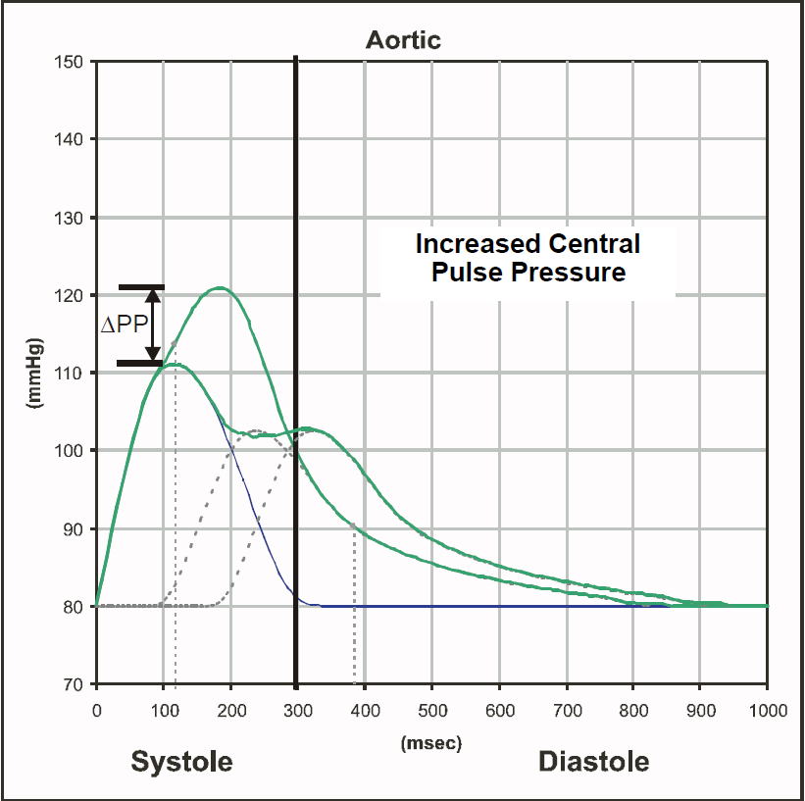
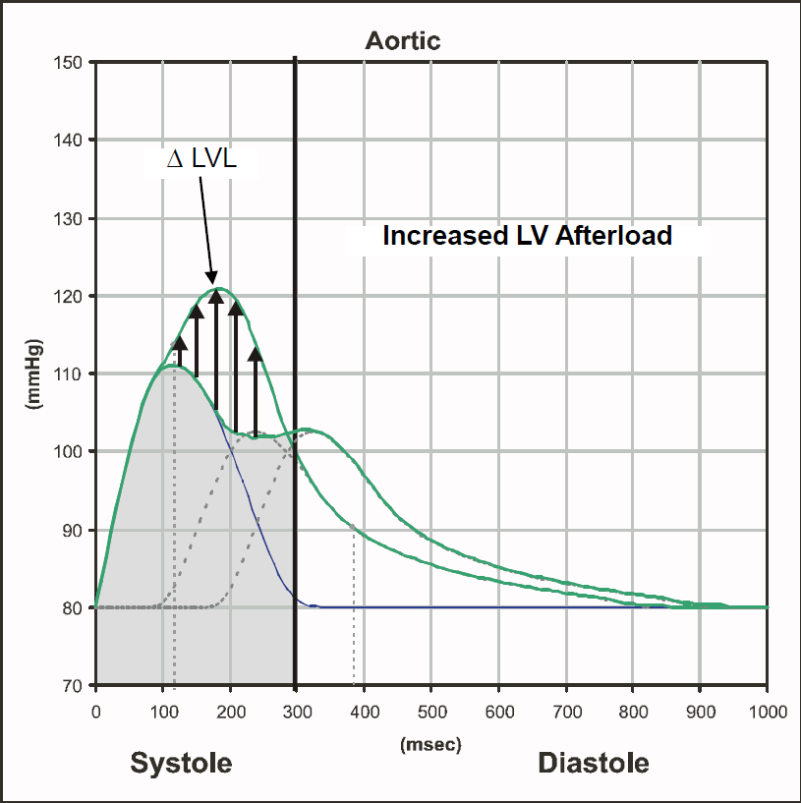
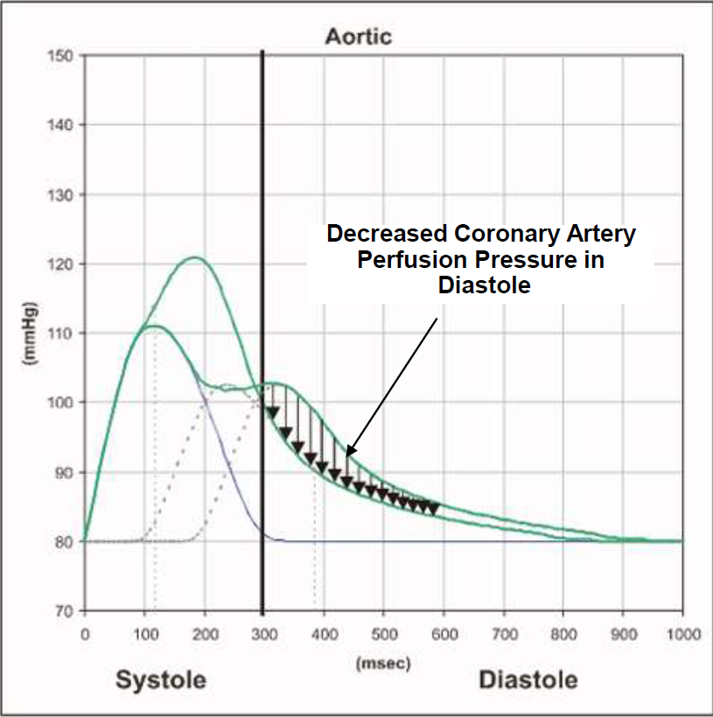
Pressure wave reflection

Slide 11
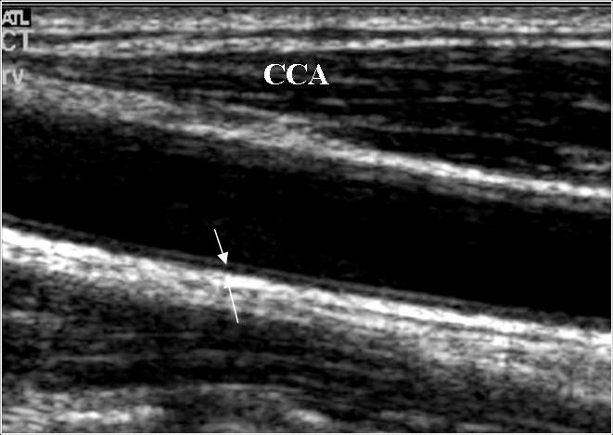
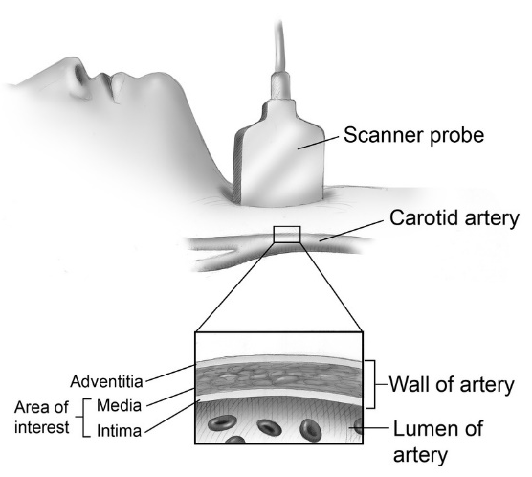
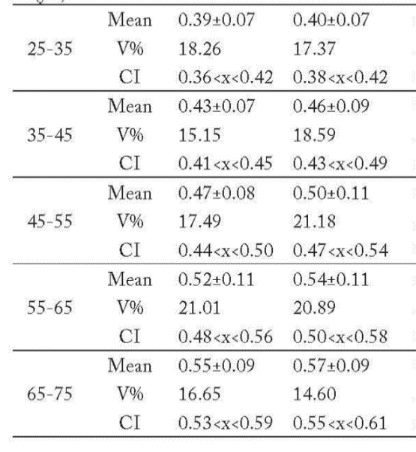
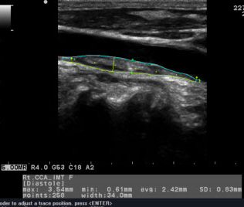
Ultrasound measurement
age
IMT_{R} (mm)
IMT_{L} (mm)

Slide 12
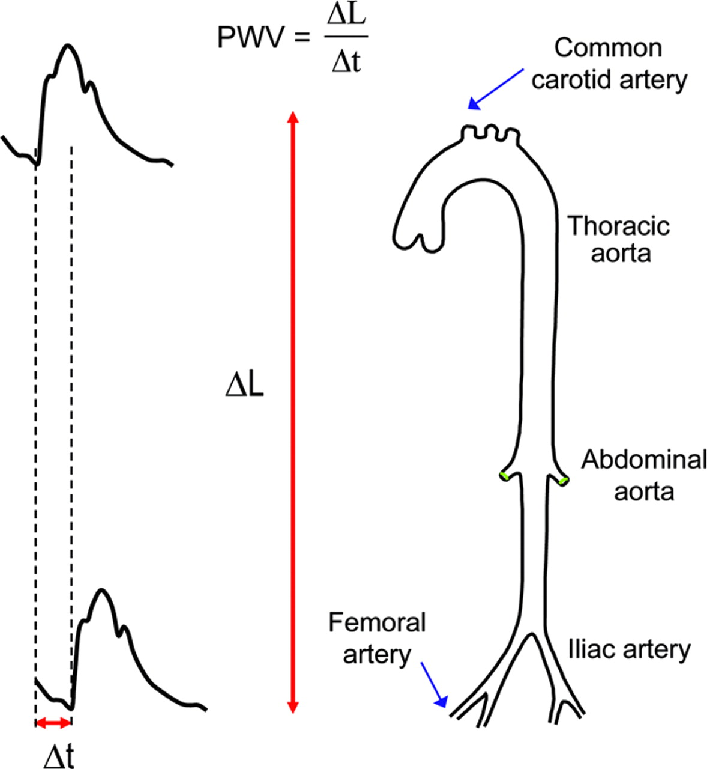
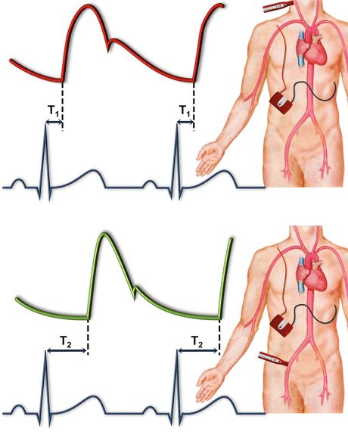
PWV measurement
A highly compliant aorta has a relatively low PWV (< 6 m/s)

Slide 13
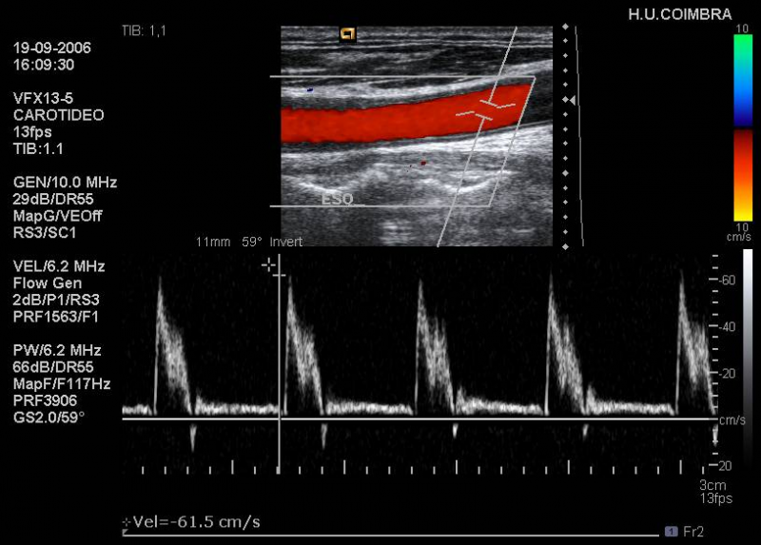
Ultrasound measurement (β – index).

Slide 14
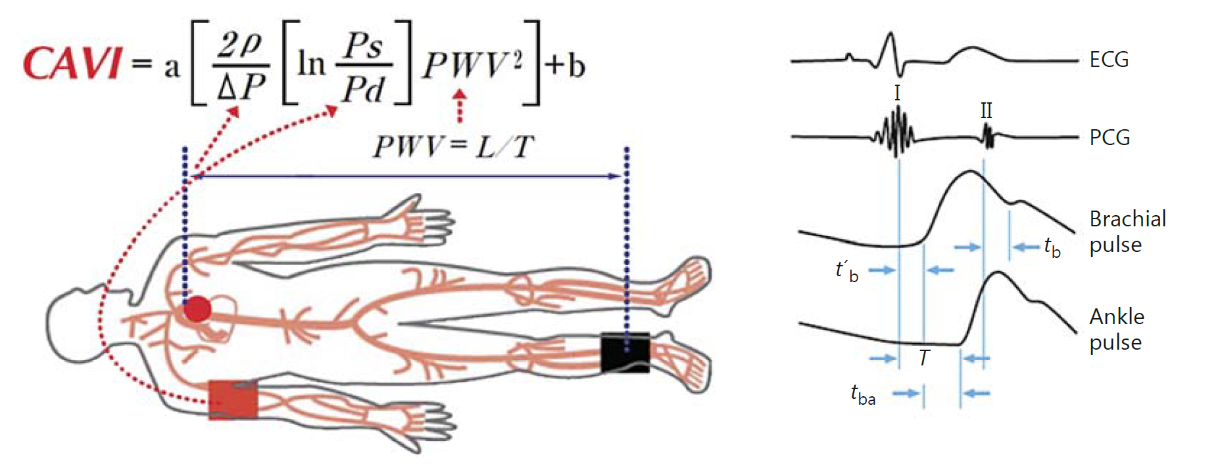
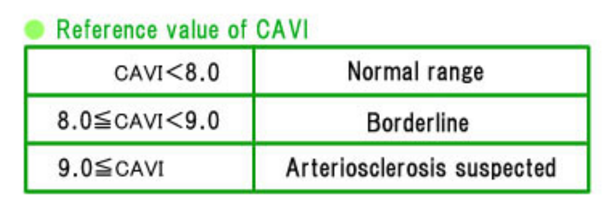
CAVI measurement

Slide 15
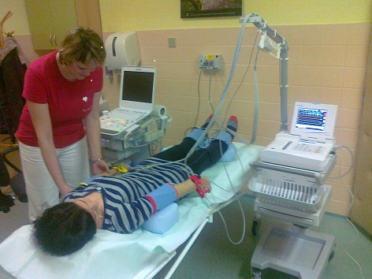
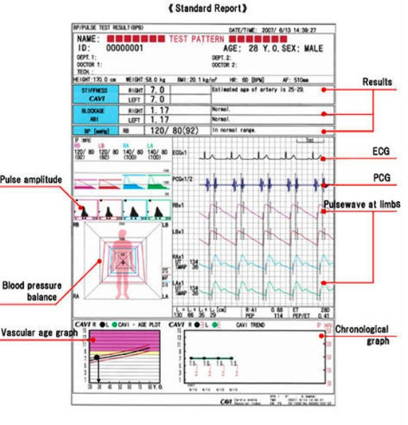
CAVI measurement

Slide 16
P[mmHg]
Diastole
Systole
250
SBP<SBP
P₂>P₂
120
110
AP<AP
80
0
t [s]

Slide 17
Thank you for your attention
Find mistakes)))))

