Slide 1
PHYSIOLOGY OF REPRODUCTION

Slide 2
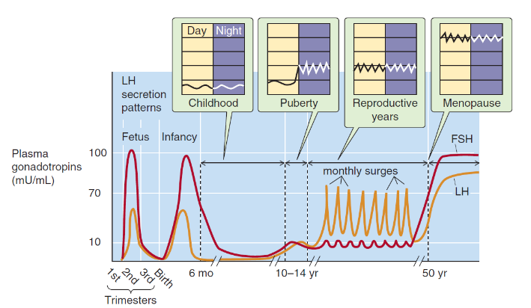
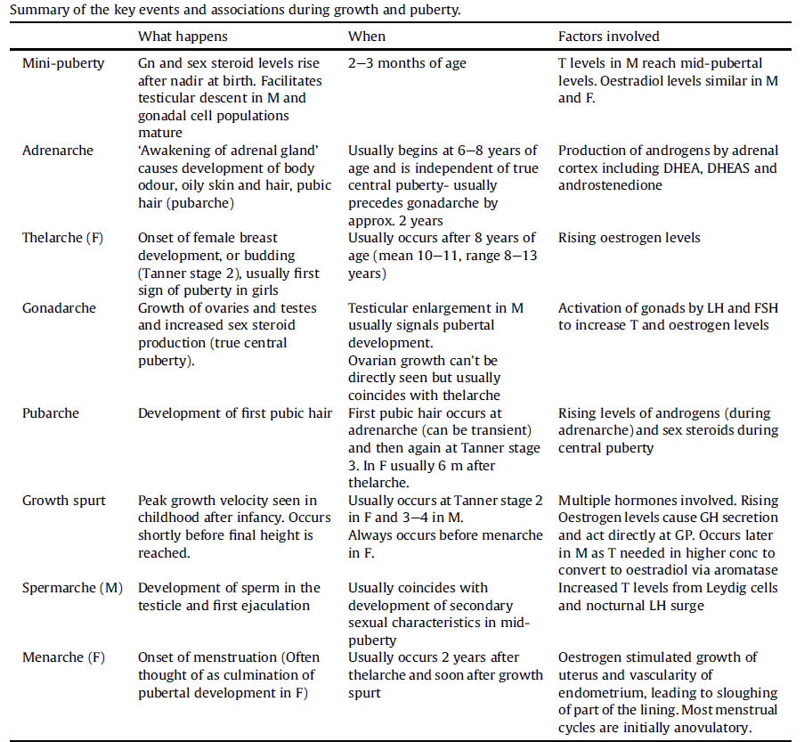
PUBERTY

Slide 3
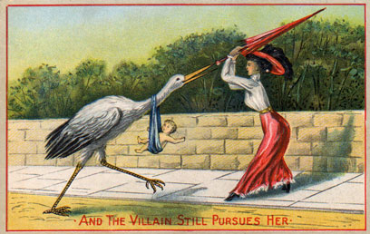
CONTRACEPTIVES
BARRIER CONTRACEPTIVES:
condoms
contraceptive sponges with spermicide
diaphragms
cervical caps
HORMONAL:
oral pills
implants under the skin
injections
patches
IUDs
vaginal ring
INTRAUTERINE DEVICES:
copper IUDs
IUD with levonorgestrel
BEHAVIORAL:
fertility awareness methods
coitus interruptus
lactation
STERILIZATION:
tubal ligation
vasektomy

Slide 4
ORAL PILLS
P
0,4
E
0,3
0,2
0,1
0
1
7
14
21
28
day

Slide 5
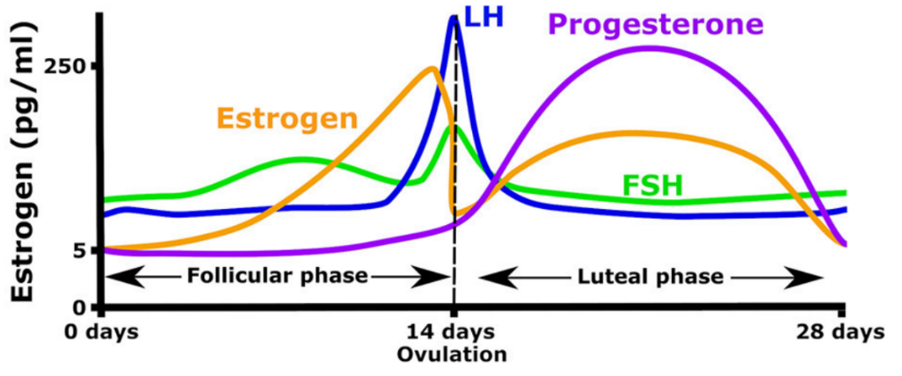
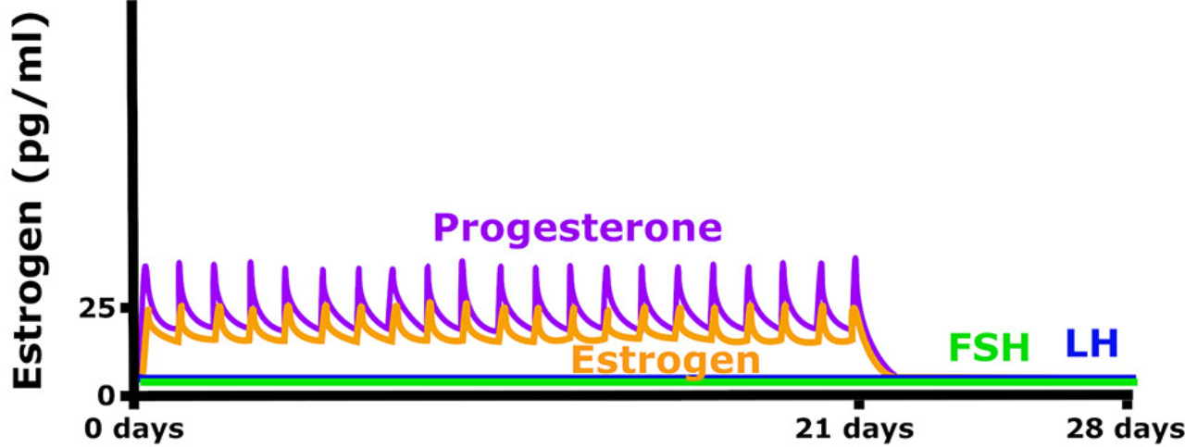
ORAL PILLS

Slide 6
ORAL PILLS
Progestational effects include:
Inhibition of ovulation by suppressing luteinizing hormone (LH);
Thickening of cervical mucus, thus hampering the transport of sperm;
Possible inhibition of sperm capacitation;
Hampered implantation by the production of decidualized endometrium with exhausted and atrophic glands
Estrogenic effects include:
Partial inhibition of ovulation in part by the suppression of follicle-stimulating hormone (FSH) and luteinizing hormone (LH), depending on dose;
Alteration of secretions and cellular structures of the endometrium within the uterus

Slide 7
BENEFITS AND RISCS OF HC
reducing the risk of total cancer by 12%:
ovarian cancer
endometrial cancer
colorectal cancer
ovarian cysts
acne
venous thromboembolism (VTE)
arterial thrombosis (AT)
breast cancer
diseases associated with VTE and AT

Slide 8
FERTILIZATION

Slide 9
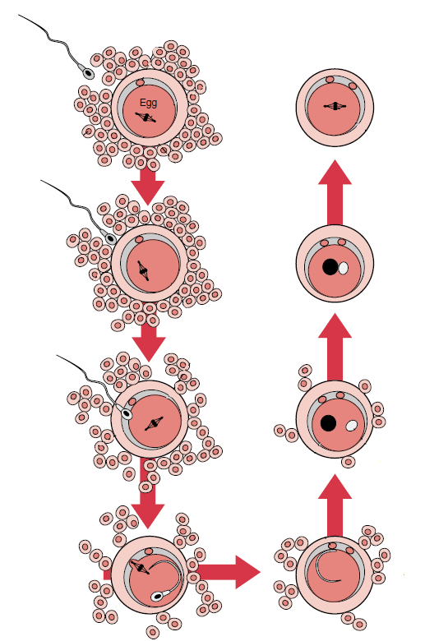
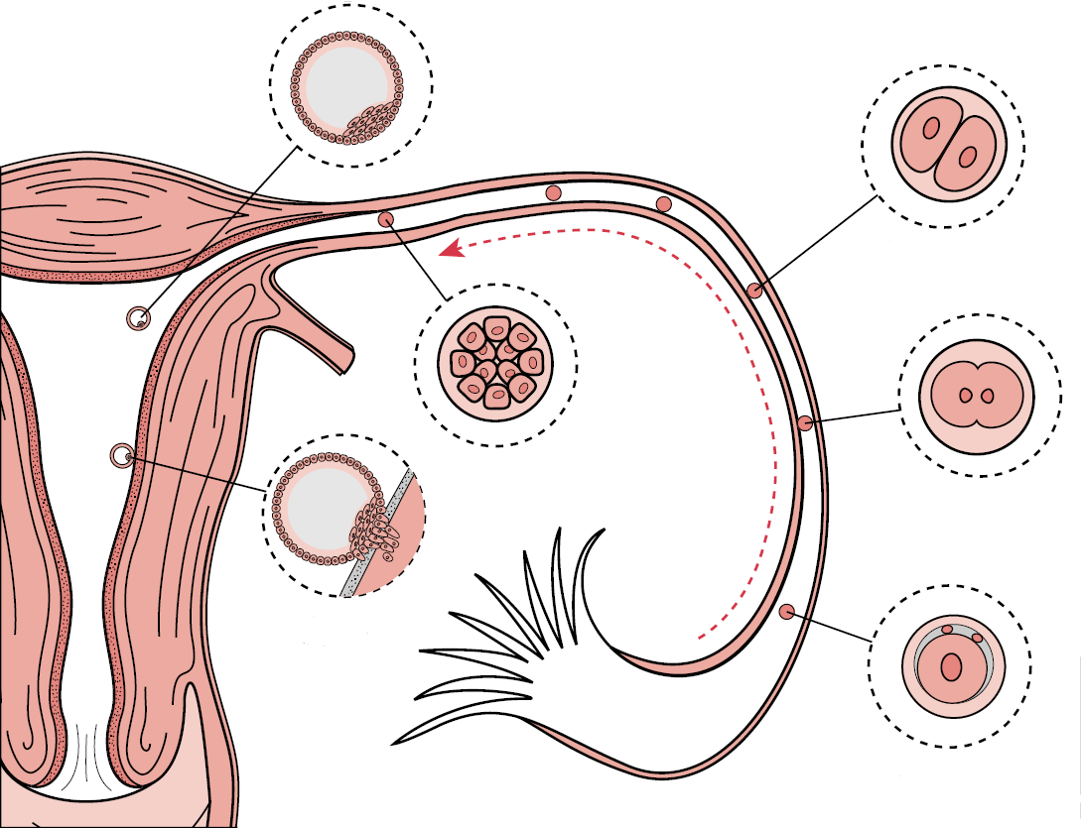
FERTILIZATION
PRVNÍ POLÁRNÍ TĚLÍSKO
BLASTOCYSTA
GRANULÓZNÍ
BUŇKY
I. MITOTICKÉ DĚLENÍ
ZONA PELLUCIDA
OOPLAZMA
MORULA
PRVNÍ DĚLENÍ
ŽENSKÝ
PRONUKLEUS
MUŽSKÝ
PRONUKLEUS
IMPLANTACE
OOLEMMA
DRUHÉ POLÁRNÍ
TĚLÍSKO
FIMBRIE
OPLODNĚNÍ

Slide 10
PLACENTAL FUNCTION
Transport and metabolism
Transfer of respiratory gases
Transport and metabolism of carbohydrates
Transport and metabolism of amino acids
Transport and metabolism of lipids
Transfer of water, inorganic ions, minerals and vitamins
Endocrine functions
Oestrogens
Progesterone
Chorionic gonadotrophin
Placental lactogen
Placental growth factors
Protektivní funkce
Cytochrome P450 (xenobiotics)
A barrier against transmission of many bacteria
!!! IgG

Slide 11
HORMONAL PROFILE OF PREGNANCY
4
8
12
16
20
24
28
32
36
40
1
2
3
Notes:
nebezpečí

Slide 12
HORMONAL PROFILE OF PREGNANCY
HCG (Human Chorionic Gonadotropin)
glycoprotein
secreted by the syncytial trophoblast cells
prevents involution of the corpus luteum
prevent menstruation and cause the endometrium to continue to grow
can ﬁrst be measured in the blood 8 to 9 days after implantation
effect on the fetal testes
↓ - ectopic pregnancy, dead fetus
↑ - multiple pregnancy and diagnosis of trisomy 21 - Down syndrome
HCG
4
8
12
16
20
24
28
32
36
40
1
2
3
Notes:
nebezpečí

Slide 13
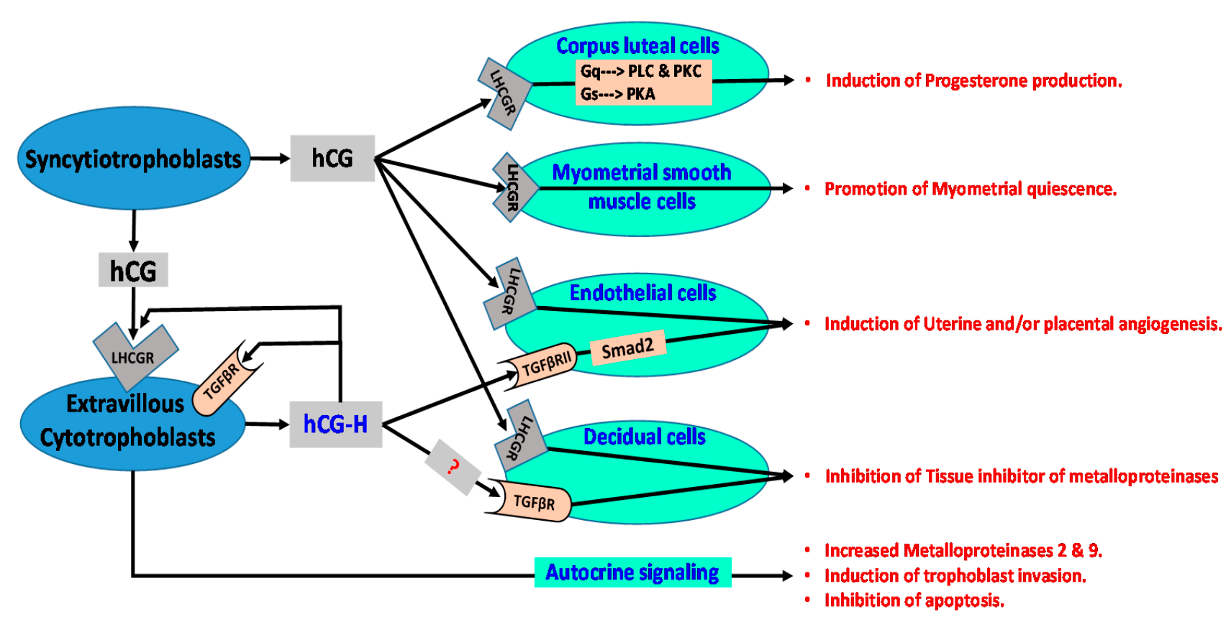
HORMONAL PROFILE OF PREGNANCY
Notes:
nebezpečí

Slide 14
HORMONAL PROFILE OF PREGNANCY
TĚHOTENSKÉ HORMONY
4
8
12
16
20
24
28
32
36
40
1
2
3
Notes:
nebezpečí

Slide 15
HORMONAL PROFILE OF PREGNANCY
TĚHOTENSKÉ HORMONY
RX (Relaxin)
relaxes the pubic symphysis and other pelvic joints and softens
dilates the uterine cervix
mediate hemodynamic changes (pregnancy)
RLX₁, RLX₂ (organs of reproduction) and RLX₃ (brain tissue, stress and food intake regulation)
RX
4
8
12
16
20
24
28
32
36
40
1
2
3
Notes:
nebezpečí

Slide 16
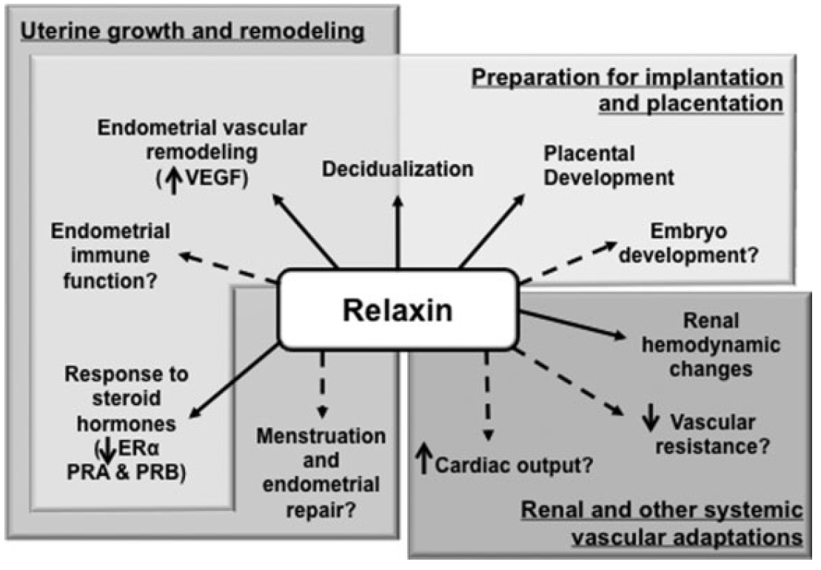
HORMONAL PROFILE OF PREGNANCY
TĚHOTENSKÉ HORMONY
Notes:
nebezpečí

Slide 17
HORMONAL PROFILE OF PREGNANCY
TĚHOTENSKÉ HORMONY
4
8
12
16
20
24
28
32
36
40
1
2
3
Notes:
nebezpečí

Slide 18
HORMONAL PROFILE OF PREGNANCY
TĚHOTENSKÉ HORMONY
HCS (Human Chorionic Somatomammotropin)
placental growth hormone - Human placental lactogen (hPL)
has weak actions similar of growth hormone
causes retention of nitrogen, potassium, calcium
causes decreased insulin sensitivity and decreased utilization of glucose in the mother
secretion of this hormone increases progressively in direct proportion to the weight of the placenta
HCS/HPL
4
8
12
16
20
24
28
32
36
40
1
2
3
Notes:
nebezpečí

Slide 19
HORMONAL PROFILE OF PREGNANCY
TĚHOTENSKÉ HORMONY
4
8
12
16
20
24
28
32
36
40
1
2
3
Notes:
nebezpečí

Slide 20
HORMONAL PROFILE OF PREGNANCY
TĚHOTENSKÉ HORMONY
PROL (Prolactin)
luteotropic hormone or luteotropin
stimulates the mammary glands to produce milk (lactation)
“luteotrophic” action of prolactin (enhanced progesterone secretion)
plays an important role in maternal behavior (psychosomatic reactions including pseudopregnancy)
inhibits maturation of ovum
PROL
4
8
12
16
20
24
28
32
36
40
1
2
3
Notes:
nebezpečí

Slide 21
HORMONAL PROFILE OF PREGNANCY
TĚHOTENSKÉ HORMONY
4
8
12
16
20
24
28
32
36
40
1
2
3
Notes:
nebezpečí

Slide 22
HORMONAL PROFILE OF PREGNANCY
TĚHOTENSKÉ HORMONY
OX (Oxytocin)
secreted by the neurohypophysis (nucleus paraventricularis)
causes uterine contraction
mediates the let-down reflex
OX
4
8
12
16
20
24
28
32
36
40
1
2
3
Notes:
nebezpečí

Slide 23
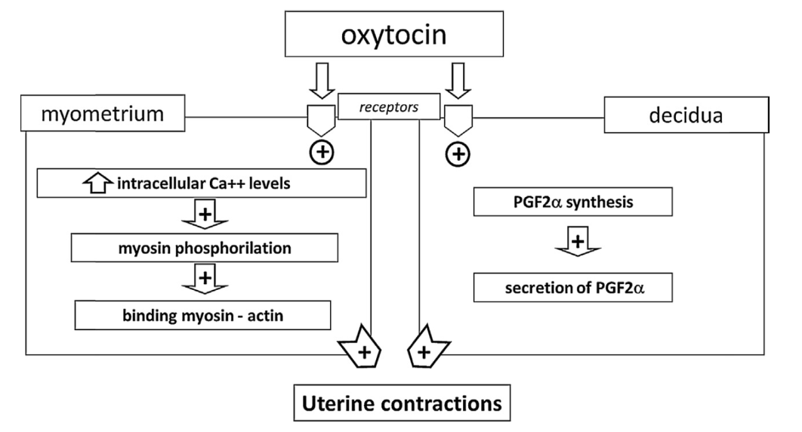
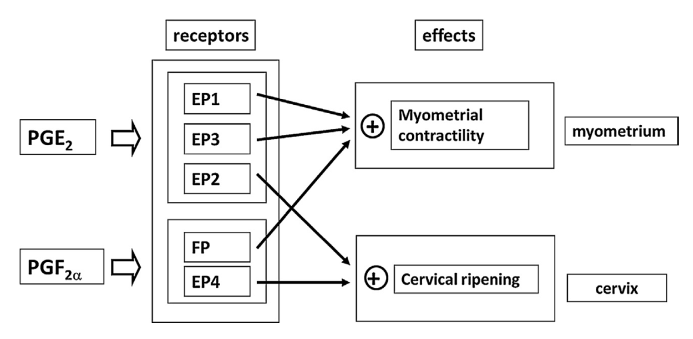
HORMONAL PROFILE OF PREGNANCY
Notes:
nebezpečí

Slide 24
HORMONAL PROFILE OF PREGNANCY
TĚHOTENSKÉ HORMONY
4
8
12
16
20
24
28
32
36
40
1
2
3
Notes:
nebezpečí

Slide 25
HORMONAL PROFILE OF PREGNANCY
TĚHOTENSKÉ HORMONY
P (Progesteron)
causes decidual cells to develop in the uterine endometrium
decreases the contractility of the pregnant uterus
contributes to the development of the conceptus even before implantation
prepares the mother’s breasts for lactation
P
4
8
12
16
20
24
28
32
36
40
1
2
3
Notes:
nebezpečí

Slide 26
HORMONAL PROFILE OF PREGNANCY
TĚHOTENSKÉ HORMONY
4
8
12
16
20
24
28
32
36
40
1
2
3
Notes:
nebezpečí

Slide 27
HORMONAL PROFILE OF PREGNANCY
TĚHOTENSKÉ HORMONY
E (Estrogen)
enlargement of the mother’s uterus
enlargement of the mother’s breasts and growth of the breast ductal structure
and enlargement of the mother’s female external genitalia
relax the pelvic ligaments of the mother
dampen the formation of the pituitary gonadotropins - not mature further follicles, miss menstrual cycles
E
4
8
12
16
20
24
28
32
36
40
1
2
3
Notes:
nebezpečí

Slide 28
HORMONAL PROFILE OF PREGNANCY
TĚHOTENSKÉ HORMONY
E
HCG
P
PROL
RX
HPL
OX
4
8
12
16
20
24
28
32
36
40
1
2
3
Notes:
nebezpečí

Slide 29
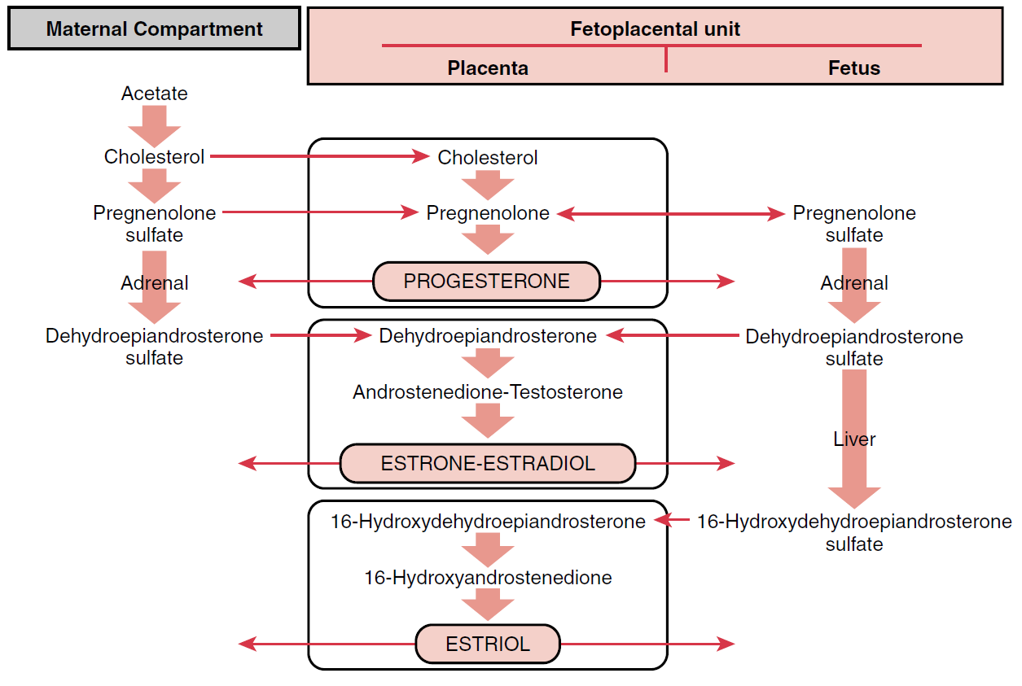
FETOPLACENTAL UNIT
Notes:
nebezpečí

Slide 30
FETOPLACENTAL UNIT
FETUS
HPA axis
CORTISOL
GROWTH OF FETUS
PLACENTAL
ENDOCRINE AXIS
UTERINE
GROWTH
EXTENSION
OF UTERUS
(+)
P
E
(-)
ACTIVATION
STIMULATION
Gap junctions
oxytocin
PGs
PARTURITION
Notes:
nebezpečí

Slide 31
PARTURITION
FETUS
FETOPLACENTAL
UNIT
MATERNAL
COMPARTMENT
cortisol
cortisol
cortisol
cholesterol
hypotalamus
hypotalamus
CRH
estrogens
adenohyp.
neurohyp.
ACTH
adrenal gl.
placental OT
PGs
OT
cortisol
(lungs)
placental CRH
uterus
(vasodilation of the placenta)
PARTURITION
Notes:
nebezpečí

Slide 32
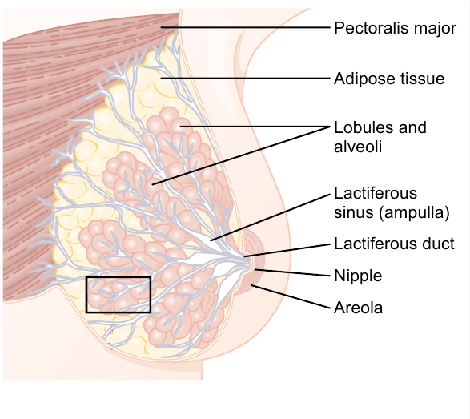
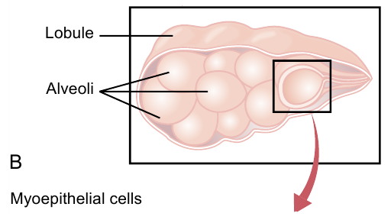
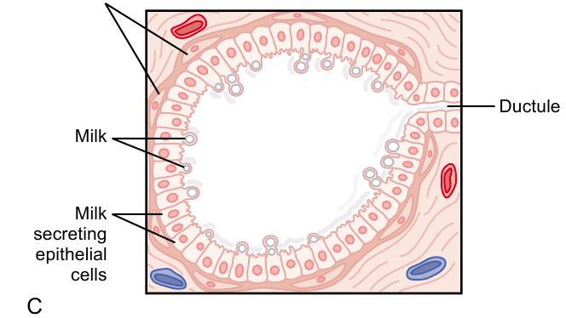
LACTATION
Notes:
nebezpečí

Slide 33
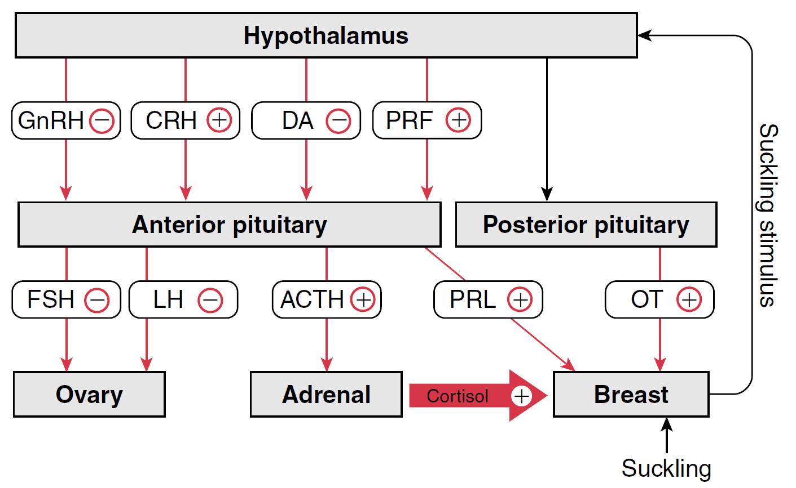
LACTATION

Slide 34
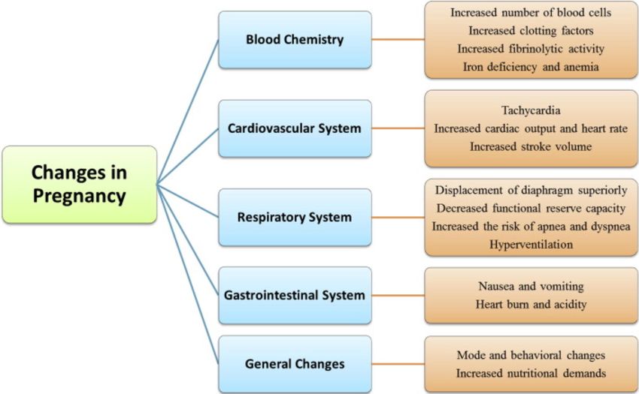
PHYSIOLOGICAL CHANGES DURING PREGNANCY
Notes:
nebezpečí

Slide 35
THANK YOU FOR YOUR ATENTION
Notes:
nebezpečí

