Slide 1
Medical Statistics
Public Health I

Slide 2
Seminar Outline I. Hypothesis Testing II. Variables & Analysis III. Distribution & Abnormality BREAK III. Prognosis & Survival V. Measurement Performance & Bias

Slide 3
Hypothesis
A supposition, arrived at from observation or reflection, that leads to refutable predictions.
alt.
Any conjecture cast in a form that will allow it to be tested and refuted.
An idea or explanation for something that is based on known facts but has not yet been proved.

Slide 4
Null Hypothesis
Prevalent knowledge
Common proposition
Old theory
No effect
No difference
The first step in testing for statistical significance in which it is assumed that the exposure is not related to disease.
H₀
Alternative Hypothesis
Research hypothesis
New theory
The hypothesis, to be adopted if the null hypothesis proves implausible, in which exposure is associated with disease.
H_{a}
There is difference
There is association
Effective drug

Slide 5
Exercise 1
Null Hypothesis vs. Alternative Hypothesis
It is believed that a candy machine makes chocolate bars that are on average 5g. A worker claims that the machine after maintenance no longer makes 5g bars. Write H₀ and H_{a.}

Slide 6
Exercise 2
Null Hypothesis vs. Alternative Hypothesis
Doctors believe that the average teen sleeps on average no longer than 10 hours per day. A researcher believes that teens on average sleep longer.
Write H₀ and H_{a}.

Slide 7
Confidence Level
Significance Level
The probability of rejecting the null hypothesis when it is true.
α = 1 – C
α = 1 – 0.95 = 0.05
How confident are we in our decision.
C = 90%
C = 95%
C = 99%
Decision
p-value
Fail to Reject
Reject
H₀
Correct Decision Probability is 1 – α (confidence level) | Type I Error Probability is α (significance level)
Type II Error Probability is β | Correct Decision Probability is 1 – β (power of test)
Significance Value
False Positive
True
The smaller the p-value is, the stronger the evidence that you should reject the null hypothesis.
False
False Negative

Slide 8
Exercise 3
Null Hypothesis vs. Alternative Hypothesis
A company has stated that their straw machine makes straws that are 2 mm diameter. A worker believes the machine no longer makes straws of this size and samples 100 straws to perform a hypothesis test with 99% confidence.
Write H₀, H_{a}, n, C, and α.

Slide 9
Exercise 4
Null Hypothesis vs. Alternative Hypothesis
The school board claims that at least 60% of students bring a phone to school. A teacher believes this number is too high and randomly samples 25 students to test at a level of significance of 0.02.
Write H₀, H_{a}, n, α, and C.

Slide 10
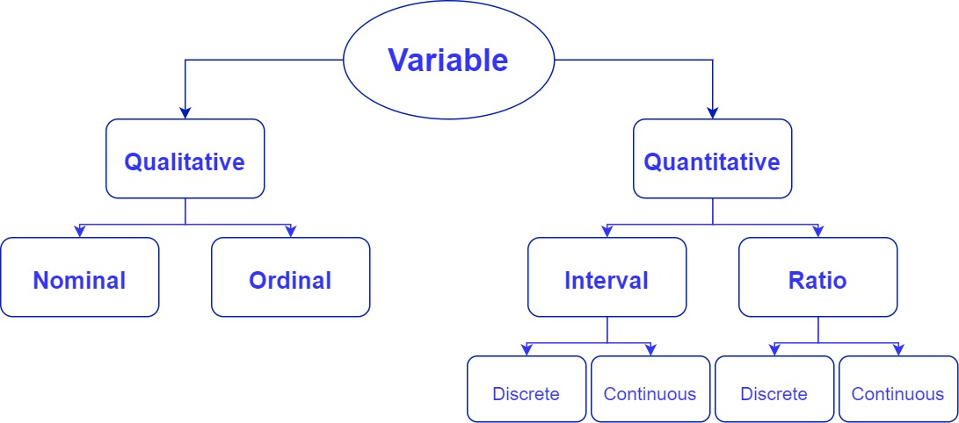
Variable
In epidemiology, variable refers to any characteristic or attribute that can be measured.

Slide 11
Nominal Variable
Interval Variable
is measured on a scale of equally spaced units, but without a true zero point.
Example:
Celsius Temperature; Fahrenheit Temperature
= Categorical
Ratio Variable
Nominal data occur in categories without any inherent order.
has all the properties of interval variables plus a real absolute zero.
Example:
Gender; Discrete Events; Dichotomous
Example:
Height; Weight; Duration
Ordinal Variable
Discrete vs. Continuous
Ordinal data possess some inherent ordering or rank, but the size of the intervals between categories is not specified.
Discrete variable can take on only specific values and are expressed as counts. Continuous variable can take on any value in a continuum, regardless of whether or not they are reported that way.
Example:
Cancer Staging; Age Group; Glasgow Coma Scale
Example:
Blood pressure (continuous); no. of HT patients (discrete)

Slide 12
Statistical Tests
If we study one qualitative variable
If we study two qualitative variables
If we study one numerical variable
If we study one numerical and one qualitative variable
If we study two numerical variables
1-sample proportion test
Chi-squared test
T-test
T-test or Analysis of Variance (ANOVA)
Correlation test

Slide 13
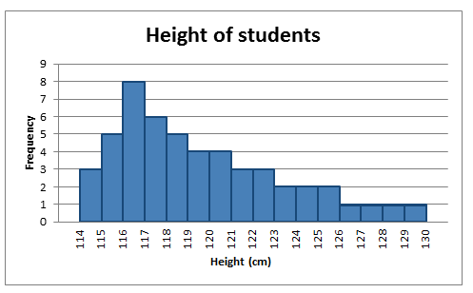
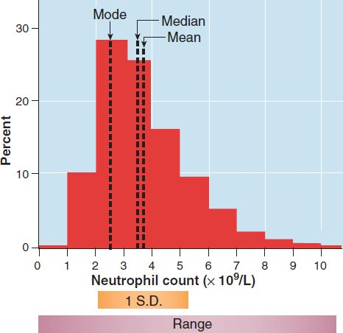
Distribution
Data that are measured by numerical variables are often presented using frequency distribution figures.
Frequency distribution figures show the number (or proportion) of a defined group of people possessing the different values of the measurement.
Two properties are used to summarize frequency charts: central tendency (the middle of the distribution) and dispersion (how spread out the values are).

Slide 14
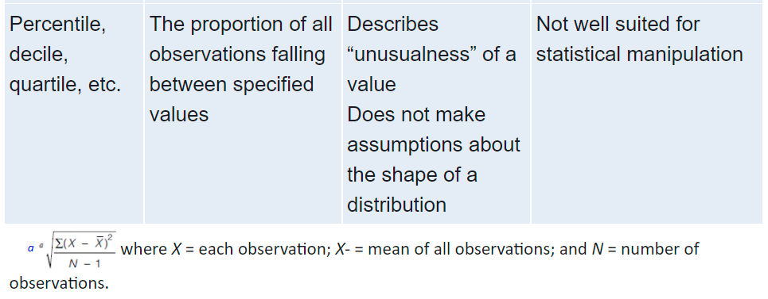
Distribution

Slide 15
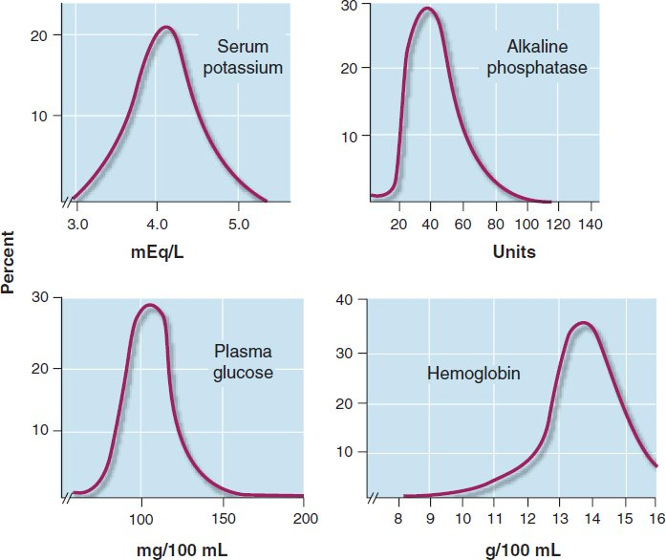
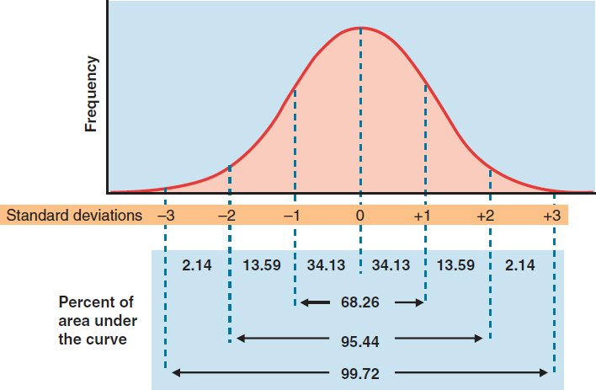
Actual Distribution
Distributions of clinical phenomena have many different shapes.
In general, most of the values appear near the middle of the distribution.
The high and low ends of the distributions stretch out into tails, with the tail at one end often being more elongated than the tail at the other (i.e., the curves are skewed toward the longer end).
Normal Distribution
Gaussian (normal) distribution is represented by a symmetrical curve (bell-shaped) which has the mathematical property that about two-thirds of the observations fall within 1 standard deviation of the mean, and about 95%, within 2 standard deviations.
Although clinical distributions often resemble a normal distribution, the resemblance is superficial.

Slide 16
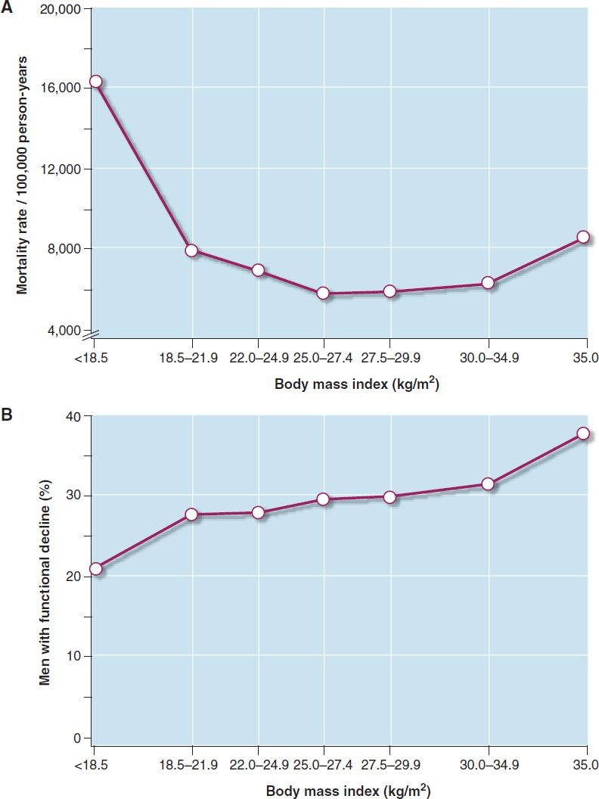
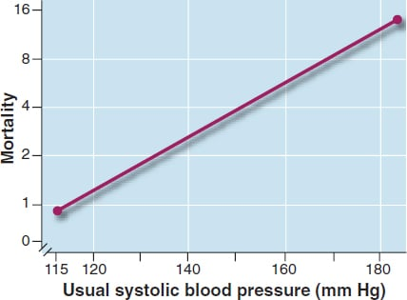
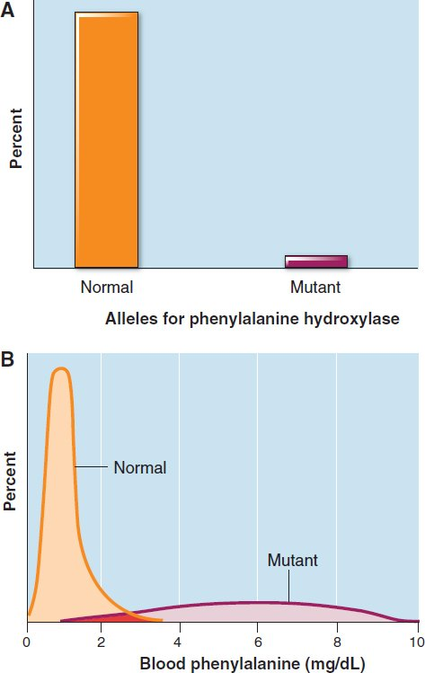
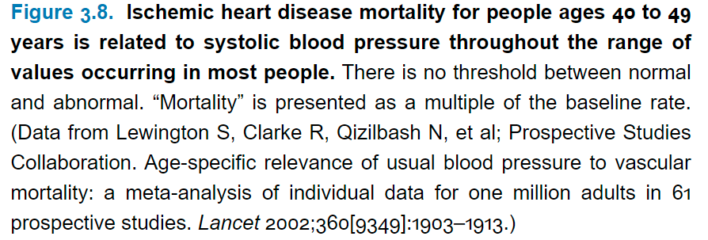
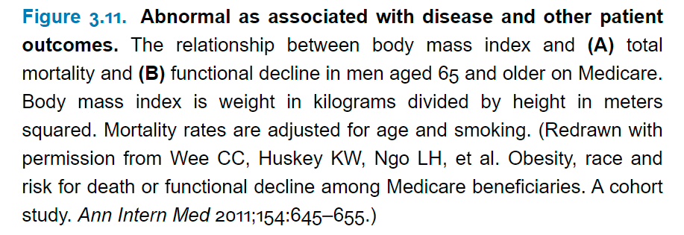

Slide 17
BREAK

Slide 18
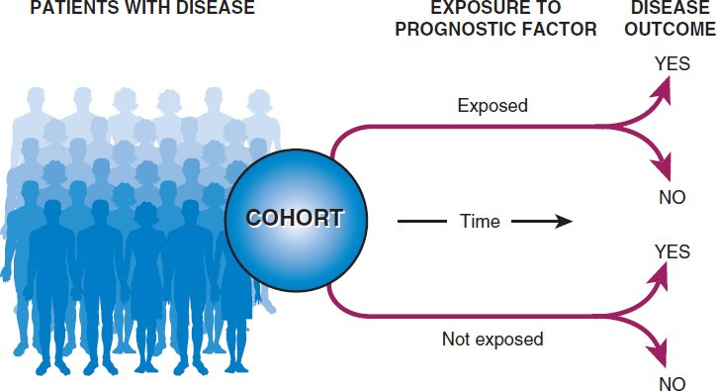
Prognosis
Different from Cohort Studies of Risk?
Cohorts in prognostic studies should begin from a common point in time in the course of disease, called zero time, such as at the time of the onset of symptoms, diagnosis, or the beginning of treatment.
The term inception cohort is used to describe a group of patients that is assembled at the onset (inception) of their disease.
Prognosis of cancer is often described separately according to patients’ clinical stage (extent of spread) at the beginning of follow-up. Stage migration occurs when a newer technology is able to detect the spread of cancer better than an older staging method.

Slide 19
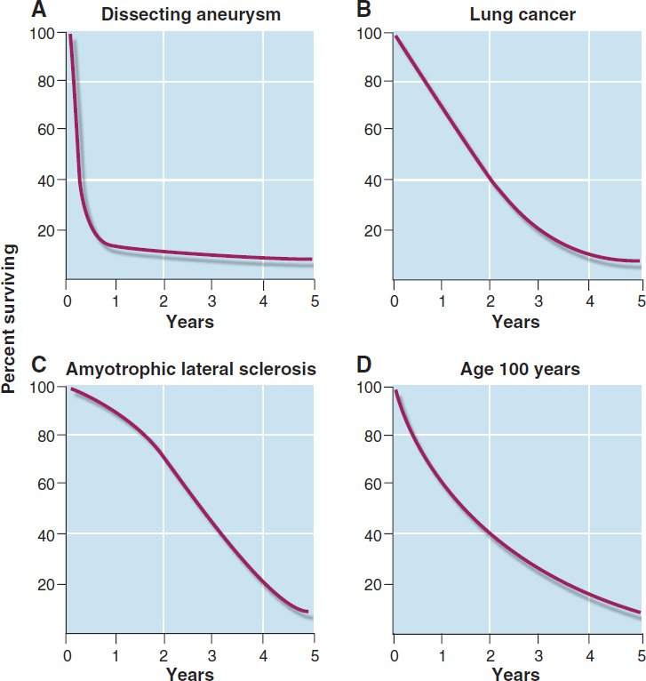
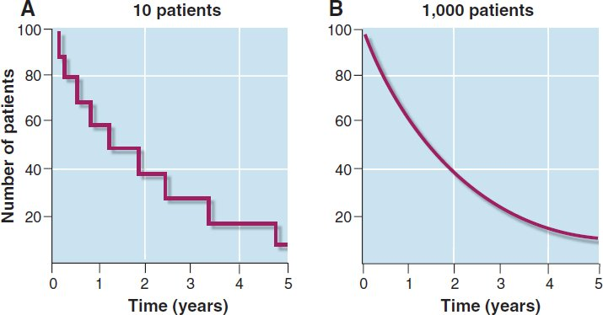
Survival Analysis
When interpreting prognosis, it is preferable to know the likelihood that patients with a given condition will experience an outcome at any point in time.
An event refers to a dichotomous clinical outcome that can occur only once.
Survival analysis has been developed to estimate the survival of a cohort over time. The usual method is called Kaplan–Meier analysis.
The more patients in the cohort, the smoother the curve.
A more general term, useful when an event other than survival is described, is time-to-event analysis.

Slide 20
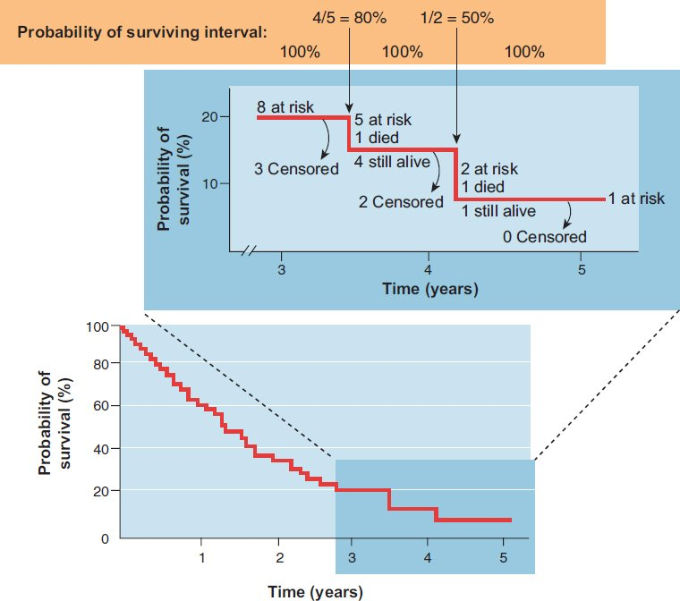
Survival Curve
The vertical axis represents the estimated probability of surviving for members of the cohort, not the cumulative incidence of surviving if all members of the cohort were followed up.
One can be more confident that the estimates on the left-hand side of the curve are sound, because more patients are at risk early in follow-up. But estimates of survival toward the end of the follow-up period are imprecise and can be strongly affected by what happens to relatively few patients.

Slide 21
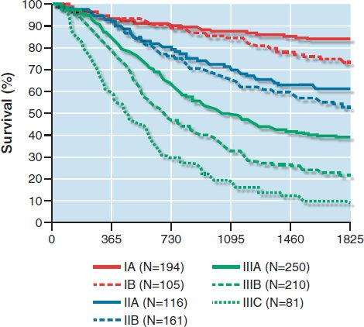
Survival Curve
To evaluate prognostic factors, multiple survival curves, are represented on the same figure where they can be visually (and statistically) compared.
The effects of one prognostic factor relative to the effects of another can be summarized by a hazard ratio, which is analogous to a risk ratio (relative risk).

Slide 22
Validity
Content Validity
is the extent to which a particular method of measurement includes all of the dimensions of the construct one intends to measure and nothing more.
For example, a scale for measuring pain would have content validity if it included questions about aching, throbbing, pressure, burning, and stinging, but not about itching, nausea, and tingling.
Criterion Validity
is the degree to which the data measure what they were intended to measure—that is, the degree to which the results of a measurement correspond to the true state of the phenomenon being measured. Another word for validity is accuracy.
Validation of non-physical health measures (subjective outcomes) have three basic elements:
is present to the extent that the measurements predict a directly observable phenomenon.
For example, one might see whether responses on a scale measuring pain bear a predictable relationship to pain of known severity; mild pain from minor abrasion, moderate pain from ordinary headache and peptic ulcer, and severe pain from renal colic.
Construct Validity
is present to the extent that the measurement is related in a coherent way to other measures, also not physically verifiable, that are believed to be part of the same phenomenon.

Slide 23
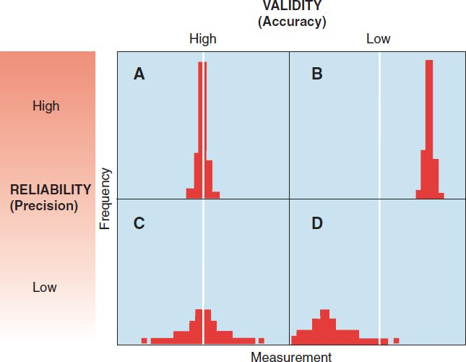
Reliability
is the extent to which repeated measurements of a stable phenomenon by different people and instruments at different times and places get similar results. Reproducibility and precision are other words for this property.
The reliability of symptoms can be established by showing that they are similarly described to different observers under different conditions.

Slide 24
Bias
In cohort studies of risk or prognosis, bias can alter the description of the course of disease.
Bias can also create apparent differences between groups when differences do not actually exist in nature or obscure differences when they really do exist.
Study Timeline
Sampling
Bias
Migration
Bias
Measurement
Bias
occurs when the patients in a study are not like other patients with the condition.
is present when some patients drop out of the study during follow-up and they are systematically different from those who remain.
is present when members of the cohort are not all assessed similarly for outcome.
Sensitivity
Analysis
Best-case/worst-case Analysis

Slide 25
THANK YOU
abanoub.riad@med.muni.cz
Abanoub Riad (abanoub.riad@med.muni.cz)
Pavilion: A21 / Third Floor / Office: 315

