Slide 1
Evidence-Based Medicine
Public Health I

Slide 2
Seminar Outline I. What is EBM? II. Medical Evidence III. Clinical Question IV. Search Strategy V. Critical Appraisal VI. Evidence Synthesis VII. GRADE

Slide 3
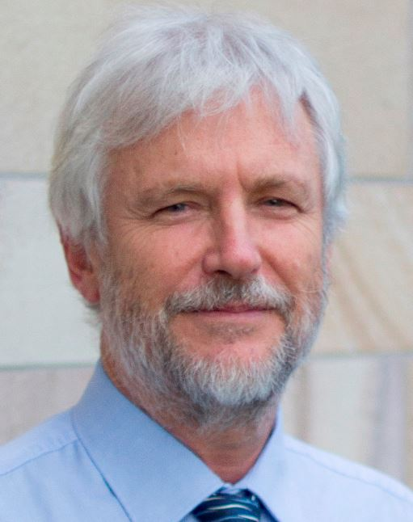
“Can a physician practice medicine without knowing EBM?”
“In medicine, we are continually making decisions, and if medicine is to be a science or a ‘‘learned’’ profession, we need to think critically about HOW and WHY we make those decisions.”
=
Prof. Paul Glasziou, MBBS, PhD
Why is evidence-based medicine important?

Slide 4
Evidence-based medicine (EBM) is the conscientious, explicit and judicious use of current best evidence in making decisions about the care of individual patients.
Evidence based medicine: what it is and what it isn't

Slide 5
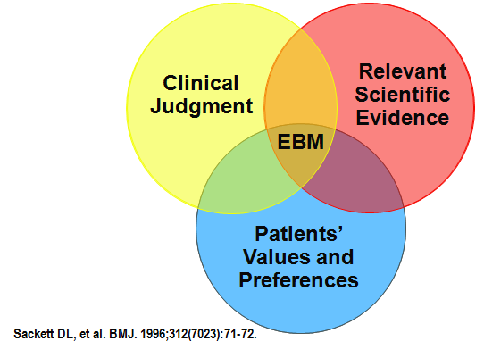
EBM Principles
EBM aims to integrate clinical experience and patient values with the best available scientific evidence.
EBM is not dogmatic cookbook medicine – it never implies that “one-size-fits-all”.
The EBM-oriented clinicians of tomorrow have three tasks:
to use evidence summaries in clinical practice;
to help develop and update selected systematic reviews or evidence-based guidelines in their area of expertise;
to enrol patients in studies of treatment, diagnosis and prognosis on which medical practice is based.

Slide 6
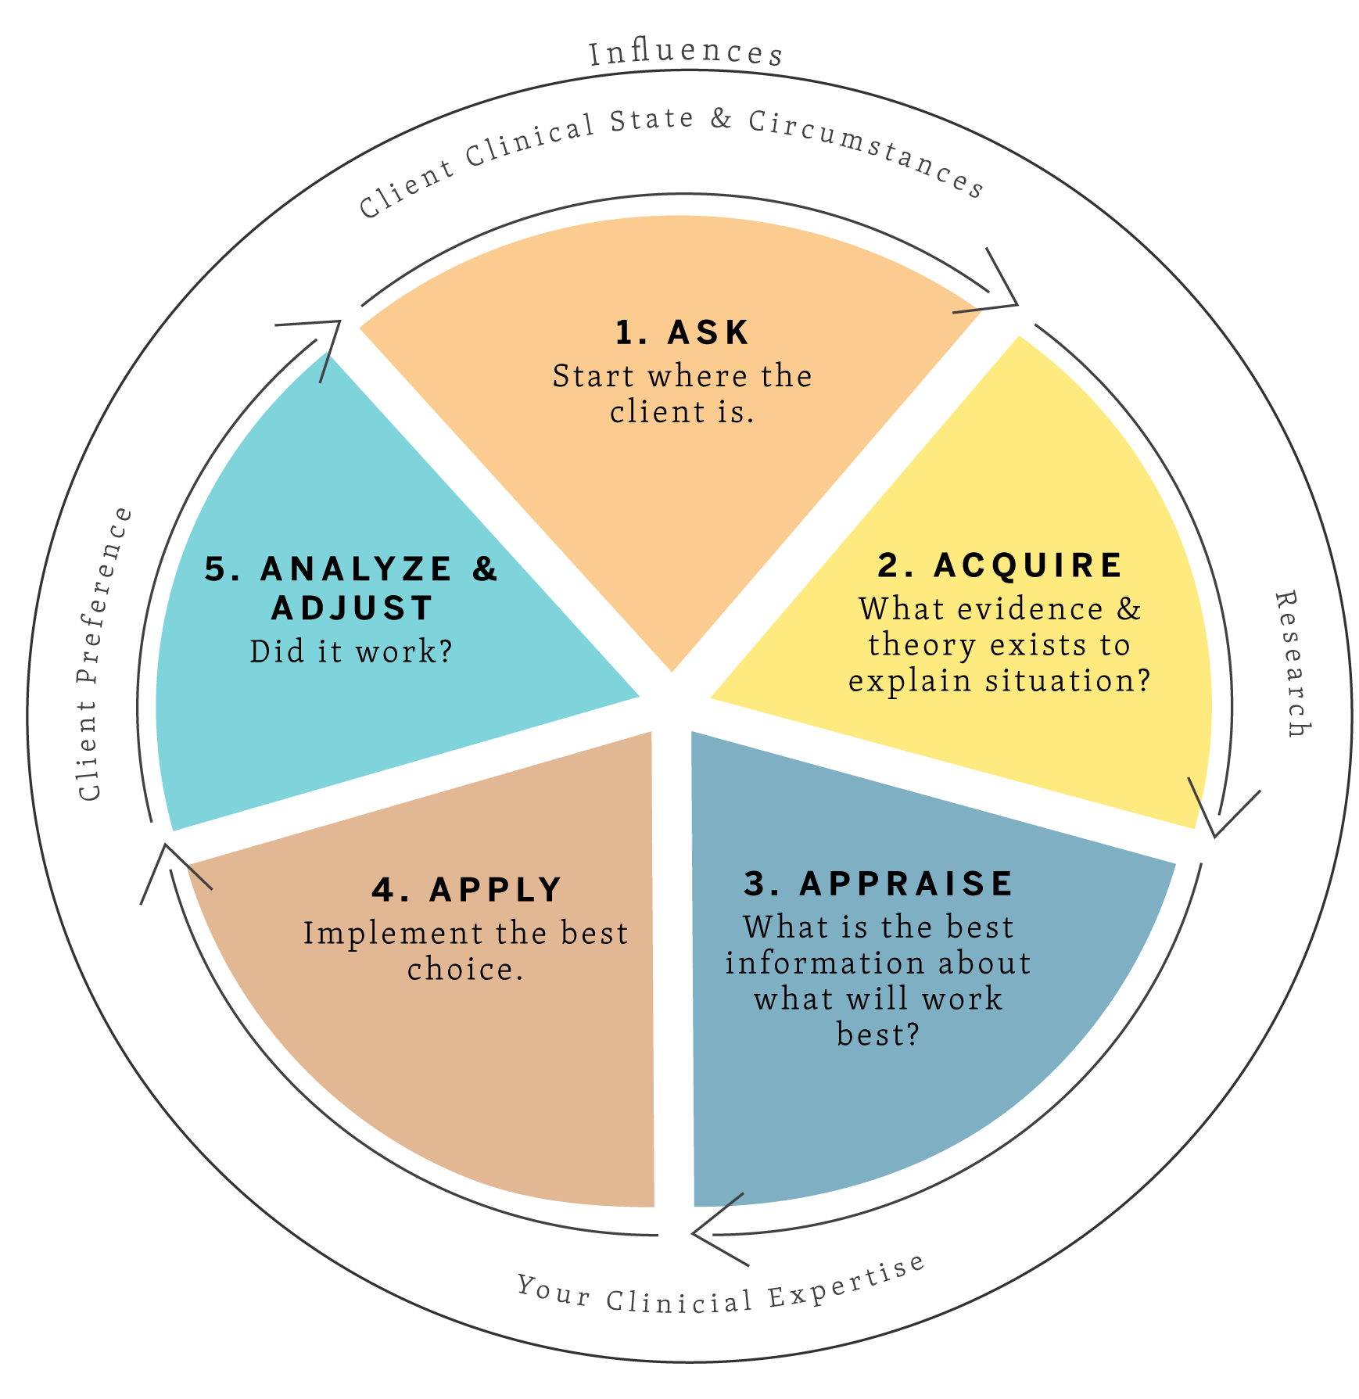
EBM Approach
Various models of EBM have been created for various clinical settings, but the general steps of EBM are as follows:
Generate Clinical Question
Find Best Evidence
Critical Appraisal
Apply the Evidence
Evaluate

Slide 7
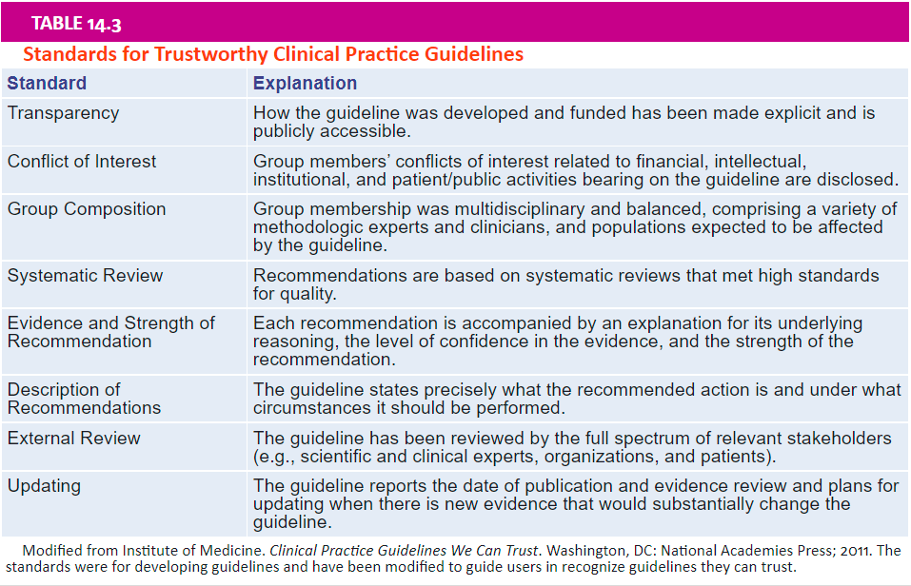
Medical Evidence
Clinical Practice Guidelines
CPG are advice to clinicians about the care of patients with specific conditions.
CPG are meant to be a starting place for decision making about individual patients, to be modified by clinical judgment; that is, they are guidelines, not rules.
High-quality guidelines represent the wise application of research evidence to the realities of clinical care.
Clinicians need to be able to look up answers to questions that arise during the care of their patients.
It is best to get answers to questions just at the time and place where they arise during the care of patients. This has been called the point of care and the associated learning just-in-time learning.

Slide 8
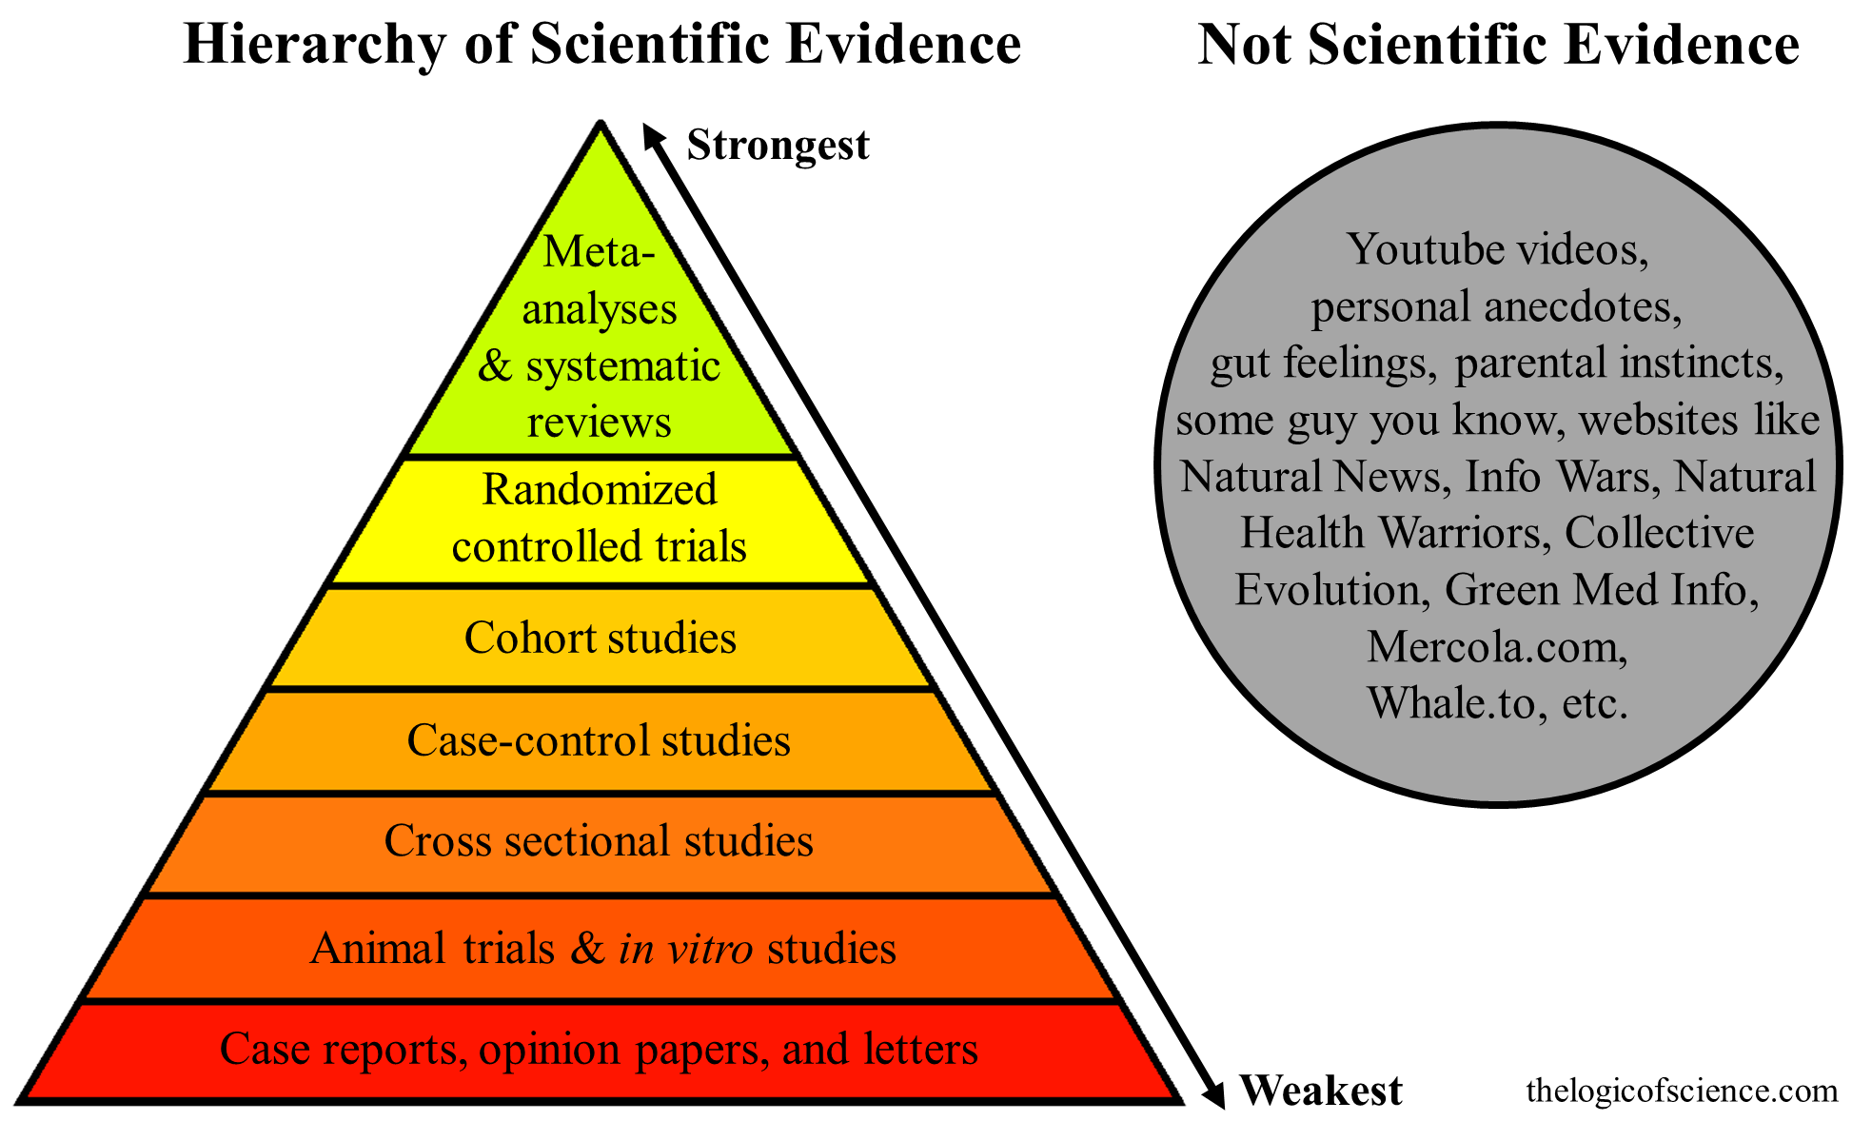
Systematic Review
Systematic reviews are rigorous reviews of the evidence bearing on specific clinical questions.
They are “systematic” because they summarize original research following a scientifically based plan that has been decided on in advance and made explicit at every step.

Slide 9
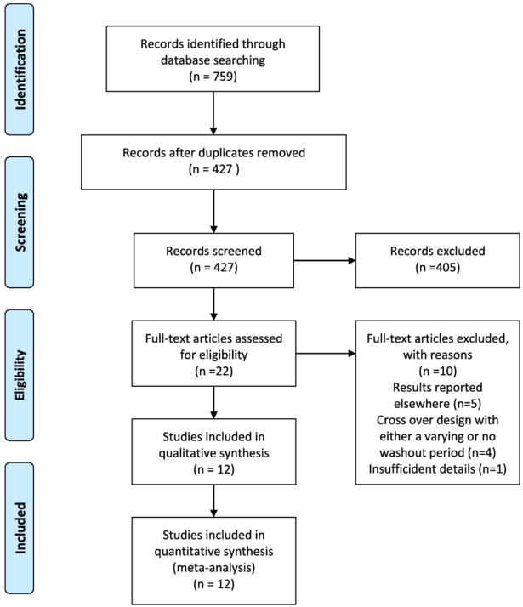
Systematic Review
A methodological protocol of the SR needs to be published in advance.
The workflow of SR is summarized using the Preferred Reporting Items for Systematic Reviews and Meta-Analyses (PRISMA) flow diagram.
The quality of the evidence obtained by SR is proportionate to the quality of the individual (primary) trials included.

Slide 10
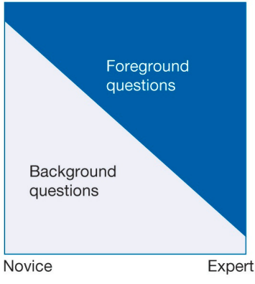
Generate Clinical Question
Generating clinical questions, the first step of EBM, is the most difficult and the most important step.
One can think of the first set of questions, those of the medical student, as background questions and of the browsing and problem-solving sets as foreground questions.
Dissecting the question into its component parts to facilitate finding the best evidence is a fundamental skill.
PICO = Population, Intervention, Comparison, Outcome
Background
Question
Foreground
Question
Clinical
Question

Slide 11
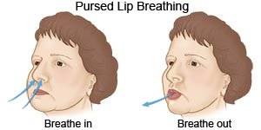
Exercise 1
P = patients with COPD
I = pursed lip breathing
C = regular breathing
O = improved exercise endurance
Clinical Question Formulation
You have a patient who has difficulty exercising due to COPD and you wonder if pursed lip breathing techniques may improve their endurance.
In patients with COPD, does using pursed lip breathing, as compared to regular breathing, improve exercise endurance?

Slide 12
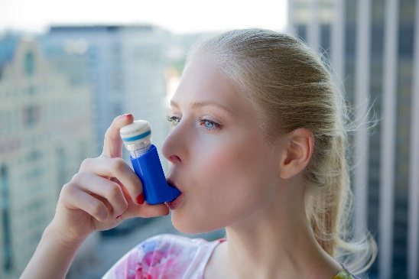
Exercise 2
P = exercise-induced asthma
I = regular use of inhalers
C = no rescue-inhalers
O = dependency (addiction)
Clinical Question Formulation
A female patient asks you whether using a rescue-inhaler for her exercise-induced asthma can cause any sort of dependency.
In young adult female patients with exercise-induced asthma, does using a rescue-inhaler regularly increase probability that one then becomes dependent to inhalers, compared to similar patients who do not use inhalers?

Slide 13
Clinical Questions
Types of
Effectiveness
Diagnostic Test Accuracy
Etiology & Risk Factor
Prevalence & Incidence
Qualitative
Population
Intervention
Comparison
Outcome
P I C O
P I R D
P E O
Co Co Pop
P I Co
Population
Index Test
Reference Test
Diagnosis
Population
Exposure
Outcome
Condition
Context
Population
Phenomena of Interest
Population
Context

Slide 14
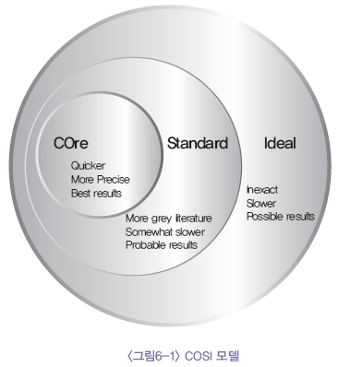
Search Strategy
What is good evidence?
Where to find it?
The conditions for the evidence acquired in EBM are that the evidence should be attainable, obtained externally from research, up-to-date, timely, of high quality, applicable to individual patients, and appropriately the best.
The U.S. NLM provides the scope for a literature survey, which is the COSI (Core, Standard, Ideal) model.

Slide 15
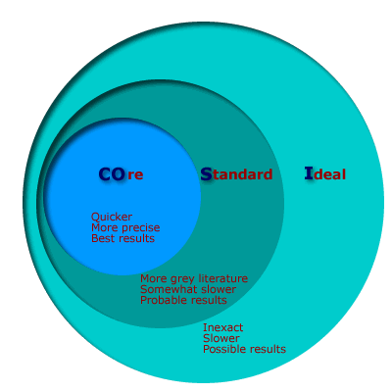
Search Strategy
Core = MEDLINE, Cochrane Library, EMBASE, Scientific Citation Index
Standard = Core + Conference abstracts, citation searching
Ideal = Core + Standard + grey literature, book chapters, websites of manufacturers and medical association, hand searching
https://www.nlm.nih.gov/archive/20060905/nichsr/ehta/chapter3.html#COSI

Slide 16
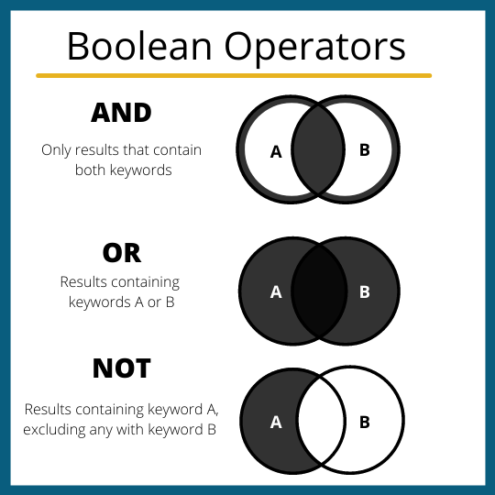
Search Strategy
Boolean Operators

Slide 17
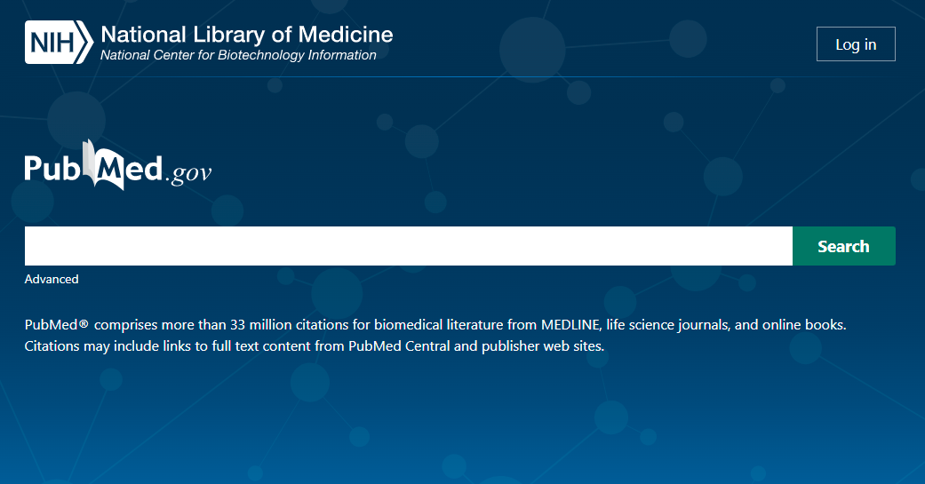
Exercise 3
Search Strategy
P = COVID-19 patients
I = corticosteroids
C = no corticosteroids
O = clinical improvement
(
COVID-19 OR SARS-CoV-2 OR 2019-nCoV OR coronavirus disease OR severe acute respiratory syndrome
)
AND
(
corticosteroid OR corticoid OR prednisolone OR meticortelone OR dexamethasone OR cortisol
)
https://www.cochranelibrary.com/cdsr/doi/10.1002/14651858.CD014963/appendices#CD014963-sec-0133

Slide 18
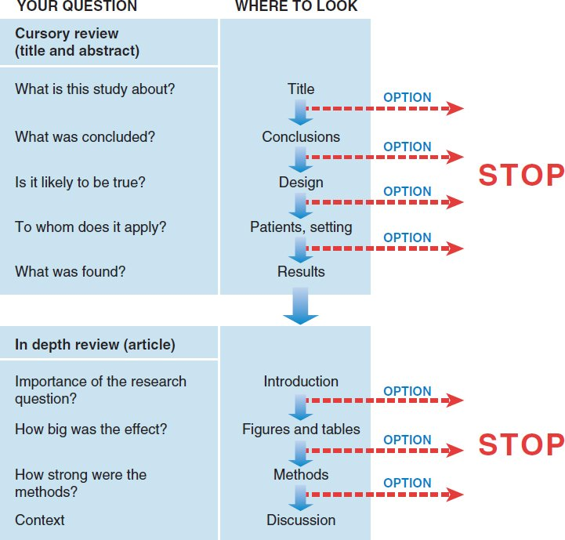
Search Strategy
Approaches to streamlined reading vary.
It is a good idea to at least survey the titles and abstracts of all articles in an issue to decide which articles matter most to you.
For those that do, you might read more deeply, adjusting the depth as you go.

Slide 19
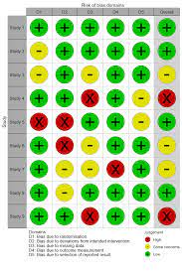
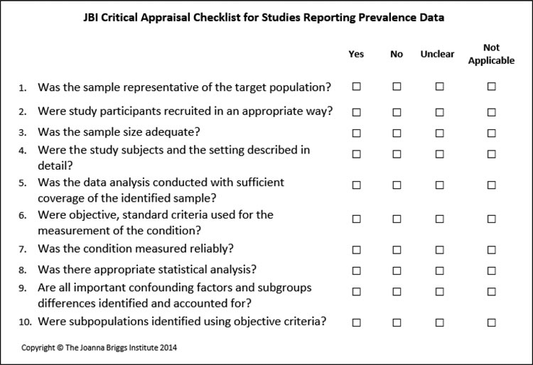
Critical Appraisal
Once the literature has been surveyed, appropriate literature should be selected and the quality and usefulness of the literature should be appraised.
Appraisal of the quality of literature enables decisions to be made regarding whether to accept the conclusions drawn.
Tools of appraisal are classified as scoring system or checklist system, e.g. RoB 2.0, ROBINS-I, JBI Checklists
Checklists of critical appraisal are composed of signalling questions, each question is related one or more sources of potential bias.

Slide 20
Exercise 4
Critical Appraisal
Go to: https://jbi.global/critical-appraisal-tools
Download the “Checklist of Case Reports”, “Checklist of Analytical Cross-sectional Studies”, and “Checklist for Cohort Studies”.
Read carefully the explanation of each checklist before the seminar!

Slide 21
Evidence Synthesis
Qualitative Synthesis
Thematic analysis refers to the various processes of reading texts and refining the findings into key ‘themes’.
Meta-ethnography is a qualitative synthesis technique which involves: a) the mapping of key themes and concepts across studies (which may parallel a thematic analysis approach); b) the identification and resolution of any contradictions, and c) the building of a general interpretation based on the data.
Quantitative Synthesis
Meta-analysis is a quantitative, formal, epidemiological study design used to systematically assess the results of previous research to derive conclusions about that body of research.

Slide 22
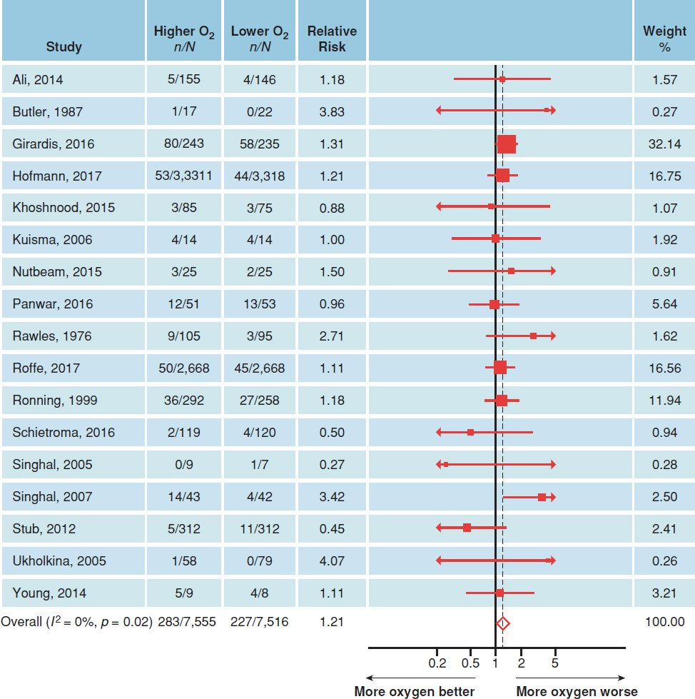
Meta Analysis
Meta Analysis is the quantitative synthesis of the critically appraised evidence.
Forest plots show the point estimate of effectiveness and confidence interval for each study in the review.

Slide 23
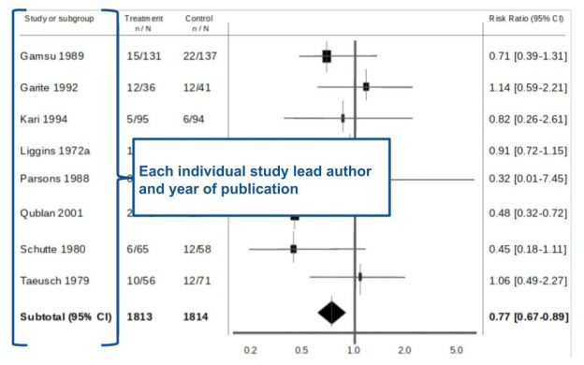
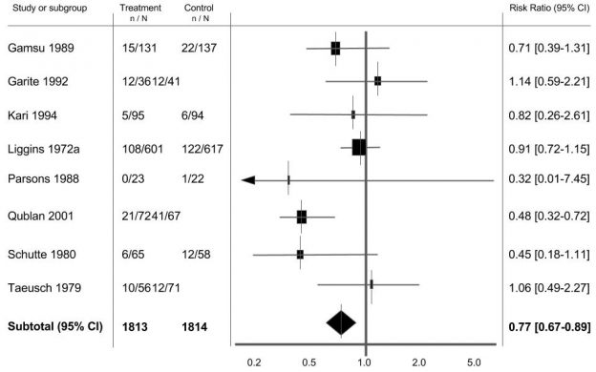
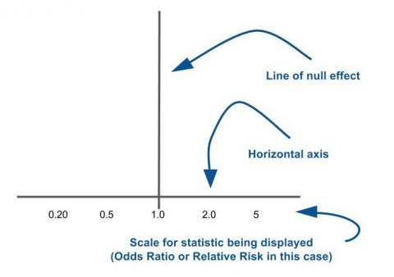
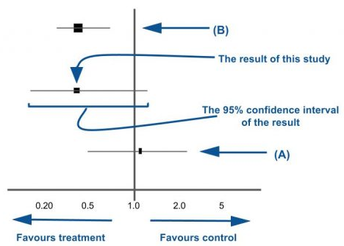
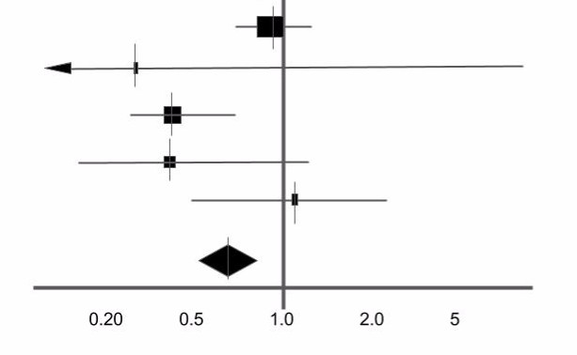
Meta Analysis
https://s4be.cochrane.org/blog/2016/07/11/tutorial-read-forest-plot
How to interpret forest plot?

Slide 24
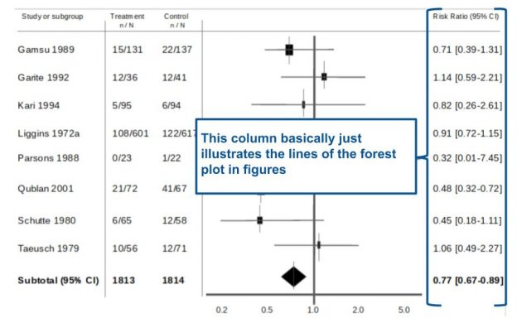
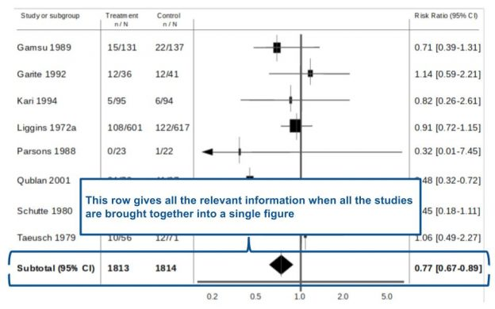
Meta Analysis
How to interpret forest plot?
https://s4be.cochrane.org/blog/2016/07/11/tutorial-read-forest-plot

Slide 25
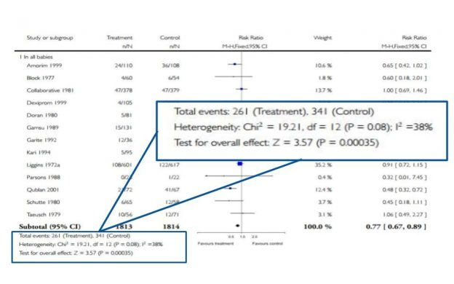
Meta Analysis
How to interpret forest plot?
https://s4be.cochrane.org/blog/2016/07/11/tutorial-read-forest-plot

Slide 26
Apply the Evidence
Getting evidence into practice is not necessarily straightforward, with a simple estimate of the time it takes from evidence being created to its use in practice being 17 years.
How to bridge the gap between the evidence and the translation (or uptake) of research into clinical practice has been a point of ongoing debate over the years
The questions that we should ask before the decision to apply the results of the study are:
Are the participants in the study similar enough to my patient?
Is the treatment available and is health care system prepared to fund it?
What alternatives are available?
Do the potential side effects of the drug or procedure outweigh the benefits?
Are the outcomes appropriate to the patient? Does the treatment conflict with the patient’s values and expectations?

Slide 27
Evaluate
The final step of EBM is the evaluation.
During this process it is important to assess whether certain evidence, which is applied to the patient, caused changes to better and that to the extent that it is confirmed by research. If the data differ significantly, it would be necessary to investigate why some patients did not respond to the changes introduced in the expected way and what can be done to change it.

Slide 28
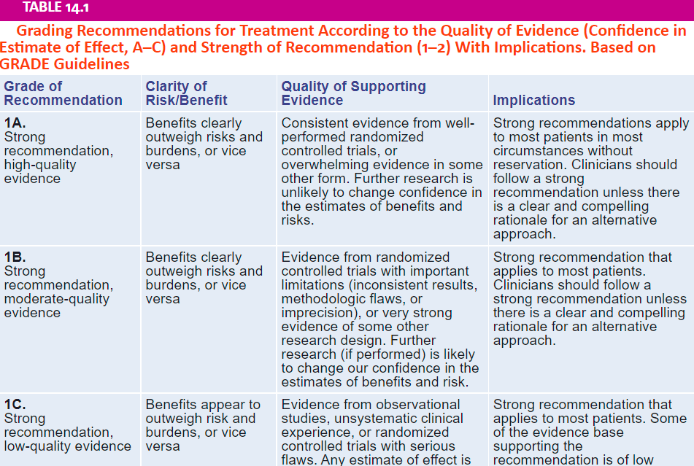
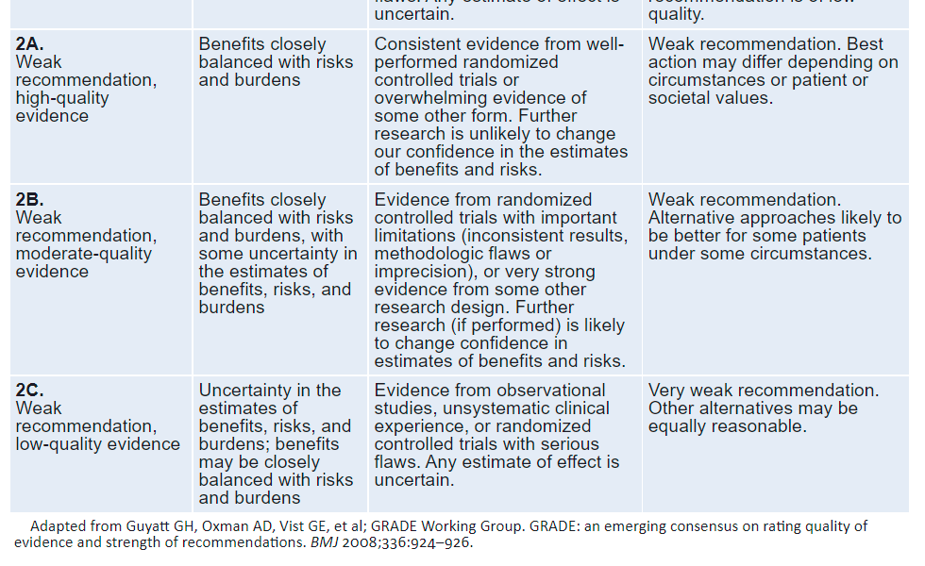
GRADE
Grading of Recommendations, Assessment, Development and Evaluations) is a transparent framework for developing and presenting summaries of evidence and provides a systematic approach for making clinical practice recommendations.

Slide 29
Useful Resources
Cochrane Library: https://www.cochranelibrary.com
Students 4 Best Evidence: https://s4be.cochrane.org
Centre for Evidence-Based Medicine (CEBM): https://www.cebm.ox.ac.uk
JAMAevidence: https://jamaevidence.mhmedical.com
JBI Evidence Synthesis: https://journals.lww.com/jbisrir
BMJ Evidence-Based Medicine: https://ebm.bmj.com

Slide 30
THANK YOU
abanoub.riad@med.muni.cz
Abanoub Riad (abanoub.riad@med.muni.cz)
Pavilion: A21 / Third Floor / Office: 315

