Slide 1
Pathophysiology of chronic inflammation, ethiopathogenesis, consequences, systemic inflammation, SIRS, MODS
Julie Dobrovolná

Slide 2
Immune system
Immune system = cells, tissues and molecules that mediate resistance to infections
Immunology = study of the structure and function of the immune system Immunity = host resistance to pathogens and their toxic effects
Immune response = collective and coordinated response to the introduction of foreign substances into an individual mediated by cells and immune molecules system

Slide 3
The role of the immune system
Defense against microbes
Defense against tumor cell growth kills tumor cell growth
Homeostasis of destruction of abnormal or dead cells (e.g. dead red or white blood cells, antigen-antibody complex)

Slide 4
The components of the immune system

Slide 5
The type of immune response
Innate (non-adaptive): the first-line immune response relies on mechanisms that existed before infection
Acquired (adaptive) immunity: The second line of response (if innate immunity fails) relies on mechanisms involving cellular memory of key T- and B-lymphocytes

Slide 6
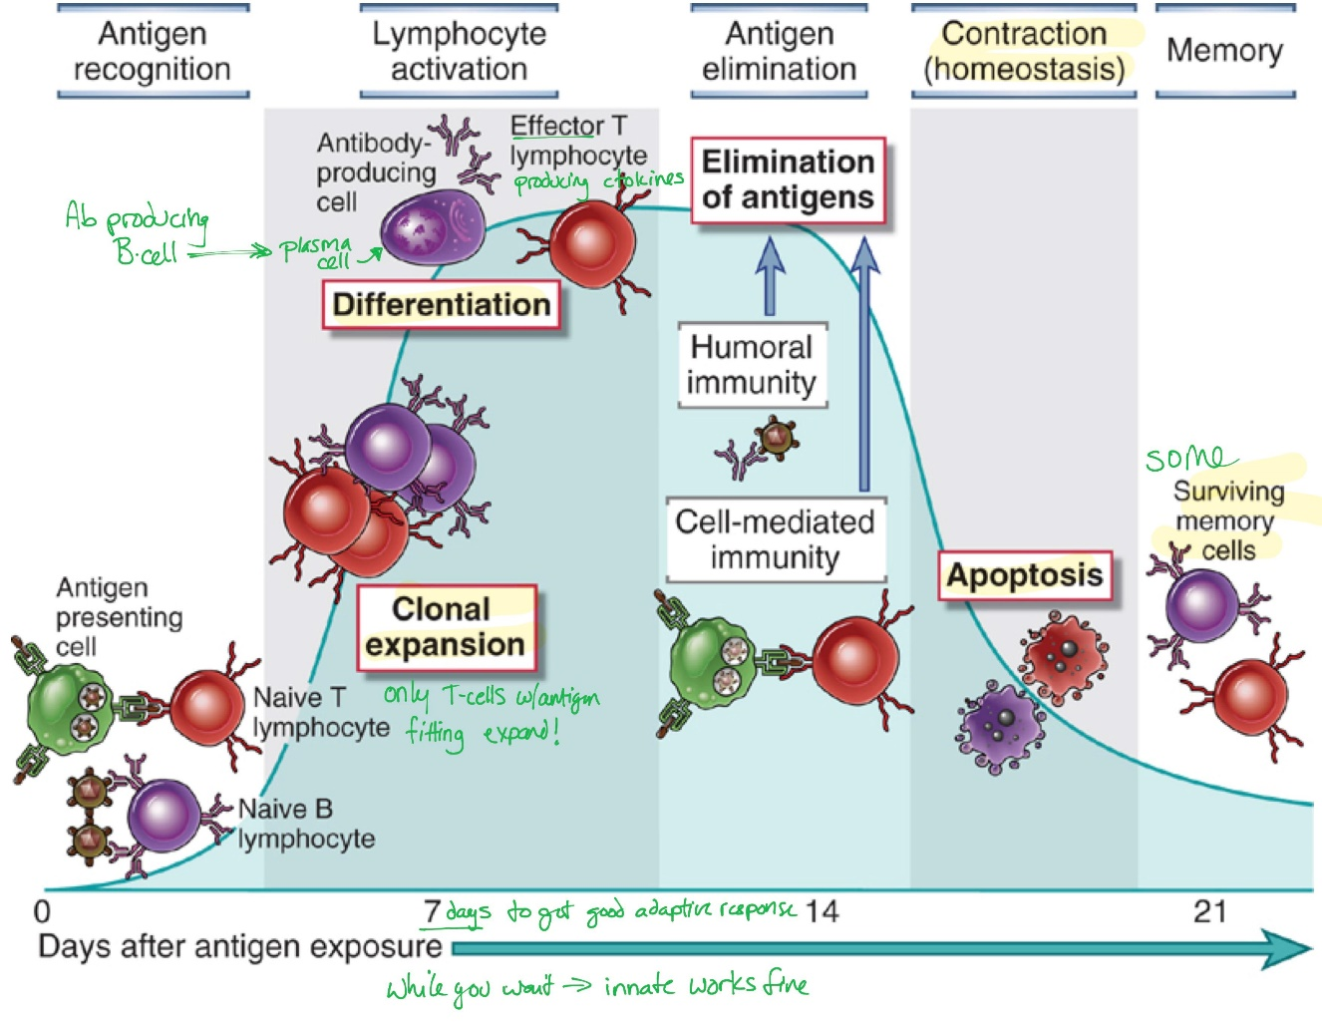
Timeline

Slide 8
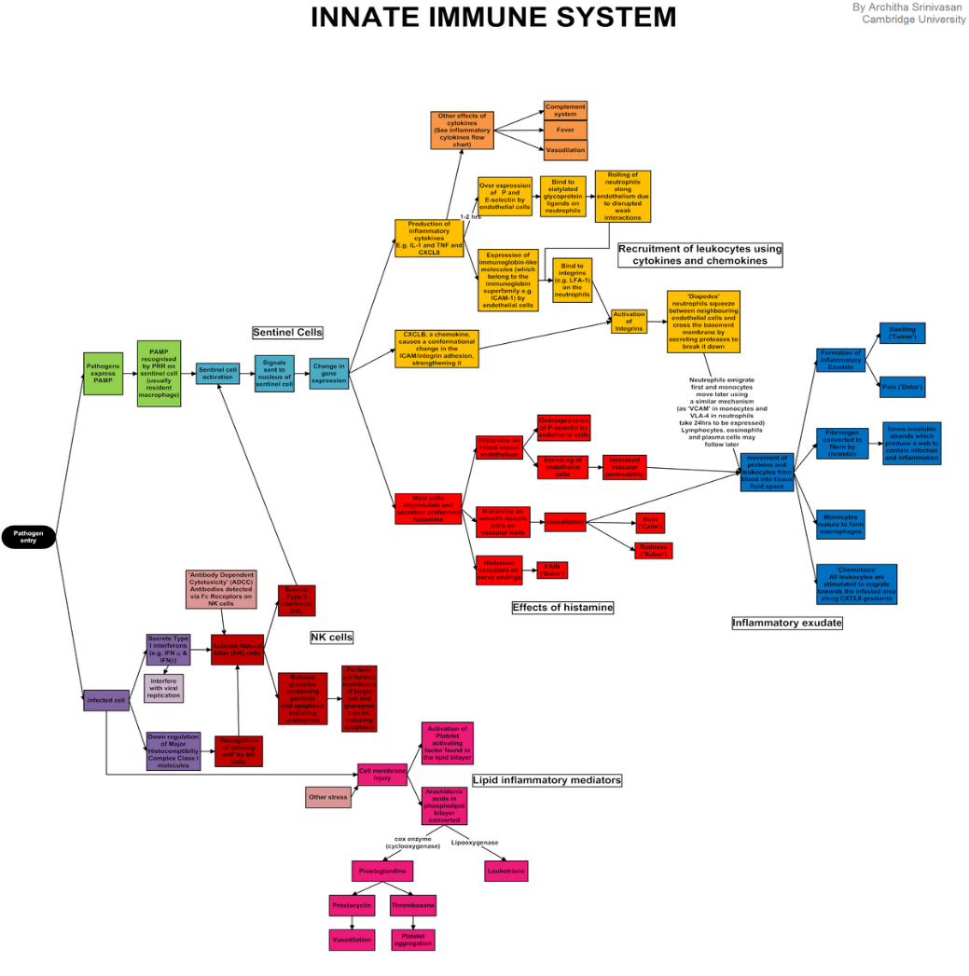
Innate immunity
Based on genetic background
Relies on existing system components
Rapid response: within minutes of infection
Not specific: the same molecules / cells respond to many pathogens
No memory: the same response after repeated exposure
Does not lead to clonal expansion

Slide 9
Innate immunity mechanisms
Mechanical barriers / excretion on the skin surface, acidic pH in the stomach, cilia
Humoral mechanisms
Lysozymes, basic proteins, complement, interferons
Mechanisms of cell defense by natural killers (NK cells) neutrophils, macrophages, mast cells, basophils, eosinophils

Slide 10
Adaptive immunity
Based on resistance acquired during life
Relies on the genetic background of the individual and cell growth
The reaction is slower, in a number of days
It is specific
Each cell responds to one epitope on the antigen
It has anamnestic memory
Repeated exposure leads to a faster and stronger reaction
It leads to clonal expansion

Slide 11
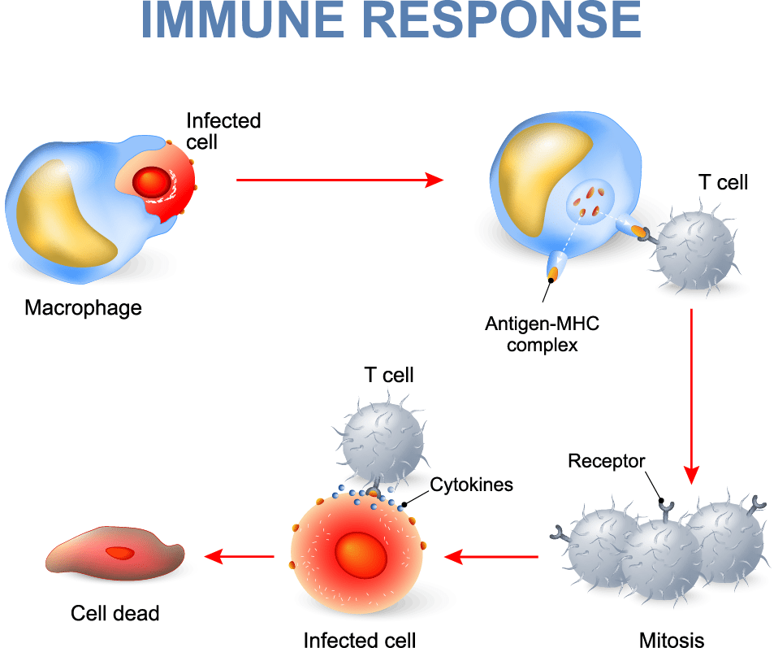
Adaptive immunity mechanisms
Cell-mediated immune response (CMIR)
T-lymphocytes
Elimination of intracellular microbes that survive inside phagocytes or other infected cells
Humoral immune response (HIR)
B-lymphocytes
antibody-mediated
Elimination of intracellular microbes or their toxins

Slide 12
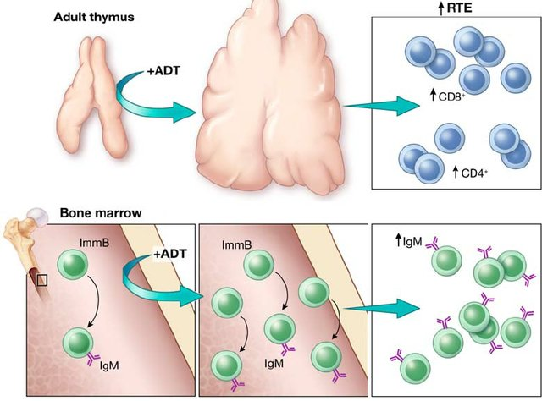
Adaptive immunity: mechanisms

Slide 13
Inflammation

Slide 14
Inflammation
Inflammation is a protective response intended to eliminate the initial cause of cell injury as well as the necrotic cells and tissues resulting from the original insult
The reaction of vascularized living tissue to local injury.

Slide 15
How inflammation accomplishes its protective mission?

Slide 16
How to accomplishes protective mission?
Inflammation serves to destroy, dilute or isolate the injurious agent (microbes, toxins) and eliminate the necrotic cells and tissues.
Inflammation is part of a broader protective response (innate immunity )
It starts a series of events which leads as far as possible to the healing and reconstitution of the damaged tissue.

Slide 17
Inflammation
During repair, the injured tissue is replaced by :
Regeneration of native parenchyma cells
Filling of the defect by fibroblastic tissue or both
Inflammation and repair are protective response

Slide 18
Can Inflammation cause considerable harm to the body?
They may induce harm
e.g. anaphylactic reaction
rheumatoid arthritis
atherosclerosis
pericarditis

Slide 19
How?
The components of the inflammatory reaction that destroy and eliminate microbes and dead tissues are capable of also injuring normal tissues.
This may accompany
entirely normal, beneficial inflammatory reactions, (e.g., when the infection is severe),
prolonged (e.g., when the eliciting agent resists eradication)
inappropriate (e.g., when it is directed against self-antigens in autoimmune diseases)
against usually harmless environmental antigens (allergic disorders)

Slide 20
Then what happens?
Inflammation is terminated when the offending agent is eliminated and the secreted mediators are broken down or dissipated.
There are active anti-inflammatory mechanisms that serve to control the response and prevent it from causing excessive damage to the host.

Slide 21
What are the cells and molecules that play important roles in inflammation?
blood leukocytes
plasma proteins
cells of vascular walls
cells of the surrounding connective tissue
extracellular matrix (ECM) of the surrounding connective tissue

Slide 22
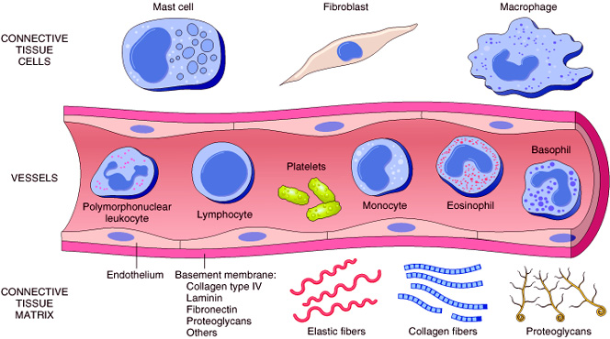
The connective tissue cells
The circulating cells:
The extracellular matrix

Slide 23
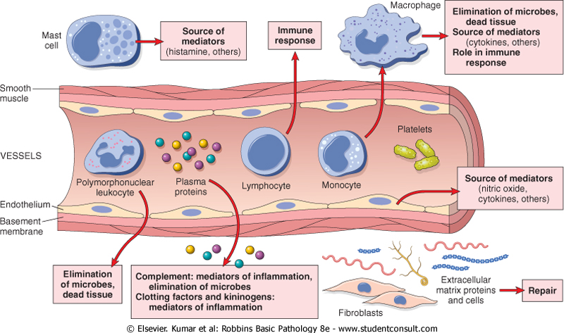
Cells and molecules that play important roles in inflammation

Slide 24
Tissues and cells involved in inflammatory response :
The fluid and proteins of plasma, circulating cells, blood vessels and connective tissue
The circulating cells: neutrophils, monocytes, eosinophils, lymphocytes, basophils, and platelets.
The connective tissue cells are the mast cells, the connective tissue fibroblasts, resident macrophages and lymphocytes.
The extracellular matrix, consists of the structural fibrous proteins (collagen, elastin), adhesive glycoproteins (fibronectin, laminin, nonfibrillar collagen, tenascin, and others), and proteoglycans

Slide 25
What are types of inflammation?
What is the difference between these types of inflammation?

Slide 26
Acute inflammation
rapid in onset (seconds or minutes)
relatively short duration, lasting for minutes, several hours, or a few days
its main characteristics:
the exudation of fluid and plasma proteins (edema)
the emigration of leukocytes, predominantly neutrophils.
is of longer duration
associated histologically with the presence of lymphocytes and macrophages, the proliferation of blood vessels, fibrosis, and tissue necrosis.
Less uniform.
Chronic inflammation

Slide 27
What is the source of chemical mediators in inflammation?

Slide 28
What is the action of chemical mediators in inflammation?
Some of mediators act on small blood vessels
Promote the efflux of plasma
Recruitment of circulating leukocytes to the site where the offending agent is located

Slide 29
What are the cardinal signs of inflammation?

Slide 30
Acute Inflammation
Local clinical signs of acute inflammation:
Heat
Redness
Swelling
Pain
Loss of function

Slide 31
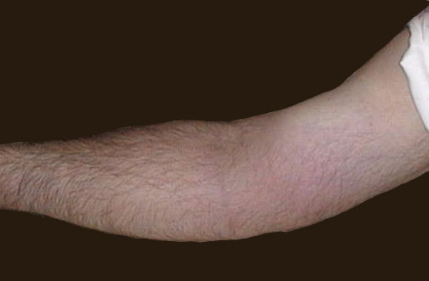
Redness
Notes:
The cardinal signs of inflammation are rubor (redness), calor (heat), tumor (swelling), dolor (pain), and loss of function. Seen here is skin with erythema, compared to the more normal skin at the far right.

Slide 32
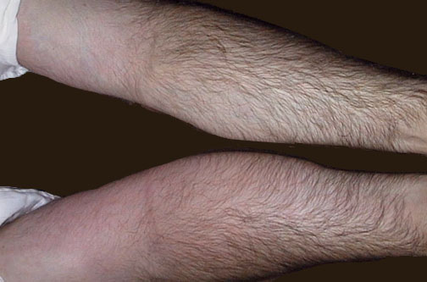
Swelling
Notes:
The arm at the bottom is swollen (edematous) and reddened (erythematous) compared to the arm at the top. Click to determine which areas are painful to touch.

Slide 33
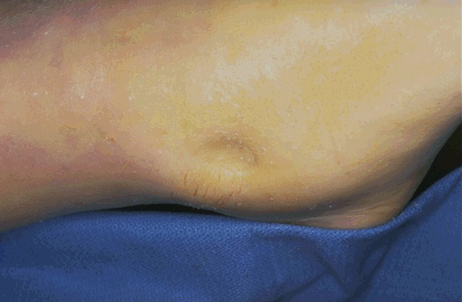
Swelling
Notes:
Here is simple edema, or fluid collection within tissues. This is "pitting" edema because, on physical examination, you can press your finger into the skin and soft tissue and leave a depression.

Slide 34
What are the steps of the inflammatory response which can be remembered as the five Rs?

Slide 35
Steps of the inflammatory response
(1) Recognition of the injurious agent
(2) Recruitment of leukocytes
(3) Removal of the agent
(4) Regulation (control) of the response
(5) Resolution

Slide 36
Learning Objectives:
Define inflammation, its causes and clinical appearance.
Describe the sequence of vascular changes in acute inflammation (vasodilation, increased permeability) and their purpose.
Know the mechanisms of increased vascular permeability.
Define the terms edema, transudate, and exudate.

Slide 37
What are the two major components of acute inflammation?

Slide 38
Components of acute inflammation
Vascular changes
Cellular events
Vasodilation: alterations in vessel caliber resulting in increased blood flow
Increased vascular permeability: permit plasma proteins to leave the circulation
Emigration of the leukocytes from the microcirculation and accumulation in the focus of injury
Principal leukocytes in acute inflammation are neutrophils (polymorphonuclear leukocytes).

Slide 39
Chronic inflammation
Is a pathogenic process of chronic duration (weeks, months, years)
Where attempts at healing, inflammation and persistent tissue damage occur in different proportions

Slide 40
Causes of chronic inflammation
Persistent infection
Toxic agents (pollutants, etc)
Immune-mediated inflammatory diseases

Slide 41
Primary chronic inflammation
Is the cause of tissue damage in some of the most common and disabling human diseases
Rheumatoid arthritis
Atherosclerosis
Primary pulmonary fibrosis
Tuberculosis
Also, the chronic inflammation has been implicated in progression of cancerous lesions

Slide 42
Mechanisms of chronic inflammation

Slide 43
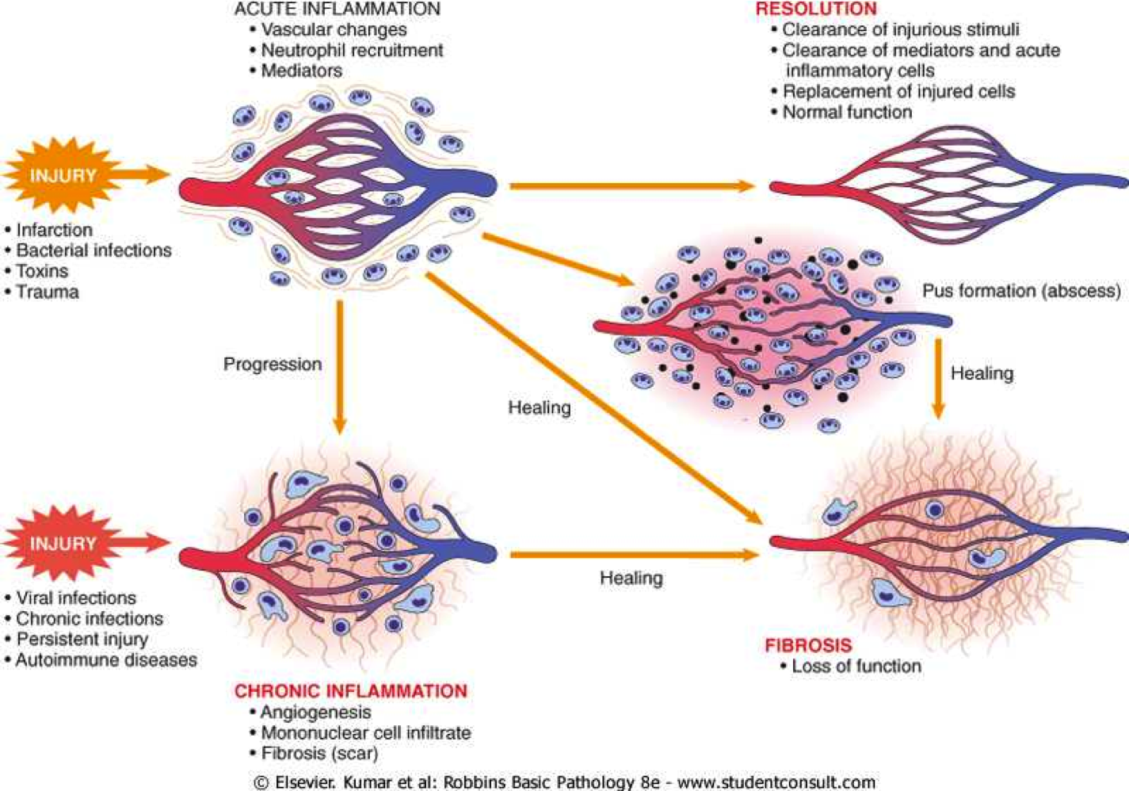
Morphological features of chronic inflammation

Slide 44
The role of macrophages in chronic inflammation

Slide 45
The role of macrophages in chronic inflammation

Slide 46
The role of macrophages in chronic inflammation

Slide 47
The role of macrophages in chronic inflammation

Slide 48
The role of neutrophils in chronic inflammation

Slide 49
The role of neutrophils in chronic inflammation

Slide 50
The role of neutrophils in chronic inflammation

Slide 51
Age-dependent consequences

Slide 52
SIRS – systemic inflammatory response syndrome
Generalized acute inflammatory reaction that spreads throughout the body
Intense inflammatory response to primary local, multiple or otherwise complex damage
In SIRS, subsequent inflammation is not limited to the area where the inflammation occurred, but spreads throughout the body
Even common inflammation spreads throughout the body - the difference from SIRS is that in SIRS, the mechanisms of inflammation control stop working

Slide 54
Pathogenesis of Covid-19 disease
Coronaviruses belong to the Coronaviridae family in the Nidovirales order
Corona represents crown-like spikes on the outer surface of the virus; thus, it was named as a coronavirus
Coronaviruses are enveloped viruses, minute in size (65–125 nm in diameter) and contain a single-stranded RNA as a nucleic material, size ranging from 26 to 32kbs in length

Slide 55
Covid-19
The virus that causes COVID-19 is known as SARS-CoV-2 It appears to have first emerged in Wuhan, China, in late 2019.
The outbreak has since spread across China to other countries around the world. By the end of January, the new coronavirus had been declared a public health emergency of international concern by the WHO.
The most commonly reported symptoms include a fever, dry cough and tiredness, and in mild cases people may get just a runny nose or a sore throat.
In the most severe cases, people with the virus can develop difficulty breathing, and may ultimately experience organ failure. Some cases are fatal.

Slide 56
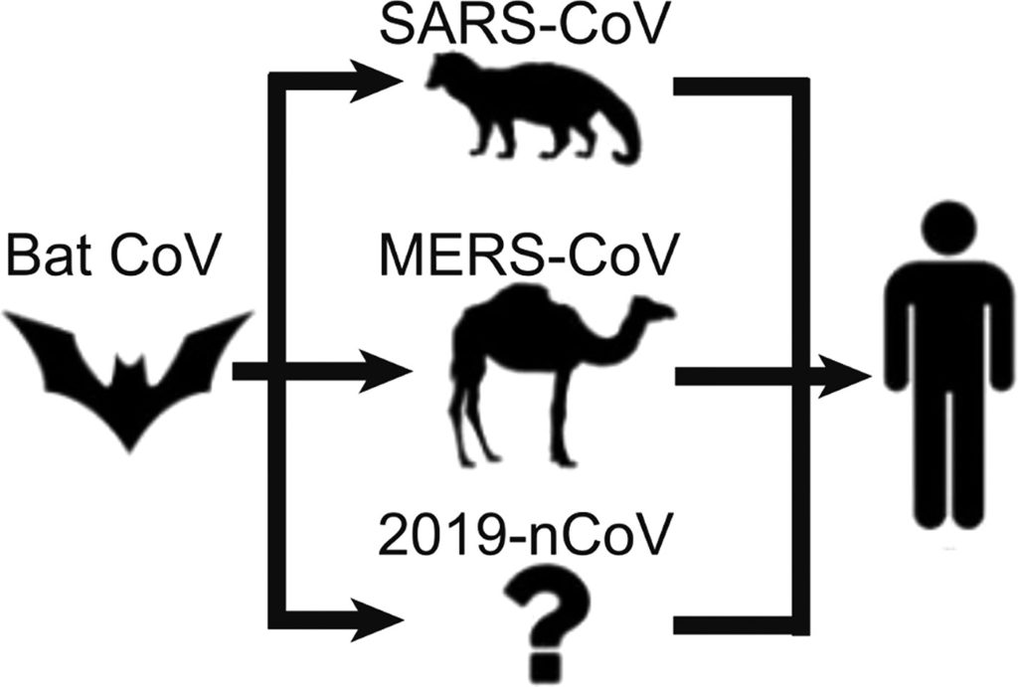
Human coronaviruses
The most likely ecological reservoirs for coronaviruses are bats, but it is believed that the virus jumped the species barrier to humans from another intermediate animal host.
This intermediate animal host could be a domestic food animal, a wild animal, or a domesticated wild animal which has not yet been identified.

Slide 57
Covid-19 timeline

Slide 58
Pathogenesis of Covid-19 disease

Slide 59
Pathogenesis of Covid-19 disease

Slide 60
Pathogenesis of Covid-19 disease
Coronavirus is one of the major pathogens that primarily targets the human respiratory system. Previous outbreaks of coronaviruses (CoVs) include the severe acute respiratory syndrome (SARS)-CoV and the Middle East respiratory syndrome (MERS)-CoV which have been previously characterized as agents that are a great public health threat. In late December 2019, a cluster of patients was admitted to hospitals with an initial diagnosis of pneumonia of an unknown etiology.

Slide 61
Pathogenesis of Covid-19 disease

Slide 62
SIRS and Covid-19

Slide 63
Pathogenesis of Covid-19 disease – key steps

Slide 64
SIRS
Generalized deregulated destructive process
Often associated with the devastation of distant organs
In hypersensitivity individuals, SIRS may occur even with very small amounts of antigen
Classification:
1) septic SIRS - associated with infection
2) unseptic SIRS - after severe trauma, hypoxemia, burns, poisoning, incompatible transfusion

Slide 65
Septic SIRS
Disseminated microbial infection
50% - gram-positive bacteria, 30% - gram-negative bacteria, 5% - polymicrobial infections, 5% yeasts and fungi and 1% anaerobes
1/3 of those affected die
Primary SIRS
Secondary SIRS

Slide 66
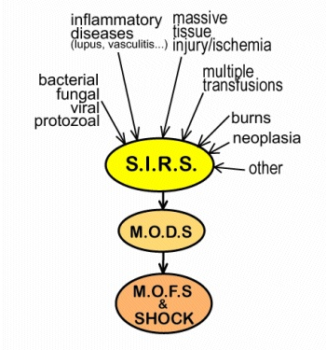
MODS

Slide 67
SIRS, MODS and Covid-19

Slide 69
Thank you for you attention

