Slide 1

The main health problems of elders.
Geriatric syndromes.
Frailty and its prophylaxis.
The modern strategy of health support
and increasing of independence of seniors
Brno, October-November 2017

Slide 2
Cardiovascular diseases
hypertension
ischemic heart disease – acute coronary syndrome
- cardiac failure
- arrythmias
valvular disorders

Slide 3
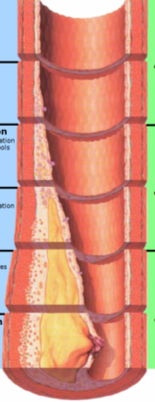
Vascular changes development
1. decade
3. decade
4. decade
6. decade
8. decade
1. decade
3. decade
4. decade

Slide 4
Hypertension
 | BPs | BPd
optimal | below 120 | below 80
normal | below 130 | below 85
normal for seniors | 130-150 | 75-85
borderline | 130-139 | 85-89
hypertension I | 140-159 | 90-99
hypertension II | 160-179 | 100-109
hypertension III | above 180 | above 110
isolated systolic hypertension
unstable hypertension
compliance problems
ischemic brain attack
haemorrhagic brain attack
cardiac failure

Slide 5
Risks
unstable blood pressure values – collapsing
orthostatic hypotension
interaction with prostatic medications – uncontrolled BP decrease – dizziness, falls
bradycardia – beta blockers
serum mineral dysbalancies – arrythmias
……..

Slide 6
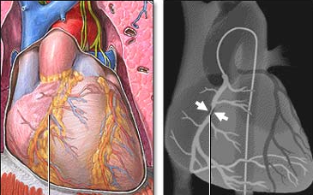
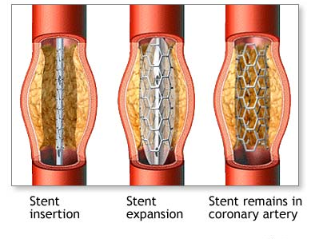
Ischaemic heart disease
stable angina pectoris – atypical symptomatology – dyspnea, confusion, falls, overal weakness
acute coronary syndrome – unstable angina pectoris, myocardial infarction – decrease of cardiac output – possibility of confusion or collapse, danger of malignant arrythmia
PTCA – coronary angioplasty – all ages!!

Slide 7
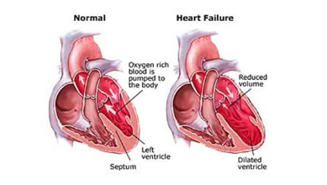
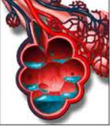
Cardiac failure – left ventricle
causes – hypertension, ischemic heart disease, valvular disorders
symptoms - dyspnoea, orthopnoea, night cough, confusion, sleeping disorders, pulmonary oedema

Slide 8
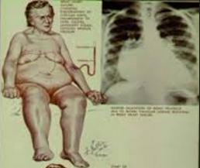
Cardiac failure – right ventricle
causes – chronic obstructive pulmonary disease
right ventricle – swellings of legs, peripheral cyanosis, ascites, anasarca, hydrothorax

Slide 9


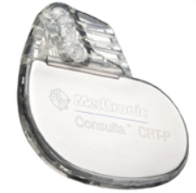
Arrythmias
tachyarrythmias, bradyarrythmias
unstability, falls, confusion, cognitive decline, consciousness disturbances – palpitations less frequent
the most frequent diagnosis during checking blood pressure
atrial fibrillation – risk of ischemic brain attacks, antiaggregation, anticoagulation – warfarin, oral antikoagulants
pacemaker, cardioverter implantation – all ages!!

Slide 10
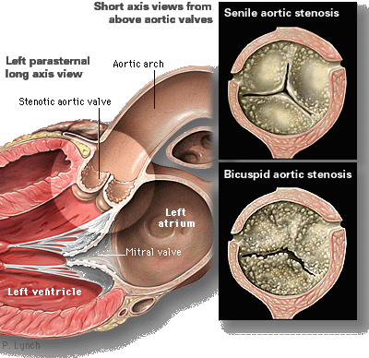
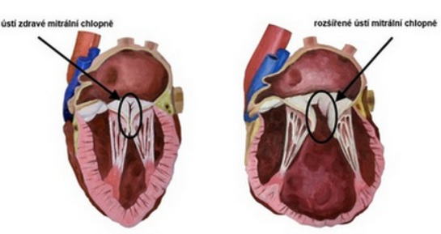
Valvular disorders
aortic stenosis – short unconsciousness, vertigo
mitral insufficiency – dyspnea, tendency to pulmonary oedema

Slide 11
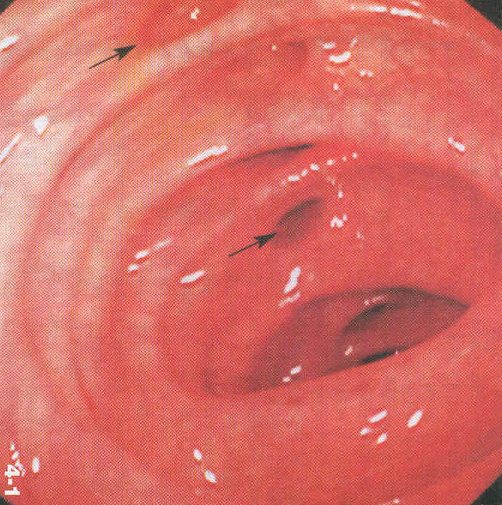
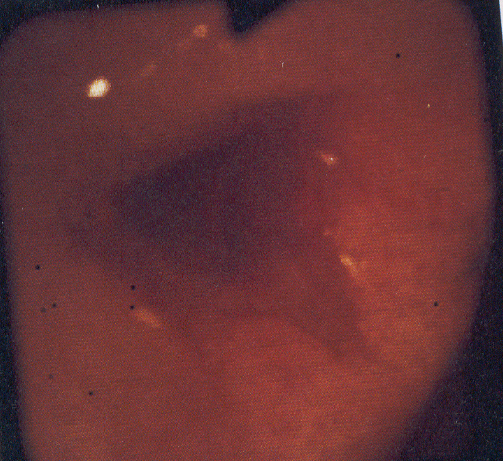
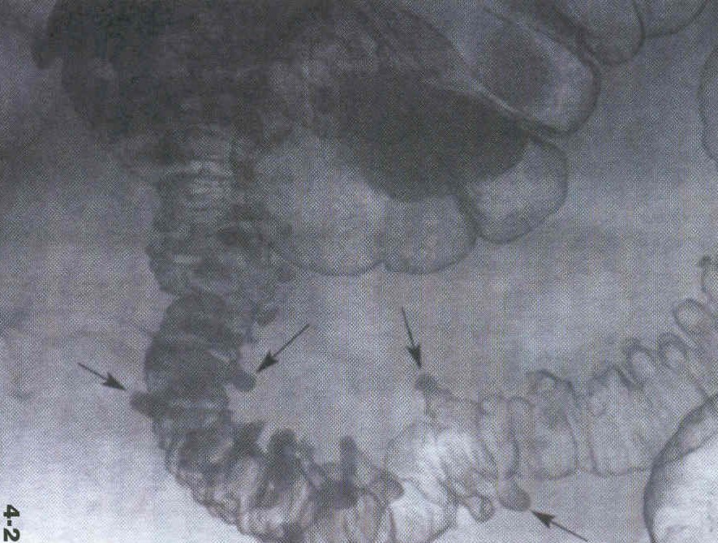
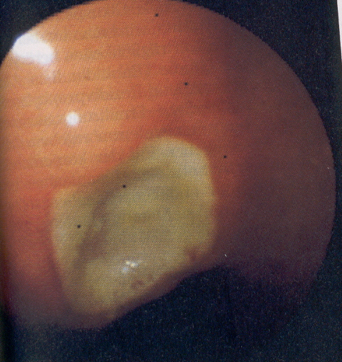
Gastrointestinal diseases
loss of teeth, xerostomia
swollowing difficulties
gastroesophageal rephlux
senile gastric ulcers
maldigestion, malabsorption
ischaemic colitis, vascular ileus
diverticulosis

Slide 12
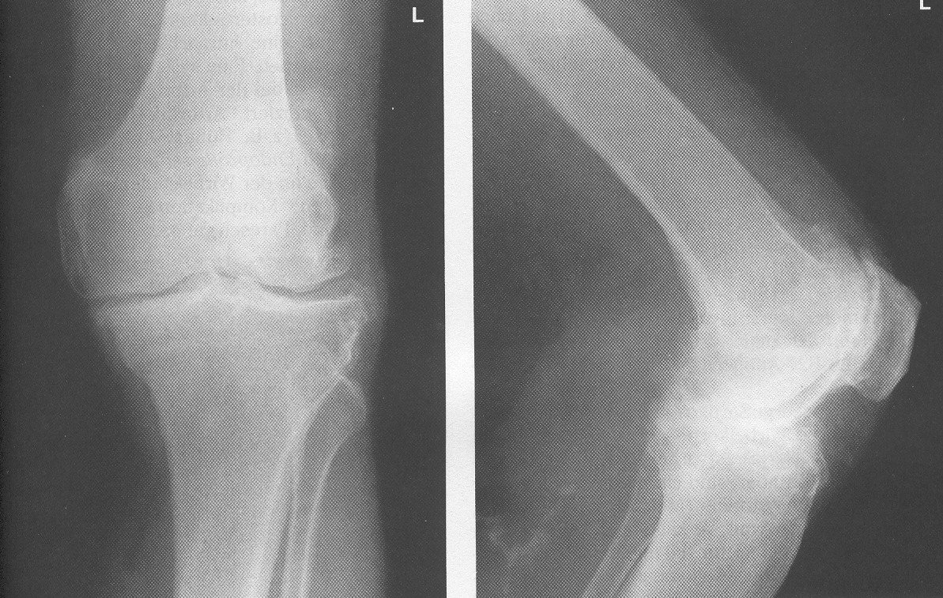
Diseases of locomotor system – osteochondrosis, spondylarthrosis
limited reparation of cartilago
osteochondrosis – Alzheimer dementia of cartilago
coxarthrosis, gonarthrosis – long life body overweight, burden
spondylosis, spondylathrosis
up to 70% of seniors – NSAIDs OTC
pain, immobility, falls, depression

Slide 13
Bone remodelation
peak bone mass – up to 30 years of age only
permanent controlled bone osteoclasts resorption followed by creation of new bone by osteoblasts – cycle duration 3-4 months
bone remodelation units
30% of remodelation runs in compact bone, 70% in spongious bone

Slide 14
Peak bone mass – up to 30 years of age

Slide 15
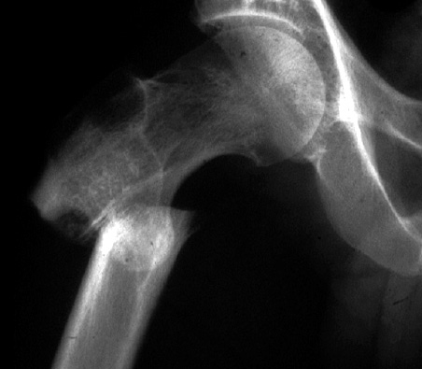
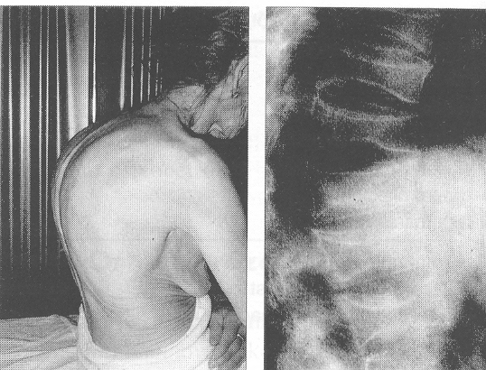
Diseases of locomotor system - osteoporosis
postmenopausal osteoporosis – vertebral fracture
½ women with physiological menopause
2/3 women with arteficial menopause
senile osteoporosis – hip fracture
½ of women
1/3 of men

Slide 16
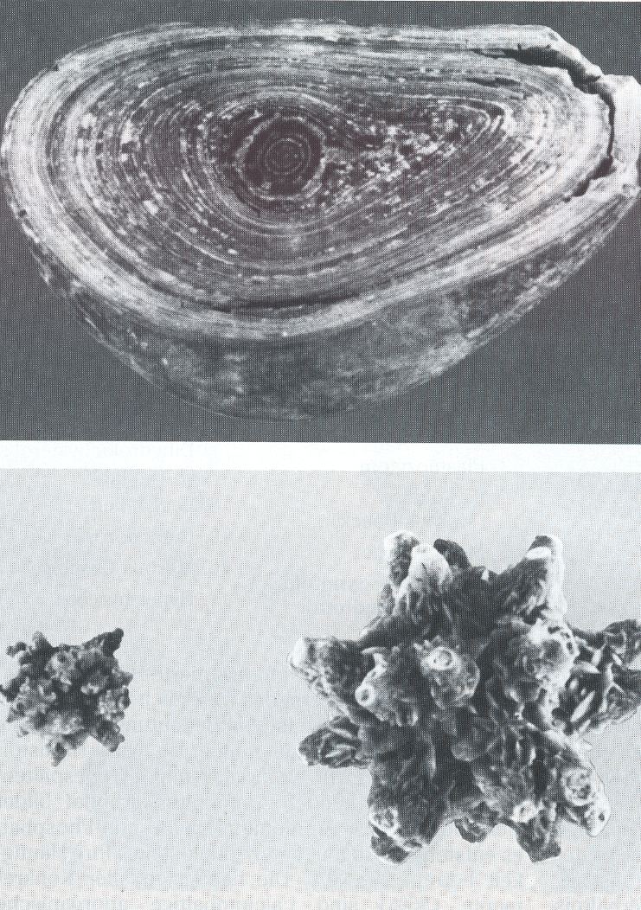
Urogenital diseases in elderly
UTI – urogenital tractus infections with atypical symptoms
repeated – permanent subclinical dehydration
- decreased defence of urinary mucosa
- slower flow of urine
- microbial colonization of bladder and urethra
- permanent catheterization
- high concentration of urine, lithiasis

Slide 17
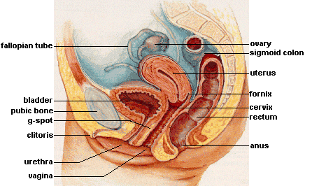
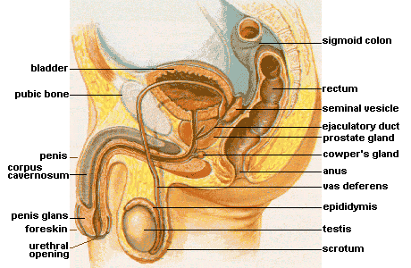
Incontinentia
stress incontinentia – in women, cough, lough
- weak muscles of pelvic bottom
- shorter urethra
- less effective constriction
urgent incontinentia – in men
- prostatic hyperplasia
- permanently higher tonus of detrusor
mixed incontinentia – in 40% of elderly

Slide 18
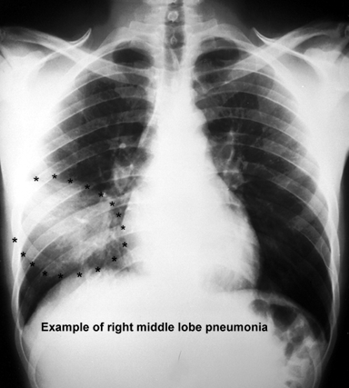
Respiratory diseases
chronic obstructive pulmonary disease, cor pulmonale
lung stifness, decrease of vital capacity
worse function of ciliary epitel – mucus retention – pneumoni
aspiration risk

Slide 19
Metabolic diseases
metabolic syndrome
hypertension
diabetes mellitus
hyperlipidaemia
truncal obesity
hyperuricaemia
cardiac failure
atherosclerosis acceleration
increase of insulin resistence
cognitive decline acceleration
loss of independency
worsening of locomotor problems

Slide 20
Interdisciplinary syndromes – geriatric giants
instability
cognitive decline
imobilisation
incontinency, skin integrity loss

Slide 21
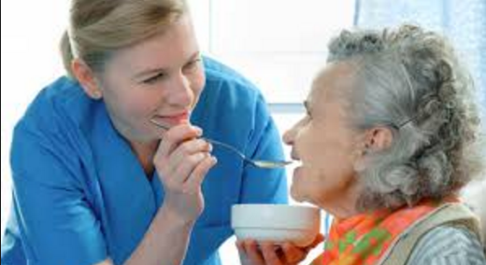
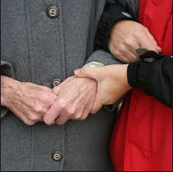
Interdisciplinary syndromes
somatic
eating, drinking disorders
termoregulation disturbances
psychical
depression
behavior disturbance , maladaptation
social
loss of independency
social isolation
family dysfunction, elderly abuse

Slide 22
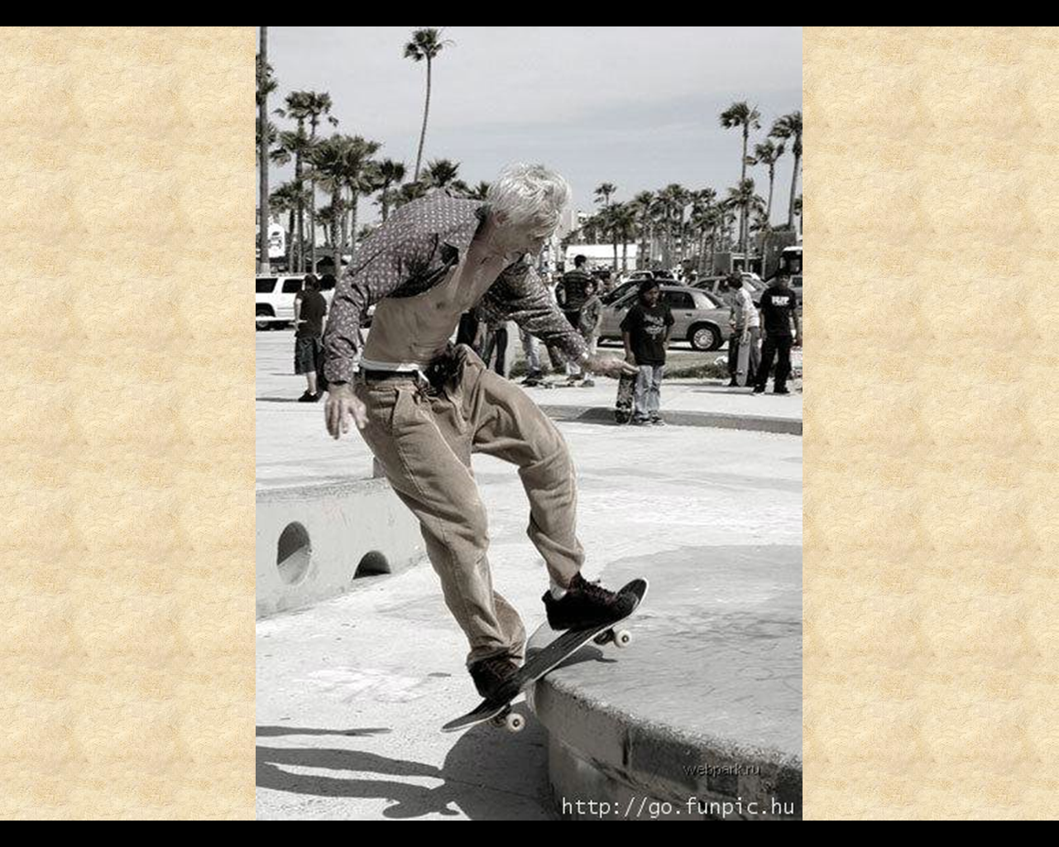
Instability and falls
backbone disorders
vascular origine
heart diseases
brain damage
external influences

Slide 23
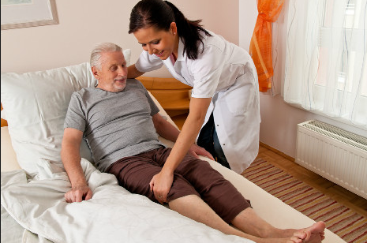
Immobility
caused by trauma
serious osteoporosis with fractures
caused by brain attacks
ancle diseases
chronic internal diseases
imobilisation syndrome – unfavourable cascade leading to death

Slide 24
Incontinency
allways to solve - urology, gynecology
nursing issue
social issue
economical issue

Slide 25
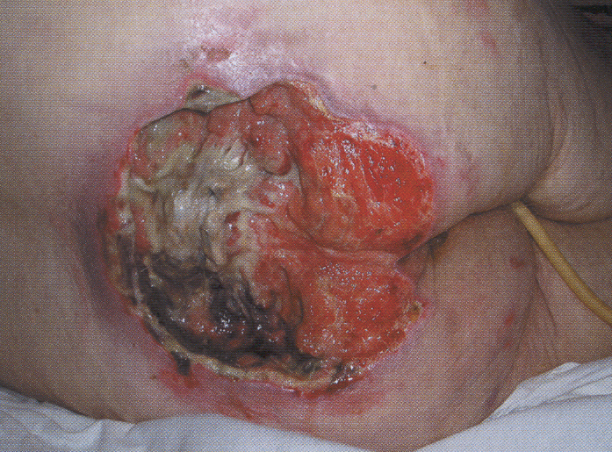
Skin integrity disorders
sore ulcers, leg ulcers
slower skin renovation
decreased skin barriere function
slower wound healing
decreased immunological reaction
less effective termoregulation
lower mechanical resistence

Slide 26
Frailty – aging biomarker
common geriatric syndrome that embodies an elevated risk of catastrophic declines in health and function
increases incrementally with advancing age
connected with weakness, slowing, decreased energy, lower activity, and unintended weight loss – if 3 or more are present,the risk of death is high
increased vulnerability to stressors (e.g. extremes of heat and cold, infection, injury, or even changes in medication)
components – sarcopenia, osteoporosis, muscle weakness
not only fragility of bones

Slide 27
Risk factors for frailty
physiologic impairments
activation of inflammation and coagulation systems,
anemia
atherosclerosis
autonomic dysfunction
hormonal abnormalities
obesity
hypovitaminosis D in men
chronic diseases
cardiovascular disease
diabetes mellitus
chronic kidney disease
depression
cognitive impairment
environment-related factors such as life space and neighborhood characteristics

Slide 28
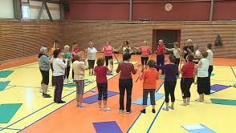
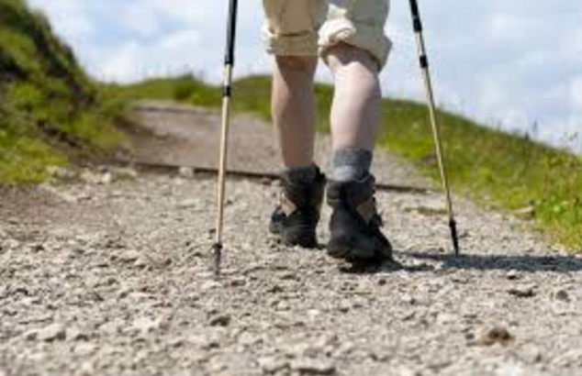
Prevention of frailty
treatment and close follow up of chronic diseases
vitamin D serum levels above 50-75 nmol/l maintenance
management of chronic inflammation
management of coagulation disorders
stable compensation of diabetes mellitus
metabolic syndrome management
promotion of physical activity as a prevention of sarcopenia, osteoporosis and muscle weakness

Slide 29
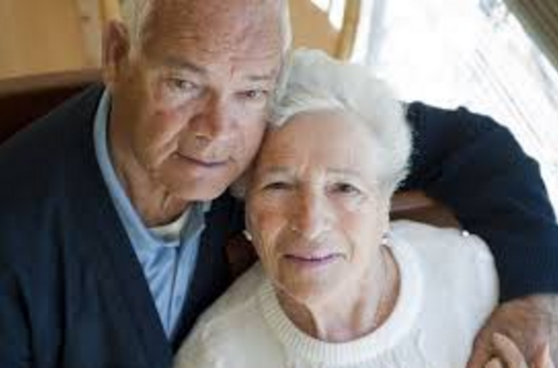
Thank you for your attention

