Slide 4
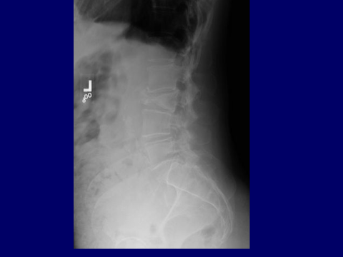

Slide 14
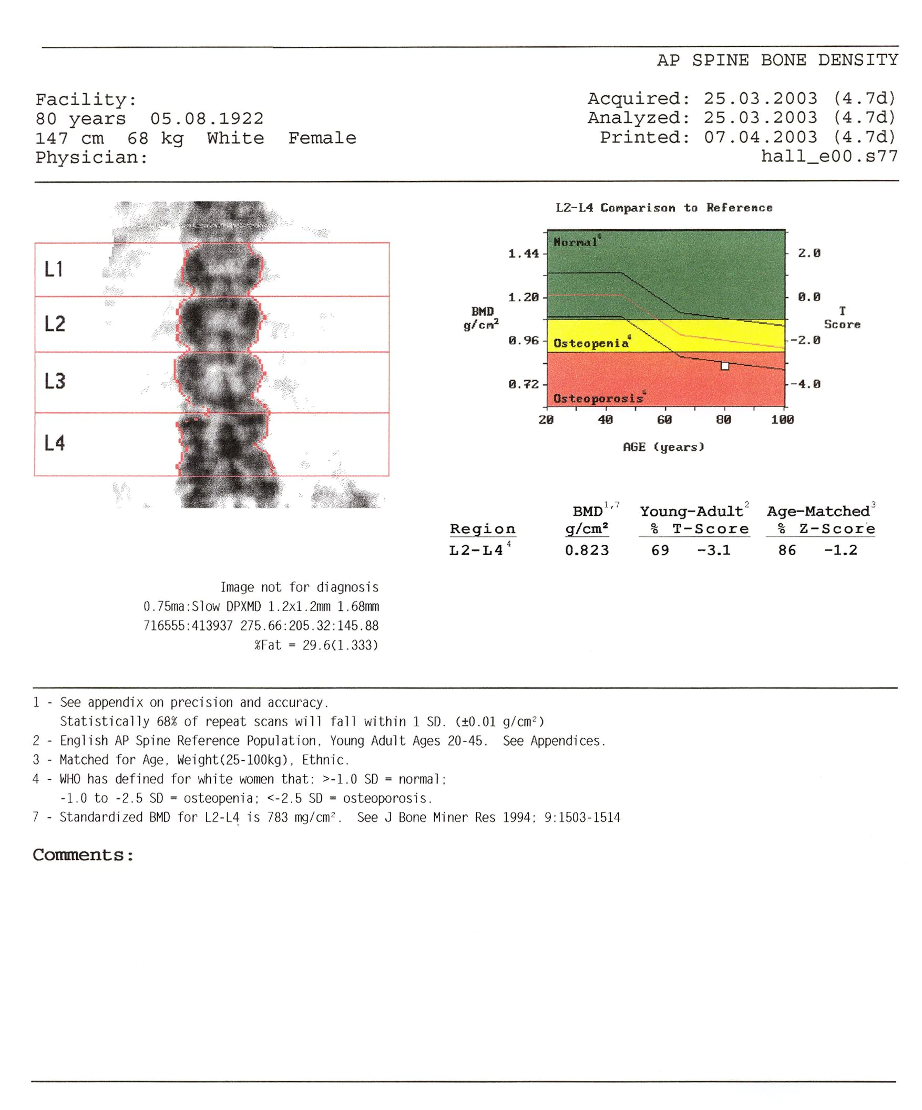
Definition | Bone Mineral Density Measurement | T-Score
Normal | BMD within 1 SD of the mean bone density for young adult women | T-score ≥ –1
Low bone mass (osteopenia) | BMD 1–2.5 SD below the mean for young adult women | T-score between –1 and –2.5
Osteoporosis | BMD ≥2.5 SD below the normal mean for young-adult women | T-score ≤ –2.5
Severe or “established” osteoporosis | BMD ≥2.5 SD below the normal mean for young-adult women in a patient who has already experienced ≥1 fracture | T-score ≤ –2.5 (with fragility fracture[s])

Slide 16
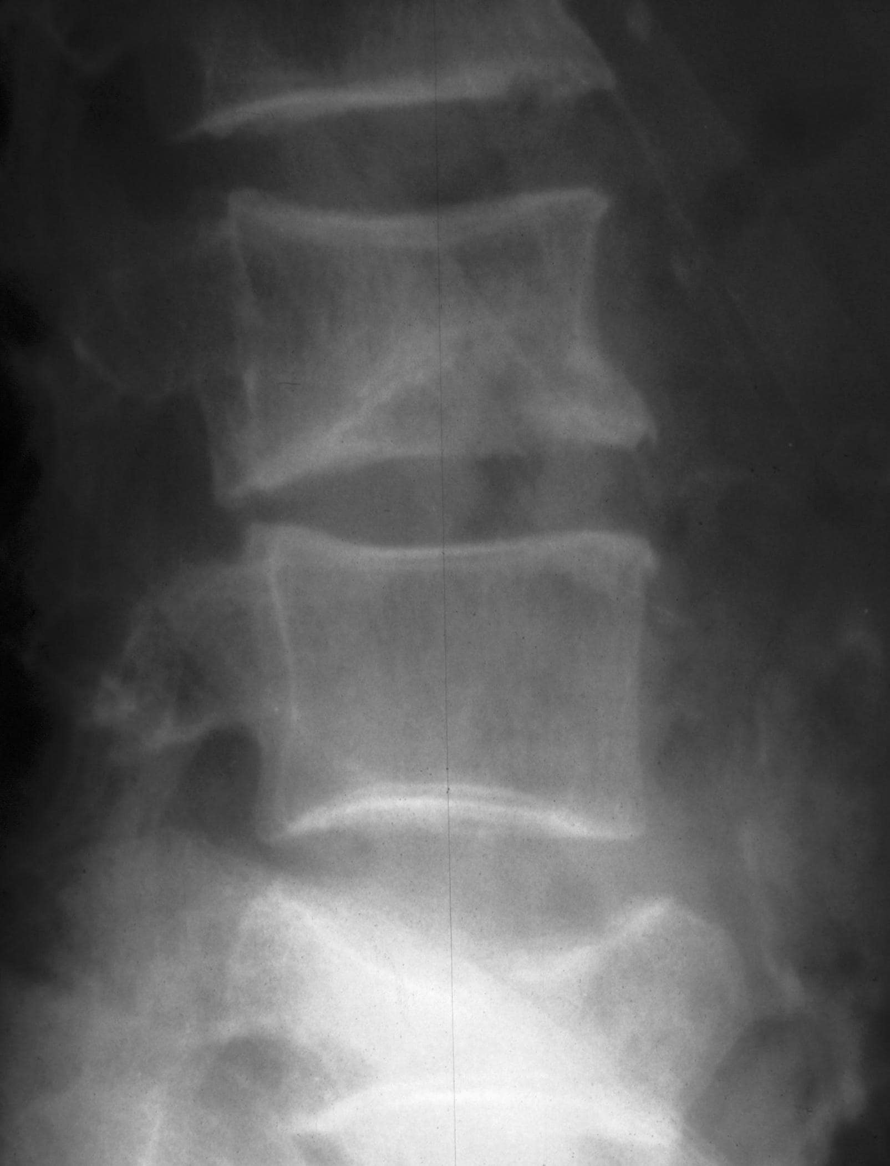
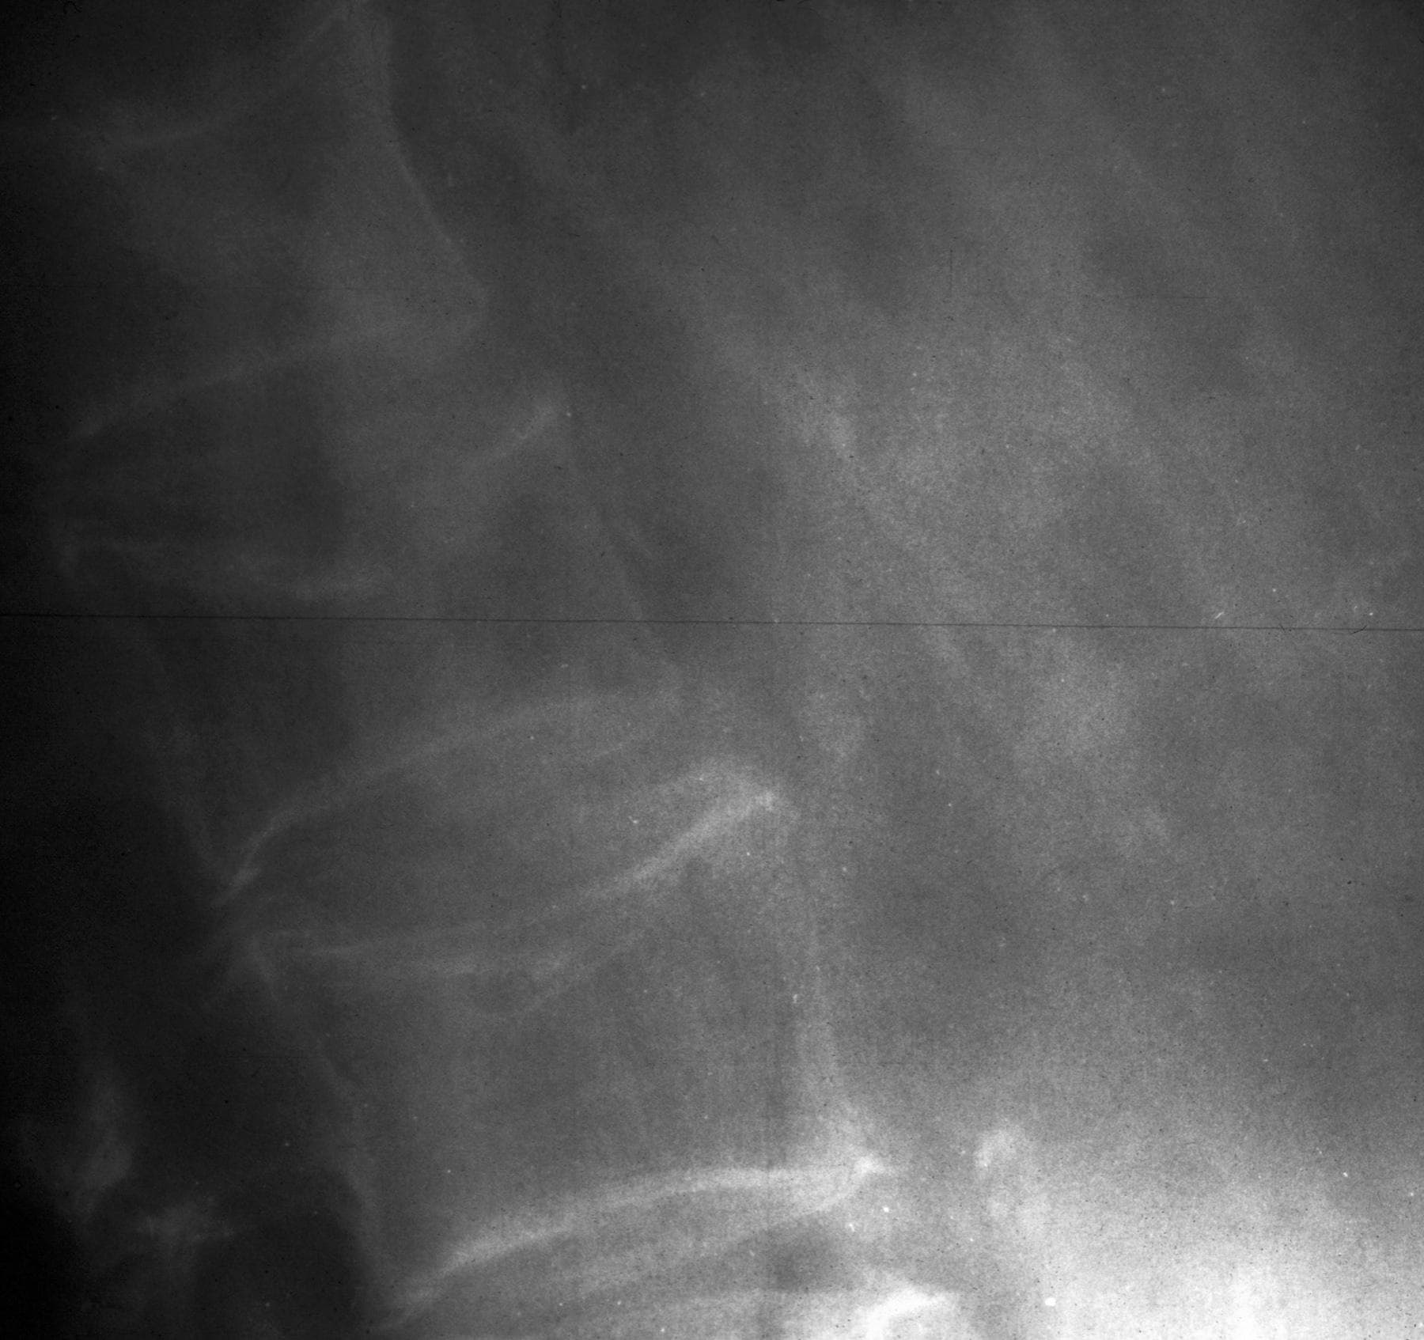

Slide 22
Riziko zlomenin u pacientů užívajících glukokortikoidy v závislosti na dávce
6
Prednisolon <2.5 mg
Prednisolon 2.5–7.5 mg
Prednisolon >7.5 mg
5
4
3
Relativní riziko zlomeniny
2
1
0
krček kosti stehenní
páteř
1. van Staa TP, et al. J Bone Miner Res. 2000;15:993-1000.
Notes:
Míra ztráty kostní hmoty a riziko zlomeniny se vztahuje k dávce glukokortikoidů. U rizika vertebrálních zlomenin zjevně i nejmenší hodnocená dávku glukokortikoidů zvyšuje riziko zlomeniny
Background¹:
This was a retrospective cohort study conducted in a general medical practice setting in the United Kingdom. There were over 240,000 systemic (oral) and an equivalent number of nonsystemic (topical, aural, ophthalmic, or nasal) GC users who were matched by age, gender, and clinical practice. The average age was 57.1 and 56.9 years on the systemic and nonsystemic cohorts, respectively. In both cohorts 58.6% were female.
There was a dose-dependent increase in risk of hip and spinal fractures. An oral dose of prednisolone (approximately equivalent to the potency of prednisone) as low as 2.5 mg/day was associated with an increased risk of vertebral fracture.
Relative to control (no steroid), RRs for vertebral fracture were 1.55 (95% CI 1.20-2.01), 2.59 (95% CI 2.16-3.10), and 5.18 (95% CI 4.25-6.31) for <2.5-mg, 2.5–7.5-mg, and >7.5-mg prednisolone, respectively.
Relative to control (no steroid), RRs for hip fracture were 0.99 (95% CI 0.82-1.20), 1.77 (95%CI 1.55-2.02), and 2.27 (95% CI 1.94-2.66) for <2.5-mg, 2.5–7.5-mg, and >7.5-mg prednisolone, respectively.
All fracture risks declined toward baseline rapidly after cessation of oral corticosteroid treatment.
UK General Research Practice Database
GC users matched by age, gender, and clinical practice to non-GC users (n=244,235 in each arm)
~60% female, mean age 57 years
Reference:
van Staa TP, Leufkins HG, Abenhaim L, et al. Use of oral corticosteroids and risk of fractures. J Bone Miner Res. 2000;15:993-1000.

