Slide 1
Drugs used in diseases characterized by bronchial obstruction

Slide 2
Bronchial asthma
chronic inflammatory disease of airways
affecting 300 million people all across the globe
prevalence in CZ: 8 %, in children over 10 %
Characteristics:
bronchial hyper-reactivity
obstruction (often reversible)
inflammation
Symptoms:
shortness of breath (bronchoconstriction, mucous plug, oedema, airway remodeling due to the inflammation)
difficult and prolonged expiration → wheezing, whistling
cough (especially at night or in early morning)

Slide 3
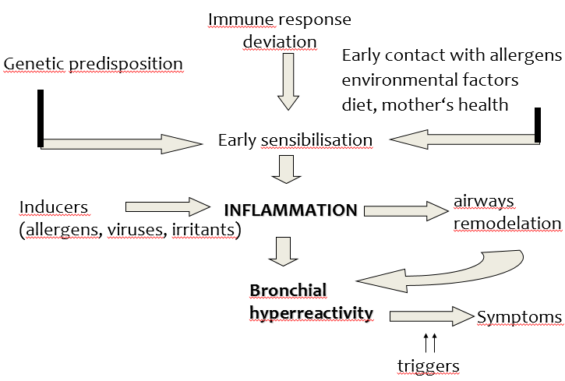
Bronchial asthma
ALERGIC ASTHMA
NON-ALERGIC ASTHMA
allergy not present
excercire-induced, aspirin-sesitive, infectious, work-related, endogenous

Slide 4
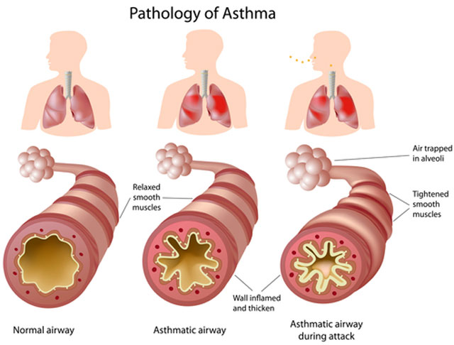
https://www.canstockphoto.com/anatomy-of-asthma-6231875.html

Slide 5
Diagnose
Anamnesis – personal, familiar
Clinical examinations - auscultation, signs of atopy, eosinophilia,
PEF – Peak Expiratory Flow
FEV 1 – Forced Expired Volume
Laboratory tests- eosinophilia, IgE
Allergy testing

Slide 6
Classification with regard
to seriousness
Intermittent – sign up to once a week, night symptoms up to twice a month, pulmonary function normal
Mild persistent– signs no more than once daily, night symptoms up to twice a month, PEF at least 80 %
Moderate persistent– signs once a day and are not permanent, night sign no more than once a week, PEF 60-80 %
Severe persistent– permanent signs, daily, obstruction, PEF ≤ 60 %

Slide 7
Managment of asthma
the disease itself cannot be fully treated, the goal is to keep asthma under control
Goals:
minimalize both acute and chronic symptoms
reduction of exacerbations (lessen SABA administration)
improvement of the quality of life (physical activity)
avoid adverse effects of the treatment

Slide 8
Chronic obstructive pulmonary
disease (COPD)
affecting 600 million people all across the globe
prevalence: 8 %
risk factors: smoking, polluted air, dust and chemical vapors at workplace, genetic predisposition
Characteristics:
chronic inflammation caused and maintained by long-term exposure to harmful agents (irritating gases and particles)
poorly reversible, progressing bronchial obstruction
production of mucus
Symptoms:
cough (usually whole day, hardly ever only during night)
expectoration
shortness of breath

Slide 9
Managment of COPD
we can only slow the progression
reduction of risk factors is necessary (mainly top quit smoking)
Goals:
symptom reduction
improvement in physical condition and overall health state
prevention of complications and exacerbations

Slide 10
Administration
oral, parenteral (injections, infusions)
inhalation
- local administration, high drug concentration at the site
of action
- fast onset of the effect
- minimal penetration to systemic circulation → ↓ risk of side effects

Slide 11
Drugs used in diseases characterized
by bronchial obstruction
BRONCHODILATATORS
- β₂ sympathomimetics
- parasympatholytics
- glucocorticoids
- methylxanthines
- roflumilast (COPD only)
- antileukotrienes
- imunoprofhylactics
- monoclonal antibodies
- noselective sympathomimetics (epinephrine, life-saving medication)
- adjuvant medication (antitussics, drugs facilitating expectoration)
asthma only

Slide 12
β₂ sympathomimetics
MoA: selective β₂ stimulants
- inhibition of mediator release from mast cells + stimulation of ciliary beat frequency
- diagnostics – post-bronchodilator test (salbutamol)
- mostly inhaled, may be also given orally (mainly in kids)
- not completely selective in their binding to β receptors
long-term use = down-regulation of receptors

Slide 13
β₂ sympathomimetics
Indication: asthma, COPD
AE: nervousness, tremor, cephalgia, palpitation, hypokalemia (mainly when given orally)
CI: hypertension, dysrhythmia, pregnancy

Slide 14
β₂ sympatomimetics
Short-acting = SABA (also rapid-acting = RABA)
fast onset of effect, which lasts 4 – 6 hours, inhalation
salbutamol
fenoterol
Long-acting = LABA
effect lasts for up to 12 hours, inhaled or administered orally
salmeterol
clenbuterol
formoterol (RABA)
indakaterol (U-LABA)
vilanterol (U-LABA)

Slide 15
Parasympatholytics
MoA: competitive antagonism of M receptors
- in a form of inhalation
- can be combined with β₂-sympathomimetics or glucocorticoids
Indication: COPD, asthma
AE: if entering the systemic circulation (low risk, they contain quaternary nitrogen in their structure) – anticholinergic effects
CI: glaucoma, prostate hypertrophy, pregnancy

Slide 16
Parasympatholytics
ipratropium
- used in asthma as well – in patients resistent to β2 sympathomimetic treatment (approx. 1/6 of patients)
short acting (SAMA)
aclidinium (LAMA)
tiotropium (U-LAMA)
glykopyrronium-bromide (U-LAMA)
umeclidinium (U-LAMA)
COPD
only

Slide 17
Glucocorticoids
MoA: inhibition of phospholipase A2
by lipocortin
Effects I:
↓ cytokine, PG a LT secretion
↓ lipolytic and proteolytic enzyme secretion
↓ endothelial permeability
block of cell migration
↓ bronchial hyperreactivity,

Slide 18
Glucocorticoids
Effects II:
reduction of edema
prevention of chronic irreversible changes (hypertrophy and hyperplasia of bronchial smooth muscles, subendothelial fibrosis and thickening of mucous basal membrane)
increase in sensitivity of β₂ adrenergic receptors to β₂-SM

Slide 19
MoA at the cellular level
glucocorticoid + cytoplasma receptor
production of specific mRNA
production of some proteins (lipocortins)

Slide 20
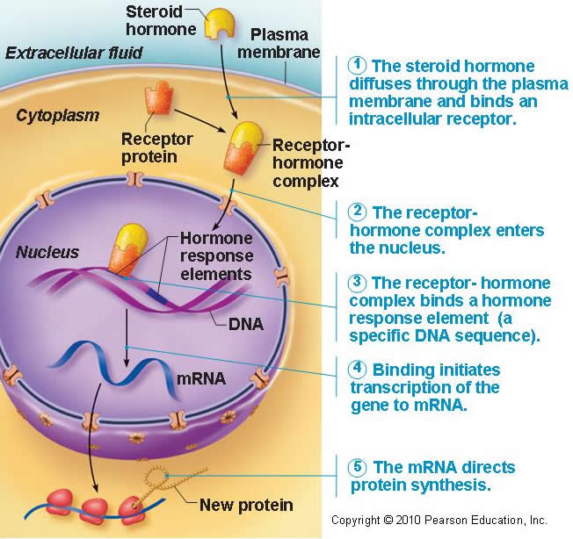
MoA at the cellular level
After entering the cell they bind to specific receptors in cytoplasm causing change of conformation = activation of receptors
Complexes of corticoid + receptor are transported to cell nucleus and bind to DNA elements.
The result is increased transcription of genes either inducing or inhibiting synthesis of other proteins
GLC receptors are present in all tissues!!!
Proteins called lipocortins are able to suppress phospholipase A

Slide 21
Antiinflammatory effect of GC
AA cascade inhibition
glucocorticoids
membrane phospholipids
lipocortin
phospholipase A2
arachidonic acid
Inh. 5-LOX
A-A
NSAIDs
lipooxygenase
PROSTAGLANDINE
PROSTACYCLINES
TROMBOXANES
cyclooxygenase
LEUKOTRIENS
Mobilization of fagocytosis
Changes in vessels permeability
Inflammation
inflammation

Slide 22
Glucocorticoids
given by inhalation
lower risk of systemic adverse effects
AE: affected vocal cords – croaky voice, oral candidiasis (thrush)
beclomethasone
budesonide
fluticasone
ciclesonide
mometasone
systemic administration
orally, via injection – acute conditions, doses are gradually decreased, in severe persistent asthma – if nothing else is effective
prednisone
triamcinolone
hydrocortisone (injection)

Slide 23
Methylxanthines
MoA: phosphodiesterase 1 – 4 inhibitors
adenosine receptors antagonists
sustained-release drug forms
Effects:
– bronchodilatation
– cardiostimulation (+chrono, +inotropic eff. )
– diuretic eff.
– CNS and respiratory center stimulation
– stimulation of hydrochloric acid secretion

Slide 24
Methylxanthines
Effects:
- substrates of CYP450 – be cautious if patient is a smoker!
CI: pregnancy, epilepsy, cardiovascular disease
AE: tachycardia, palpitations, sleeplessness

Slide 25
Methylxanthines
theophylline
- combination therapy with β₂ SM is convenient
- becoming obsolent, therapeutic drug monitoring needed
- variable pharmacokinetics, low therapeutic index
aminophylline
- a complex of theophylline and ethylendiamine (better solubility)
- COPD, emphysema

Slide 26
roflumilast
selective long-acting inhibitor of phosphodiesterase 4
reduces the inflammation in bronchi in COPD

Slide 27
Antileukotrienes
MoA: antagonism of LT-receptors / inhibition of lipoxygenase
LT receptor antagonists:
treatment of persisting asthma, allows lowering of glucocorticoid dose
1-2x a day, orally
montelukast
Inhibitors of LOX:
need for frequent application
not registered in CZ (zileuton – USA)

Slide 28
Imunoprophylactics (mast cells stabilizers)
MoA: stabilisation of mast cell membrane → ↓ Ca²⁺ influx → ↓ degranulation of mast cells and thereby ↓ histamine release
influence on lymphocyte function
prevention of asthma attack, they do not affect already present bronchospasm
Use: as preventive, long-term, maintenance therapy – mild and moderate asthma
when combined with other antiasthmatics, they allow lowering of their dose
CI: pregancy (1. trimester)
nedokromil, ketotifen (H1 antihistamine), cromoglycate

Slide 29
Monoclonal antibodies
Anti-IgE
omalizumab
antibodies against a part of IgE, which binds to mast cells
Indication: severe persistent allergic asthma, which cannot be otherwise controlled
administered subcutaneously in specialized centers only

Slide 30
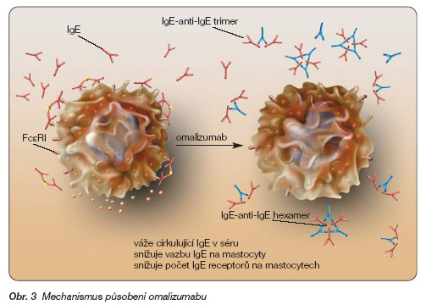
Anti-IgE
omalizumab
http://www.remedia.cz/Okruhy-temat/Respiracni-onemocneni/Omalizumab-terapeuticka-perspektiva-v-lecbe-tezkeho-bronchialniho-astmatu/8-1o-gD.magarticle.aspx

Slide 31
Monoclonal antibodies
Anti-IL-5
mepolizumab, reslizumab
add-on treatment for severe refractory eosinophilic asthma in adult patients

Slide 32
Other options
Bronchial thermoplasty
bronchoskopic procedure, during which a therapeutic radiofrequency energy is delivered to the airway wall, resulting in reduction of smooth mucle cells
Allergen immunotherapy
induces tolerance to the triggering allergen

Slide 33
Devices for inhaled medications
MDI = metered dose inhalers
drugs as solutions, propellants
BAI = breath-actuated inhalers
DPI = dry powder inhalers
spinhaler, diskhaler, turbohaler
nebulizers (liquid → aerosol)

Slide 34
Devices for inhaled medications
spacers for children and elderly
patient must be educated how to use their inhaler → up to 41 % of patients use incorrect technique
inhalers often combine two drugs (bronchodilator + glucocorticoid or two bronchodilators)

Slide 35
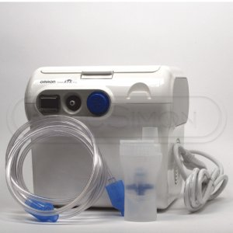
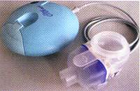
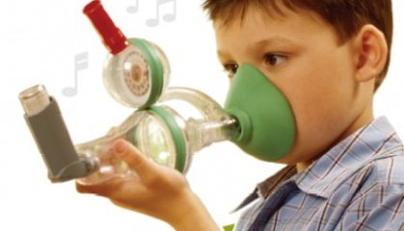

Slide 36
Adjuvant medication in diseases characterized
by bronchial obstruction and
another drugs affecting respiratory system
antitussives
drugs facilitating expectoration
H₁ antihistamines (mainly II. a III. generation)

