Slide 1

Antidepressants

Slide 2
Depression
loss of interest, happiness and motivation
loss of self-confidence, remorses, feeling of guilt
suicidal tendencies (in 2/3 patients)
loss of energy and tiredness
attention deficit, indecision
agitation (if anxiety is present)
sleep disorder (characteristic is early wake-up)
change in apettite
decrease of libido
the most common affective disorder
pesimistic mood with feelings of dejection, low self-worth or guilt for at least two weeks
different grades of severity
world-wide one of the most common causes of premature death
emotional and biological symptoms

Slide 3
Monoamine theory of depression
depression = monoamine deficit in particular parts of the brain
mania = hyperactivity of monoamines in the CNS
clinical evidence – substances decreasing monoamine activity = mood aggravation
the specific roles of 5-HT and NA are not clear
antidepressants directly or indirectly increase the monoamine activity

Slide 4
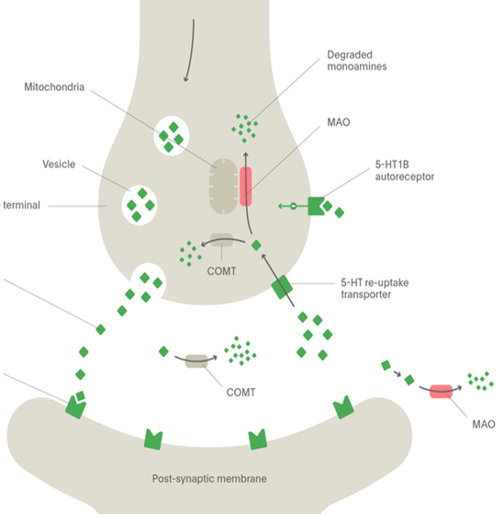
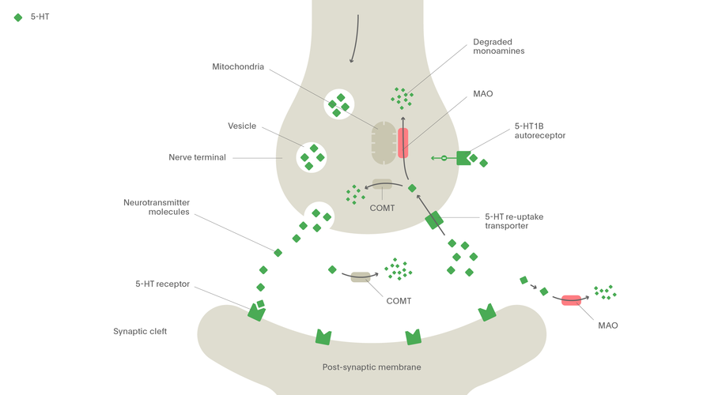
Mechanismus účinku antidepresiv
iMAO
MAO
SMS
MAO
5HT - AUTORECEPTOR
TCA
α2- AUTORECEPTOR
SNRI
NARI
Noradrenaline
Serotonin
NET
SERT
SSRI
SARI
MAO
5-HT1A
MAO
α1
β3
5-HT2A
5-HT2C
NASSA

Slide 5
Mode of action of antidepressants
most AD increase 5-HT, NA or D activity
General modes of action of antidepressants:
MAO inhibition (selective MAO A/ nonselective)
reuptake inhibition (SERT, NAT)
desensitisation/antagonism of presynpatic
autoreceptors (5-HT_{1D}, α₂)
agonism of postsynaptic receptors 5-HT_{1A}
antagonism of postsynaptic receptors 5-HT_{2A}
increase of
5-HT and/or NA
increased BDNF
activity

Slide 6
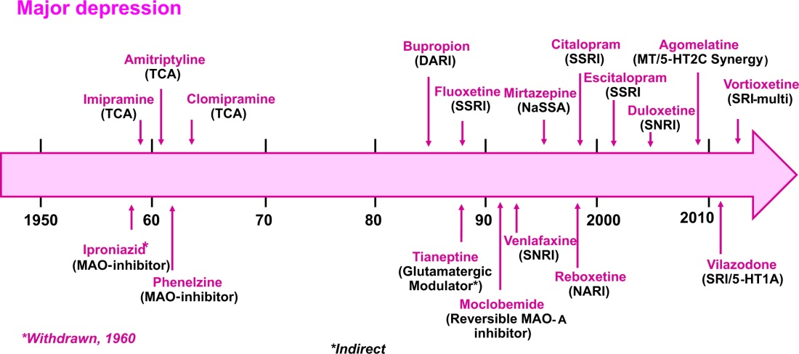
History of antidepressants
MILLAN, Mark J., et al. Learning from the past and looking to the future: Emerging perspectives for improving the treatment of psychiatric disorders.European Neuropsychopharmacology, 2015, 25.5: 599-656.

Slide 7
Efficacy of antidepressants
in general partial response or remission in 60-70% of patients
„only 30 %“ in the first line of antidepressant treatment
significant interindividual differences in treatment response
the efficacy of distinct groups of AD is equipotential
= criteria of AD selection
1. depression side symptoms (agitation, anxiety, insomnia)
2. decrease of adverse reactions risk

Slide 8
SSRI – selective serotonin reuptake inhibitors
inhibit also NAT, but more selective for SERT
PK and PD differences between single agents = one SSRI can be replaced by other in case of therapy failure
drugs of choice in most patients
great safety profile – but not tolerability
↑ risk of suicide in tennagers
risk of drug-drug interactions (iCYP 2D6 and 3A4 inhibitors)
I: depression, anxiety, OCD, PTSD, migraine, pain

Slide 9
SSRI
AE
GIT irritation
↑ bleeding, sex. dysfunction, anhedonia
Serotonin syndrome
induced by hyperactivity of serotonine in the CNS
high risk in combinations of serotonergic drugs (AD, triptans, analgesics)
Antidepressant discontinuation syndrome - FINISH

Slide 10
SSRI
fluoxetine
5-HT_{2A}antagonist, CYP2D6 strong inhibitor
sertraline
- the strongest SERT inhibitor
- weak DAT inhibitor, anxiolytic activity
paroxetine
- weak antimuscarinic effect = sedative; CYP2D6 strong inhibitor
citalopram
- the lowest risk of drug-drug interactions

Slide 11
SSRI - escitalopram
MofA: SERT selective inhibition
Indications: depression, anxiety
Administration: per os
PK: good absorption from GIT, low protein binding, complete biotransformation in liver (CYP2C19), active metabolites, dominantly excreted into urine
AE: prolongation of QT, serotonine syndrome
DDI: iMAO ↑risk of serotonine syndrome, CYP inhibitors
KI: till 18 years, gravidity, lactation

Slide 12
SNRI – serotonin and noradrenaline reuptake inhibitors
MofA – nonselective blockade of 5-HT and NA reuptake
„activating“ drugs
AE
stimulation of adrenergic receptors = insomnia, sex. impairment, ↓ apetite, hypertension
increased risk of suicide, discontinuation sydrome
venlafaxine + desvenlafaxine
duloxetine – also for neuropathic pain, hepatotoxic

Slide 13
NDRI – noradrenaline and dopamine reuptake inhibitors
bupropion
little effect on 5-HT
in comparison to other DAT and NAT inhibitors does not cause euphoria
in the treatment of smoking cessation
AE
risk of seizures
aggravation/development of psychotic signs

Slide 14
NARI – noradrenaline reuptake inhibitor
reboxetine
MofA – blockade of NAT: SERT = 20:1
M, H1 and α₁ antagonist
AE
stimulation of adrenergic receptros = insomnia, restlessness, anxiety
constipation, sex. dysfunction
atomoxetine –ADHD therapy

Slide 15
SARI – serotonine antagonist and reuptake inhibitor
trazodone
MofA
SERT inhibition
5-HT_{1A} agonism
5-HT_{2A} and _{2C} antagonis
H₁ and α₁antagonismus
AE: hypotension, sleepiness
CYP2D6 substrate, 3A4 inhibitor

Slide 16
mirtazapine
NASSA – noradrenergic and specific serotonergic antidepressants
MofA: block of presynaptic α₂ + postsynaptic 5-HT2A, 5-HT2C and 5-HT3
stimulation of 5-HT1
block of H1 and weak antagonism of α1
Administration: per os
PK: F from GIT app. 50%, protein binding, substrate of CYP3A4, CYP2D6 and CYP1A2, complete metabolization, some metabolites are active
AE: serotonine syndrome, sedation, ↑ weight
Interactions: serotonergic drugs, including St. John‘s wort, CYP inducers/inhibitors
KI: till 18 years, combination with iMAO
drug discontinuation– slow dose decrease
suitable in depression with insomnia, low risk of sex. disorders

Slide 17
SMS – serotonin modulator and stimulator
vortioxetine
MofA: inhibice SERT
5-HT_{1A}agonism
5-HT_{1D}, 5-HT₃ antagonism
AE: pruritus, nausea, live dreams
risk of serotonin syndrome
CYP2D6 substrate

Slide 18
MASSA-melatonine agonist and serotonin selective antagonist
MofA: MT₁ and MT₂ agonist
5- HT_{2C} antagonist
increased melatonin release and resynchronizes circadian rhythm
CYP1A2 substrate
risk of hepatotoxicity = monitoring of transaminases
in single dose when going to bed

Slide 19
TCA
MofA: 5-HT, NA and D reuptake inhibition
+ 5-HT2A antagonism and 5-HT1A agonism
+ antagonism of H₁, M, α₁ and 5-HT_{2C} => AE
serotonergic adrenergic
clomipramine imipramine, desipramine amitriptyline, nortriptyline

Slide 20
TCA
AE:
antiM – confusion, cognitive deficit, peripheral effects
antiH₁ – sedation, weight gain
antiα₁ – ortostatic hypotension
anti 5HT_{2C} - weight gain
proarrhythmogenic
significant acute toxicity
initial dose usualy titrated

Slide 21
TCA
liver metabolism - CYP2D6 and 3A4
plasma protein binding
long t_{1/2} = risk of drug accummulation
„older“ drugs, still in use
I: resistant depression
co-analgesics

Slide 22
iMAO
ireversible inhibitors today obsolete
reversible selective iMAO A – moclobemide
the strongest effect on 5-HT > NA > D
„cheese reaction“
positive effect on cognition
inhibitor of CYP2D6, 2C19 and 1A2
AE: hypotension, CNS stimulation, weight gain

Slide 23
Side effects of antidepressant therapy
Nonselective serotonergic activity (SSRI, iMAO, TCA, SNRI)
+ anxiolytic and antidepressant activity
- sex. impairment, emotional flatness, serotonin syndrome
Nonselective noradrenergic activity (TCA, NARI)
+ „activation“ of patient, antidepressant activity
- tremor, tachycardia, hypertension

Slide 24
Side effects of antidepressant therapy
Antihistaminergic activity = sedation, weight gain
α₁lytic activity= ortostatic hypotension and risk of falls
Antimuscarinic activity = cognitive deficit and peripheral effects
QT interval prolongation
SSRI, TCA

Slide 25
activating x sedative AD
fluoxetine
nortriptyline
venlafaxine
paroxetine, fluvoxamine, citalopram
dosulepin, maprotiline
trazodone
mirtazapine
agomelatine

Slide 26
Augmentation of antidepressant terapy
Antipsychotics
separately or in combination with antidepressants
in depression with psychotic symptoms, and in prophylaxis
atypical antipsychotics
Anxiolytics
in the begining of therapy of depression with significant anxiety component to decrease the risk of suicide
Phytopharmacology

