Slide 1
Microbes and Men
Martin Krsek
Masaryk University Brno, Faculty of Medicine
Department of Public Health
Notes:
Microbiota x microbiome

Slide 2
What is the main role of microbes?!
Degradation
Nutrient cycling
Photosynthesis
Interaction with plants and animals
Keeping live alive/running

Slide 3
How many microbial cells are on/in our body?
Numbers represent the number
of organisms per gram
of homogenized tissue or fluid
or per square centimeter of skin surface.
Skin – 10¹², mouth – 10¹⁰, intestine - 10¹⁴

Slide 4
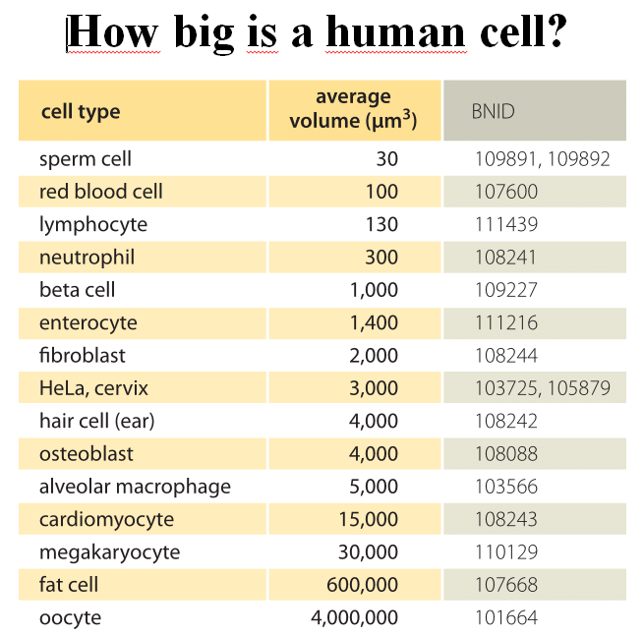
How many cells are in our body?

Slide 5
How many cells are in our body?
5 billion (10⁹) – 200 million trillion (10¹⁸) ?
Mean weight - 70 trillion cells (10¹²)
Mean volume – 15 trillion cells (10¹²)
Perhaps 37.2 trillion cells (10¹²)

Slide 6
Predominant bacteria at various anatomical location
in adults
A diverse microbial flora is associated with the skin
and mucous membranes of every human being
from shortly after birth until death. The human body,
which contains about 10¹³ cells, routinely harbors
about 10¹⁴ bacteria . This bacterial population
constitutes the normal microbial flora .
Normal Flora - Medical Microbiology - NCBI Bookshelf
https://www.ncbi.nlm.nih.gov/books/NBK7617/
Overall ratio men : microbes
1 : 1-10

Slide 7
Significance of the Normal Flora
The normal flora influences the anatomy, physiology, susceptibility to pathogens,
and morbidity of the host.
The normal microbial flora is relatively stable, with specific genera populating various
body regions during particular periods in an individual's life.
Three developmental changes in humans: weaning, the eruption of the teeth,
and the onset and cessation of ovarian functions
Even though most elements of the normal microbial flora inhabiting the human skin,
nails, eyes, oropharynx, genitalia, and gastrointestinal tract are harmless in healthy
individuals, these organisms frequently cause disease in compromised hosts.

Slide 8
Significance of the Normal Flora
Germ-free animals (intestinal atonia)
alimentary lamina propria is underdeveloped, little or no immunoglobulin is present
in sera or secretions, intestinal motility is reduced, and the intestinal epithelial cell
renewal rate is approximately one-half that of normal animals
Animals treated with streptomycin infected with streptomycin-resistant Salmonella.
10⁶ cells x fewer than 10 to establish a gastrointestinal infection
fermentation products (acetic and butyric acids) produced by the normal flora
inhibited Salmonella growth in the gastrointestinal tract.

Slide 9
Normal Flora of Skin
The adult human - 2 square meters of skin- permanent contact with environment
Skin regions = geographic regions of Earth: the desert of the forearm, the cool woods
of the scalp, and the tropical forest of the armpit.
- greasy, sweaty (head, neck,…) – production of sebum – Propionbacterium spp.
- wet regions – Corynebacterium spp.
- dry regions – the highest diversity – Staphylococcus spp.
Most bacteria on the skin are sequestered in sweat glands.
Gram-positive cocci: Staphylococcus epidermidis – life threatening disease in hospitals -
catheters and surgery; and Micrococcus sp.;

Slide 10
Normal Flora of Skin
- corynebacteria such as Propionibacterium sp. – considered non-pathogenic
- staphylococci and propionibacteria produce fatty acids that inhibit the growth of fungi
and yeast on the skin.
but, if Propionibacterium acnes - anaerob, a normal inhabitant of the skin, becomes trapped
in hair follicle, pores and glands, it may cause inflammation and acne
– but at the same time it prevents colonization by more dangerous pathogens.
- different communities even in different layers of skin
- also micromycetes – Malassezia spp.
- mainly on legs

Slide 11
Skin microbiota and immunity
P. acnes – strains on healthy skin – genes for thiopeptides – inhibition of G+ bacteria
(Staphylococcus epidermis)
- strains of P. acnes responsible for acne do not produce thiopeptides
S. epidermis – secretion of lipoteichoic acids - prevention of release of inflammatory
cytokins from skin cells
S.epidermis – on skin of axenic mouse – support of immunity (T-cells)
Various microbes influence different part of immune system.
Some microbes produce antimicrobial substances, other induce release of cytokins
connected with illnesses.
Skin probiotics? Return to the original status?

Slide 12
Normal Flora of the Conjunctiva
Historicaly - small numbers of Staphylococcus epidermidis and certain coryneforms
(Propionibacterium acnes)
blinking wipes the conjunctiva every few seconds
lachrymal secretions (tears) also contain bactericidal substances including lysozyme
Neisseria gonorrhoeae and Chlamydia trachomatis are thought to be able to specifically
attach to the conjunctival epithelium
Today – rich microbiota including viruses
Conjunctiva and cornea – about 12 slightly different bacterial genera
1/3 of them – impossible to classify

Slide 13
Normal Flora of the Respiratory Tract
upper respiratory tract (nasopharynx), mainly nares (nostrils) heavily colonized
- Staphylococcus epidermidis and corynebacteria
- 20% of the general population - Staphylococcus aureus (MRSA)
- healthy sinuses sterile
- pharynx (throat) - streptococci and various Gram-negative cocci
- sometimes pathogens (Streptococcus pneumoniae, Streptococcus
pyogenes, Haemophilus influenzae and Neisseria meningitidis)
lower respiratory tract (trachea, bronchi, and pulmonary tissues) nearly free of
microorganisms (cleansing action of the ciliated epithelium, coughing, sneezing, swallowing)
- islands of microbes – Streptococcus spp., Prevotella spp., Veillonella spp.
- damaged epithelium - H. influenzae or S. pneumoniae descending from the nasopharynx

Slide 14
Normal Flora of the Urogenital Tract
Urine - sterile, microorganisms have problems gaining access and becoming established.
Anterior urethra - Staphylococcus epidermidis, Enterococcus faecalis, alpha-hemolytic
streptococci, some enteric bacteria (e.g. E. coli, Proteus) and corynebacteria (contaminants)

Slide 15
Vagina
Vagina - various microbiota depending on race , age
- highly individual
- colonized after birth with corynebacteria, staphylococci, streptococci, E. coli, and
a lactic acid bacterium historically named "Doderlein's bacillus" (Lactobacillus acidophilus).
During reproductive life the vaginal epithelium contains glycogen. Doderlein's bacillus
predominates, being able to metabolize the glycogen to lactic acid. The lactic acid
and other products of metabolism inhibit colonization by all except this lactobacillus
and a select number of lactic acid bacteria. The resulting low pH of the vaginal epithelium
prevents establishment by most other bacteria as well as the potentially-pathogenic yeast,
Candida albicans. This is a striking example of the protective effect of the normal bacterial
flora for their human host.

Slide 16
Vagina
- most of the women - dominate one of the 4 Lactobacillus spp. strains - sometimes other anaerobic bacteria - but they also produce lactic acid - dominance of Lactobacillus spp. 80% Asian women and 90% white (pH 4.4 and 4.2) 60% Hispanic and Black (pH 5.0 and 4.7) - possible association with premature birth on average 10% of premature births in an area dominated by black and Hispanic populations it is 20% - fast changes of microbiota (even 24 hours)

Slide 17
Maternal microbiota
vagina - Lactobacillus newborn - Actinobacteria, Proteobacteria, Bacteroides postpartum placenta - E. coli, Bacteroides, Prevotella tannerae, Neisseria lactamica - species composition - the most similar to oral cavity - metabolic pathways - metabolism of cofactors and vitamins breast milk - microbial soup - Streptococcus spp., Staphylococcus spp., Serratia spp., Corynebacterium spp., Lactobacillus spp., but highly individual - mother handover microbes from the child's environment - training of immune system during pregnancy and breastfeeding – changes in maternal microbe – important even for mother‘s health

Slide 18
Maternal microbiota
Mastitis - disappearance of Lactobacillus spp., dominance of one strain of pathogenic bacteria
Adding lactobacilli to food - the same bacterium has been shown in milk after
a three-week cure – disappearance of problems - better than antibiotics? Breast - their own microbiota even at non breast feeding woman - meaning for cancer?

Slide 19
Normal Flora of the Oral Cavity
1676 - Anthony van Leewenhoek - "animacules" 1890 - W.D. Miller - The Microorganisms of the Human Mouse 2016 - Jakubovics - structure of dental plaque
500-600 (700) of different bacterial species (30% non-cultivated) streptococci, lactobacilli, staphylococci, corynebacteria and anaerobic bacteria (bacteroides)
a common development with us for millions of years - use of fire, agriculture, processed food (sugar), - antimicrobial therapy
age-dependent: - after birth - Streptococcus salivarius (98%) - tooth eruption - S. mutans (lactic acid) and S. sanguis - around puberty - Bacteroides and Spirochetes

Slide 20
Normal Flora of the Oral Cavity
Three Habitats - mucous membranes of the cheeks, gums, hard palate - Firmicutes, Streptococcus sp. - throat, tonsils, back of the tongue, saliva – Veillonella spp., Neisseria spp.and Leptotrichia spp. - dental plaque – Capnocytophaga spp., Actinomyces spp., Rothia spp. and Corynebacterium spp. Mouth - warm, moisture, nutrients - saliva, crevicular fluid of gums - proteins, glycoproteins - immunoglobulin A, lactoferrin, lactoperoxidase, lysozyme, staterin, histatin
- result is a balanced microbiota - these substances together with other (even microbial) form a biofilm allowing microbes to hold and at the same time protect teeth against acid attack

Slide 21
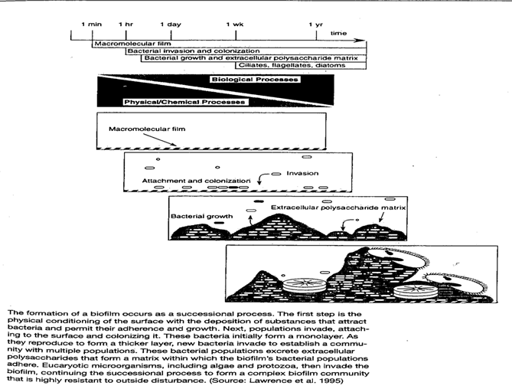
Biofilm in general

Slide 22
Normal Flora of the Oral Cavity
at first, the physical process - covering the surfaces with a film of dissolved substances - then (minutes) - reversible attachment - irreversible - oral bacteria - various adhesions - interactions with molecules and receptors on other bacteria - Streptococcus spp., Actinomycetes spp., Veillonella spp., Porphyromonas spp.,
Fusobacterium spp., Spirochetes spp., Candida spp.

Slide 23
Normal Flora of the Oral Cavity
Biofilm - the coadhesion of late colonizers to previously attached ones - increased diversity and biofilm biomass - the importance of bacterial polymers (glucans, fructans, heteropolymers) - matrix - nutrients, water, enzymes - gradient - pH, O₂, nutrients - regulation of gene expression - different from the same planktonic microbes - facilitated horizontal gene transfer - quorum sensing peptides increased the frequency of transformation in S. mutans 10-600x - increased resistance to antimicrobial agents

Slide 24
Normal Flora of the Oral Cavity
Viruses - pathogenic - mumps, rabies, hepatitis, HIV, respiratory infections - most but bacteriophages - lytic, lysogenic - ....... Fungi - 85 genera were detected - Candida spp., Cladosporium spp., Aureobasidium spp., Saccharomycetales spp.,
Aspergillus spp., Fusarium spp., and Cryptococcus spp. - C. albicans - its presence allows the growth of anaerobes in aerobic conditions Archea - minor component - metanogens - especially people with periodontitis

Slide 25
Normal Flora of the Oral Cavity
Bacteria Expanded Human Oral Microbiome Database (eHOMD) - November 22, 2017 - 772 prokaryotic species (70% cultivated) - 16S rDNA profiling - 6 groups: Firmicutes, Actinobacteria, Proteobacteria, Fusobacteria,
Bacteroids and Spirochaetes = 96%
- the discovery of ultra-small bacteria (not just in the oral cavity) - reduced genome, absence of many biosynthetic and metabolic pathways including the electron transport chain - obligatory symbionts?

Slide 26
Normal Flora of the Oral Cavity
Dental plaque - bacteria living side by side use different nutrients, produce different substances: - synergism, induction of response in target cells and competition
- the same substance - different functions – according to situation, concentration - H₂O₂ - inhibition, but in sub-lethal concentrations signaling function - likewise organic acids, bacteriocins - antagonism, synergism - bacteriocins – induction of cell competence, DNA release

Slide 27
The role of normal oral cavity microflora
the mere presence inhibits colonization of GIT by potential pathogens
nitrate metabolism and cardiovascular disease - ¼ of the received nitrate returns to the oral cavity (saliva ...) - the microbiota converts nitrates into nitrites - into the blood and transformed into NO - NO - vital to vascular health - flexibility, elasticity – blood pressure reduction - but also erections, relaxation of the muscles in the digestive system - transport of food - the use of antibacterial mouthwash significantly reduced the intake of nitrite, eliminating the effect of nitrite on decrease of blood pressure - also connection with other systemic diseases: - metastatic infections of heart, brain, spleen, pancreas, liver, and bone
- arthrosclerosis, cardiovascular diseases, stroke, - respiratory diseases, meningitis, pneumonia, diabetes

Slide 28
The role of normal oral cavity microflora
Negative effects
dental caries, gingivitis, periodontitis - UK - 46% of 15-year-old children - decay in permanent teeth - 45% of adults - perionditis Tooth decay
dissolving the teeth structure by acid from sugars, reducing buffering capacity of saliva
and thus reducing pH in mouth
change of oral microbiota in the benefit of acidophilic species - Streptococcus mutans
and lactobacilli - further acid production S. mutans is not the only one – Bifidobacterium spp., Propionibacterium spp., Scardovia spp. Some bacteria, on the contrary, increase the pH (urea, arginine - ammonia) - the same obligatory anaerobes are enriched in both inflammatory and tumorous tissues

Slide 29
The role of normal oral cavity microflora
gingivitis
90% of adults - dental plaque - primary colonizers - G + aerobic and fac. anaerobic bacteria (streptococci and Actinomyces) - mature plaque - G- anaerobic – Fusobacterium spp., Treponema spp., Synergistetes spp. - regular teeth brushing- plaque "does not mature" - neglected hygiene - endotoxins and other enzymes into the gums – irritation and
inflammation
- loss of gum and tooth connections - periodontal pocket - anaerobic colonization - host reaction (protease formation) makes the situation even worse - teeth release - Porphyromonas gingivalis, Treponema denticola, Tannerella forsythia, Anaeroblobus geminatus, Eubacterium saphenum, Allocus filipactor, Porphyromonas endodontalis, Prevotella denticola and others

Slide 30
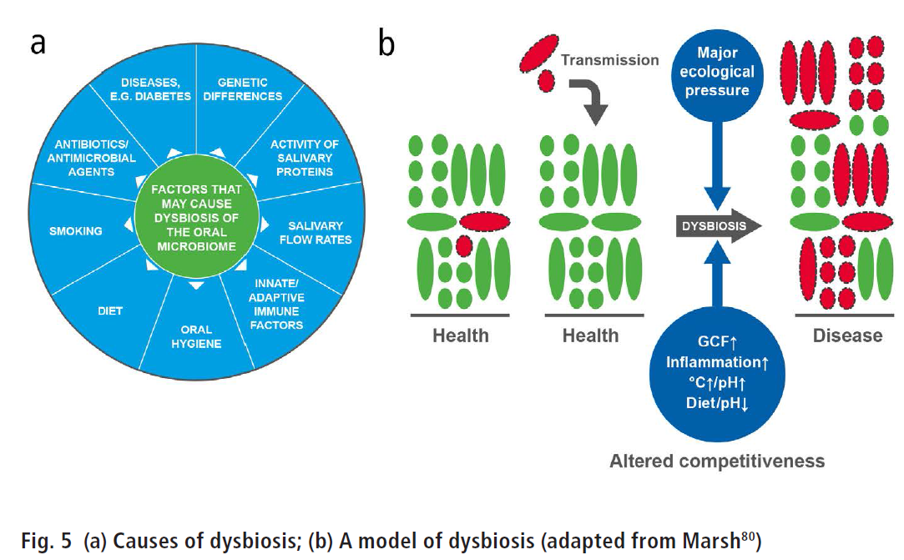
The role of normal oral cavity microflora
Healthy mouth - most bacteria in symbiosis with the host Disease - increased occurrence of cariogenic and periodontopathic bacteria - disturbance of balance - dysbiotic status

Slide 31
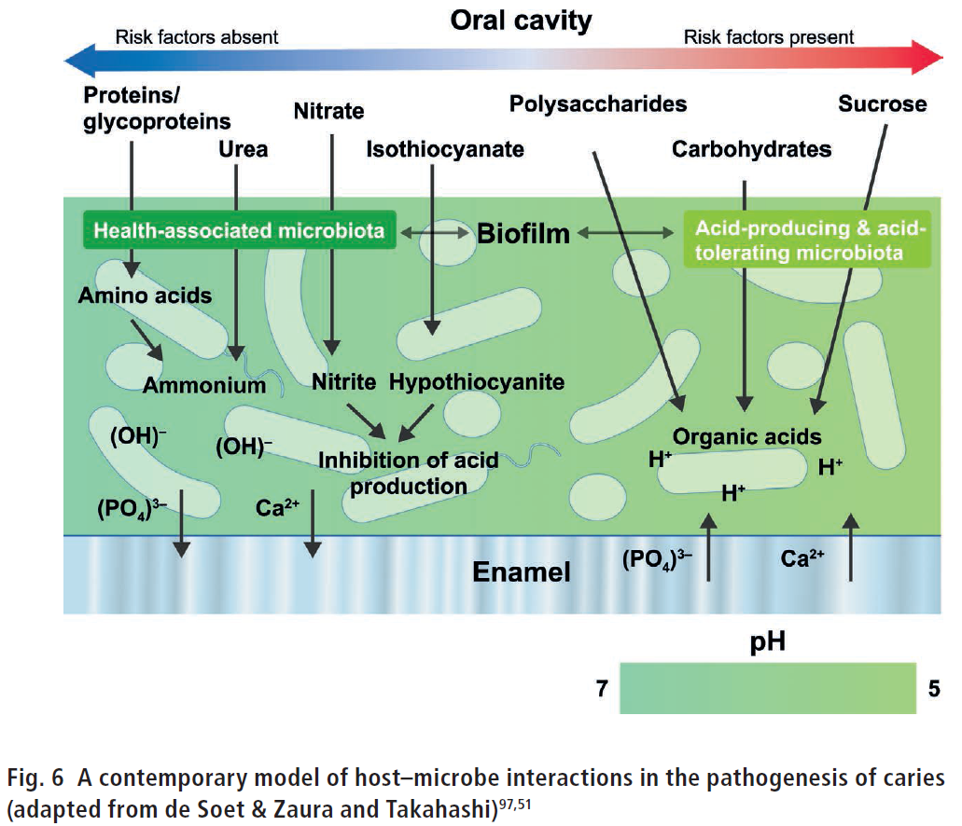
Dental plaque and dental diseases

Slide 32
Dental plaque and dental diseases
Non-specific Plaque Hypothesis (19th Century)
dental infections caused by non-specific increase of all bacteria - remove the maximum
Specific plaque hypothesis
diseases caused by a few species, their removal will solve the problem
Ecological Plaque Hypothesis (1980)
significant changes in the plaque environment change relationships between bacteria
enrichment of some species.
disease prevention not only by inhibiting pathogens but also by changing conditions of the environment.

Slide 33
Normal Flora of the Oral Cavity
Dentures
- more aerobes, yeast and lactobacilli - on denture - Candida albicans - under denture - a more acidic environment, fewer saliva - again C. albicans
Tooth decay
- vaccination, genetically modified S. mutans
BUT – S. mutants can be replaced by other bacteria - S. pneumoniae
benefits of microbes - vitamins, inducing low levels of circulating and secretory antibodies,
antagonism against nonindigenous species (fatty acids, peroxides and bacteriocins)
at the same time – diseases: abscesses, dental caries, gingivitis, periodontal disease
but also abscesses of alveolar bone, lung, brain, or the extremities (Bacteroides
melaninogenicus)

Slide 34
Microflora of the oral cavity and tooth brushing
cleaning teeth for several thousand years before Christ - but regular use of brushes and pastes only after World War II - various teeth cleaning techniques - manual x electric brush - choice of paste
- ads - sterile oral cavity ?!

Slide 35
Normal Flora of the Gastrointestinal Tract
Birth - bacteria enter with the first food - breastfed babies - bifidobacteria (90%), Enterobacteriaceae and enterococci - artificial nutrition - bifidobacteria do not dominate - switching to cow's milk or solid food - bifidobacteria plus enteric bacteria,
bacteroides, enterococci, lactobacilli and clostridia - human milk - a growth factor supporting the growth of bifidobacteria - bifidobacteria prevent colonization by non-indigenous or pathogenic species - evidence of "tissue tropism" and specific adherence - gram-positive bacteria - gastrointestinal epithelium – polysaccharides of capsules or teichoic acids of the cell wall are bound to specific epithelial cell receptors - gram-negative bacteria - specific fimbria binds to glycoproteins on epithelial cell surface

Slide 36
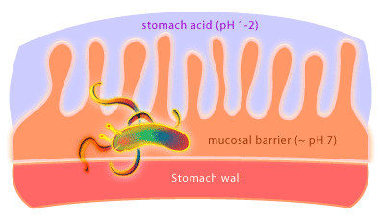
Normal Flora of the Gastrointestinal Tract
age, diet, cultural conditions, use of antibiotics, …
esophagus – none bacteria
stomach – pH - acid-tolerant lactobacilli
Helicobacter pylori - gastric ulcers, gastric and duodenal cancer
urease – urea – ammonium
maybe also positive functions - protection against infant diarrhea
and esophageal disease.

Slide 37
Normal Flora of the Gastrointestinal Tract – cont.
small intestine - high flow rates - lactobacilli and Enterococcus faecalis - 10⁵ - 10⁷
distal part (10⁸/ml) - additional species - E. coli and relatives and Bacteroides
digestion mainly by human enzymes, microbes could compete for essential nutrients
large intestine (colon) - similar microbes as in feces - 10¹¹/ml or even more – 10¹³
bacteria - about 35-50% of the colon contents - 2 lbs
coliforms, enterococci, clostridia and lactobacilli
predominant anaerobic Bacteroides and anaerobic lactic acid bacteria Bifidobacterium
(Bifidobacterium bifidum)
- significant numbers of anaerobic methanogens

Slide 38
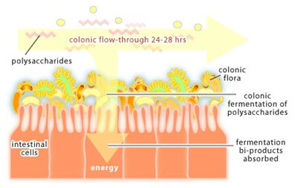
Normal Flora of the Gastrointestinal Tract – cont.
Role of bacteria in GI tract
protection from infection by alien microbes
contribution to nutrition and digestion (polysaccharides – acetate, butyrate and
propionate - source of carbon and energy for mucosal cells of the colon)
- production of vitamins
stimulation of development and activity of the immunological tissues
BUT ALSO:
production of carcinogenic metabolites (colon cancer)
alterations in the GI flora (poor nutrition, antibiotics)
shifts in populations and colonization by nonresidents
gastrointestinal disease

Slide 39
Viruses and our microbiota
majority of known viruses are pathogenic - because we learned just about them (diseases) - but many viruses infect us without any disease symptoms - molecular methods - many other viruses discovered - originally 2 human polyomaviruses - today 13 - infect us during childhood and then waiting
Koch's postulates - a problem with viruses (cultivation in pure culture)
majority of viruses are neither completely pathogenic nor harmless - according to the situation

Slide 40
Viruses and our microbiota
Benefits of viruses - childhood infections stimulate the development of the immune system - protection against later infection and exaggerated reaction – allergies
- comensal virus may provide protection against a pathogenic virus - pegivirus C (related to hepatitis C, Zika virus, dengue fever) mitigates the effects of HIV
- ¾ billion people are infected - viruses prefer fast dividing cells - cancerous - spontaneous regression - about 8% of our genome are retroviral DNA sequences - some of their functions are essential for host survival and development

Slide 41
Mycobiota
- 2015 - only 269 out of 6,000 results for microbes mentioned fungi - mykobiome - only 55 results - oral mycobiota of HIV patients (C. albicans)
- more severe symptoms of hepatitis B correlate with a number of species of Candida
spp. and Saccharomyces spp.
- the excessive presence of Candida tropicalis exacerbates the symptoms of inflammatory bowel disease (IBD)
- undisturbed microbial community - fungi harmless or even beneficial - after disruption - possible problems

Slide 42
Mycobiota
oral cavity - not just Candida spp. and Saccharomyces spp. - study on 20 volunteers - 101 fungi identified, each with 9-23 species - Cladosporium spp. (asthma), Aureobasidium spp.(transplant), Aspergillus spp. (devastating infections), Fusarium spp. (difficult infections), Cryptococcus spp. (meningitis in HIV) - elsewhere on the body of Malassezia spp. - skin diseases - lungs - Aspergillus spp. in healthy people, Candida spp. in patients (cystic fibrosis,
cardiovascular diseases, ...) - inflammatory bowel disease - other mycobiota than in healthy people - obesity - more Ascomycota spp. representatives, but overall reduced diversity - Mucor spp. - slim people (correlation with obesity)

Slide 43
Do we all have the same microbes?
Differences: digestive tract, vagina (species and metabolic diversity)
Similarities: microflora of the mouth and skin - changes in time, but less variable in different individuals

Slide 44
Establishment of human microbiota
- fetus in the womb is not sterile - vaginal microflora varies during pregnancy (80% Lactobacillus sp.) - newborn - Actinobacteria, Proteobacteria, Bacteroides - microbiota of the placenta - a non-pathogenic comensal microbiota: Firmicutes, Tenericutes, Proteobacteria, Bacteroides and Fusobacteria (E. coli, Prevotella tannerae, Neisseria lactamica) - similar to the oral microflora - further colonization during delivery, then breastfeeding (milk is not sterile), from the mother's skin - milk: Streptococcus spp., Staphylococcus spp., Serratia spp., Corynebacterium spp. depends on mother's environment (preparation ...) - also baby is exploring the environment by mouth - around the second year of life a certain balance is achieved

Slide 45
Manipulation of human microbiota
4th century Chinese medical literature mentions faecal transplant to treat food poisoning and severe diarrhea
Bedouins – camel faeces for bacterial dysentery
example of successful manipulation of our microbiota is faecal transplant (stool bank - OpenBiome) for treatment of infections caused by Clostridium difficile But first WE MUST KNOW our microbiota, only then we can think about targeted manipulation

Slide 46
Clostridium difficile
C.difficile
- anaerobic gram-positive spore-forming bacteria
- transmitted by fecal-oral route
- colonizes the large intestine
- release of exotoxins (TcdA, TcdB) causes colitis
typically after recent antibiotic exposure (penicillins, cephalosporins, clindamycin, fluoroquinolones)
Presentation:
Abdominal pain
Fevers
Diarrhea, can be bloody
Dehydration

Slide 47
Clostridium difficile – cont.
Diagnosis:
Stool testing for toxin
Sigmoidoscopy
Oral antibiotics to treat CDI
Metronidazole, Vancomycin → ~70-75% effective
Fidaxomicin for Vancomycin failure → 90% effective

Slide 48
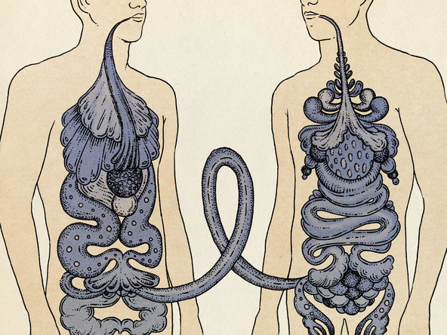
Clostridium difficile – cont.

Slide 49
Fecal transplant
Donor contraindication:
Donors should not:
Have had any antibiotic exposure in the past six months
Be immunocompromised
Have had any tattooing or body piercing in past six months
Have any history of incarceration
Have recently traveled to endemic areas
Have any chronic GI disorders, such as inflammatory bowel disease

Slide 50
Faecal transplant cont.
Donor screened for:
hepatitis A, B, C
HIV
syphilis
C.difficile
Giardia,
E.coli, Salmonella, Shigella, H.pylori, Campylobacter infections

Slide 51
Faecal transplant cont.
Recipient
Before procedure:
stop any antibiotic therapy two days before the procedure
a liquid diet followed by laxative preparation the night before
scheduled procedure

Slide 52
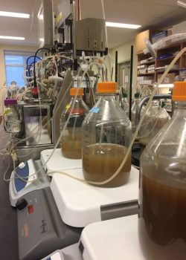
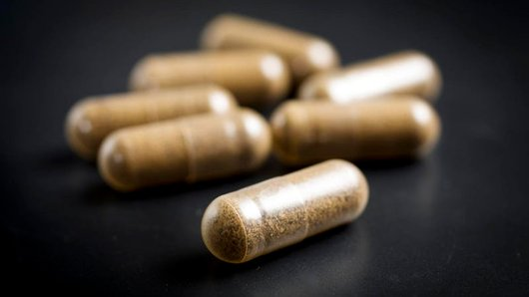
Faecal transplant cont.
- Fresh stool collection
less than 6 hours prior to procedure
volume 20 ml to 30ml mix 250 ml of sterile
0.9% normal saline with stool in a blender

Slide 53
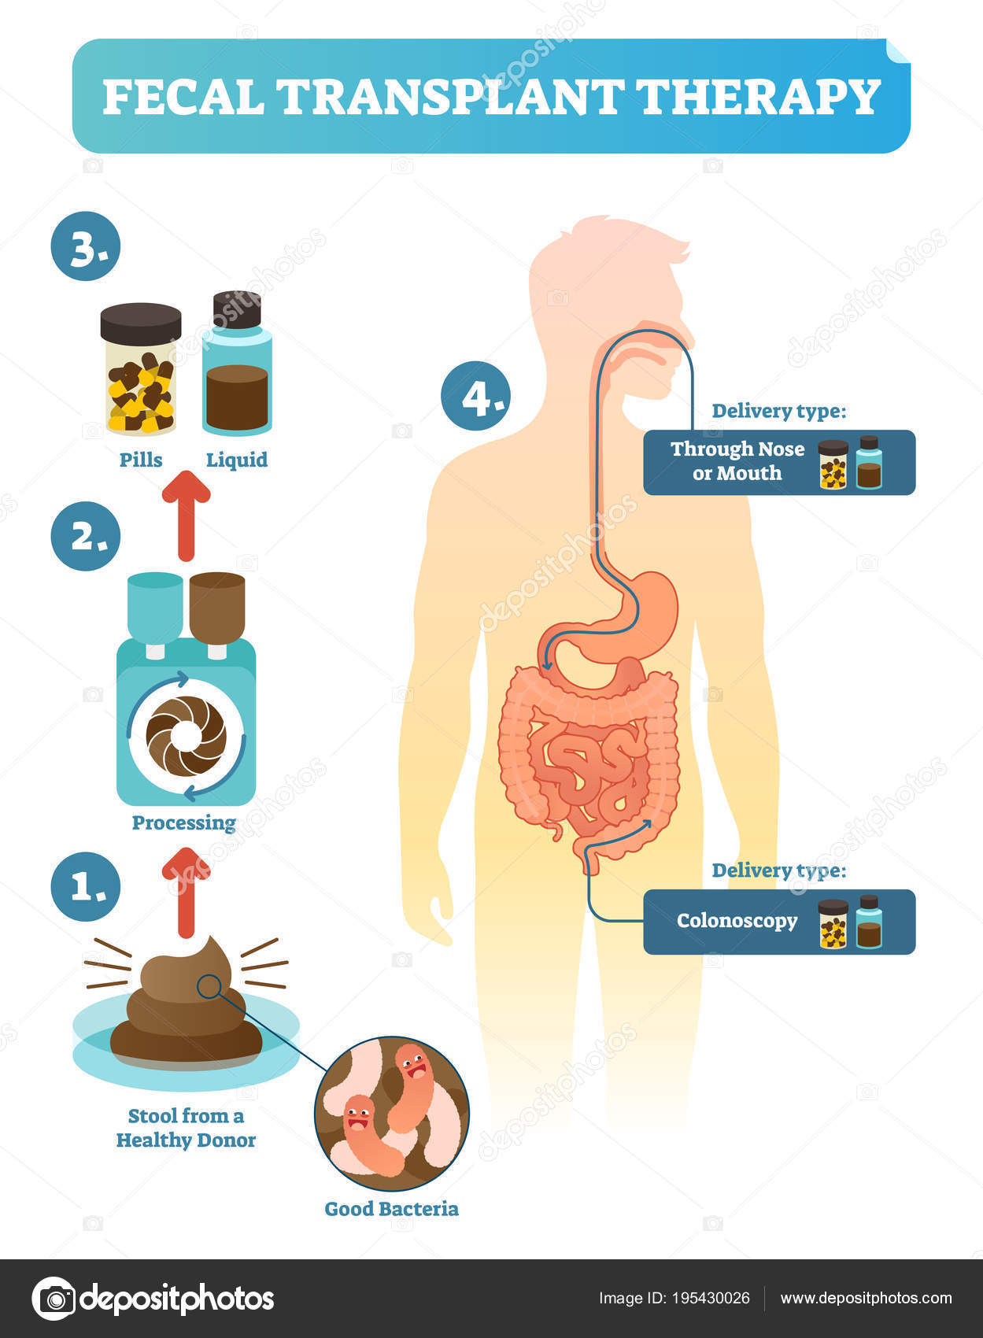
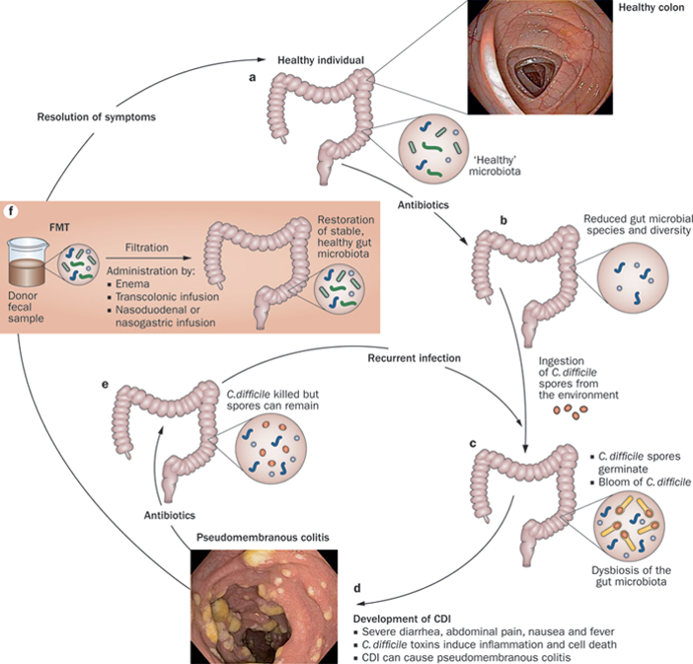
Faecal transplant cont.

Slide 54
Faecal transplant cont.
Risk of aspiration if not delivered deep into upper small intestine
Risk of acquiring infection from donors – rare
Risk of complications from sedation and endoscopy – bleeding, perforation, transmission of other infections: 1/1000-1/10,000

Slide 55
Manipulation of human microbiota
Probiotics – 100 years history – Mutaflor
MUTAFLOR® IS A PROBIOTIC THAT COMPRISES AS ITS ACTIVE SUBSTANCE A VIABLE NON-PATHOGENIC STRAIN
OF ESCHERICHIA COLI (E.COLI)
FIRST ISOLATED IN 1917 BY PROFESSOR ALFRED NISSLE FROM THE FAECES OF A SOLDIER DURING THE FIRST WORLD
WAR WHO AS HE REMARKED, “IN CONTRAST TO THE LARGE MAJORITY OF HIS COMRADES, HAD SUFFERED NEITHER
FROM DYSENTERY NOR FROM ANY OTHER INTESTINAL DISEASES”. THEREAFTER, APPROPRIATELY NAMED
ESCHERICHIA COLI STRAIN NISSLE 1917.
Used to relief and management of chronic constipation
Characteristics of Escherichia coli strain Nissle 1917
- the ability to colonize
- antagonistic activity – Inhibition of growth and or killing of pathogens
- anti-invasive – prevention of colonisation in the gut by pathogens
- synthesis of endogenous antimicrobial peptides-defensins
- mucosal integrity – contributing to luminal metabolism and stability of intestinal milieu-enhanced epithelial barrier function
- anti-inflammatory and immunomodulatory effects
stimulation of colonic mucosa
Adminitered to Hitler by his doctor Theodor Morell during second world war

Slide 56
Manipulation of human microbiota
prebiotics – non-digestible part of our food
cellulose, hemicellulose, lignin
but also polyphenols (resveratrol – red wine), minerals
vitamins - riboflavin
lactating mothers produce oligosaccharides
that are not digested
- bait for pathogens?
- supporting beneficial bacteria (able to digest them)?
microbiome influences/modifies efficiency administered medications

Slide 57
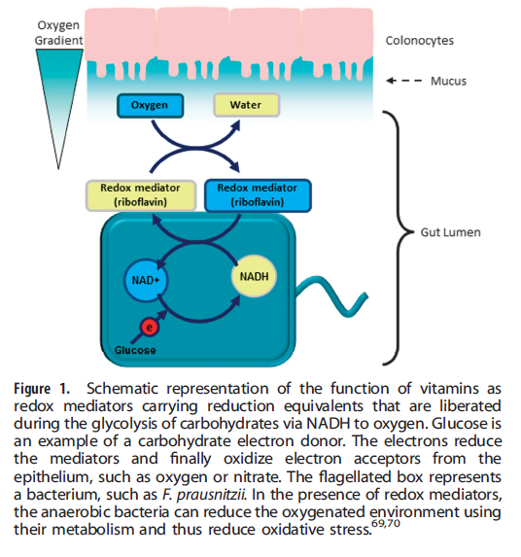
Prebiotika – pokr.
Experiments with riboflavin: - Riboflavin increased the incidence of
Faecalibacterium prausnitzii - this bacterium is responsible for production
of anti-inflammatory peptides - for example IBD (inflammatory bowel
disease) is characterized by low numbers
of F. prausnitzii
Steinert 2016

Slide 58
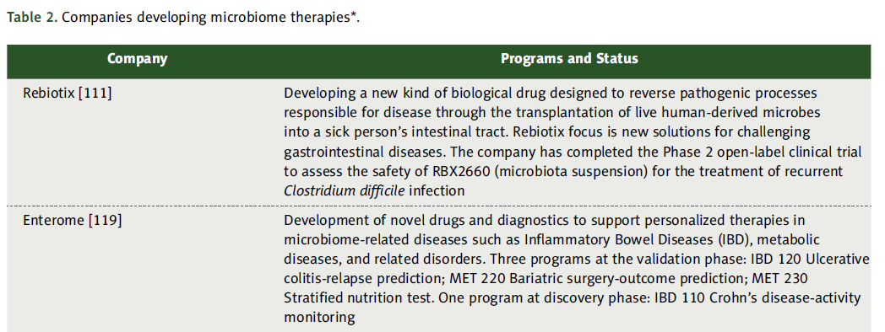
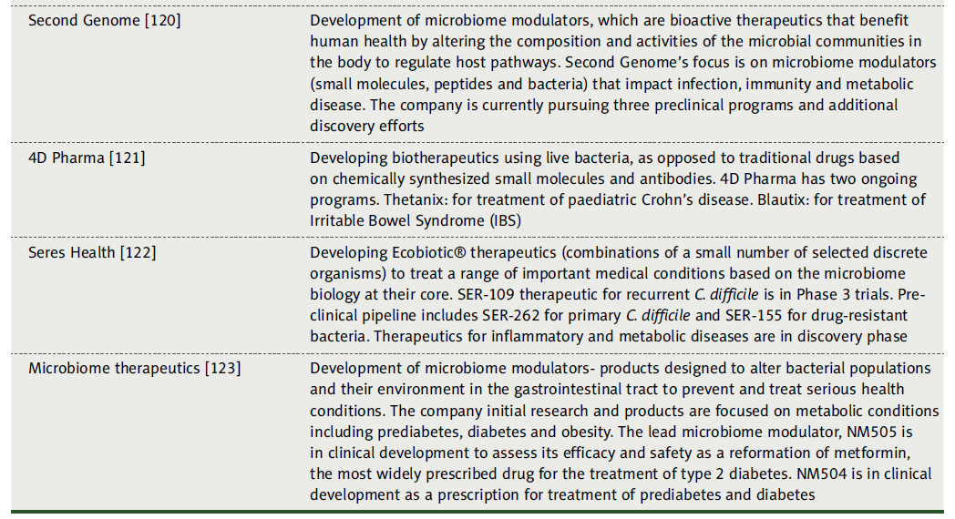

Slide 59
Human Microbiome Project
- launched in 2008 - five-year project - total budget of $115 million
(Human Genome Project - launched in 1990 and was declared complete in 2003)
oral, skin, vaginal, gut, and nasal/lung – from 300 healthy subjects
how changes in the human microbiome are associated with human health or disease
BUT – what was here first ?!?!?!?!
many more (specialized) studies of human microbiome are underway:
American Gut Project, MetaHIT, MyMicrobes, Human Longevity, Earth Microbiome
project, Human Food Project
RESULTS:
dramatic variation between individuals as far as species composition is concerned
BUT when classified by function - very similar
each individual´s microbiome is fairly stable over time
main problem of interpreting results – public databases

Slide 60
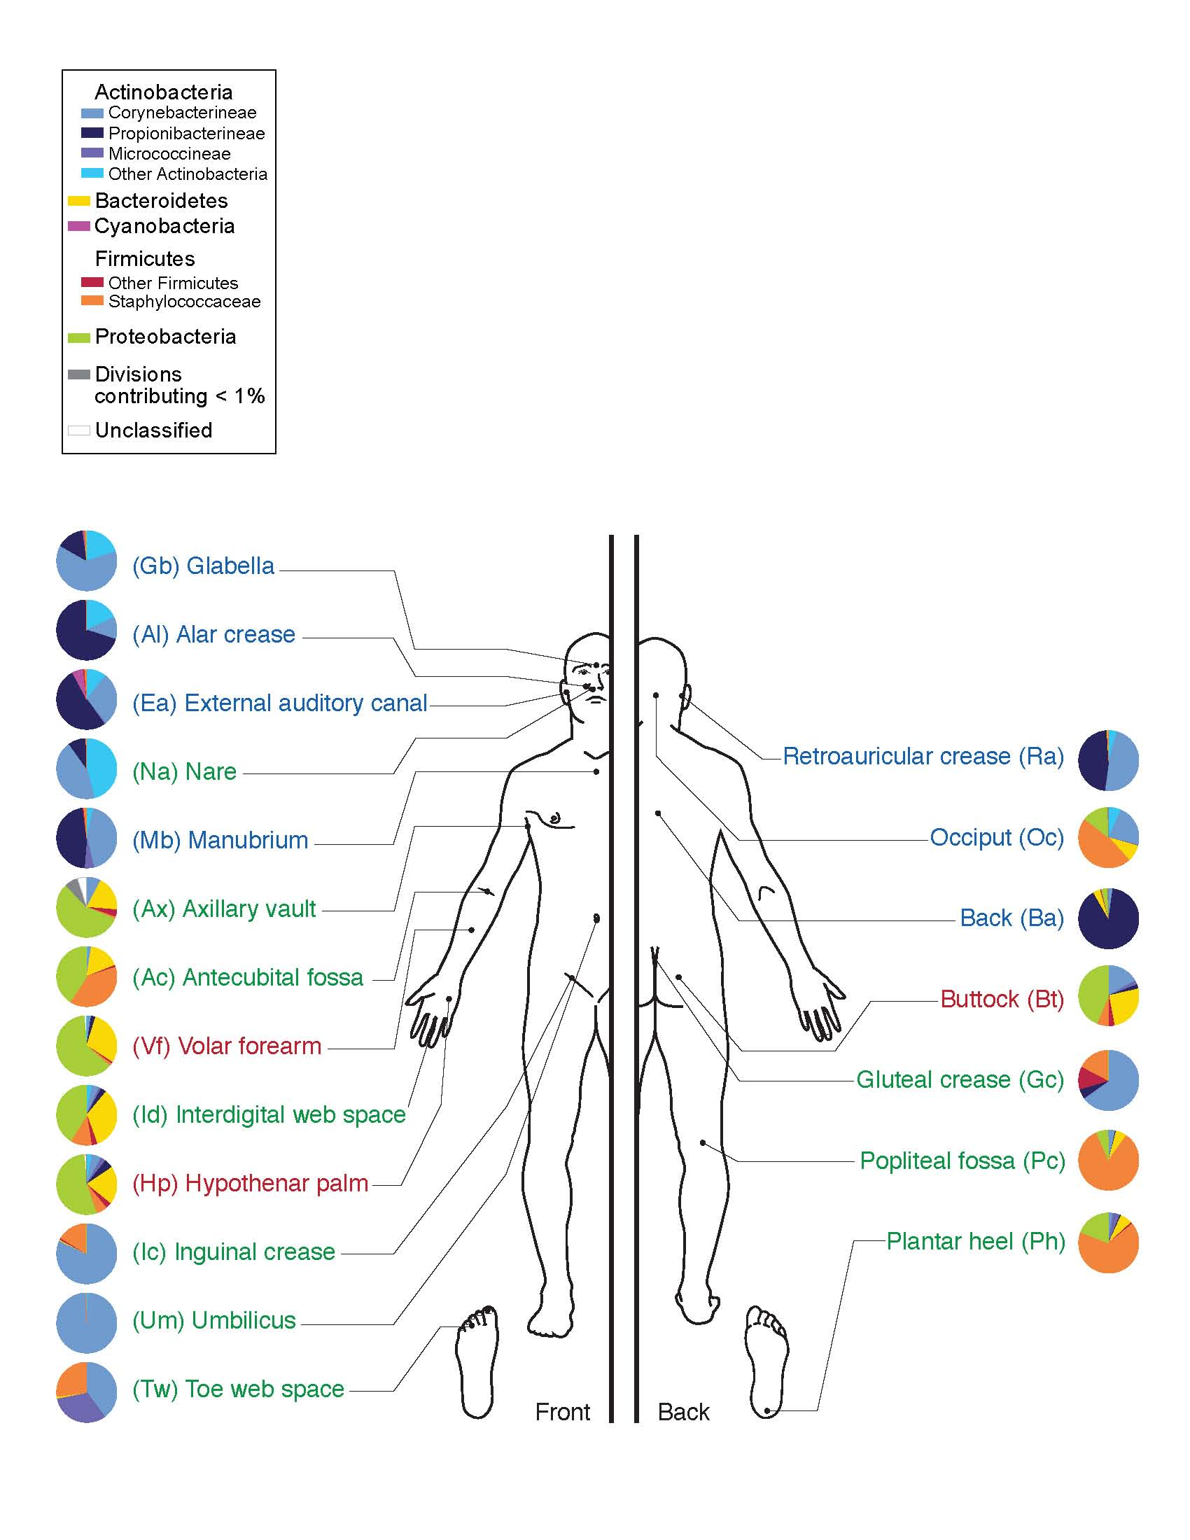
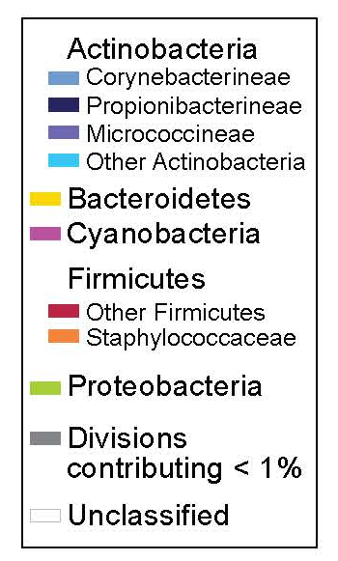

Slide 61
Importance of human microbiota
up to 2015 – about 19 000 papers published (5,000 in 2015 alone)
majority is descriptive – identification of which microbes are there
but what they are doing there?
how they cooperate in between them and with human host?
human microbiome includes also viruses, archaea, fungi, single-cell eukaryotes….
human genome -20 000-25 000 protein coding genes
human microbiogenome - 2-20 millions protein coding genes
all microbes constantly excrete/secrete small and large molecules and vesicles
containing RNA, DNA, proteins - communication with neighbours and host – many of
these molecules and vesicles can penetrate gut wall to bloodstream
microbiome´s metagenome can change much faster than human genome – fast response
microbiome = sophisticated additional organ (or set of organs)

Slide 62
Importance of human microbiota
- disturbance to human microbiota is connected to many diseases:
inflammatory bowel disease (ulcerative colitis and Crohn's
disease)
- diabetes
- obesity
microbes influence signal pathways/communication between digestive system
and brain
neural, endocrine, immune signals

Slide 63
Human microbiota and obesity
- 2014 – 1,9 billion overweight people (600 mil. obese)
- GM of obese people shows special metabolism of carbohydrates and fats
- GM of obese people can digest substrates which human enzymes cannot
- result is gain of energy, SCFAs – they influence metabolism of glucose,
cholesterol, and fats in human tissues
- western diet (too much fats) reduce Bacteroides and promote Firmicutes
- GM activate bile acids and regulate metabolism (absorption of lipids)
- germ free mouse on diet rich in fats do not demonstrate obesity (urine, feaces)
- main thing is efficiency of utilization of energy from food

Slide 64
Facts about obesity
Worldwide obesity has nearly tripled since 1975.
In 2016, more than 1.9 billion adults, 18 years and older, were overweight.
Of these over 650 million were obese.
39% of adults aged 18 years and over were overweight in 2016, and 13% were obese.
Most of the world's population live in countries where overweight and obesity kills
more people than underweight.
41 million children under the age of 5 were overweight or obese in 2016.
Over 340 million children and adolescents aged 5-19 were overweight or obese in 2016.
Obesity is preventable.

Slide 65
Human microbiota and obesity
Obesity is not only problem of weight, but is connected with higher risk of cancer (uterus, breast, cervix, large gut, rectum, throat, kidney, prostate, pancreas, etc.)
Obesity is connected with ready-to-cook meals (preserve chemicals, emulators)
Obesity is connected with higher incidence of Firmicutes and Actinobacteria and lower incidence of Bacteroides

Slide 66
Thank you for your attention

