Slide 1
Malignant transformation
Stages of tumor development
Theories of cancerogenesis
Hallmarks of cancer
Oncogenes and tumor suppressors
Metastases
Interaction of tumor and organism
Cancer biomarkers

Slide 2
Tumor development
Cancerogenesis
The process of tumor formation is a complex involving multiple alterations of cells/tissues and their physiologic control mechanisms.
The complexity of this process is reflected in the long time periods required for most human cancers to develop.
Multi-step tumor progression can be depicted as a form of Darwinian evolution occurring within tissues.

Slide 3
Theories of carcinogenesis
Tissue Organization Field Theory (TOFT)
Carcinogenesis is “development gone awry.”
Normal tissue blocks the proliferation and motility of cells (tissue homeostasis).
Disruption of the normal tissue organization leads to the loss of constraints and subsequent cell proliferation and cell invasion.
Abnormal tissue architecture.
Significant role of the microenvironment.
DNA mutations are less significant.
Somatic Mutation Theory (SMT)
Changes in the DNA of the founder cell make this cell unable to control its proliferation.
Clonal expansion.
Somatic mutations versus tissue organization

Slide 4
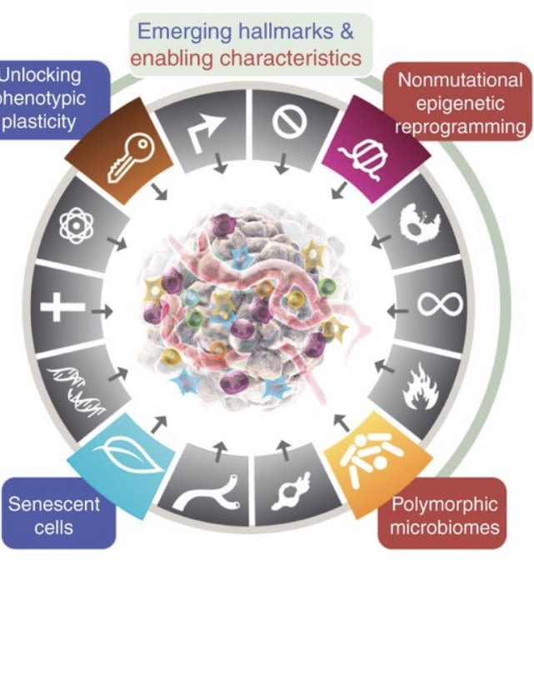
Enabling characteristics of cancer
Genomic instability and nonmutational epigenetic reprogramming
Unlocking phenotypic plasticity
Tumor microenvironment
Polymorphic microbiomes

Slide 5
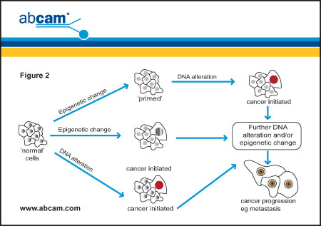
Genomic instability and non-mutational epigenetic reprogramming
Genetic alterations can appear due to internal errors during DNA replication and cell division or as a consequence of exposure to external factors (carcinogens)
physical – e.g. UV and ionizing light
chemical – organic substances, toxins, heavy metals
biologic – some RNA and DNA viruses
Epigenetic alterations can contribute to the acquisition of hallmark capabilities during tumor development and malignant progression.
hypoxia-mediated epigenetic changes
the acidic tumor microenvironment-mediated epigenetic changes
extracellular matrix (ECM) motifs

Slide 6
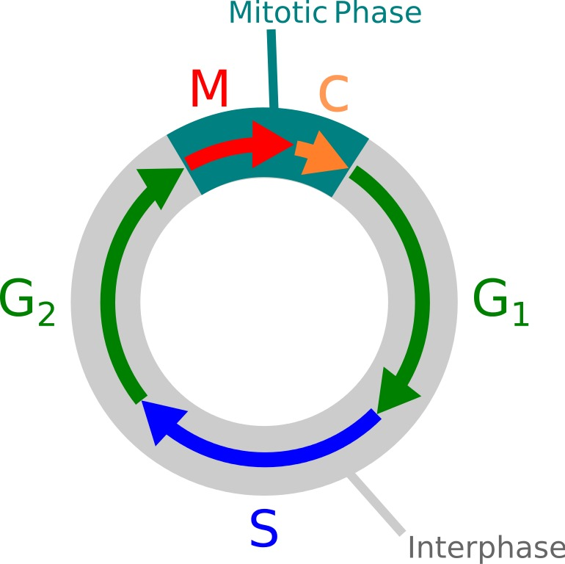
PC-3 prostate cells, quantitative phase imaging, 10X
double DNA strand break
single DNA strand break
50/cell cycle
5000/cell cycle
30 000 000 000 000 breaks/day in human
10.1089/ars.2010.3368

Slide 7
Double strand breaks – most serious DNA damage
repair of 1 double strand break = 10⁴ ATP molecules

Slide 8
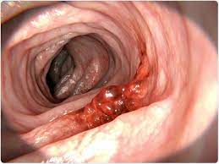
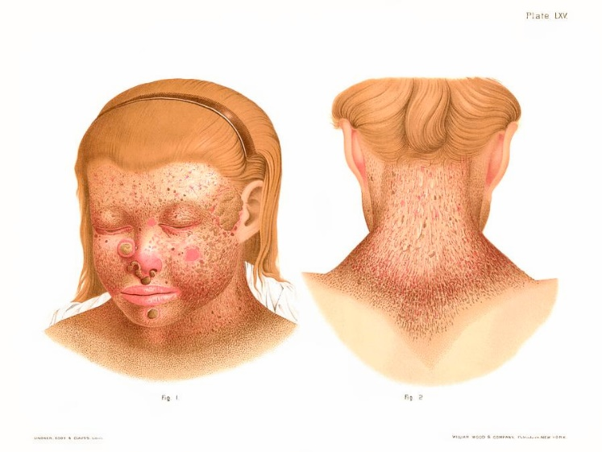
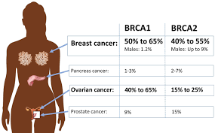
DNA repair genes/proteins
MMR genes/proteins (“Mismatch repair”)
defect in respective genes leads to the microsatellite instability (MSI). Variable length of microsatellites (e.g. (CA)n repetition) leads to the DNA replication errors. MSI is most prevalent in colon cancers.
Nucleotide excision repair genes/proteins (“single strand break repair”)
NER-defects cause xeroderma pigmentosum (XP). XP patients show severe sun sensitivity and develop skin cancers during childhood.
Genes/proteins of homologous recombination (“ double strand break repair ”)
BRCA1 and BRCA2 "breast cancer susceptibility genes"
ATM and ATR (ATM-related) kinases ("mutated in ataxia-telangiectasia")

Slide 9
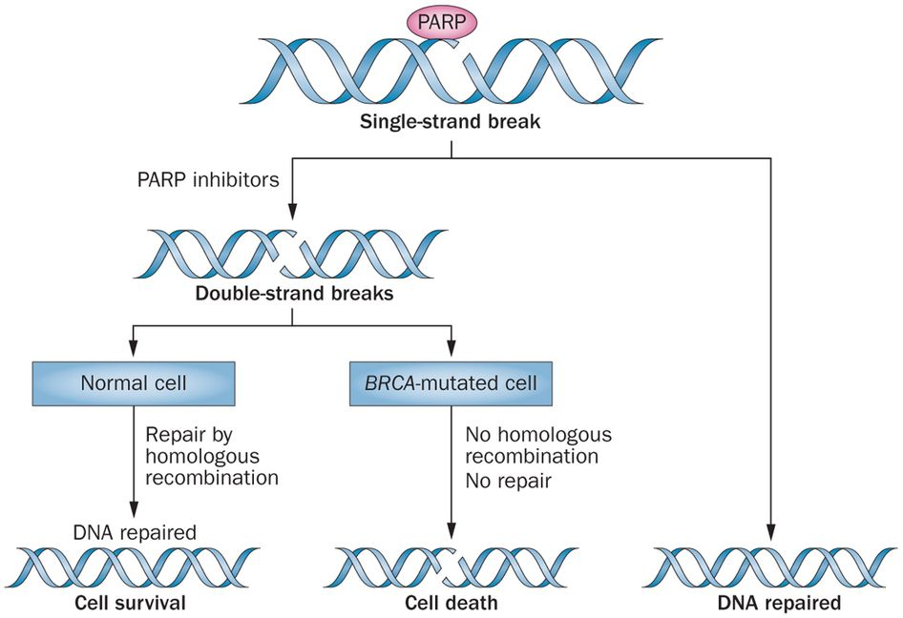

Slide 10
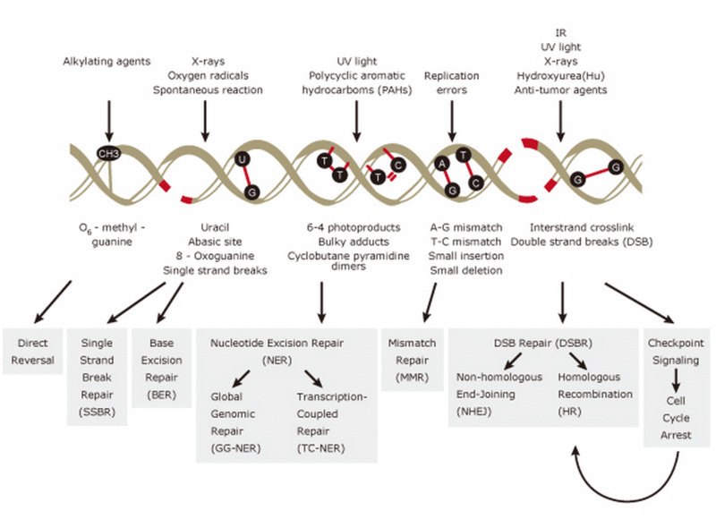

Slide 11
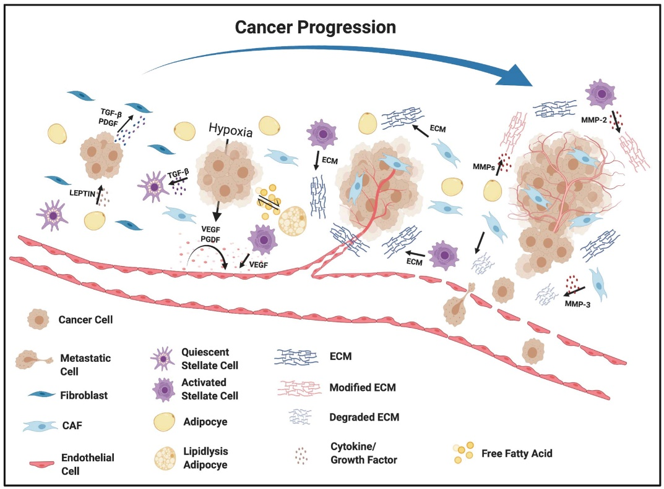
Tumor microenvironment
reciprocal relationship between cancer cells and components of the TME
Tumor cells stimulate significant molecular, cellular and physical changes within their host tissues to support tumor growth and progression.
Cancer cells recruit stromal cells from neighboring tissue during tumorigenesis.
TME includes immune cells, stromal cells, blood vessels, and extracellular matrix (ECM) and can have an anti-tumor or pro-tumor effects.
The stromal cell composition varies between tumor types but includes endothelial cells, fibroblasts, adipocytes, and stellate cells. The TME orchestrates angiogenesis, proliferation, invasion, and metastasis through the secretion of growth factors and cytokines.
Acidic metabolic waste products accumulate in the tumor microenvironment because of high metabolic activity and insufficient perfusion. The pH of TME influences cancer and stromal cell function, their mutual interplay, and their interactions with the ECM.

Slide 12
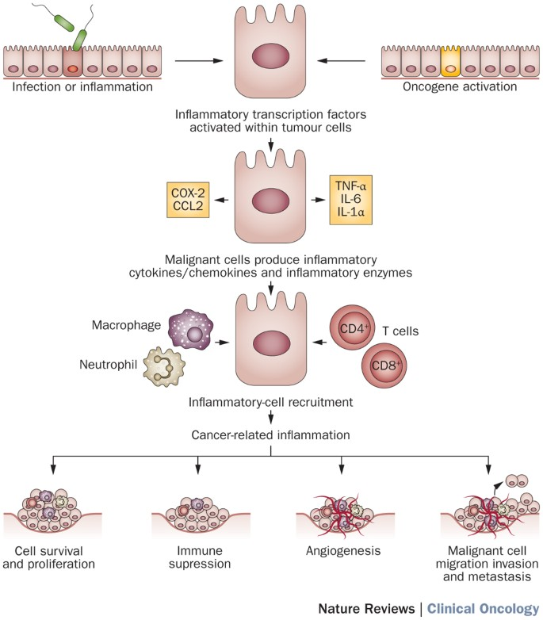
Inflammation
There are important similarities between tumors and the inflammatory response associated with wound healing
“Tumors: Wounds that do not heal”.
Many cancers arise from sites of infection, chronic irritation, and inflammation.
Chronic inflammation can cause DNA damage and permanent activation of fibroblasts.

Slide 13
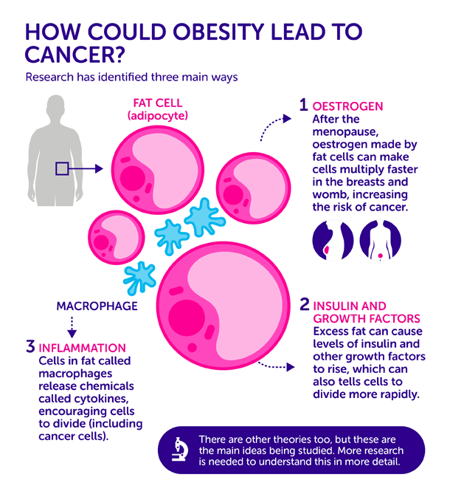
Inflammation and obesity
As people become obese more fat cells are build up in their tissues and macrophages are recruited to clear up dead fat cells. The number of macrophages in obese fatty tissue can be substantial– 4 in 10 cells. Macrophages release cocktail of cytokines that can trigger chronic inflammation.
Obese people tend to have higher levels of inflammatory cytokines in their blood.
Fat isn’t just padding: it’s like another organ that is essentially a huge gland sending out biological information that affects the rest of the body. Oestrogen and growth factors produced by fat cells increase the risk of cancer.

Slide 14
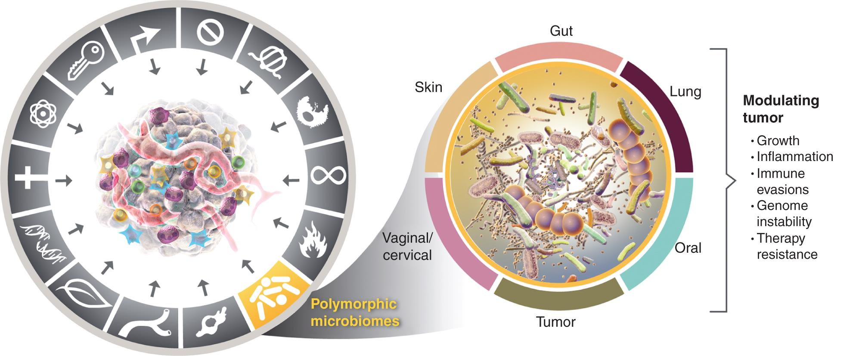
Polymorphic microbiomes
The evidence is increasingly compelling that polymorphic variability in the microbiomes between individuals in a population can have a profound impact on cancer phenotypes.
There are both cancer-protective and tumor-promoting microbiomes, involving particular bacterial species, which can modulate the incidence and pathogenesis of tumors.
A mouse model of colon carcinogenesis populated with bacteria Porphyromonas developed more tumors than mice lacking such bacteria.

Slide 15
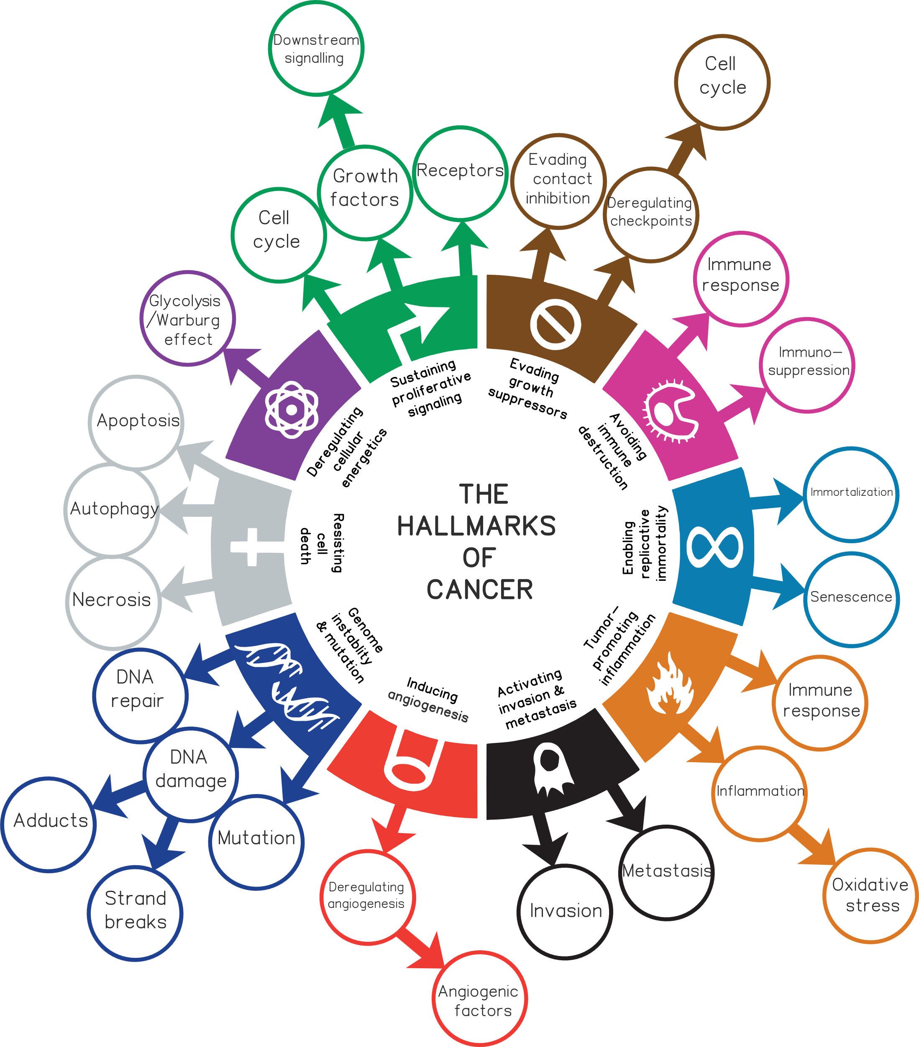
Hallmarks of cancer
All these features do not have to be newly evolved, because they are part of physiological processes such as embryogenesis and wound healing. Cancer cells only use these processes at the wrong intensity, time, and place.
Cancer is a disease of regulation.
Continual upregulated proliferation of cancer cells (sustaining proliferative signaling and evading growth suppressors)
Replicative immortality
Genome instability
Resisting cell death and senescence
Inducing angiogenesis
Inflammation
Avoiding immune destruction
Altered metabolism
Invasion and metastasis

Slide 16
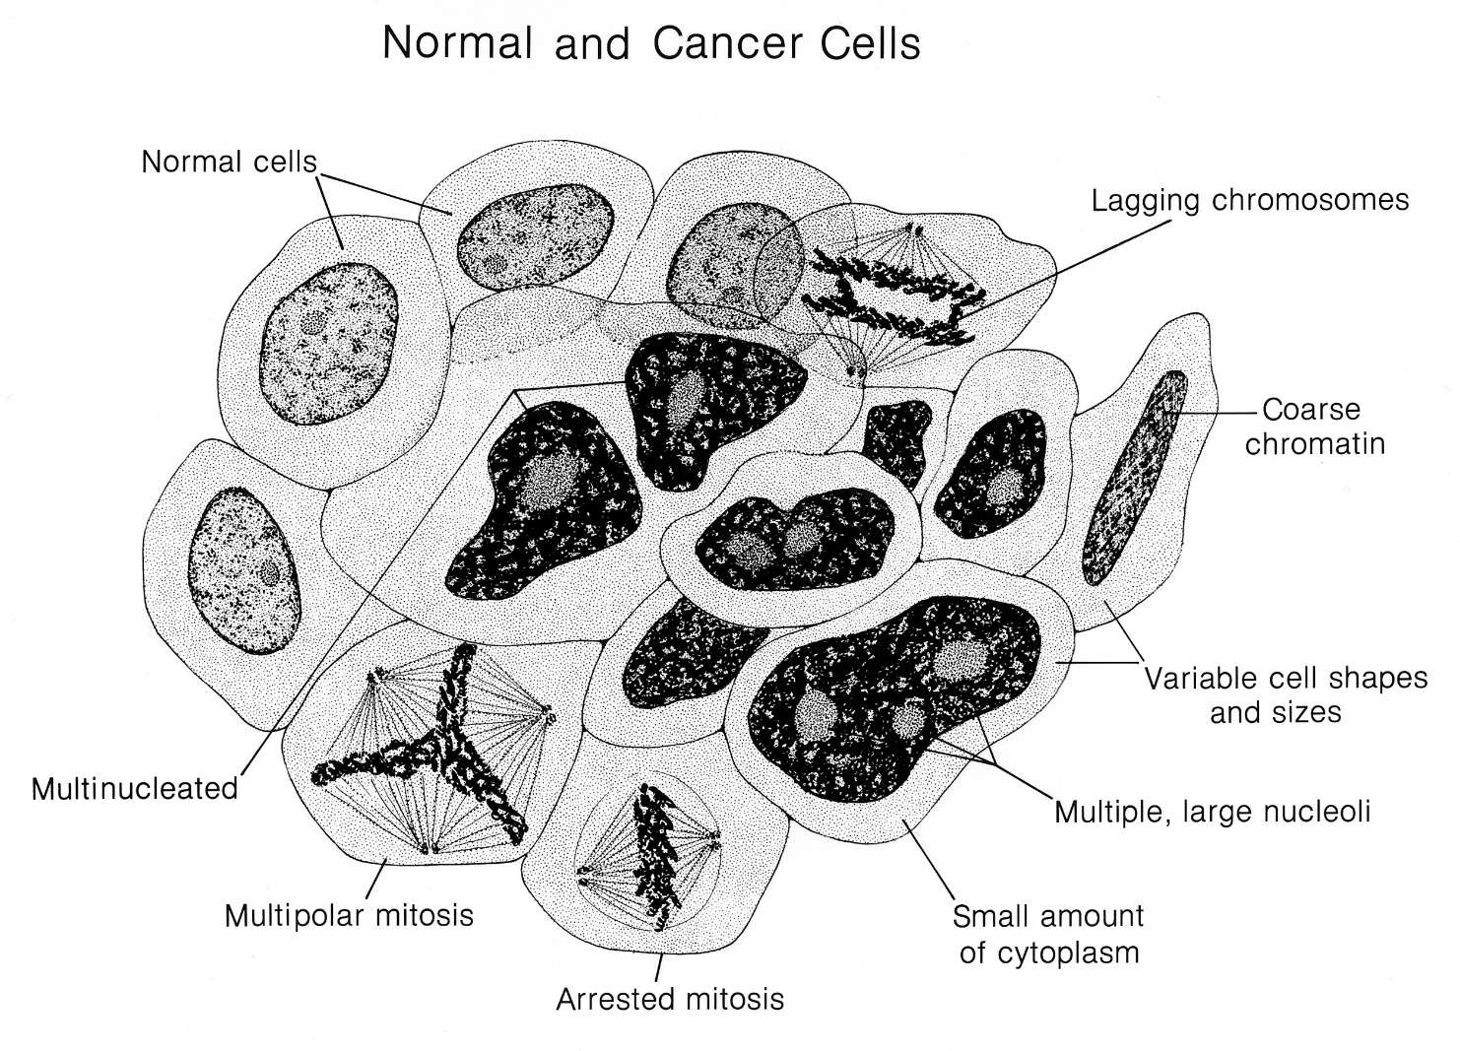
Cancer cell
Cancer cells divide excessively - they have too many “GO” signals or not enough “STOP” signals and can also ignore “DIE”, “ DIFFERENTIATE “, or “GROW OLD” signals.

Slide 17
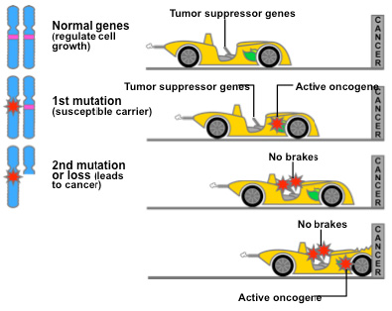
Oncogenes and tumor suppressors
Proto-oncogenes – Genes whose products encode components of the molecular cascades that mediate cell growth, cell survival, and block cell differentiation.
The abnormal, mutated form of the proto-oncogenes that lead to excessive cell proliferation and cancer are called oncogenes.
Proteins encoded by tumor suppressor genes inhibit cell proliferation or survival and support cell differentiation.

Slide 18
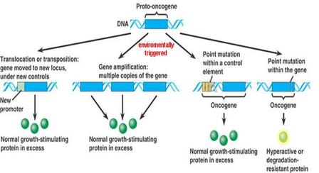
Oncogenes
Oncogenes differ from proto-oncogenes in three basic ways:
1. timing and quality of expression
2. structure and function of protein products
3. degree to which their protein products are regulated by cellular signals

Slide 19
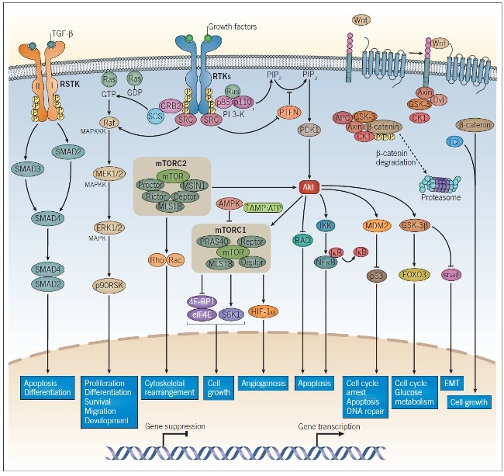
Uncontrolled growth - “GO” signals
“GO” signals = main mitogenic signals include:
1. growth factors (e.g. EGF, VEGFA, PDGF)
2. growth factor receptors (e.g. the receptors for epidermal growth factor EGF (EGFR) and its close homologue HER2/neu (ERBB2)
3. receptor-coupled signal transduction molecules (RAS family)
4. proteinkinases (SRC,ABL)
5. transcription factors (MYC, MYB, FOS, JUN)
6. cyclins
7. cyclin-dependent kinases (cdk)

Slide 20
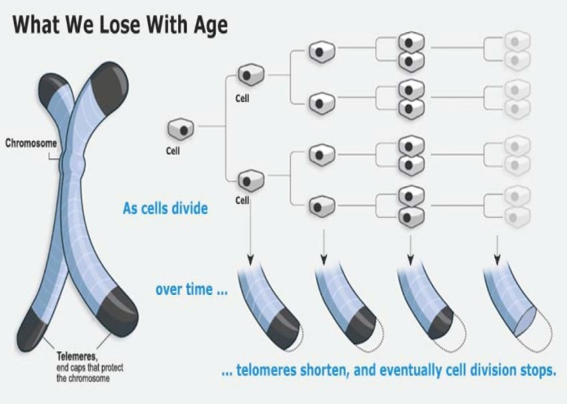
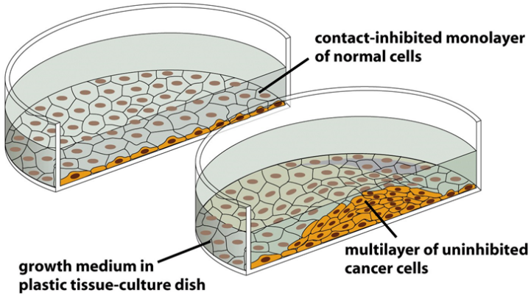
Contact inhibition and immortalization
Proliferation of many normal cells is inhibited by cell-cell contact (contact inhibition) and by erosion of telomeres (Hayflick limit), but cancer cells are characteristically insensitive to such inhibition of growth.
Most pre-malignant cells escape from Hayflick limit by stabilizing their telomeres (telomerase, hTERT).
Cells that have stabilized their telomeres can proliferate indefinitely and are therefore said to be immortalized. Immortal cells are not necessarily transformed (tumorigenic) cells.

Slide 21
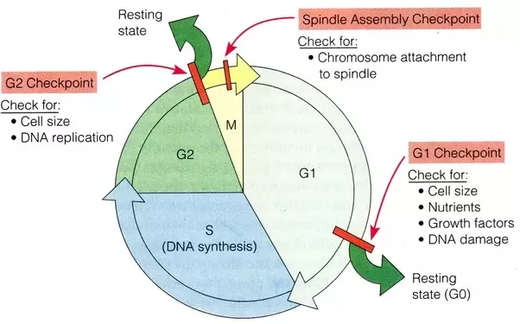
Uncontrolled growth – loss of “STOP” signals
The critical decisions concerning growth versus quiescence are made in the G1 phase of the cell cycle.
Growth of normal cells is controlled by signals from the external environment (extracellular matrix, surface of adjacent cells) and from the inside of the cell (DNA damage, cell damage, mitotic spindle damage).

Slide 22
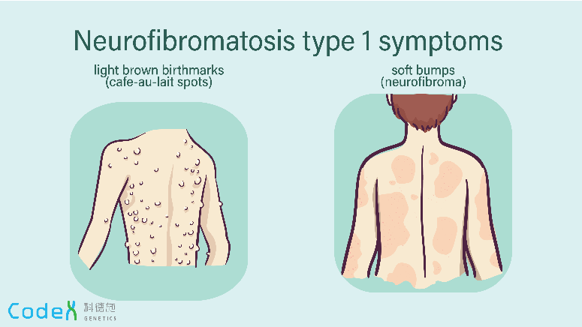
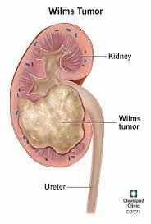
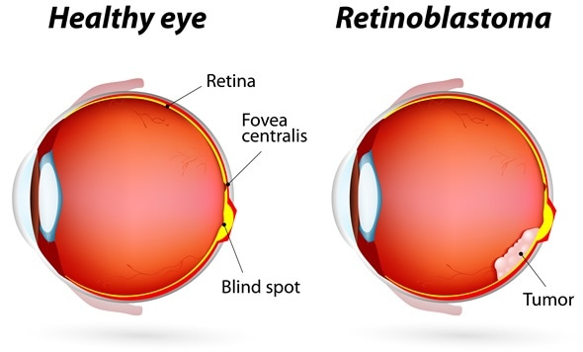
Tumor suppressors
tumor suppressor proteins inhibit the same cell regulatory pathways that are stimulated by the products of oncogenes.
Most familial cancer syndromes are inherited as a recessive trait and correspond to the constitutive inactivation of an important tumor suppressor gene.
In many tumors suppressors are lost or inactivated.
Tumor suppressors are often named according to the type of tumor developing due to their loss of function.
Rb (= retinoblastoma)
WT (= Wilm’s tumor)
NF1 and NF2 (= neurofibromatosis)
APC (= Adenomatous Polyposis Coli)
DCC (= Deleted in Colon Cancer)
VHL (= von Hippel-Lindau syndrome)

Slide 23
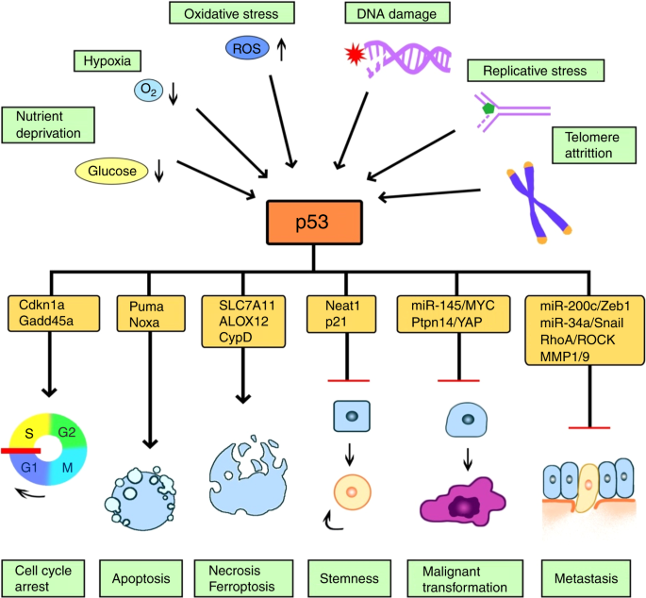
p53 – the guardian of the genome
Located at ch. 17p13
“guardian of the genome” – active in G1 and G2 checkpoints
DNA damage increases expression of p53
acts as a transcription factor for DNA repair, apoptosis and other genes
Li-Fraumeni syndrome – inherited TP53 mutation
Inhibitors of cyclin-dependent kinases (e.g. p21, p16, etc.)
p21 is the main target of p53 = inhibitor of Cdk – cell cycle arrest in G1 phase by inhibition of Cdk2/cyclin E complex

Slide 24
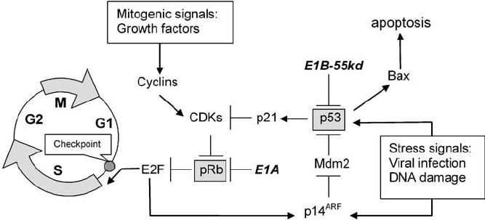
Rb protein–true tumor suppressor
Rb is a main inhibitor of the cell cycle and controls the transition from G1- to S-phase.
Rb inhibits the transcription factor E2F, which upon release from Rb ↑ expression of S phase genes (e.g. DNA replication enzymes).
Rb is present all the time, its activity is modulated by phosphorylation.
– phosphorylated Rb =inactive
– dephosphorylated Rb=active
Rb mutations are also involved in tumors of adults (bladder, breast, and lung carcinomas).
The significance of the Rb tumor suppressor gene thus extends beyond retinoblastoma.

Slide 25
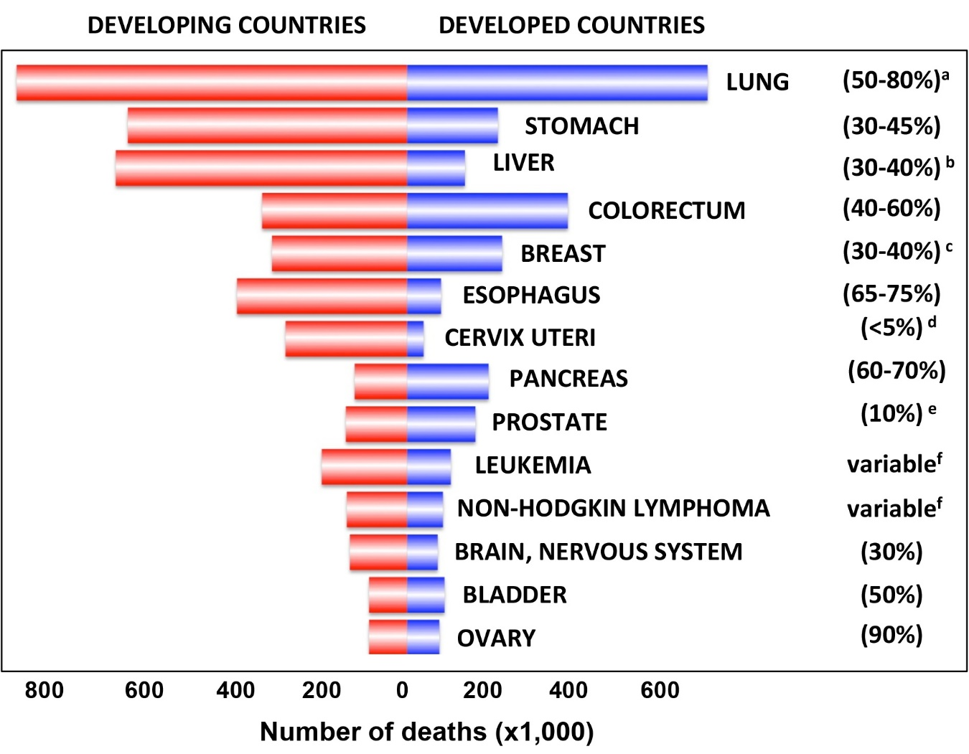
Percentage of tumors with mutated p53

Slide 26
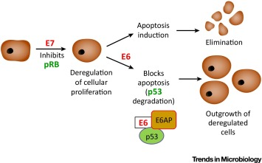
HPV and p53
The E6 viral protein expressed by HPV specifically binds to the p53 protein and induces its degradation. This observation explains the rarity of p53 mutations in HPV-positive cervical cancers.

Slide 27
Cell death
Apoptosis
Active (=needs energy), programmed cell death. The action of caspases and other apoptotic enzymes (proteases and nucleases) leads to cell fragmentation to apoptotic bodies that are removed by macrophages.
Necrosis
Accidental cell death caused mainly by external factors (temperature, pH). Cellular content is released into the environment and damage surrounding tissues. Necrosis has pro-inflammatory and tumor-promoting potential.
Regulated necrosis
Necroptosis (driven by kinases RIP1 and RIP3).
Ferroptosis (dependent on iron and characterized by the accumulation of lipid peroxides).
Parthanatos (dependent on the activity of poly (ADP-ribose)-polymerase (PARP)).
MPT-driven necrosis (induction of the mitochondrial membrane permeability transition (MPT), can lead to mitochondrial swelling and cell death).
Pyroptosis (Pyroptosis is an inflammatory cell death usually caused by microbial infection, accompanied by activation of inflammasomes and maturation of pro-inflammatory cytokines interleukin-1β and interleukin-18. Proteins from Gasdermin family are the executors).

Slide 28
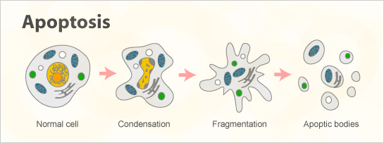
Apoptosis
https://www.youtube.com/watch?v=DR80Huxp4y8&ab_channel=WEHImovies
Apoptosis is the first described form of programmed cell death, and it plays a critical role in tissue homeostasis.
It contributes to cell turnover, the proper functioning of the immune system, and embryonic development.
There are several key characteristics of apoptosis:
cellular, organelle, and DNA fragmentation and formation of apoptotic bodies
active, energy consuming process executed by a subset of cellular proteins
Even though, in general, this process is immunological silent, apoptosis has been shown to be involved in inflammatory pathologies as well.

Slide 29
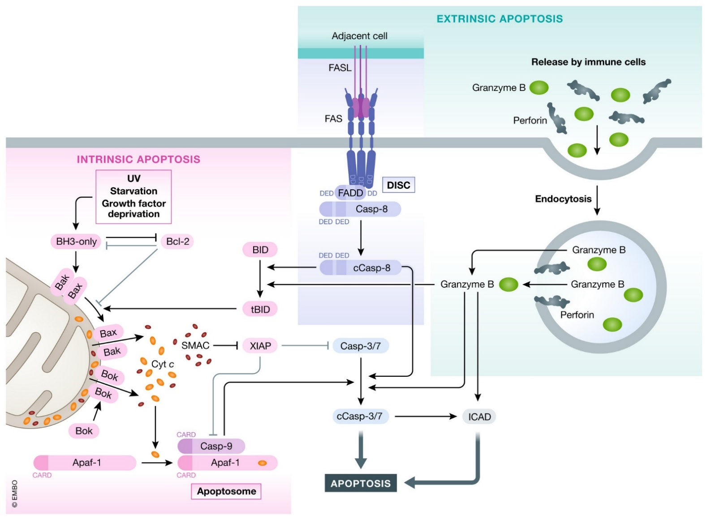
Apoptosis
There are two (or 3) major pathways that mediate apoptosis: intrinsic and extrinsic pathways.
During extrinsic apoptosis, TNF (tumor necrosis factor) superfamily (TNFSF) can induce cell death by binding to their cell surface receptors and activating a deathly signaling cascade causing extrinsic apoptosis.
Intrinsic apoptosis is controlled by the equilibrium of the different Bcl‐2 (B‐cell lymphoma 2) family members which can be disrupted by various stimuli leading to cell death.
The third modality of apoptosis induction is cell‐based. Cytotoxic T cells can engage cells that present non‐self‐antigens leading to cell death induction by proteases called granzymes.
All apoptotic pathways converge on the central proteases of this pathway: caspases, which are either playing a role in transmitting cell death stimulus (initiator caspases) or in the execution (effector caspases).

Slide 30
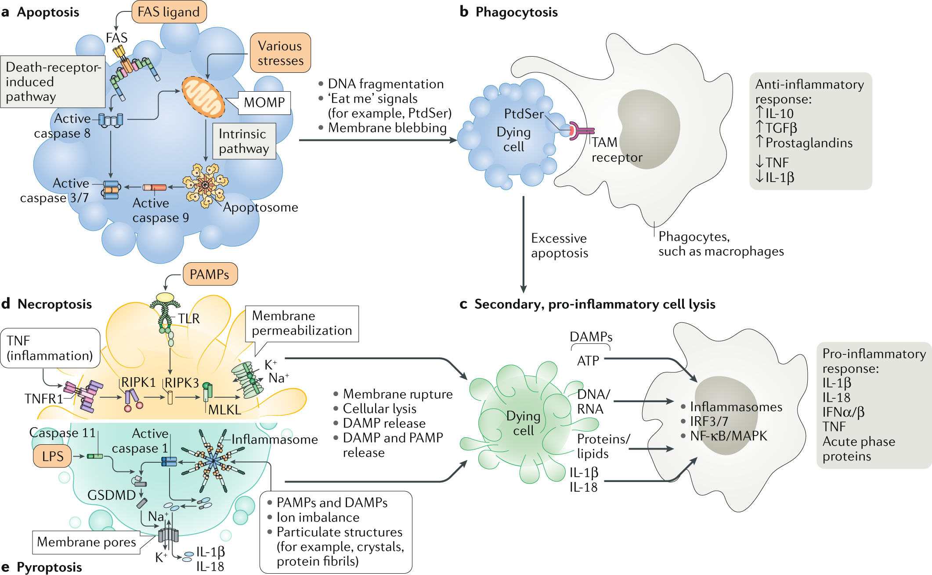
Immunogenicity of different types of cell death
Non-lytic cell death, apoptosis (the integrity of plasma membrane is sustained).
Plasma membrane rupture (PMR) is the final cataclysmic event in lytic cell death (regulated or accidental necrosis).
PMR releases intracellular molecules known as damage-associated molecular patterns (DAMPs) that propagate the inflammatory response.
Bedoui, S., Herold, M.J. & Strasser, A. Emerging connectivity of programmed cell death pathways and its physiological implications. Nat Rev Mol Cell Biol 21, 678–695 (2020). https://doi.org/10.1038/s41580-020-0270-8

Slide 31
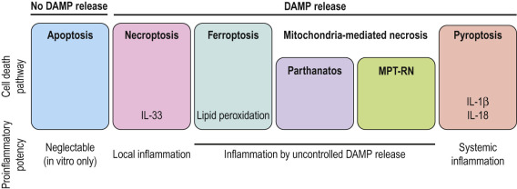
Immunogenicity of different types of cell death
The loss of plasma membrane integrity that occurs during regulated necrosis leads to the release of molecular damage-associated molecular patterns (DAMPs) into the extracellular space.
During necroptosis, anti-inflammatory cytokines (IL33) may be released in a specific context. IL33 promotes the recruitment of regulatory T-lymphocytes to the intestinal mucosa, which may limit immunogenic response in necroptosis.
In contrast, during ferroptosis or MPT-driven necrosis, no active production of cytokines or immunomodulatory factors has been described that could attenuate the immunogenic effect of DAMPs.
The most immunogenic form of regulated necrosis is pyroptosis, which involves the active production of pro-inflammatory cytokines (IL-1β, IL-18) leading to the systemic inflammatory response.

Slide 32
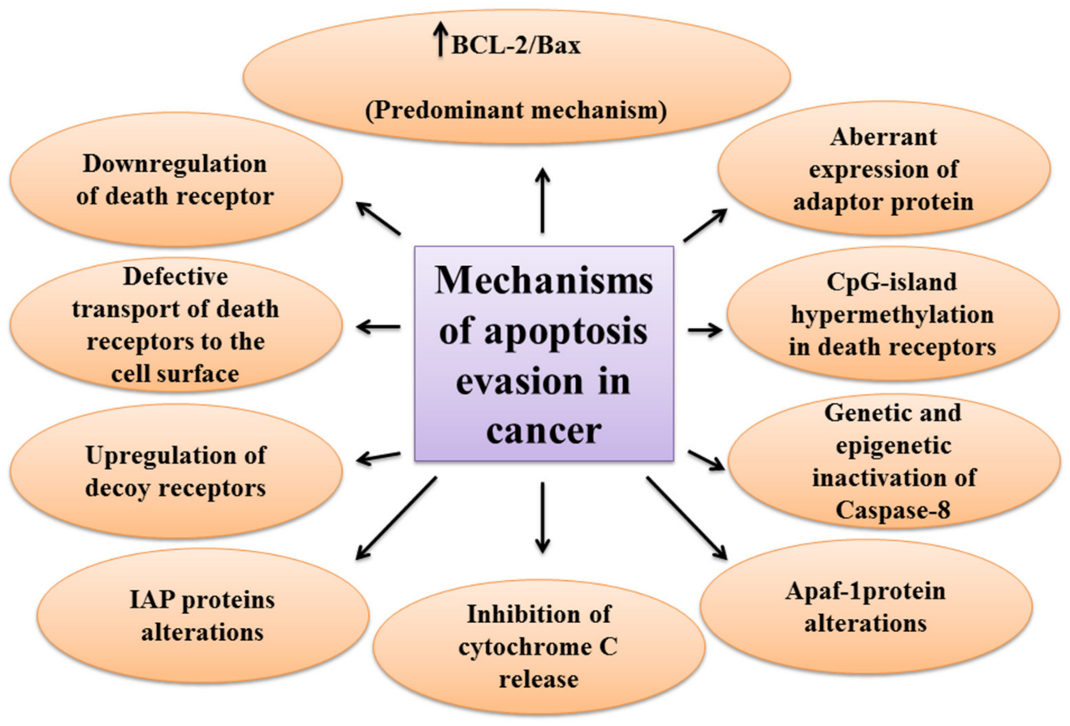
Resisting apoptosis
Tumor cells evolve a variety of strategies to limit cell death.
Most known are:
increased expression of antiapoptotic regulators (Bcl-2, Bcl-xL) and survival signals (insulin-like growth factors; Igf1/2)
downregulating of proapoptotic factors (Bax, Bim, Puma)
loss of p53

Slide 33
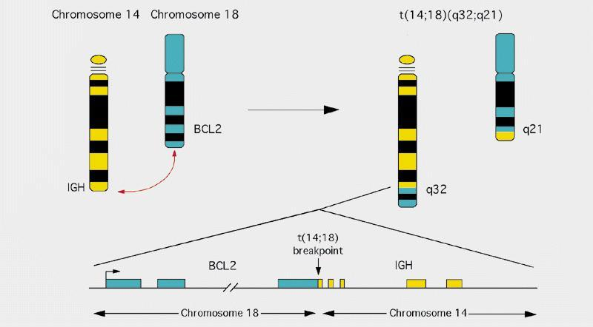
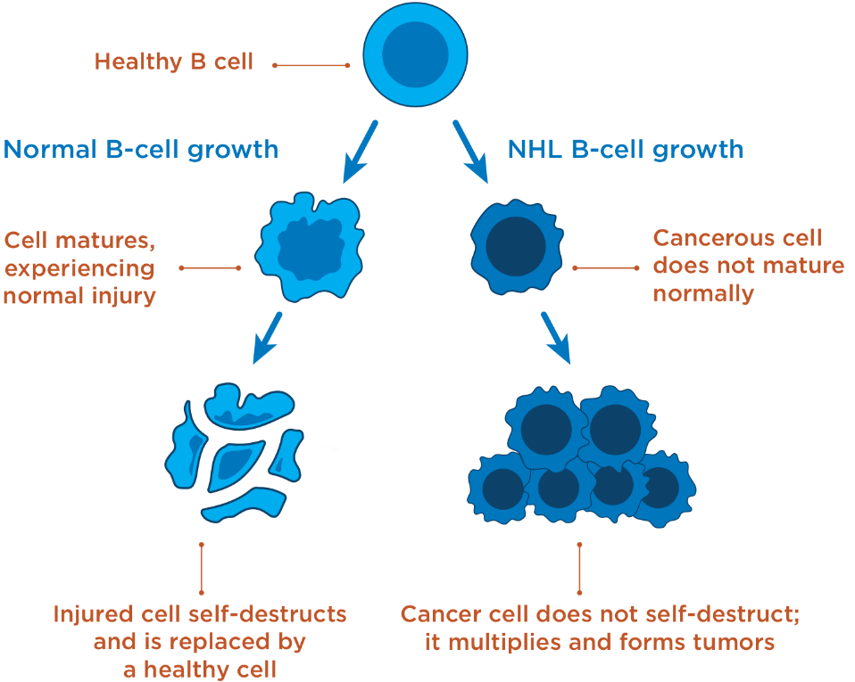
Resisting apoptosis
https://www.youtube.com/watch?v=tzwaPWElklo&t=4s&ab_channel=WEHImovies
Chromosomal translocation associated with B-cell lymphomas. The Bcl-2 gene is translocated behind a potent immunoglobulin gene promoter. Increased expression of Bcl-2 gene is associated with inhibition of apoptosis.

Slide 34
Resisting cell death by cell fusion
opportunistic behavioral patterns (cell fusion)

Slide 35
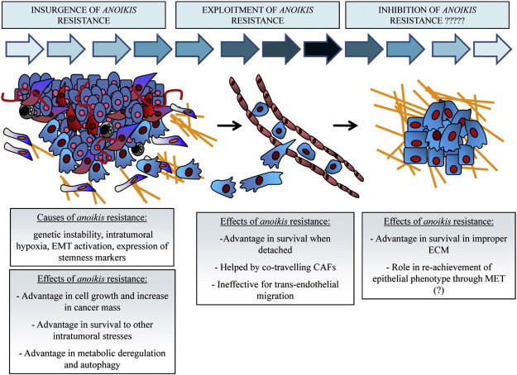
Resistance to anoikis
Anoikis is a form of programmed cell death that occurs in anchorage-dependent cells when they detach from the surrounding extracellular matrix.
barrier to metastasis
circulating tumor cells are anoikis resistant
TrkB (neurotrophic receptor) overexpression protects disseminated, circulating tumor cells from undergoing anoikis.

Slide 36
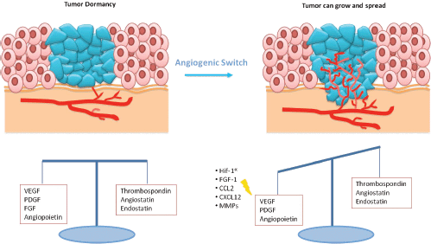
Inducing angiogenesis
Like normal tissues, tumors need nutrients and oxygen.
Tumor without blood circulation grew to 1–2 mm³. In the absence of vascular support, tumors may become necrotic.
Up-regulation of the activity of angiogenic factors is not sufficient for angiogenesis of the neoplasm. Negative regulators of vessel growth need to be downregulated.
New vessels enable the invasion of tumor cells into circulation and the creation of distant metastases.

Slide 37
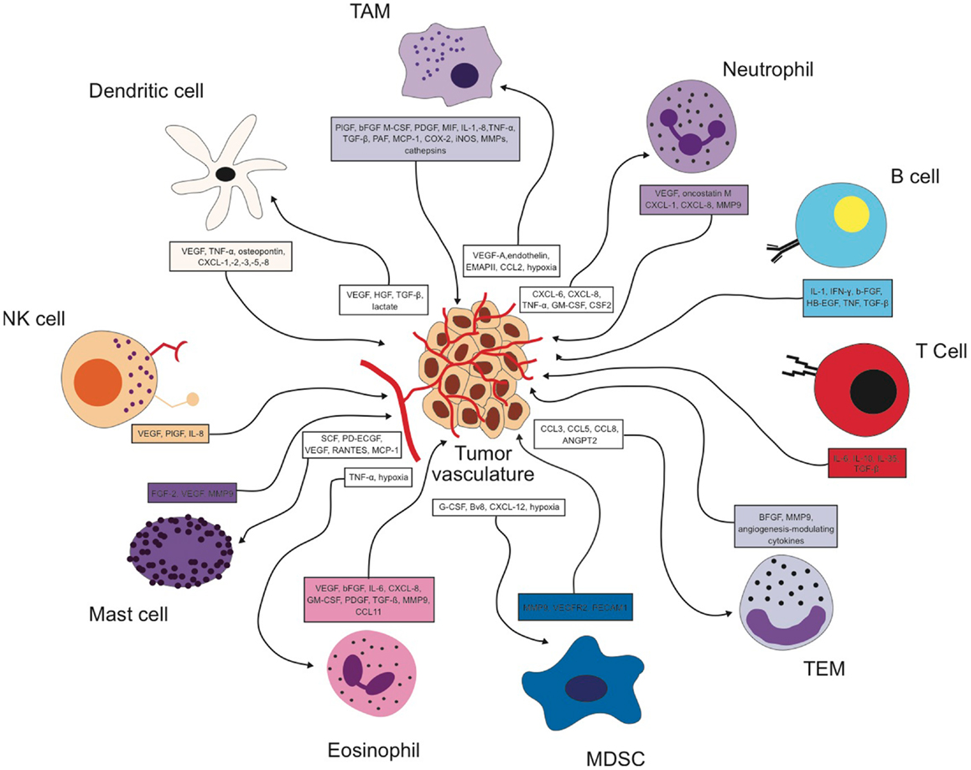
Inducing angiogenesis
Cells of the innate immune system (macrophages, neutrophils, mast cells, and myeloid progenitors) can infiltrate premalignant lesions and contribute to tumor angiogenesis.
Vascular endothelial growth factor (VEGF) production by stromal fibroblasts plays an important role in tumor angiogenesis.

Slide 38
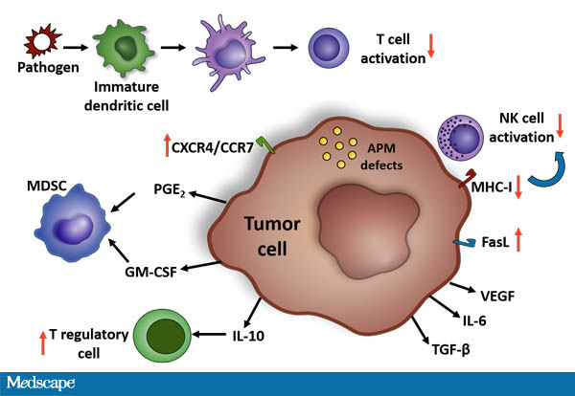
Evading immune destruction
Defective antigen presentation due to down-modulating antigen-presenting machinery (↓ major histocompatibility complex, MHC).
Immune suppression in the tumor microenvironment, mediated by CD4+CD25+ FoxP3+ regulatory T cells (Tregs), or other types of suppressive cells.
Paralyzing cytotoxic T lymphocytes (CTLs) and natural killer (NK) cells via production of immuno-suppressive cytokines (by the cancer cells or by the non-cancerous cells in the tumor microenvironment). TGF-β is a chief mediator of this activity.
Down regulation of death receptors prevents death ligand-mediated killing of tumor cells by both CTLs and NK cells.

Slide 39
Altered metabolism of cancer cells
the ability to acquire necessary nutrients from a nutrient-poor (low glucosis) and hostile (hypoxia, oxidative stress) environment and utilize these nutrients to maintain viability and build new biomass.
cancer-associated metabolic reprogramming have profound effects on gene expression, cellular differentiation, and the tumor microenvironment.
These adaptations involve an ability to access normally inaccessible nutrient sources.

Slide 40
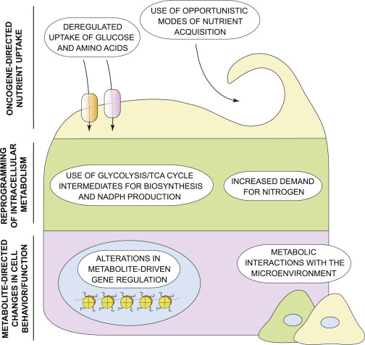
Hallmarks of cancer metabolism
deregulated uptake of glucose and amino acids (Warburg effect, glutaminolysis)
use of opportunistic modes of nutrient acquisition (cannibalism)
use of glycolysis/TCA cycle intermediates for biosynthesis and NADPH production
increased demand for nitrogen
alterations in metabolite-driven gene regulation – metabolites influence enzymes involved in deposition and removal of epigenetic marks.
metabolic interactions with the microenvironment (lactate, tomor acidosis)

Slide 41
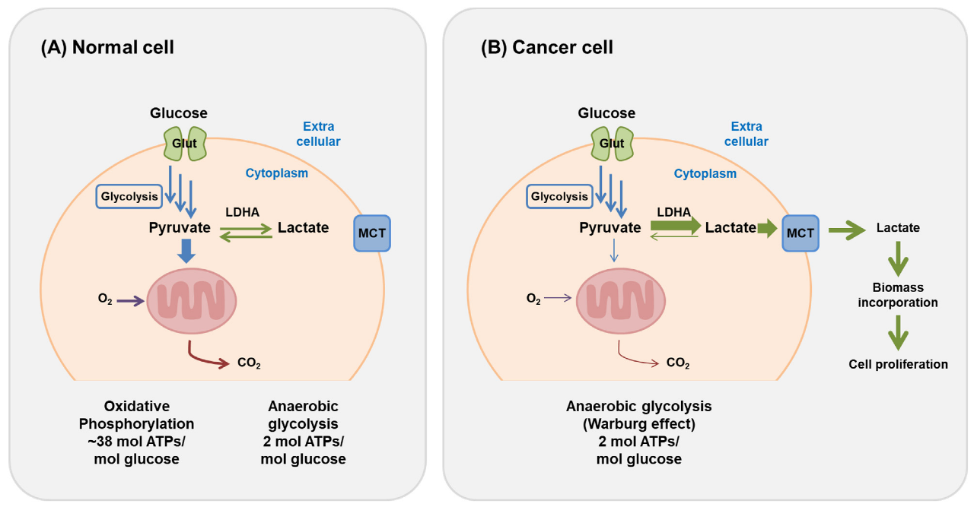
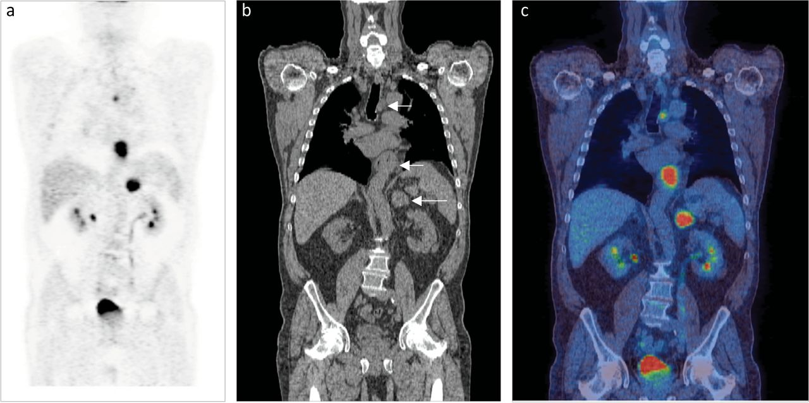
Altered metabolism
Two principal nutrients that support survival and biosynthesis are glucose and glutamine.
Glutamine provides the nitrogen required for the biosynthesis of purine and pyrimidine nucleotides and nonessential amino acids.
Warburg effect - a markedly increased consumption of glucose by some tumors in comparison to the nonproliferating normal tissues.
Positron emission tomography (PET)-based imaging of the uptake of a radioactive fluorine-labeled glucose analog, ¹⁸F-fluorodeoxyglucose (¹⁸F-FDG) has been successfully used in the clinic for tumor diagnosis.

Slide 42
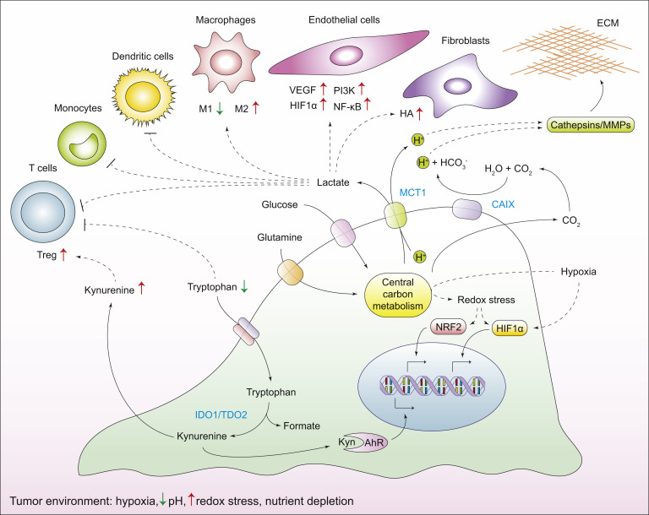
Metabolic interactions with the microenvironment
Cancer cells alter the chemical composition of the extracellular milieu, which exerts pleiotropic effects on the phenotypes of normal cells that reside in the vicinity of the tumor.
Reciprocally, the microenvironment affects the metabolism and signaling responses of cancer cells.
The high metabolic demand of cancer cells leads to an accumulation of H+ ions in the TME– acidosis.

Slide 43
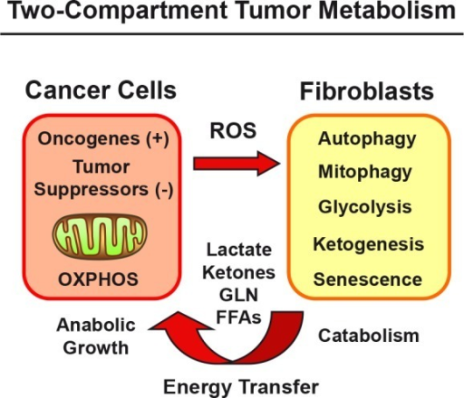
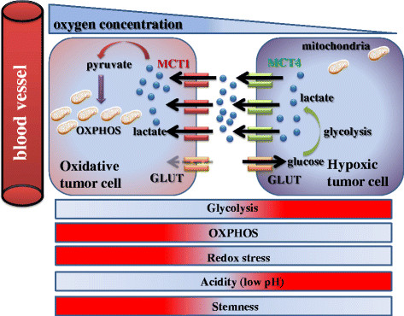
Metabolic symbiosis
Catabolic fibroblasts are a rich source of energy and biomass for the growth and survival of anabolic cancer cells.
A linear path of clonal succession oversimplifies the reality of cancer; a number of genetically distinct subclones of cells coexist within a single tumor mass: intra-tumor heterogeneity - oxidative and glycolytic tumor cells in one tumor.

Slide 44
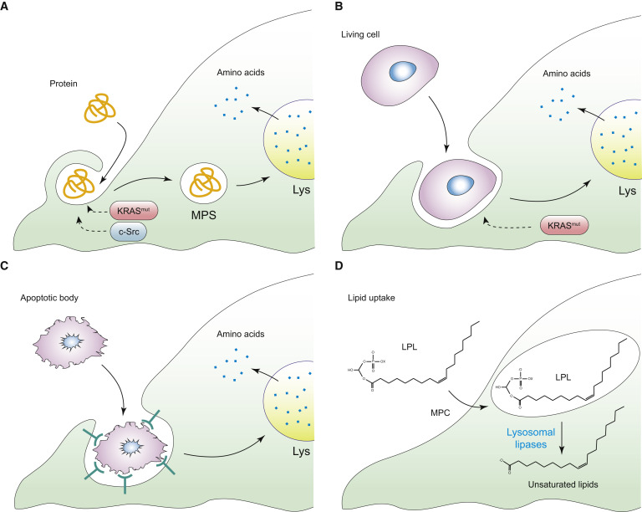
Use of opportunistic modes of nutrient acquisition
Ras or c-Src oncogenes allow to recover free amino acids through the lysosomal degradation of extracellular proteins.
Macropinocytosis.
Macroautophagy (autophagy cannot supply cells with new biomass and thus cannot support proliferation in nutrient-poor conditions).
Phagocytosis of apoptotic cellular corpses.
Cannibalism.

Slide 47
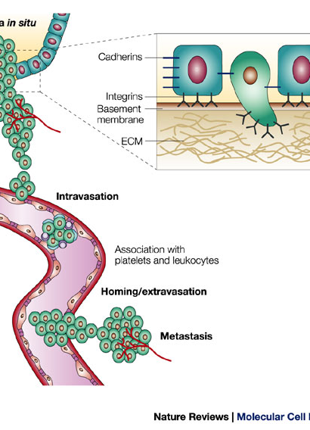
Invasion and metastasis
Cancer cells lose E-cadherin-dependent intercellular adhesions, acquire a migratory phenotype (anoikis resistance, epithelial-mesenchymal transition=EMT), penetrate the basement membrane, and invade the interstitial matrix (production of MMPs).
Tumour angiogenesis allows cancer cells to enter the bloodstream (circulating tumor cells), either directly or through the lymphatic system, by a process called intravasation.
In the circulation, tumour cells form small aggregates with platelets and leukocytes.
After stopping in the microcirculation of the target organ, tumour cells exit the bloodstream, by a process called extravasation, and undergo local expansion.

Slide 48
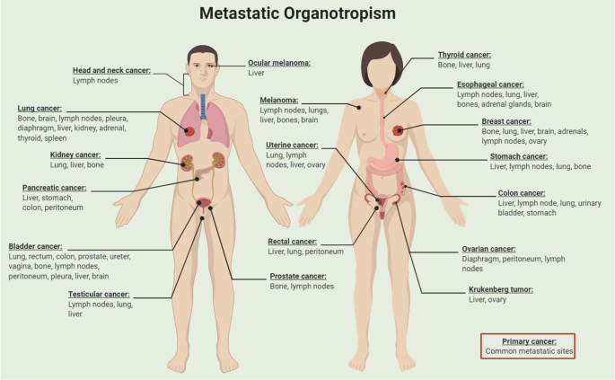
Seed and soil hypothesis –permissive microenvironment
Metastasis is dependent on the interactions between 'seeds' (the cancer cells) and the 'soil' (the host microenvironment).
Different cancers have preferential sites of metastasis=organotropism (prostate cancer - the bone and the liver).
Tumour-secreted factors and tumor-shed extracellular vesicles enable the 'soil' at distant metastatic sites to encourage the outgrowth of incoming cancer cells.
Pre-metastatic niches (PMNs) are sites of immune deregulation, owing to the presence of a pro-tumorigenic, inflammatory milieu induced by tumor-secreted factors, which creates immunosuppression and coagulation disorders.

Slide 49
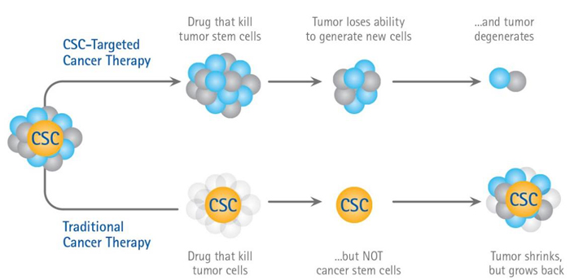
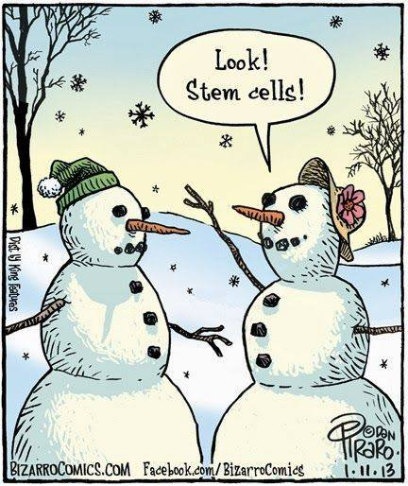
Cancer stem cell (CSC) hypothesis
Cancer stem cells are rare immortal cells within a tumor that can both self-renew by dividing and give rise to many cell types that constitute the tumor.
CSCs are responsible for tumor initiation and growth.
CSCs are associated with metastasis and relapse.
Enhanced resistance to therapy and cell stress.
Such cells have been found in various types of human tumors and might be attractive targets for cancer therapy.

Slide 50
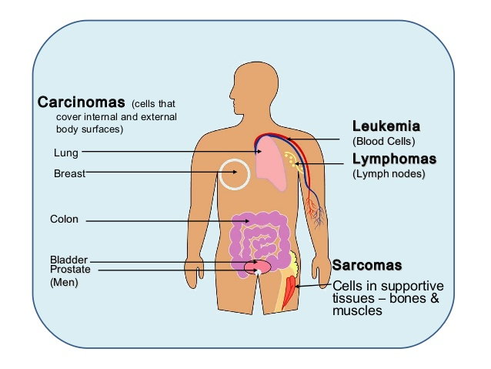
Tumor clasification
the most common human cancers are of epithelial origin—carcinomas.
two main categories: squamous cell carcinomas (from epithelia that form protective cell layers) and adenocarcinomas (from secretory epithelia).
Nonepithelial malignant tumors include sarcomas (from mesenchymal cells); hematopoietic cancers (from the precursors of blood cells); and neuroectodermal tumors (from components of the nervous system).

Slide 51
Tumor clasification
If a tumor’s cells have dedifferentiated (lost all tissue-specific traits), its origin can not be readily identified; such tumors are said to be anaplastic.
Benign tumors may be hyperplastic or metaplastic. Hyperplastic tissues are normal except for an excessive number of cells, whereas metaplastic tissues show displacement of normal cells by normal cell types not usually encountered at that site.
Dysplastic tumors contain cells that are cytologically abnormal. Dysplasia is a transitional state between completely benign and premalignant.
Adenomas, polyps, papillomas, and warts are dysplastic epithelial tumors that are considered to be benign because they respect the boundary created by the basement membrane.

Slide 52
Tumor clasification
typing = histological type
grading = benign × malignant
staging = TNM classification (T = tumor, N = node, M =metastasis)

Slide 53
Interaction of tumor with the host
local effect of tumor
mechanical compression (eg. brain tumors)
obstruction (e.g. carcinoma of the ductus choledochus)
bleeding, bruise (leukaemia)
chronic blood losses into GIT (gastric and intestinal tumors)
oedema (e.g. lymphomas)
coughing (lung carcinoma)
thromboses
difficult swallowing (oesophageal ca)
loss of vision (compression of optic nerve by hypophyseal adenoma)
voice changes (laryngeal carcinoma)
pathological fractures (myeloma)

Slide 54
Interaction of tumor with the host
systemic effects of tumor
anemia (suppression of bone marrow) – effect of proinflammatory cytokines
fever - production of cytokines (pyrogens) by tumor (IL-1, TNFα)
tumor cachexia – anorexic mediators (TNFα)
paraneoplastic syndromes – some tumors produce hormones (adenomas); important diagnostically!
–pigmentation
–endocrinopathy (Cushing sy., hypercalcemia).

Slide 55
Cancer biomarkers
Cancer biomarkers are substances that are produced in response to cancerogenesis.
These substances can be found in the tumor tissue, stool, blood, urine, or other bodily fluids.
Most cancer biomarkers are proteins. However, patterns of gene expression (mRNA, miRNA) and changes in DNA can be used (SNPs, mutations).

Slide 56
Cancer biomarkers
Cancer biomarkers can be classified into the categories based on their usage:
Predictive biomarkers predict response to specific therapeutic interventions (positivity/activation of HER2 that predicts response to trastuzumab in breast cancer).
Prognostic biomarkers aim to inform regarding the risk of clinical outcomes such as cancer recurrence or disease progression.
Diagnostic biomarkers are used to identify whether a patient has a specific disease.

Slide 57
Cancer biomarkers – clinically relevant examples
Alpha-fetoprotein (AFP)
Cancer types: Liver cancer and germ cell tumors
Tissue analyzed: Blood
How used: To help diagnose liver cancer and follow response to treatment; to assess stage, prognosis, and response to treatment of germ cell tumors
BCR-ABL fusion gene (Philadelphia chromosome)
Cancer type: Chronic myeloid lukemia, acute lymphoblastic leukemia, and acute myelogenous leukemia
Tissue analyzed: Blood and/or bone marrow
How used: To confirm diagnosis, predict response to targeted therapy, and monitor disease status
Cencer antigen (CA) 15-3
Cancer type: Breast cancer
Tissue analyzed: Blood
How used: To assess whether treatment is working or disease has recurred

Slide 58
Cancer biomarkers - examples
HER2/neu gene amplification or protein overexpression
Cancer types: Breast cancer, gastric cancer
Tissue analyzed: Tumor
How used: To determine whether treatment with certain targeted therapies is appropriate
Prostate-specific antigen (PSA)
Cancer type: Prostate cancer
Tissue analyzed: Blood
How used: To help in diagnosis, assess response to treatment, and look for recurrence
Carcinoembryonic antigen (CEA)
Cancer types: Colorectal cancer and some other cancers (lung, breast)
Tissue analyzed: Blood
How used: To assess response to treatment, and look for recurrence

Slide 59
Thank you for your attention

