Slide 1
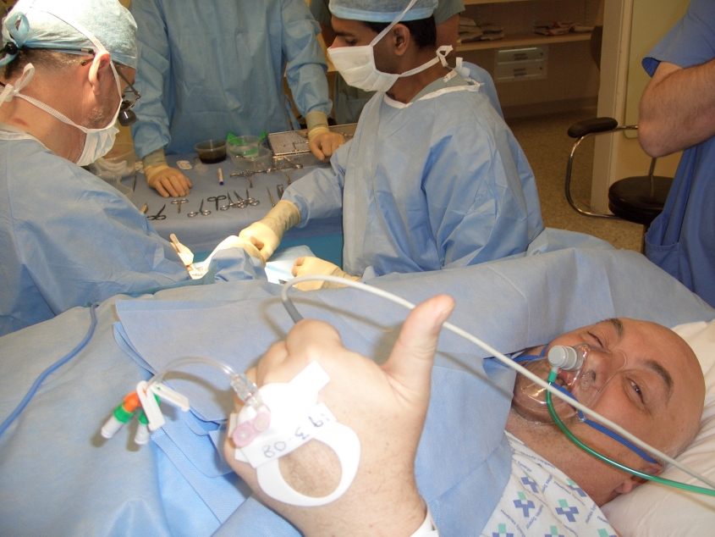
REGIONAL ANAESTHESIA
Katarina Zadrazilova
Kamil Hudacek
Faculty of medicine, Masaryk University
University Hospital Brno

Slide 2
Local anaesthetics
Regional anesthesia
Types
Uses and benefits
Video

Slide 3
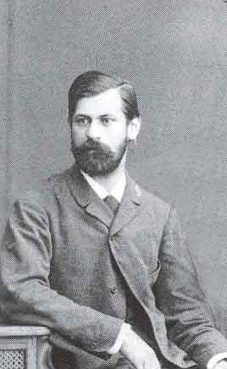
History
1860 cocaine isolation– Niemann
1884 clinical use – Koller
1905 synthesis of procaine – Einhorn
1943 synthesis of lidocaine – Löfgren
50-th – trimekaine (CSSR)
1950 bupivacaine synthesis – Ekenstam
1963 clinical use of bupivacaine - Widman

Slide 5
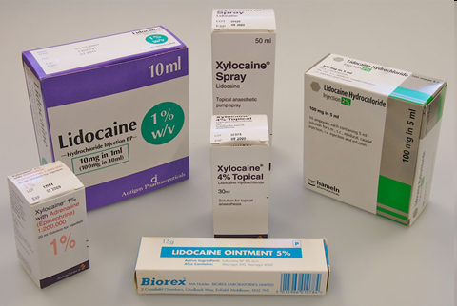
Local anaesthetics
Block transmission of action potentials in nerve fibers
LA blocks somatic sensory, autonomic and motor nerve conduction
Weak bases

Slide 6
What does the block of nerves lead to?
Somato-sensory nerves - loss of cutaneous sensation (numbness), proprioception
Motor nerve - loss of movement
(if it is a motor nerve) in the distribution of the peripheral nerve
Autonomic nerves - vasodilation and warmth

Slide 7
Regional anesthesia
Surgery can proceed without pain
Postoperative analgesia dependent on the choice of LA and the anatomical location of the block
Possible use of catheter – prolonged analgesia
RA can be placed awake, with sedation or under general anaesthesia

Slide 8
Use of RA
Analgesia, e.g. fractured femur, fractured ribs
As the sole anaesthetic for surgery with or without sedation, e.g. hand surgery
In combination with GA, e.g. total knee replacement
For postoperative analgesia

Slide 9
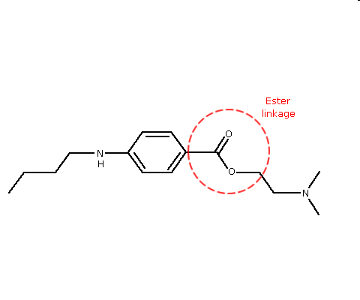
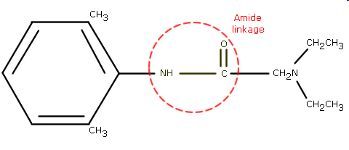
LA – structure
Esters | Amides
procaine | lidocaine
chlorprocaine | bupivacaine
tetracaine | ropivacaine
amethocaine | trimecaine

Slide 10
Pharmacokinetics
Esters
Poorly protein bound – shorter duration of action
Broken down by esterases
Allergic reaction
Amides
Highly protein bound – longer duration of action
Metabolised by amidases in the liver
Rarely allergic reactions

Slide 11
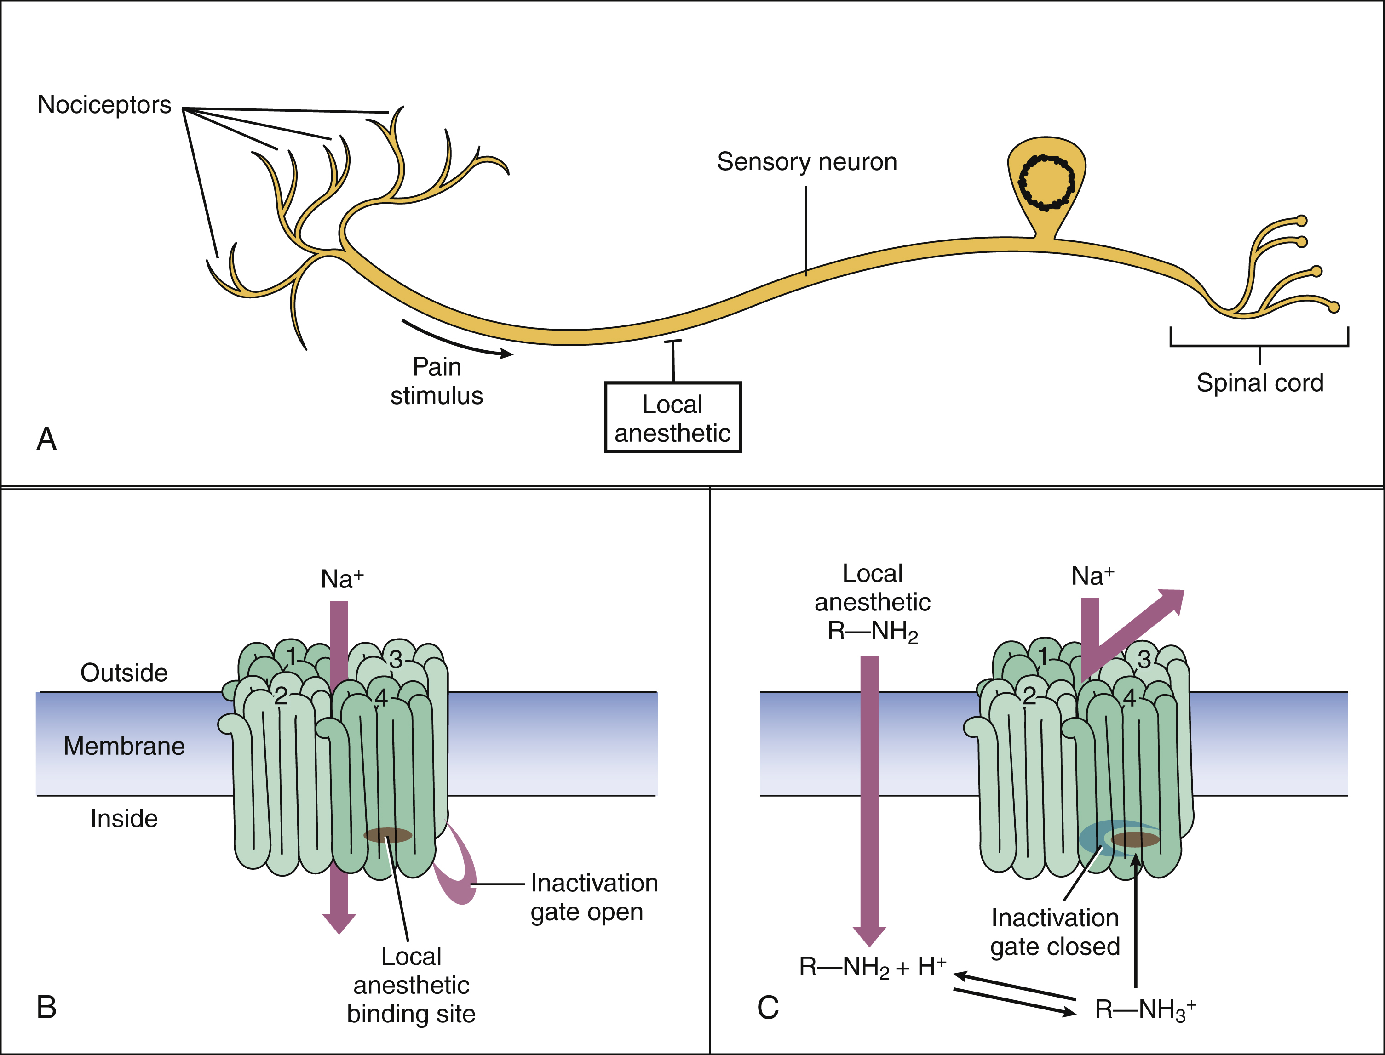
Mechanism of action
reversible blockade of Na channels
Notes:
11
The unionized form of the local anaesthetic must cross the axonal lipid membrane to reach the inside. Once inside, it is the ionized form of the drug that is effective in blocking the channel. The more unionized, the more rapid the passage across the membrane and the faster the onset of block.

Slide 12
Choice of LA
Potency
Speed of onset
Duration of action
Toxicity

Slide 13
Potency
Lipid solubility
bupivacaine is more lipid soluble than lidocaine by a factor of about nine
Lidocaine | Bupivacaine
150 | 1000

Slide 14
Speed of onset
What determines the proportion of any drug in the ionized form compared with the unionized form?
Three factors:
whether the drug is a weak acid or a weak base
the pKa of the drug - pH at which the ionized and unionized forms are present in equal amounts
the pH of the environment
Notes:
14
Local anaesthetics are weak bases; weak bases are ionized below their pKa. Both lidocaine and bupivacaine have a pKa above plasma pH. At pH 7.4 both these drugs will mainly be ionized, but for lidocaine approximately 25 % will be unionized, whereas for bupivacaine just 15 % is unionized.

Slide 15
Speed of onset - pKa
The higher the proportion of unionized drug, the more rapid the passage across the membrane and the faster the onset of block.
Lidocaine | Bupivacaine
7.7 | 8.1
Can you think of a situation when tissue pH is low and local anaesthesia may be indicated?

Slide 16
Duration of action
Protein binding
Rate of removal from the site and subsequent metabolism
Drug’s inherent vasodilator property
Additives - epinephrine
 | Lidocaine | Bupivacaine
Protein binding | 70 % | 95 %
Metabolism | liver | liver
Notes:
16
Adrenaline is a vasoconstrictor that will reduce blood flow at the site where the local anaesthetic is placed.
prolong the duration of block
By restricting lidocaine absorption into the blood stream, the addition of adrenaline allows a higher dose of lidocaine to be used

Slide 17
Local anaesthetics - additives
Epinephrine = adrenaline – decreased absorption, metabolism, toxicity
CAVE: do not use for terminal part of extremity
Bicarbonate – faster onset of action
Clonidine or dexmedetomidine - α2 adrenergic agonist, prolongs duration of sensory and motor block
Opiods – spinal/peripheral opiates receptors
Ketamine – NMDA receptor agonist, weak LA properties
Dexamethasone - prolong duration, reduce inflammation

Slide 18
LA - complications
Bleeding
Infection / gangrene – with additives
Block failure
Allergic reactions – anaphylaxis
Nerve injury - very rare
Toxicity – cardiac and neuro
Technique related
Notes:
Nerve damage, bleeding, hematoma, inadvert subarachnoidúepidural injection, iv injection, pneumothorax

Slide 19
LAST = local anesthetic systemic toxicity
Cardiotoxicity
Block of Na cardiac channels
Direct myocardial depressant effect - CV collapse
Tachycardia may enhance frequency - dependent blockade
Bupivacaine > ropivacaine > lidocaine

Slide 20
Toxicity of LA
Neurotoxicity
Biphasic effect
Inhibitory neurons are blocked – excitatory effects
Central neurones are then depressed
Circumoral tingling
Visual disturbance
Tremors
Dizziness
Convulsions
Arrhythmias
Coma
Apnoea
Death

Slide 21
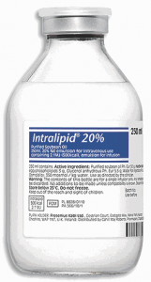
Management of LAST
ABC approach
100% Oxygen
Treat convulsions - BZD or thiopental
Treat arrhythmias - amiodarone
Lipid emulsion (20% Intralipid)
If cardiovascular collapse – start CPR

Slide 22
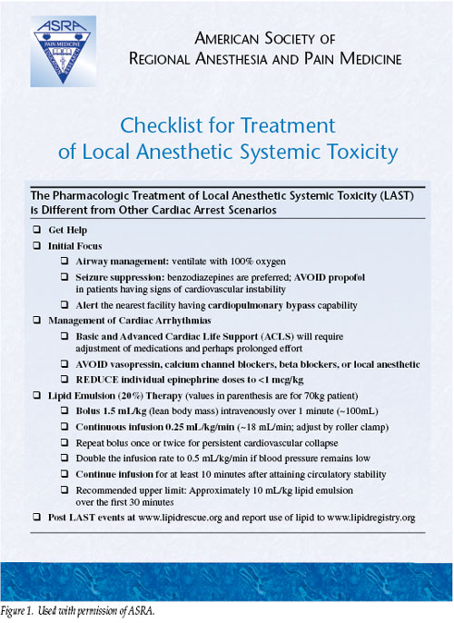

Slide 23
Lidocaine, Trimecaine
Low level of toxicity
Lidocaine – class Ib anti-arrhytmic
Max doses lidocaine
3mg/kg without adrenaline
7 mg /kg with adrenaline
Concentrations
Topical 10%, 2%
Nerve blockade 0.5 – 1%

Slide 24
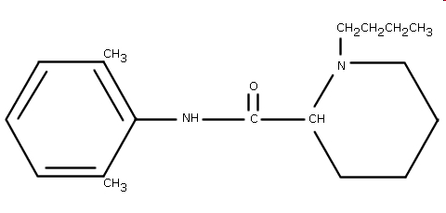
Bupivacaine
Slower onset
Longer duration of action
More toxic
Racemic mixture
0.25 % and 0.5 % concentrations
Also in combination with glucose 80 mg/ml
Max dose 2mg/kg

Slide 25
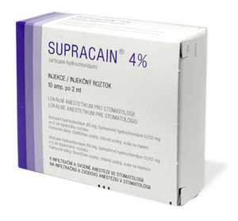
Articaine
Fast onset
Moderate duration of action
Used in dentistry with adrenaline
Concentrations - 1 - 2 %

Slide 26
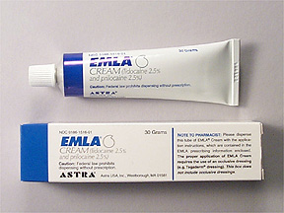
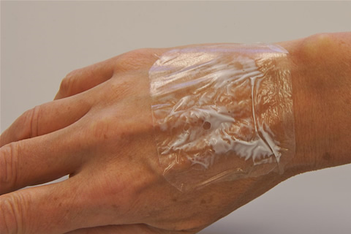
EMLA cream
Eutectic mixtute of local anaesthetic in cream
2.5 % lidocaine + 2.5 % prilocaine
Topical anaesthesia prior cannulation

Slide 27
Local anaesthetics - summary
Esters and amides
Onset of action – pH and pKa
Duration of action – protein binding, vascularity
Potency – lipid solubility
Used with additives
Side effects – neuro and cardiac toxicity, alllergic reaction (esters)

Slide 28
Use of Local Anaesthetic agent
Topically: skin, mucous membranes, gel, cream, spray
Infiltration: for field-blocks where superficial nerves are blocked locally
Intravenously: for intravenous regional anaesthesia (IVRA) – lidocain only
Epidural or subarachnoid: for regional anaesthesia blocking spinal nerves

Slide 29
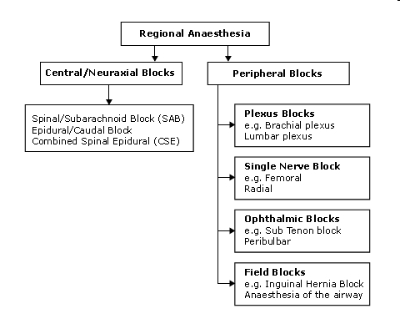

Slide 30
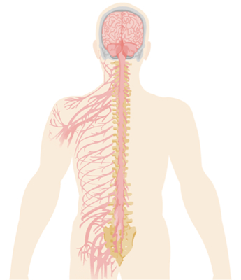
When to use regional techinques
Patient safety
Patient satisfaction
Surgical outcome
Notes:
30

Slide 31
1.Patient safety
A frail elderly diabetic patient with severe COPD, requires an amputation of the fifth toe.
Ring block
Ankle block
Popliteal block
Sciatic block
Spinal or epidural

Slide 32
1.Patient safety
A frail elderly diabetic patient with severe COPD, requires an amputation of the fifth toe.
Ring block
Ankle block
Popliteal block
Sciatic block
Spinal or epidural

Slide 33
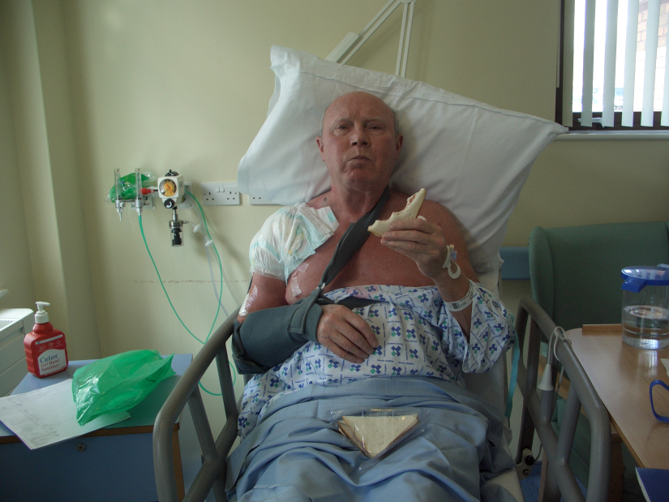
2.Patient satisfaction
Very low incidence of
postoperative nausea or vomiting (PONV)
Rapid resumption of oral intake
No sore throat
Good initial post operative analgesia
Early ambulation/discharge
Increased 'control'
Notes:
33
Fear of unknown/awareness/confusion/rare risks of GAs. - controll

Slide 34
3.Surgical outcome
Any measure that improves safety will improve surgical outcome.
'awake' carotid endarterectomy
'awake' craniotomy
assess the patient’s neurological status during surgery

Slide 35
Other benefits
Supression of stress response
Vasodilation
improved delivery of O2
Better tissue perfusion
Analgesia – low dose or no opioids
GA + epidural analgesia / fascial block

Slide 36
Prerequisites for the RA
Informed patient consent incl. risks/benefits
Discussion with the operating surgeon
Check no contraindications to block
Skilled assistance available
Intravenous access
Full patient monitoring
Immediate access to emergency drugs / defibrillator
Fasted patient

Slide 37
Golden rules
1. Know the anatomy, the technique and the possible complications
2. Be prepared to fail – have a back up plan
Regional anaesthesia is simply an exercise in applied anatomy
Alon Winnie
Notes:
37
As Alon Winnie, the United States regional anaesthesia guru states, “Regional anaesthesia is simply an exercise in applied anatomy”.

Slide 38
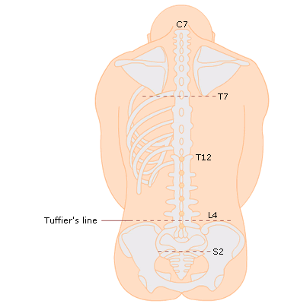
Most common regional anaesthesia
Caesarian section
Patient safety
Control of airway
Patient satisfaction
Awake during the delivery of the child
Presence of partner
Surgical outcome
Intraoperative bleeding is reduced
Reduced stress response

Slide 39
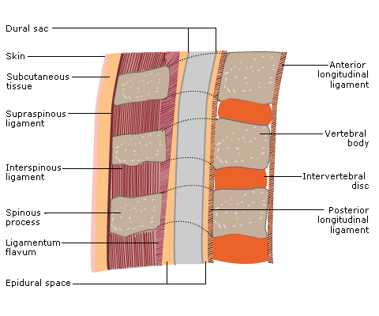
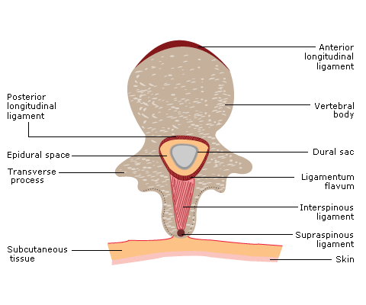
Neuroaxial blocks

Slide 40
RA combined with GA
Typically, blocks are performed in the awake or sedated patient before inducing general anaesthesia.
Able to respond to severe pain and paraesthesia
Verbal contact – LA toxicity signs, side effects related to blocks / intrathecal injection
Notes:
40

Slide 41
RA combined with GA
After induction
Paediatric population
Non compliant adult population
Difficult position, e.g. placement of an epidural for a fractured pelvis
If the patient refuses to have the technique performed awake

Slide 42
Regional anaesthesia - summary
RA can be used alone or in combination with general anaesthesia
RA can improve patient safety and satisfaction or surgical outcome
RA is a serious and potentially dangerous procedure
All the appropriate consent, monitoring and safeguards need to be in place before block performance
The subset of neuraxial blocks are very common and have clear contraindications and complications

Slide 44
Questions ?

