Slide 1
Endocrine function of selected organs and tissues

Slide 2
Hormones synthesized and secreted by dedicated endocrine glands
Pituitary Gland
Growth hormone (GH)
Prolactin
Adrenocorticotropic hormone (ACTH)
Thyroid-stimulating hormone (TSH)
Follicle-stimulating hormone (FSH)
Luteinizing hormone (LH)
Thyroid Gland
Tetraiodothyronine (T4; thyroxine)
Triiodothyronine (T3)
Calcitonin
Parathyroid Glands
Parathyroid hormone (PTH)
Pancreas (Islets of Langerhans)
Insulin
Glucagon
Somatostatin
Adrenal Gland
Epinephrine
Norepinephrine
Cortisol
Aldosterone
Dehydroepiandrosterone sulfate (DHEAS)
Hormones Synthesized by Gonads
Ovaries
Estradiol-17β
Progesterone
Inhibin
Testes
Testosterone
Antimüllerian hormone (AMH)
Inhibin

Slide 3
Hormones synthesized in organs with a primary function other than endocrine
Brain (Hypothalamus)
Antidiuretic hormone (ADH)
Oxytocin
Corticotropin-releasing hormone (CRH)
Thyrotropin-releasing hormone
Gonadotropin-releasing hormone (GnRH)
Growth hormone–releasing hormone (GHRH)
Somatostatin
Dopamine
Brain (Pineal Gland)
Melatonin
Heart
Atrial natriuretic peptide (ANP)
Kidney
Erythropoietin
Adipose Tissue
Leptin
Adiponectin
Stomach
Gastrin
Somatostatin
Ghrelin
Intestines
Secretin
Cholecystokinin
Glucagon-like peptide-1 (GLP-1)
Glucagon-like peptide-2 (GLP-2)
Glucose-dependent insulinotropic peptide (GIP; gastrin inhibitory peptide)
Motilin
Liver
Insulin-like growth factor-I (IGF-I)

Slide 4
Hormones Produced to a Significant Degree by Peripheral Conversion
Lungs
Angiotensin II
Kidney
1α,25-dihydroxyvitamin D
Adipose, Mammary Glands
Estradiol-17β
Liver
Testosterone
Genital Skin, Prostate, Sebaceous Gland
5-Dihydrotestosterone (DHT)
Many Organs
T3

Slide 5
Cardiovascular endocrinology
Endocrine hormones | ANP | Natriuresis and vasodilation
 | BNP | Natriuresis and vasodilation
 | GDF-15 | Inhibiting body growth
 | Myostatin | Reducing skeletalmuscle mass
Autocrine/paracrine factors | CNP | Vasodilation
 | Activin A | Protecting cardiomyocyte
 | ET-1 | Promoting cardiomyocyte survival
 | IL-33 | Antihypertrophic and antifibrosis
ANP = atrial natriuretic peptide; BNP = brain natriuretic peptide; CNP = C-type natriuretic peptide; ET = endothelin; GDF = growth differentiation factor; IL = interleukin;
*Myostatin:
produced and released by myocytes
acts on muscle cells to inhibit muscle growth
require relatively large amounts of E/nutrients

Slide 6
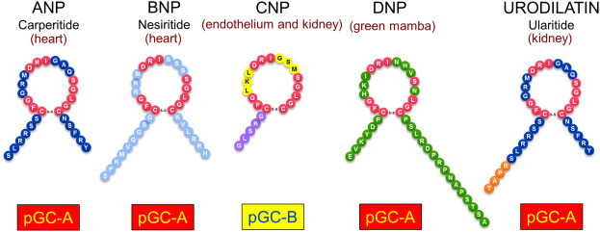
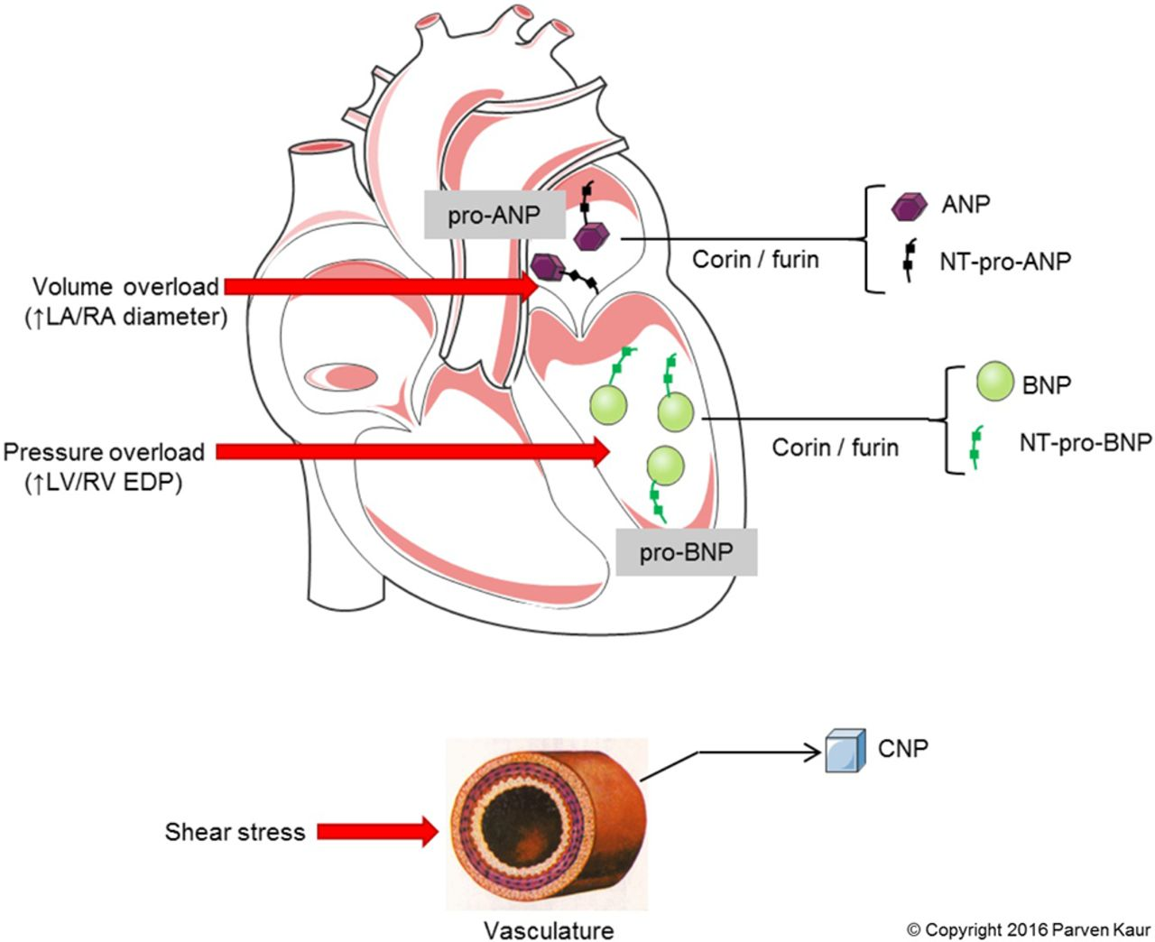
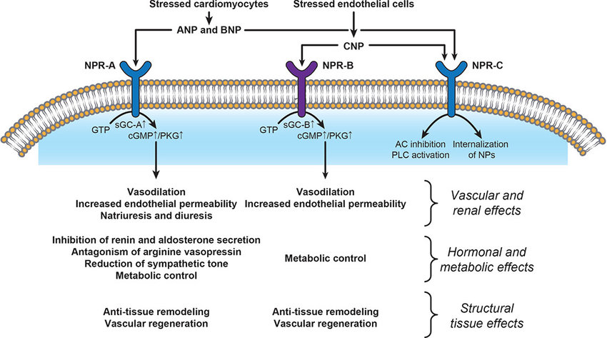
Natriuretic peptides
atrial natriuretic peptide (ANP)
B-type natriuretic peptide (BNP)
C-type natriuretic peptide (CNP)
dendroaspis-type natriuretic peptide (DNP)
urodilatin
http://dx.doi.org/10.1136/heartjnl-2017-311295

Slide 7
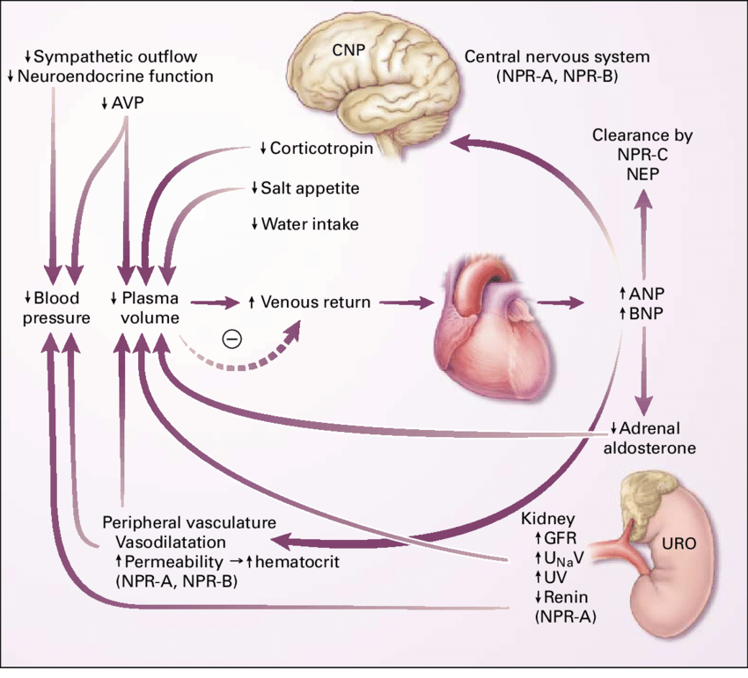
Natriuretic peptides
BP=HRxSVxTPR

Slide 8
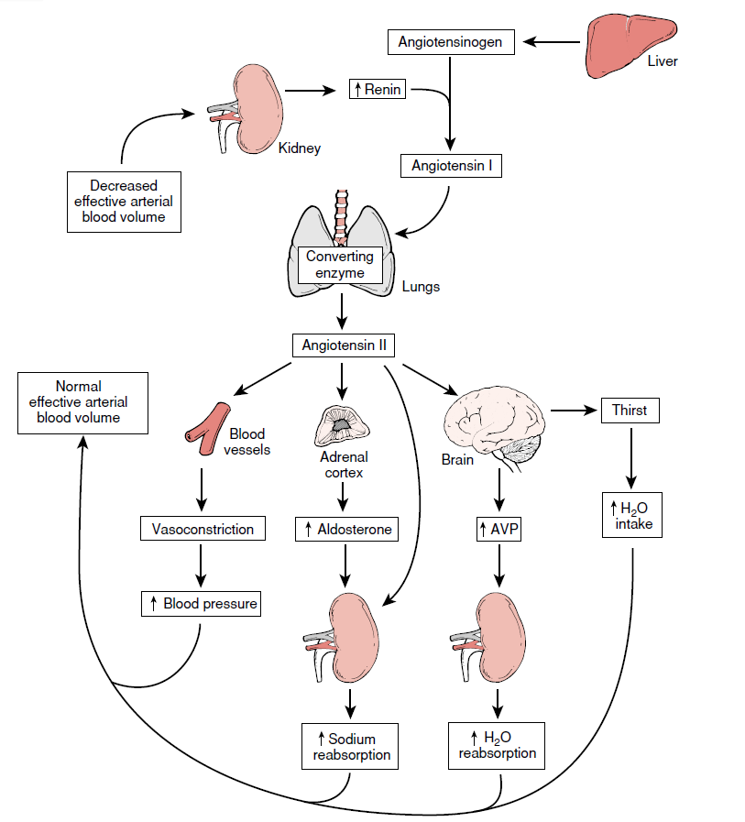
RAAS

Slide 9
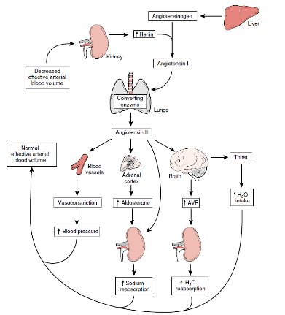
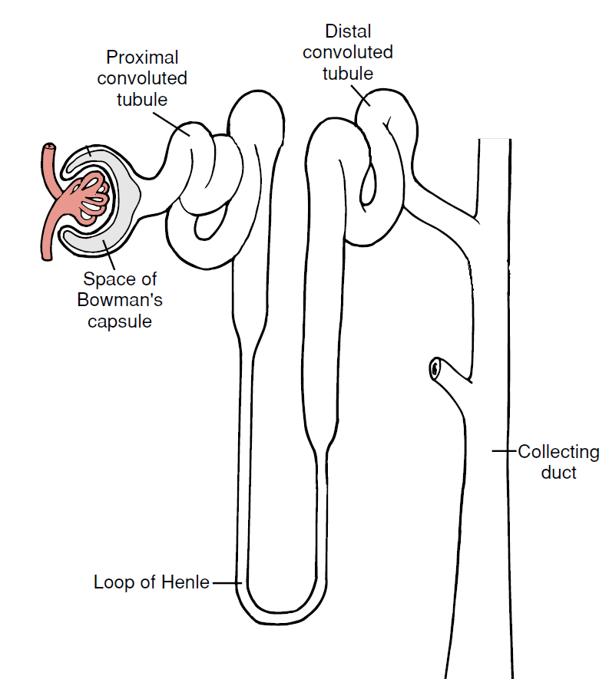
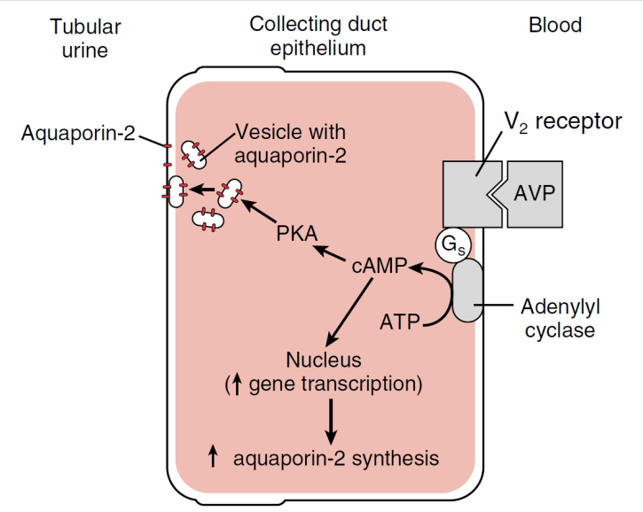
ADH
ADH
ADH

Slide 10
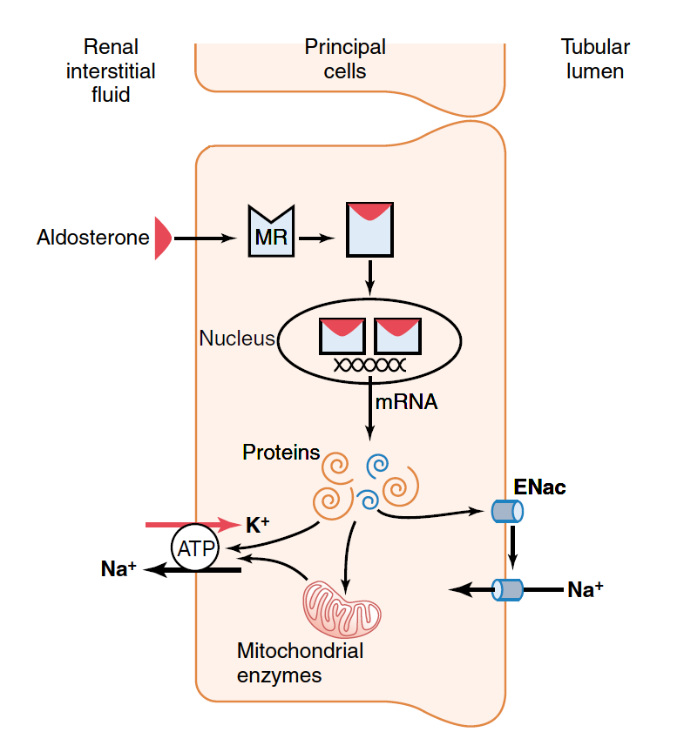
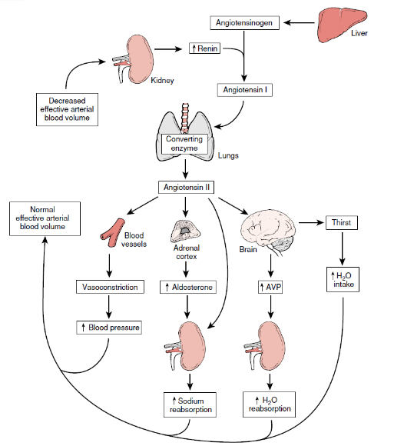
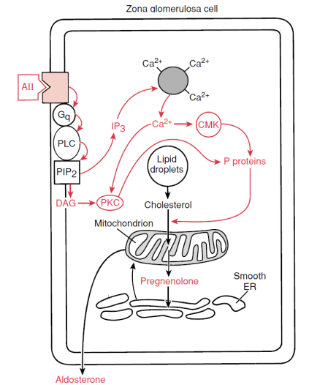
Aldosterone
ALDOSTERONE

Slide 11
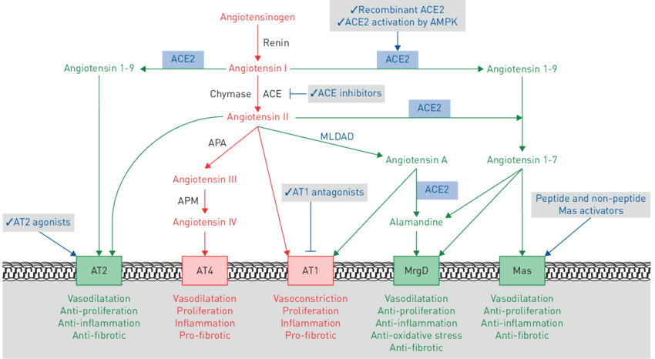
RAAS

Slide 12
Endothelial cells
Endothelial cells and organ function: applications and implications of understanding unique and reciprocal remodelling; Moritz Reiterer and Cristina M. Branco; accepted 15 November 2019; doi:10.1111/febs.15143

Slide 13
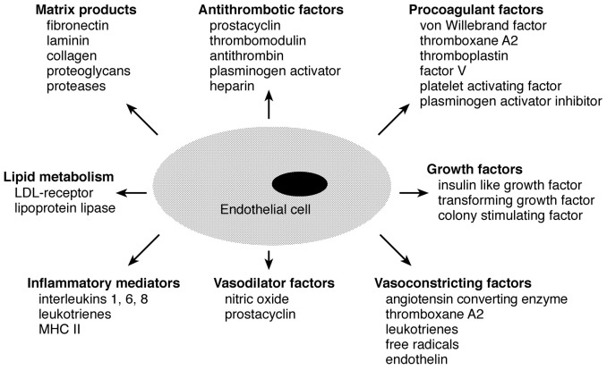
Endothelial cells
EC:
metabolic functions
synthetic functions
Physiology of the endothelium; H. F. Galley and N. R. Webster; Br J Anaesth 2004; 93: 105-13

Slide 14
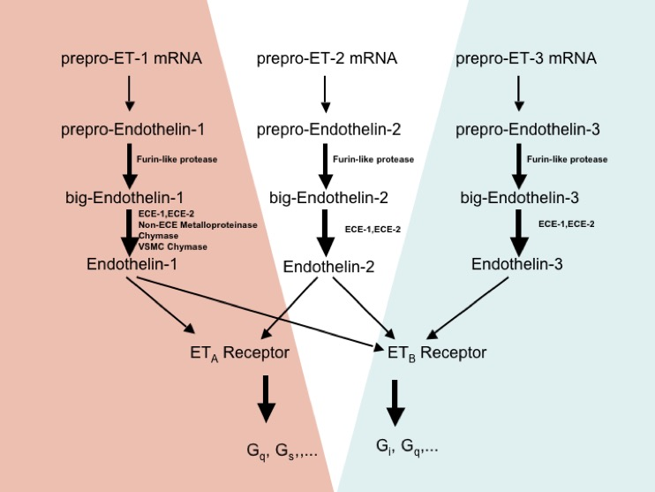
Endothelins and their receptors
ET_{A}R – vasoconstriction
ET_{B}R – vasodilation
Endothelin: 20 years from discovery to therapy; Matthias Barton and Masashi Yanagisawa; Article in Canadian Journal of Physiology and Pharmacology; September 2008; DOI: 10.1139/Y08-059

Slide 15
Skin physiology
skin pH and skin integrity
4.1–5.8
pigmentation, age, localization and skin layer
microbiome
mechanical barrier
collagen
elastin
filaggrin
immune barrier
Langerhans cells, T lymphocytes, granulocytes, keratinocytes, fibroblasts and melanocytes, skin associated lymphoid tissue
thermoregulation
photoprotection
endocrine function

Slide 16
Endocrine function of skin
Parathyroid hormone‑related peptide |  | Keratinocytes
Corticotrophin‑releasing hormone |  | Sebocytes, follicular keratinocytes, endothelial cells, dermal nerves
Urocortin |  | Epidermal and follicular keratinocytes, sweat glands, epidermal melanocytes, dermal smooth muscle cells and fibroblasts, endothelial cells
Pro‑opiomelanocortin peptides | Adrenocorticotrophic hormone | Epidermal keratinocytes, melanocytes, outer root sheath of anagen follicles, dermal fibroblasts, endothelial cells
 | Alpha‑melanocyte‑stimulating hormone
 | β‑Endorphin | Outer root sheath of anagen follicles, dermal fibroblasts
PRL |  | Dermal fibroblasts
Catecholamines (epinephrine and norepinephrine) |  | Keratinocytes
Insulin‑like growth factor‑I |  | Dermal fibroblasts, melanocytes, keratinocytes of stratum gcranulosum
Sex steroids |  | Sebaceous and sweat glands with intracellular activation depending on expression of enzymes
Retinoids (all‑transretinoic acid) |  | Low amounts in keratinocytes
Vitamin D |  | Keratinocytes
Eicosanoids (prostaglandins, prostacyclins and leukotriene) |  | Keratinocytes, sebocytes

Slide 17
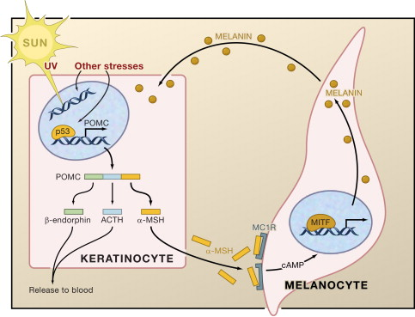
Skin and CRH-ACTH axis
POMC
↓
Pro-ACTH
↓
ACTH
POMC: The Physiological Power of Hormone Processing; Erika Harno et al; Physiol Rev. 2018 Oct 1; 98(4): 2381–2430

Slide 18
Endocrine function of adipose tissue

Slide 19
Leptin - functions

Slide 20
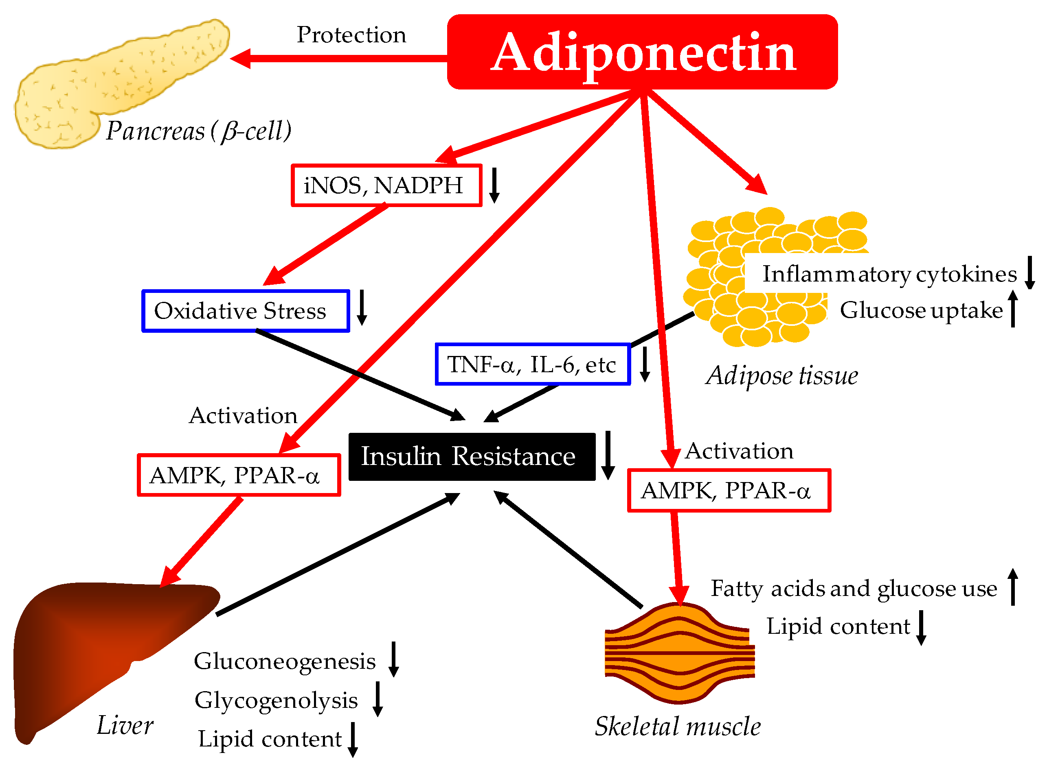
Adiponectin

Slide 21
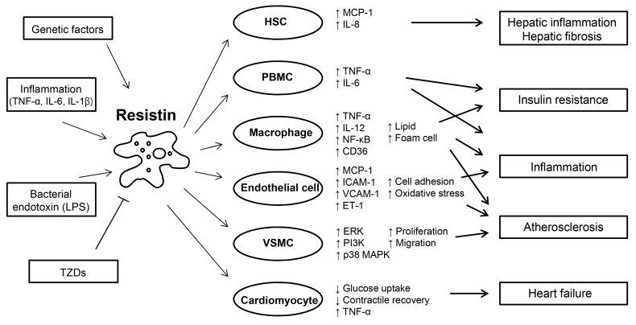
Resistin

Slide 22
Thank you for your attention

