Slide 1
POSITION
Expressing Position in Medical Terminology
Cham Ghannoum

Slide 2



EXPRESSING POSITION
A ) P R E P O S I T I O N S
B ) C O M P A R A T I V E F O R M S
C ) A D J E C T I V E S
D ) C O M P O U N D S
E ) P R E F I X E S

Slide 3
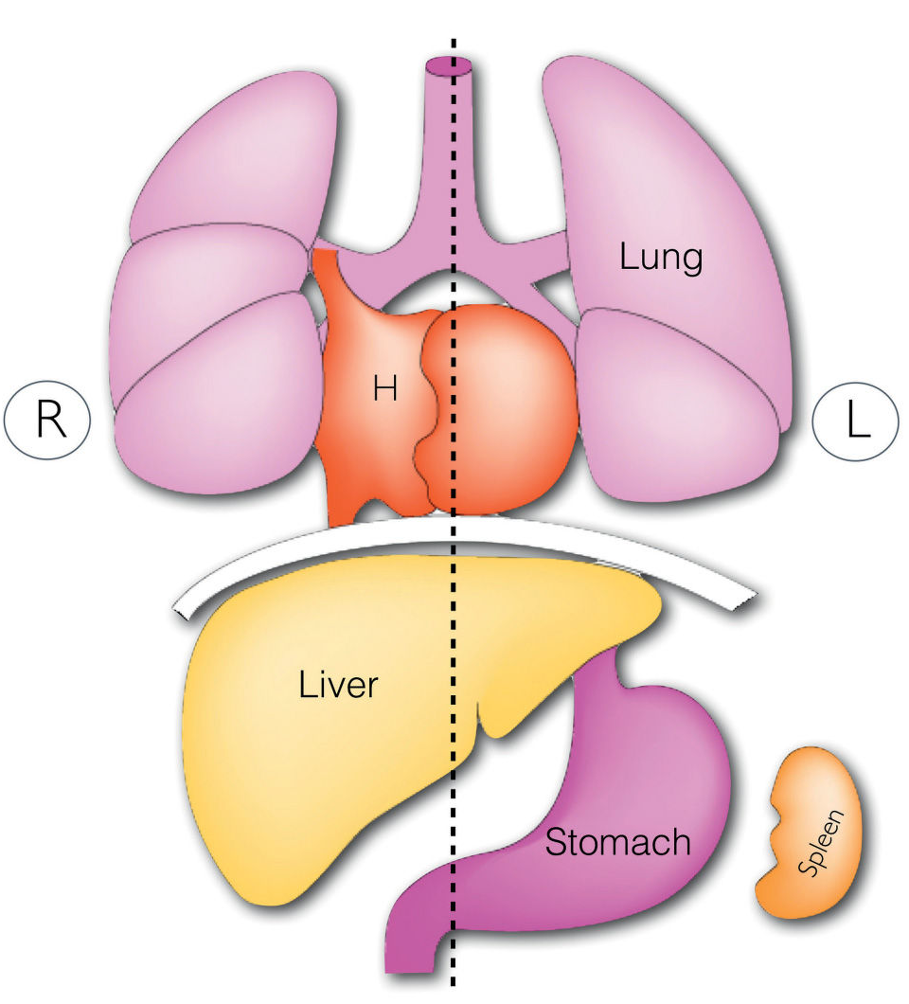
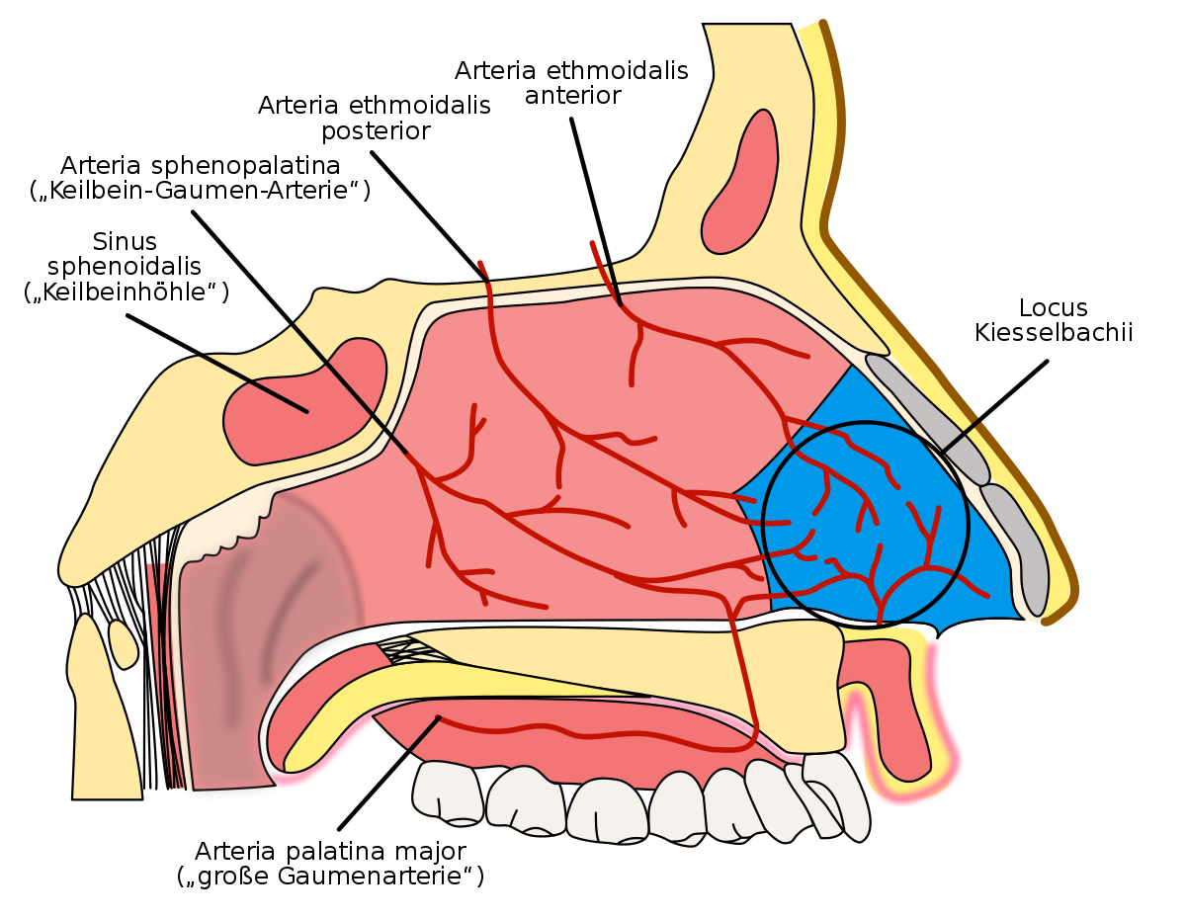
GENERAL TERMS
Locus, i, m. / Situs, us, m. = greek prefix topo- = place
> Locus is a more concrete, specific term while situs is a more abstract term with a broader sense
locus kiesselbach:
is a region in the anteroinferior part of the nasal septum
situs solitus:
refers to the normal position of the thoracic and abdominal organs

Slide 4
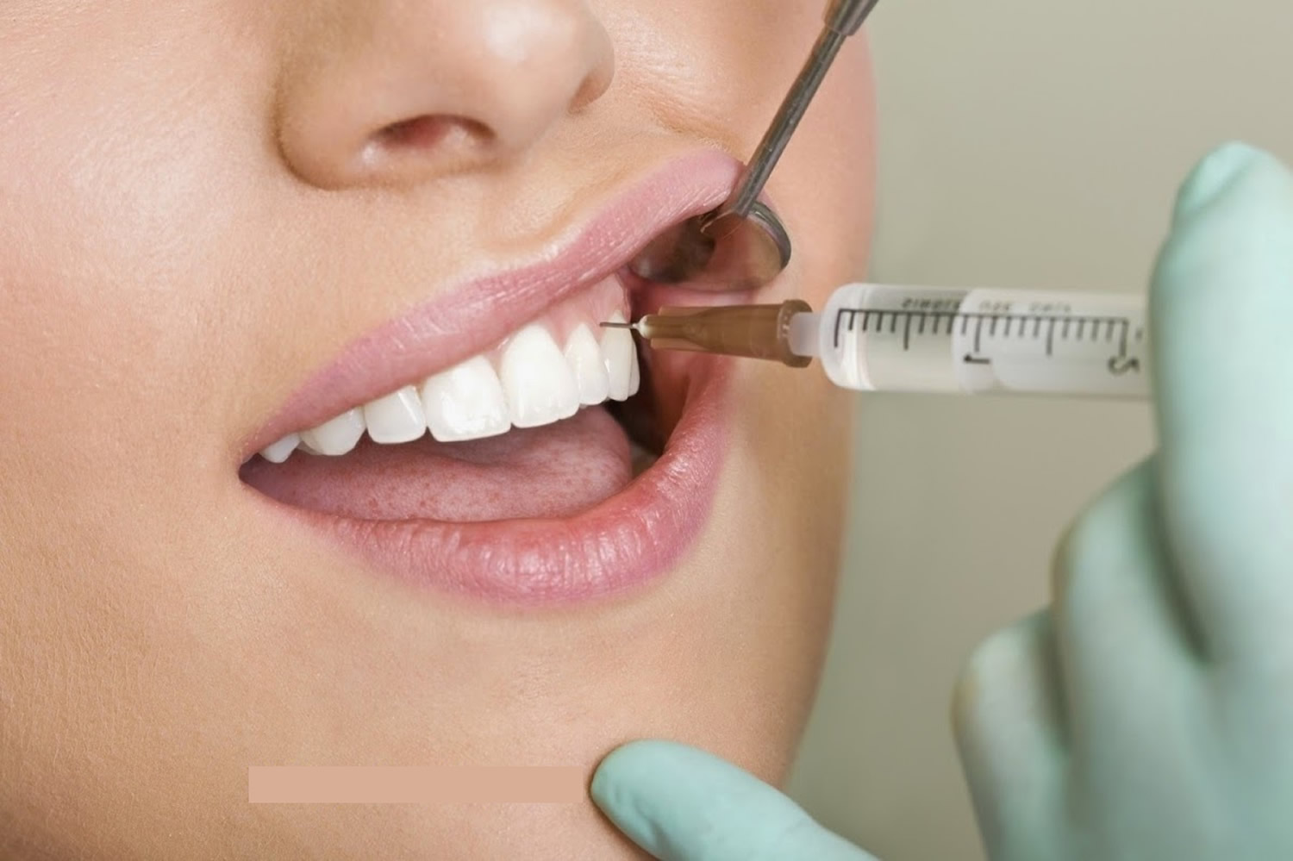
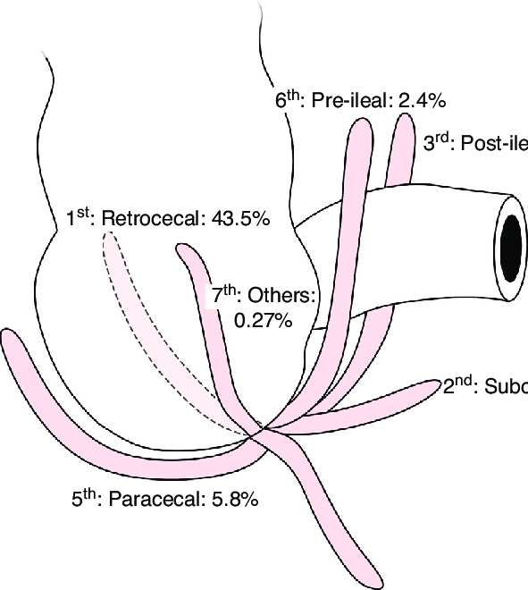
GENERAL TERMS
Localis, e
anaesthesia localis
Commonly used in:
In situ in the (mentioned) place
Loco typico in the typical place
Loco cicatricis in the place of the scar
cicatrix, icis, f. = scar
Eodem loco in the same place
positio, onis, f.
Positio retrocaecalis

Slide 5
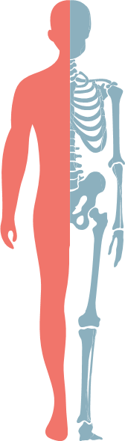
LATERAL POSITION
lateris dextri (l.dx.)
lateris sinistri (l.sin.)
lateris utriusque (l. utr.)
= on the right side, the right one
= on the left side, the left one
= on both sides, both

Slide 6
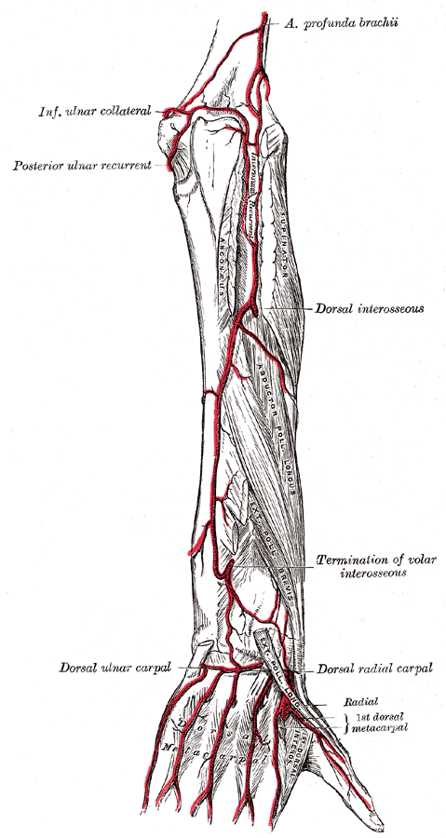
Lateral Position
- later- *(prefix) = related to side e.g., lateropositio uteri
/bi/lateralis, e = /bi/lateral e.g., decubitus bilaterales
collateralis, e = located on the same side e.g., arteria collateralis
sinistro-/dextropositio = reversal of an organ to the left/right e.g. dextropositio cordis
marginalis, e = marginal e.g., gingivitis marginalis
acralis, e = referring to extremities e.g., cyanosis acralis
arteria collateralis

Slide 7
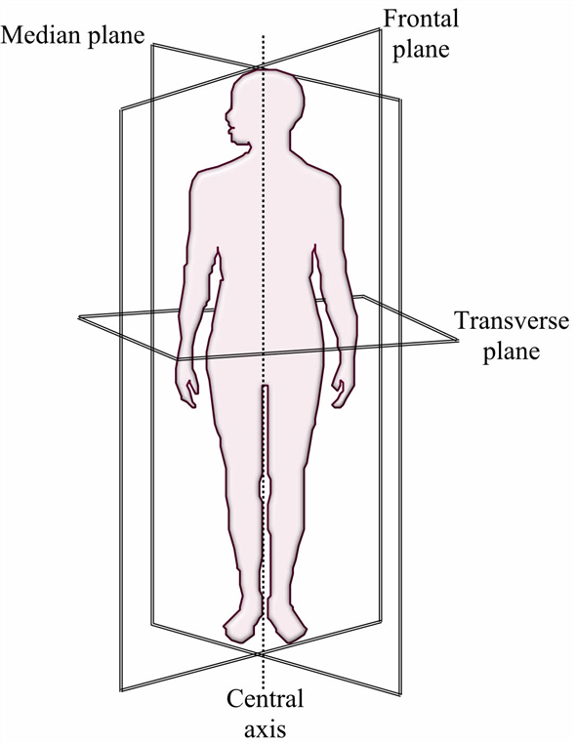
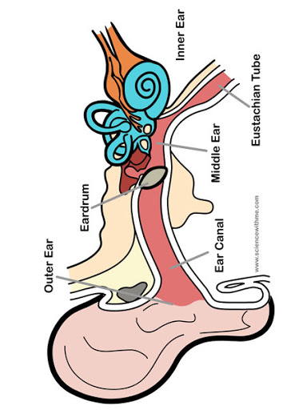
Medial Position
medius, a, um
medianus, a, um = exactly in the middle
medialis, e versus lateralis, e
intermedius, a, um = in between
two other structures
auris media
linea mediana

Slide 8
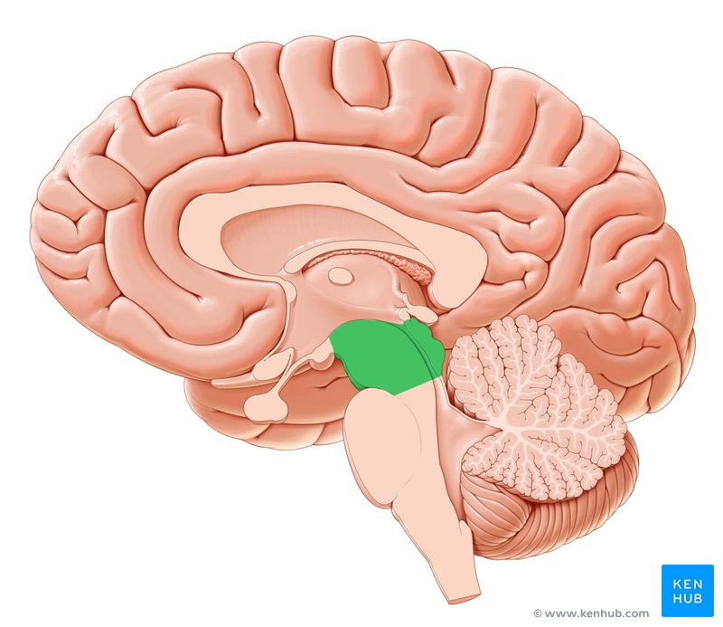
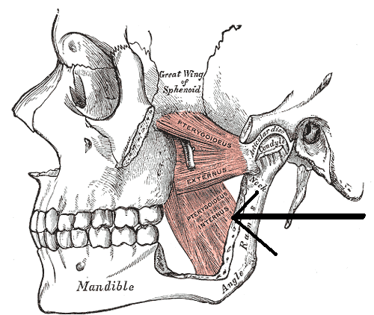
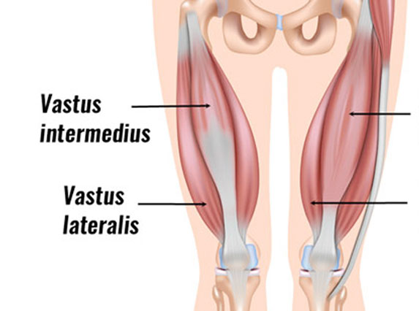
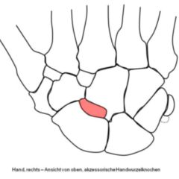
medialis, e
Musculus pterygoideus medialis
mes-o- (prefix)
mesencephalon
intermedius, a, um
Musculus vastus intermedius
centralis, e
Os centrale carpi

Slide 9
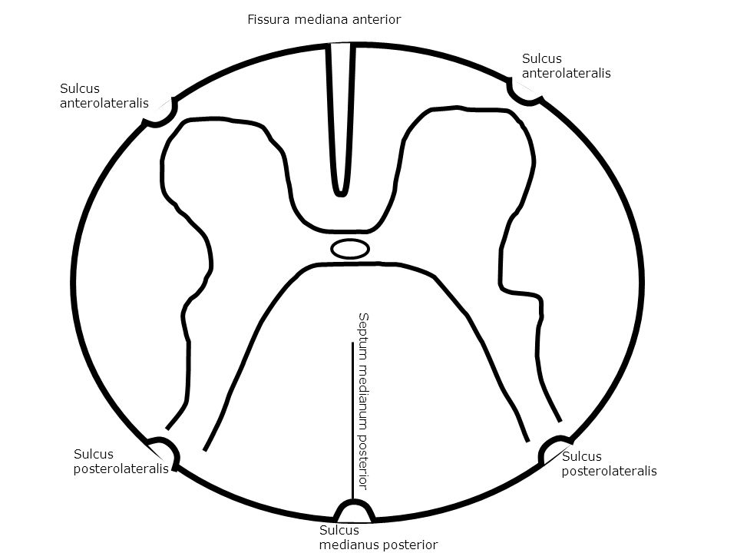
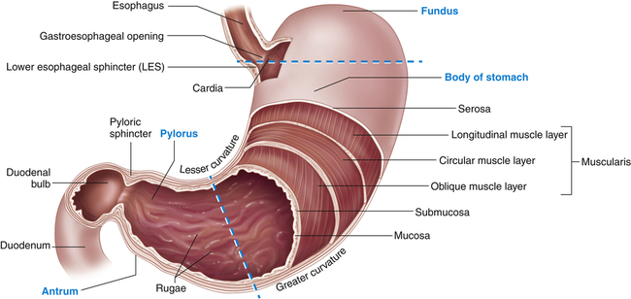
ANTERIOR POSITION / before something
anterior, ius
(comparative form)
e.g. paries anterior gastris
antero- before, earlier, front
(prefix)
e.g. funiculus anterolateralis

Slide 10
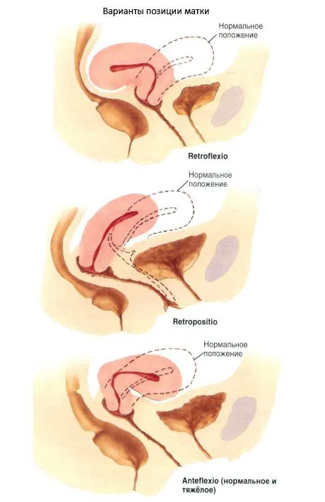
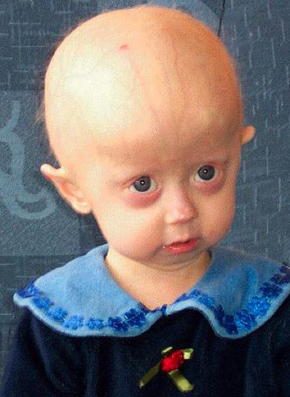
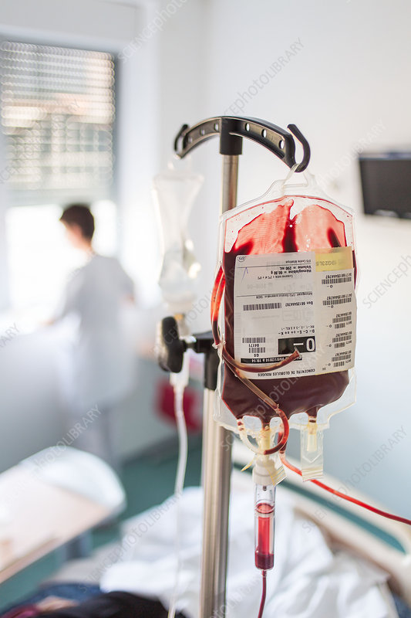
Ante- = before or in front of e.g. antepositio uteri
Pro- = before or in front of
e.g. progeria adultorum; prognathia
Prae- = before or in front of
Synonym of ‘pre’
e.g. transfusio praeoperativa

Slide 11
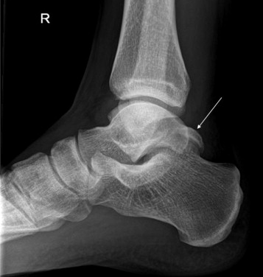
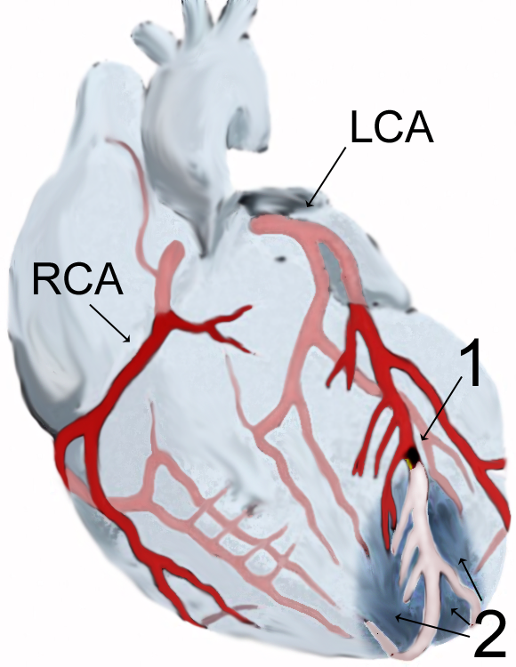
POSTERIOR POSITION / after something
posterior, ius
(comparative form)
e.g. processus posterior tali
postero- behind
(prefix)
e.g. infarctus posterolateralis

Slide 12
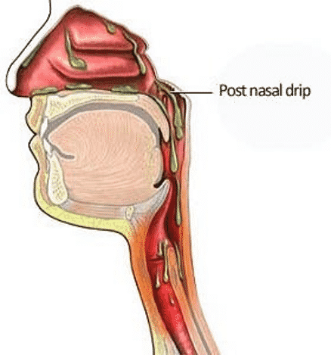
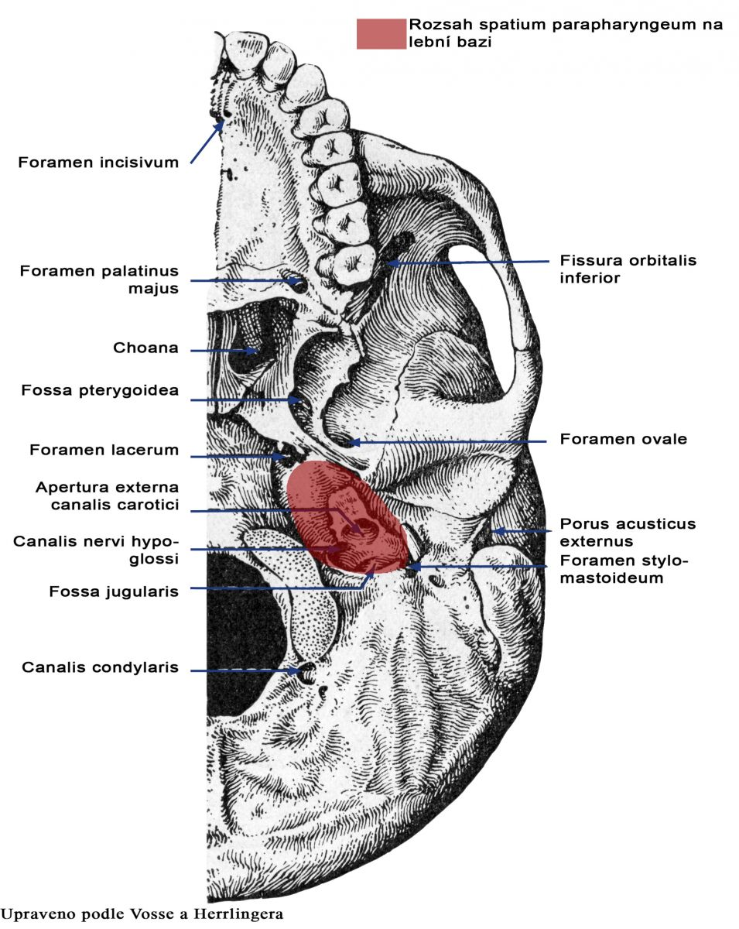
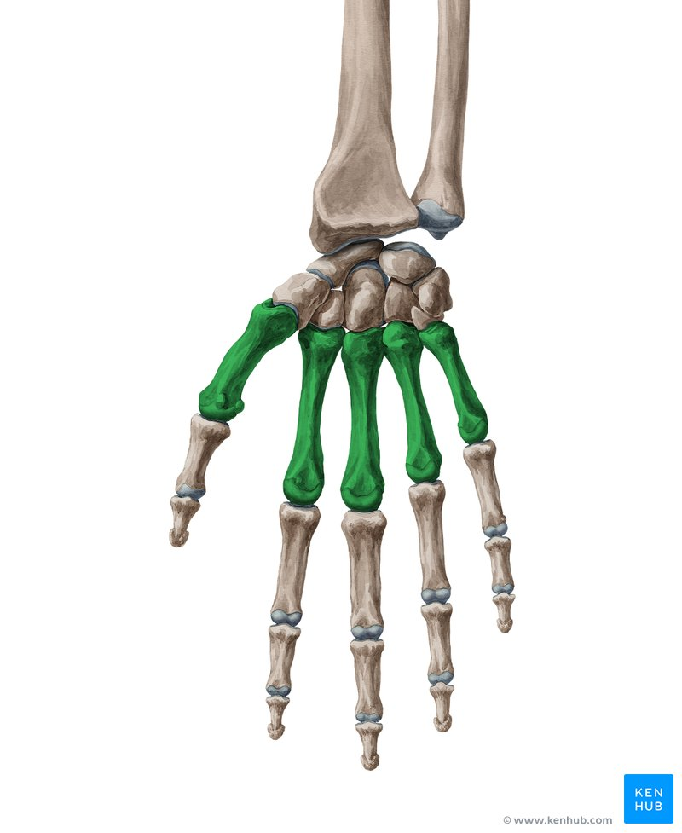
Post – (L.) - after, behind or later
e.g. regio postnasalis
Retro – (L.) – behind, backwards
e.g. spatium retropharyngeum
Meta – (L.) –after, beyond
e.g. ossa metacarpalia

Slide 13
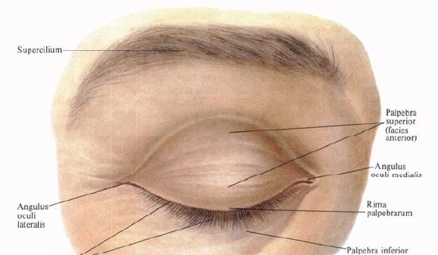
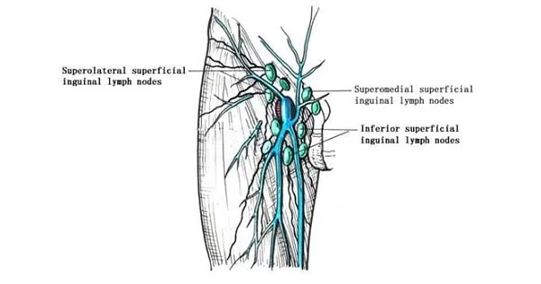
SUPERIOR POSITION
superior, ius
(comparaitive form)
e.g. palpebra superior
supero- above, over, beyond
(prefix)
e.g. nodi lymphatici inguinale superficiales superomediales

Slide 14
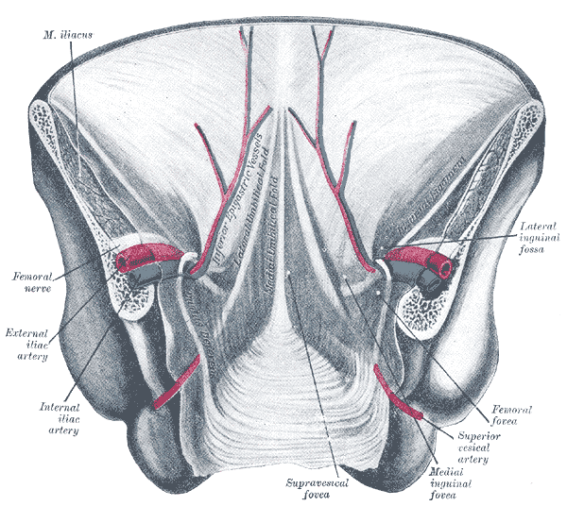
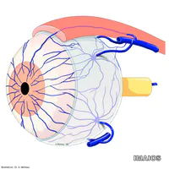
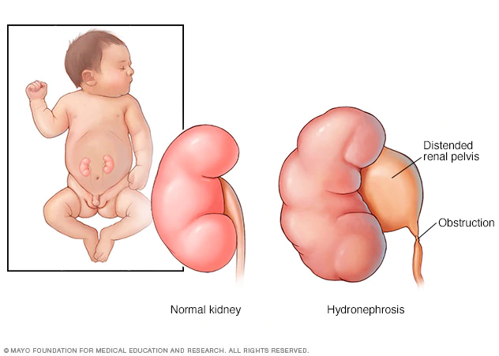
Supra- / Super- (prefix) over/ on the surface of
e.g. fossa supravesicalis
Epi- (prefix) on the surface of
e.g. venae episclerales
Hyper- (prefix) over, above, excessive
e.g., hypernephritis

Slide 15
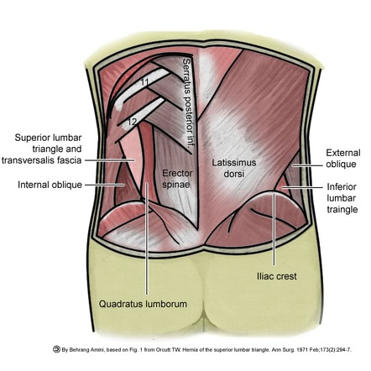
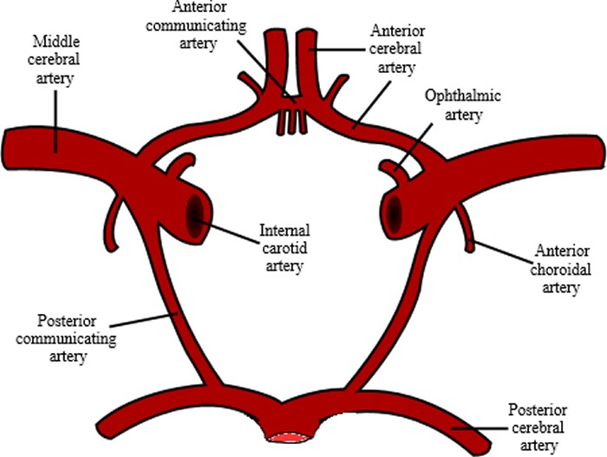
INFERIOR POSITION
inferior, ius
(comparative form)
e.g. trigonum lumbale inferius
infero- lower, inferior
(prefix)
e.g. infarctus inferoposterior

Slide 16
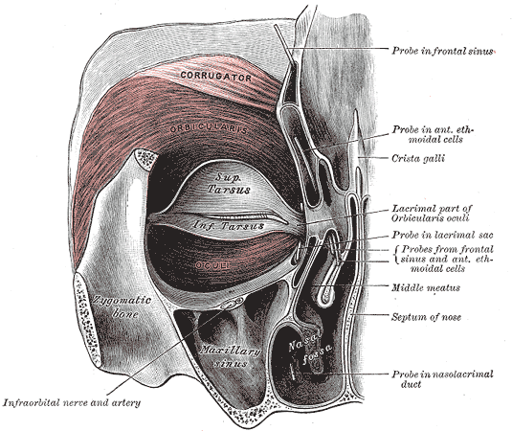
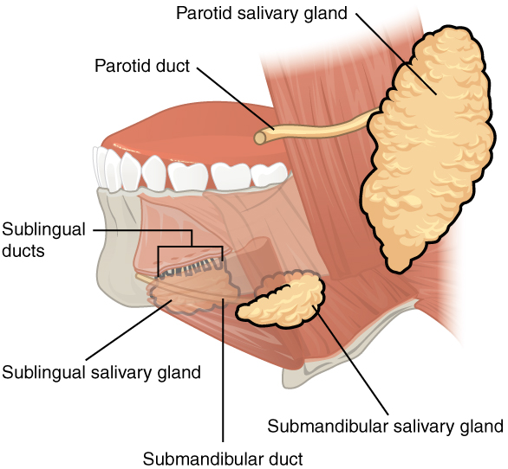
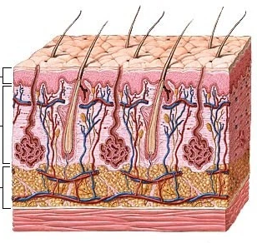
Infra (prefix) below/ beneath location
e.g. nervus infraorbitalis
Sub- (prefix) under, below
e.g. ductus sublingualis major
Hypo- (prefix) below normal (rarely for location)
e.g., hypodermis

Slide 17
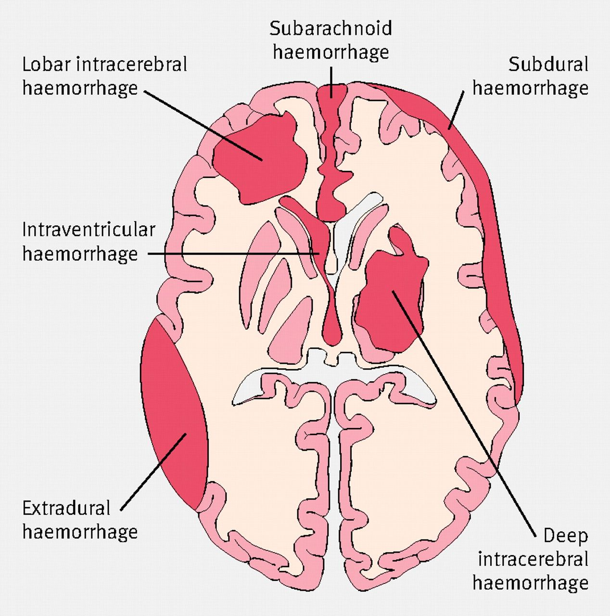
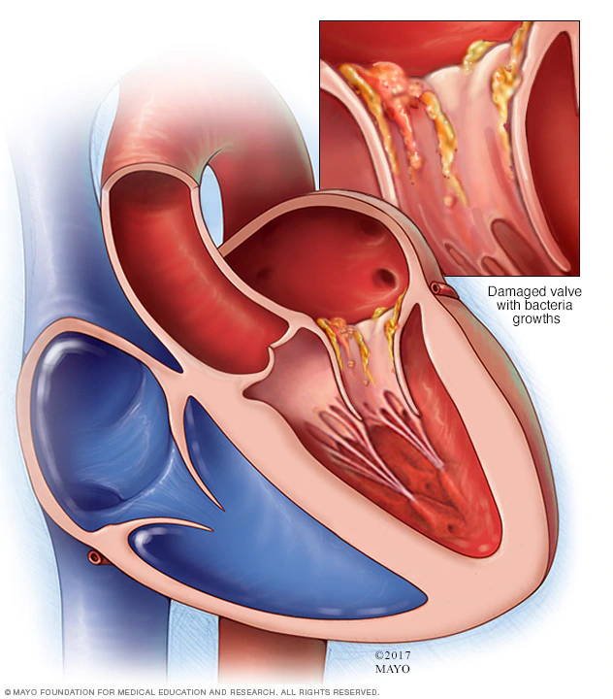
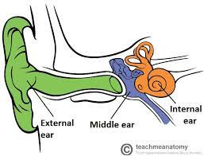
INTERNAL POSITION
Endo- (prefix)
inside, within
e.g. endocarditis
Internus, a, um - internal, deep, inward
e.g. auris interna
Intra- (prefix) between, within
e.g haemorrhagia intracranialis

Slide 18
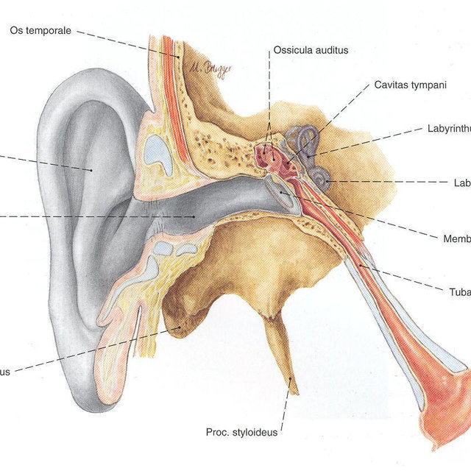
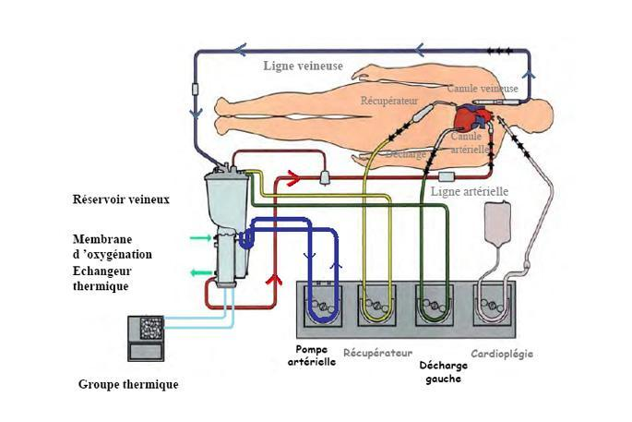
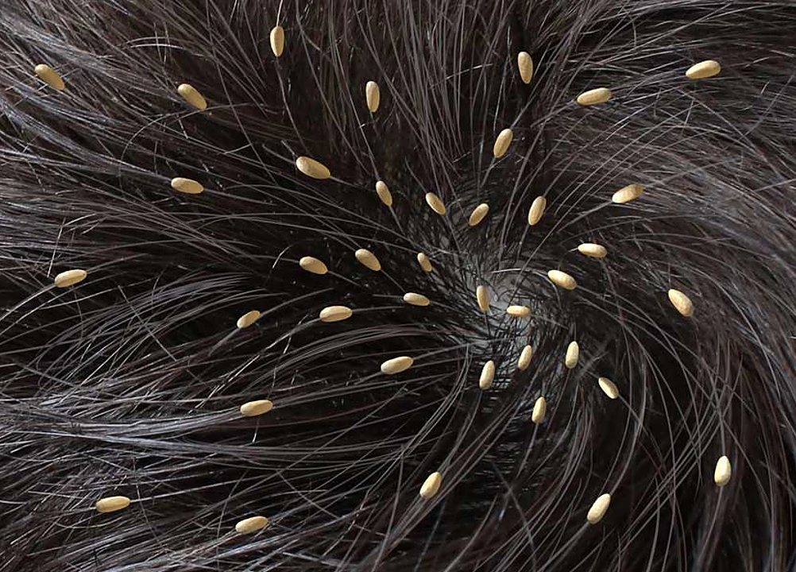
EXTERNAL POSITION
Externus, a, um
outward, external
e.g. meatus acusticus externus
Extra- (prefix)
Outside, beyond
e.g. circulatio extracorporalis
Ecto-/exo- (prefix)
Outermost, external
e.g. ectoparasitus; neurosis exogenes

Slide 19

MEDICAL JEOPARDY
Expressing Position In Medical Terminology

Slide 20
LATERAL
MEDIAL
RANDOM
GENERAL
GENERAL 2.0
400
400
400
400
400
500
500
500
500
500
Thank You

Slide 21

LATERAL
Translate the following to english:
Tendines digitorum manus lateris dextri

Slide 22
LATERAL
Tendons of the fingers of the right hand

Slide 23
LATERAL
Fill in the blank:
------------ post resectionem pulmonis lateris dextri propeter metastases

Slide 24
LATERAL
Fill in the blank:
------------ post resectionem pulmonis lateris dextri propeter metastases
Status post resectionem pulmonis lateris dextri propter metastases

Slide 25

MEDIAL
Translate the following to Latin:
Trochlea of the middle phalanx

Slide 26
BLOOD
Answer:
Trochlea phalangis mediae

Slide 27
BLOOD
Name three adjectives of the 3rd declension that has two gender forms and describes position

Slide 28
BLOOD
Name three adjectives of the 3rd declension that has two gender forms and describes position
Centralis, e
Localis, e
Medialis, e

Slide 29

DIAGNOSIS
True or False:
In anatomical position the palmar surface is in posterior position.

Slide 30
DIAGNOSIS
Answer:
False

Slide 31

RANDOM
Translate the following to English:
Venae superficiales membri superioris

Slide 32
RANDOM
Superficial veins of upper limb

Slide 33
GENERAL
Last week recap:
Form the comparative and superlative of the following prefix: supra-

Slide 34
GENERAL
Comparitive: superior, ius
Superlative: supremus, a, um

Slide 35
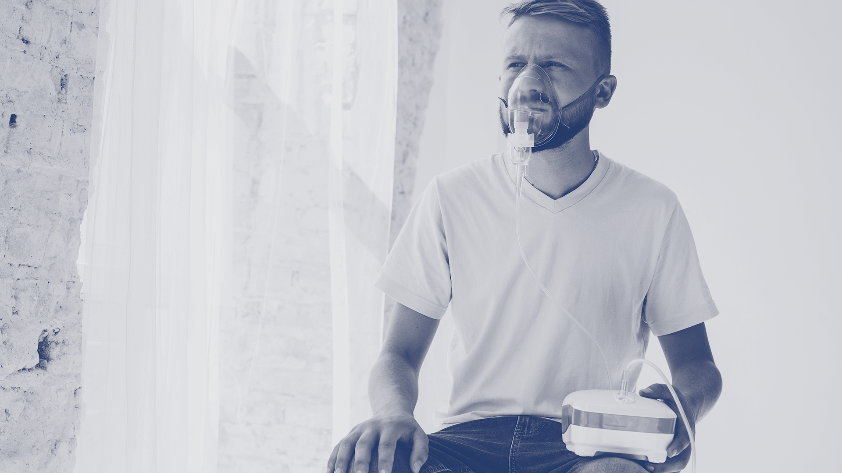
GENERAL
anterior, ius
Fill in the blank with the word given:
peritoneum parietale -----------

Slide 36
GENERAL
peritoneum parietale anterius

Slide 37
GENERAL 2.0
Translate the following to latin:
posterior deep temporal artery

Slide 38
GENERAL 2.0
Translate the following to latin:
posterior deep temporal artery
arteria temporalis profunda posterior

Slide 39

BODY PARTS
Translate the following to English:
curvatura minor ventriculi cordis

Slide 40
GENERAL 2.0
lesser curvature of ventricle of heart

Slide 41
THANKS

