Slide 1
Pharmacotherapy in ophthalmology
Veronika Matušková

Slide 2
Outcome from learning
Student can describe basic forms of drugs used in ophthalmology.
Student knows groups of drugs used in ophthalmology.
Oční lékařství (aVLOL7X1)

Slide 3
Local therapy
Eye drops - the most common form of application. Apply 1 drop to the conjunctival sac, followed by squeezing of the inner corner for a few seconds to prevent rapid dripping of the drops.
Eye ointment - longer effect than drops. Application approx. 1 cm strip of ointment in the conjunctival sac. The ointment base is toxic to intraocular structures, so the ointment is not used for penetrating eye injuries.
Good penetration of drugs only into the anterior segment of the eye.
The time interval between multiple drugs should be 5-10 minutes.
In the case of superficial infectious inflammations of the cornea and conjunctiva, we do not cover the eye with a cover.
The trend is for new preparations without preservatives.
We apply ATB, corticosteroids and fixed combined preparations of ATB with corticosteroid, antivirals, antifungals, immunosuppressants, nonsteroidal antiphlogistics, drugs suppressing the manifestations of allergies - antihistamines, mast cell stabilizers, antihistamines with stabilizing effect on mast cells, anesthetics, anesthetics.
Oční lékařství (aVLOL7X1)

Slide 4
ATB - differs in the spectrum of efficiency:
Fluoroquinolones - broad spectrum ofloxacin, levofloxacin, moxifloxacin
Aminoglycosides - gentamicin, tobramycin, neomycin (in combination with bacitracin as Ophthalmo-framykoin ®)
Macrolides - azithromycin
Pregnant and lactating female - kanamycin, moxifloxacin
Antivirals - ganciclovir
Antifungals - natamycin
Corticosteroids - differ in anti-inflammatory effect - dexamethasone, prednisolone, hydrocortisone, fluorometholone. There is a risk of developing steroid glaucoma and cataracts with long-term local and general administration.
NSAIDs - indomethacin, diclofenac, nepafenac
Allergy medications:
Antihistamines - azelastine, emedastine
Mast cell stabilizers - sodium cromoglycate
Antihistamines with stabilizing effect on mast cells - olopatadine, ketotifen
Lubricant - to moisturize the eye surface in the form of drops, gel, ointment. Selection of the preparation and frequency of application according to the degree of dry eye.

Slide 5
Antiglaucoma - they work by reducing the production of intraocular fluid in the ciliated body or by facilitating the outflow of intraocular fluid from the eye.
Beta-blockers - not suitable for heart disease, bronchial asthma
Sympathomimetics (adrenergic agonists)
Carbonic anhydrase inhibitors - contraindicated in people with sulfonamide allergy
Parasympathomimetics (miotics) - pilocarpine, standardly no longer used in the treatment of glaucoma
Prostaglandin / prostamide analogues - currently the drug of first choice (highest effectiveness, safe, application only once a day)
Fixed combination preparations - the combination of 2 effective drugs in one preparation will further reduce the intraocular pressure
Anesthetics - oxybuprocaine
Mydriatics and cycloplegics - induce mydriasis and some also cycloplegia (paresis of the ciliary muscle of the ciliary body, ie it eliminates accommodation). They differ in the intensity and duration of mydriasis (short-acting mydriatics commonly used in the outpatient clinic to examine the ocular background are tropicamide and phenylephrine, while long-acting drugs for the treatment of intraocular inflammation are scopolamine, homatropine, atropine). By reckless induction of artificial mydriasis, we can induce a glaucoma attack in predisposed individuals with a closed iridocorneal angle. During the induction of artificial mydriasis, driving is prohibited. In young patients, general side effects (vertigo, nausea) may occur temporarily.
Sympathomimetics - short-term: phenylephrine, long-term: adrenaline, cocaine
Parasympatholytics - short-term: tropicamide, long-term: atropine, homatropine, scopolamine, cyclopentolate
Oční lékařství (aVLOL7X1)

Slide 6
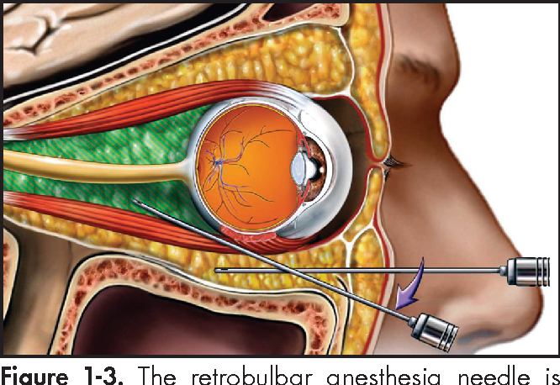
Periocular therapy
Risk of bulbar perforation with a needle.
Subconjunctival drug administration - injection under the conjunctiva, most often in the lower half of the bulb and after previous application of a topical anesthetic. Good penetration into the anterior segment. We administer a combination of corticosteroids and mydriatics for severe intraocular inflammation.
Para / retrobulbar drug administration - injection next to / behind the bulbus, we also administer an anesthetic with the drug. Good penetration into the posterior segment of the eye. We apply corticosteroids for severe intraocular inflammation.
Parabulbar injection
Retrobulbar injection
Oční lékařství (aVLOL7X1)

Slide 7
Intraocular drug administration
Intravitreal application - injection of the drug into the vitreous space. It is performed in the operating room and after previous desinfection of the eyelids, rinsing of the conjunctival sac with a solution of povidone iodinatum and application of a topical anesthetic and local ATB. We apply antiVEGF drugs, ATB, corticosteroids, methotrexate (for intraocular lymphoma).
Risk of needle injury with careless application, development of infectious endophthalmitis several days after application, retinal detachement.
Oční lékařství (aVLOL7X1)

Slide 8
Systemic therapy
Indicated, if the process is not manageable by local treatment, to enhance local treatment. In the form of oral or, in the case of more severe conditions, parenteral (i.v. or i.m.).
ATB - most have poor penetration into the eye. We use the drug empirically or on the basis of cultivation and sensitivity, sometimes it is necessary to consult a clinical pharmacologist. We administer 3rd generation cephalosporins (ceftazidime) together with vancomycin for infectious endophthalmitis, amoxicillin with clavulanic acid or clindamycin for inflammation of the orbit, lacrimal sac, azithromycin for toxoplasmosis.
Antivirals - aciclovir in herpes inflammation
Antifungals
Anthelmintics
Corticosteroids - indicated for severe intraocular inflammation. Most often prednisone p.o. (0.5 - 1 mg / kg / day), methylprednisolone p.o. (5mg prednisone corresponds to 4mg methylprednisolone) or i.v. (250 - 1000mg / day), hydrocortisone i.v., i.m.
Immunosuppressants - indicated as monotherapy or combination therapy with corticosteroids for vision-threatening, non-infectious intraocular inflammation. The most common is methotrexate, azathioprine.
Biological treatment - a modern method of treatment of non-infectious intraocular inflammations after meeting the indication criteria.
Antiglaucoma - indicated if high intraocular pressure cannot be managed with local antiglaucoma. They can only be administered for as long as is absolutely necessary. Carbonic anhydrase inhibitors (acetazolamide p.o.) - necessary simultaneous potassium substitution, NÚ - hypokalaemia, paraesthesia. Hyperosmotic drugs (mannitol in short i.v. infusion), risk of circulatory overload and heart and kidney failure.
Oční lékařství (aVLOL7X1)

Slide 9
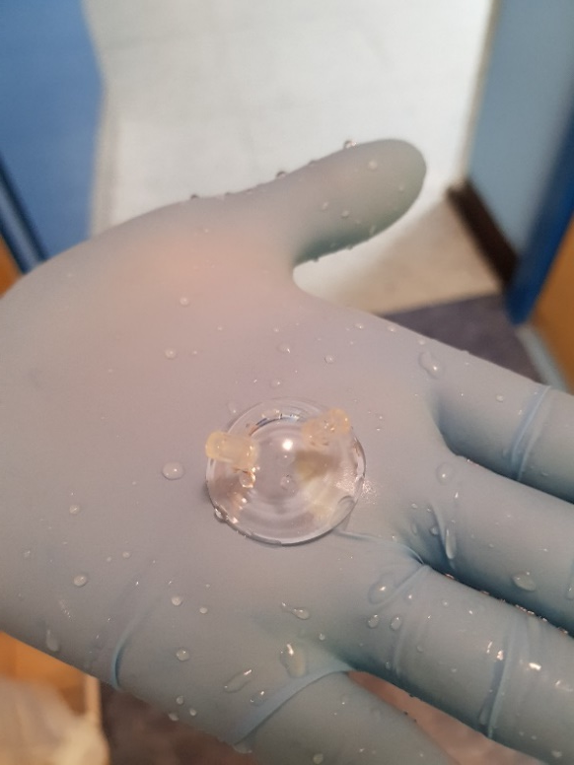
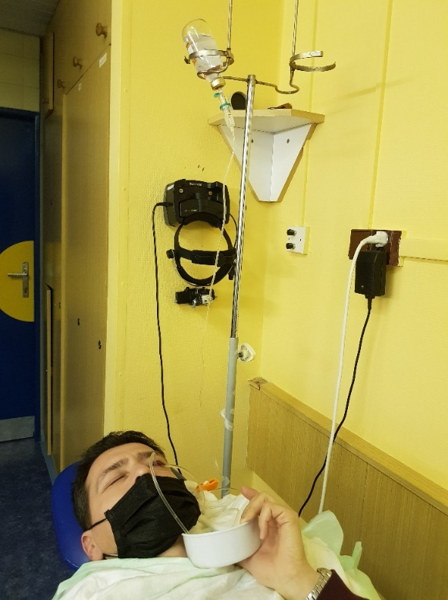
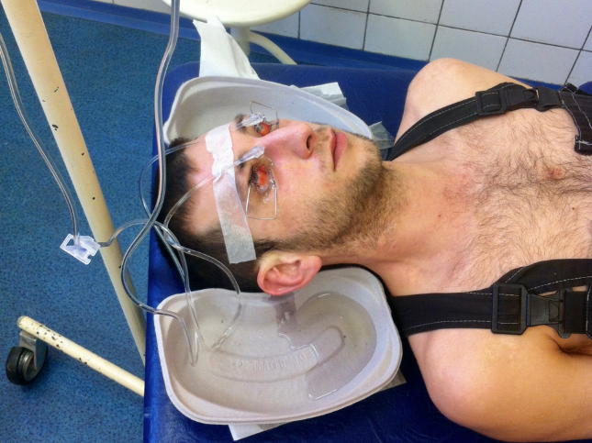
Conjunctival sac lavage
We perform at:
Alcali or acid burns: the first aid is to rinse the eye immediately with a stream of water at home. At the eye clinic, we rinse with pine water or glucose solution with ascorbic acid until the pH is neutralized (pH paper test), we always perform a single or double rotation (eversion) of the upper lid. Continuous rinsing through a special contact lens is suitable. At the same time, we remove deposits and bubbles from the conjunctiva with a brush.
Presence of foreign bodies in the conjunctival sac - rinse with pine water.
Severe infectious conjunctivitis or corneal inflammation - rinse with pine water or povidonum iodinatum solution (Betadine®).
Oční lékařství (aVLOL7X1)

Slide 10
Take home message:
Or „What students often don‘ t know“ :
Miotics and mydriatics
Four groups of local antiglauocomatics
Oční lékařství (aVLOL7X1)

