Slide 1
Health Demographics
Public Health I

Slide 2
Demography
Epidemiology
the study of changes (such as the number of births, deaths, marriages, and illnesses) that occur over a period of time in human populations.
the study of the distribution and determinants of health-related states or events in specified populations, and the application of this study to the control of health problems.
+

Slide 3
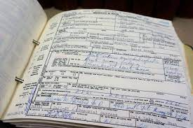
Vital Statisitics
Vital statistics (VS), as a scientific discipline, is a subdomain of demography, the study of the characteristics of human populations.
According to the Epidemiology Glossary, VS are defined as “systematically tabulated information about births, marriages, divorces, and deaths, based on registration of these vital events”.
VS are equally important for both individuals and policy makers.
VS are driven from vital records; therefore, their quality is dependent on robustness of recording and analyzing the vital events in each country.

Slide 4
Routine Data
The availability and quality of routine health statistics that can be utilised for epidemiological investigations may vary considerably:
Data may be collected on a systematic and ongoing basis or only intermittently (such as in health surveys)
They may be collected for the entire population or for a sample of the population
They may be available nationally, regionally or locally
They may be cohort or cross-sectional in concept
They may be person or episode-based
The ability to compare mortality or morbidity, for example cancer rates or cancer survival, between countries may prove problematic because coverage, as well as both the methods of data collection and the classification of certain cancers, may vary significantly between countries.

Slide 5
Routine Data

Slide 6
Health-related Demographics
Birth (Natality)
Measures
Death (Mortality)
Measures
Morbidity
Measures

Slide 7
Birth (Natality) Measures
Crude Birth Rate = Number of live births during a specified time interval / Mid-interval population
Crude Fertility Rate = Number of live births during a specified time interval / Number of women aged 15 – 44 years at mid-interval
Crude Natural Increase Rate = (Number of live births – Number of deaths during a specified time interval) / Mid-interval population

Slide 8
Birth (Natality) Measures
https://www.who.int/data/gho/indicator-metadata-registry
Low-birth weight ratio = Number of live births < 2,500 grams during a specified time interval / Total number of live births during the same time interval
Births by caesarean section ratio = Number of births by C-section during a specified time interval / Total number of births during the same time interval
Births attended by skilled health personnel ratio = Number of births attended by skilled health personnel / Total number of births during the same time interval

Slide 9
Death (Mortality) Measures
All-cause Mortality Rate
Crude Mortality Rate = Total number of deaths during a given time interval / Mid-interval population
Cause-specific Mortality Rate = Number of deaths assigned (attributed) to a specific cause during a given time interval / Mid-interval population
Proportionate Mortality = Number of deaths assigned (attributed) to a specific cause during a given time interval / Total number of deaths from all causes during the same time interval
Cause-specific Mortality Ratio

Slide 10
Death (Mortality) Measures
Death-to-case Ratio = Number of deaths assigned (attributed) to a specific cause (disease) during a given time interval / Number of new cases of same disease reported during the same time interval
Case Fatality Ratio (CFR) = Number of deaths assigned (attributed) to a specific cause (disease) among the new cases during a given time interval / Number of new cases of same disease reported during the same time interval
https://www.who.int/news-room/commentaries/detail/estimating-mortality-from-covid-19

Slide 11
Death (Mortality) Measures
Sex-specific Mortality Rate = Total number of deaths among a specific sex during a given time interval / Mid-interval population of the same sex
Race-specific Mortality Rate = Total number of deaths among a specific race during a given time interval / Mid-interval population of the same race
Age-specific Mortality Rate = Total number of deaths among a specific age group during a given time interval / Mid-interval population of the same age group

Slide 12
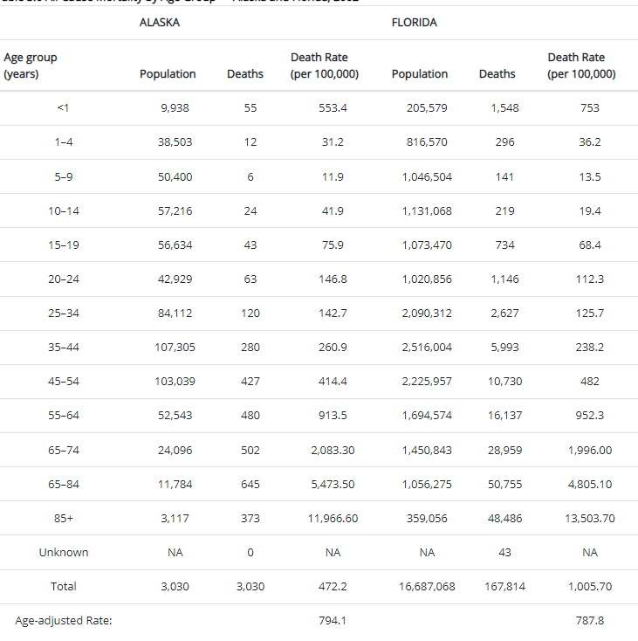
Death (Mortality) Measures
Age-standardized (Age-adjusted) Mortality Rate

Slide 13
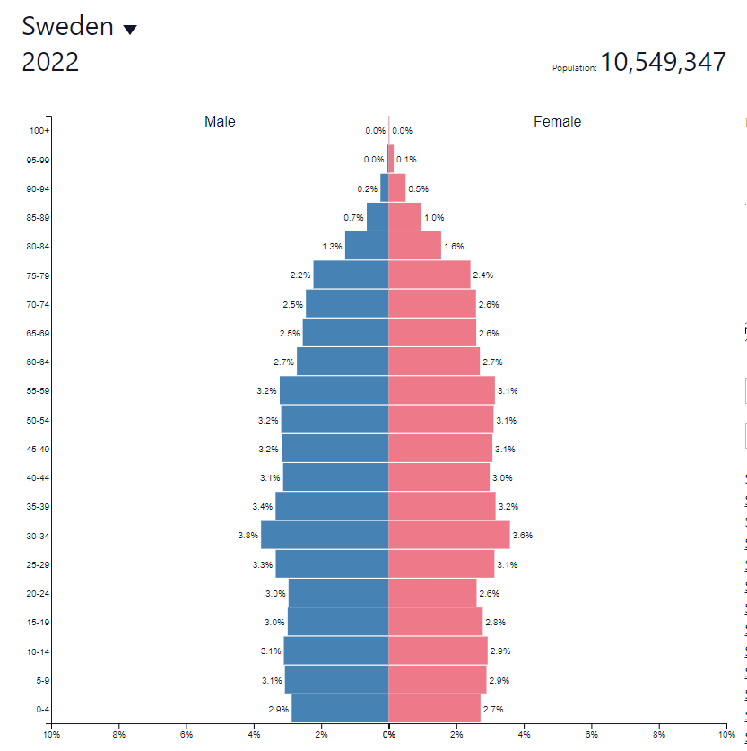
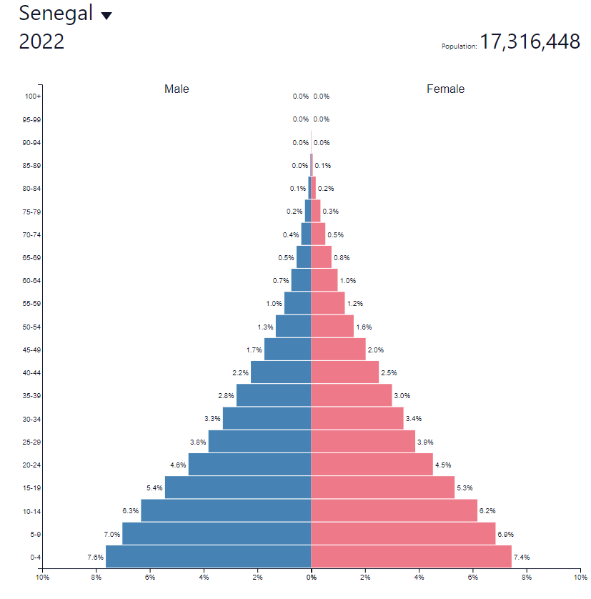
Death (Mortality) Measures
19%
5%
Age-standardized (Age-adjusted) Mortality Rate

Slide 14
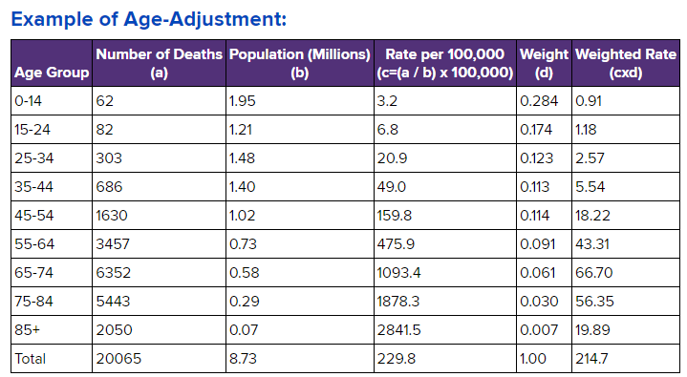
Death (Mortality) Measures
Age-standardized (Age-adjusted) Mortality Rate

Slide 15
Death (Mortality) Measures
Neonatal Mortality Rate = Number of deaths among children < 28 days of age during a given time interval / Number of live births during the same time interval
Postneonatal Mortality Rate = Number of deaths among children 28–364 days of age during a given time interval / Number of live births during the same time interval
Infant Mortality Rate = Number of deaths among children < 1 year of age during a given time interval / Number of live births during the same time interval

Slide 16
Death (Mortality) Measures
Child Mortality Rate = Number of deaths among children < 5 year of age during a given time interval / Number of children < 5 year of age during the same time interval
Maternal Mortality Rate = Number of deaths assigned to pregnancy-related causes during a given time interval / Number of live births during the same time interval

Slide 17
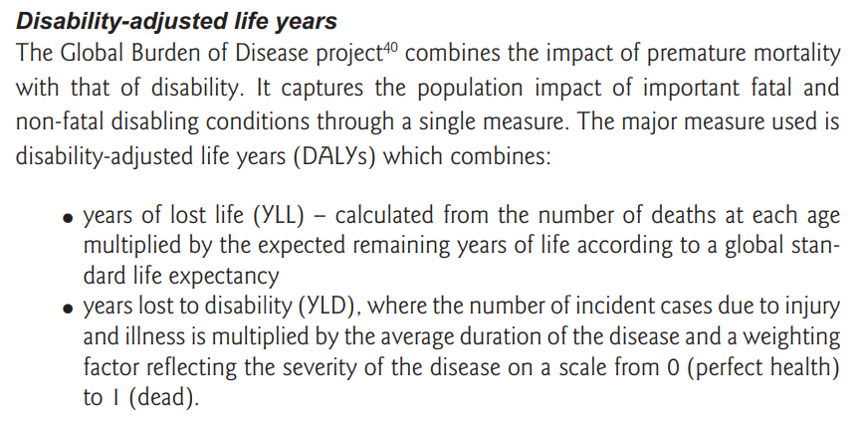
Morbidity Measures
Common Measures of Morbidity
Years of potential life lost (PLL) based on the years of life lost through premature death (before an arbitrarily determined age);
Healthy life expectancy (HALE);
Disability-free life expectancy (DFLE);
Quality-adjusted life years (QALYs);
Disability-adjusted life years (DALYs).
Sources of Morbidity Data
Surveillance Systems of Infectious Diseases
Sentinel Networks
Specific Disease Registries (e.g. CVD, Cancer, etc)
Hospital Records
General Practice Records
Insurance Statistics

Slide 18
Morbidity Measures

Slide 19
Global Burden of Disease (GBD)
Since 1990 (350 diseases, 195 countries, +3600 researchers)
The largest study for diseases distribution and their impact.
Quantifying mortality, and morbidity.
Symbol of coordinated “global health” efforts.
http://www.healthdata.org/gbd

Slide 20
Exercise Global Burden of Disease
Go to: https://vizhub.healthdata.org/gbd-compare/
Click “Compare” – then “By Year”
Select “1990” for “Top Chare Settings”
What happened in the last 30 years?

Slide 21
BREAK

Slide 22
Data Summarization
Tables
Graphs
The sole purpose of tables and graphs is to communicate information.
Your answer to this type of questions will help you to determine the choice of display.
Are you highlighting a change from past patterns in the data?
Are you showing a difference in incidence by geographic area or by some predetermined risk factor?
What is the interpretation you want the reader to reach?

Slide 23
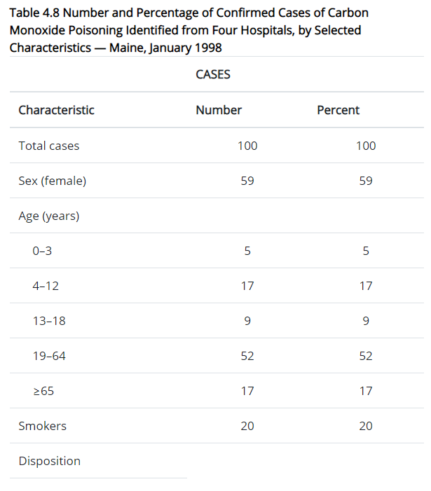
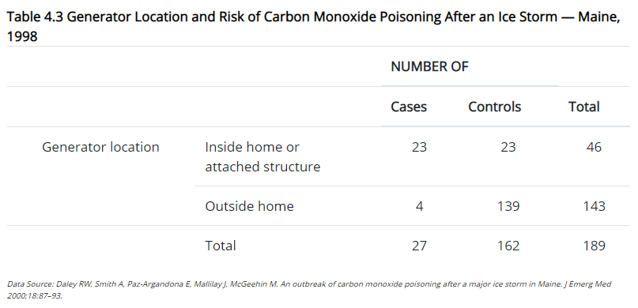
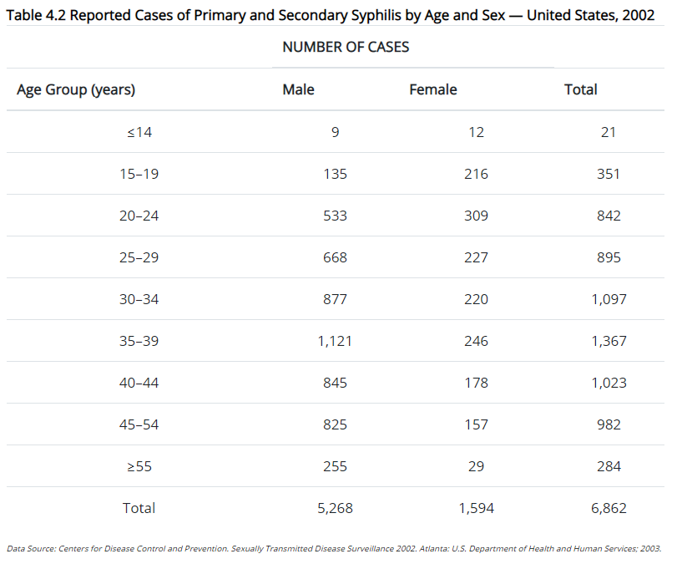
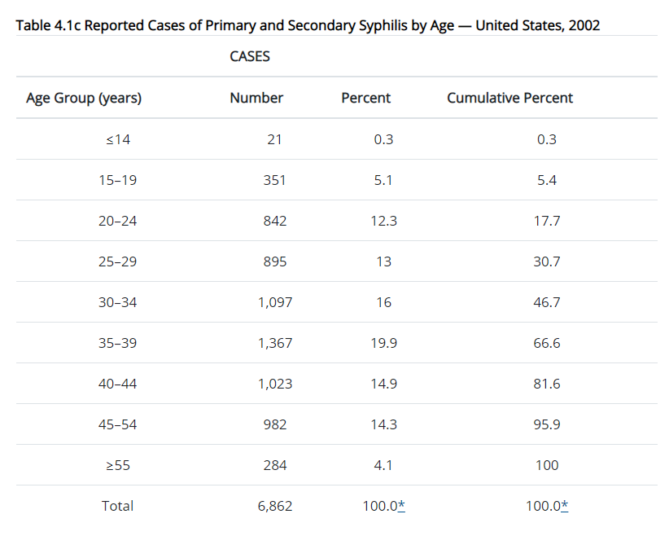
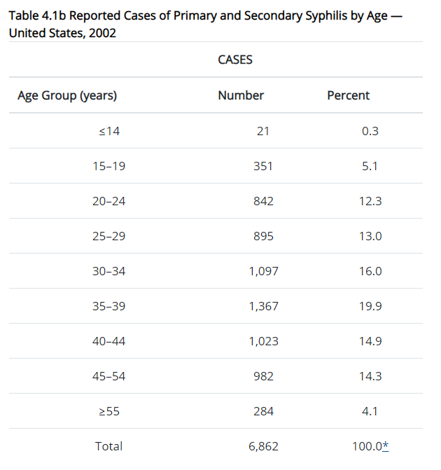
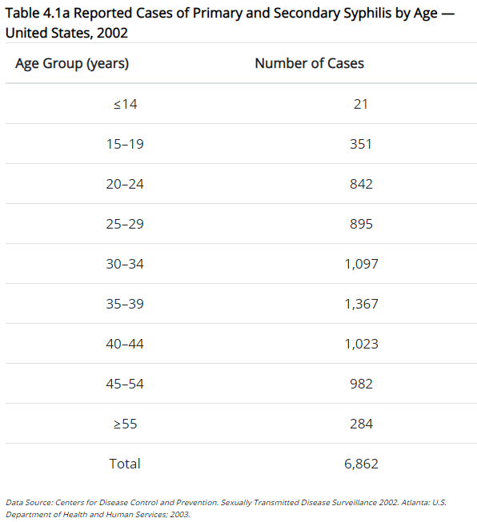
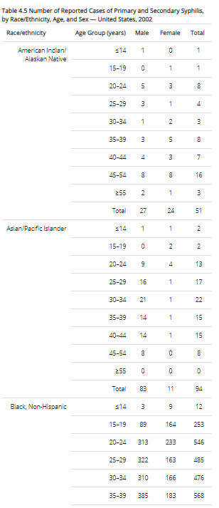
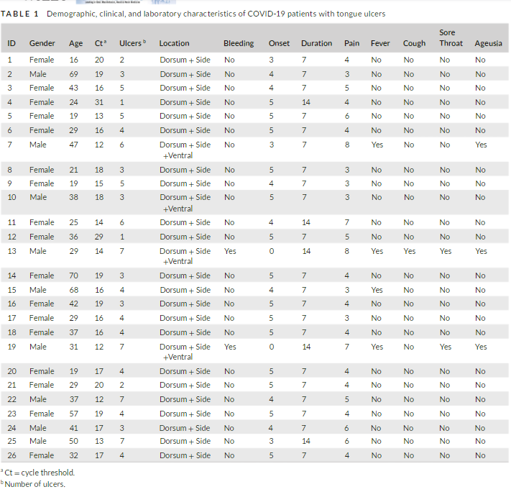
Tables
One-variable tables
Two-variable tables
Contingency tables (2x2 tables)
Three-variable tables
Line listing
Composite tables

Slide 24
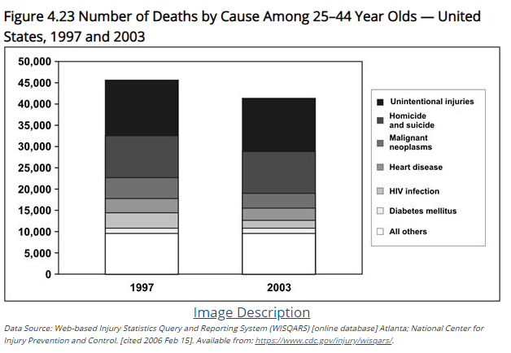
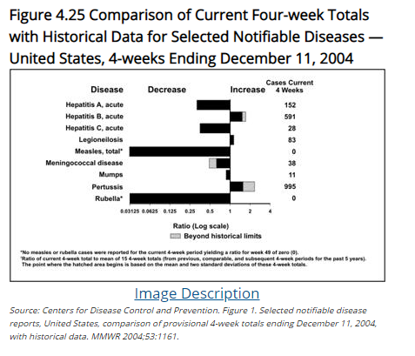
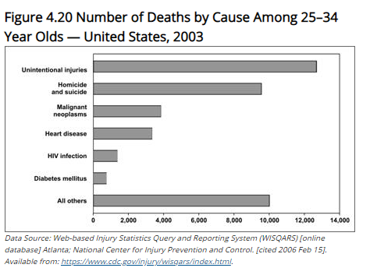
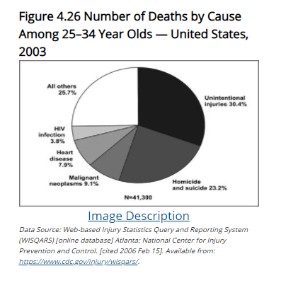
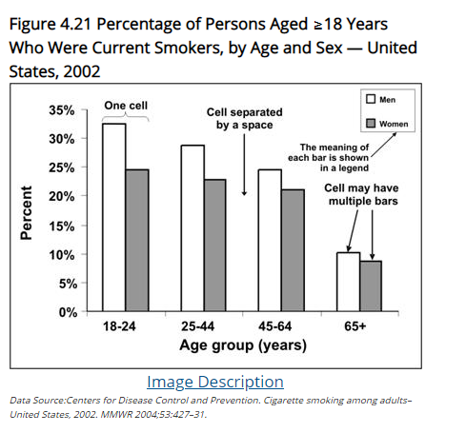
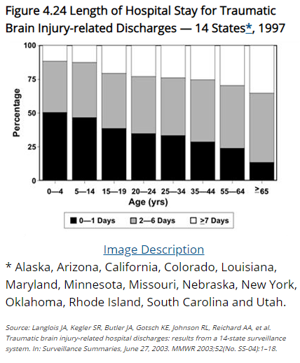
Graphs
Bar charts
Grouped bar charts
Stacked bar charts
100% component bar charts
Deviation bar charts
Pie charts

Slide 25
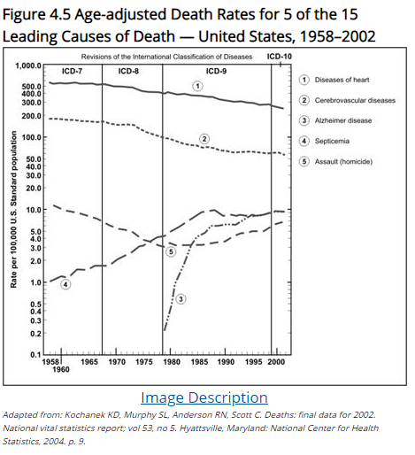
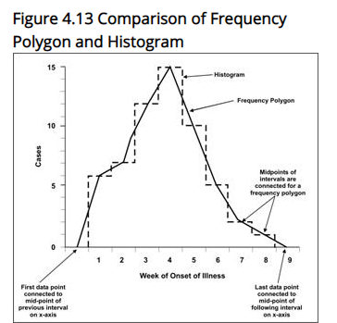
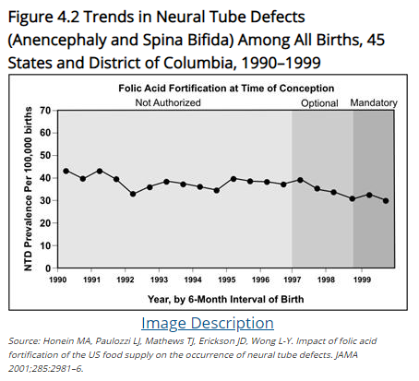
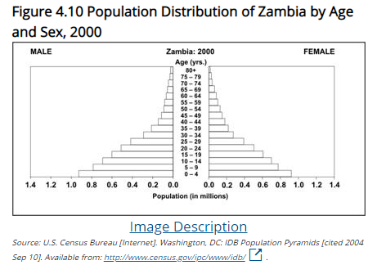
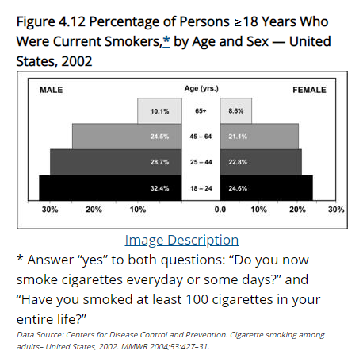
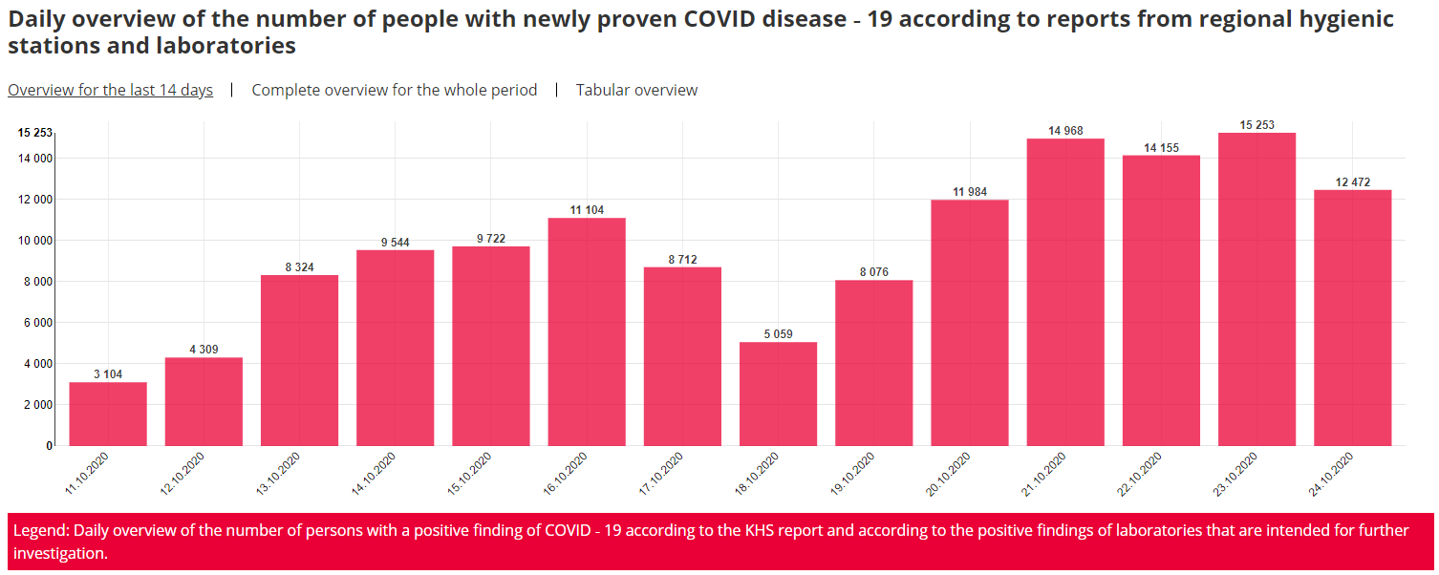
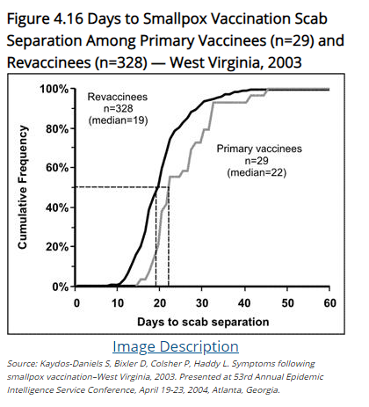
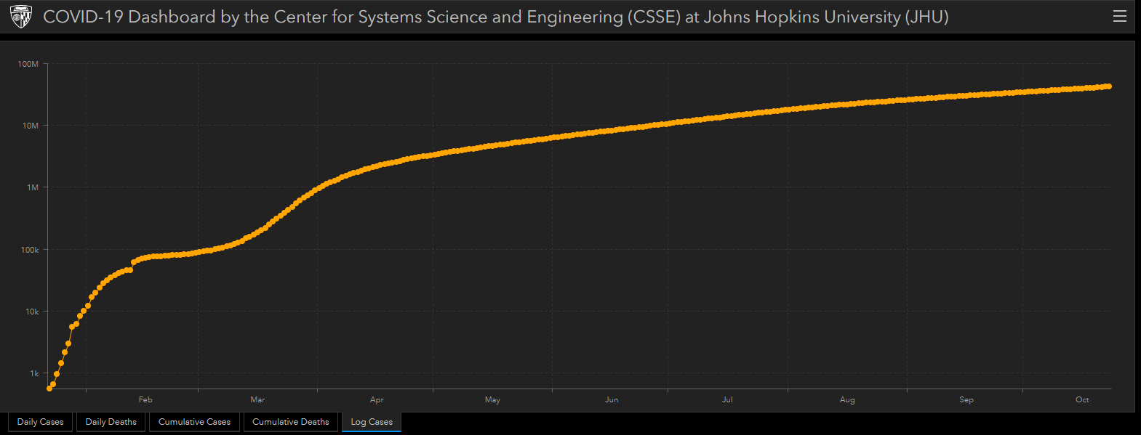
Graphs
Arithmetic-scale line graphs
Semilogarithmic-scale line graphs
Histograms
Population pyramids
Frequency polygons
Survival curves
https://koronavirus.mzcr.cz
https://coronavirus.jhu.edu/map.html

Slide 26
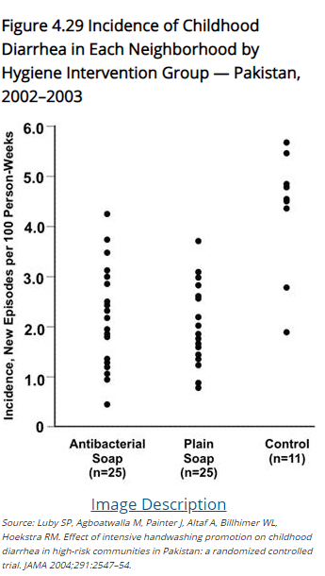
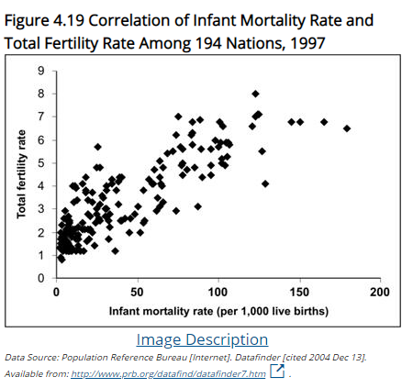
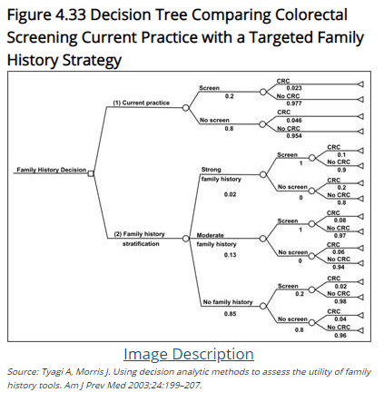
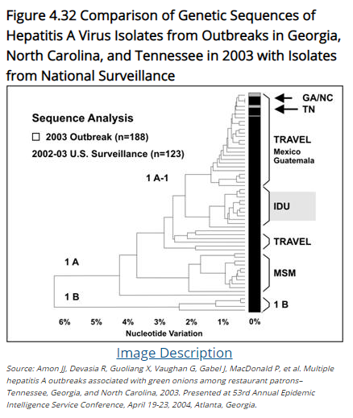
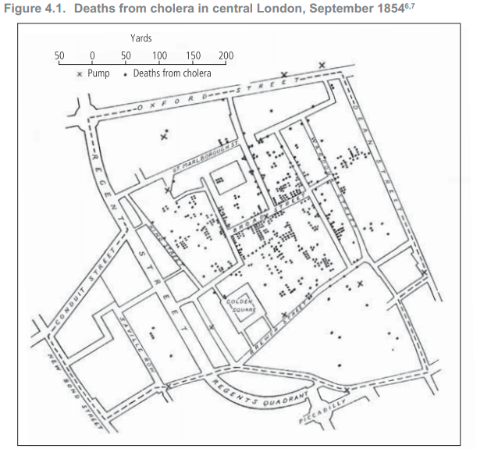
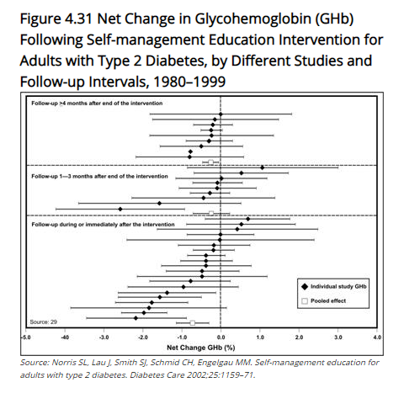
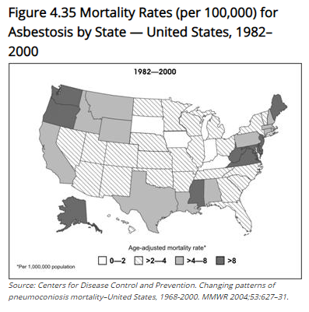
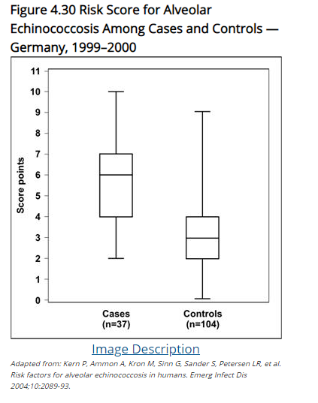
Graphs
Scatter diagrams
Dot plots / box plots
Forest plots
Polygenetic trees
Decision trees
Rate maps
Spot maps

Slide 27
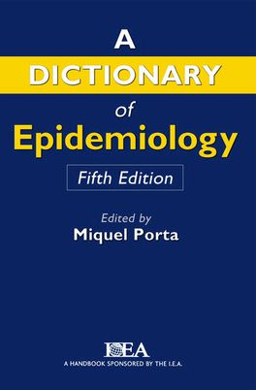
Hypothesis
A supposition, arrived at from observation or reflection, that leads to refutable predictions.
alt.
Any conjecture cast in a form that will allow it to be tested and refuted.
An idea or explanation for something that is based on known facts but has not yet been proved.

Slide 28
Null Hypothesis
H₀
A general statement or default position that there is no difference between two measured phenomena.
Alternative Hypothesis
H_{a}
A position that states something is happening, a new theory is preferred instead of an old one.

Slide 29
Null Hypothesis
Prevalent knowledge
Common proposition
Old theory
No effect
No difference
The first step in testing for statistical significance in which it is assumed that the exposure is not related to disease.
H₀
Alternative Hypothesis
Research hypothesis
New theory
The hypothesis, to be adopted if the null hypothesis proves implausible, in which exposure is associated with disease.
H_{a}
There is difference
There is association
Effective drug

Slide 30
THANK YOU
abanoub.riad@med.muni.cz

