Slide 1
Global Health
Zuzana Derflerová Brázdová
Dept. of Public Health

Slide 2
Introduction
After the lecture you will be able to understand:
the concept of global health
the difference between global and public health
the main challenges to tackle in 2021-22
why is global health so important

Slide 3
Definition
Global Health is an area for study, research, and practise that places a priority on improving health and achieving health equity for all people world-wide.
(Koplan et al., 2009)

Slide 4
Definition
Those health issues that transcend national boundaries and governments and call for actions on the global forces that determine the health of people.
Kickbush I.: The need for an European strategy on global health (2006)

Slide 5
Public Health
PH is defined as the art and science of preventing disease, prolonging life and promoting health through the organized efforts of society”
(Acheson, 1988; WHO)

Slide 6
Global vs. Public health
 | Global Health | Public Health
Geopolitical | Healthcare problems and policy issues that transcend internationally | Major focus is on specific communities or meeting national goals
Collaboration and Alliances | Global. Strongly propagates interdependence and not merely a flow of resources and information from the developed to the developing nations | National. Based on economic and knowledge dependence of the developing on the developed, directly or via world associations and organizations.
Population Health | Prevention and clinical | Primarily Prevention
Healthcare economics and outreach | Equitable distribution of healthcare resources including finances among nations | Healthcare equity within a nation or locality
Interrelationship amongst Allied Disciplines | Supports high interdisciplinary approach | Multidisciplinary, especially with healthcare and social sciences

Slide 7


Importance of global health
GH is important because life in the 21st century is global.

Slide 8
Globalization
Growing interconnectedness of countries, centered around trade and the flow of ideas, facilitated by communications technologies, cultural convergence, and common concerns for environmental and health impacts.
(McMichael A, Beaglehole R, 2003)

Slide 9

Concept of Classification of Nations
Original construct: „free world - communist block – third world“ is now obsolete.
Other classifications:
„North – South“
„Developing – Developed“ („Less developed – more developed“)
Classification used by WHO:
„Established market economies – former socialist economies of Europe – China and India as distinct entities due to population size – the rest of the world by geographic region“

Slide 10
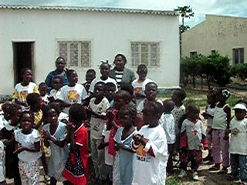
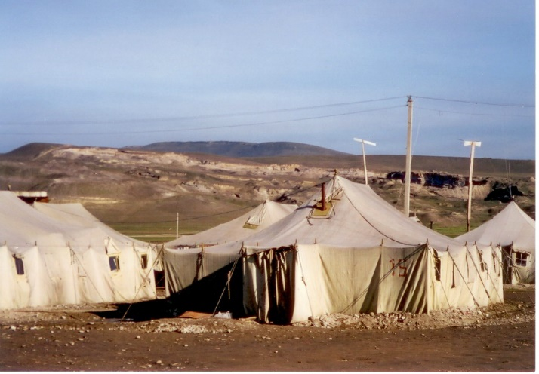
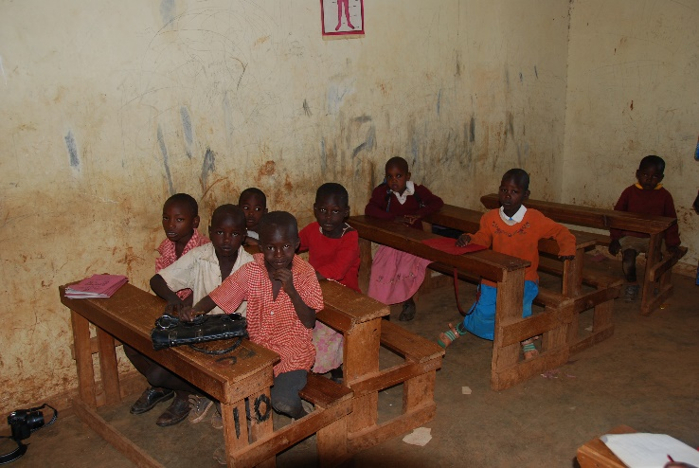

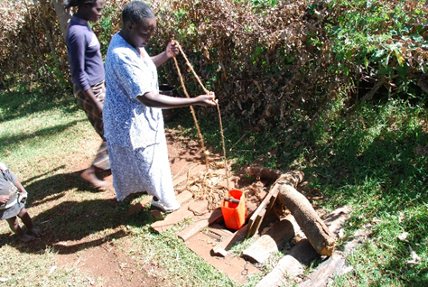
Global Health Challenges

Slide 11
WHO List of 10 Threats to Global Health (2019)
Air pollution and climate change
Noncommunicable diseases
Threat of a global influenza pandemic
Fragile and vulnerable settings, such as regions affected by drought and conflict
Antimicrobial resistance
Ebola and high-threat pathogens
Weak primary care
Vaccine hesitancy
Dengue
HIV

Slide 12
Top 8 Global Health Issues from another perspective
Physical Activity and Nutrition.
Overweight and Obesity.
Tobacco.
Substance Abuse.
HIV/AIDS.
Mental Health.
Injury and Violence.
Environmental Quality.

Slide 13
Poverty and poor health – Is it Global health problem?
Poverty and poor health worldwide are inextricably linked.
The causes of poor health for millions globally are rooted in political, social and economic injustices.
Poverty is both a cause and a consequence of poor health.

Slide 14
Global health and poverty
Poverty increases the chances of poor health.
Poor health, in turn, traps communities in poverty.
Infectious and neglected tropical diseases kill and weaken millions of the poorest and most vulnerable people each year.

Slide 15
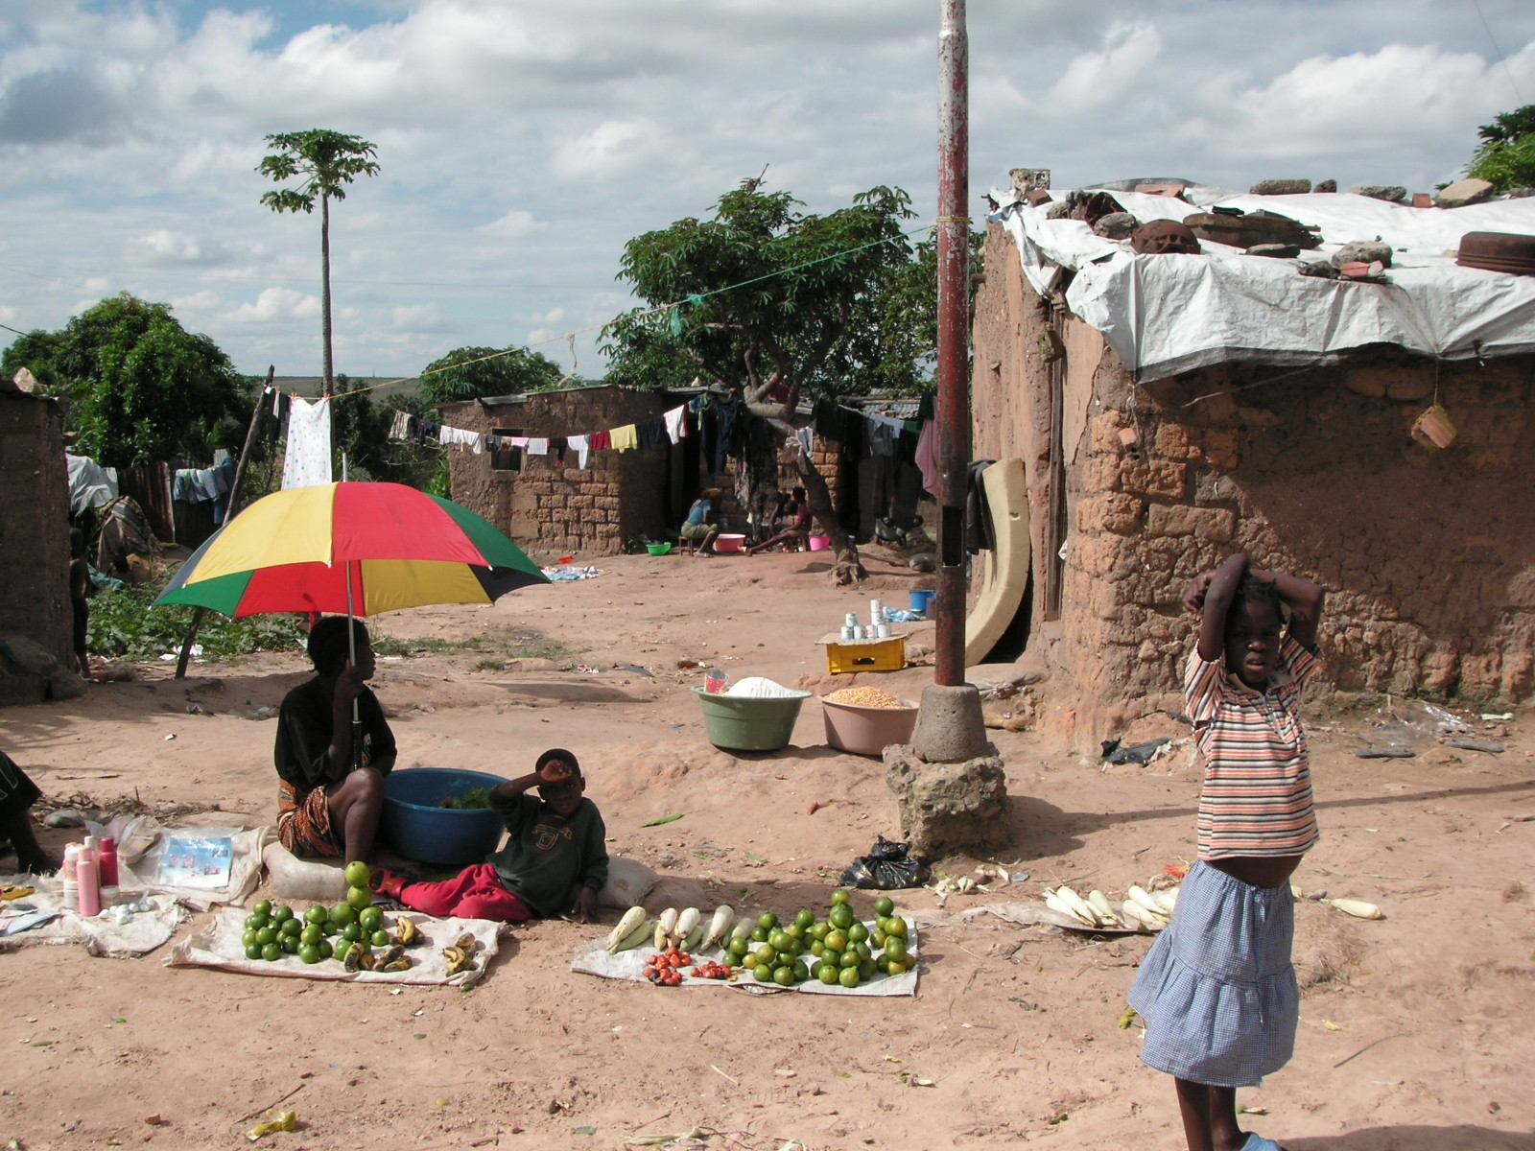
Poverty…

Slide 16
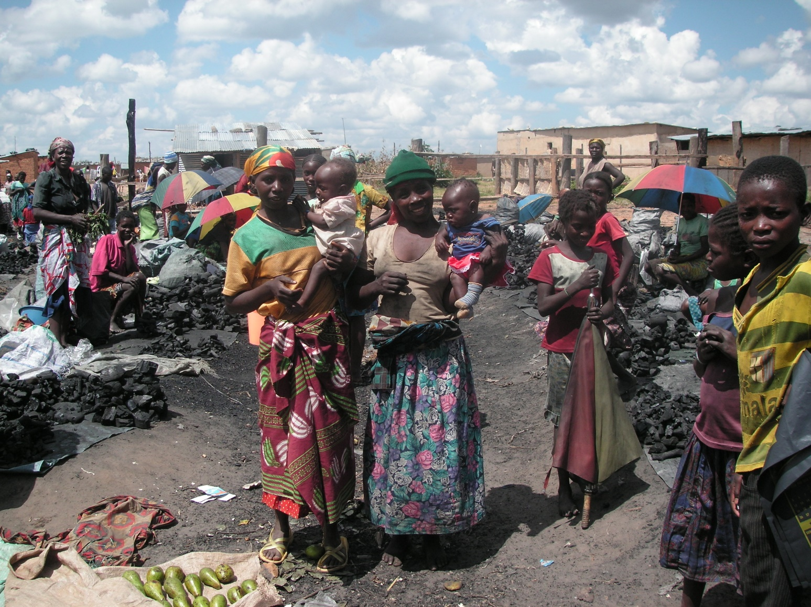
Poverty…

Slide 17
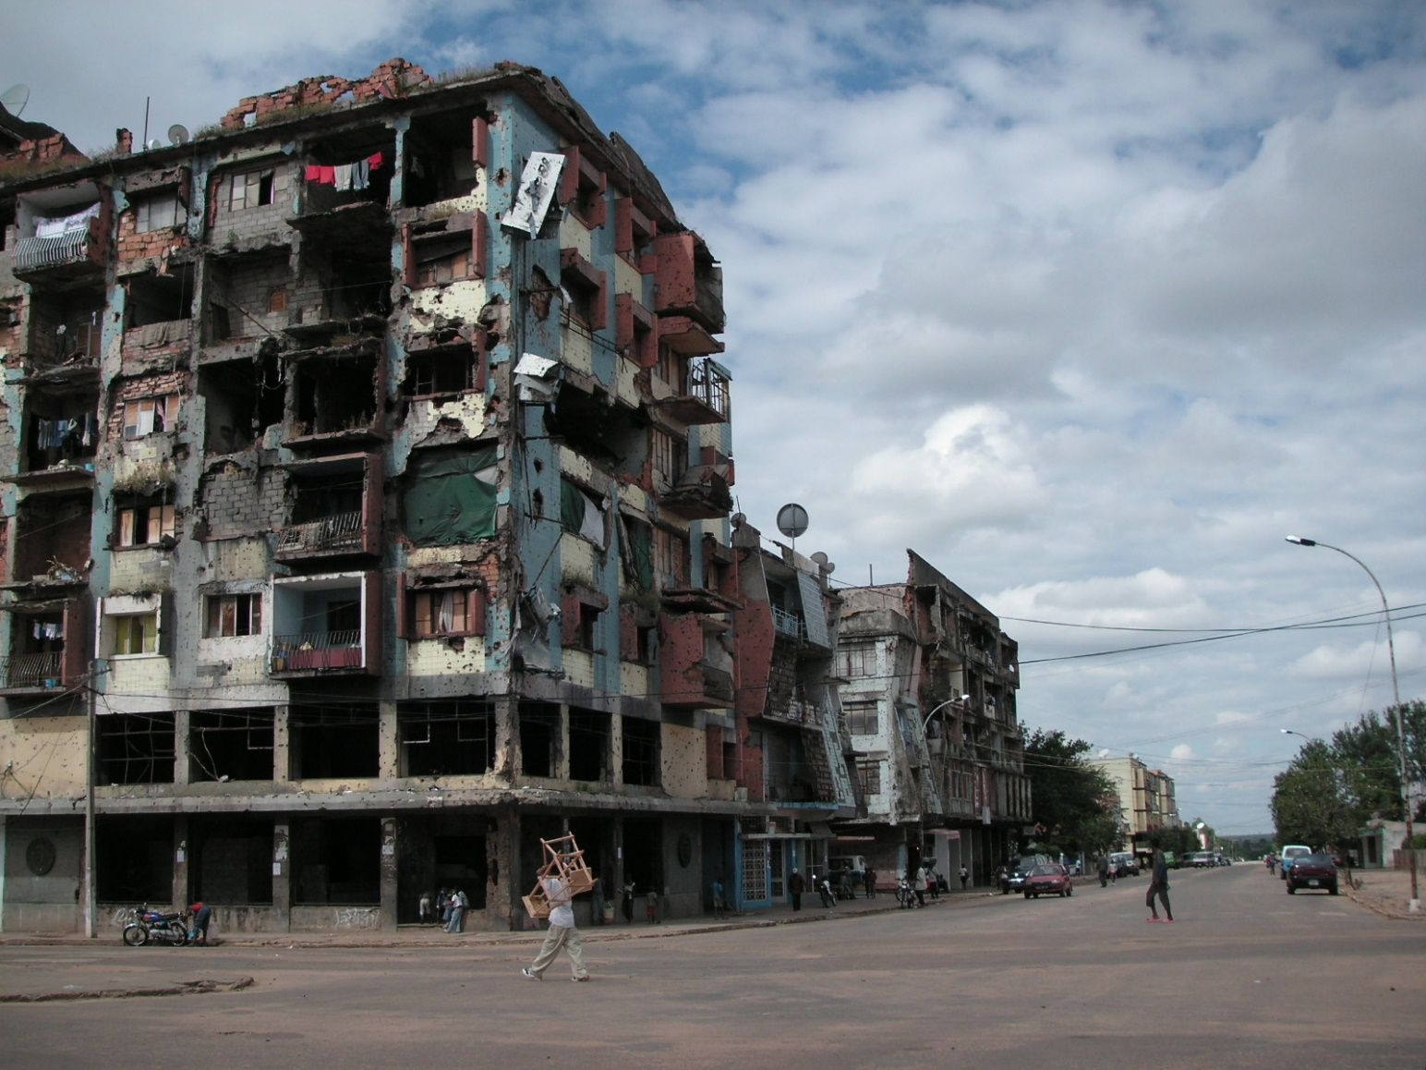
Poverty…

Slide 18
Which infectious diseases are the main killers worldwide? (1)
HIV
Diarrhoea
Tuberculosis
Malaria
as well as communicable respiratory diseases such as pneumonia
kill the most people.
Diarrhoea, pneumonia and malaria account for nearly half of all child deaths globally.

Slide 19
Which infectious diseases are the main killers worldwide? (2)
Neglected tropical diseases affect over one billion people
Almost all in the poorest and most marginalised communities
Leprosy, lymphatic filariasis, onchocerciasis, schistosomiasis, soil-transmitted helminths and trachoma can cause severe pain and life-long disabilities – and mean enormous productivity losses.
However, efforts to tackle them have usually taken a back seat to the bigger killers.

Slide 20
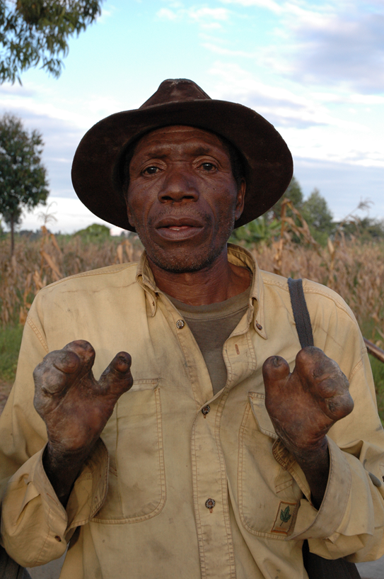
Leprosarium - Angola

Slide 21
13 Most Pressing Global Health Issues This Decade
( Caruso, C., January 16, 2020)
Focusing on health when discussing climate change
The climate crisis not only impacts the environment directly, but it also poses many health risks to people all over the world. For instance, nearly 7 million people die from air pollution every year. Natural disasters and catastrophic weather events caused or fueled by climate change worsen the spread of disease and can lead to or inflame malnutrition. World leaders must address these urgent health risks.

Slide 22
2. Providing health care to nations in crisis
Outbreaks of diseases are very difficult to treat or contain in countries experiencing conflict or crisis. Continued attacks on health care facilities and medical professionals also limit the amount of access to basic health care residents have in a given region. While it is imperative that organizations like the WHO provide medical teams to distribute health care services to countries in crisis, political solutions are also needed to put an end to these life-threatening conflicts.

Slide 23
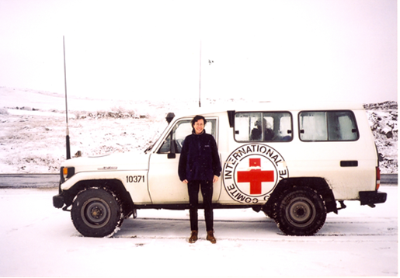
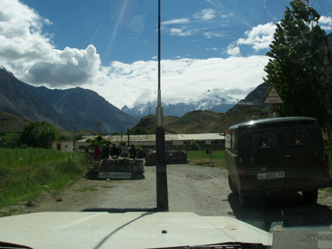
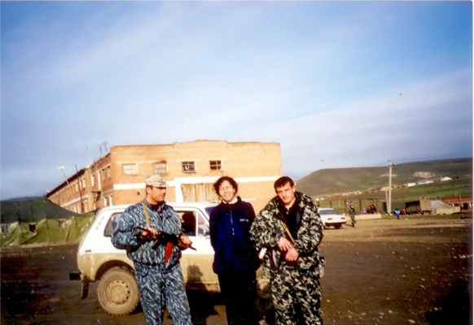

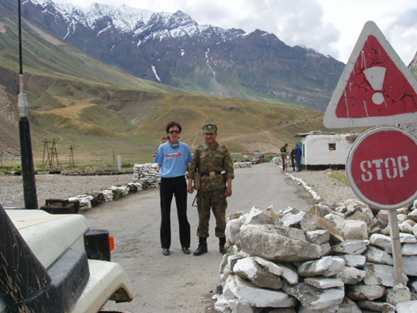
Health workers safety …. ?

Slide 24
3. Making health care accessible to everyone
Health care should be accessible to people of all socio-economic backgrounds. As it stands, there is an 18-year discrepancy in life expectancy between people living in rich and poor nations. With the overall increase of cancer, diabetes, and other noncommunicable diseases worldwide, access to quality health care for all is essential in reducing health inequality. In order to make this possible, countries must be willing to set aside 1% of their gross domestic product (GDP) for primary health care services.

Slide 25
4. Expanding access to vaccines and medicine
Nearly one-third of the world’s population doesn’t have access to quality medicine and vaccines, which puts millions of lives in danger.
Making these potentially life-saving drugs and vaccines more accessible is key to improving the lifespan and quality of life of people living in low-income communities and impoverished nations.

Slide 26
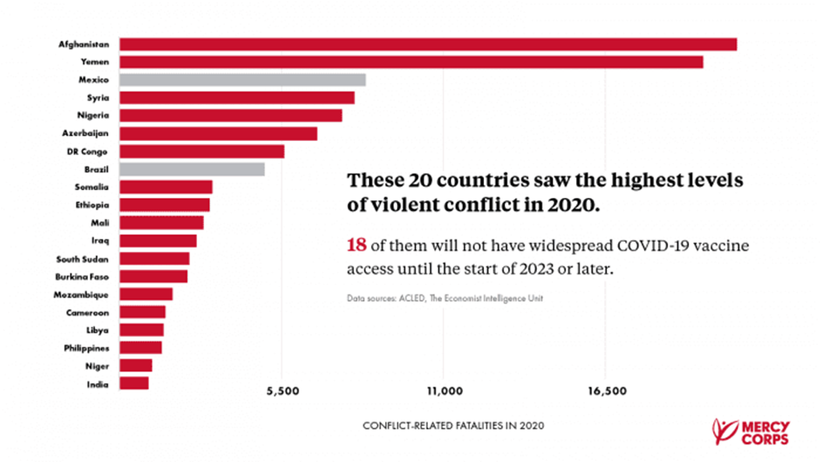
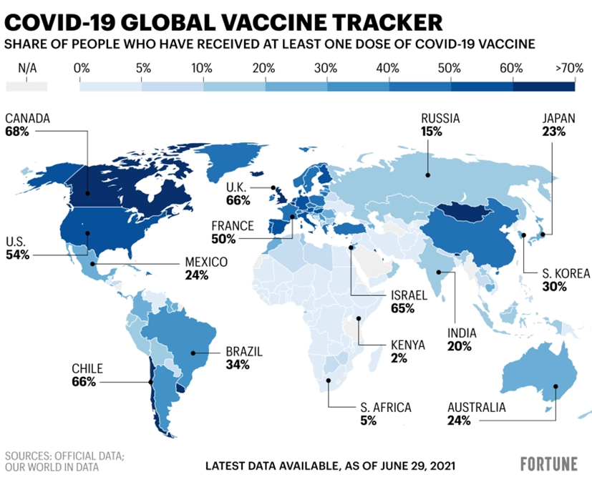
Vaccination - availability

Slide 27
5. Fighting communicable diseases
Communicable diseases are estimated to kill around 4 million people this year alone, over 28 times the amount of those who died due to vaccine-preventable diseases in 2019.
In order to decrease this death toll, endemic countries need sufficient health funding to improve the quality of treatments, invest in research, and expand the outreach of immunization.
Commentary: This article was published before coronavirus pandemic.

Slide 28
6. Preparing for epidemics
When it comes to disease outbreaks or epidemics, it is important to stay ahead of the curve, especially when millions of lives are potentially at risk.
Whether it is a new vaccine-resistant strain of influenza or the continued spread of various mosquito-transmitted diseases like malaria, it is important for countries to focus on preparedness and preventative measures by investing in health care and infrastructure.

Slide 29
7. Making healthy food more accessible
As food insecurity continues to afflict millions, especially in war-torn regions, many are left with either unsafe or unhealthy food options, which directly causes a third of all diseases worldwide.
To combat the rise of obesity and diet-related diseases, nations must develop better public policies and provide healthier food options for all.

Slide 30
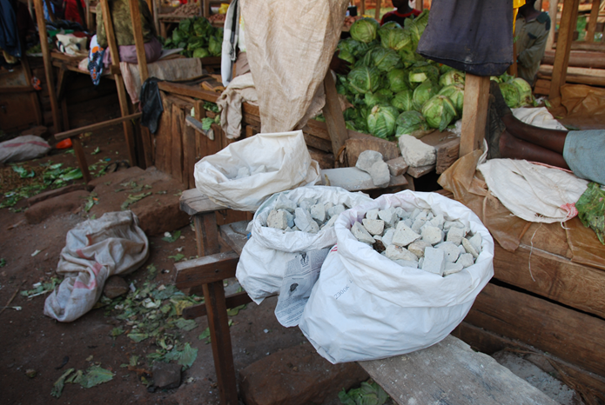
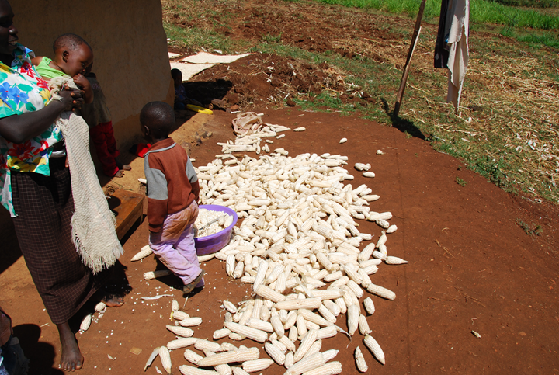
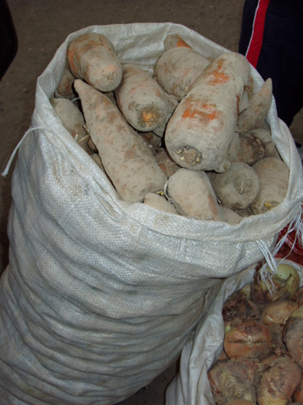
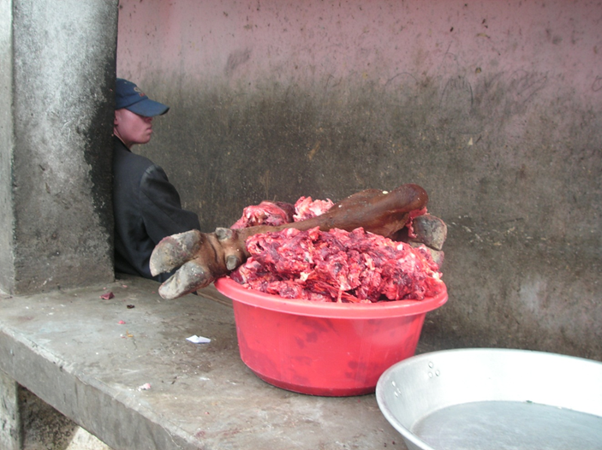
Availability of healthy food

Slide 31
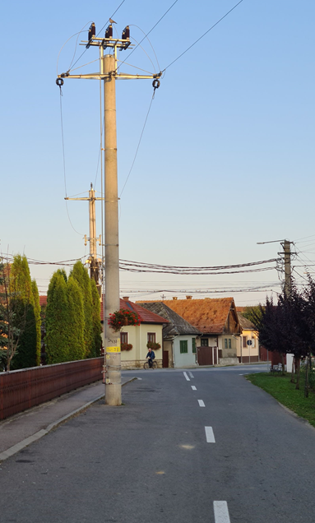

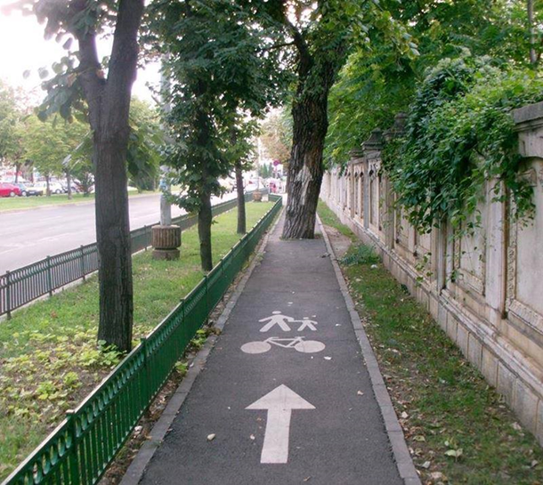
Public policy aimed at increasing physical aktivity…

Slide 32
8. Investing in health care workers
Health workers around the world are often overworked and underpaid, which has led to a worldwide shortage of health care professionals, placing both health care systems and people at risk.
To keep global health care systems afloat, the world requires an additional 18 million health care workers by the end of 2030.

Slide 33
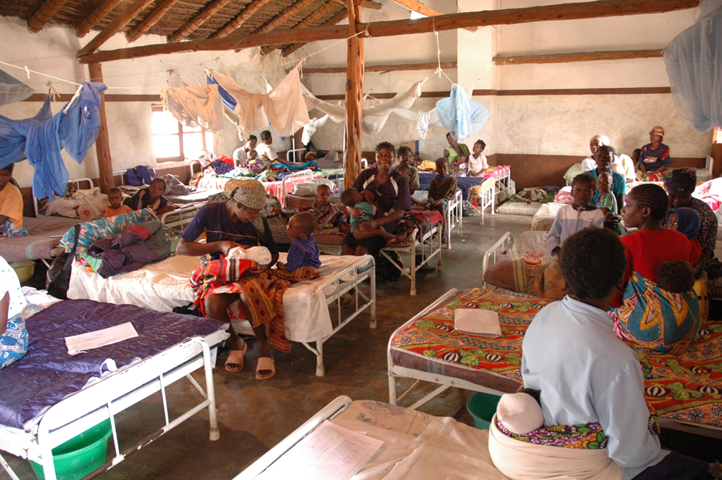
Pediatric inpatient clinic with 1 doctor 24/7

Slide 34
9. Promoting adolescent safety
Nearly 1 million teenagers die from violence, HIV/AIDS, and suicide every year.
Providing educators and health care professionals with the necessary tools to educate teenagers about sex, drug use, and mental health can help significantly reduce this number.
Protecting our future means protecting the world’s next generation.

Slide 35
Policy against sex education as a part of school programs
https://www.theguardian.com/education/2019/apr/27/sex-education-around-the-world
Re: Sexual Education in Poland - Watch the full documentary | ARTE

Slide 36
10. Strengthening trust between health care systems and the public
Misinformation around medicines and vaccines can be detrimental to public health on a global scale. Groups like the anti-vaccination movement, for instance, use social media to spread misinformation, eroding public trust in health care institutions on a global scale. Increased quality health education and social media accountability can thwart this mistrust.

Slide 37
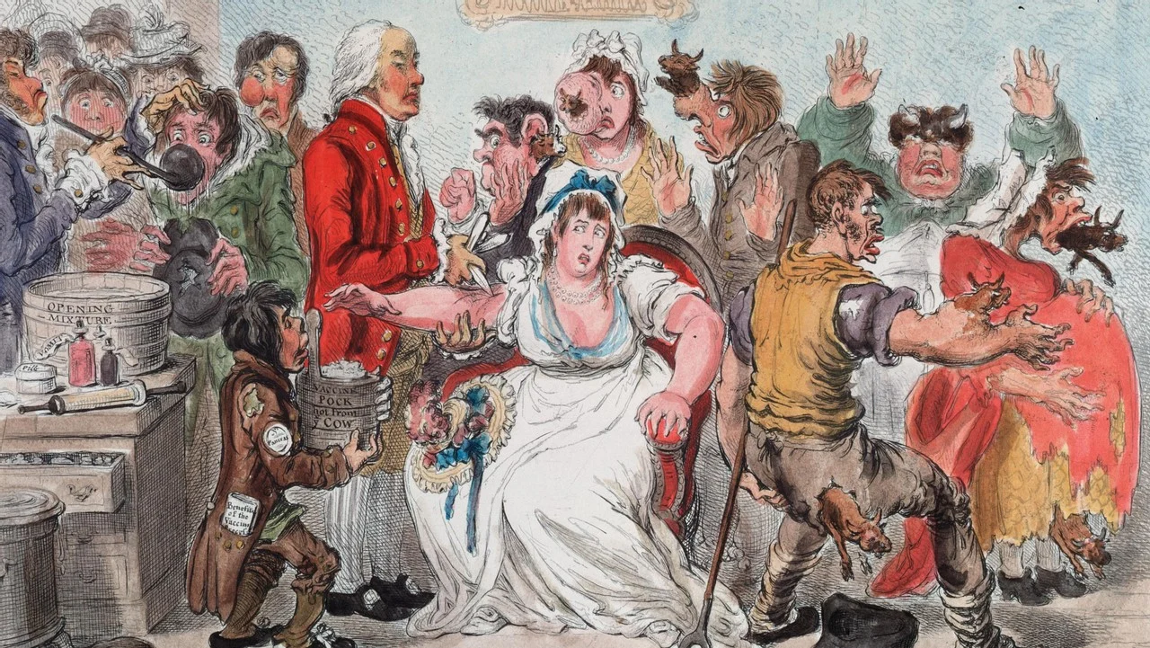
Anti-vaccine movement
George Bernard Shaw (1856–1950) was a famous Irish playwright who was known as the leading dramatist of his generation, winning the Nobel Prize in Literature in 1925.
He was against vaccination, calling it “a peculiarly filthy piece of witchcraft.”

Slide 38


Myths about vaccination
„I read that vaccinated women will not have children…“
„Don't believe it. I was vaccinated and when I returned home, they were still there. All four.“

Slide 39
11. Utilizing modern technology and innovations
New technological advancements are coming out every day, making it easier to detect and treat various illnesses. However, it is important to understand the ethical implications of these new advancements when bringing them into the public health sector so people seeking medical treatment are not harmed by the very tool that is supposed to help them.

Slide 40
Utilizing modern technology and innovations
Patient dies after X-Ray blunder • healthcare-in-europe.com
Patient dies after X-Ray blunder
ONE patient died and 13 others were seriously affected by an overdose of X-ray radiation at a hospital in Epinal, north-east France.
Medical errors and accidents: an ongoing threat to health- STAT (statnews.com)
Use systems redesign and the law to prevent medical errors and accidents

Slide 41
12. Preventing antibiotic resistance
Antimicrobial resistance (AMR) is when certain bacteria or viruses can no longer be treated by antibiotics and can be caused by the overuse of antibiotics, poor hygiene, or lack of access to clean water. Because AMR could pose a serious threat to modern medicine, international authorities must allocate funding for research into new antibiotics.
Comment:
Author does not mention causes of AMR and specific methods of prevention.

Slide 42
13. Ensuring health care facilities are clean and sterile
Clean water and sanitation are key to keeping health care facilities sterile. Currently, 1 in 4 health facilities worldwide lacks basic water and sanitation services, increasing the overall risk of infection for patients and health care professionals alike.

Slide 43
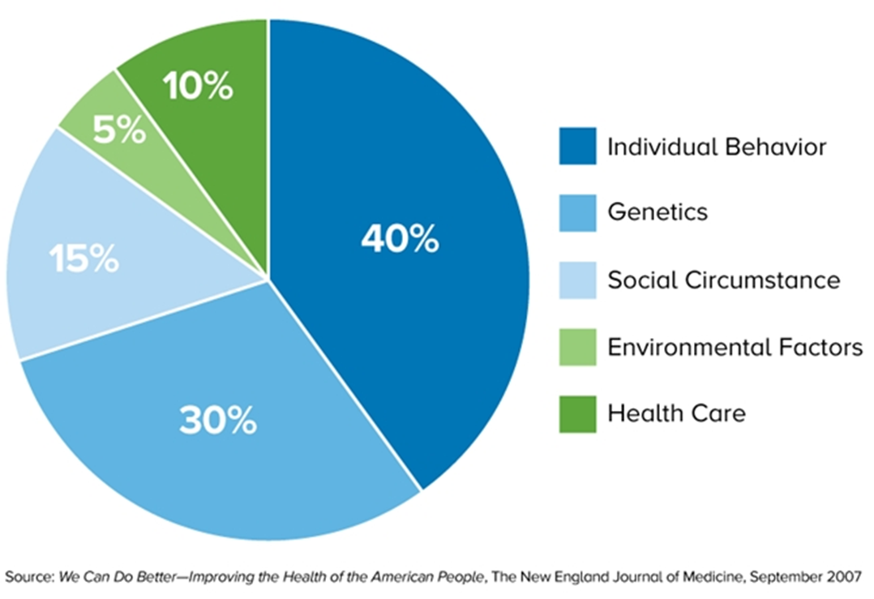
Environment as a determinant of overall health

Slide 44
Environment and health (“forever chemicals”)
E.g. Per- and polyfluoroalkyl substances (PFAS)
Items containing “forever chemicals”:
microwave popcorn bags, pizza boxes, confectionery packaging
non-stick dishes
waterproof clothing
detergents
personal care and cosmetics (shampoos, dental floss, nail polishes)
and many others…

Slide 45


Medialization
Movie The Devil We Know – YouTube
(2018)
Movie Dark Waters (2019)

Slide 46
Human health concerns associated with PFASs
Cancer (kidney, testes)
Possible liver damage
Thyroid disease
Ulcerative colitis
Hypercholesterolemia
Pregnancy-induced hypertension and pre-eclampsia

Slide 47


PFASs in objects of common use, eg. in the surface of pans

Slide 48
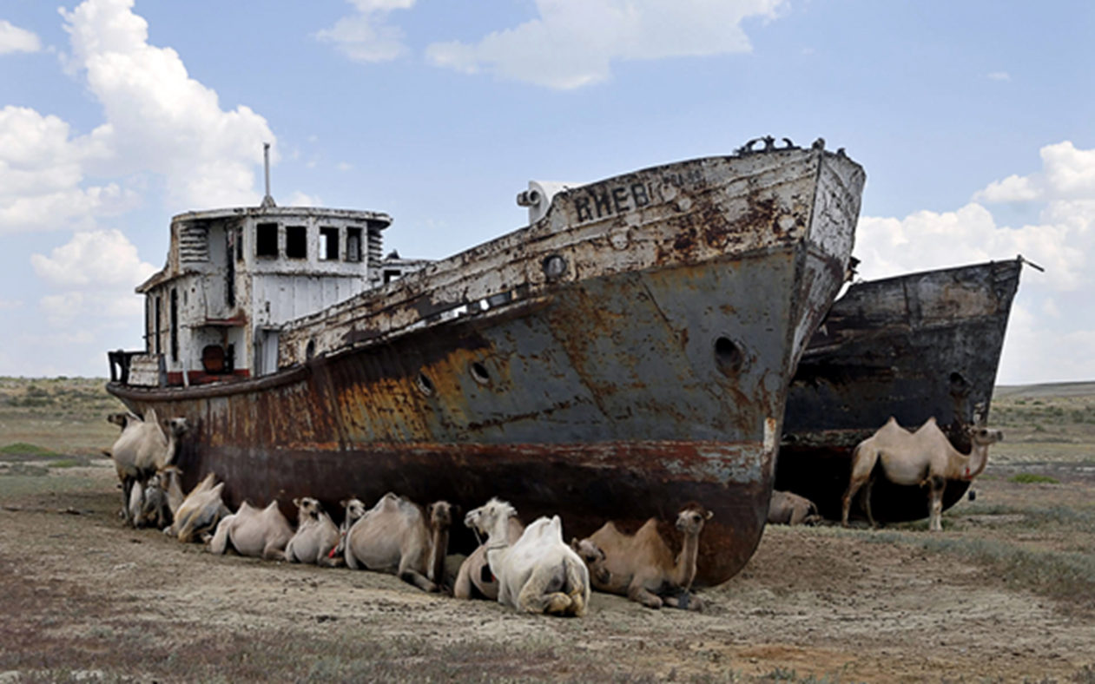
Climate change and health – the example of the Aral Sea

Slide 49
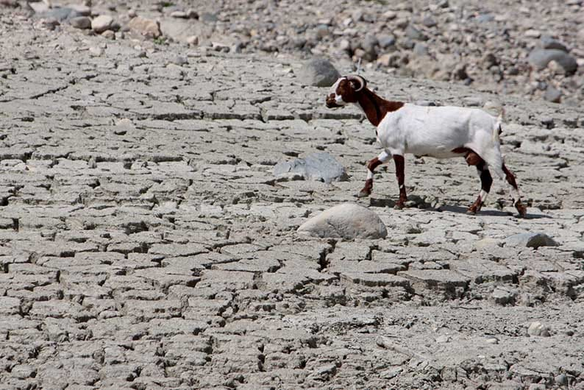
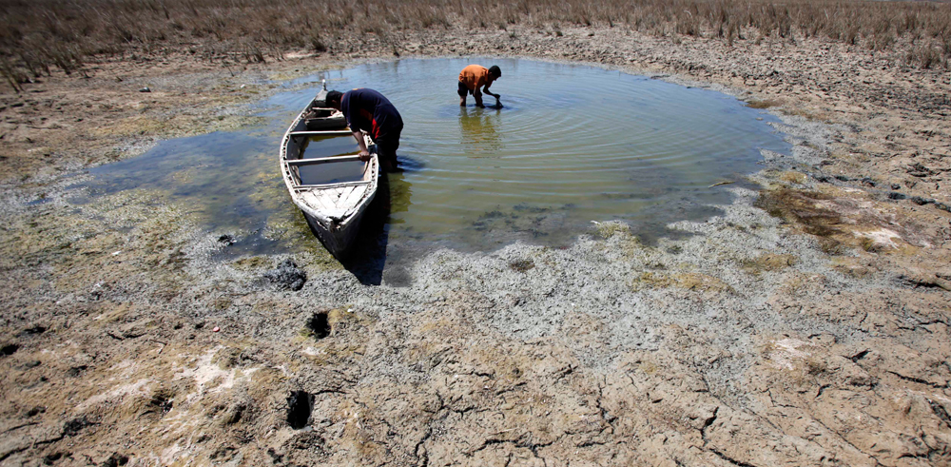
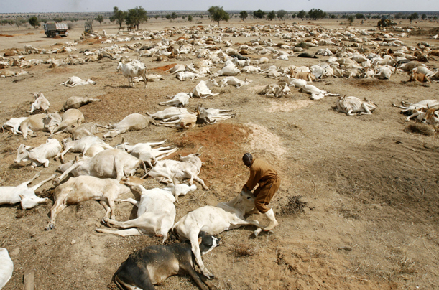
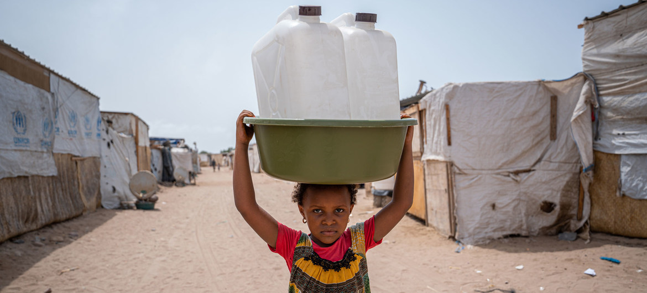
Water shortage and health

Slide 50
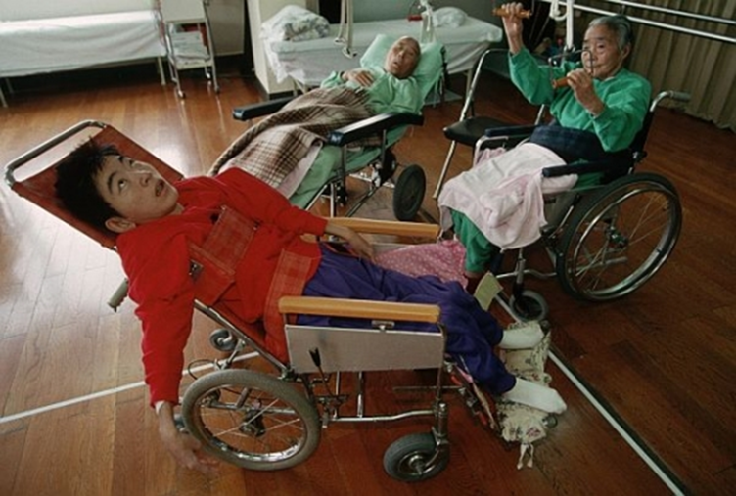
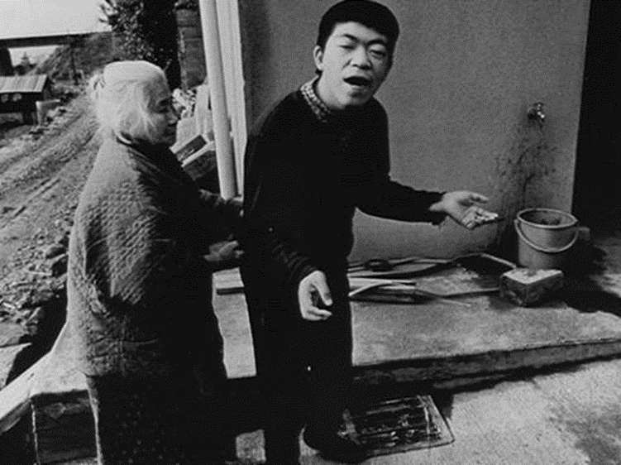
Patients with Niigata Minamata disease (web source)

Slide 51
Medialization
https://www.youtube.com/watch?v=WP3pKTssw_E
Film Minamata, 2020 (starring Johnny Depp, Bill Nighy, dir. Andrew Levitas)
The film was shot according to real events (belongs to art production).

Slide 52


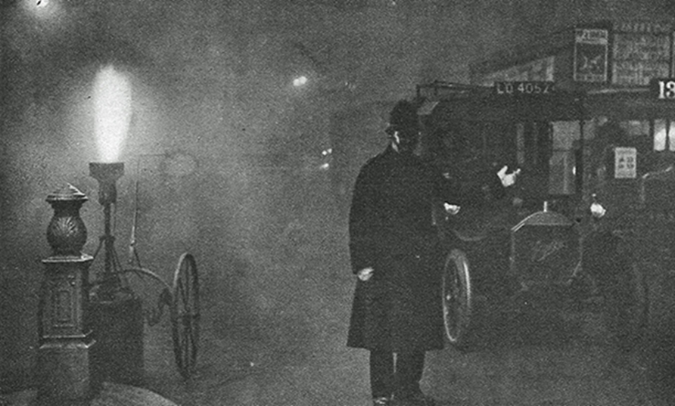
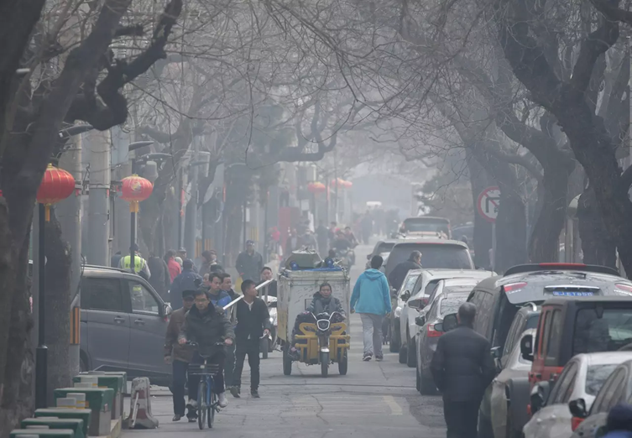
Smog: local or already global problem?

Slide 53
Nuclear power plant accidents and global health
Kyshtyma catastrophe (former Soviet Union), 1957
Windscale, UK, 1957
Jaslovske Bohunice A1, Czechoslovakia, 1976 and 1977
Three Miles Island, USA, 1979
Chernobyl, former Soviet Union, 1986
Fukushima, Japan, 2011

Slide 54
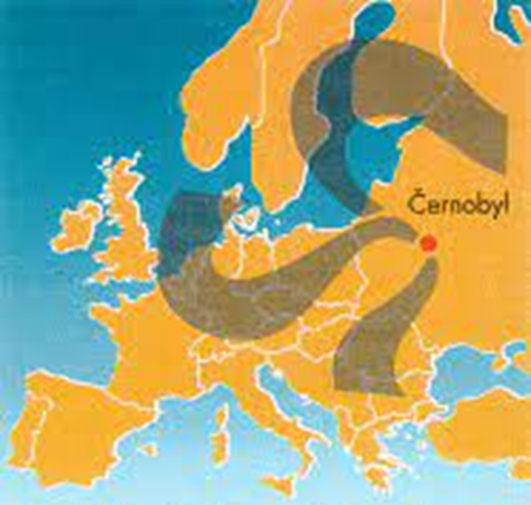
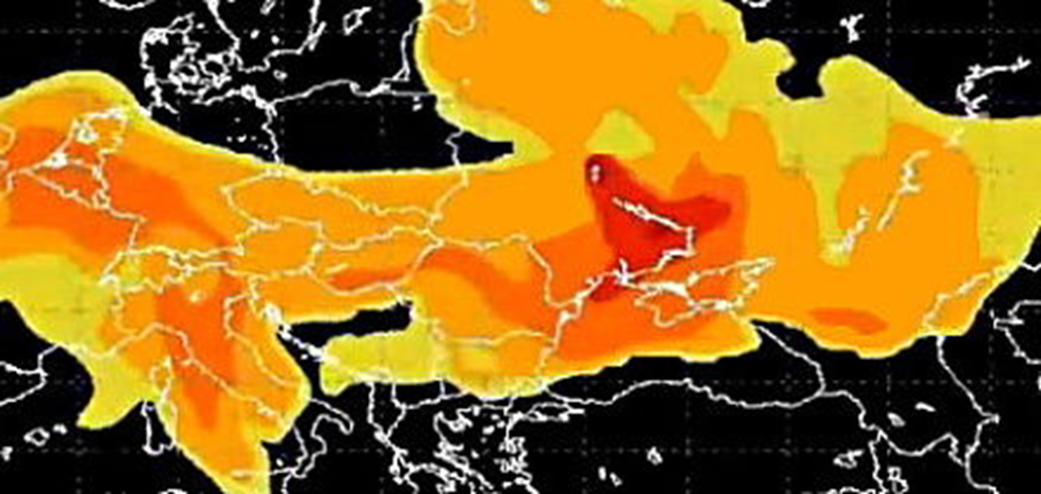
The movement of a radioactive cloud after the Chernobyl accident - 1986

Slide 55
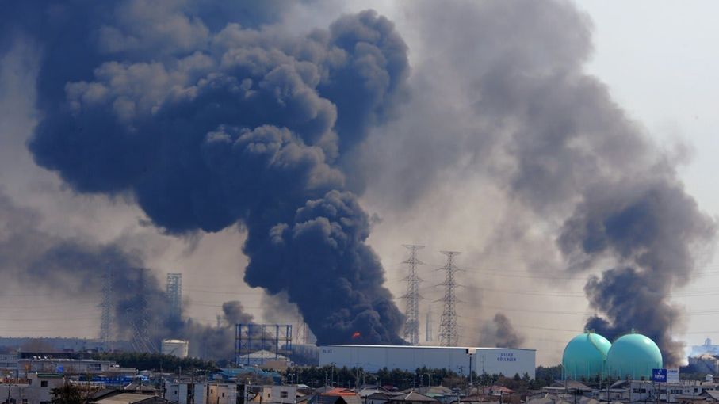
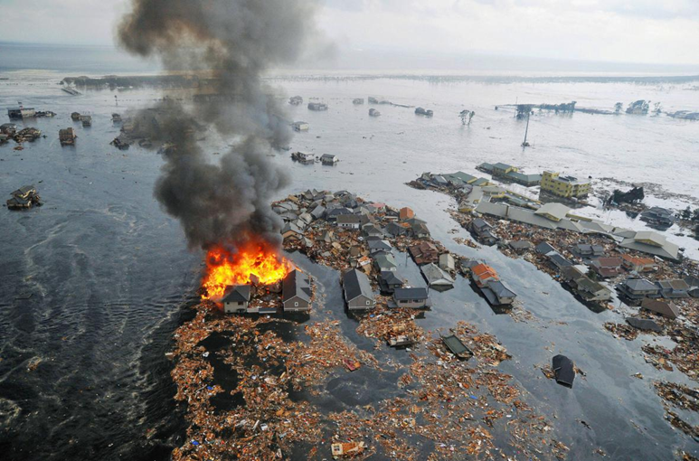
Fukushima in 2011 and after 5 years

Slide 56
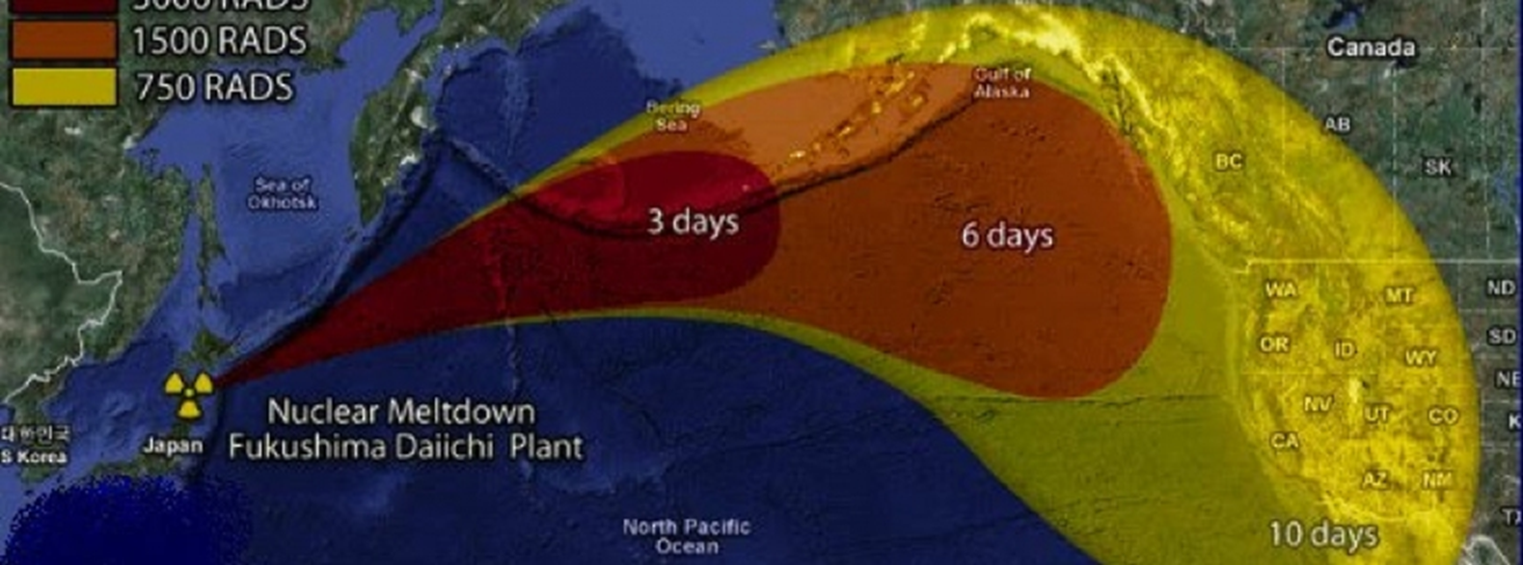
The movement of radioactive cloud after Fukushima accident - 2011

Slide 57

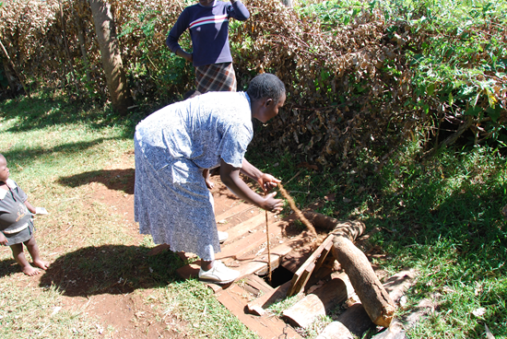
Threatening biological factors of the environment
biodiversity loss and soil degradation
access to drinking water and food (ecosystem services)
overpopulation of certain biological species due to climate change
infection (facilitating the action of pathogens)

Slide 58
Additional challenges for global health
Respiratory infections with longer incubation time
Biological weapons?
Climate change
Forever chemicals
Ethics in global health (eg Which population groups have priority in vaccination? Should vaccination be mandatory? Do the unvaccinated have the same rights to low-availability treatment?)

Slide 59
Recommended readings
Global_Health_Summit_Rome_Declaration.pdf (reliefweb.int)
Fit-For-Purpose-EU-Role-Global-Health-Era-COVID-19-Discussion-Paper-282-ECDPM-October-2020-1.pdf
https://ec.europa.eu/health/sites/health/files/eu_world/docs/20140930_global_health_infograph_en.pdf
https://ec.europa.eu/health/international_cooperation/global_health_cs
Arah, Onyebuchi A. “On the relationship between individual and population health.” Medicine, health care, and philosophy vol. 12,3 (2009): 235-44. doi:10.1007/s11019-008-9173-8

Slide 60
END

