Slide 1
NSAIDs, Antipyretics Antigout drugs
Copyright notice
The presentation is copyrighted work created by employees of Masaryk university.
Students are allowed to make copies for learning purposes only.
Any unauthorised reproduction or distribution of the presentation or individual slides is against the law.
Department of Pharmacology MU

Slide 2
Analgesics-antipyretics (A-A) drugs against fever and pain
Nonsteroidal antiinflammatory drugs (NSAIDs) - against inflammation, fever and pain
A-A and NSAIDs overlap partially

Slide 3
Mechanism of action
all of them have similar mechanism of action– inhibition of eicosanoids synthesis (with higher or lower selectivity and strength)
NSAIDs differ in the strength of COX1/COX2 inhibition and the incidence of typical AE (ulcer disease, bleeding)

Slide 4
Cyclooxygenases
COX-1 – constitutive – prostanoids involved in physiological processes (gastroprotective effects, platelet activities)
COX-2 – inducible – activity enhanced by proinflammatory factors (IL-1, IL-2, TNF-α, oncogenes,..)
prostanoids → inflammation, fever, pain
COX-3 ? – central mechanism of analgesic and antipyretic effect (localization: heart + CNS)
Notes:
úči

Slide 5
Classification by COX1/COX2 inhibition
Nonspecific inhibitors
ASA, ibuprofen, diclofenac, …
Preferential inhibitors of COX-2
meloxicam, nimesulid
Specific inhibitors of COX-2
coxibs

Slide 6
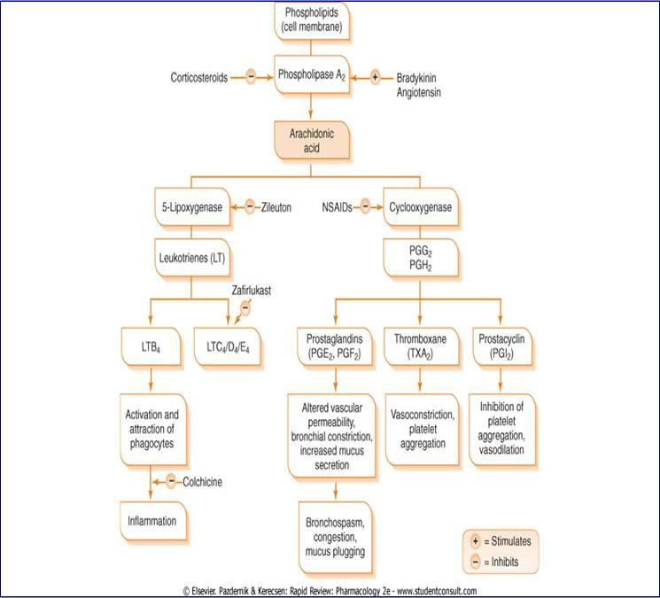

Slide 7
Classification
Salicylic acid derivatives
Aniline derivatives
Propionic acid derivatives
Pyrazolones
Acetic acid derivatives
Oxicams
Coxibs
Other

Slide 8
1. Salicylates
Effects:
analgesic
antiinflammatory
antipyretic
antirheumatic
antiaggregation → inhibition of platelet function

Slide 9
Salicylic acid derivatives – drugs
NSAIDs:
ASA (acetylsalicylic acid)
sodium salicylate
cholinsalicylate
Therapy of inflammatory bowel desease:
sulfasalazine
→ sulfapyridine + 5-aminosalicylic acid
mesalazine

Slide 10
Acetylsalicylic acid
efficiency standard of AA and NSAIDs
selective inhibitor of COX1 (100-200 : 1)
irreversible acetylation of COX-1 active centre
pharmacokinetics:
weak acid, complete and rapid absorption in stomach and proximal part of intestine
salicylic acid (SA) is product of metabolisation
T_{1/2} ASA 15-20 min, T_{1/2} SA 30 hrs depending to dose
80-95% binding to plasma proteins, elimination and exkretion via kidneys
higher doses – risk of cumulation in a body

Slide 11
Usual dosages
antipyretic 500 mg
analgesic 500 mg (4 - 6 hrs)
anti-phlogistic, -rheumatic, -uratic 3,6 – 4 g/day
antiaggregative 30 –100 mg
total daily dose 4 g/day

Slide 12
ASA – adverse effects
salicylism (↑d.) – hearing impairment, tinnitus, deafness, vertigo
allergy - itching, rash, anaphylaxis,…
aspirin-induced asthma - ↑LT
GIT - nausea, dyspepsia, bleeding, ulcer disease
„analgetic“ nephropathy – reversible decrease of glomerular filtration
increased bleeding
CAVE
pregnancy- differs in trimesters
children- Rey‘s syndrome
elders- more sensitive to AE

Slide 13
ASA interactions
anticoagulants
NSAIDs and other analgesics (except of opioids)
other
valproate, sulfonylureas – competition on plasma proteins – increase of efficacy
SSRI – potentiate ASA antiaggregative effect (citalopram, fluoxetine)
glucocorticoids decrease ASA plasma levels, but increase the risk of GIT bleeding and ulceration

Slide 14
ASA - contraindications
hemophilia and other diseases influencing blood coagulation
administration prior to surgery
gastroduodenal ulcers, gastritis
children to 12 years
Rey‘s syndrome (hyperpyrexia, acidosis, seizures, vomiting, psichiatric disorders, hepatopathy)
pregnancy (only temporary)
asthma, allergy, nasal polyps

Slide 15
2. Aniline derivatives
Paracetamol (=acetaminophen)
analgesic, antipyretic, is not antiinflammatory active
does not influence blood coagulation or uric acid levels
mechanism of action is unclear:
central mechanism due to COX-3 inhibition
indirect effect on 5-HT₃ spinal receptors
elevates PGG₂ to PGH₂conversion in peripheral tissues
influencing the endocannabinoid and vanillin system and Ca²⁺ channels

Slide 16
Usual doses
comparable effect to ASA, but better tolerance
drug of choice to ↓ fever and pain in children younger than 12 years
pain in adults
300 to 500 mg every 3-4 hrs
650 mg every 4 to 6 hrs
1000 mg every 6 hrs
total daily dose up to 4 g

Slide 17
Pharmacokinetics:
p.o. good absorbtion, maximum in 30-60 min, low plasma protein binding, hepatic metabolism
production of hepatotoxic mtb. – binding to gluthathione
overdose (10 – 15 g) → antidote N-acetylcysteine
AE, CI:
allergy
hepatotoxicity after ↑ doses
comorbidities:
alcohol addiction
nephropathy
hepatopathy

Slide 18
3. Pyrazolones
Propyphenazone
in combinations (with paracetamole and caffein)
AE: GIT intolerations, rash, bronchospasm, hematopoetic disorders
Metamizole
analgetic, antipyretic + spasmolytics effect
combined with spasmolytics (pitofenone, fenpiverine)
AE: rare but serious - the most serious are agranulocytosis and pancytopenia

Slide 19
4. Propionic acid derivatives
Ibuprofen
good analgesic and antiinflammatory effect
used often for acute pain therapy
low AE incidence, well tolerated NSAID, indicated for children
Ketoprofen
phototoxicity
Dexketoprofen

Slide 20
4. Propionic acid derivatives
Naproxen
longer T_{1/2} (12-15 hrs)
low gastro- and cardiovascular toxicity compared to other NSAIDs
Tiaprofenic acid
good penetration to synovial fluid → joints diseases
Flurbiprofen

Slide 21
5. Acetic acid derivatives
Diclophenac
antiinflammatory, analgesic, weak antipyretic ef.
bioavailability 30-70%
short biological halftime → retarded DDF
more AE than ASA, less than indomethacin
mild: cephalgia, insomnia, GIT disorders, photosensitivity
significant risk of cardiovascular AE
Aceclofenac

Slide 22
5. Acetic acid derivatives
Indomethacin
very strong nonselective COX inhibitor
toxic → short-time treatment of acute states
urikosuric effects→ used in gout attacks
AE in 30 % of pacients
GIT, cephalgia, depression, confusion, hallucinations, hematoxicity, cartilages destruction

Slide 23
6. Oxicams
high plasma protein binding (interactions!)
long biological halftime (once daily dosing)
different COX affinity
Meloxicam
COX-2 more selective
lower AE incidence
Lornoxicam
nonselective COX inhibitor
low occurence of GIT adverse effect
Piroxicam
nonselective COX inhibitor, high toxicity

Slide 24
7. Coxibs
100 x more selective to COX-2 (specific COX-2 inhibitors)
lower AE in GIT
do not influence thrombocyte aggregation or renal perfusion
good analgesic effect, not suitable for treatment of acute or transient pain → effect is progressing slowly
prescription and indication restrictions
I: osteoarthritis, rheumatoid arthritis, ankylosing spondylitis
AE: increase of thrombembolisms (myocardial infarction, strokes) after chronic use

Slide 25
7. Coxibs
Celecoxib
Parecoxib – only inj.
Etoricoxib
Pharmacokinetics:
after p.o. administration good absorption from GIT, but not too fast, max levels reach in 2-4 hours
fat diet slows down absorption

Slide 26
8. Other
Nimesulide
preferential inhibitor of COX-2
inhibits enzymes destroys cartilage (elastases, collagenases), due to occurrence of AE, indication of treatment of painful osteoarthritis has been taken
is not the first choice medicine in any of indications
PK: lipophilic, short elimination half-life (1,5-5 hrs), analgesia up to 12 hrs
AE: hepatotoxicity (max duration of therapy 15 days)

Slide 27
Adverse effects
because of COX-1 inhibition:
GIT - ↓ cytoprotective PGE₂, PGI₂
⇒ erosions, ulcerations
thrombocytes - ↓ TXA₂: inhibition of thrombocytes aggregation
⇒ increased bleeding
PGE₂, PGI₂ regulation of renal functions
⇒ renal failure
↑ LT production induces in predisposed people bronchoconstriction
⇒ asthma attack
uterus - ↓ PGE/F: inhibition of constriction
⇒ prolongation and complications during delivery
coxibs:
thromboembolic cardiovascular and cerebrovascular complications

Slide 28
Prevention of AE
dose reduction or DDF change
combination with protective drugs
proton pump inhibitors (lansoprazole, omeprazole)
prostaglandine analogues (misoprostol)
H₂ antihistamines (ranitidine, famotidine)
think about preferential or specific COX-2 inhibitors

Slide 29
NSAIDs for local aplication
ketoprofen, ibuprofen, naproxen, indomethacin, diclophenac, nimesulide, piroxicam
flurbiprofen (lozenges), choline salicylate (oral gel)
DDF: creams, gels, solutions (sprays), patches, lozenges
AE: hypersensitivity reaction, phototoxic reaction

Slide 30
Treatment of gout

Slide 31
Drugs
Acute gout attack
strong anti-inflammatory action
pain-killers
inhibition of leucocyte migration to the joint
Hyperuricemia therapy / prevention of gout attack
increase of uric acid excretion
block of synthesis
+ diet

Slide 32
Treatment of acute gout attack
NSAIDs
higher doses (i.m., p.o., p.r.)
some have preferably uricosuric effect
indometacine, diclofenac, piroxicam
colchicine
alcaloid obtained from Colchicum autumnale
p.o. every 2-4 hrs
mitotic poison, inhibits phagocytosis and leukocyte migration
AE: severe diarrhea – rehydratation!
glucocorticoids
local adm. (i.a.) – triamcinolone
systemic (p.o., i.m., i.v.) – prednison, methylprednisolon
canakinumab
IL-1 inhibitor, human monoclonal antibody
patients who do not tolerate NSAIDs and GC
s.c. aplication

Slide 33
Chronic treatment of gout
Uricosurics
inhibit reabsorption of uric acid in primary tubulus
Lesinurad
only in combination with xantin oxidase inhibitors
Probenecide
sometimes used with antibiotics or antivirotics to make them stay longer in the body
Not registered in Czech Rep.

Slide 34
Antiuratics
inhibit syntesis of urine acid by inhibition xantin oxidase (XO)
Allopurinol
isomer of hypoxanthin, competitive inhibition of xanthin oxidase
inhibits de novo syntesis of purines
not combine with cytostatics of purine structure (azathioprin, 6-mercaptopurin) – allopurinol ↑ their toxicity!
AE: usually well tolerated, most common:
rash, GIT intoleration, hypersensitive reaction
XO
XO
hypoxanthin
xanthin
uric acid

Slide 35
Febuxostat
MA: non-purine inhibitor of xantinoxidase
clinical trials proved higher efficacy than allopurinol
AE: gout attacts, liver function abnormalities, diarrhoea, nausea, headache
Pegloticase (recombinant uricase)
MA: transforms uric acid to alantoin with better solubility
AE: anaphylactic shock, reaction to infusion, gout attacts at the beginning of therapy
i.v. aplication (only to inpatient)

