Slide 1




Analgesia and anesthesia
Department of Trauma Surgery FN Brno

Slide 2
Definition
Anesthesia - from Greek, without perception
  general - artificial sleep (coma) patient
  local - desensitizing certain body parts
  elimination of all sensation - tactile and painful
Analgesia - algos, no pain
  exclusion only pain perception
Analgosedation
  analgesia with a slight decline of consciousness
  it is possible to make contact after a stronger pulse

Slide 3


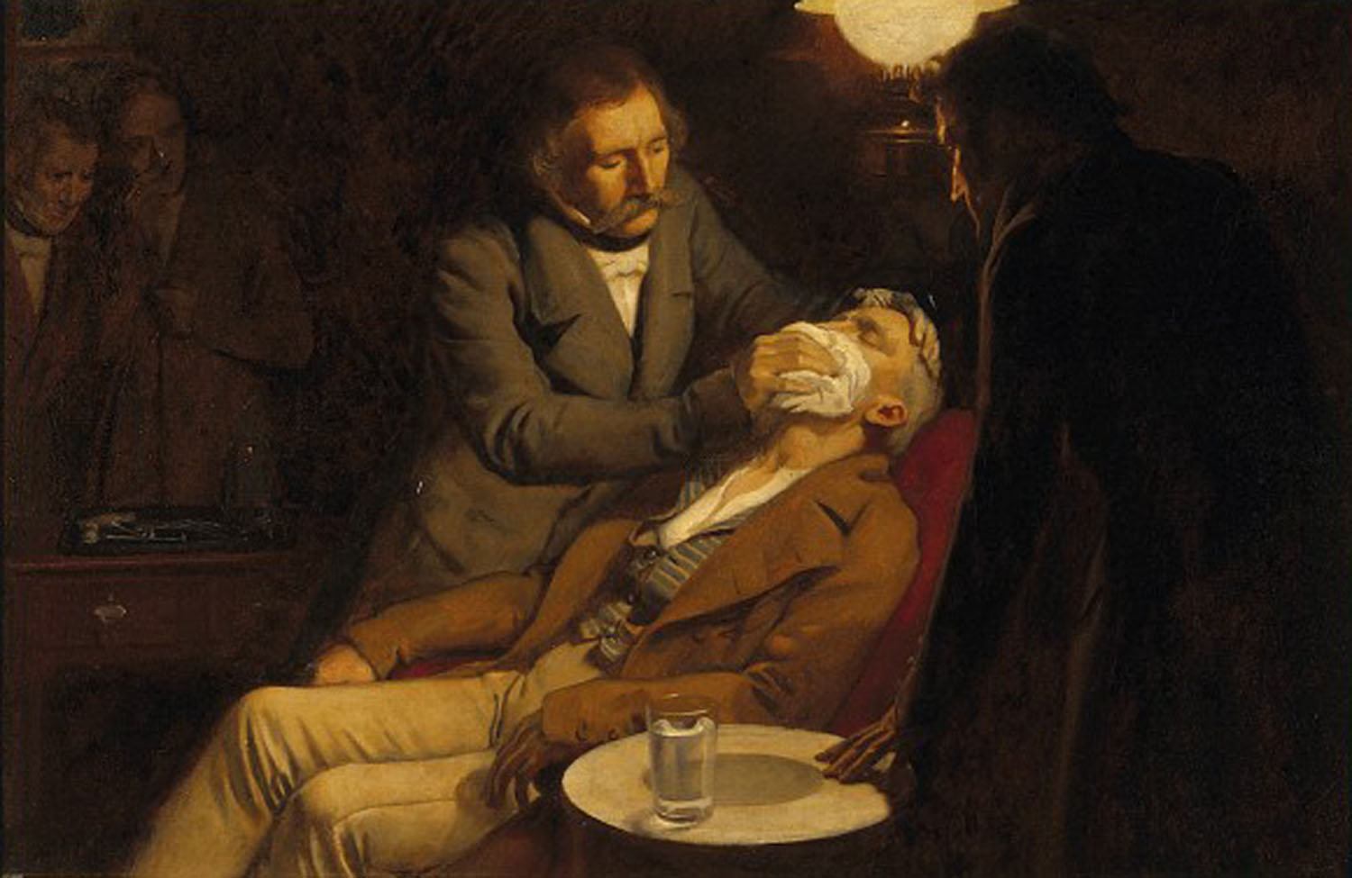
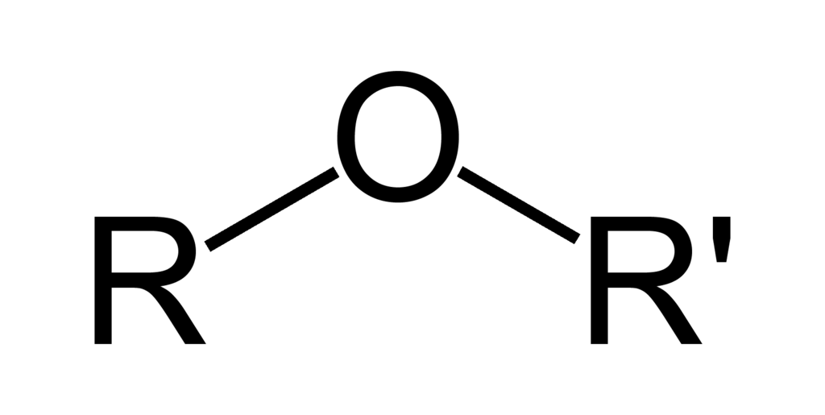
History
Antiquity (Egypt, Syria)
Decoction of opium, mandrake
Czech lands
1947 ether anesthesia in Prague (Celestin Opitz)
First anesthesia department after WW2
ÚVN, Sv. Anna Brno

Slide 4
Anesthesiology
Anesthesiology - is a branch of medicine that focuses on pain relief during and after surgery. This treatment is called anesthesia. Practitioners of anesthesiology are called anesthesiologists
Resuscitation - is a term describing the process of correcting physiological disorders in an acutely unwell patient
Cardiopulmonary resuscitation - commonly known as CPR, is an emergency procedure performed in an effort to manually preserve intact brain function until further measures are taken to restore spontaneous blood circulation and breathing in a person who is in cardiac arrest
Intensive care medicine or critical care medicine is a branch of medicine concerned with the diagnosis and management of life-threatening conditions requiring sophisticated organ support and invasive monitoring.

Slide 5
General anesthesia
medically induced coma and loss of protective reflexes resulting from the administration of one or more general anesthetic agents.
a variety of medications may be administered, with the overall aim of ensuring unconsciousness, amnesia, analgesia, relaxation of skeletal muscles, and loss of control of reflexes of the autonomic nervous system.
The optimal combination of these agents for any given patient and procedure is typically selected by an anesthesiologist or another provider such as an anesthesiologist assistant or nurse anesthetist, in consultation with the patient and the medical or dental practitioner performing the operative procedure

Slide 6
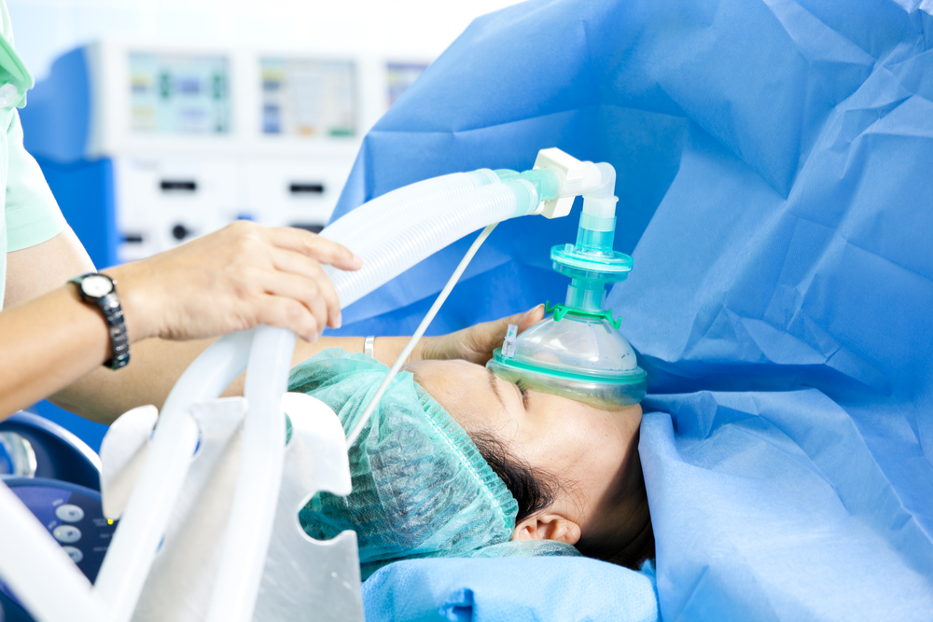
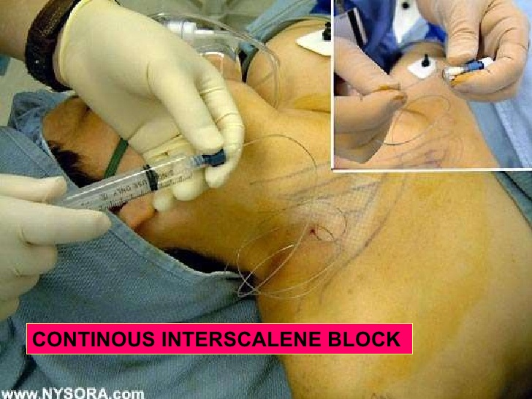
Combined anesthesia
General + Local

Slide 7
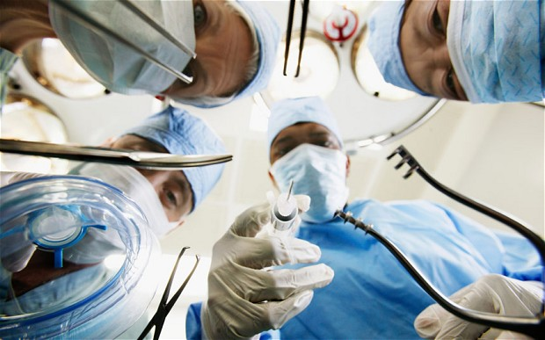
Surgery
Types of surgery
  elective - to correct a non-life-threatening condition
  semi-elective - can be postponed for a short time
  emergency - must be done promptly to save life, limb, or functional capacity
preoperatively
  pre-operation examination
  treatment of laboratory values – CBC, ions

Slide 8
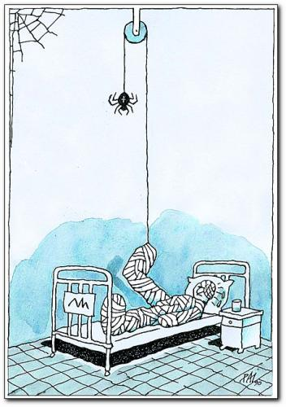
Perioperative period
Preoperative
to perform tests, attempt to limit preoperational anxiety, include the preoperative fasting.
Intraoperative
begins when the patient is transferred to the operating room bed ends with the transfer of a patient to the postanesthesia care unit (PACU). Patient is monitored, anesthetized, prepped, and draped, and the operation is performed. Nursing activities during this period focus on safety, infection prevention, and physiological response to anesthesia. Radiation therapy and blood salvage may also be performed during this time.
Postoperative
transfer to the PACU (Post Anesthesia Care Unit) and terminates with the resolution of the surgical sequelae. It is quite common for this period to end outside of the care of the surgical team. It is uncommon to provide extended care past the discharge of the patient from the PACU.

Slide 9
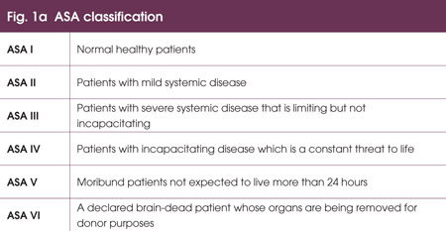
Preoperative phase
Meeting anesthesiologist with patient
evaluation of preoperative examinations
introduction to surgary
evaluate the degree of the fitness before surgery
- ASA physical status classification system
prescribe premedication, reassure the patient
fasting - 6 hours
Prepremedication - the evening before surgery
Premedication - on the day of the surgery
sedation, sleep
- tranquilizers (benzodiazepine)
elimination of unwanted vagal reflexes
- vagolytic (atropine)

Slide 10
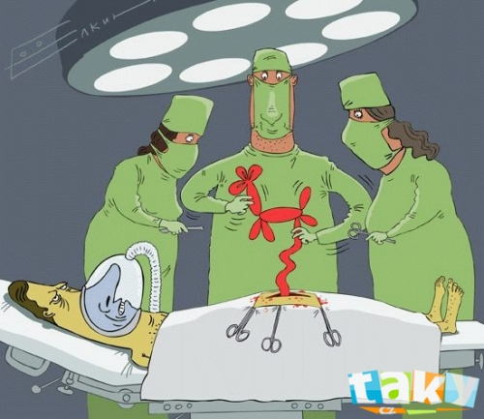
Intraoperative phase
eliminate of painful stimuli
anesthesia, analgesia
stabilization of the condition
sufficient breathing and
keeping the filling bloodstream
muscle relaxation
controlled hypotension
cardiopulmonary bypass

Slide 11
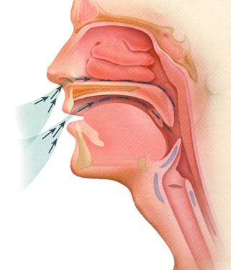
Airway management
set of medical procedures performed in order to prevent airway obstruction
head-tilt/chin-lift
jaw-thrust maneuvers
oropharyngeal airways (OPA)
nasopharyngeal airways (NPA)
laryngeal mask
does not prevent further leaking and aspirations
endotracheal tube
indications - full stomach (ileus, trauma), position on the abdoben or side, muscle relaxation, circulatory and respiratory insufficiency

Slide 12
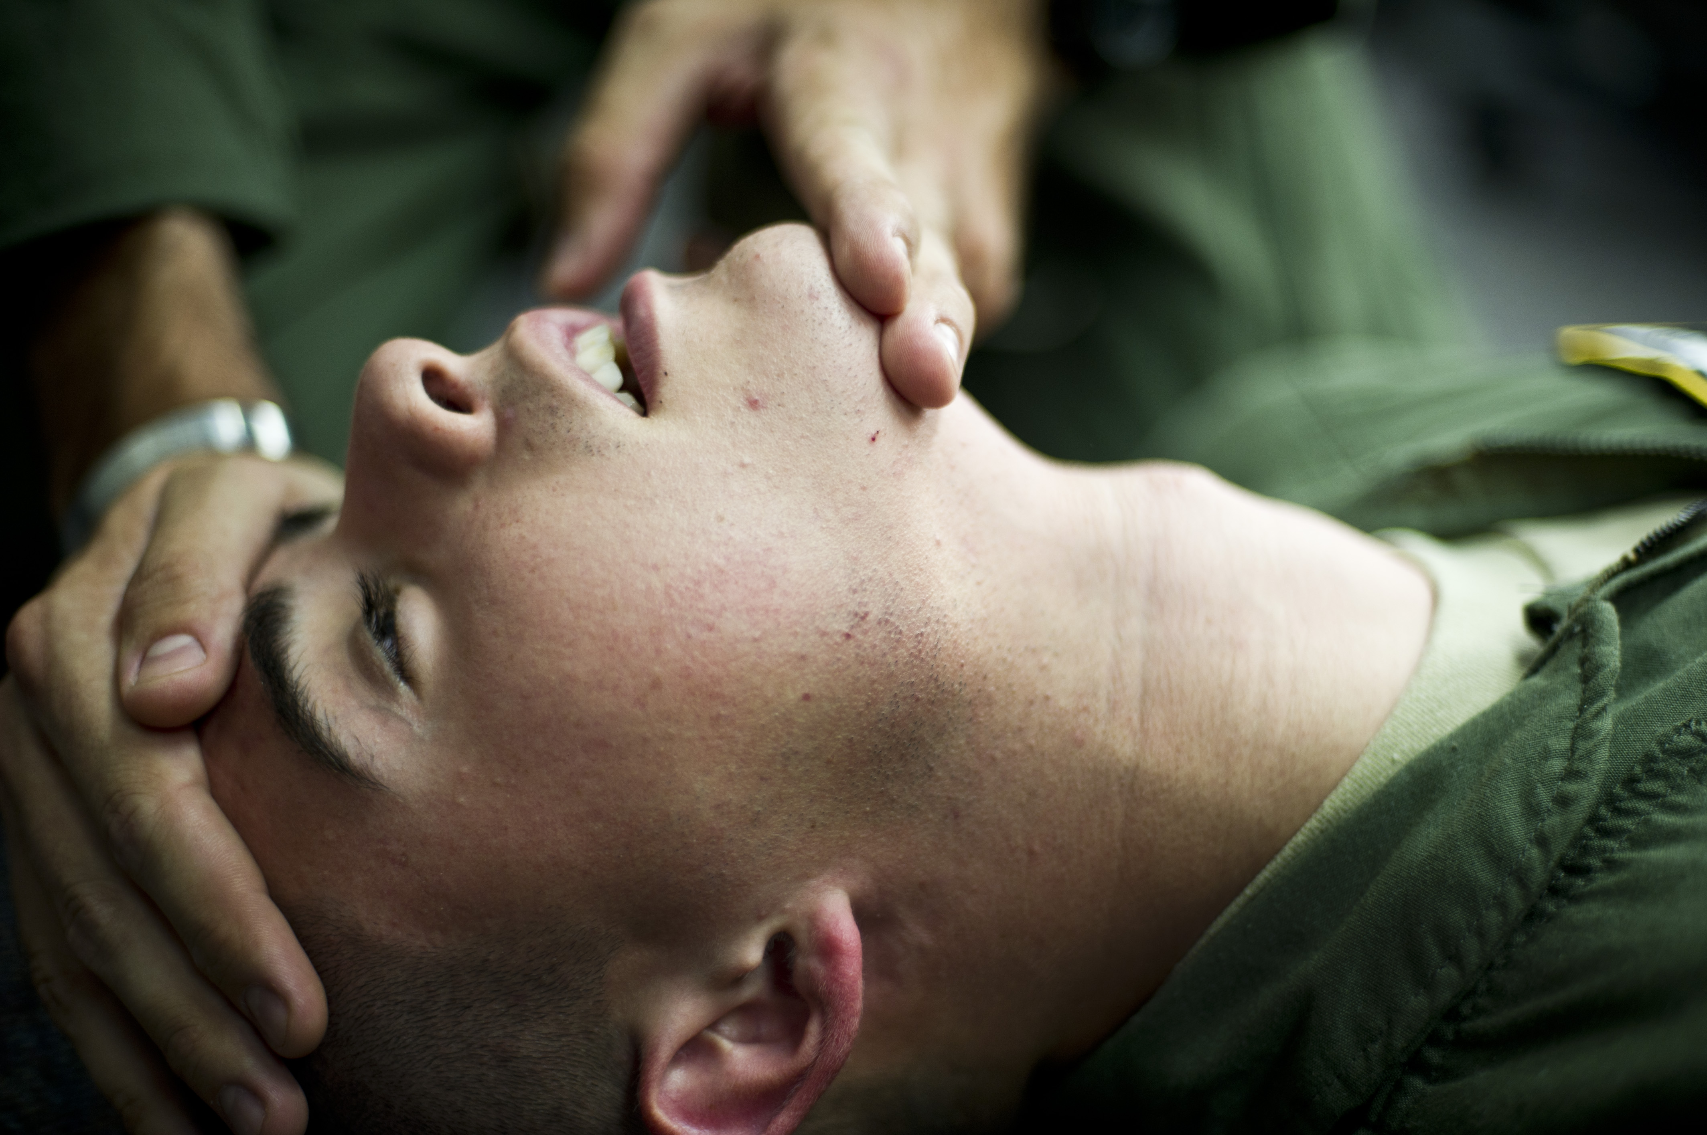
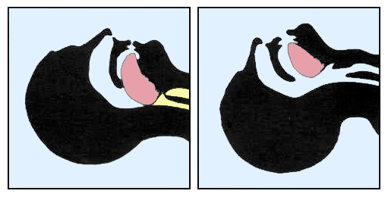
Airway management
head-tilt/chin-lift

Slide 13
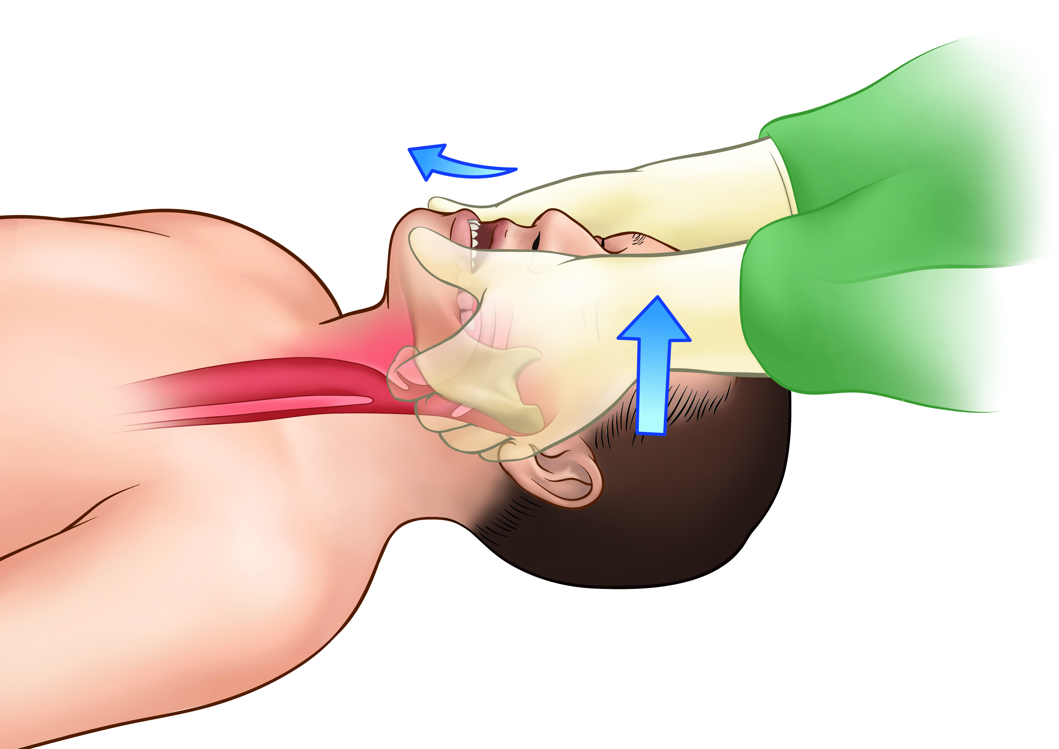
Airway management
jaw-thrust maneuvers

Slide 14
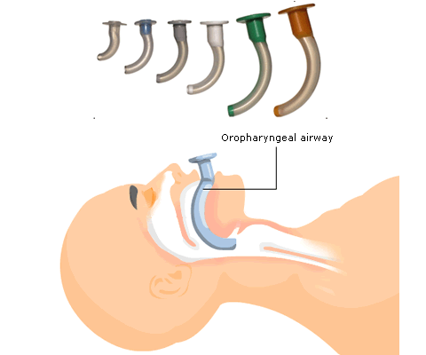
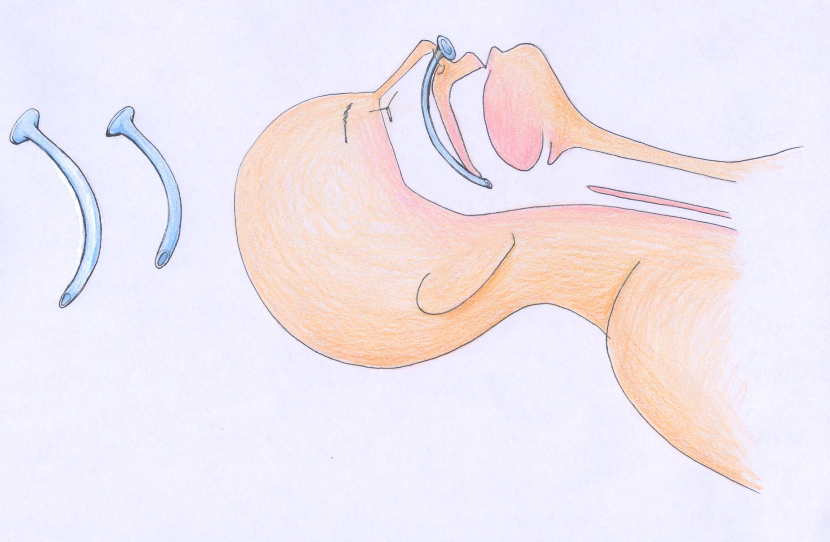
Airway management
oropharyngeal (OPA) and nasopharyngeal airways (NPA)

Slide 15
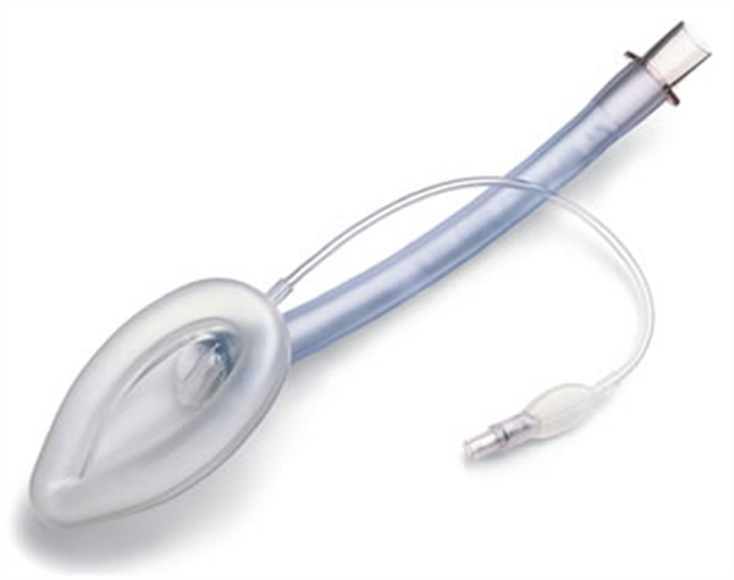
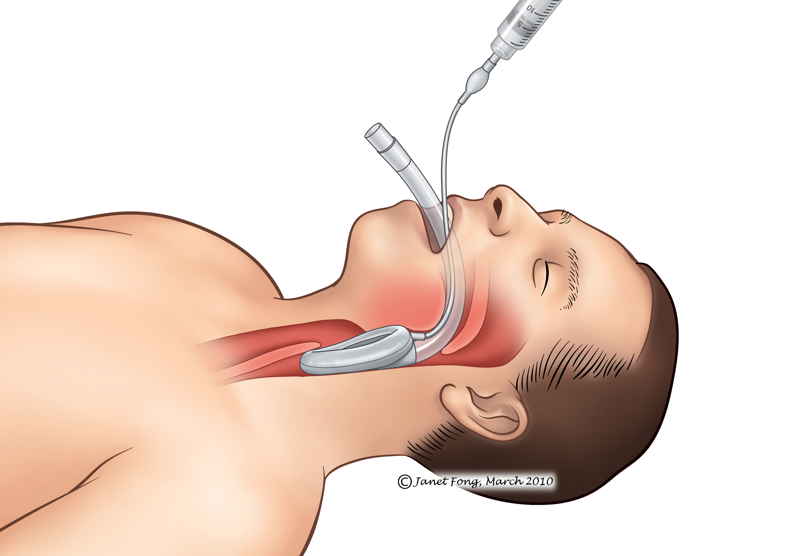
Airway management
laryngeal mask

Slide 16
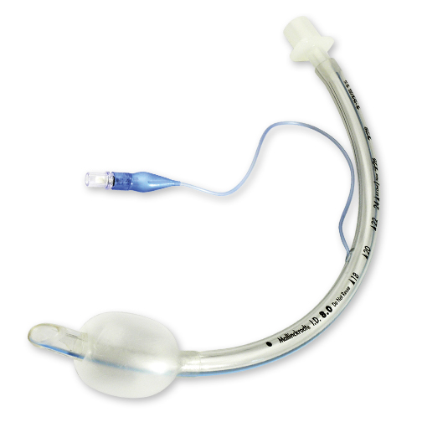
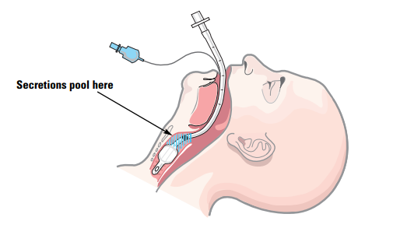
Airway management
endotracheal tube

Slide 17
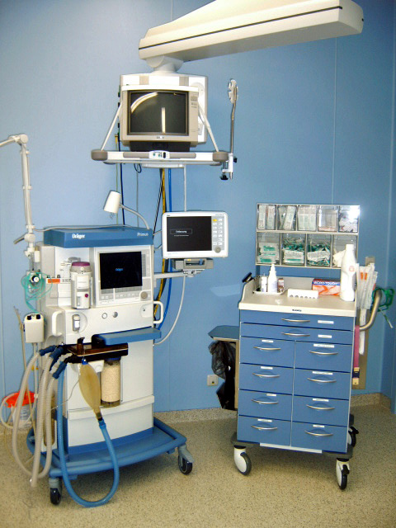
Mechanical ventilation
method to mechanically assist or replace spontaneous breathing
Indications - relaxed patients who are unable to spontaneous breathing (due to anesthesia, surgical position, surgery of the chest cavity ...)
endotracheal tube connected to the device (ventilator)
INSULFATION anesthetic mixture into the lungs
inspirium (20-25 cm H20)
expirium passive - INSULFATION is stopped, the pressure drop to atmospheric pressure
can also be performed manually - useful at the beginning and end of anesthesia
after anesthesia, the patient without respiratory effort, clears his throat, he raises his head

Slide 18


Types of general anesthesia
By entering (routes) -
inhalation
injection (intravenous, intramuscular or subcutaneous)
oral
rectal

Slide 19
Stages of anaesthesia
Stage 1
"induction", is the period between the initial administration of the induction agents and loss of consciousness. During this stage, the patient progresses from analgesia without amnesia to analgesia with amnesia. Patients can carry on a conversation at this time.
Stage 2
"excitement stage", is the period following loss of consciousness and marked by excited and delirious activity. respirations and heart rate may become irregular. uncontrolled movements, vomiting, breath holding, and pupillary dilation. Since the combination of spastic movements, vomiting, and irregular respirations may lead to airway compromise, rapidly acting drugs are used to minimize time in this stage and reach stage 3 as fast as possible.
Stage 3
"surgical anaesthesia„, the skeletal muscles relax, vomiting stops, and respiratory depression occurs . Eye movements slow, then stop, the patient is unconscious and ready for surgery. It has been divided into 4 planes: eyes initially rolling, then becoming fixed, loss of corneal and laryngeal reflexes, pupils dilate and loss of light reflex, intercostal paralysis, shallow abdominal respiration
Stage 4
"overdose", too much medication has been given relative to the amount of surgical stimulation and the patient has severe brain stem or medullary depression. This results in a cessation of respiration and potential cardiovascular collapse. This stage is lethal without cardiovascular and respiratory support.

Slide 20

Intraoperative phase
procedure in the operating field
operation of technical systems
Physiologic monitoring
state vital signs - blood pressure, ECG, pulse oximetry, carbone dioxide, agent concetrationt measurement, temperature
the position of the patient - to prevent hyperextension, oppression NC structures
keeping in stage III - adequate analgesia, anesthesia, payment amount, breath support.
reliable venous access - infusion solutions, anesthetics ...
2x, insertion CVC (v. Subclavian, v. Jugularis)

Slide 21
Intraoperative phase
drug infusion
provides volume replacement to increased capacity bloodstream covers diuresis, blood loss, (HAES, Ringer ...)
RBD under 80 -100 HBG, greater blood loss
adjuvant pharmacotherapy - glucose, arrhythmias, blood circulation support

Slide 22
Postoperative phase
Period termination and the unwinding of anesthesia
full consciousness and alertness
obey simple calls , to cough, head rises above the pad
Supervision 2h - ICU / recovery room - Post Anesthesia Care Unit
Monitoring 4-6 h after surgery - BP, consciousness
Postoperative analgesia required quality
after major surgery, the need for mechanical ventilation
– hospitalization on ICU, Department of Anesthesiology

Slide 23
Postoperative phase
Risks
hypoventilation
hidden shock with temporary centralization
surgical complications - bleeding

Slide 24
Risks and Complication of GA
introduction and awakening are most risky
polymorbid patient and emergency surgery
aspiration (acid content, a full or atonic stomach)
anaphylactic shock, embolism, myocardial infarction, malignant hyperthermia, arrhythmias
hypoventilation (on the end of GA)
Prevention of the aspiration - NGT, prokinetic agents and H2 block premedication

Slide 25
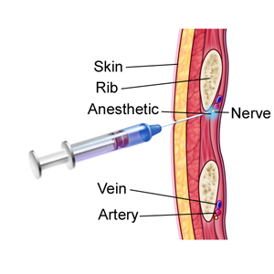
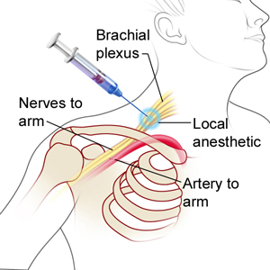
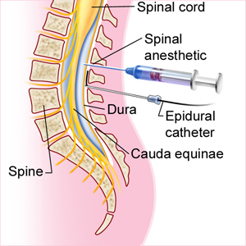
Local anesthesia
It acts on the peripheral nerves - no CNS
from the output of radicular nervs to the terminal end

Slide 26
Local anesthesia
A wide range of performances - bronchoscopy to TEP
Consciousness is retained
Positives: analgesia (persists postoperatively), improves perfusion, does not restrict breathing, allows contact with patients
Surgeon - infiltration anesthesia
Anesthesiologist - conduction anesthesia, nerve block, epidural and subarachnoidal anesthesia

Slide 27
Local anesthesia
Topical (skin, mucosal) - application to the surface anesthetics, amide type anesthetics
vocal cords, trachea, urethra
Infiltration - infiltration on-site surgery
Field block - interrupts conduction of nerve fibers in small distance from the surgical site
Peripheral nerve block
Plexus anesthesia
Epidural anesthesia
Spinal anesthesia

Slide 28
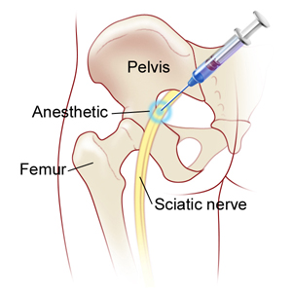
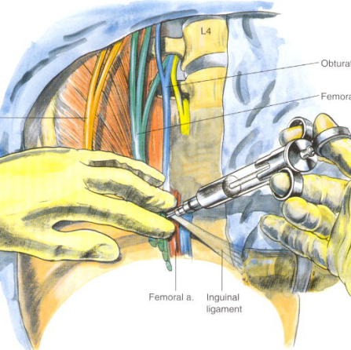
Peripheral nerve block and plexus anesthesia
Plexus brachialis
Axillary block
Intercostal nerv
Sciatic nerv
Femoral nerv

Slide 29
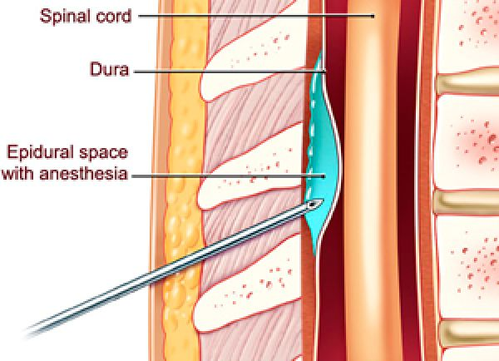
Epidural anesthesia
surgery purposes
ongoing analgesia - serial rib fracture, burns
complex effect - analgesia, improving perfusion
disposable needles
cannula for repeated administration - epidural catheter

Slide 30
Spinal anesthesia
subarachnoid anesthesia
applications below under the arachnoid into the spinal fluid
spreading density and body position
instillation L1-L2 - "Spinal Tap„

Slide 31
Complication SA
failure effect
wrap catheter in the epidural space
hypotension during epidural anesthesia -volumoterapie, ephedrine
the upward extension of the anesthetic in the subarachnoid anesthesia (cough, hypobaric solution, incorrect posture) => motor paralysis, hypotension, respiratory insufficiency
urinary retention

Slide 32
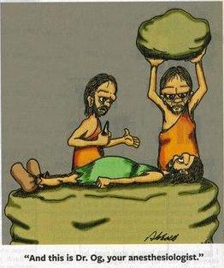
Thank you for your attention

