Slide 1
The Foundation Course on Physics
Thermodynamic Laws
See also Glencoe pp. 318 – 355, 368-371

Slide 2
1st Law of Thermodynamics
In general, the laws of thermodynamics belong to the most important laws in natural sciences. They are of crucial importance also for description and explanation of the processes in living systems.
The 1st Law of Thermodynamics is a special form of the principle of conservation of energy and is usually written as follows:
ΔU = W + Q
(or better dU = dW + dQ)
The right way of reading: The internal energy of a thermodynamic system increases by ΔU if the surroundings does work W on the thermodynamic system and heat Q is absorbed by the system from its surroundings.

Slide 3
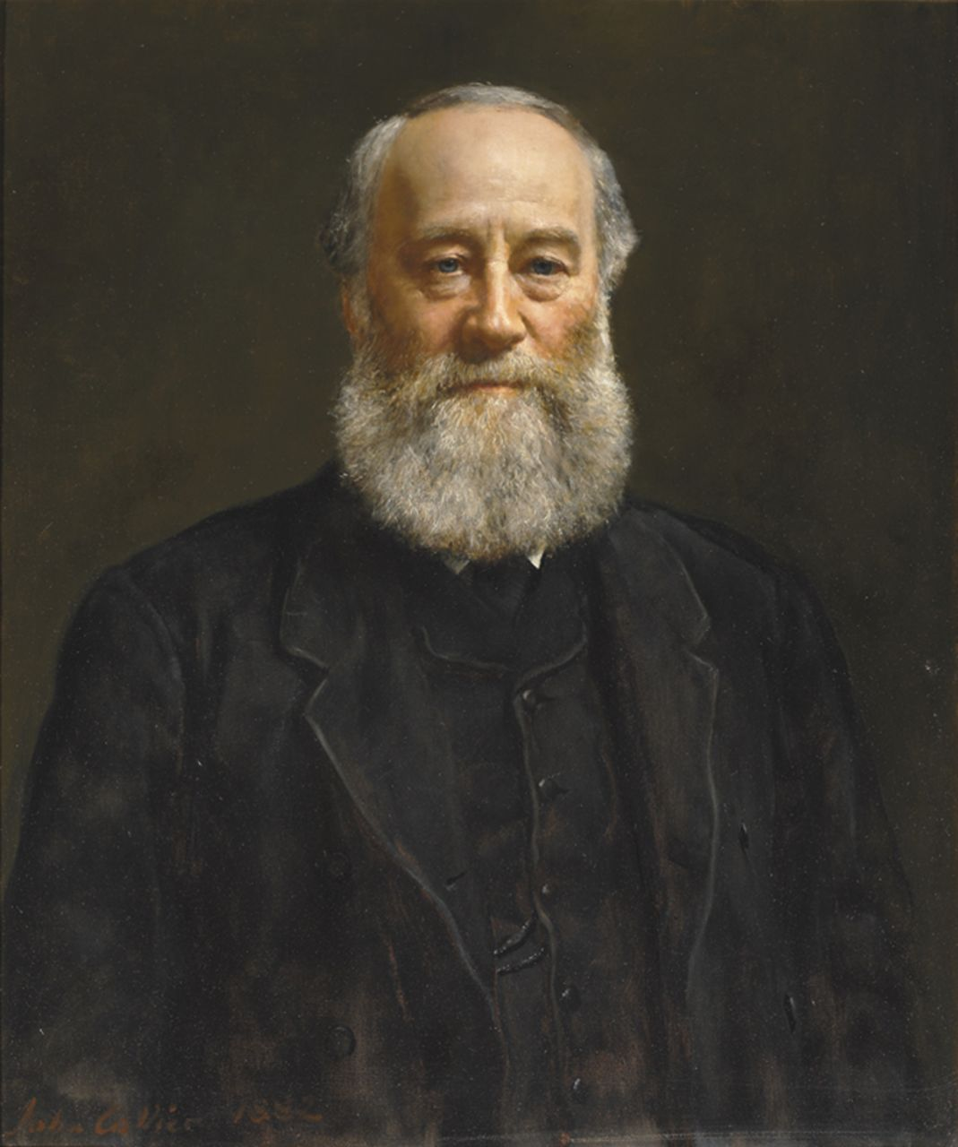
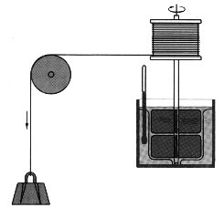
Joule experiment
Transformation of mechanical energy in heat – one of the crucial experiments to verify energy conservation law.
Rotating paddles in water.
Temperature increase due to friction is measured.
Weight moves down with a constant speed
James Prescott Joule (1818–1889)

Slide 4
1st Law of Thermodynamics
The following statement is another valid formulation of the 1st law of thermodynamics:
In a cyclic (and reversible) process, the change in the internal energy of the system equals zero.
Therefore, the 1st law of thermodynamics provides a complete definition of internal energy U, which is one of the basic state parameters.
The absolute value of the internal energy in a real system is very difficult to determine (just consider the calculation of the potential energies of all the particles present in the system).
As a result, classical thermodynamics deals almost only with its change (ΔU, dU).

Slide 5
2nd Law of Thermodynamics
One can imagine many processes which are in agreement with the 1st law of thermodynamics (during which energy is conserved), which (given by our experience) definitely cannot happen in nature:
In an isolated system consisting of a colder body and a hotter one, the hotter body is never heated solely by the cooling of the colder body, i.e. at the expense of the internal energy of the colder body.
Gas, which leaves an enclosure and is dispersed in space, will never spontaneously return into the enclosure.
A wheel will not be turned by the heat from a hot brake.
Rubbing hands produces heat but heated palms will not start to rub mutually ☺.
Etc.
These practically impossible processes are characterised by the fact that they are (better: would be) reversed irreversible processes, sequences of non-equilibrium states. We know already that their course cannot be reversed. The law determining the sense or direction of the processes running in isolated systems (and with sufficient accuracy in similar systems) is the 2nd law of thermodynamics.

Slide 6
Irreversible processes once again
ageing
Dough and bread

Slide 7
Back to ideal gas: Its free expansion is a simple example of an irreversible process
A) A box is divided into two compartments by a wall. There is compressed ideal gas in equilibrium state in the left compartment. In the right compartment, there is vacuum.
B) We make someway an opening in the wall; the gas expands in the second part of the box – an irreversible process is in progress.
C) After certain time, thermodynamic equilibrium is reached in both parts of the box.
What about a change of temperature in this process? Discuss the problem.
What about the same situation with a small number of molecules?

Slide 8
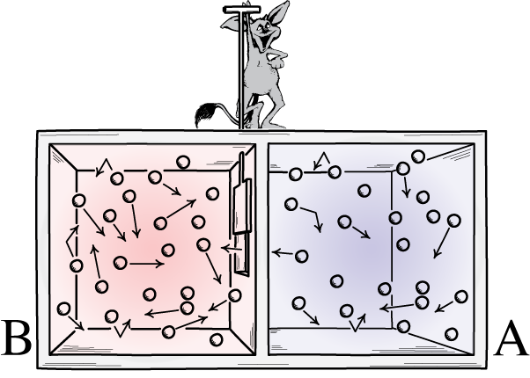
„Ghosts“ in physics: Maxwell´s Daemon
How to break the 2nd law?!?!
The ghost separates fast and slow particles, temperature difference appears. What has happened to the 2nd law?
Answer: nothing
http://www.pitt.edu/~jdnorton/Goodies/exorcism_phase_vol/exorcism_phase_vol.html

Slide 9
2nd Law of Thermodynamics
2nd Law of Thermodynamics has many mathematical formulations or wordings. We mention only four:
1. It is impossible to make a cyclic (working) engine that would only extract heat from a reservoir and convert it to equivalent work, without a certain amount of heat being transferred from the hotter to the colder body, i.e. it is impossible to construct the so-called perpetuum mobile of the second kind.
(Note: A perpetuum mobile of the first kind contradicts the law of conservation of energy.)
2. It is impossible to transfer heat from a colder to a warmer body without doing work.
3. Heat cannot spontaneously flow from a colder to a warmer body.

Slide 10
2nd Law of Thermodynamics - entropy
- 4. There is an additive* state parameter/function S, entropy, defined by the relation:
where ΔS is change in entropy and Q is the amount of heat added to the system at temperature T. The inequality applies to irreversible processes. In a reversible process:
Entropy is the result of efforts to find a thermodynamic quantity (a state parmeter) that would include heat transferred into or outside the system. Heat is not a state function.
*Additive state parameters: we can summarise their values in individual compartments of the whole system. Additive/non-additive = extensive/intensive. Example: energy/temperature

Slide 11
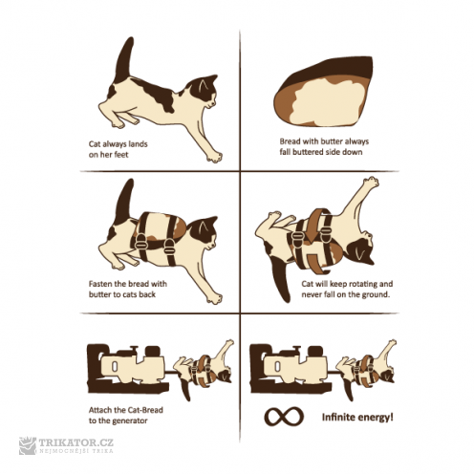
Perpetuum mobile (to relax)

Slide 12
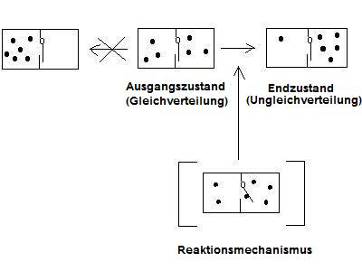
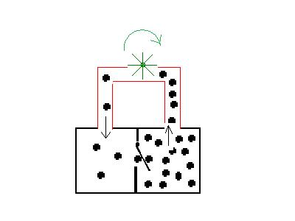
Perpetuum mobile of 2nd kind „seriously“
Original state
Equal distribution
final state
Non-equal distribution
Can it work forever? Where is the problem?
Is the problem influenced by the number of particles?

Slide 13
Interesting vids
https://www.youtube.com/watch?v=Y9nOV7u8Y4A
https://www.youtube.com/watch?v=Tay3-2WKQ5Y

Slide 14
Entropy
In a thermally isolated system (e.g. during an adiabatic process, Q – amount of heat added - equals zero) the following relation applies:
ΔS ≥ 0
As a result, the second law of thermodynamics is sometimes referred to as the increase-in-entropy law. The change in entropy in an isolated system can be only positive, hence entropy can only increase. Processes in an isolated system tend towards establishing thermodynamic equilibrium, so that under thermodynamic equilibrium entropy reaches its maximum.

Slide 15
Combined Formulation of the 1st and 2nd law
For a reversible process we can formulate Q = T·ΔS and W = -p·ΔV (taking into consideration only the volume work of the system). If we pass the following for Q in the first law of thermodynamics, we obtain:
ΔU = T·ΔS - p·ΔV.
This equation is sometimes referred to as the combined formulation of the first and the second law of thermodynamics.
The third law of thermodynamics is mentioned merely for the sake of completeness: No finite process can bring the system to the temperature of absolute zero.

Slide 16
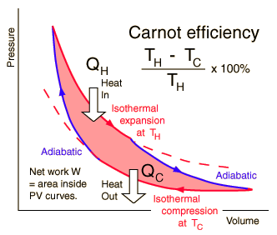
The Carnot cycle (optional)
Carnot cycle – a theoretical heat engine
The most efficient heat engine cycle is the Carnot cycle, consisting of two isothermal processes and two adiabatic processes. The Carnot cycle can be thought of as the most efficient heat engine cycle allowed by physical laws. When the 2nd law of thermodynamics states that not all the supplied heat in a heat engine can be used to do work, the Carnot efficiency sets the limiting value on the fraction of the heat which can be so used.
Red area quantifies the useful work done.
Heat was transformed into work!
http://hyperphysics.phy-astr.gsu.edu/hbase/thermo/carnot.html

Slide 17
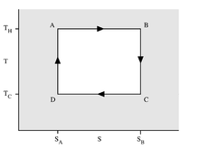
Carnot cycle in T(S) diagram
Q = TΔS
Q_{H} = T_{H}ΔS
Q_{C} = T_{C}ΔS
Q_{H} – Q_{C} = heat absorbed which can be changed in useful work
Efficiency =
=
H – hot C - cold

Slide 18
Carnot cycle
(Carnot’s theorem) The efficiency of any heat engine operating between two specified temperatures can never exceed the efficiency of a Carnot engine operating between the same two temperatures.
Maximum achievable efficiency of this engine η (eta) could be equal to 1 (i.e. 100%) but only if the lower temperature T₂ = 0 K. Efficiency of real heat engines (e.g. diesel engines) does not exceed about 50 %.
The heat engine is a system that converts heat or thermal energy (and chemical energy!) to mechanical energy, which can be used to do mechanical work.
25 % for most automotive gasoline engines.
49 % for a modern coal-fired power stations
60 % for a steam-cooled gas turbine.

Slide 19
Entropy and disorder (formula is optional)
We can easily imagine that absorption of heat in a system can influence its structure – the increased thermal motion can disintegrate molecules, for example.
Moreover, it can be relatively easily shown that any increase of entropy is connected with increase of disorder.
Disorder has higher probability compared with an ordered state.
Thus, there is an equation showing relation between entropy and probability of a thermodynamic state. It is very famous formula called Boltzmann principle:
ΔS = k ln(P₁/P₂)
k is the Boltzmann constant

Slide 20
The 2nd Law of Thermodynamics
How to explain these jokes? (Jokes of physicists are sometimes difficult to understand.)

Slide 21
☺
Version December 2024

