Slide 1
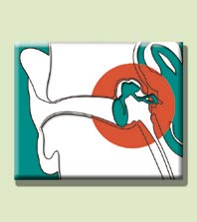
Lectures on Medical Biophysics
Introduction to biophysics of receptors
Biophysics of hearing and vestibular sense

Slide 2
Lecture outline
General features of sensory perception
Perception of sound
  Properties of sound
  Biophysical function of the ear
Biophysical function of the vestibular system

Slide 3
Biophysics of sensory perception
Sensory perception – reception and perception of information from outer and inner medium.
From outer medium: Vision, hearing, smell, taste and sense of touch
From inner medium: information on position, active and passive movement (vestibular organ, nerve-endings in the musculoskeletal system ). Also: changes in composition of inner medium and pain.
Complex feelings: hunger, thirst, fatigue etc.

Slide 4
Categorising receptors
a) According to the acting energy:
mechanoceptors
thermoceptors
chemoceptors
photoceptors
- adequate and inadequate stimuli
b) According to the complexity:
free nerve-endings (pain)
sensory bodies (sensitive nerve fibre + fibrous envelope - cutaneous sensation)
sensory cells (parts of sensory organs) - specificity
non-specific: receptors of pain - react on various stimuli.
c) According to the place of origin and way of their reception:
- teleceptors (vision, hearing, smell),
- exteroceptors (from the body surface - cutaneous sensation, taste),
- proprioceptors, in vestibular organ, muscles, tendons, joints - they inform about body position and movement,
interoceptors - in inner organs
In biophysics, the receptors are energy transducers above all.

Slide 5
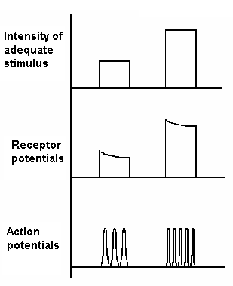
Conversion function of receptors
Primary response of sensory cell to the stimulus: receptor potential and receptor current are proportional to the intensity of stimulus. The receptor potential triggers the action potential.
Transformation of amplitude modulated receptor potential into the frequency-modulated action potential.
Increased intensity of stimulus, i.e. increased amplitude of receptor potential evokes an increase in action potential frequency.

Slide 6
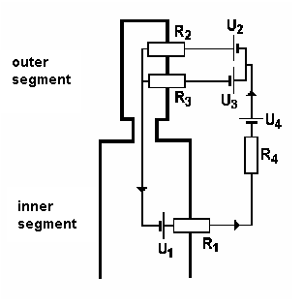
Sensory cell
A typical sensory cell consists of two segments:
The outer one is adequate stimulus-specific. (microvilli, cilia, microtubular or lamellar structures)
The inner one contains mitochondria
Electric processes in a receptor cell:
The voltage source is in the membrane of the inner segment - diffusion potential of K⁺ (U₁, resistance R₁ is given by the permeability for these ions).
Depolarisation of a sensory cell is caused by increase of the membrane permeability for cations in outer segment (R₂, U₂; R₃, U₃). During depolarisation, the cations diffuse from outer segment into the inner one.
There are additional sources of voltage in supporting (neuroglial) cells (U₄, R₄).

Slide 7
Biophysical relation between the stimulus and sensation
The intensity of sensation increases with stimulus intensity non-linearly. It was presumed earlier the sensation intensity is proportional to the logarithm of stimulus intensity (Weber-Fechner law, 1860). Intensity of sensation is I_{R}, intensity of stimulus is I_{S}, then:
I_{R} = k₁ log(I_{S}).
Today is the relation expressed also exponentially (so-called Stevens law, 1957):
I_{R} = k₂ I_{S}ª,
k₁, k₂ are the proportionality constants, a is an exponent specific for a sense modality (smaller than 1 for sensation of sound or light, greater for sensation of warmth or tactile stimuli). The Stevens law expresses better the relation between the stimulus and sensation at very low or high stimulus intensities.

Slide 8
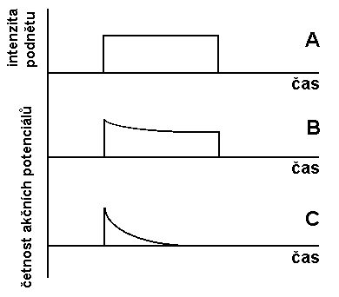
Adaptation
Stimulus
intensity
If the intensity of a stimulus is constant for long time, the excitability of most receptors decreases. This phenomenon is called adaptation. The adaptation degree is different for various receptors. It is low in pain sensation - protection mechanism.
time
time
Number of action potentials
time
Adaptation time-course. A - stimulus, B - receptor with slow adaptation, C - receptor with fast adaptation

Slide 9
Biophysics of sound perception
Physical properties of sound:
Sound - mechanical oscillations of elastic medium, f = 16 - 20 000 Hz.
It propagates through elastic medium as particle oscillations around equilibrium positions. In a gas or a liquid, they propagate as longitudinal waves (particles oscillate in direction of wave propagation - it is alternating compression and rarefaction of medium). In solids, it propagates also as transversal waves (particles oscillate normally to the direction of wave propagation).
Speed of sound - phase velocity (c) depends on the physical properties of medium, mainly on the elasticity and temperature.
The product ρ·c, where ρ is medium density, is acoustic impedance. It determines the magnitude of acoustic energy reflection when the sound wave reaches the interface between two media of different acoustic impedance.
Sounds: simple (pure) or compound. Compound sounds: musical (periodic character) and non-musical - noise (non-periodic character).

Slide 10
Main characteristics of sound: (tone) pitch, colour and intensity
The pitch is given by frequency.
The colour is given by the presence of harmonic frequencies in spectrum.
Intensity - amount of energy passed in 1 s normally through an area of 1 m². It is the specific acoustic power [W·m⁻²].

Slide 11
Intensity level
The intensity level allows to compare intensities of two sounds.
Instead of linear relation of the two intensities (interval of 10¹²) logarithmic relation with the unit bel (B) has been introduced. In practice: decibel (dB). Intensity level L in dB:
L = 10·log(I/I₀) [dB]
Reference intensity of sound (threshold intensity of 1 kHz tone) I₀ = 10⁻¹² W·m⁻² (reference acoustic pressure p₀ = 2×10⁻⁵ Pa).

Slide 12
Loudness, hearing field
Loudness is subjectively felt intensity approx. proportional to the logarithm of the physical intensity change of sound stimulus. The ear is most sensitive for frequencies of 1-5 kHz.
The unit of loudness is sone. 1 sone corresponds (when hearing by both ears) with the hearing sensation evoked by reference tone of 40 dB.
Loudness is a threshold quantity.
The loudness level is expressed in phons (Ph). 1 phone corresponds with intensity level of 1 dB for the reference tone (1 kHz). For the other tones, the loudness level differs from the intensity level. 1 Ph is the smallest difference in loudness, which can be resolved by ear. For 1 kHz tone, an increase of loudness by 1 Ph needs an increase of physical intensity by 26%.
When connecting in a graph the threshold intensities of audible frequencies, we obtain the zero loudness contour. For any frequency, it is possible to find an intensity at which the hearing sensation changes in pain - pain threshold line in a graph. The field of intensity levels between hearing threshold and pain threshold in frequency range of 16 - 20 000 Hz is called the hearing field.

Slide 13
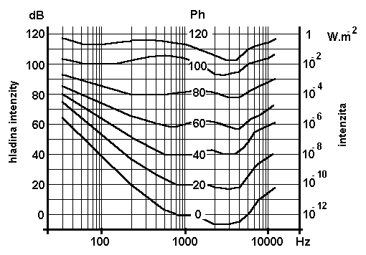
Hearing field with equal loudness contours
Intensity level
intensity
frequency

Slide 14






Loudness level of some sounds
Sort of sound | Loudness level [Ph]
whispering | 10 - 20
Forest silence | 20 - 30
Normal speech | 40 - 60
Traffic noise | 60 - 90
Pneumatic drill | 100 - 110
Jet propulsion | 120 - 130

Slide 15
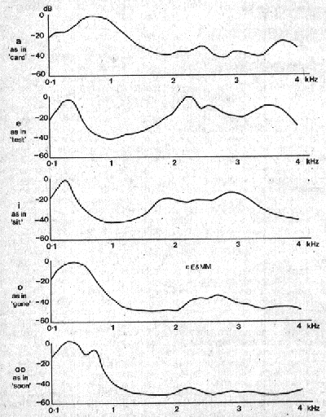
Sound spectrum
A
Phoniatrics excursion:
After analysis of compound sounds, we obtain frequency distribution of amplitudes and phases of their components - the acoustic spectrum.
In vowels: band spectrum. Harmonic frequencies of a basic tone form groups - formants - for given vowel are characteristic.
The consonants are non-periodic, but they have continuous (noise) acoustic spectrum.
E
I
O
U
http://web.inter.nl.net/hcc/davies/vojabb2.gif

Slide 16
Biophysical function of the ear
The ear consists of outer, middle and inner ear.
Transmission of sounds into inner ear is done by outer and middle ear.
Outer ear: auricle (ear pinna) and external auditory canal. Optimally audible sounds come frontally under the angle of about 15° measured away the ear axis.
Auditory canal is a resonator. It amplifies the frequencies
2-6 kHz with maximum in range of 3-4 kHz, (+12 dB). The canal closure impairs the hearing by 40 - 60 dB.
Middle ear consists of the ear-drum (~ 60 mm²) and the ossicles – maleus (hammer), incus (anvil) and stapes (stirrup). Manubrium malei is connected with drum, stapes with foramen ovale (3 mm²). Eustachian tube equalises the pressures on both sides of the drum.
A large difference of acoustic impedance of the air (3.9 kPa·s·m⁻¹) and the liquid in inner ear (15 700 kPa·s·m⁻¹) would lead to large intensity loss (about 30 dB). It is compensated by the ratio of mentioned areas and by the change of amplitude and pressure of acoustic waves (sound waves of the same intensity have large amplitudes and low pressure in the air, small amplitudes and high pressure in a liquid). Transmission of acoustic oscillations from the drum to the smaller area of oval foramen increases pressure 20x.

Slide 17
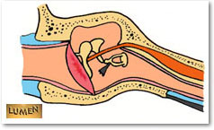
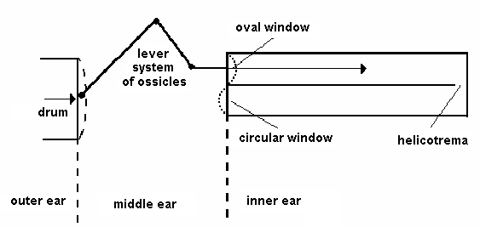
Lever system of ossicles
Maleus and incus form an unequal lever (force acting on stapes and the oval window increases 1.3-times).
Protection against strong sounds: Elastic connection of ossicles and reflexes of muscles (mm. stapedius, tensor tympani) can attenuate hearing of strong sounds by 15 dB.

Slide 18
Mechanism of reception of acoustic signals
The inner ear is inside the petrous bone and contains the receptors of auditory and vestibular analyser.
The auditory part is formed by a spiral, 35 mm long bone canal - the cochlea. The basis of cochlea is separated from the middle ear cavity by a septum with two foramina.
The oval foramen is connected with stapes, the circular one is free.
Cochlea is divided into two parts by longitudinal osseous lamina spiralis and elastic membrana basilaris. Lamina spiralis is broadest at the basis of cochlea, where the basilar membrane is narrowest, about 0.04 mm (0.5 mm at the top of cochlea).
The helicotrema connects the space above (scala vestibuli) and below the basilar membrane (scala tympani).

Slide 19
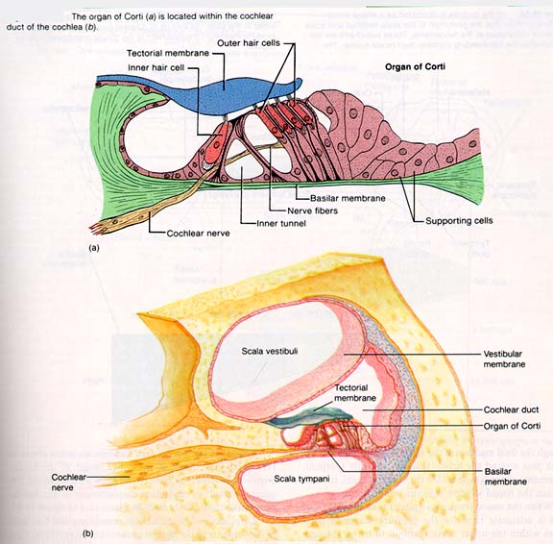
Organ of Corti
http://www.sfu.ca/~saunders/l33098/Ear.f/corti.html
Lamina
spiralis

Slide 20
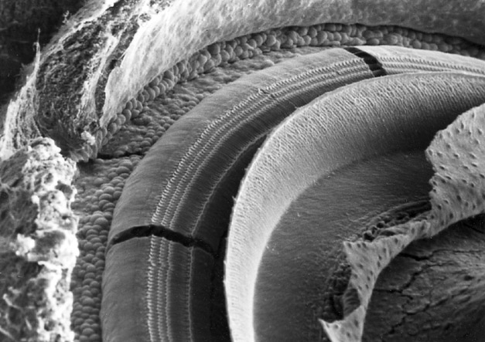
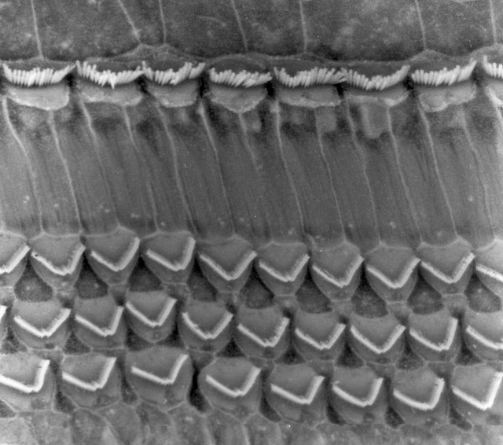

www.sickkids.on.ca/auditorysciencelab/ pictures1.asp.
Pictures obtained from SEM. Organ of Corti with rows of hair-cells. Above general view after removal of vestibular (Reissner) and tectorial membrane. Right a detail of hair-cells.

Slide 21
Organ of Corti
Perilymph - ionic composition like liquor, but it has 2x more proteins. Endolyph - protein content like liquor, but only 1/10 of Na+ ions and 30x more K+ ions - like intracellular liquid.
Sensory cells of Corti's organ: hair-cells (inner and outer). In cochlea there are about 4000 inner and about 20000 outer hair-cells.
sensory hairs (cilia) - stereocilia, deformed by tectorial membrane. Bending of hairs towards lamina spiralis leads to depolarisation, bending away lamina spiralis causes hyperpolarisation.
Periodic stimulation of outer cells causes their active oscillations with the same frequency. These oscillations are transmitted through the tectorial membrane to the inner hair cells. Therefore the (sound) oscillations are amplified.
About 95% neurons begin on inner cells (20 axons on one inner cell), about 5% neurons begin on outer cells - nerve-endings of 10 outer cells are connected in 1 axon. There are about 25 - 30 000 axons in auditory nerve.

Slide 22
Mechanism of sound perception: Békésy theory of travelling wave.
Békésy theory of travelling wave: Sound brings the basilar membrane into oscillations, and the region of maximum oscillation shifts with increasing frequency from the top to the basis of cochlea.
The receptor system in cochlea performs probably a preliminary frequency analysis. The further processing is done in cerebral auditory centres.
Sound comes to the receptors in three ways: air (main), bone (the hearing threshold is by about 40 dB higher) and through circular foramen – small importance.

Slide 23
Electric phenomena in sound reception:
Perilymph and endolymph differ in content of K⁺ and Na⁺. Endolymph content of K⁺ is near to the intracellular content. The resting potential between endolymph and perilymph equals + 80 mV - endocochlear potential.
The big hair-cells of Corti's organ have a negative potential -80 mV against the periplymph. The potential difference between the endolymph and hair-cells is about 160 mV.
The stimulation of Corti's organ leads to cochlear microphone potential, which can be measured directly on cochlea or in its close surroundings. At high frequencies, the maximum of microphone potential shifts to the basis of cochlea, what is in agreement with the theory of travelling wave.
Negative summation potential is caused by stimulation of inner hair-cells of Corti's organ.
The mechanism of the origin of final action potential led by auditory nerve is not yet fully explained. We suppose: The cochlear microphone potential and also the negative summation potential take place directly in action potential origin. This potential keeps the receptors in functional state.

Slide 24
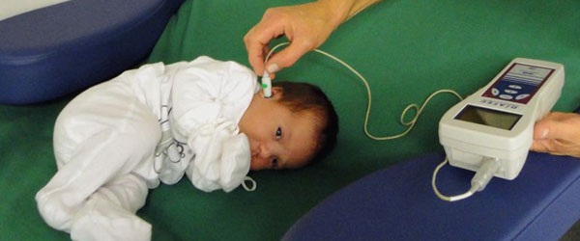
Otoacoustic emission
The inner ear itself is a source of sound which can appear immediately after external acoustic stimulation or spontaneously. These sounds are very weak – most people do not hear them. They arise by oscillations of outer hair cells at a frequency of 500 – 4500 Hz.
The otoacoustic emission is examined mainly in newborns. If present – hearing is probably normal.

Slide 25
Biophysical function of vestibular system
Vestibular system - organ of position and balance sense - placed in the semicurcular canals in petrous bone lying in three mutually perpendicular planes. The canals start in utricle, which is connected with sacculus. Both parts are placed in vestibulum communicating with ductus cochlearis.
One outlet of each canal is transformed in ampulla, divided by the ampullary crist into two parts. Macula utriculi is in the lower part of utricle, the macula sacculi in sacculus. The crists and ampullae are covered by sensory epithelium composed of hair-cells. There are also gelatinous cupulae on ampullary crists and the statoconia membranes in maculae. Their function is to stimulate stereocilia of sensory cells. The statoconia are crystals of CaCO₃ - it increases the mass of gelatinous membranes.

Slide 26
Biophysical function of vestibular system
The semicircular canals allow analyse the rotational motion of the head. Receptors of ampullary crists react on angular acceleration. The cupulas of crists work as valves, which are deflected by streaming endolymph and stimulate the hairs of sensory cells by bending – depolarisation or hyperpolarisation takes place.
The receptors of utricle and sacculus react on linear acceleration and gravitation. When changing the head position, the membrane with statoconia shifts against hairs of sensory cells - excitation arises. Important for keeping erect position - static reflexes.

Slide 27
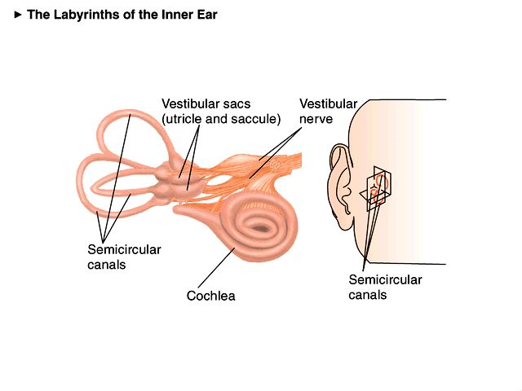
Vestibular organ
http://www.driesen.com/innerearlabyrinth.jpg

Slide 28
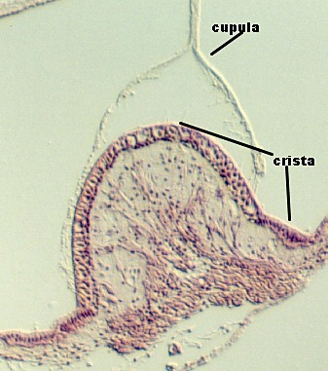
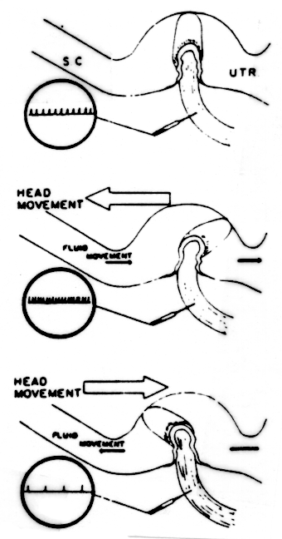
Function of crists and cupullae
http://cellbio.utmb.edu/microanatomy/Ear/crista1.jpg
http://www.bcm.tmc.edu/oto/studs/rotation.gif

Slide 29
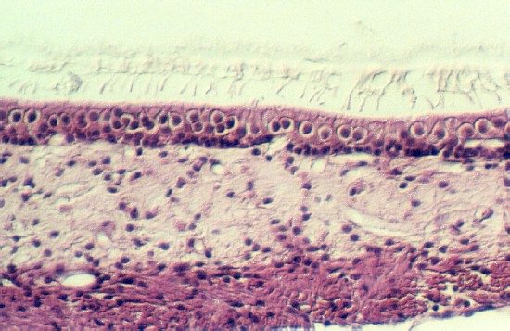
Statoconia membrane in sacculus
cellbio.utmb.edu/.../Ear/ organization_of_the_inner_ear.htm.

Slide 30
Author:
Vojtěch Mornstein
Content collaboration and language revision:
Ivo Hrazdira, Carmel J. Caruana
Last revision September 2024

