Slide 1
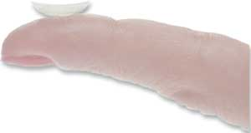
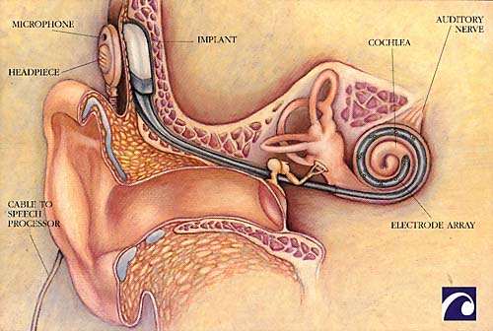
Lectures on Medical Biophysics
Sensory perception examination and aids

Slide 2
Lecture outline
Visual acuity
Ametropia - errors of the optical system of the eye
Spherical ametropia: Nearsightedness and farsightedness
Aspherical ametropia (astigmatism)
Examination of vision
Electroretinography (ERG)
Retinal implant
Audiometry – assessment of hearing impairment
Hearing aids for correction of hearing impairment
Cochlear implants

Slide 3
Visual acuity
Definition: clarity and sharpness of vision (Latin “acuitas” = sharpness)
Often referred to as “Snellen” acuity. The Snellen charts used in its assessment are named after a 19th-century Dutch ophthalmologist Hermann Snellen (1834–1908) who created them as a test of visual acuity in case of myopia.
The optotypes are made for a viewing distance of 4, 5 and 6 m. Visual acuity is expressed by means of a fraction where the numerator is the viewing distance in m and the denominator the number of the row of correctly distinguishable symbols (e.g., acuity of 6/18 indicates visual acuity reduced to a third).
Someone with 6/6 vision is just able to distinguish a symbol that subtends a visual angle of 5 minutes of arc (written 5') at the eye.

Slide 4
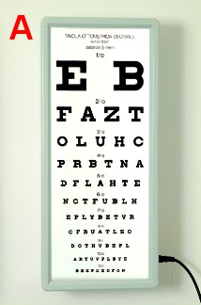
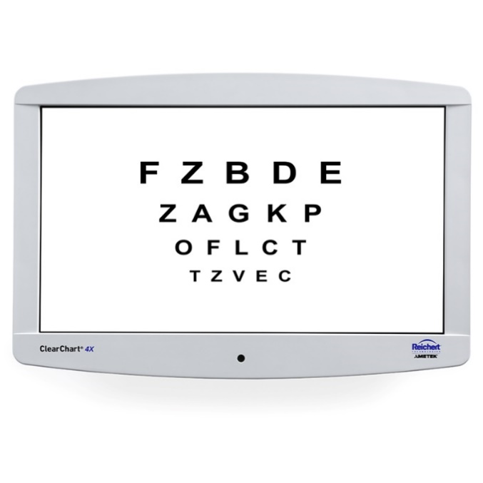
Snellen charts

Slide 5
https://is.muni.cz/do/rect/el/estud/lf/js16/refrakcni_vady/web/pages/03-naturalni-zrakova-ostrost.html
Jaeger test card for examination of hyperopia

Slide 6
Ametropia - errors of eye optical system
Emmetropia: the normal (“emmetropic”) eye images in points and images are focused (projected) on the retina.
Ametropia: If the image focus is not situated on the retina or the eye does not image in points (the eye is “ametropic”).
We can distinguish two main ametropias:
spherical (nearsightedness and farsightedness)
aspherical (astigmatism)

Slide 7
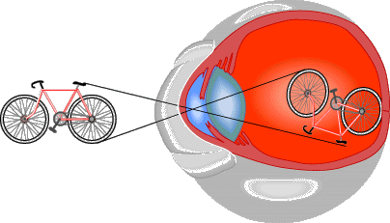
Normal eye
Normally, our eye can project an image exactly on the retina:
(this picture is painted in absolutely wrong way but otherwise it is nice)

Slide 8
Spherical ametropia: Nearsightedness and farsightedness
Nearsightedness (myopia): see near objects well, and difficulty seeing faraway. Light rays coming from far distance are focused in front of the retina. This is caused by an eyeball that is too long, or a lens system that has too high dioptric power. Corrected with a concave (diverging) lens. This lens causes the light to diverge slightly before it reaches the eye.
When farsightedness (hyperopia): see distant objects well but not near objects. Light rays are focused behind the retina. This is caused by an eyeball that is too short, or by a lens system that has too little dioptric power. Corrected with a convex (converging) lens.

Slide 9
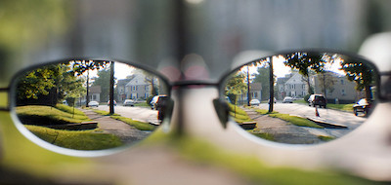
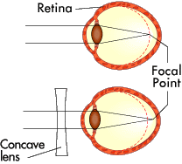
Nearsightedness (myopia)
https://genetics.thetech.org/ask-a-geneticist/vision-genetic

Slide 10
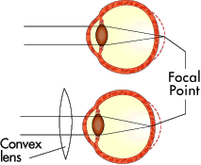
Farsightedness (hyperopia)
http://www.2012rok.sk/wp/wp-content/uploads/subory/dalekozrakost.jpg

Slide 11
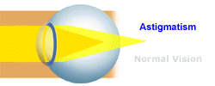
Aspherical ametropia (astigmatism)
Astigmatism occurs when the cornea or the lens, have a different curvature in different planes. This irregular shape prevents light from focusing properly on the retina. As a result, vision may be blurred at all distances.

Slide 12
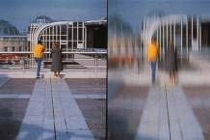
Astigmatismus demonstration
https://www.uhren-schell.de/optiker/sehstoerungen-merkmale-uebersicht.php

Slide 13
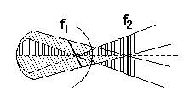
Astigmatism
Simple astigmatism: One of the focal lines does not lie on retina
Mixed astigmatism: Both focal lines are not on the retina – one in front, one behind.
Compound astigmatism: means the eye has characteristics of both astigmatism and nearsightedness / farsightedness. Both focal lines are in front or behind the retina.
Main meridians (characterised by biggest difference in curvature) of the eye can be seen – case of mixed astigmatism.

Slide 14
How to correct astigmatism
Simple astigmatism is corrected by a cylindrical lens, or refractive surgery.
Compound and mixed astigmatism are corrected by toric lenses (a toric refraction surface originates by a combination of cylindrical and spherical surfaces, i.e. has different radii of curvature in different planes).

Slide 15
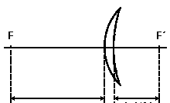
Eyeglass lenses - back vertex power
As opposed to other optical systems which are characterized by power, eyeglass lenses are characterised by their ‘back vertex’ power
A´ = 1 / a’
a
a’

Slide 16
Contact lens
Contact lens made of hydrophilic gel (weak – prof. Otto Wichterle invention) or hard contact lenses (RGP – Rigid Gas-Permeable)

Slide 17
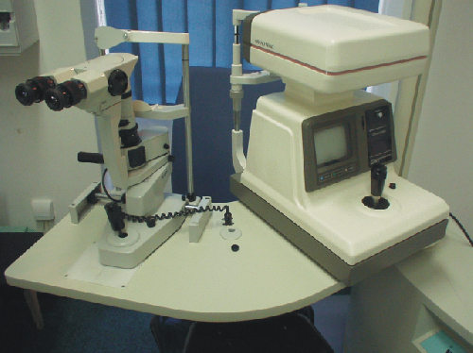
Refractometer – objective examination of vision

Slide 18
Further devices for examination of vision
The analyzer of nerve fibres layer - GDX (Glaucoma Diagnostics). Thickness of the layer of nerve fibres of the retina is measured using a laser scanning polarimetry. This technique uses birefringence of nerve fibres. Phase shift between ordinary and extraordinary beam after passing through a layer of retinal nerve fibre will be used to measure the thickness of peripapilar area. The device is equipped with a scanning unit with a light-emitting diode (wavelength 780 nm), which is associated with the computer transferring the degree of polarization in each image point to the thickness of nerve fibres using Fourier analysis.
Perimetry the investigative method to assess the extent of visual field. Its essence is the ability of the eye to distinguish two stimuli in the field of vision. One stimulus is a light mark and the second the background surrounding the light mark. It is performed at the suspected loss of visual field, called scotoma.

Slide 19
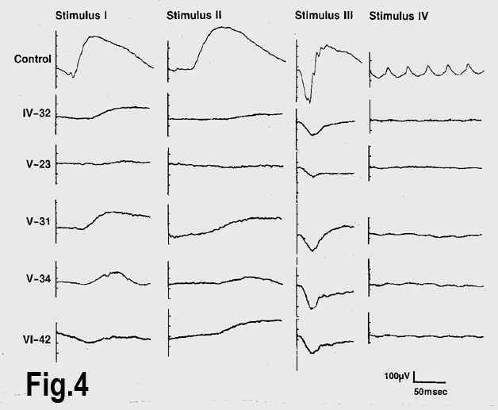
Electroretinography (ERG)
Electroretinography
is a test to measure the electrical response of the eye's light-sensitive cells (rods and cones). Electrodes are placed on the cornea and the skin near the eye (monitored by unipolar leads ), 100 – 400 μV.

Slide 20
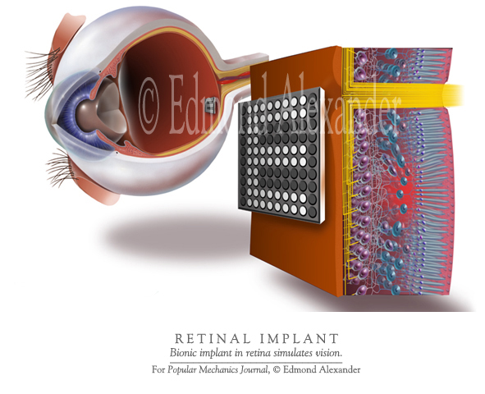
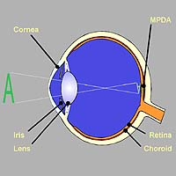
Retinal implant
www.nmi.de/deutsch/ showprj.php3?id=3&typ=1
MPDA – micro-photo-diode-array
This device is still in clinical testing. It should enable basic spatial orientation of blind people.

Slide 21
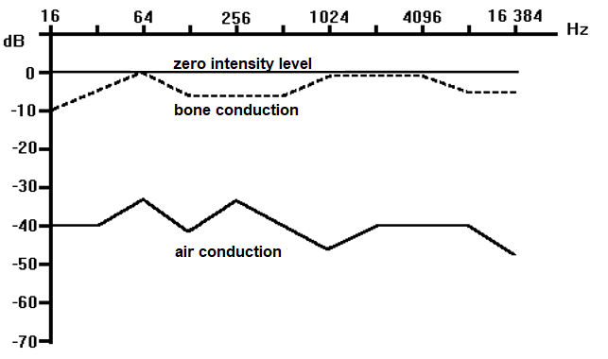
Audiometry - hearing disorder examination
Audiometry - see practical exercises. In practice, we obtain a graph of loudness differences versus frequency in comparison with normal hearing.
Bone conduction is examined by tuning forks or special oscillators laid on proc. mastoideus.
finding: bone conduction normal, air conduction impaired

Slide 22
Two types of hearing disorders
1) Sound conduction disorder - caused by cerumen (ear wax), Exudate or mucus in meatus, rigid drum, lowering of ossicular motility after inflammation. No full hearing loss is caused in this case - sound partly penetrates through bones into inner ear. The audiogram for air conduction is lowered in the whole range of audible frequencies, however the bone conduction is not damaged.
2) Perception or nerve conduction disorder. Initially often limited to frequencies around 4000 Hz. It can be caused by long action of strong noise. Patient sound perception is distorted. Audiogram shows lowering of perception at these frequencies, bone conduction lowers as well. It increases with age.

Slide 23
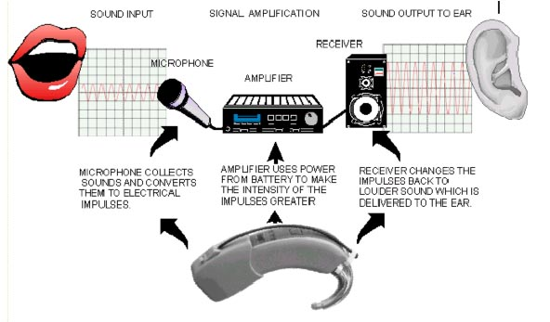
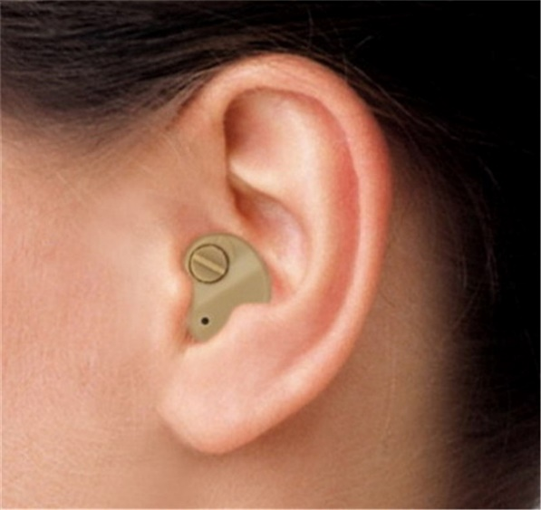
Hearing aid - correction of hearing disorders
Hearing aid: Consists of a microphone, amplifier, energy supply and a reproduction system (loudspeaker). It is an earphone with the end-piece inserted into meatus. For bone conduction, it is better to use a vibrator fixed to proc. mastoideus.
Purpose of hearing aids: amplification of frequencies at which hearing is lowered. Filtration. Hearing aids can be mounted into side-pieces of glasses.

Slide 24
Other methods in audiology
Otoacoustic emission – see the lecture on hearing
Measurement of evoked potentials – objective testing of information transfer between the inner ear and brain
Tympanometry – testing of acoustic energy transfer into middle ear be means of a reflected 226 Hz tone. In principle, elasticity of the eardrum and ossicle system is tested.

Slide 25
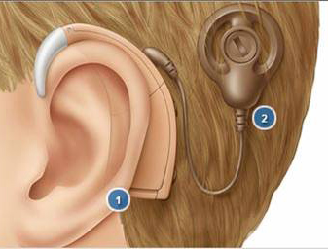
Cochlear implant
http://www.accessexcellence.org/AB/BA/biochip3.html
This up to date method utilises the electronic cochlear implants, which can partly replace the Corti's organ, mainly in children which have functioning auditory nerve. It is an electrode system implanted into cochlea, which can stimulate the nerve, by impulses generated by a so-called speech-processor.

Slide 26
Authors: Vojtěch Mornstein, Lenka Forýtková Content collaboration and language revision: Ivo Hrazdira, Carmel J. Caruana Last revision September 2024

