Slide 1
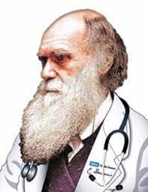
Evolutionary Medicine
Miriam Nývltová Fišáková
Department of Physiology

Slide 2
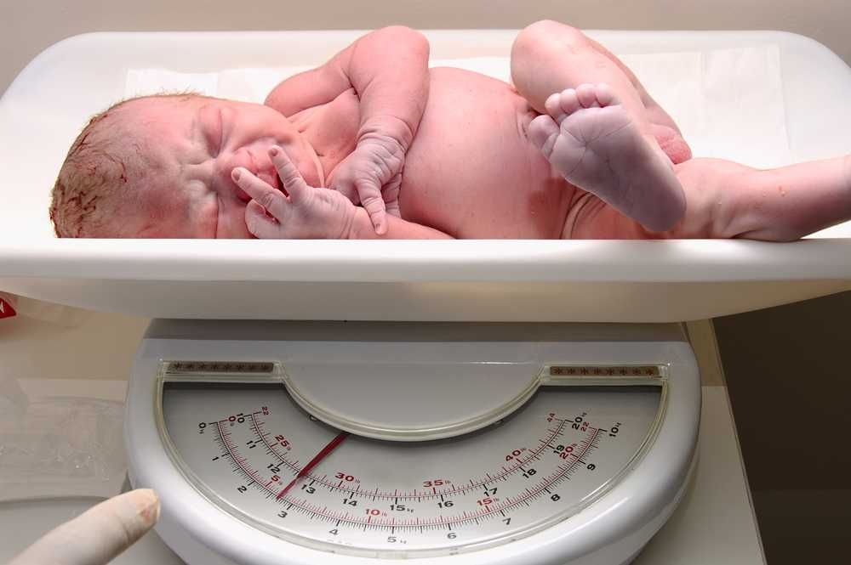
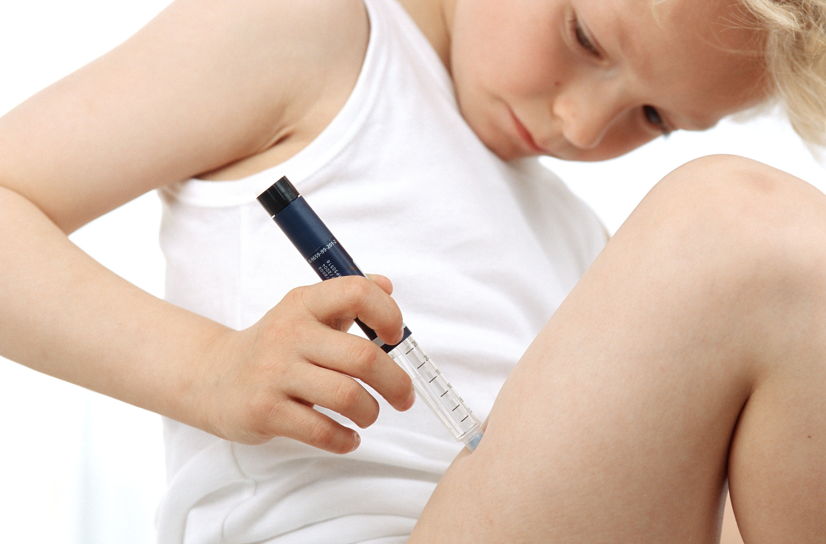
The developmental origins model in contemporary and past populations
The developmental origins of adult health and disease model (DOHaD) is a well-established paradigm concerning plasticity in early life and has been adopted into Evolutionary Medicine. It relates primarily to the uterine and infant environments (up to age 2), and to nutritional deficits experienced during this time that appear to shape health in later adulthood. DOHaD practitioners have conducted numerous observational and experimental studies in contemporary human populations and animal models to examine how early life stressors might influence susceptibility to later life chronic, or non-communicable, pathologies including cardiovascular diseases (CVD), hypertension, stroke, type 2 diabetes (T2DM) and obesity. For example, systematic reviews and meta-analyses of human studies have consistently shown a relationship between birth weight and risk for T2DM in later life, where low birth weights (<2500 g) increase the odds of susceptibility to this disease. The DOHaD framework has been applied primarily to contemporary populations, but the effects of developmental environments were presumably also operating in recent history. Taking a more bioarchaeological approach to DOHaD, the deceased, whether ancient or recent, are essentially ‘witnesses’ to the past. They potentially record permanent markers of early life disruption that enable reconstructions of historic and prehistoric developmental environments and their impact on adult health, thus facilitating a much broader DOHaD picture. In this chapter, therefore, we underscore the utility of integrating bioarchaeological information with that drawn from comparative studies of contemporary individuals to gain insight into the DOHaD model. we refer to indicators of growth disruption in skeletal remains as ‘stress’ experiences and use the term ‘health’ generically to refer to the absence of visible skeletal indicators of disrupted growth or disease.

Slide 3
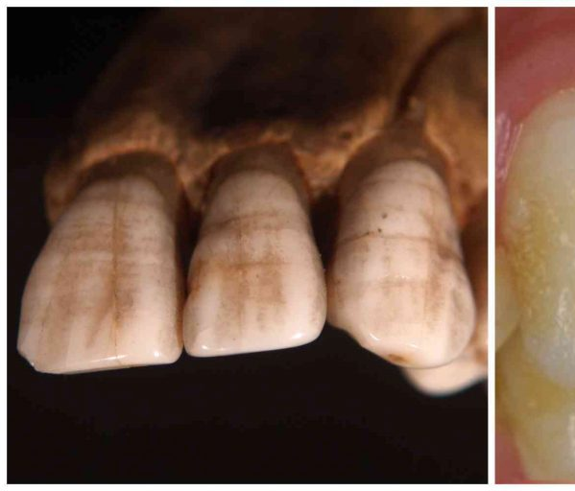
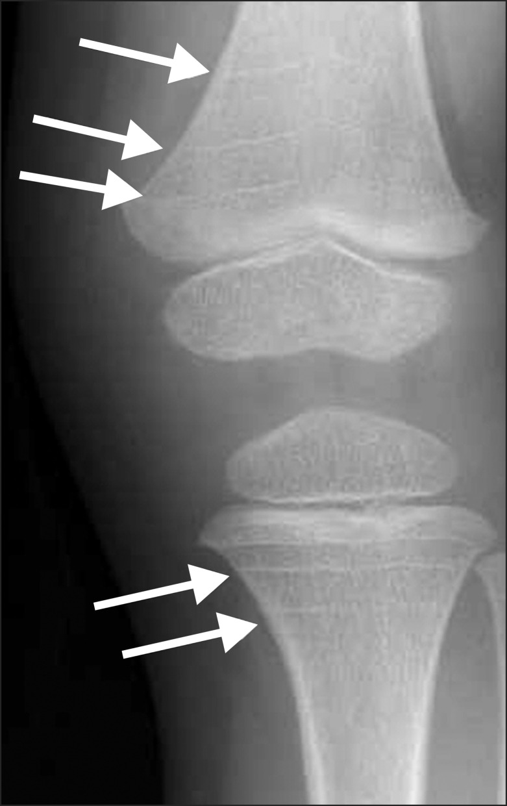
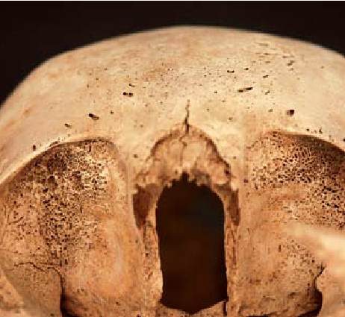
Bioarchaeological evidence
To date, the DOHaD paradigm has made a relatively recent appearance in bioarchaeology while studies of foetal bioarchaeology are still, should we say, in their infancy. It is tied heavily to the concept of frailty, which considers individuals in mortality samples to be at differential risk of succumbing to morbidity and mortality at any given age. Of particular interest from the DOHaD perspective are those conditions reflecting disruptions to early life growth and development classified according to skeletal and dental indicators. These include Harris lines, cribra orbitalia and porotic hyperostosis, reduced vertebral neural canal dimensions and other growth dimensions (stature, body proportions, fluctuating asymmetry). Dental indicators include enamel hypoplasia and associated conditions (i.e. accentuated striae of Retzius, enamel opacities and disruptions in dentine and cementum).

Slide 4
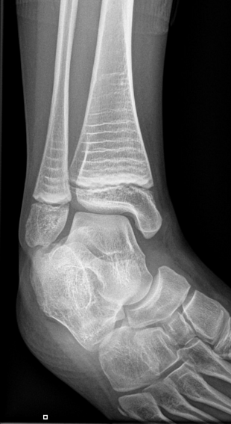
Harris lines (HL) are horizontally expressed increases in bone density appearing in the long bone shaft created by changes in mineralisation along the growth plate during long bone formation and development. These are frequently interpreted as pathological, induced, arrested growth caused by dietary deficiency or disease, although they may also form in response to normal non-linear physiological changes in growth rates, such as those caused by saltatory1 growth. While more work is needed to elucidate their aetiology, HL are broadly recognised to form in response to a range of childhood experiences and are referred to as non-specific stress markers. Given that HL form in relation to the ossification front (i.e. the area of active bone formation at the ends of long bones), it is also possible to estimate age at their formation. However, bone remodelling during adulthood can obliterate them, leading to increased and unknown errors in scoring for older individuals.

Slide 5
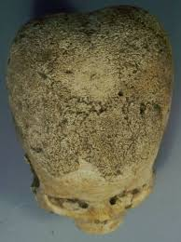
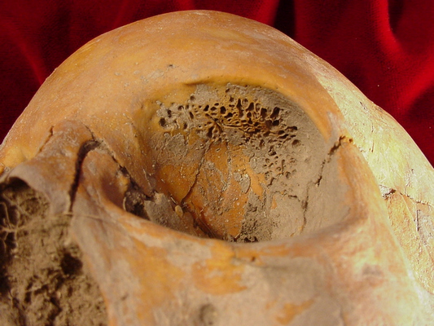
Cribra orbitalia and porotic hyperostosis are resorptive,
porous lesions formed during childhood, and are related
to red blood cell production. The former forms in
the orbital roof of the skull while the latter forms on
the cranial vault. While frequently considered
together, the aetiology of these two conditions and
the extent to which this is shared is problematic.
Traditionally interpreted as evidence for dietary iron deficiency anaemia, both cribra orbitalia and porotic hyperostosis appear to reflect a more diverse origin, including iron deficiency anaemia due
to disease (in particular, helminth infections), deficiencies
in vitamins B12 and B9 (folate) and haemolytic and megaloblastic
anaemia caused by blood disorders. More recently, a potential
association with respiratory infections has been identified
for porotic hyperostosis.

Slide 6
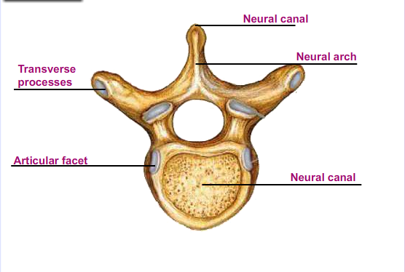
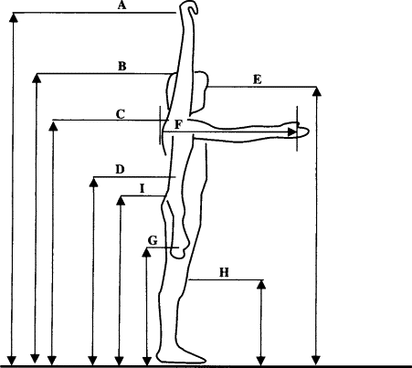
Measurement of various body metrics in bioarchaeology can provide insight into different developmental periods in the context of past populations. Stature (seen as capturing cumulative growth) has long been evaluated as a proxy for individual and population health and has been considered in relation to other markers of stress and health. Long bone growth also occurs at different times, depending on the specific bone, and has been used to evaluate shorter periods of growth, as well as changes in body proportions potentially associated with periods of growth. Vertebral neural canals are potentially valuable in capturing shorter periods of time, with approximately 95% of their growth completed by age 5. Work on the use of these vertebral neural canal dimensions (measured transversely and antero-posteriorly across the canal) as evidence of early life growth disruption in the past was undertaken by, was further recognised by, and has recently seen increased attention in bioarchaeology

Slide 7
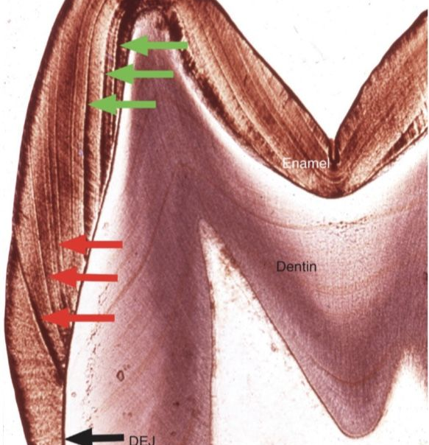
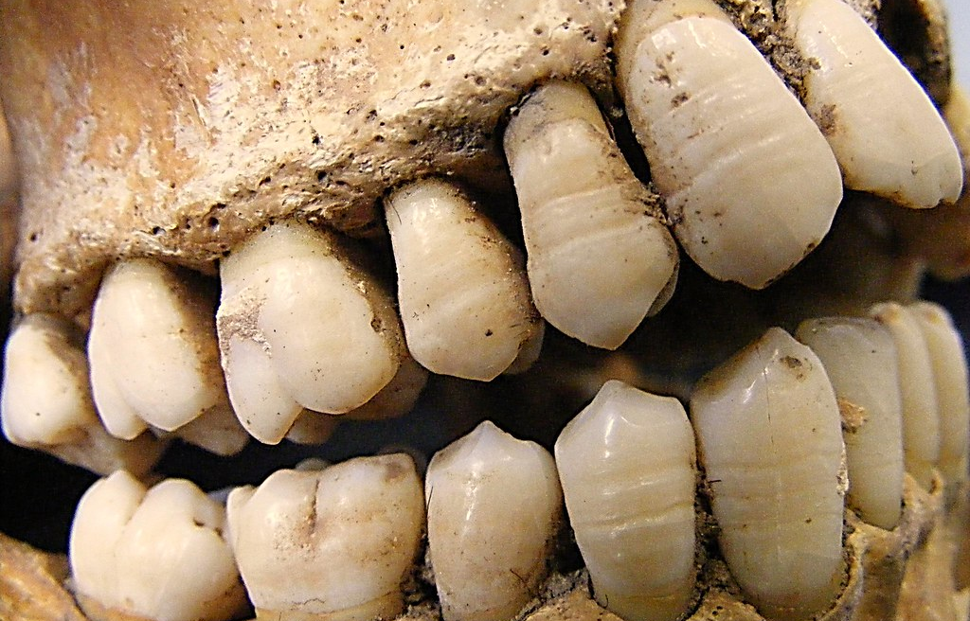
Teeth
Dental enamel has been studied extensively in bioarchaeology both as macroscopic and microscopic surface manifestations of growth disruption, known as dental enamel hypoplasia.
Enamel can also contain internal disruptions, known as accentuated striae of Retzius or Wilson Bands.
We refer in general to dental enamel defects (DED) here for simplicity, encompassing both internal and surface markers. Parallel lesions can also be seen in the softer dental tissue underlying enamel, called dentine, which is subject to some remodelling (referred to as the secondary dentine). More recent work has explored the utility of growth arrest lines in cementum (the mineralised tissue covering the tooth root) to consider experiences of physiological disruption occurring into adulthood.

Slide 8
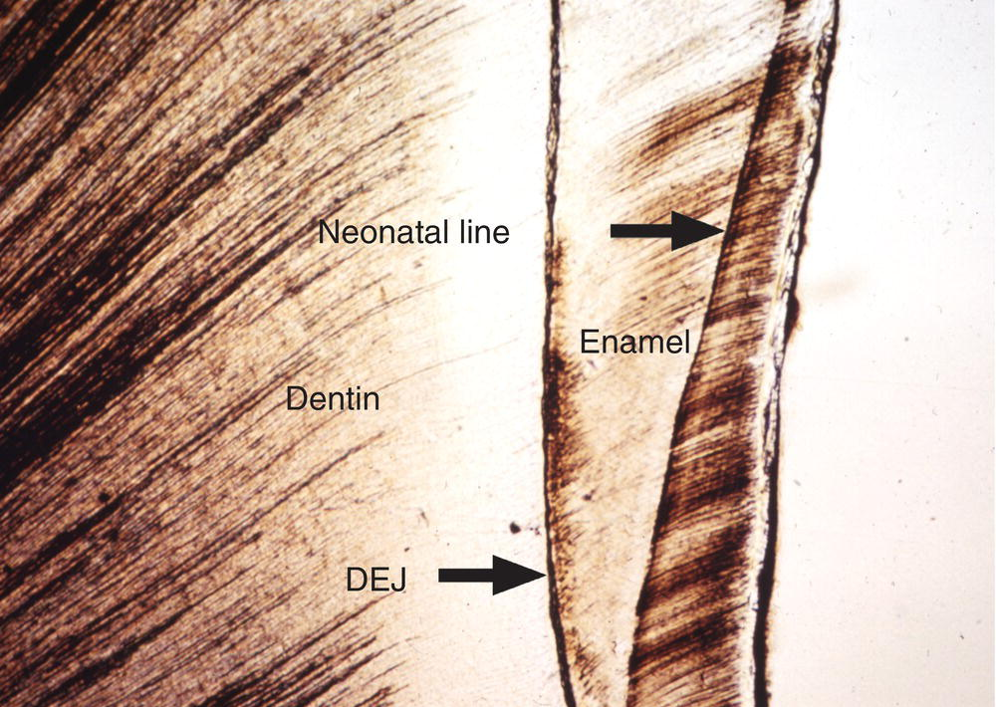
Teeth
The incremental nature of dental structure and their early formation from featal life to adolescence makes them particulary relevant for the study of childhood stress and DOHaD. Dental enamel is also permanent once formed and, unlike bone, does not remodel. Enamel on some of the permanent teeth in adults, such as the first molar, can also provide evidence of insult from birth, provided there has been on limited enamel war. In this cases, the neonatal line (a pronouced internal enamel defect linked to the birth event) can be used to anchor post-natal developmental sequences. More commonly, DED studies cover a slightly later period than that frequently emphasised in DOHaD. This is because dental wear on permanent teeth obliterates the earliest growth, and studies of deciduous teeth cannot demonstrate their potencial influences on later life health (i.e. being lost in childhood).

Slide 9
Teeth
Fewer studies have considered deciduous enamel defects, partly because deciduous teeth are harder to recover and observe archeologically if they are not fully erupted. Their thinner enamel also makes them friable and subject to damage. It was detected that individuals who died younger tended to have both more accentuated striae of Retzius and a thicker neonatanal line. These results suggest that the width of this line may relate in some way to child fraility and later life stress episodes.

Slide 10


Research on DOHaD in the living population began roughly in the middle of the 20th century as a result of experiences during the Second World War, when pregnant women were exposed to starvation during the blockade of Amsterdam (1944-1945-Barcroft, 1947) or pregnant women during the blockade of Leningrad (today St. Petersburg-Antonov , 1947). Both described a low birth weight of 500-600 g less than a healthy newborn, and a greater tendency to cardiovascular disease is described in survivors.

Slide 11

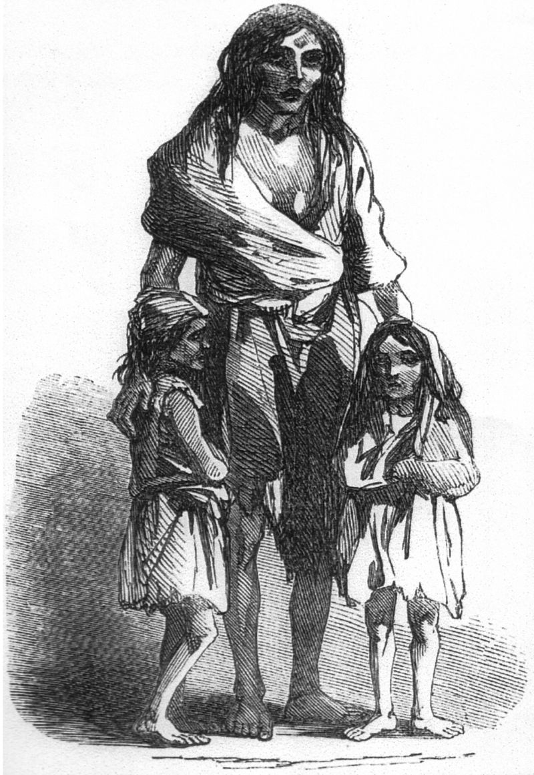
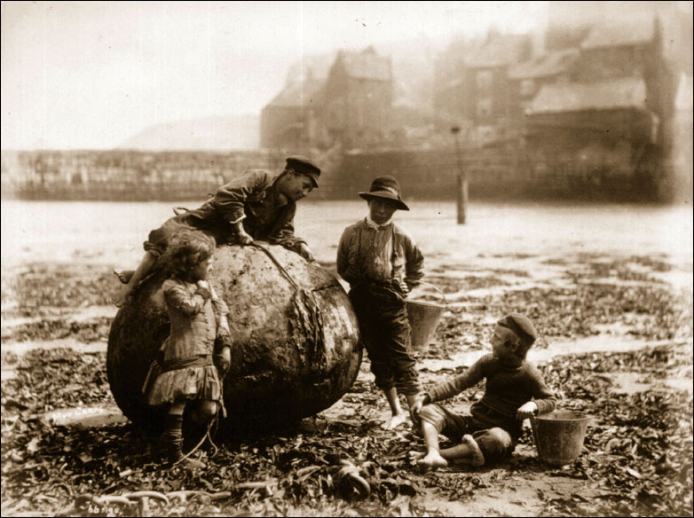
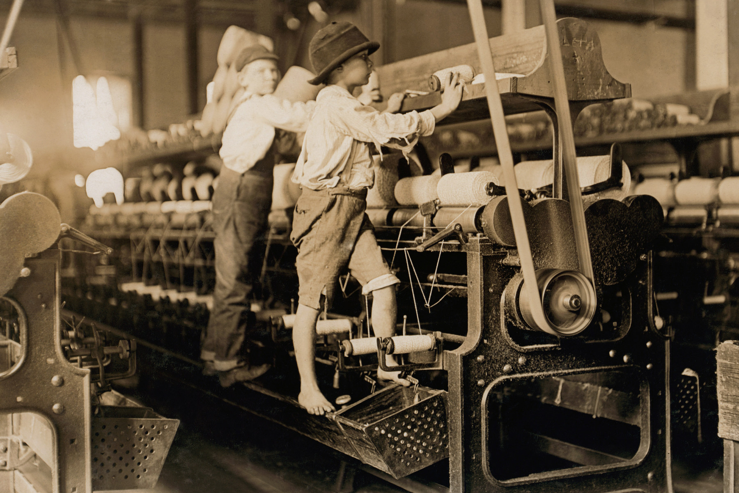
Famine in Ireland
Geber (2014) examined the remains of 545 juveniles from the Kilkenny Union Workhouse cementery and found enamel defects, Harris lines and growth arrest. Defects were identified during this famine, but individuals with defects earlier before this famine survived longer and better than individuals without these effects. It has a similar effect to immunization in early childhood as allergy prevention

Slide 12
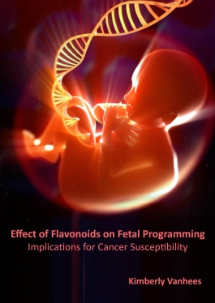
Fetal programming
is the theory that environmental cues experienced during fetal development play a seminal role in determining health trajectories across the lifespan.
Three main forms of programming that occur due to changes in the maternal environment are:
Changes in development that lead to greater disease risk;
Genetic changes which alter disease risk;
Epigenetic changes which alter disease risk of not only the child but also that of the next generation - i.e. after a famine, grandchildren of women who were pregnant during the famine, are born smaller than the normal size, despite nutritional deficiencies having been fulfilled.
These changes in the maternal environmental can be due to nutritional alteration, hormonal fluctuations or exposure to toxins.

Slide 13
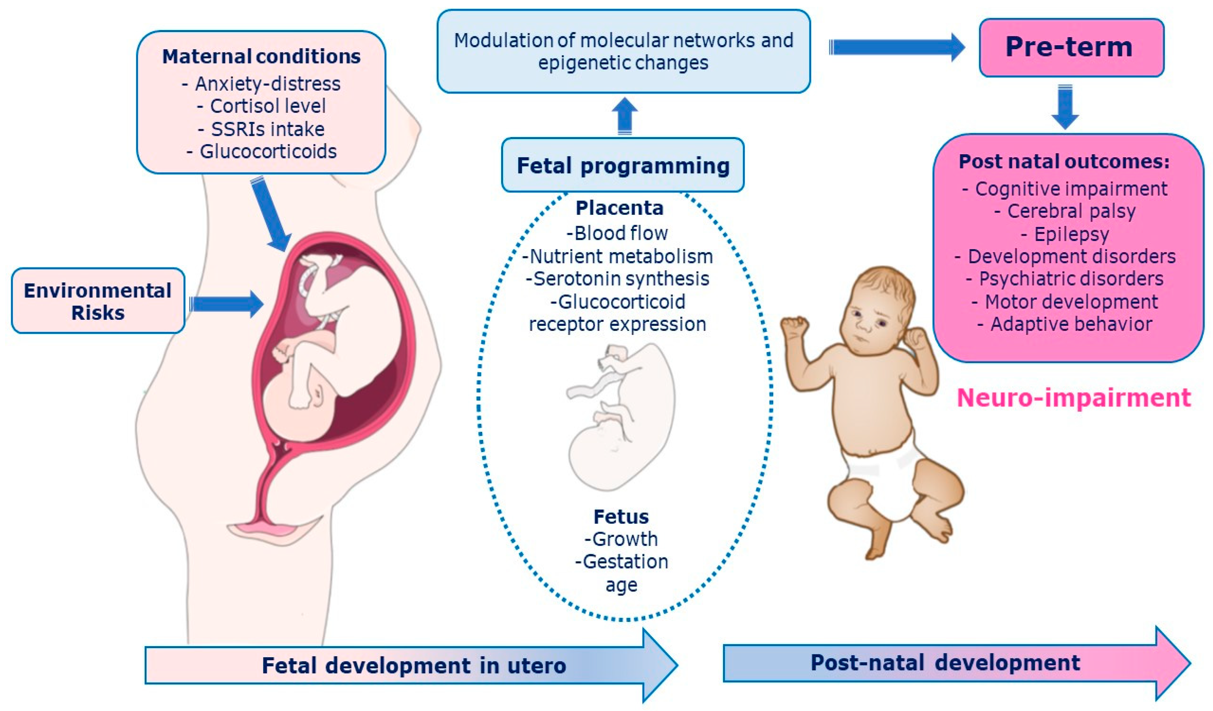
Dutch famine 1944–45
In 1944–45, the German blockade of the Netherlands led to a lack of food supplies, causing the Dutch famine of 1944–45. The famine caused severe malnutrition among the population, including women in various stages of pregnancy. The Dutch Famine Birth Cohort Study examined the impact of lack of nutrition on children born during or after this famine. It showed that over the course of their life, these children were at greater risk of diabetes, cardiovascular disease, obesity, and other non-communicable diseases.
Barker hypothesis
David Barker (1980) began a research study on this topic. The Barker Hypothesis, or Thrifty phenotype, forms the basis for much of the research conducted on fetal programming. This hypothesis states that if the fetus is exposed to low nutrition, it will adapt to that particular environment. Nutrients are diverted towards the development of the heart, brain, and other essential organs of the fetus. The body also undergoes metabolic alterations that ensure survival in spite of low nutrition but may cause problems in situations with normal or high nutrition. This leads to increased risk of metabolic syndrome.

Slide 14
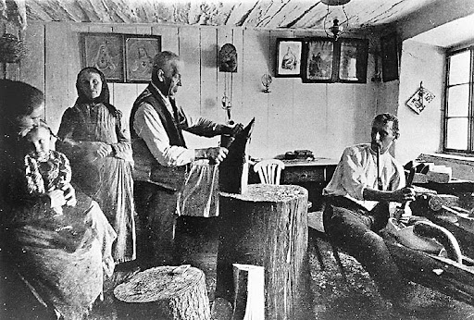
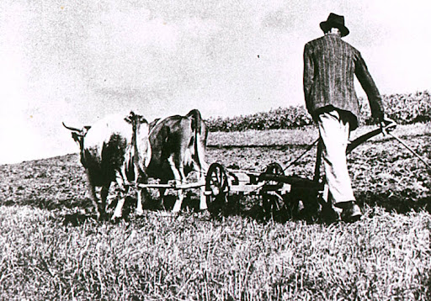
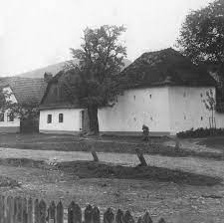
The effect of fluctuation, seasonality on birth weight and health of children born in agricultural Gabon was also determined. Children born in the summer and wet period had a lower weight than children born in the winter in the dry period, when there is plenty of food (see Hanning et al, 2017). Similar changes occurred in our ancestors, when children born at the end of summer and in autumn survived best (Gavrilov and Gavrilova, 2011).

Slide 15
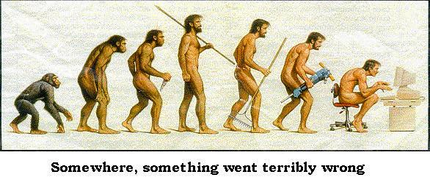
Spinal
Each of us has experienced spine problems, 2/3 of people in the world have long-term spine problems and these problems also have an economic impact.
Spine problems have a very long history (millions of years).
Paleopathological studies are limited by condition that leave traces on skeletal remains, but this still leaves a range of acquired condition, that affect the human spine, including arthritis, intervertebral disc herniation and spondylolysis

Slide 16
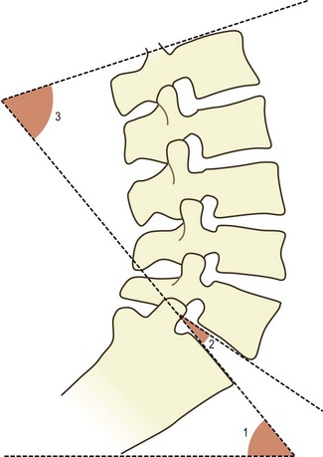
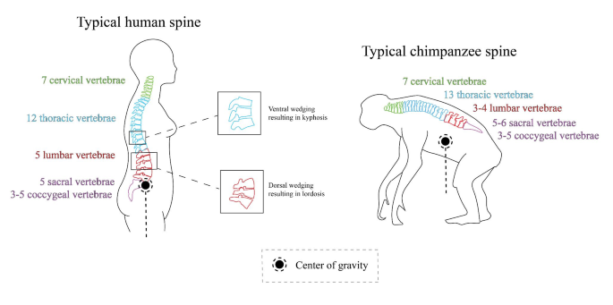
An illustration of the five regions (showing modal numbers of vertebrae in each region) and curve of a human spine and chimpanzee spine, as well as the lumbar lordosis angle, which is calculated as the angle made between two lines, one running parallel to superior end plate L1 and the other running parallel to the inferior endplate of L5.

Slide 17
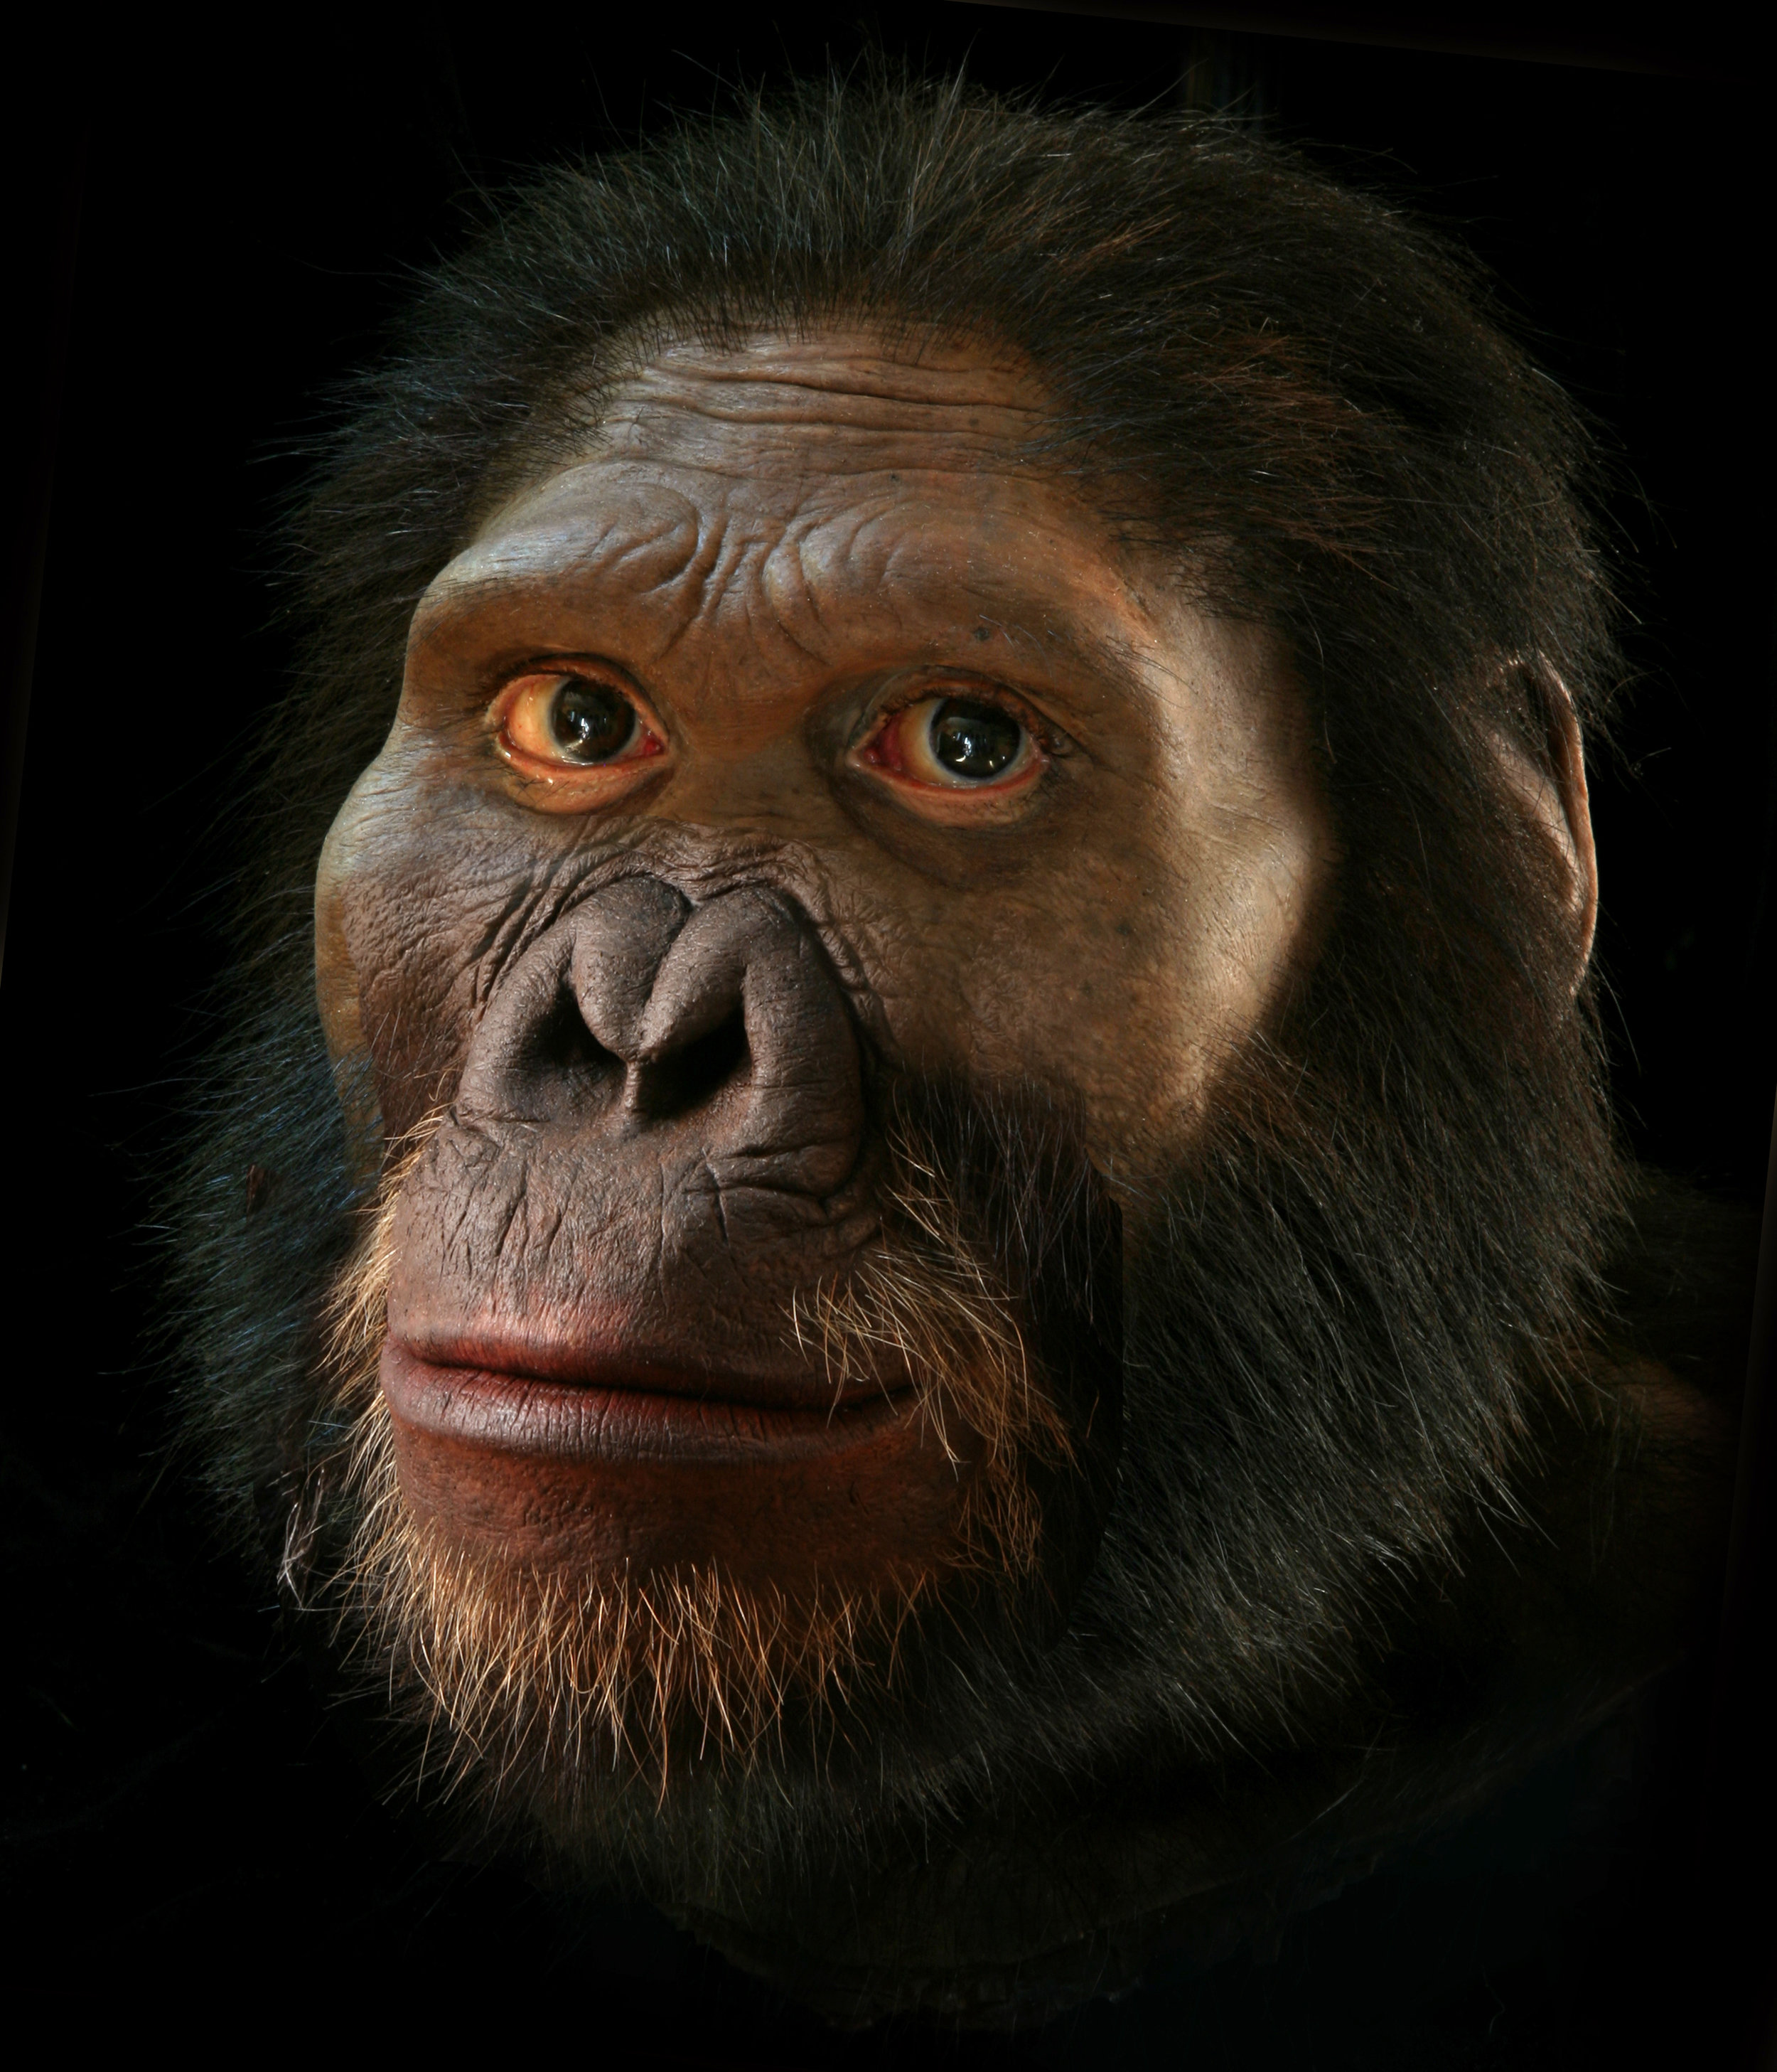
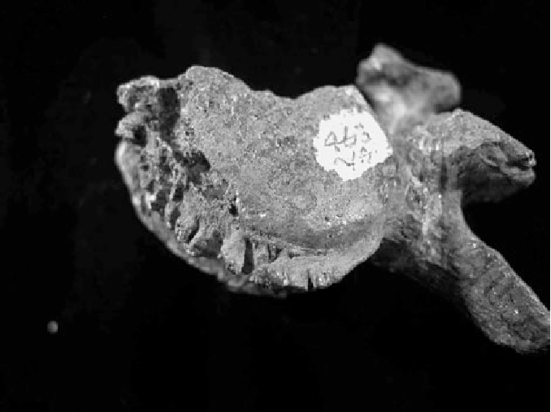
Two types of anthritis that affect the spine have been identified in ancient remains. Arthritis is a general term for inflammmatory and degenerative condition that affect joints. Arthritis of vertebral bodies, or spondylosis, exist by human skeletons (Homo sapiens) recovered from archaeological sites dating 341 000 BP (Before Present).
It has also been diagnosed in the remains of at least two extinct hominin species, identified on lower lumbal vertebrae of 2,14 milion year old Australopithecus africanus (see Odes et al., 2017). This disease is associated with brucellosis infection. Brucella is an infectious disease that can be caught by cutting, eating raw meat and unpasteurized milk.

Slide 18
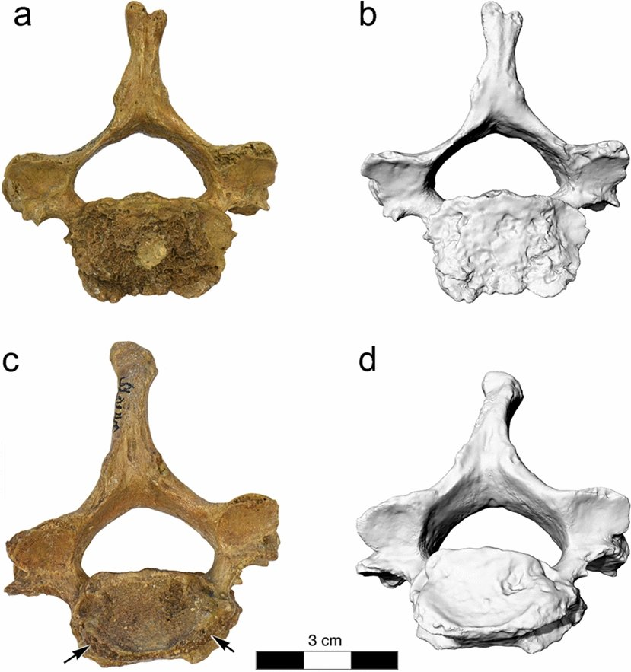
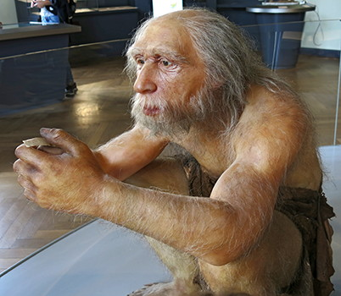
Second specimen is cervical vertebrae of Homo neanderthalensis from the site La Chapelle-aux-Saints (60 000 BP)-see Rothschild and Haeusle (2021). This disease is associated with brucellosis infection.

Slide 19
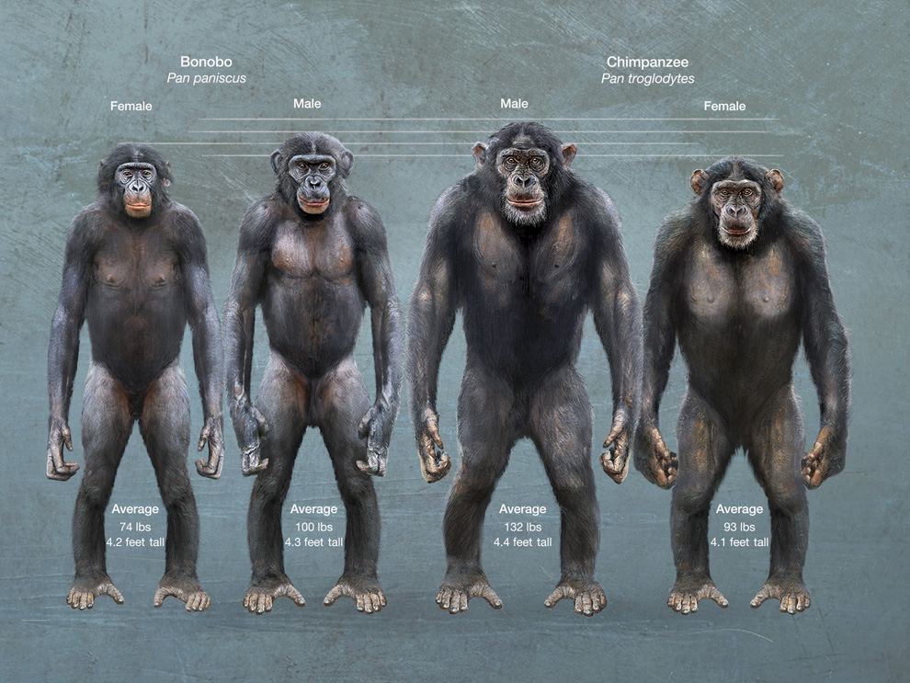
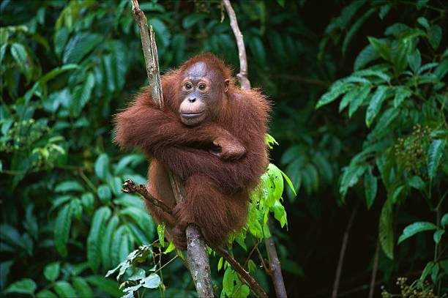
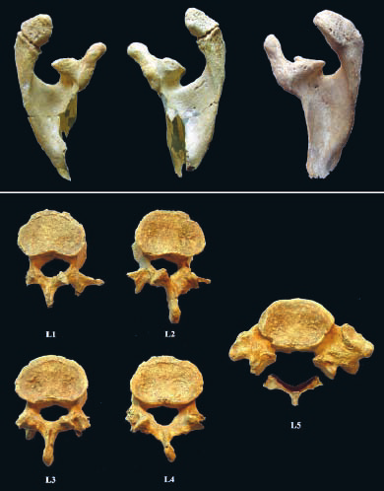
Spondylolysis is a fracture of the vertebral arch in the area of ​​the pars interarticularis. It most often occurs in the lower lumbar region. It is typically a stress fracture in children, adolescents and young adults. It is one of the most common causes of lower back pain in children and adolescents. In the vast majority of cases, it is treated with relative rest and analgesics. If spondylolysis is accompanied by displacement of the vertebral bodies relative to each other, we speak of spondylolisthesis. The etiology is not entirely clear. It is most often considered a stress fracture of the pars interarticularis after repeated microtraumas.
The oldest evidence has been identified in a late Upper Palaeolithic skeleton from Italy-Villabruna-1, which dates to 14 000 BP (see Vercellotti et al., 2009, 2014)
Spine problems have been researched from various perspectives, but no single specific reason has been identified as to why some people have spine problems and others don't.
I just know that the earliest representatives of hominins already had these problems. It is therefore clear that it is related to bipedalitis, as spondylosis (or known osteophytosis) is present in 48-95% of humans, but only 4% in gorillas, 5% in bonobos and 2% in chimpanzees, intervertebral disc herniation is only present in 2% of chimpanzees and orangutans. Spondylolysis is a unique disease of the spine only in humans and has no parallel in the animal kingdom (see Ward et al., 2007).

Slide 20
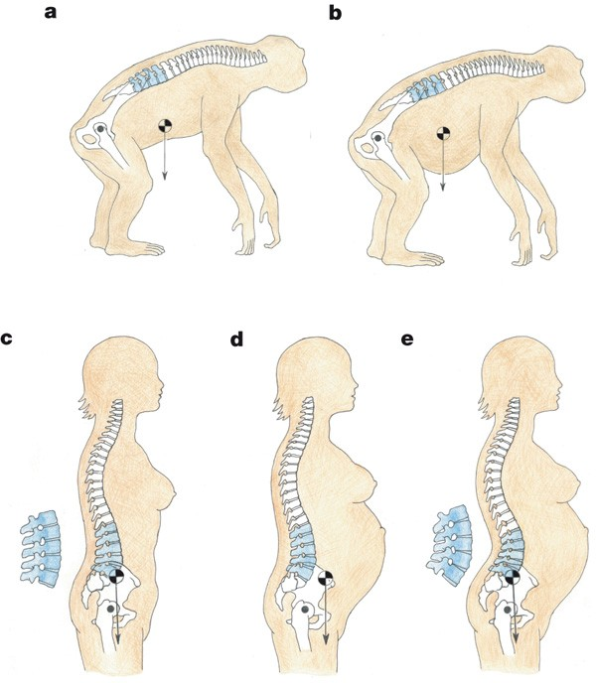
Problems occur mainly in the lumbar part of the spine, which bears the greatest load during movement and is therefore most stressed. This area is also referred to as the "evolutionary weak point" of the human spine.
The visible difference between the spines of humans and apes is apparent at first glance. Great apes have a C-shaped spine, while humans have distinct curves. Another difference is the higher number of lumbar vertebrae in humans compared to apes.
The caudal region of spinal column, which is formed by sacral vertebrae and all coccyx, has a kyphotic curve. This curve results from ventral wedging of the second to fifth sacral vertebrae and all the coccygeal vertebrae and is enhanced by a ventral tilt of the cranial end of the sacrum. The four curves of human spine are widely accepted to be functionaly important. They bring the centre of gravity of the body above the hips, unlike it being located ventrally in quadrupeds, and therefore allow the trunk to be balanced above the legs during bipedal walking. The lumbal curve is particulary important in this regard. (see Been et al., 2010, 2019)

Slide 21
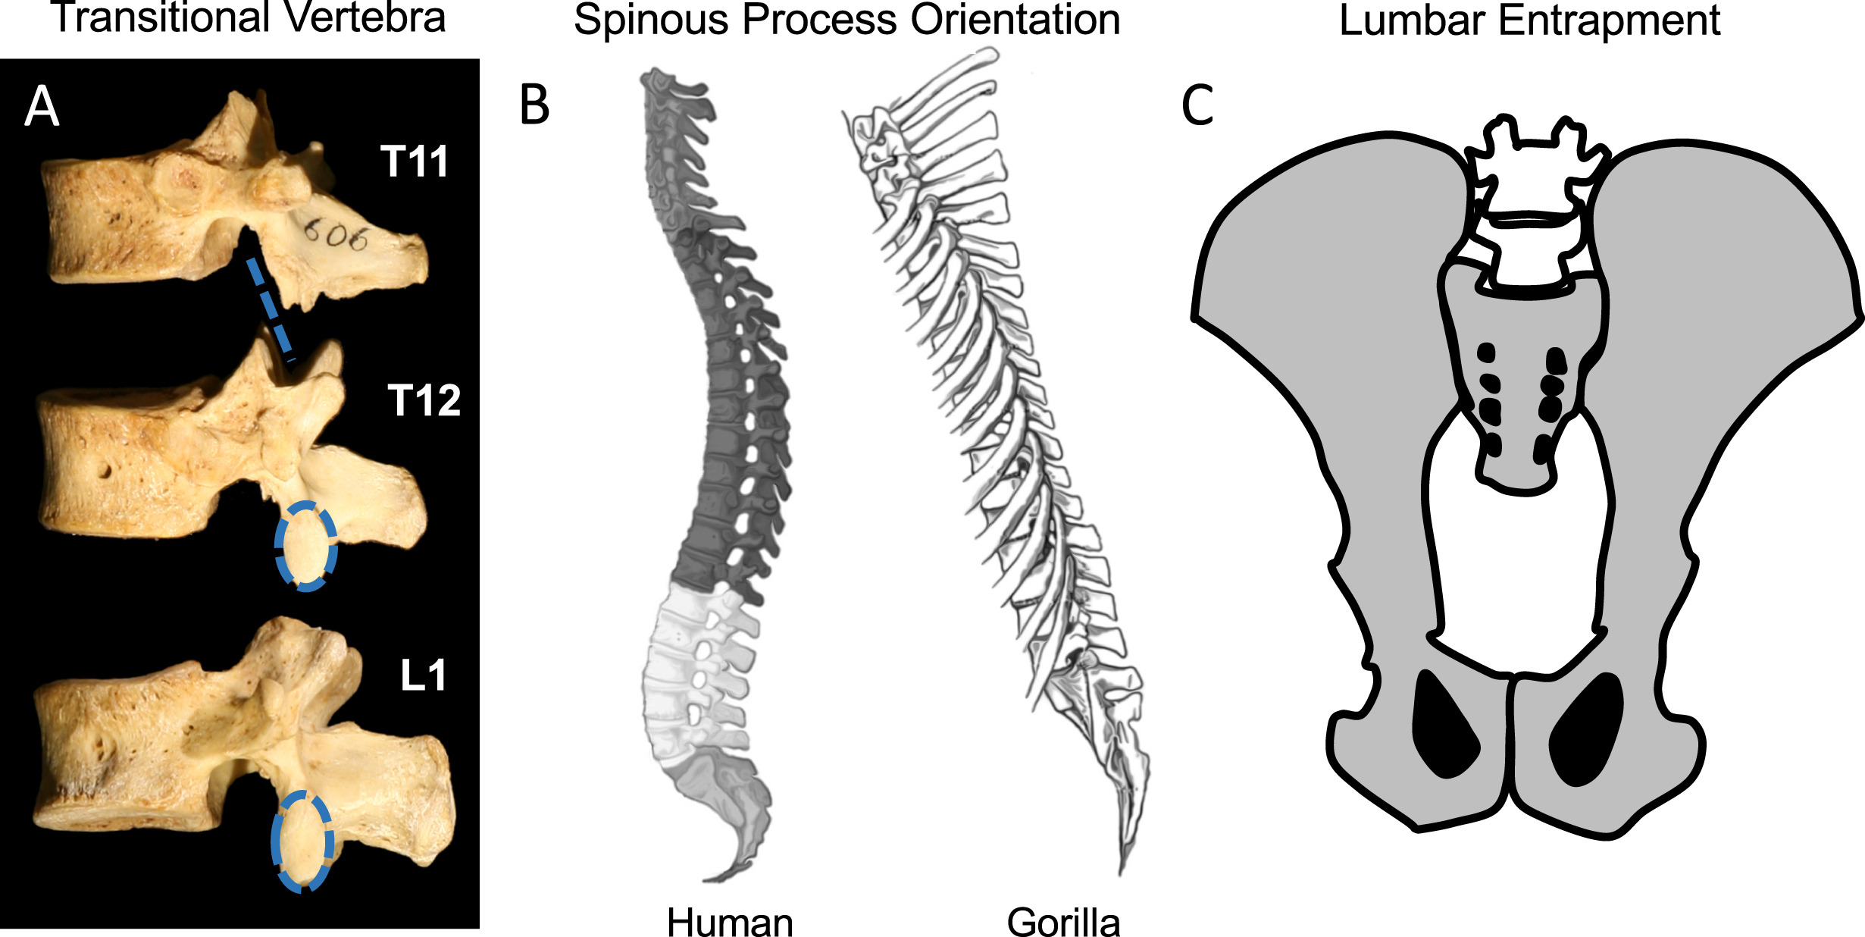
Mechanisms of stiffening the lumbar spine. (A) The T12 in this human specimen is the transitional vertebra that has dorsally facing superior articular facets and laterally facing inferior articular facets. This demarcates the boundary between rotational motions permitted in the thoracic region and dorsoventral mobility in the lumbar region. (B) In humans, the spinous processes change from caudally oriented in thoracic vertebrae (dark gray) to dorsally oriented in lumbar vertebrae (light gray). In contrast, gorillas maintain caudal orientation into the lumbar region ( Slijper, 1946 ). Gorilla figure modified from ( Slijper, 1946 ). (C) Lower lumbar vertebrae (white) can be entrapped in apes owing to the high iliac crests and narrow sacrum.

Slide 22
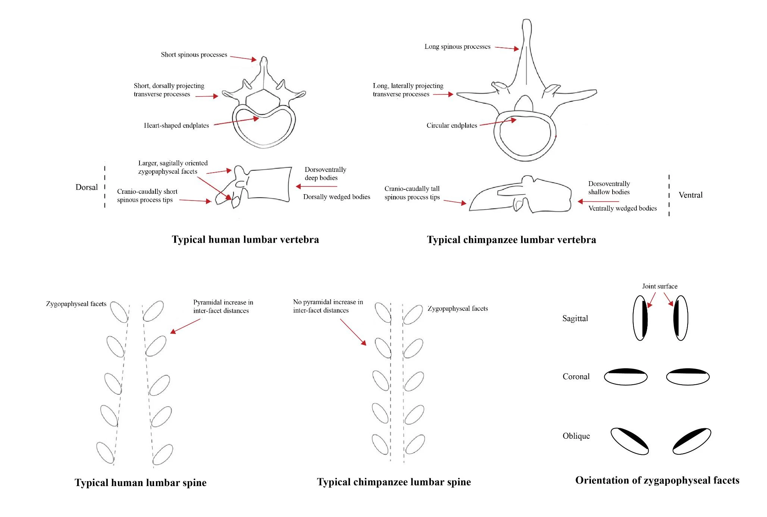

Slide 23
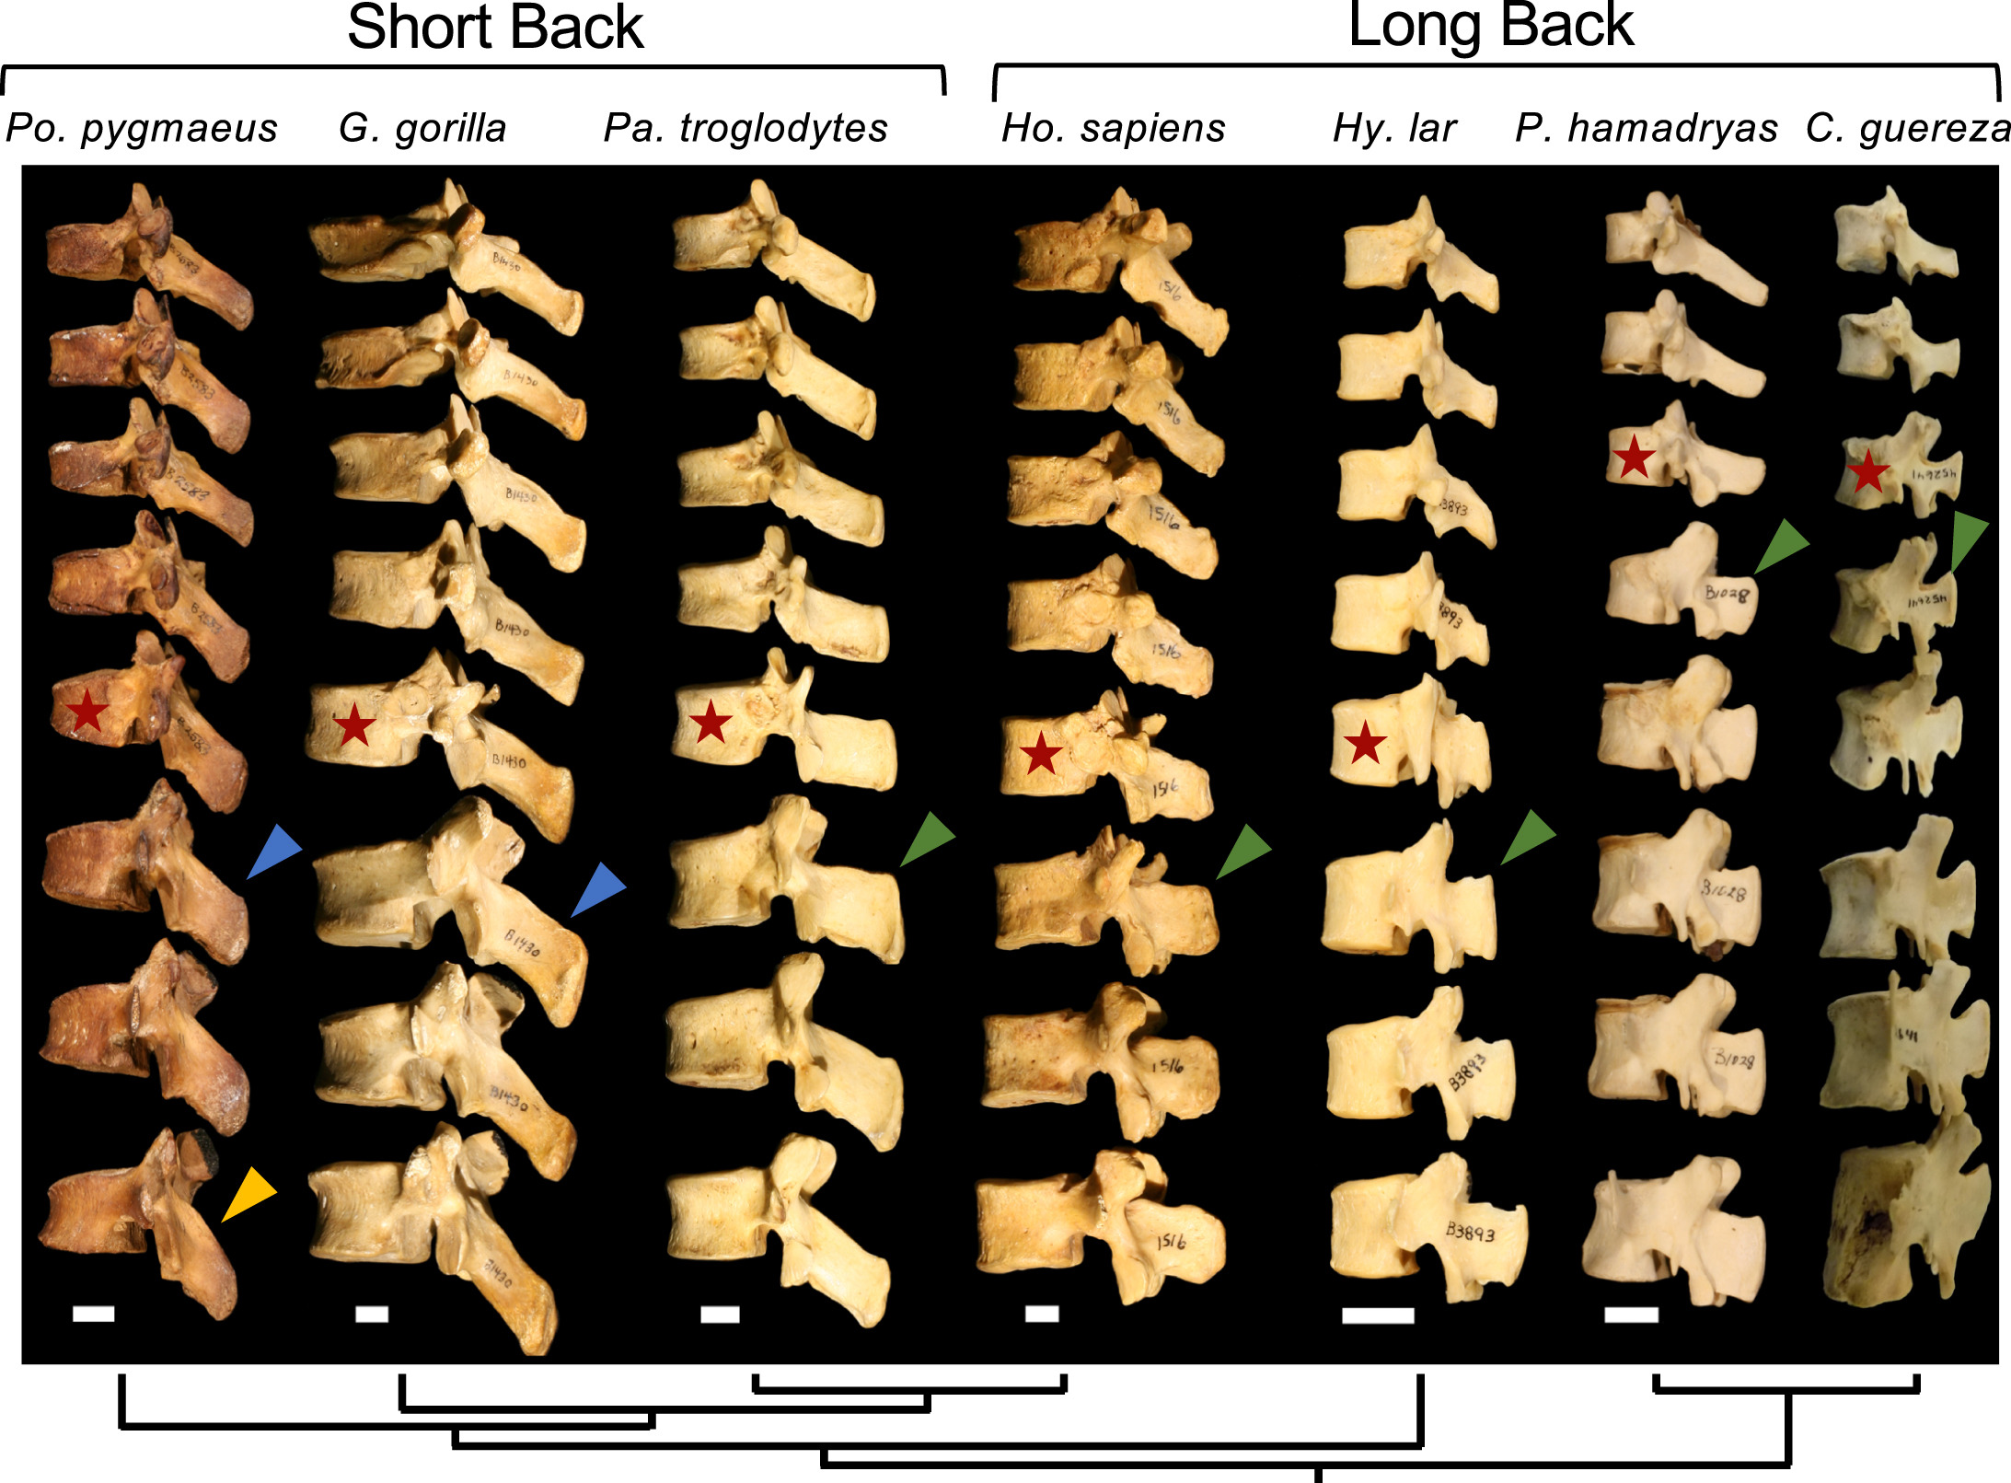
Representative individuals showing the last 5 thoracic and first 3 lumbar vertebrae. The TV is indicated by the red stars. Note the change in spinous process morphology between pre- and post-TV in long-backed humans, gibbons, and the two monkeys. The chimpanzee spinous process attains a morphology at the TV and 1st post-TV (green arrow) that is similar to long-backed species but resumes a caudal orientation by the 2nd lumbar (post-TV) vertebra. Orangutans and gorillas maintain the same thoracic-like caudally oriented spinous processes throughout the lumbar column including the TV and 1st post-TV (blue arrow). Orangutans are distinguished by the lack of cranial-caudal expansion and continued triangular shape of lumbar spinous processes (orange arrow). See SOM for additional representative individuals for each hominoid species and baboons. Scale bars = 1 cm (no scale for colobus monkey). Phylogeny depicted at bottom. TV = transitional vertebra

Slide 24
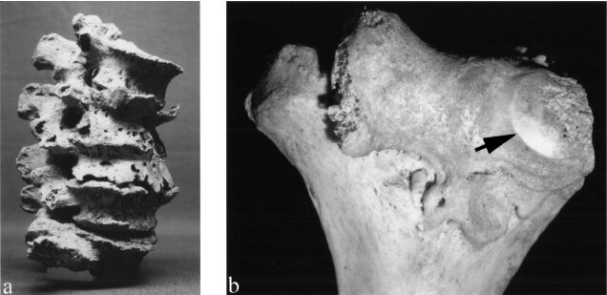
Clinical evidence
This angle is associated with lumbar lordosis in such a way that a large angle means a greater lordosis and a smaller angle a smaller one. This angle is highly variable in humans and is related to the development of spinal diseases. This angle is directly related to osteoarthritis of zygapophyseal joints. Osteoarthritis is a breakdown of synovial joints, which in the spine are zygapophyseal and costovertebral joints. Clinically, osteoarthritis preferentially affects individuals with pronounced lumbar lordosis (see Roussouly and Pinheiro-Franco, 2011)
Its occurence in the lumbar spine also seems to correlate with zygapophyseal facets that are more sagitally oriented than in healthy individuals (see Fujiwara et al., 2001)
Clinical studies have also suggested that a large lordic angle may contribute to spondylolysis which is a cleft in the neural arch caused by a fatige fracture at the site of the pars interarticularis.
Intervertebral disc herniationon the contrary, it is associated with a low angle, most often between 37° and 45°. The normal angle ranges from 51° to 53°. And in addition, people who had a round shape of the bodies of the lumbar vertebrae had a greater chance of prolapsed discs than people with a heart shape. The flat or concave joint surface also plays a role. Round surfaces are more prone to prolapse.

Slide 25
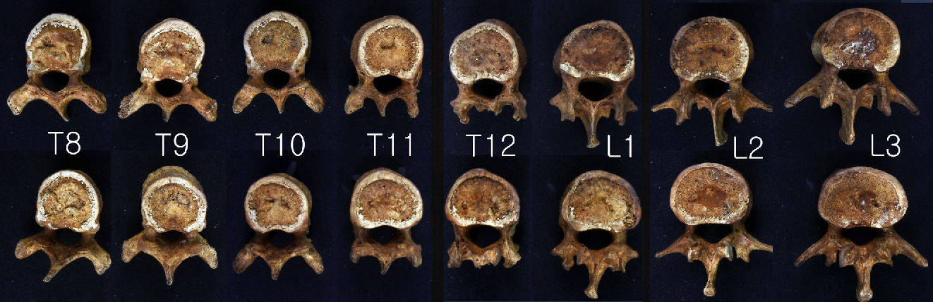
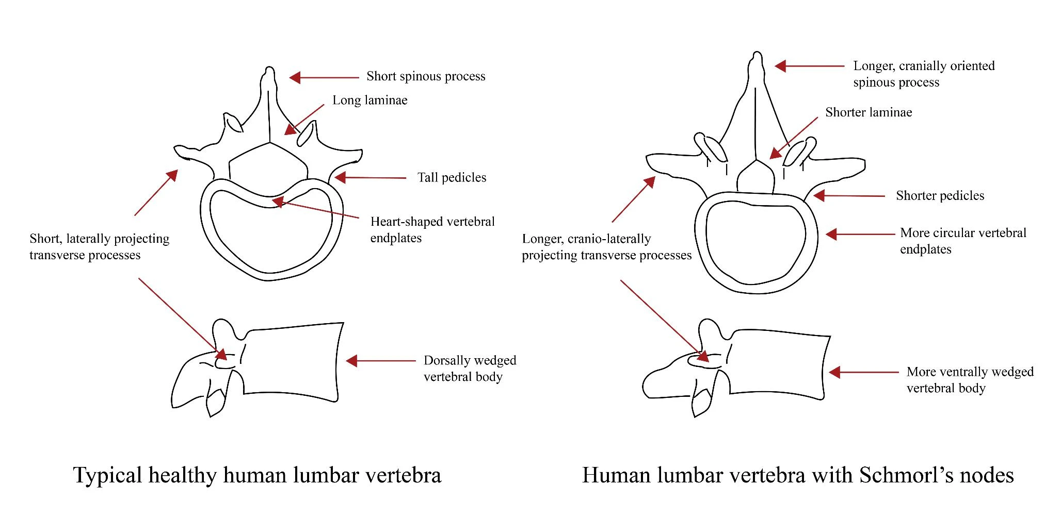
Schmorls´nodes
This pathology was investigated in a medieval to early modern burial ground in England and was found to occur in 69-81% of cases. This pathology is hereditary and does not have a clear etiology and occurs mainly in adolescent boys. These nodes have been found to occur more in vertebral bodies with a round shape. In addition, it was found that these vertebrae have shorter pedicles and laminae and smaller vertebral foramina than a healthy individual.

Slide 26
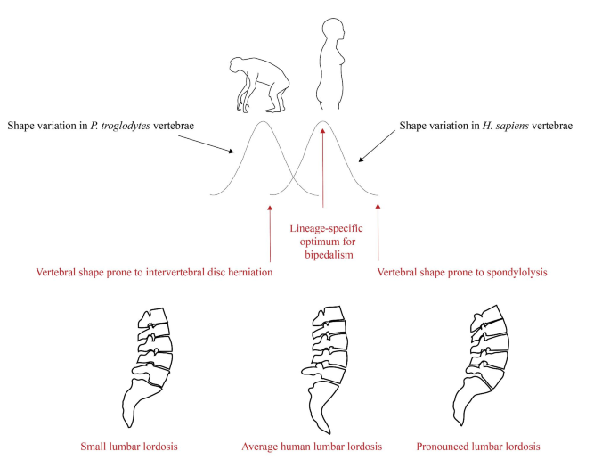
Plomp et al. (2020) conducted a similar study and focused on people who have extreme curvature and found that they exhibit shape features that are over-adapted to bipedalism. They called it the „Overshoot hypothesis“
When a healthy person, a person with Schmorl's nodes and a chimpanzee were compared, it was found that people suffering from this disease have vertebral bodies and a shape more similar to that of a chimpanzee (see Plomp et al., 2015). The authors state that this is because we share a common ancestor with the chimpanzee, and that this setting still persists in some people. They called it the "Ancestral Shape Hypothesis". After this hypothesis, Plomp et al. (2019) also tested with extinct hominin species and people with Schmorl's nodes are similar to other hominids such as Australopithecus africanus, Paranthropus robustus, Homo naledi, Homo neanderthalensis (Kebara 1). This shows that people with this pathology are closer to our ancestors than healthy people.
The logic of the Evolutionary Shape Hypothesis for acquired spinal conditions. The distribution of vertebral shape variation within Homo sapiens can be conceptualized as a bell curve with an ancestral end (left) and a derived end (right). Where an individual’s vertebral shape sits within this distribution has an important influence on their spinal health, according to the hypothesis. At the center of the range of variation are vertebrae that have the lineage-specific optimal shape for bipedalism and, therefore, a lower probability of developing spinal pathologies in response to the stresses of bipedal posture and gait. At the ancestral end, vertebrae differ little from those of the chimpanzees (P. troglodytes) and by extension from those of the common ancestor of humans and chimpanzees. People with vertebrae that fall in this part of the distribution have a heightened probability of developing intervertebral disc herniation. At the other, highly derived end of the range of variation, vertebrae exhibit exaggerated versions of our species’s vertebral adaptations for bipedalism. Individuals with vertebrae that fall in this part of the distribution are more prone to develop the fatigue fractures that cause spondylolysis

Slide 27
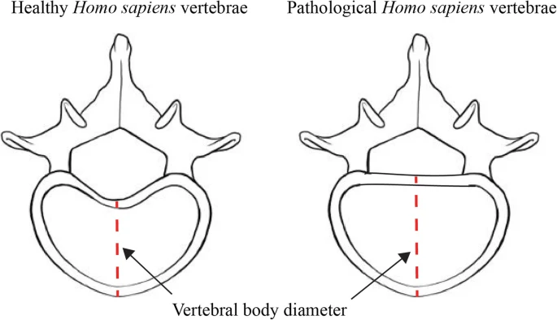
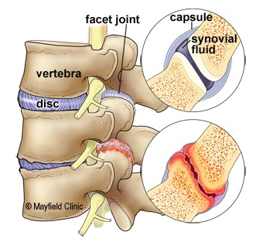
Biomechanics of both extremes. With a straighter lumbar spine and a rounder body, there is not a good transfer of walking pressure between the disc, body and arch, and the intervertebral disc is extremely stressed and can herniate. At the other extreme, the lumbar vertebrae are positioned against each other in such a way that the zygapophyseal joints rub and osteoarthritis occurs due to mechanical irritation.

Slide 28
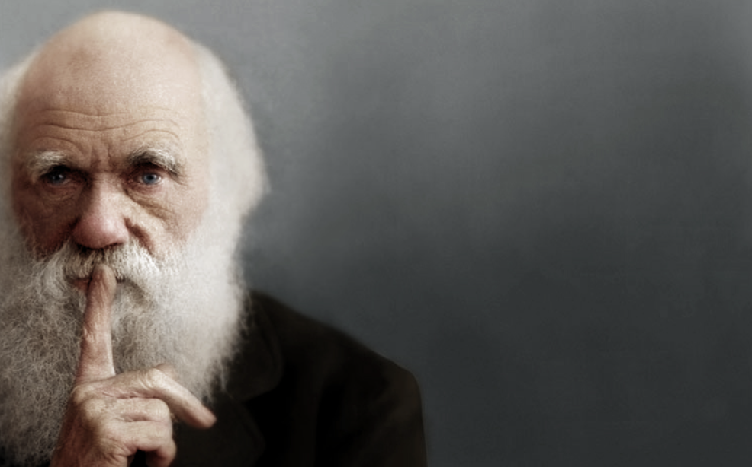
Thank you for your attention!

