Slide 1
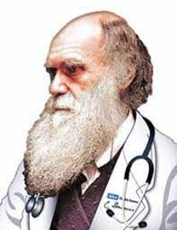
Evolutionary Medicine
Miriam Nývltová Fišáková
Department of Physiology

Slide 2

What is evolutionary medicine?
Evolutionary medicine or Darwinian medicine is the application of modern evolutionary theory to understanding health and disease. Modern biomedical research and practice have focused on the molecular and physiological mechanisms underlying health and disease, while evolutionary medicine focuses on the question of why evolution has shaped these mechanisms in ways that may leave us susceptible to disease. The evolutionary approach has driven important advances in the understanding of cancer, autoimmune disease, and anatomy. Medical schools have been slower to integrate evolutionary approaches because of limitations on what can be added to existing medical curricula

Slide 3
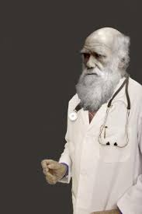
Core Principles of Evolutionary Medicine
Topic | Core Principle
Types of explanation (question framing) | Both proximate (mechanistic) and ultimate (evolutionary) explanations are needed to provide a full biological understanding of traits, including those that increase vulnerability to disease.
Evolutionary processes (evolution I) | All evolutionary processes, including natural selection, genetic drift, mutation, migration and non-random mating, are important for understanding traits and disease.
Reproductive success (evolution I) | Natural selection maximizes reproductive success, sometimes at the expense of health and longevity.
Sexual selection (evolution I) | Sexual selection shapes traits that result in different health risks between sexes.
Constraints (evolution I) | Several constraints inhibit the capacity of natural selection to shape traits that are hypothetically optimal for health.
Trade-offs (evolutionary trade-offs) | Evolutionary changes in one trait that improve fitness can be linked to changes in other traits that decrease fitness.
Life History Theory (evolutionary trade-offs) | Life history traits, such as age at first reproduction, reproductive lifespan and rate of senescence, are shaped by evolution, and have implications for health and disease.
Levels of selection (evolution II) | Vulnerabilities to disease can result when selection has opposing effects at different levels (e.g. genetic elements, cells, organisms, kin and other levels).
Phylogeny (evolution II) | Tracing phylogenetic relationships for species, populations, traits or pathogens can provide insights into health and disease.
Coevolution (evolution II) | Coevolution among species can influence health and disease (e.g. evolutionary arms races and mutualistic relationships such as those seen in the microbiome).
Plasticity (evolution II) | Environmental factors can shift developmental trajectories in ways that influence health and the plasticity of these trajectories can be the product of evolved adaptive mechanisms.
Defenses (reasons for vulnerability) | Many signs and symptoms of disease (e.g. fever) are useful defenses, which can be pathological if dysregulated.
Mismatch (reasons for vulnerability) | Disease risks can be altered for organisms living in environments that differ from those in which their ancestors evolved.
Cultural practices (culture) | Cultural practices can influence the evolution of humans and other species (including pathogens), in ways that can affect health and disease (e.g. anti-biotic use, birth practices, diet, etc.).

Slide 4
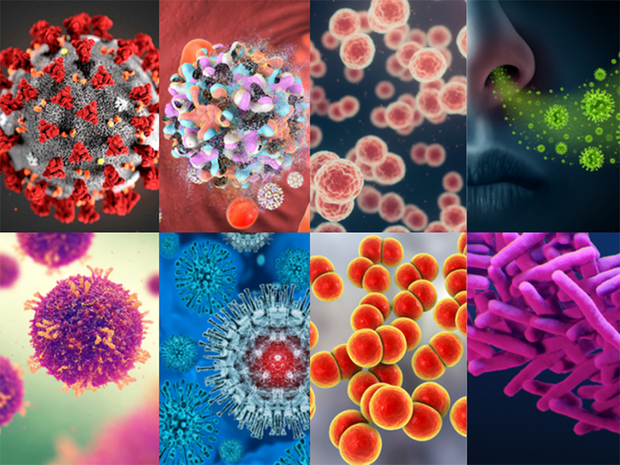
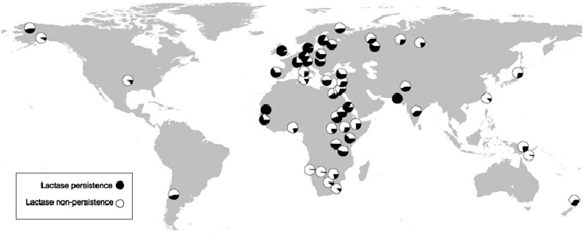
What is Disease?
Modern medicine focused on the concept of health
Evolutionary medicine focused on the determinants of optimal fitness
Fitness can be defined in relationship to a particular environment (f.e. polar bear)
This conceptual difference between health and fitness
For example lactase persistence
By European population occured
before 10 300 BP
By African population occured within past 3000-7000 BP

Slide 5
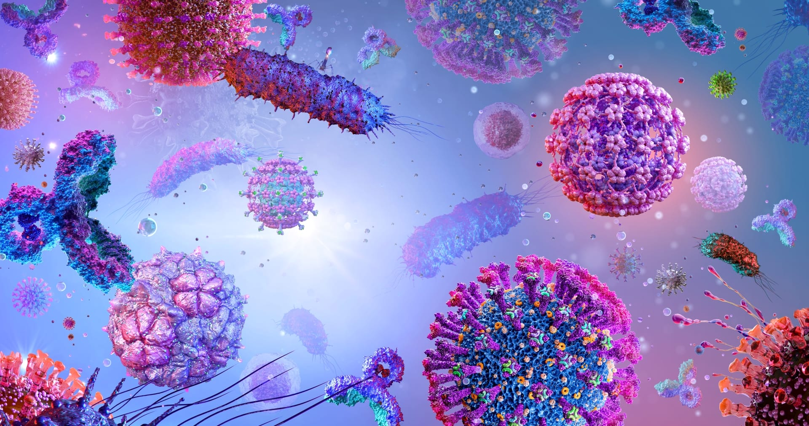
What is Disease?
The first is that our understanding of an individual´s health status may depend on our knowledge of their evolutionary origin and how that interacts with the place where they now live.
This concept of an organism matched or mismatched with its environment is fundamental to both evolutionary biology and evolutionary medicine, where mismatch-that is, failure to adapt because of temporal or structural constraints-may lead to pathology.
Second is broader. It is not always easy to define disease. Disease may be caused by an external agents such as trauma or infection, but it can also arise from mismatch between the physiology of an individual and the environment in which they live. The physiology of an individual is influenced by their evolutionary history.
Third is that the environment inhabited by humans are not constant, and much of this enviromental changes come from the activities of human themselves (f.e. lactase persistence)

Slide 6
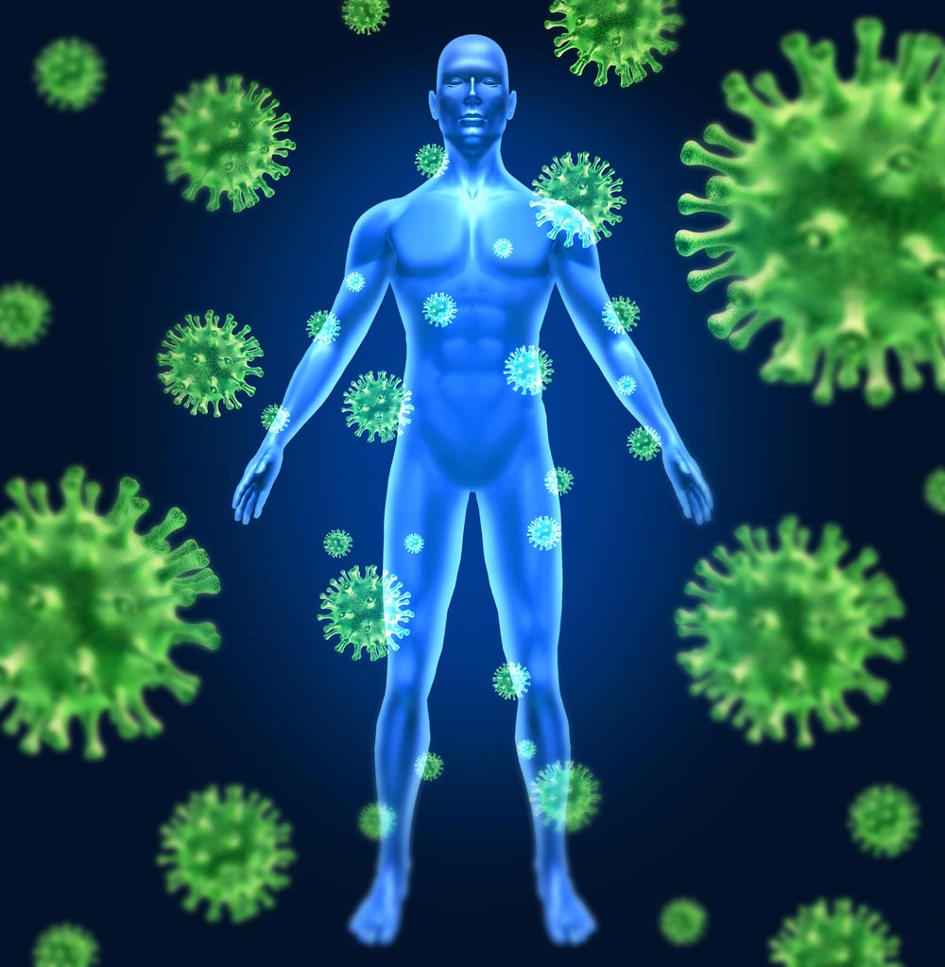
What is Disease?
Physiological system can be generally maintain homeostasis in the presence of a degree of enviromental varion, but there are limits to the capacity. When those limits are exceeded, disease can occure.
The range of enviroments to which a lineage has been exposed in its evolutionary history will influence that range of adaptility, and human health can be compromised by living in marginal enviroments beyond our homeostatic capacty (F.e. sSherpa population in Himalaya).

Slide 7
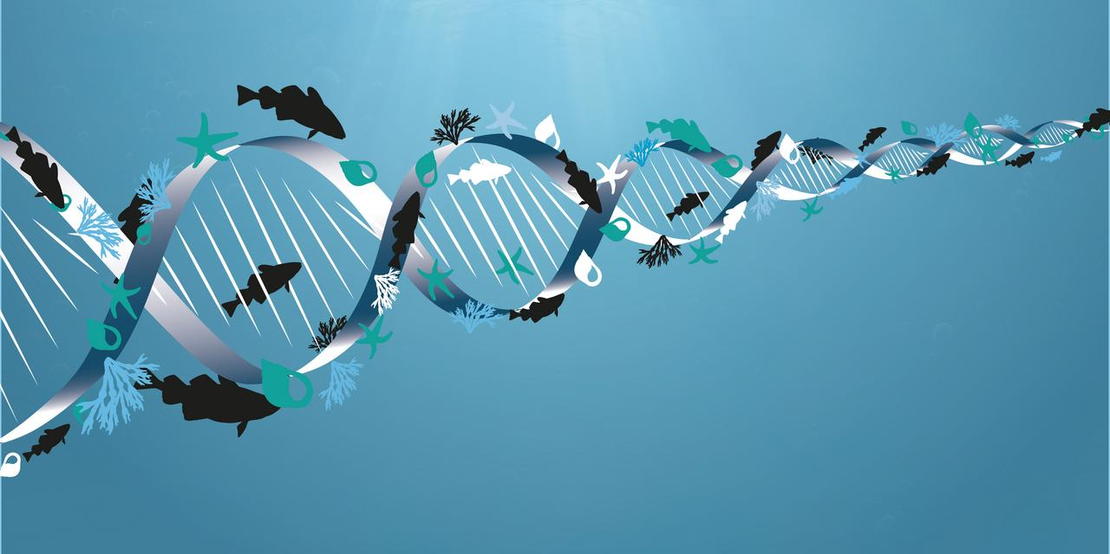
What Evolution is

Slide 8
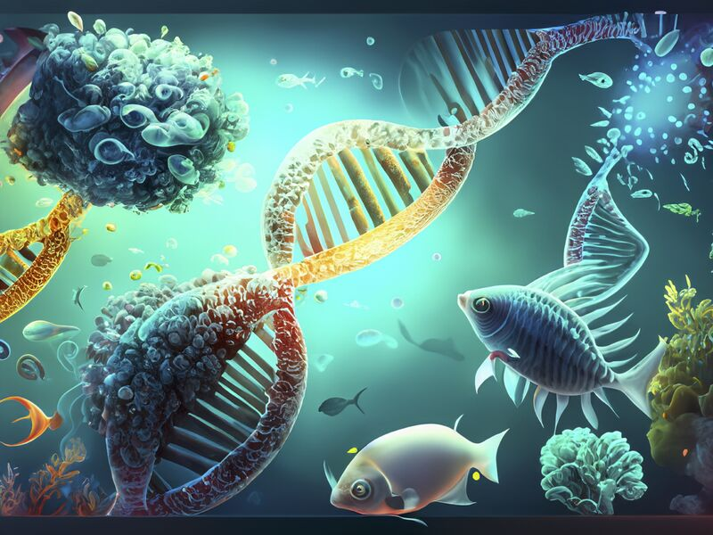
What Evolution is
Evolutionary biology is fundamentally concerned with the various processes that have determined the „design“ of the human body at all levels, from how we interact as whole organism with other members of our species to every component and level of our internal biological organization.
Design is metaphore, use as shorthand to describe the various processes by which a species evolves, such that its charakteristice-anatomical, physiological, biochemical, maturational, and behavioral- fit the environment in which population lives.
Design not imply Designer
Adaptation as used in evolutionary biology refers to those evolved elements (or traits) that can be shown to have promoted fitness.
Strategy- describe the functional signifikance of adaptation
In evolutionary thouth it is important to avoid trap of describing ana evolutionary process, or evolution itself, as having a purpose or direction, to do som is form of theology!

Slide 9
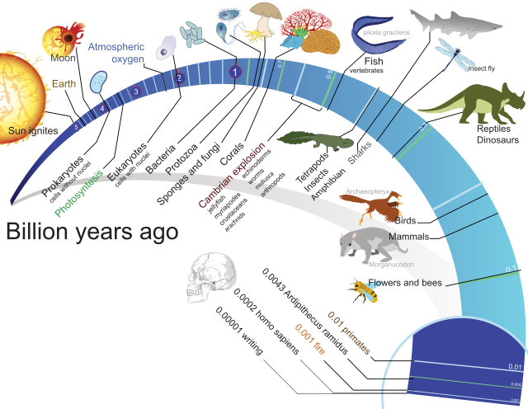
What Evolution is
One of the dangers of the design and strategy methaphors, or of speaking about higher or lower species, is that they can encourage such thinking. There is a major difference in the thought processes underlying the statement that „limbs evolved for walking“ which is theological, and the evolutionary statement that „ there was progressive selection over time on the traits associated with the ancestral fin, and the adaptive advantage associated with effective terrestrial movement.
Begining of modern evolutionary theory in the late 18th century was based on two fundamental concepts.
The first was gradualism, the idea that the geological features of the planet are results of slow processes operating over time.
The second was that biological species are not immutable but that, with time, new species could emerge, evolve into other species, or become extinct, and that in biology, as well geology, deep time provede a settings for such gradual change.
Macroevolution comprises the evolutionary processes and patterns which occur at and above the species level.
Microevolution is evolution occurring within the population(s) of a single species. In other words, microevolution is the scale of evolution that is limited to intraspecific (within-species) variation
Most evolutionary biologist focus on genetic inherence, However, there are other modes of inherence, and increasingly these have been incoporated into evolutionary science.

Slide 10
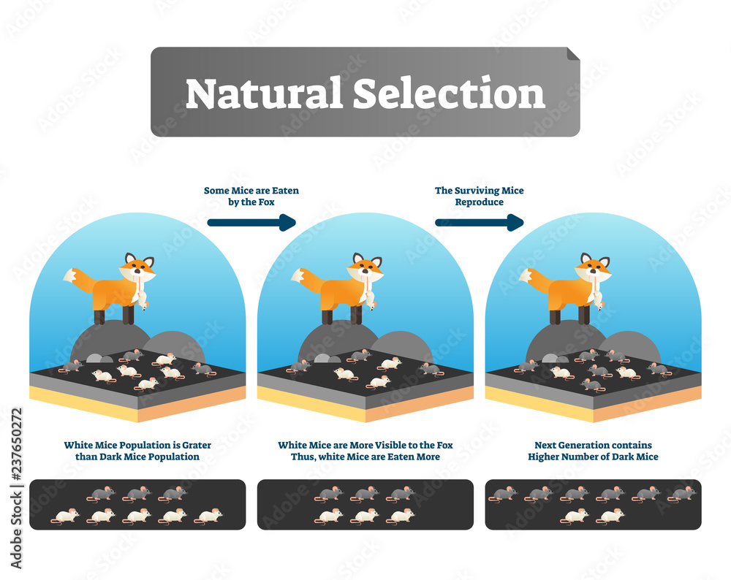
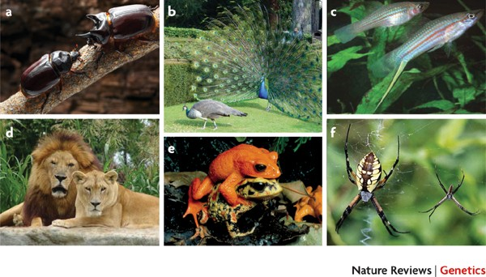
What Evolution is
Selection desribe the processes by which one individual is more likely to reporduce succefully than another within population because of the position of a particular advantageous trait.
In The Origin of Species Ch. Darwin makes one of the greatest intellectual leaps in scince to recognize that selective processes also operate in nature. He rocognized that natural variation in a trait might make an individual organism more or less likely to survive and reproduce succefully in a given environment, and that therefore as that trait became concetrate in the population over time the lineage would evolve to be well adapted to a particular environment. Darwin recognized that selection is about reproductive success. Natural selection is one mechanism for archiving this. In another book The Descendent of Man Darwin desribe another mechanism, whereby reproductive success is not related to characteristics affecting survival but rather to sexual dominace and choice- sexual selection.
Not everything has Evolved by Selection!

Slide 11
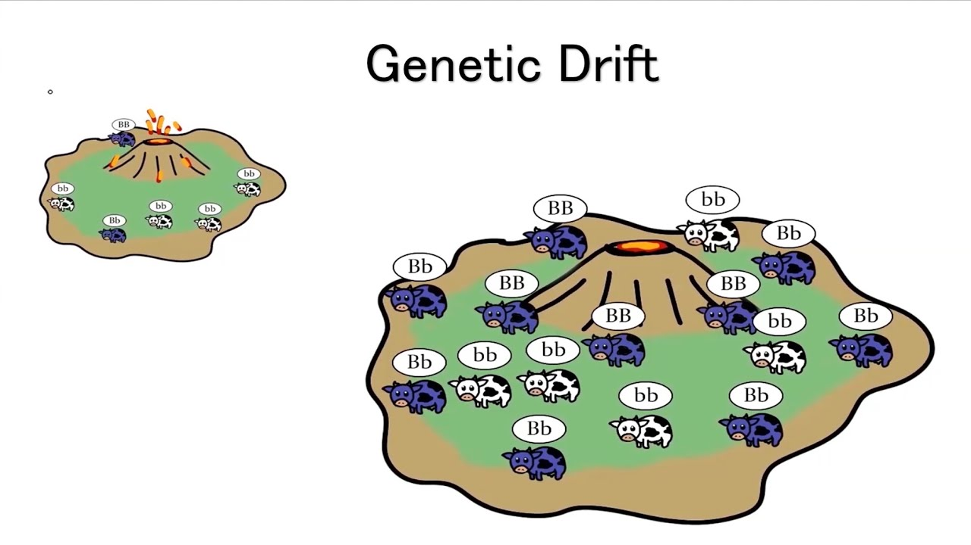
What Evolution is
Genetic drift
is the change in the frequency of an existing gene variant (allele) in a population due to random chance.
Genetic drift may cause gene variants to disappear completely and thereby reduce genetic variation. It can also cause initially rare alleles to become much more frequent and even fixed.
When few copies of an allele exist, the effect of genetic drift is more notable, and when many copies exist, the effect is less notable (due to the law of large numbers). In the middle of the 20th century, vigorous debates occurred over the relative importance of natural selection versus neutral processes, including genetic drift. R. Fisher, who explained natural selection using Mendelian genetics, held the view that genetic drift plays at most a minor role in evolution.

Slide 12
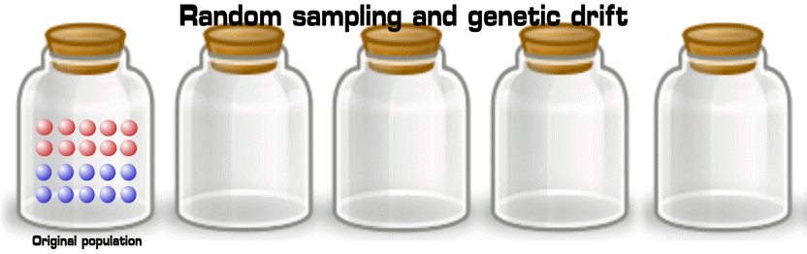
What Evolution is
Genetic drift
The process of genetic drift can be illustrated using 20 marbles in a jar to represent 20 organisms in a population. Consider this jar of marbles as the starting population. Half of the marbles in the jar are red and half are blue, with each colour corresponding to a different allele of one gene in the population. In each new generation, the organisms reproduce at random. To represent this reproduction, randomly select a marble from the original jar and deposit a new marble with the same colour into a new jar. This is the "offspring" of the original marble, meaning that the original marble remains in its jar. Repeat this process until 20 new marbles are in the second jar. The second jar will now contain 20 "offspring", or marbles of various colours. Unless the second jar contains exactly 10 red marbles and 10 blue marbles, a random shift has occurred in the allele frequencies. If this process is repeated a number of times, the numbers of red and blue marbles picked each generation fluctuates. Sometimes, a jar has more red marbles than its "parent" jar and sometimes more blue. This fluctuation is analogous to genetic drift – a change in the population's allele frequency resulting from a random variation in the distribution of alleles from one generation to the next.
In any one generation, no marbles of a particular colour could be chosen, meaning they have no offspring. In this example, if no red marbles are selected, the jar representing the new generation contains only blue offspring. If this happens, the red allele has been lost permanently in the population, while the remaining blue allele has become fixed: all future generations are entirely blue. In small populations, fixation can occur in just a few generations.

Slide 13
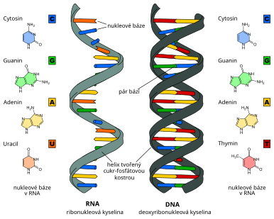
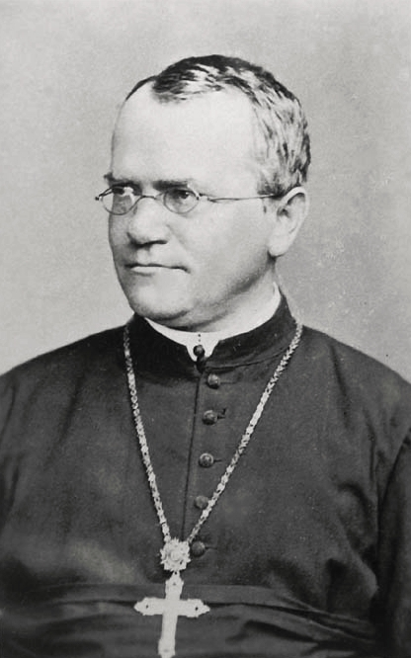
What Evolution is
Variation and Inheritance
The key features of the preceding discussion are the themes of variation and inheritance. Recognizing their importance was another of Darwin’s seminal contributions. Up to Darwin’s time, biologists (and doctors) had largely been concerned with classifying all living organisms; they therefore concentrated on similarities—as defining the average for a species— rather than variations.
Darwin shifted the focus to individual variation within a species. The most remarkable aspect of Darwin’s contributions and those of the other early evolutionists, including Alfred Russell Wallace, is that they made their observations in the absence of any understanding of how variation and inheritance might operate.
It was the discovery of particulate inheritance—the idea that characteristics could be inherited as discrete units—that led to the development of genetics and the study of mutation. The field was slow to develop because the principles of inheritance elucidated by Gregor Mendel were ignored for 20 years until their rediscovery at the beginning of the twentieth century. There were bitter disagreements between selectionist biologists and genetic biologists until the “Modern Synthesis” brought these two fields together in an integrated concept.

Slide 14
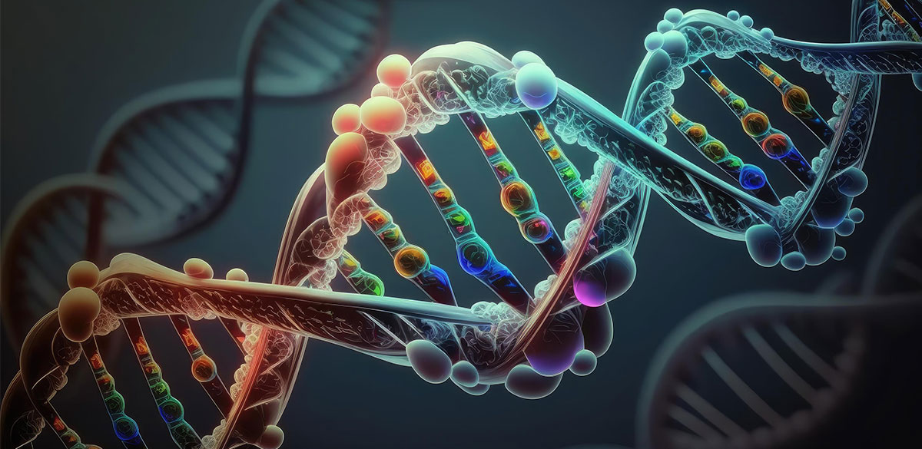
What Evolution is
Variation and Inheritance
The discovery of DNA and the power of molecular biology added impetus to this integration. In particular these discoveries
provided a mechanismfor heritable variation, but molecular architecture also provides powerful evidence for how evolution
has progressed. When used in relation to speciation, for example, the evidence from DNA goes far beyond the fossil records with which Darwin and his colleagues had to content themselves.
Subsequent evolutionary research has essentially built on these fundamental principles to describe the origin of variation: the extent to which it is driven by mutation, the link between genotype and phenotype, the role of chance, the speed of evolution,
the level at which selection operates, and the modes of inheritance.

Slide 15

What Evolution is
Development and the Life Course
One area of biology was more difficult to include in the synthesis between molecular and selectionist thinking, namely the impact of developmental processes operating from conception to maturity.
Development is not simply a matter of a fertilized ovum growing and dividing according to a pre-programmed mechanism. There are complex pathways of differentiation from a single cell into an
adult human and there are distinct components to the life course: from pre-implantation embryo, to implanted embryo, to fetus, to neonate, to dependent infant, to juvenile, adolescent, and adult. In recent years, major progress has been made in integrating our understanding of developmental plasticity—a set of processes which have themselves
evolved—with the rest of evolutionary thought, and this remains perhaps the most contentious and complex component of evolutionary theory, with ongoing robust debate.
Organisms have different biological strategies at different times in their lives. Some organisms have very distinct forms and can have very complex life courses: for example, the human parasites causing malaria (a protozoan) and schistosomiasis (a worm) have very different body forms, or morphs, according to whether they are living in humans or in their invertebrate vectors (mosquitoes and water snails, respectively).

Slide 16

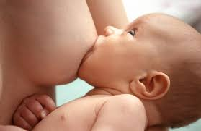
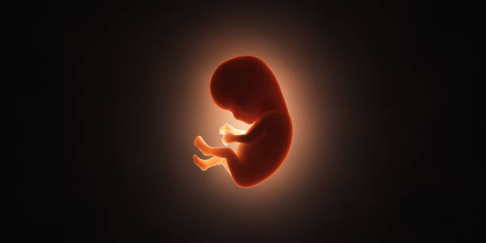
Development and the Life Course
What Evolution is
Humans too have distinct phases in their life courses. For example, the nutritional processes of the pre-implantation embryo, fetus, pre-weaning infant, and post-weaning child are all very different. The human fetus is nourished across the placenta so both placental physiology and the mother’s adaptations to pregnancy are attuned to maximize the nutrition of the fetus. The fetal gastrointestinal tract is quiescent until birth, at which time it is activated and uniquely adapted for the digestion of human milk, for example of lactose using lactase. After weaning, human gastrointestinal physiology changes yet again, one feature being that the bulk of the world’s population loses lactase activity.

Slide 17
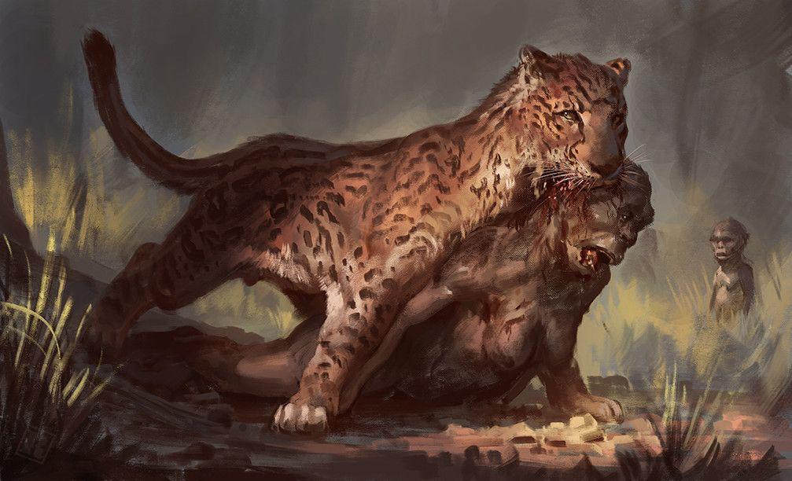
Development and the Life Course
What Evolution is
One component of evolutionary biology is to consider how different phases in the life course evolved
and how these different phases are inter-related. An organism’s life-course strategy is ultimately an issue
of the optimal use of energy supplies to maximize reproductive success. Selection therefore operates
on components of this balance, such as investment in growth, patterns of development, approaches to
reproduction, social structure, and patterns of ageing, all aimed at maximizing fitness within the environment of the population. Trade-offs must be made, given the limiting availability of energy and the
constraints of time—the risk of death from predation or disease before reproduction. Body size itself
is constrained by mechanical and thermoregulatory issues and nutrient availability. The element of evolutionary biology related to consideration of these general strategies and trade-offs is known as life -history theory. Humans have very distinct characteristics to their life-history traits, and these and their health implications.
Dinofelis and Australopithecus africanus

Slide 18
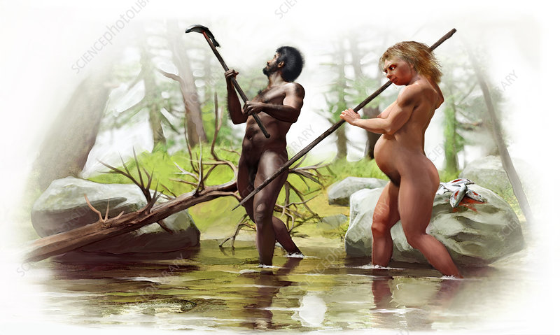
What Evolution is
Just as selection is the process of the interaction between inherited determinants of phenotype and
the environment, development is not a solely intrinsic process in which a single ovum grows into a
mature organism. Rather, the developing organism is subject to external influences which affect its later
phenotype. Vulnerability to such influences is enhanced during particular critical windows of development occurring at different stages according to the nature of the environmental stimulus.
At the most pathological level, exposure of the developing embryo to certain drugs can interferewith cell replication and interaction. For example, the anticancer drug methotrexate, which crosses the
placenta and interferes with folic acid metabolism, can cause spontaneous abortion (at high doses) and fetal defects (at moderate to low doses), particularly when given around the time of conception or in the first trimester of pregnancy. This is a pathological example, but environmental variation within the normal range can also affect fetal development. For example, exposure to severe famine during pregnancy can lead to offspring with a low birthweight, and as has lifetime health consequences, including a predisposition to a greater risk of non-communicable disease.
Development and the Life Course

Slide 19
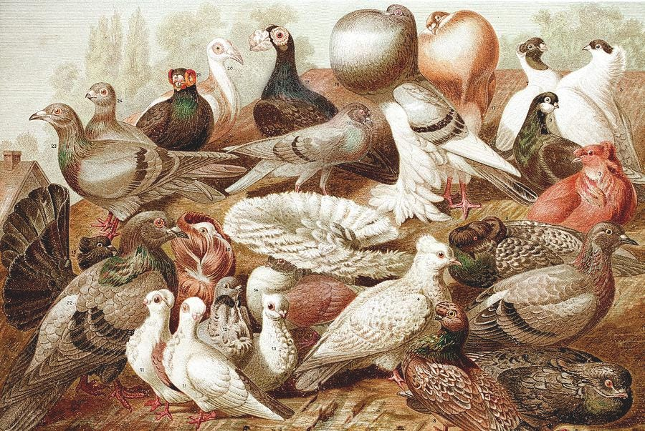
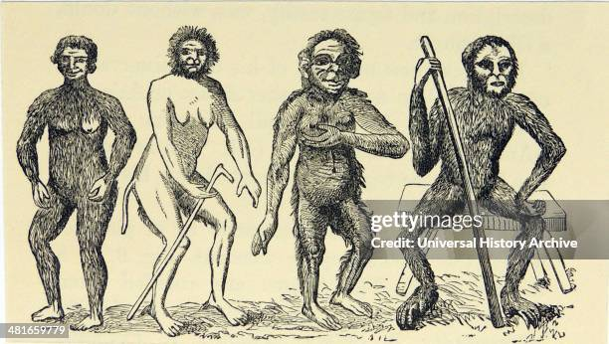
Variation and Inheritance
What Evolution is
The key features of the preceding discussion are the themes of variation and inheritance. Recognizing their importance was another of Darwin’s seminal contributions. Up to Darwin’s time, biologists (and doctors) had largely been concerned with classifying all living organisms; they therefore concentrated on
similarities—as defining the average for a species—rather than variations. Darwin shifted the focus to individual variation within a species. The most remarkable aspect of Darwin’s contributions and those of the other early evolutionists, including Alfred Russell Wallace, is that they made their observations in theabsence of any understanding of how variation and inheritance might operate.
Linnaeus's Anthropomorpha after his ''Systema naturae''. From ''Man's Place in Nature'', London, 1894, by Thomas Henry Huxley.

Slide 20
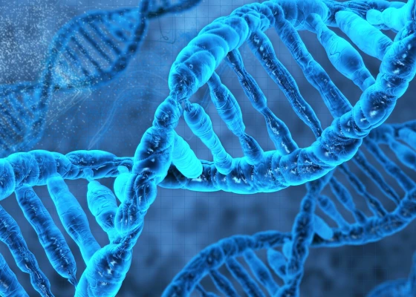
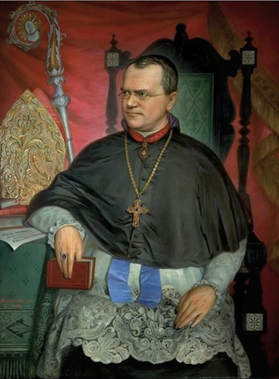
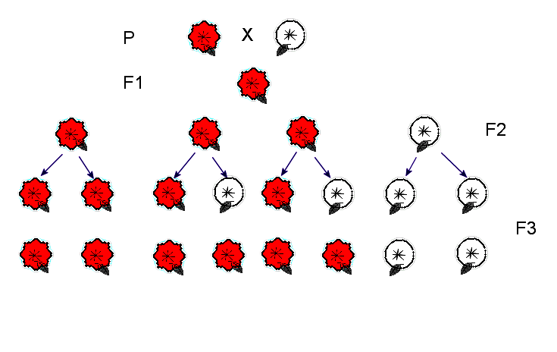
Variation and Inheritance
What Evolution is
It was the discovery of particulate inheritance—the idea that characteristics could be inherited as discrete units that led to the development of genetics and the study of mutation. The field was slow to develop because the principles of inheritance elucidated by Gregor Mendel were ignored for 20 years until their rediscovery at the beginning of the twentieth century. There were bitter disagreements between selectionist biologists and genetic biologists until the “Modern Synthesis” brought these two fields together in an integrated concept.
Johann Gregor Mendel- Brno

Slide 21
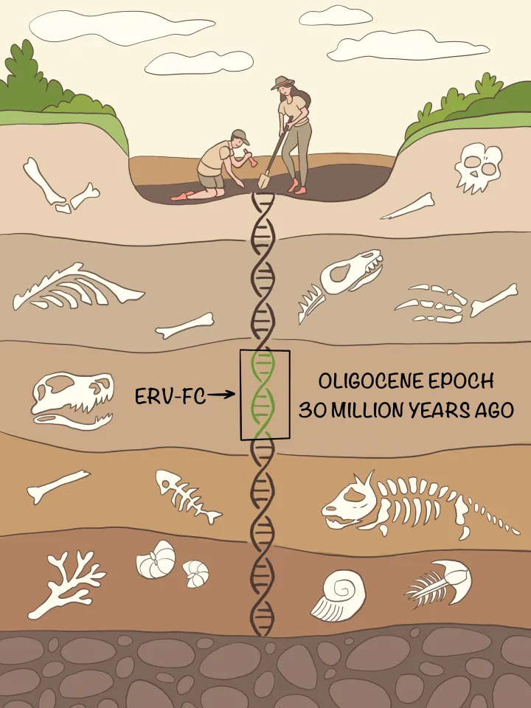
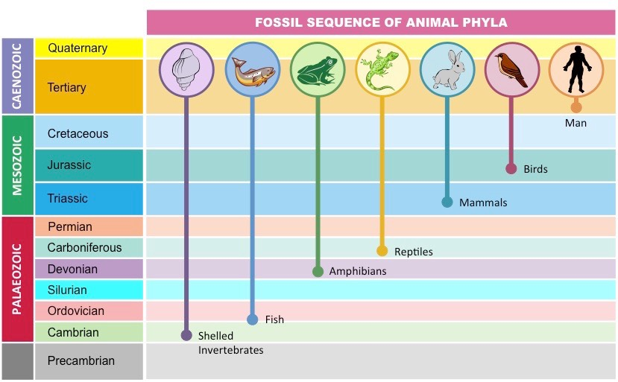
Variation and Inheritance
What Evolution is
The discovery of DNA and the power of molecular biology added impetus to this integration. In
particular these discoveries provided a mechanism for heritable variation, but molecular architecture
also provides powerful evidence for how evolution has progressed. When used in relation to speciation,
for example, the evidence from DNA goes far beyond the fossil records with which Darwin and his colleagues had to content themselves. We review how we can use our understanding of molecular biology both to explain and demonstrate evolution and to explore evolutionary history. Subsequent evolutionary research has essentially built on these fundamental principles to describe the origin of variation: the extent to which it is driven by mutation, the link between genotype and phenotype, the role of chance, the speed of evolution, the level at which selection operates, and the modes of inheritance.

Slide 22
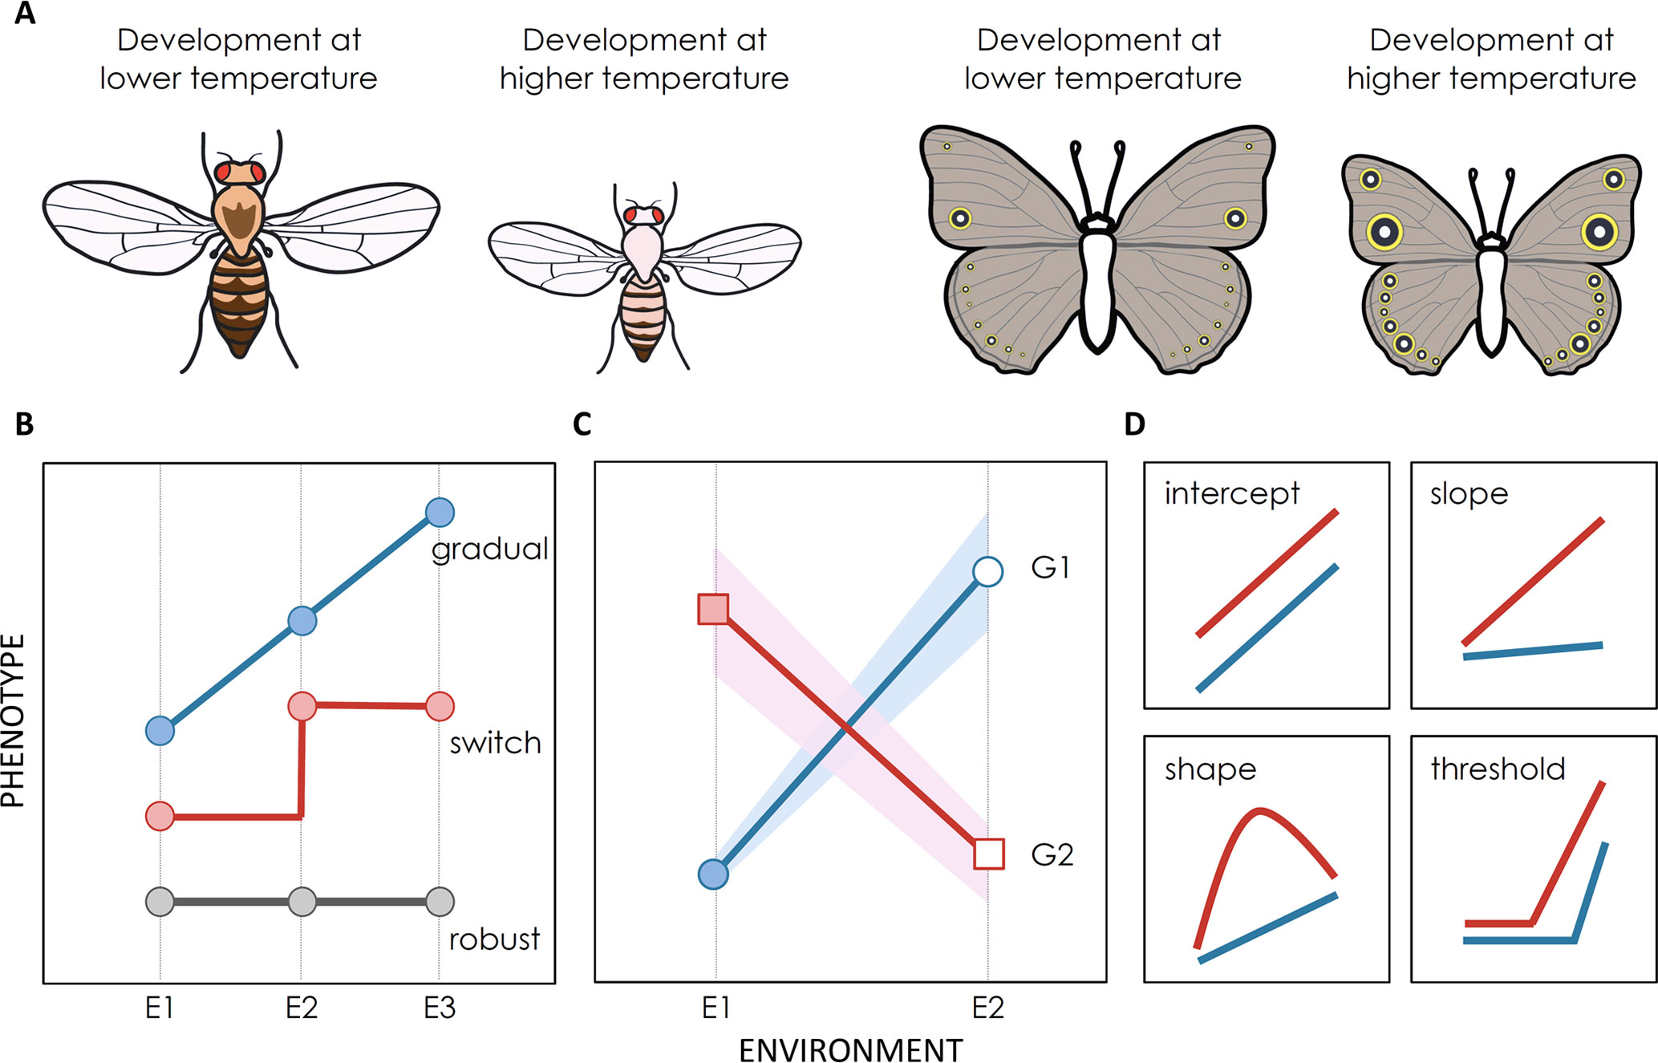
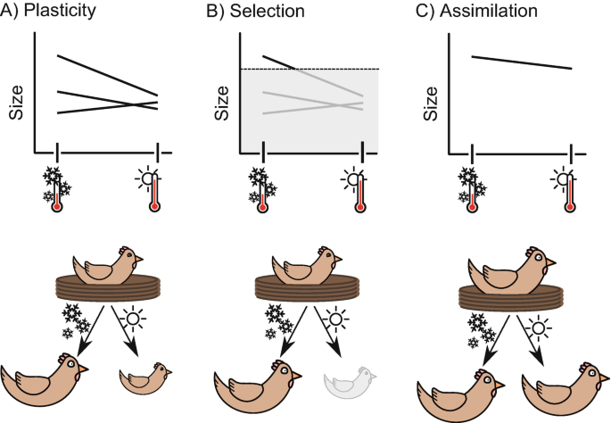
Development and the Life Course
What Evolution is
One area of biology was more difficult to include in the synthesis between molecular and selectionist
thinking, namely the impact of developmental processes operating from conception to maturity.
Development is not simply a matter of a fertilized ovum growing and dividing according to a preprogrammed mechanism. There are complex pathways of differentiation from a single cell into an
adult human and there are distinct components to the life course: from pre-implantation embryo, to
implanted embryo, to fetus, to neonate, to dependent infant, to juvenile, adolescent, and adult. In recent years, major progress has been made in integrating our understanding of developmental plasticity—a set of processes which have themselves evolved—a with the rest of evolutionary thought, and this remains perhaps the most contentious and complex component of evolutionary theory, with ongoing robust debate.

Slide 23
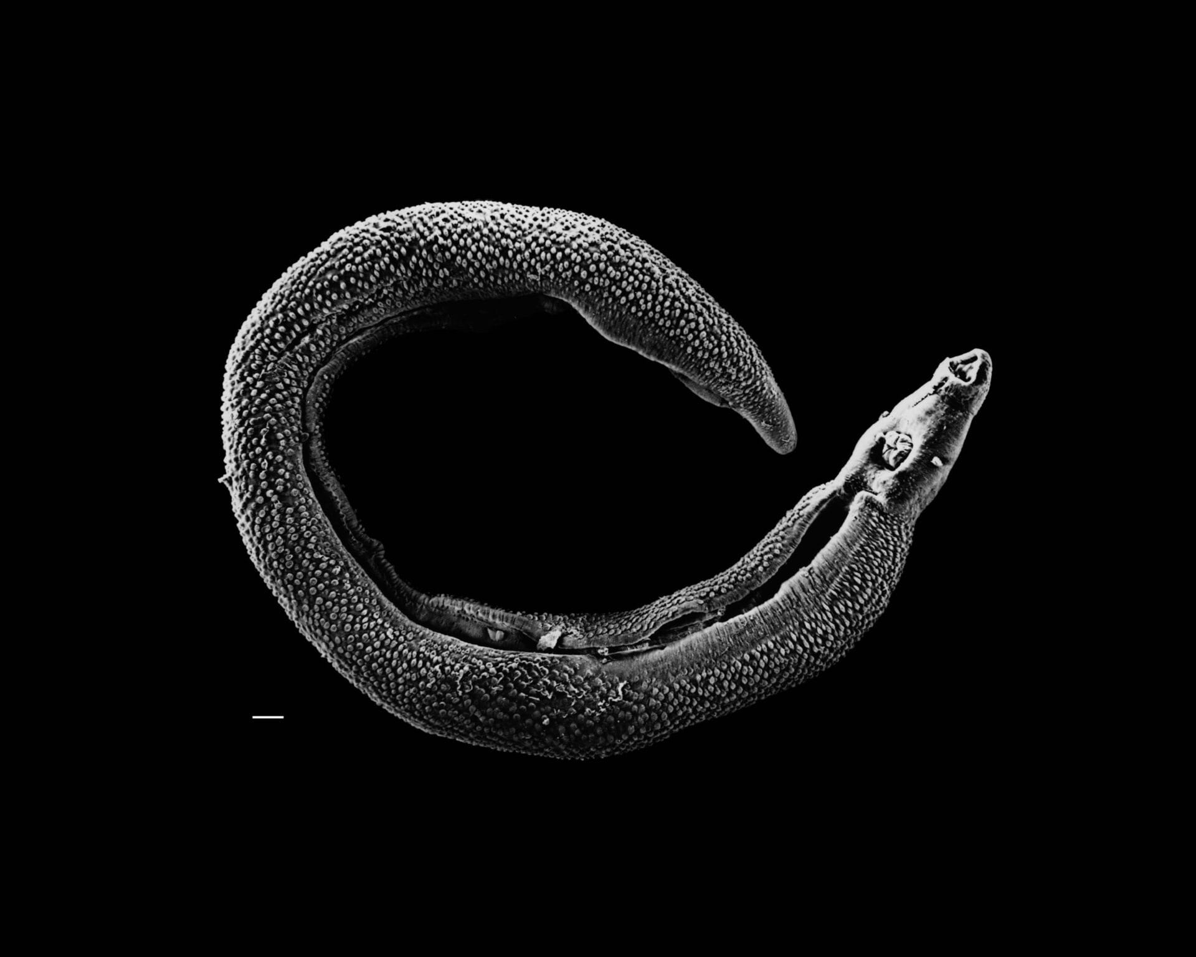
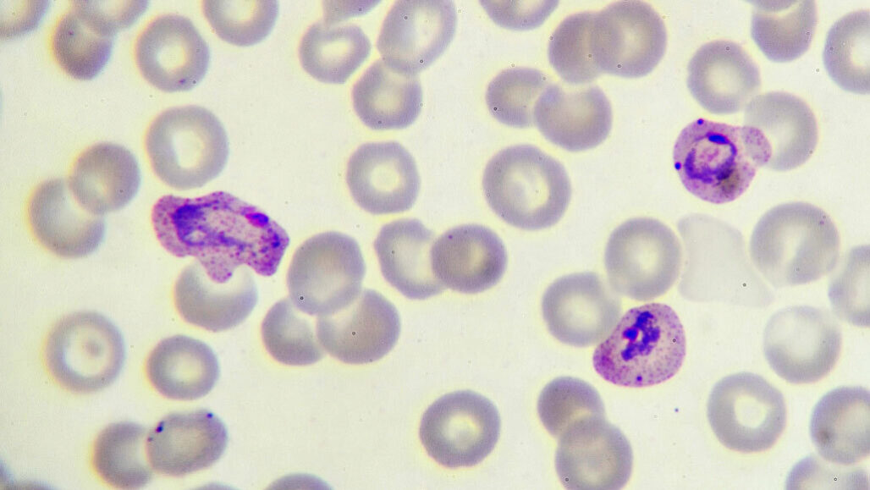
What Evolution is
Development and the Life Course
Organisms have different biological strategies at different times in their lives. Some organisms have very distinct forms and can have very complex life courses: for example, the human parasites causing malaria (a protozoan) and schistosomiasis (a worm) have very different body forms, or morphs, according to whether they are living in humans or in their invertebrate vectors (mosquitoes and water snails, respectively). Humans too have distinct phasesin their life courses. For example, the nutritional processes of the pre-implantation embryo, fetus, pre-weaning infant, and post-weaning child are all very different. The human fetus is nourished across the placenta so both placental physiology and the mother’s adaptations to pregnancy are attuned to maximize the nutrition of the fetus. The fetal gastrointestinal tract is quiescent until birth, at which time it is activated and uniquely adapted for the digestion of human milk, for example of lactose using lactase. After weaning, human gastrointestinal physiology changes yet again, one feature being that the bulk of the world’s population loses lactase activity.

Slide 24
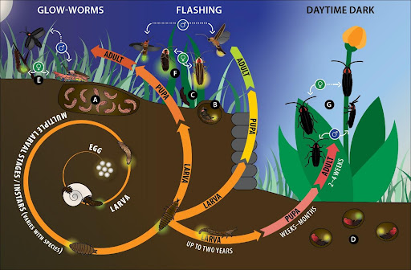
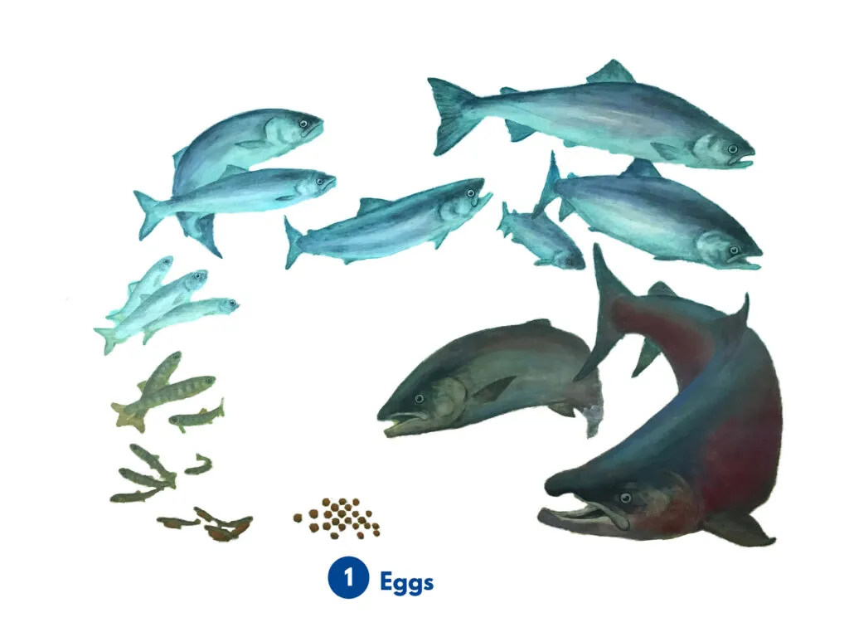
What Evolution is
Development and the Life Course
One component of evolutionary biology is to consider how different phases in the life course evolved
and how these different phases are inter-related. An organism’s life-course strategy is ultimately an issue
of the optimal use of energy supplies to maximize reproductive success. Selection therefore operates on components of this balance, such as investment in growth, patterns of development, approaches to reproduction, social structure, and patterns of ageing, all aimed at maximizing fitness within the environment of the population. Trade-offs must be made, given the limiting availability of energy and the constraints of time—the risk of death from predation or disease before reproduction. Body size itself is constrained by mechanical and thermoregulatory issues and nutrient availability. The element of evolutionary biology related to consideration of these general strategies and trade-offs is known as life-history theory. Humans have very distinct characteristics to their life-history traits, and these and their health implications.
Salmon
Firefly

Slide 25
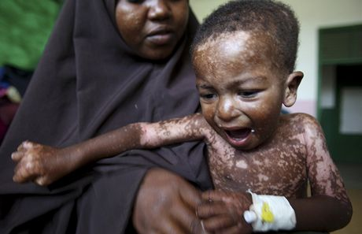

What Evolution is
Development and the Life Course
Just as selection is the process of the interaction between inherited determinants of phenotype and
the environment, development is not a solely intrinsic process in which a single ovum grows into a mature organism. Rather, the developing organism is subject to external influences which affect its later. Vulnerability to such influences is enhanced during particular critical windows of development occurring at different stages
according to the nature of the environmental stimulus. At the most pathological level, exposure of the developing embryo to certain drugs can interfere with cell replication and interaction. For example, the anticancer drug methotrexate, which crosses the placenta and interferes with folic acid metabolism, can cause spontaneous abortion (at high doses) and fetal defects (at moderate to low doses), particularly when given around the time of conception
or in the first trimester of pregnancy. This is a pathological example, but environmental variation within the normal range can also affect fetal development. For example, exposure to severe famine during pregnancy can lead to offspring with a low birthweight, and as we will this has lifetime health consequences, including a predisposition
to a greater risk of non-communicable disease.

Slide 26
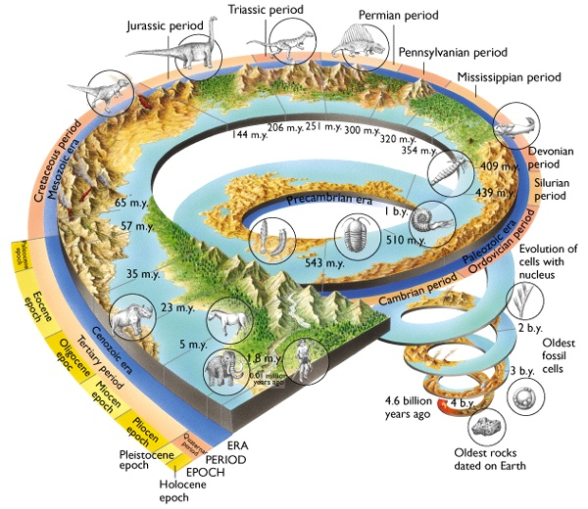
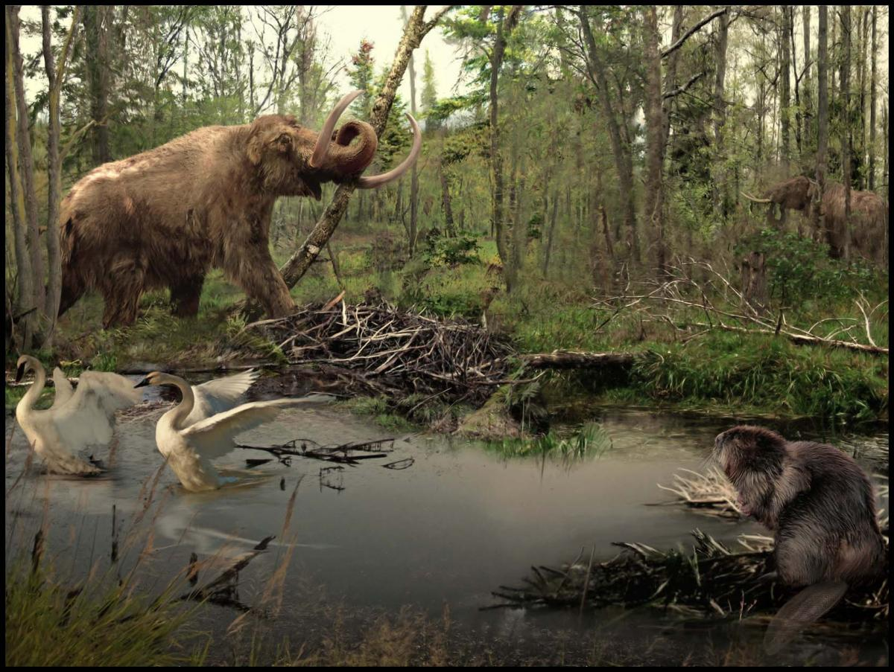
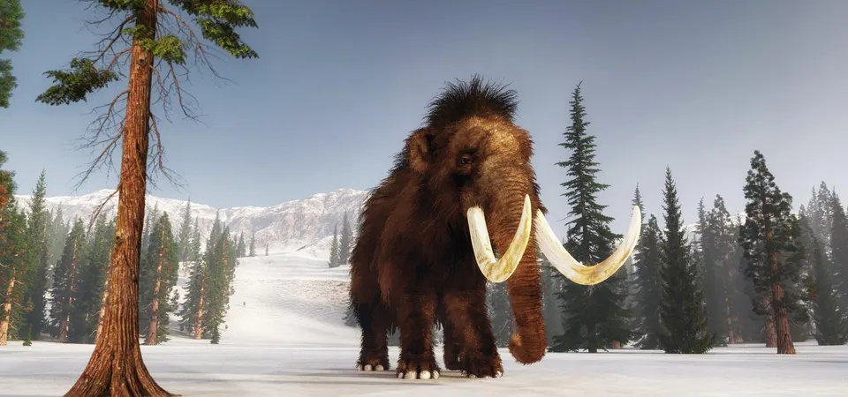
Time
What Evolution is
Organisms face challenges over a number of timescales. These include immediate physical challenges, such as intraspecific competition for energy and reproductive opportunity, attack by predators (themselves engaged in energy harvesting), and
changes in the environment. The latter may be short term (e.g., daily temperature fluctuations), medium term (e.g., seasonality of food availability), or long term (e.g., climate change causing the disappearance of preferred food sources or habitat).
Organisms have evolved a hierarchy of responses to these challenges. Some classical homeostatic responses are very rapid and highly reversible over seconds to hours, for instance those mediated by the central nervous and endocrine systems. Some
involve structural change or long-term readjustment of set points for homeostatic feedback systems (called rheostasis or homeorhesis), and these operate over hours. Many longer-term but within-lifetime effects are initiated in early life through the processes of developmental plasticity. Yet other responses are beyond the timescale of individual lifetimes and involve natural selection, resulting in genetic change over a few or many generations.

Slide 27

Time
What Evolution is
An example of a short-term (homeostatic) response is sweating or shivering in response to changes in temperature. Increased muscle size, perfusion with blood, and changes in myofiber metabolism after physical training provide an example of a medium- term and reversible plastic response affecting tissue function or organization. Stunting represents an example of developmental plasticity. Children who are chronically undernourished, either in utero or in infancy, may irreversibly
reduce their degree of somatic growth. Reduced body mass during childhood and adulthood reduces nutritional needs, thus allowing the individual to better cope with an environment that is likely to be nutritionally limited over their life course. Here we have the evolved processes of adaptive developmental plasticity acting chronically within a life course to promote survival. While the propensity to be stunted in response to developmental undernutrition is an inherited capacity, stunting itself is generally not. Nevertheless, stunted mothers may give birth to children who are smaller because of the phenomenon of maternal constraint, and due to the similarity of the environment to which mothers and children are exposed one often sees intergenerational stunting.
.

Slide 28

Time
What Evolution is
Humans from lineages that remained in tropical Africa from our initial appearance as a species have generally different body shapes from those from lineages that have lived in higher- latitude environments for many millennia. Here selective pressures are likely to have favored different body shapes to aid thermoregulation in the very different climates these lineages have faced. As another example of temporally different classes of response, consider the hierarchy of responses affecting that most extensive and sensitive of human organs— the skin. We respond to a pinprick with immediate withdrawal, on a timescale of less than a second, mediated by cutaneous nociceptors. On a slightly longer timescale of minutes to hours, another insult— ultraviolet radiation— causes sunburn characterized by erythema, pain, and edema. That also invokes a behavioral avoidance response: we cover our skin. The sensitivity of skin to ultraviolet radiation is determined by its melanin content, and for many people with light skin the melanin content can be increased by a medium- term adaptive response that increases output from melanocytes, so a suntan develops over days to weeks. And long- term genetic adaptations of human populations to the amounts of sunlight at different latitudes have created a variety of human skin colors caused by variation in the amount and type of melanin in the skin. It is likely that the selective pressure for lighter skin color in populations living at higher latitudes arose from the need to preserve vitamin D synthesis in the skin in regions with lower availability of sunlight. However, this can result in vitamin D deficiency in darker- skinned migrant populations, especially when traditional concealing clothing is worn by women

Slide 29

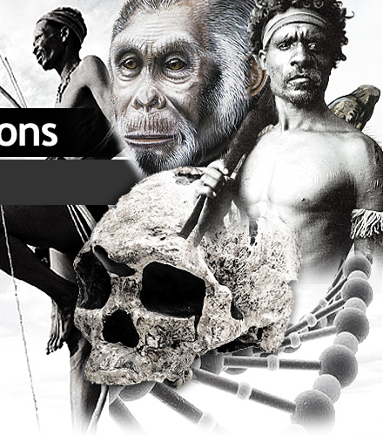
Time
What Evolution is
It is also important to appreciate how responses on the shorter timescales can be modified by an
individual’s previous developmental experience or evolutionary history. For example, susceptibility to
sunburn is modified by past exposure (suntan) and by population origin (skin color). Susceptibility to
the effects of milk consumption is modified by developmental stage (lactase is lost during development)and by ancestral nutritional history. These examples underline the importance of a complete knowledge of an individual’s history for understanding their current health status

Slide 30
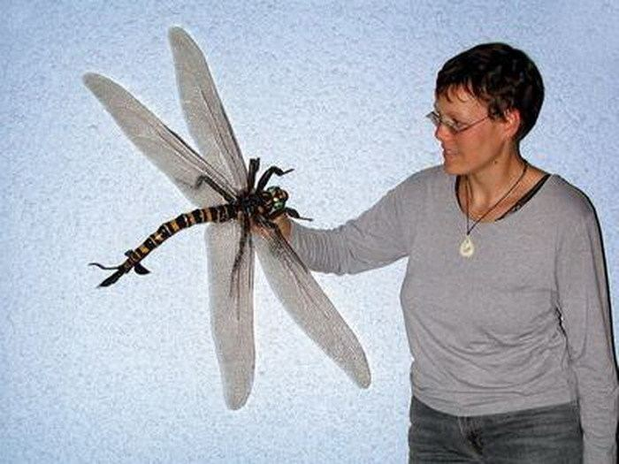
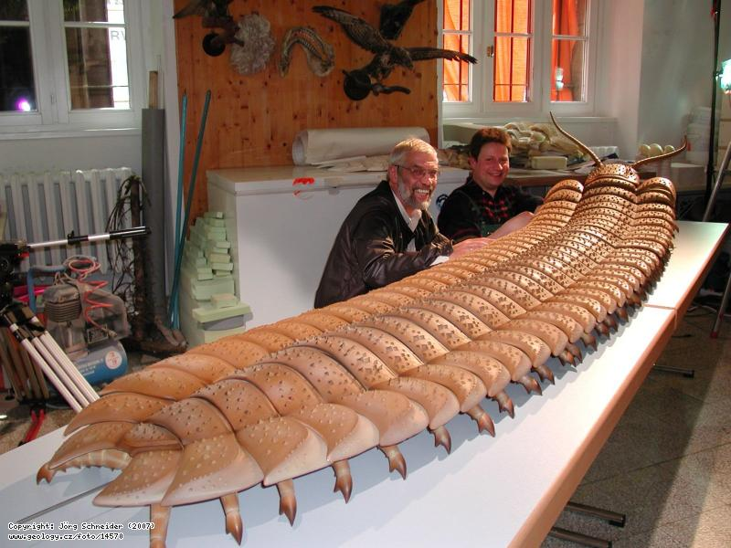
Constraints
What Evolution is
Evolution is not without limits. Such constraints may arise from the nature of physical processes. For example, insects are perhaps fortunately for human survival on the planet—limited in size by gravity, the mechanics of their exoskeleton, and the physics of oxygen diffusion along their tracheal network. Or constraints can arise because evolution generally works in an incremental way: for example, the human eye is poorly “designed,” but gradual evolution towards the structure of the superficially similar but optically superior octopus
eye would require nonfunctioning intermediate forms, so we have retained the organizational structure of our eye in a form modified from functioning eyes in our precursor lineage. We must remember that most of the discussion so far has been about qualitative aspects of the environment, but constraints will also act when there is a mismatch between the rate of environmental change and that at which natural selection can operate, or simply from an extreme degree of environmental change.
Arthropleura
Meganeura

Slide 31
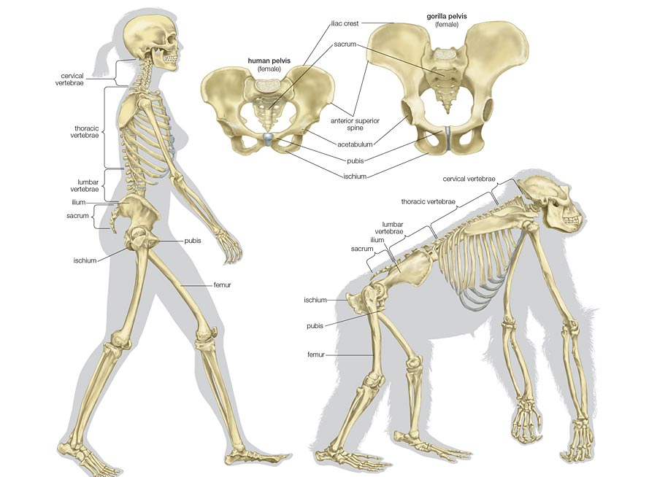
Constraints
What Evolution is
The complexity of the link between the genotype and phenotype places all sorts of constraints on how selection can operate. As will be reviewed the concept of a single gene relating to a single trait is in general misleading, as coding genes can produce multiple products due to alternative splicing. The growing understanding of regulátory networks within the genome highlights the importance of the phenomena of epistasis (multiple genes acting together to produce a trait) and pleiotropy (one gene has effects on multiple trait). Single gene effects may lead to mutations and disease, but selection operates on the integrated phenotype and this creates limitations on the rate and nature of change between generations. The shape of the human pelvis is quite distinct from that of other apes. This is because we are bipedal and the mechanics of efficient walking and running have led to selection of relatively rotated hips and a narrower pelvis. Yet there has to be a trade-off, because humans are also distinguished by a large brain. Thus if birth occurred at the same stage of neuronal maturation as in other apes, with well developed motor function at birth, the fetal head would be too large to pass through the pelvic outlet. Hence, while other apes are precocial (having relatively mature offspring at birth capable of a level of independent activity), humans have developed
secondary altricial characteristics and are extremely dependent on the mother for a long period after birth. Here is an example where a constraint was imposed on how human evolution could proceed by the development of bipedalism early in the evolution of the hominin clade. There are also constraints imposed by biochemical and physiological processes, which have in turn been imposed by the past evolution of the lineage. For example, human physiology has evolved such that we cannot live and reproduce successfully above about 5000 m, and cannot survive at all without supplementary oxygen above 9000 m. In contrast, the bar-headed goose migrates regularly over
the Himalayas at altitudes of up to 10,000 m. Constraints and exaptations (features that perform a function but were not initially selected for
their current use; for example, the three small bones of the middle ear that originally evolved in jaw- boned fish as part of their jaw hinge mechanism), and “historical contingencies” (chance events thathave determined, for example, why terrestrial life is based on l- rather than d-amino acids and why the human and cephalopod eyes look superficially similar but have fundamentally different architectures), have also played a role in determining our form and function.

Slide 32
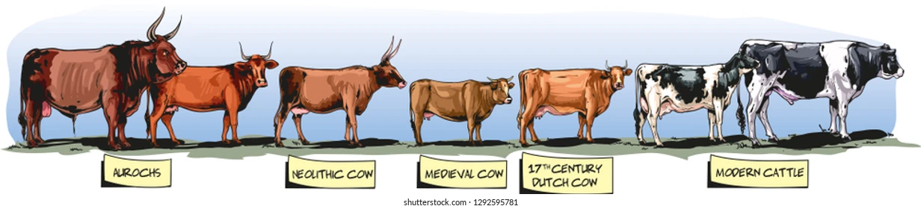
We are not alone
What Evolution is
Humans do not live in isolation from other species. Here it is useful to introduce the concept
of coevolution, a process where two species exert reciprocal selective pressures which affect the evolution
of both. The lactase story shows how some humans have evolved to live alongside cows, and after 10,000 years of artificial selection for milk or meat yield, modern breeds of Bos taurus are very different from the wild cattle first domesticated by Neolithic humans. Another example of coevolution is a predator–prey relationship in which the prey evolves some defensive or escape mechanism and the predator in turn evolves a means of overcoming the prey’s response. In predator–prey interactions, coevolution can lead to an evolutionary arms race in which the target species must continually change to maintain its fitness relative to the predator species it
is coevolving with. This is the so-called Red Queen effect, named after the character in Lewis Carroll’s book Through the Looking Glass who complains of always having to run to stay in the same place

Slide 33

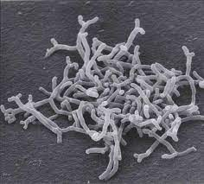
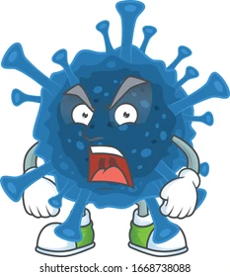
We are not alone
What Evolution is
The biggest group of organisms affecting our biology, for good or bad, is our associated microorganisms. Infectious disease was a major cause of mortality until the introduction of mass vaccination programs and antibiotics very recently in human evolutionary history, and the threat is still with us: the last few decades have seen the emergence of new viral diseases, such as acquired immune deficiency syndrome (AIDS) and severe acute respirátory syndrome (SARS), as well as the resurgence
of bacterial diseases once thought to be conquered, such as tuberculosis, now in a lethal multidrugresistant form. Humans, in common with other vertebrates, have evolved an adaptive immune system to resist infection with microorganisms, and our antimicrobial phenotype has recently been extended by the use of biotechnology to develop antibiotics and antimicrobial and antiviral drugs. But our pathogens are also engaged in this arms race, and can use the advantages of vast population
sizes and simple genomes to rapidly evolve mechanisms for evading immune surveillance and neutralizing our antimicrobial drugs. The eventual outcome of that competition is often uncertain. Of course, not all microorganisms are pathogenic. Some, such as yeasts and lactobacilli, have achieved a certain utility in food and beverage preparation, and others are used as chemical reactors in industrial processes after fierce bouts of artificial selection to increase their yield. Still other microorganisms are engaged in a mutual relationship with humans not dissimilar to that between humans and their domesticated animals. The many hundred species of bacteria that comprise the human gut flora perform critical functions, including digestion of some food components, production of vitamins, protection against pathogenic microorganisms, and fine-tuning of the immune response, in return for life in a stable and protected environment with a regular supply of nutrients.
The consequences for our health of perturbations in the composition or activity of the gut flora are being increasingly recognized, and are leading to new insights and approaches to therapy (e.g., fecal transplants).
Bifidobacterium
Covid

Slide 34

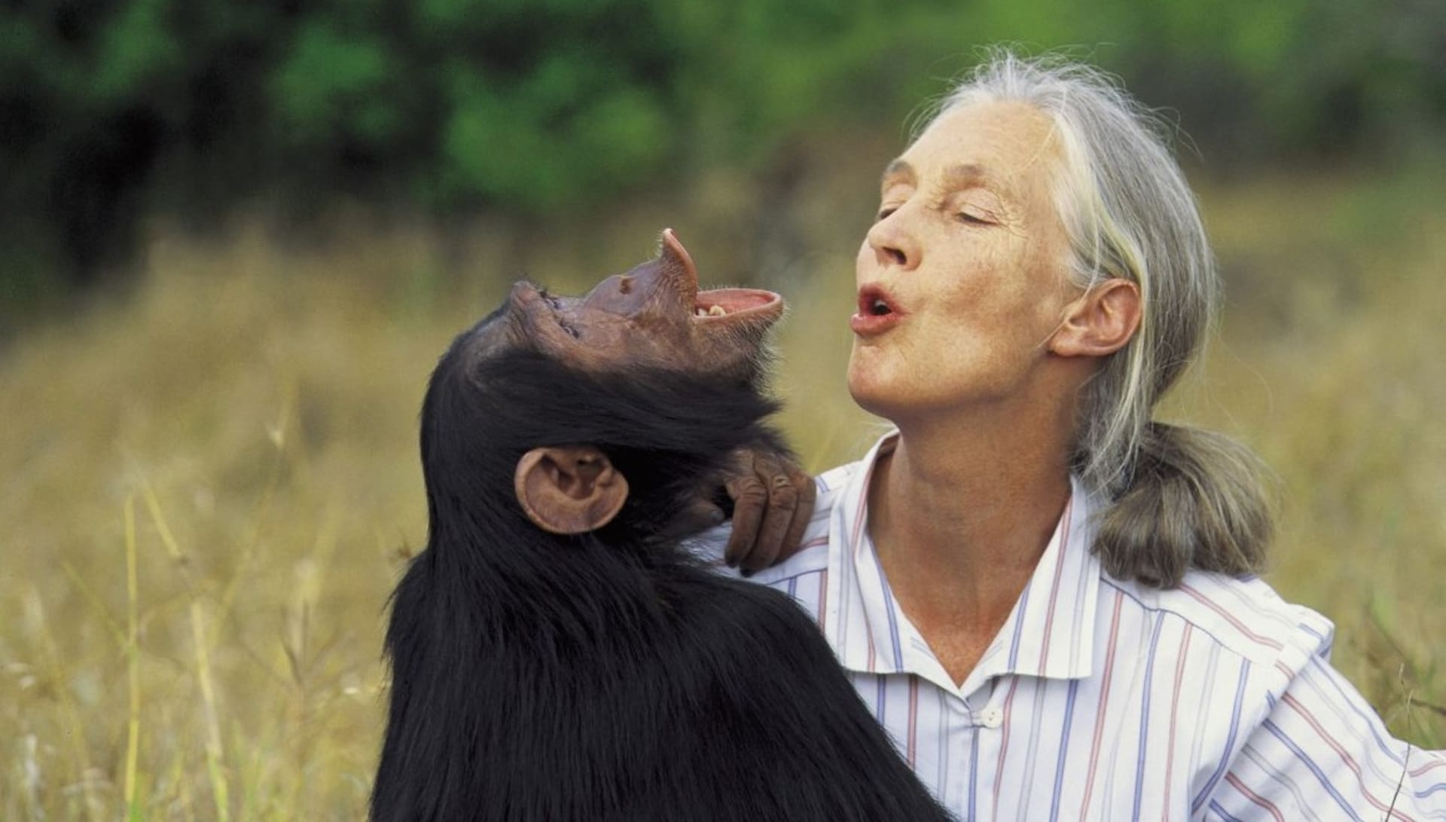
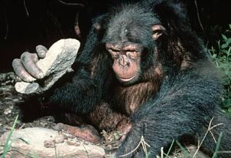
Culture and Gene-Culture Coevolution
What Evolution is
Culture can be defined as the sum of socially transmitted information obtained through the processes of teaching, imitation, and other forms of social learning. This includes not only skills involving physical constructs such as tools and technologies, but also art forms, beliefs, and the social mores of a species. Culture itself evolves, but often horizontally within a generation, rather than solely vertically as in biological evolution. Humans have particular and unique capacities to develop material, behavioral, and social cultures, because of their evolved cognitive, language, and manual capacities. But just as culture evolves, so too can it influence biological evolution, and vice versa—this interaction is known as gene–culture coevolution. The example of the development of lactase persistence is a classic example. Humans,
through their cognitive and social capacities, developer the cultural practice of herding and milking cows. This in turn led to the biological evolution of a lineage with persistent lactase expression, which in turn favored more dairy husbandry, and so on.

Slide 35
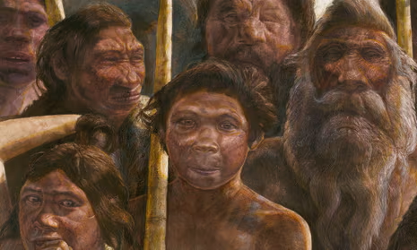
How Evolutionary Arguments Fit Alongside Other Biological Perspectives
What Evolution is
When considering biological phenomena it is important to appreciate that evolutionary questions
cannot and should not be considered separately from other perspectives. A valuable approach is that suggested by Niko Tinbergen, an ethologist
and Nobel laureate, who proposed a set of four questions originally used to interrogate the origin and significance of a behavior. The same four questions can be applied to any biological phenomenon, and they emphasize how evolutionary analysis should be as much a part of biological thought as physiology or any other basic science. Tinbergen’s four questions are as follows:
1. What is the mechanism underlying the phenomenon
of interest?
2. How does the phenomenon develop during the
lifetime of the individual? That is, what is its
ontogeny?
3. What is the function of the phenomenon? How
does it serve the organism’s interests?
4. How did the phenomenon evolve? What is its
evolutionary history, are there analogous phenomena
in other species, and what is their evolutionary
relationship to the human? What is the
evidence for a selected origin?
Another way of considering this range of perspectives is to consider causation at two levels. At one level there are the molecular, anatomical, physiological, and pathophysiological mechanisms that lead to any biological phenomenon. Thus, insulin resistance leads to type 2 diabetes mellitus, infection with the human immunodeficiency virus (HIV) may progress to AIDS, a vertebral disk prolapse leads to back pain and sciatic nerve injury, and inflammation of the appendix leads to appendicitis. These are called proximate causes. But there is another level of explanation:
why is it that some people are prone to develop obesity and insulin resistance, why is it that humans are susceptible to HIV infection, why is it that so many humans get back pain, and why do we have the appendix, a useless organ that gets infected? These questions are about ultimate
causes: the answers lie in the domain of evolutionary biology.

Slide 36
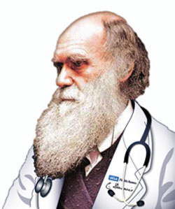
Evolution and Medicine
Modern biology rests on two related concepts. The first is the description of the gene and its structure; the second is the description of the evolution of the whole organism. Despite their close inter-relationship, it is only recently that genetics and evolutionary biology have been seen to be fully compatible. This recognition, which occurred in the middle of the twentieth century, is so important that it is termed the Modern Synthesis. Although this synthetic view is well understood in the biological sciences, its relevance to human biology and medicine is still emerging.
Medical science has become dominated by relatively reductionist approaches. That is, it hastended to regard individual levels of organization
(the gene, the cell, the tissue), or individual organ systems, or the different disciplines (physiology, biochemistry, anatomy) as quite distinct.
This approach, while necessary at one level, is not good for medicine or for the patient. Just as an integrated holistic approach to medical care and public health is optimal, so a multilevel approach aids our understanding of the etiology and mechanisms of disease.
An evolutionary perspective changes the way doctors think about health and disease. It not only helps to identify research questions but also allows engagement with individual patients in ways that promote understanding of their current health status and also contribute to the design of appropriate interventions in public health. Because so much of public health depends on an ecological perspective—that is, an understanding
of the social and broader environments—evolutionary biology also has particular application in public health,

Slide 37
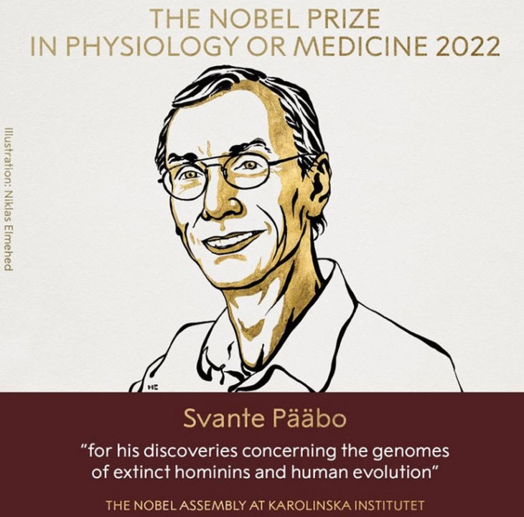
Evolution and Medicine
Human biologists and anthropologists apply evolutionary principles as a fundamental component in their research and teaching, but their focus is, by definition, on the normal human condition. Medicine has been slow to recognize the importance of such thinking to concepts of normality versus abnormality, the limits of adaptation, and the consequences of maladaptation in the etiology of disease. In medicine we are concerned primarily with the current state of the individual, but to understand that state we must understand that person’s biology and the context in which she or he lives. Traditionally, taking a medical history has focused on the story of the patient and their environment from the time of their first symptom An evolutionary perspective ensures this integration: in this lecture we will see how an evolutionary perspective assists the doctor or health professional in developing such an approach and in placing individual components of human biology in perspective.
The immediate determinants of an individual’s biological (health) status—that is the world they live in (the environment), how they live in it (their behavior), and how they function (their physiology)—are all proximate causes. Modern medicine has to a large extent been concerned with such proximate causes and with defining whether a given phenotype, or indeed a patient’s response, is “normal” or not. We are concerned primarily with ultimate causes: how evolution has led to the persistence of a particular trait or set of traits. This leads to further questions about whether the adaptation is helpful or not under present circumstances, and whether the limits of adaptability have been
exceeded.

Slide 38
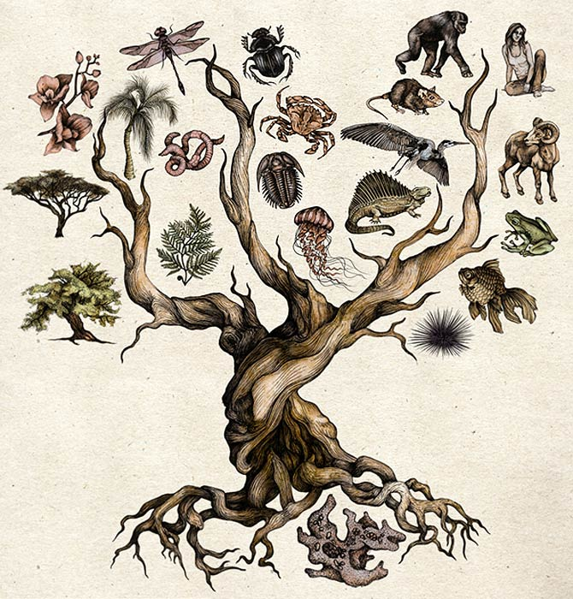
Thank you for your attention!

