Slide 1
Dyslexic pearson problem

Slide 2
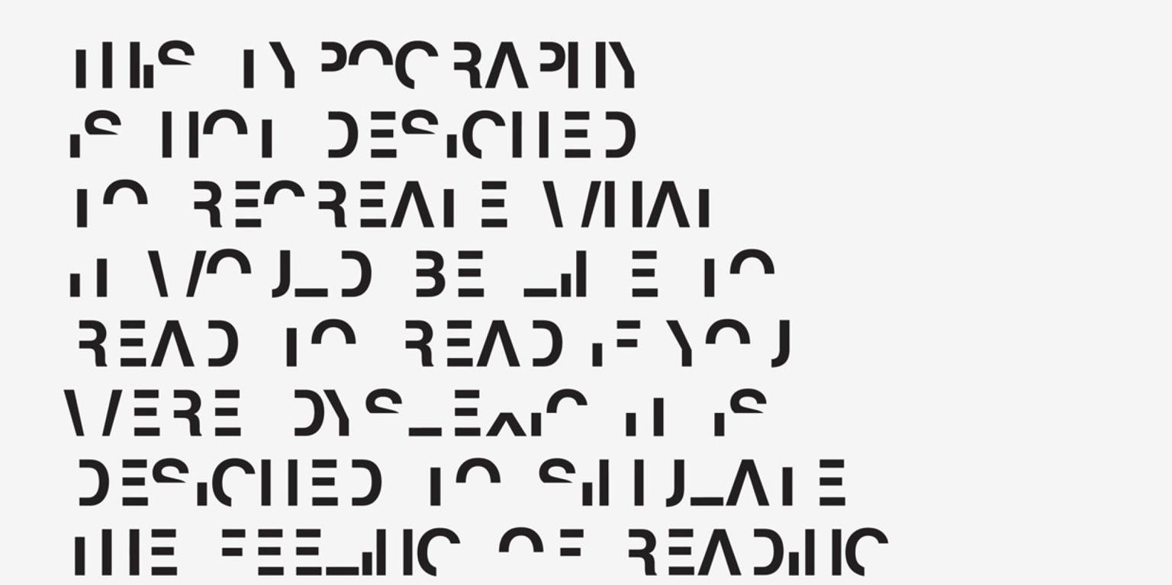
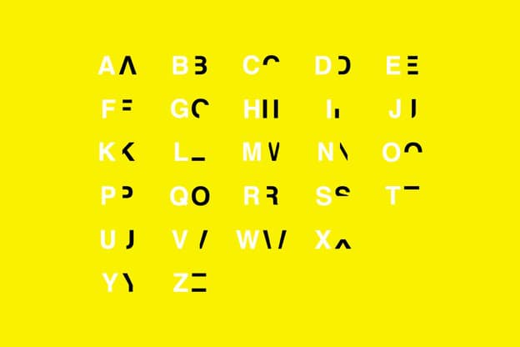
This is how a dyslexic person sees the text being read – difficulties in decoding
(in the yellow table you can see its wrong encoding for individual letters of the alphabet)

