Slide 1


LUMBAR PUNCTURE, NEUROINFECTION
Department of Children’s Infectious Diseases
MUDr. Adriana Braunová Ph.D.

Slide 2
CLINICAL MANIFESTATION OF CNS INFECTIONS
Acute encephalitis – impaired consciousness prevails, possibly focal symptoms; meningeal symptoms minimal (purulent rare – secondary with sepsis; non-purulent – perivascul. lymphoplasmacytic infiltrates)
Myelitis – Rarely a standalone condition / encephalomyelitis – fever, paraparesis weak … spastic
Lesions processes (subdural empyema, epidural abscess, brain abscess) - per continuatem, hematogenous spread
Classification by predominant symptoms - but impact is often combined
Acute purulent meningitis – inflammatory impact on the meninges (purulent discharge), predominance of polymorphonuclear cells in the cerebrospinal fluid
Acute serous meningitis – inflammatory impact on the meninges resulting in exudative serous inflammation, predominance of mononuclear cells in the cerebrospinal fluid
Chronic meningitis – long history (weeks / months), abnormal findings in the CSF lasting at least 4 weeks

Slide 3
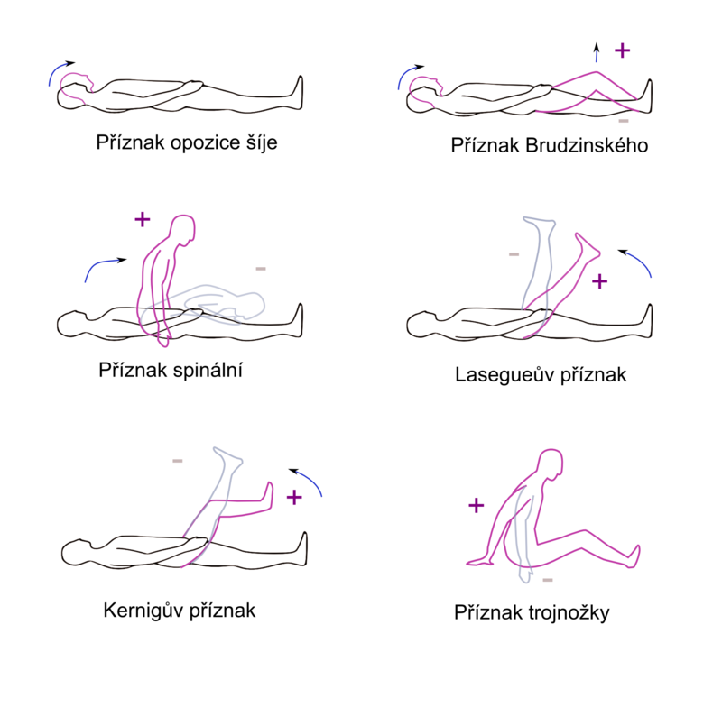
Etiology of purulent meningitis
Examining meningeal signs
Newborns / infants ( < 3 months)
Childern
Adults
Adults > 50 years
Streptococcus agalactiae | E-Coli (+ G⁻ agens)
Listeria monocytogenes
Streptococcus pneumoniae | Neisseria meningitidis
Haemophilus influenzae
Streptococcus pneumoniae | Neisseria meningitidis
Staphylococcus aureus
Streptococcus pneumoniae | Neisseria meningitidis
Listeria monocytogenes | G⁻ agens, Staphyl. aureus

Slide 4
Etiology of aseptic meningitis
Bacterial pathogens in aseptic meningitis
spirochetes – B. burgdorferi s. l., T. pallidum,
L. interrogans)
Rickettsiae, legionella, anaplasma
Mycoplasma pneumoniae
Enteroviruses | Arboviruses
Herpetic viruses | Respiratory viruses
Spirochetes | Rickettsiae, Legionella
Aspergillosis | Candidiasis
Cryptococosis | Echinococosis
Cysticerkosis | Amebiasis

Slide 5
WHEN TO PERFORM
A LUMBAR PUNCTURE (LP)
HISTORY OF HEALTH RISKS
(perinatal history, a tick latched on, epidemiological history, travel history, etc.)
SUSPECTING A NEUROINFECTION
– WE ALWAYS perform LP
Positive meningeal signs, fever, photophobia, cephalea, vomiting, phonophobia
Focal neurological findings, impaired consciousness, convulsions, hemorrhagic symptoms
CAUTION - newborn (non-specific signs, thermoregulation disorder, muscle tone, encephalic crying, does not feed properly.)
DIFFERENTIAL DIAGNOSTICS OF NEUROINFECTION
Brain tumors, post-med reactions, convulsions, migraines, intracranial hemorrhaging, insolation, trauma, intoxication, thrombosis
Meningism – signs of meningeal irritation without the inflammatory correlation in CSF - e.g. at high fevers - when the fever subsides, the meningeal symptoms also subside.

Slide 6
CONTRAINDICATION – LP
Intracranial HT – risk of spinal cord conus
Severe coagulation disorders, skin lesions at the LP site, malformations of the L spine
Circulatory and ventilatory instability of the patient
PRIORITIZING IMAGING METHODS
Interdisciplinary cooperation - neurologist
(subacute conditions, or EEG)
Risk of delay in drug therapy
(ATB < 1 hour!)
INDICATION – meets 1 criterion
  Focal neurological findings
(X paresis of the cranial nerves)
  Newly occurring convulsions (max. 7 days)
  Impaired consciousness (GCS < 10)
  Significant immunodeficiency
  CZ – papilledema on OP (with focal neurological findings)
Consider also: brain ultrasound (enlarged fontanelle)

Slide 7
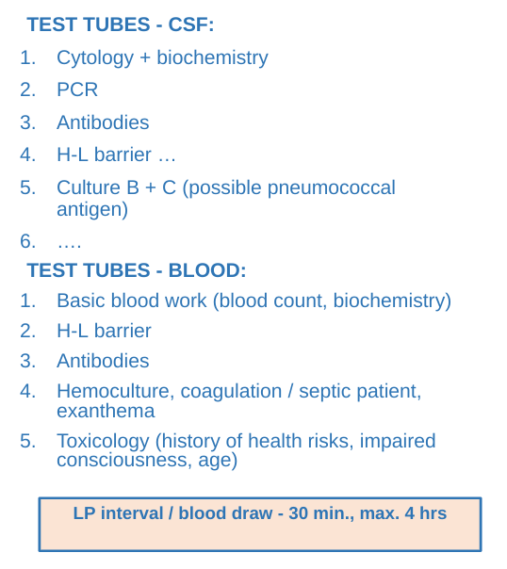
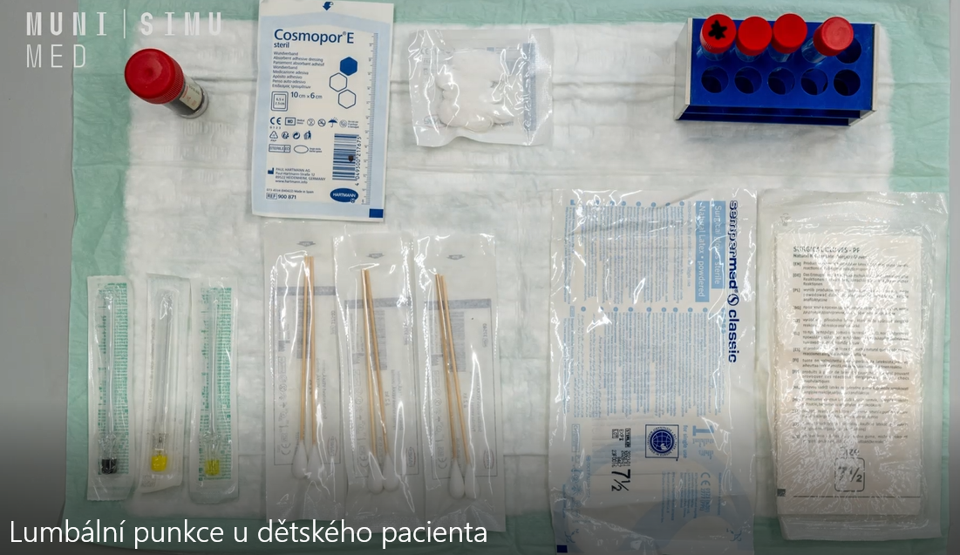

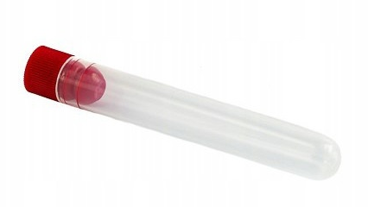
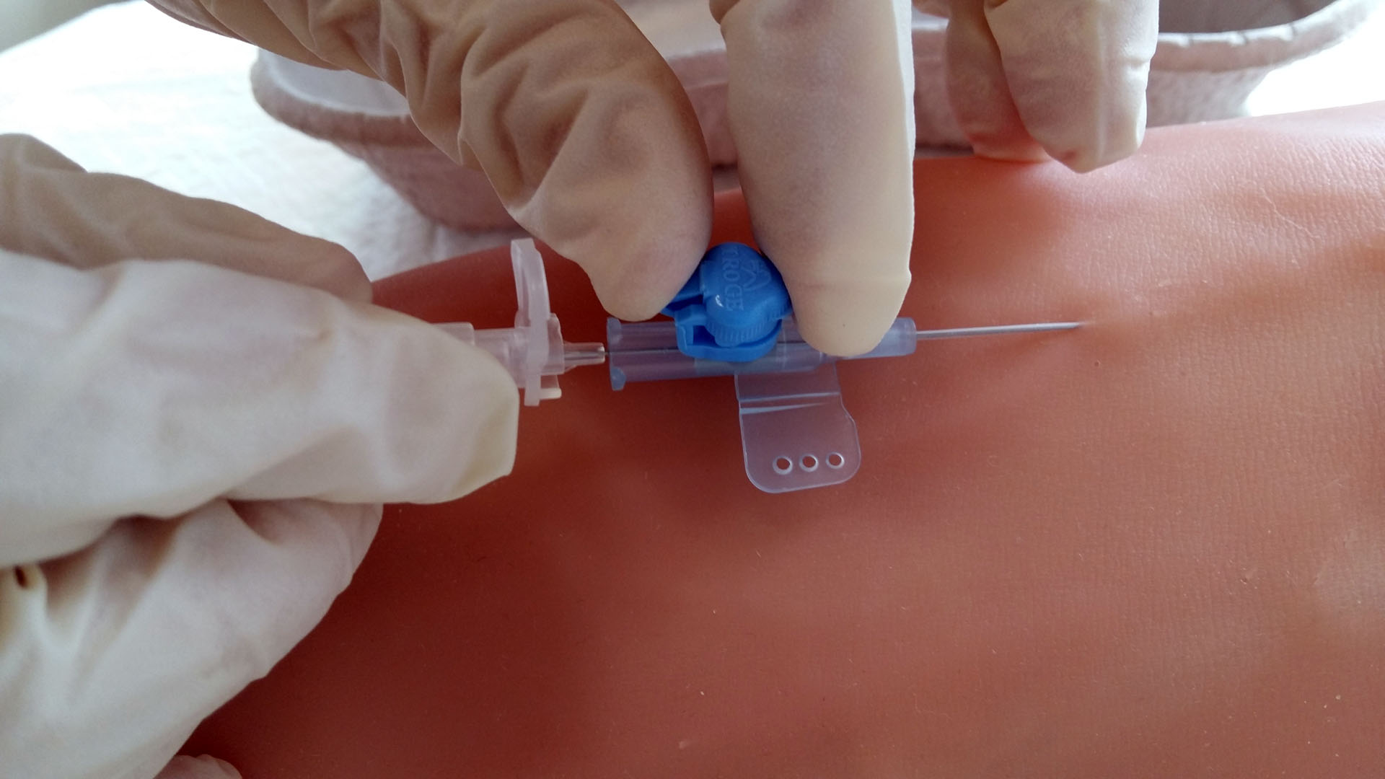
LP PREP

Slide 8
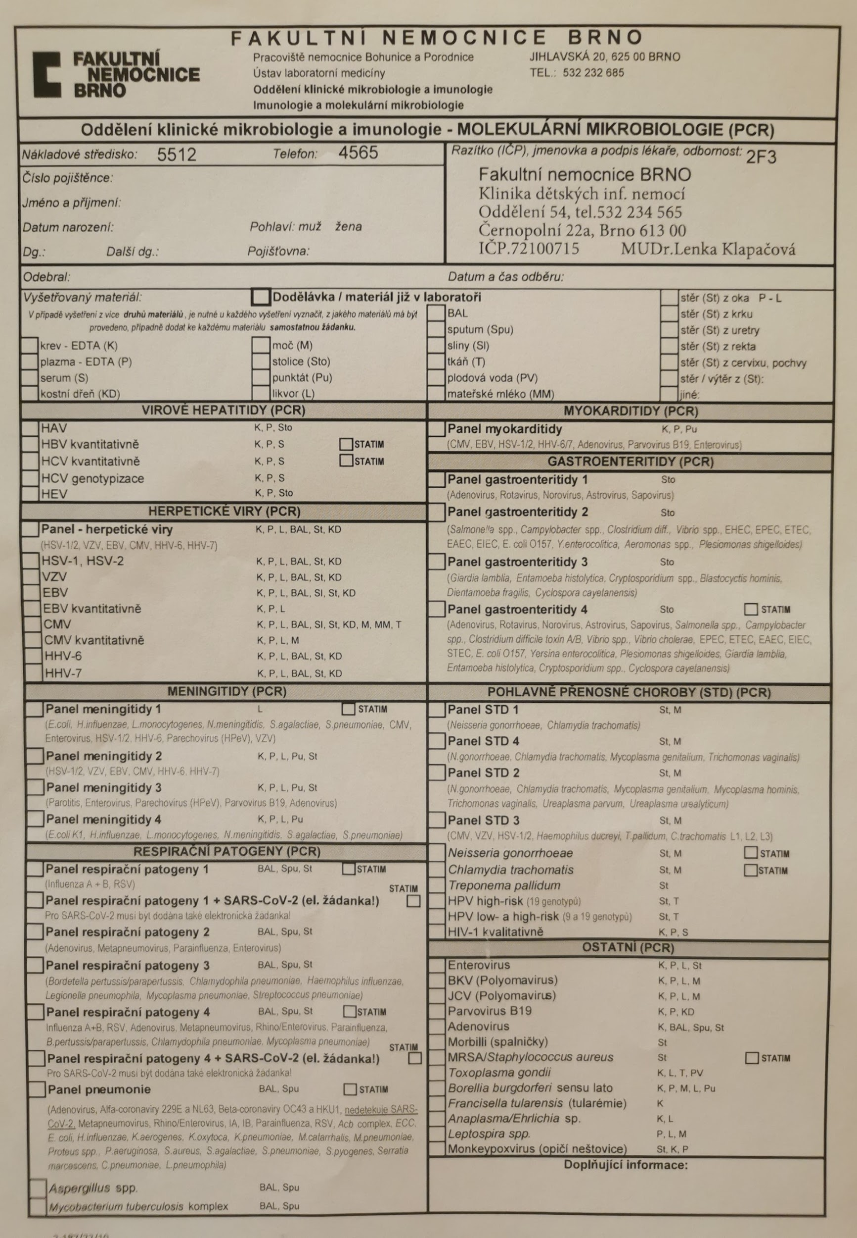
PCR tests from CSF - Test forms examples
Panels or individual pathogens
Bacteria
Viruses (enteroviruses, herpetic, respiratory)

Slide 9
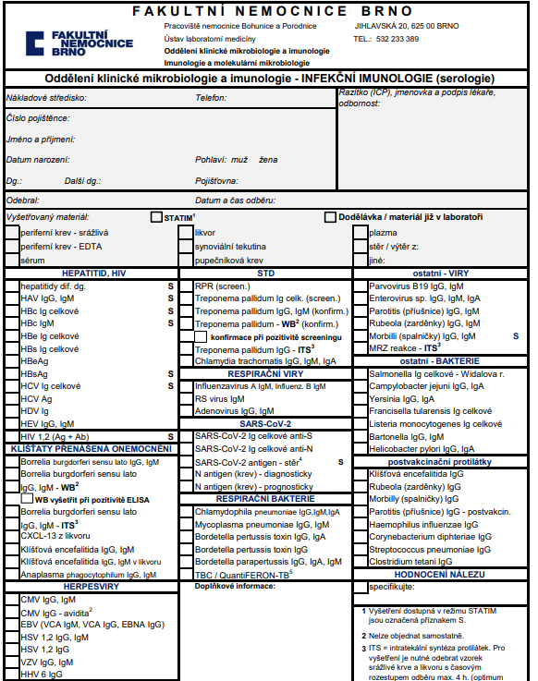
Testing antibodies in blood + CSF – example
Test forms
NOT PCR in these cases
TBE, borrelia - IT syntesis of antibodies, cytokine CXCL13)

Slide 10
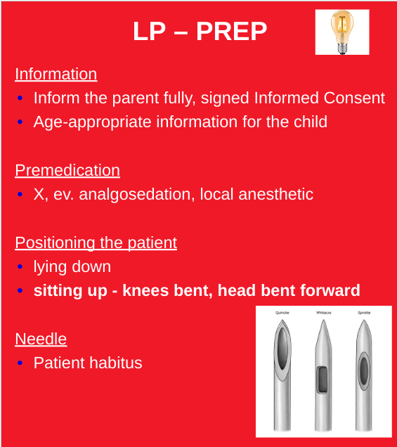
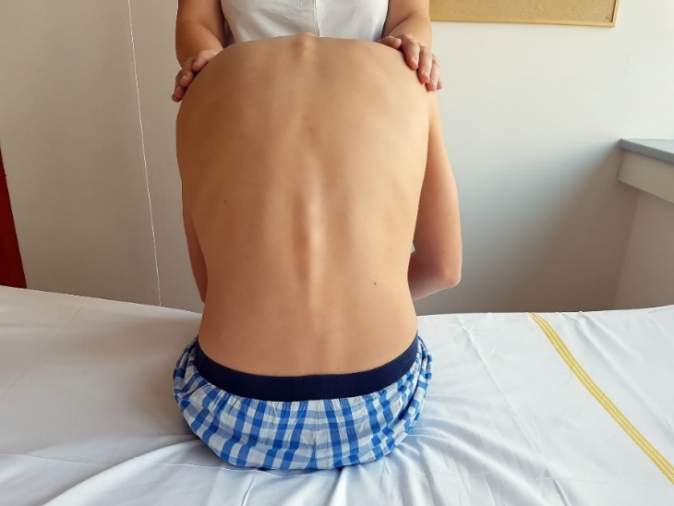
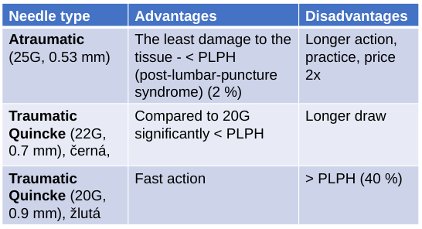
* PLPH – post-lumbar-puncture syndrome

Slide 11
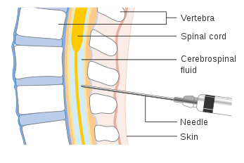
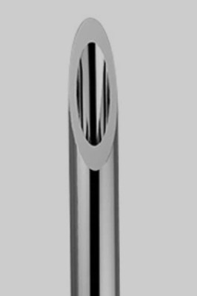
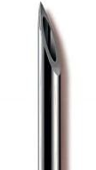
LP – TECHNIQUE
Determining the puncture site
Edges of the hip bone blades - junction - intervertebral space L3/4 - L4/5, upper side of the lower vertebra, marking the puncture site
Preparing the site
Disinfection, sterility, face-masks
Needle direction
Needle going slightly upwards, ca 15 degrees
Conus rotated to the side – minim. tissue trauma
Collecting the sample
We collect the required amount drop by drop
Concluding the LP
Inserting the mandrin / up to 2/3 of length, removing the needle, compression, coverage
Post-LP regime
Flat pad 8-10 hrs. (1 hour supine position) / min. 6 (PLPH)
Atraumatic needle (2-4 hrs.)
Rotating the needle
1 test tube - 15 drops (10 minimum)
CAUTION – PCR sample – prevent contamination
Link to an LP video / Study materials in IS
https://next.simu.med.muni.cz/s/gGCT29WcTEg5HmR

Slide 12
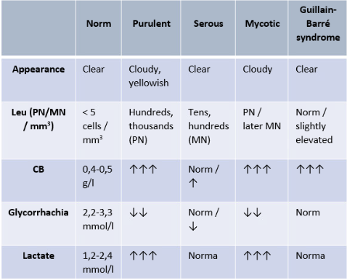
CSF RESULTS ANALYSIS
Macroscopic
  Color / transparency
    XANTOCHROMIA – yellow, orange or pink discoloration - waste products of hemoglobin – 90 % patients after 12 hrs of subarachnoid hemorrhaging (newborns with hyperbilirubinemia)
  Pressure
Microscopic
  Cytology
    Pleocytosis (polymorphonuclear / mononuclear), Ery up to 20% in traumatic LP
  Biochemistry
Total protein – significantly increased level in purul. inflammation, bleeding, Guillain-Barré syndrome, tumors, etc. (physiol. newborns)
Glycorrhachia – 2/3 glycemia, low in purul. inflammation
Lactate – purulent meningitis (significantly increased > 3.5 mmol/l)
Guillain-Barré syndrome – acute demyelinating polyradiculoneuritis – proteinocytological dissociation in the cerebrospinal fluid (severe disorder of the H-L barrier) – acute, subacute course; weak limb paresis - mainly DK, risk of respiratory muscle paralysis; often infections (EBV, CMV, HBV, HIV, VZV, mycoplasma, chlamydia, Campylobacter jejuni) in pre-illness 1-3 weeks

Slide 13
CAUSAL THERAPY
Antibiotics
Antivirals
Antimycotics
  ATB < 1 hour
  Empiric therapy by broad-spectrum ATB with penetration into CNS
ACICLOVIR! – antivirals at suspect herpetic encephalitis
HERPETIC ENCEPHALITIS
Impairment of consciousness (qualitative / quantitative) – involvement of frontal and temporal lobes; clinical presentation - convulsions, focal neurol. symptoms, aphasia, symptoms of brain edema - ↑ PRIMARY INFECTION (Family history - HSV)

Slide 14
SYMPTOMATIC THERAPY
Infusion therapy, antipyretics, analgesics
Antiedematous treatment, elevated head
Anticonvulsants, or sedation upon restlessness
If sepsis – complex approach
Improve the prognosis, hearing impairment prevention; I. dose shortly before/with ATB.
CAUTION – if suspected herpetic encephalitis, we wait for the aciclovirus to come into effect, depending on the clinical condition, min. 3-4 days (controversial topic; x edema – we have to give to patient)
Corticoids
Not enough studies of use in children / not recommended for routine use.
In CZ included in the entry treatment of purulent meningitis; at signs of severe intracranial hypertension or brain edema (ev. on CT).
Mannitol
Across-the-board administration of antiepileptics, paracetamol, activated protein C, heparinization, hypothermia – NOT RECOMMENDED
INTRAVENOUS IMMUNOGLOBULINS - YES

Slide 15

Resources
http://infektologie.cz/DoporMenPur17t.htm (2017)
Beck D, Cabellos C, Dzupova O, Sipahi OR, Brouwer MC, ESCMID guideline: diagnosis and treatment of acute bacterial meningitis. Clinical mikrobiology and infection. 2016

