Slide 1
Advanced microscopy techniques
Zuzana Tomášiková Cellular and Molecular Immunology, ICRC

Slide 2
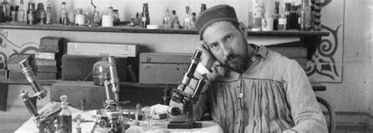
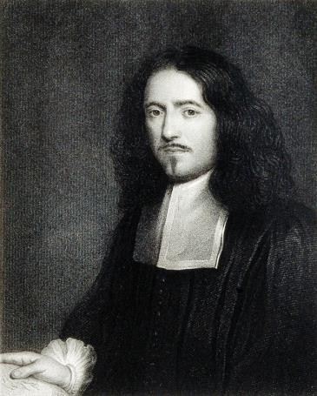
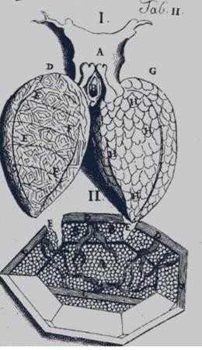
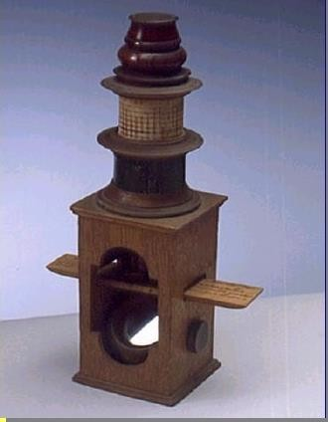
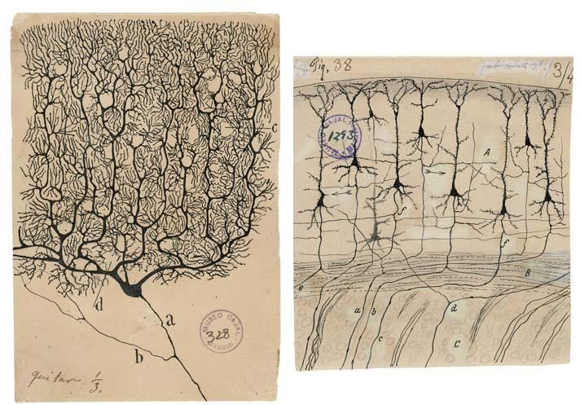
Microscopes allowed us to see the invisible...
Marcello Malpighi (1628-1694)
Santiago Ramon y Cajal (1852-1934) Nobel prize 1906 “in recognition of his work on the structure of the nervous system”
The first to observe capillaries in animals;
Described the complex pulmonary structure;
Thanks to Golgi staining technique he was able to illustrate multiple structures of the nervous system, with particular attention to the multitude of neurons found in our brain

Slide 3
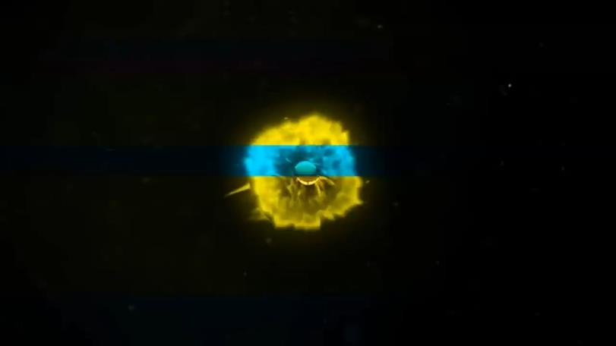
Evolution of microscopes helped us to improve our knowledge on both microorganisms and our own anatomy
Microscopy is one of the most powerful tool in many research fields;
It gave us the possibility to unravel what is beyond the capacity to be seen by
our eyes;
Since the beginning of microscopy history breakthrough discoveries have been made (e.g., electron microscopy);
Over the past two decades methods that can overcome the diffraction limit
and allow the imaging of complex structures have emerged;
1957
Confocal microscopy principles
1978
1994
2006
2014
Chemistry Nobel Prize for Super- resolution
1625
First use of term
“microscope”
1873
Abbe’s law and Electron Microscopy
1986
1990
1993
Confocal LSM
Physics Nobel Prize for EM and STM
Multiphoton microscopy
Super-
resolution
SIM and STED
techniques
PALM and STORM

Slide 4
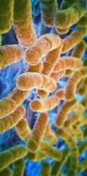
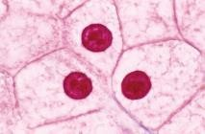
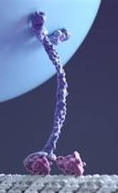
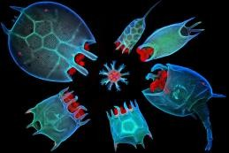
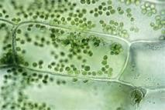
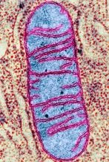
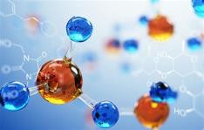
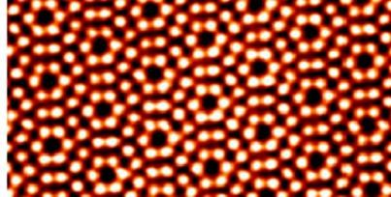
Techniques for different scales
Mitochondria/ bacteria
animal cell
proteins
Small organisms
Plant cell
Animal viruses
Small molecules
1mm
100 µm
10 µm
1 µm
100 nm
10 nm
1 nm
1Å
Fluorescence microscopy
Super-resolution microscopy
Scanning probe microscopy
Electron microscopy

Slide 5
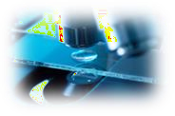
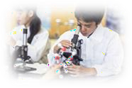
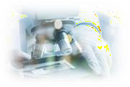
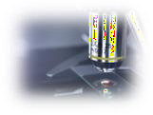
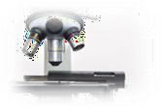
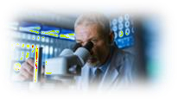
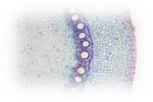
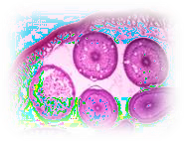
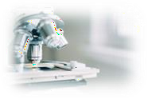
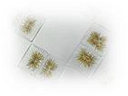
Many microscopy techniques are available for different case-study
Microscopy techniques
Optical
Electron
Scanning probe
fluorescence
Transmission (TEM)
Atomic force (AFM)
confocal
Scanning (SEM)
Scanning tunneling (STM)
multiphoton
Super-resolution

Slide 6
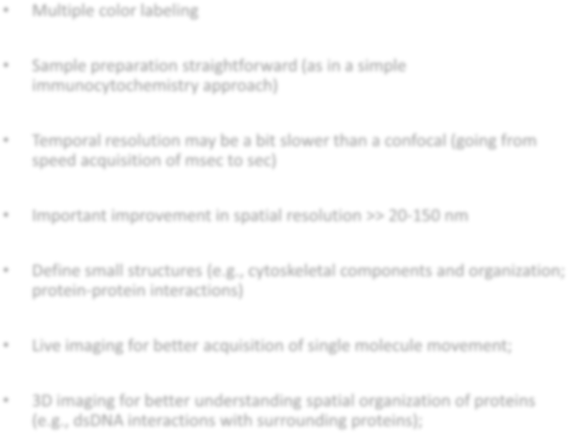
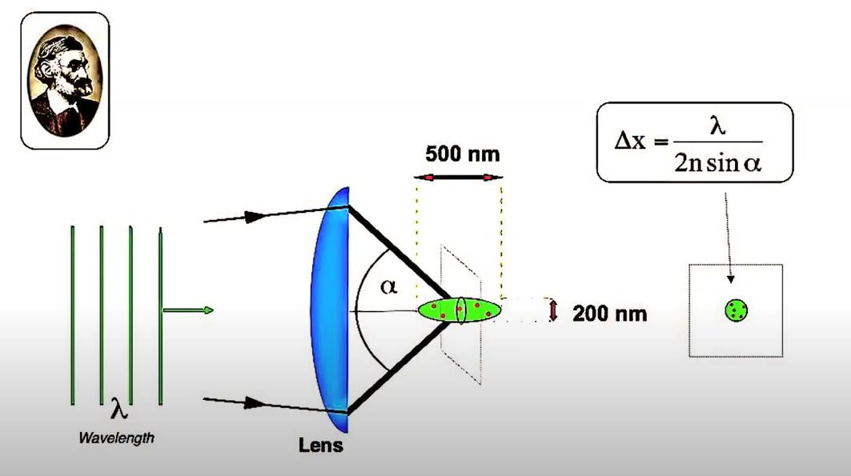
Super-resolution microscopy
Multiple color labeling
Nobel Prize in Chemistry, 2014
Sample preparation straightforward (as in a simple
immunocytochemistry approach)
Temporal resolution may be a bit slower than a confocal (going from speed acquisition of msec to sec)
Important improvement in spatial resolution >> 20-150 nm
Define small structures (e.g., cytoskeletal components and organization; protein-protein interactions)
Eric Betzig
Stefan Hell
William Moerner
Live imaging for better acquisition of single molecule movement;
Abbe’s law
3D imaging for better understanding spatial organization of proteins (e.g., dsDNA interactions with surrounding proteins);
Structured Illuminated Microscopy (SIM)
Stimulated Emission Depletion (STED)
Single Molecule Localization Microscopy (SMLM)

Slide 7
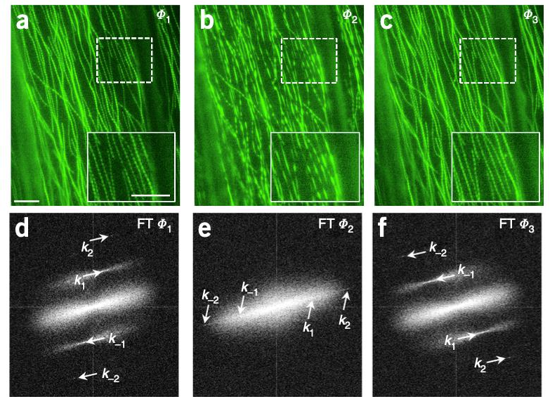
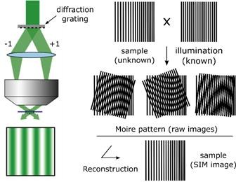
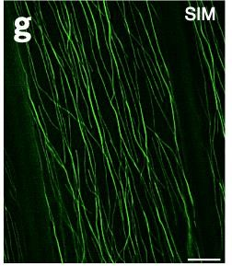
Structured Illuminated microscopy (SIM)
Different patterns
Different frequencies
Processed image (overlap of many
pattern/frequencies images)
A sample with an unknown frequency pattern is illuminated with
light of a KNOWN high-frequency pattern (moiré pattern);
Angle changes to determine different patterns to apply for acquisition (15-25);
GFP-labelled Arabidopsis thaliana microtubules
Komis et al., 2015

Slide 8
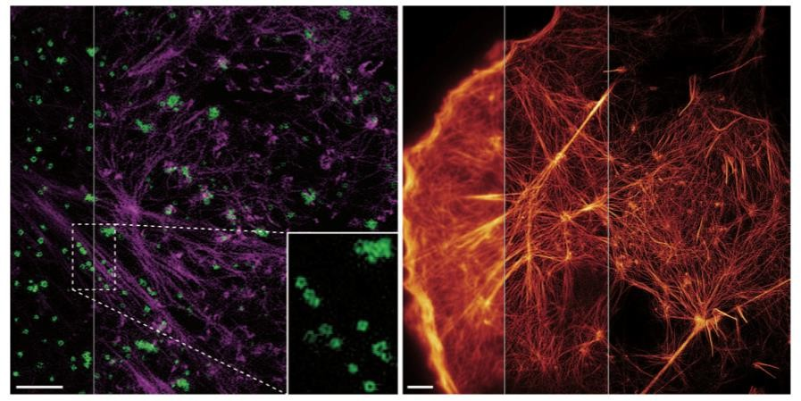
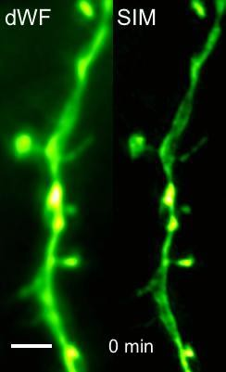
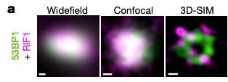
What can we do with SIM?
Visualization of proteins at high resolution levels
Actin Actin
Clathrin-coated pits
SIM-Live imaging of dendritic spines
Li et al., 2015
Cortical actin and internal filaments in COS7 cells
3D-SIM of DNA-damage repairing proteins
Turcotte et al., 2019
Cytosolic GFP expressed in mouse brain neurons
Ochs et al., 2019
DNA-proteins visualized in Retinal epithelial human cells

Slide 9
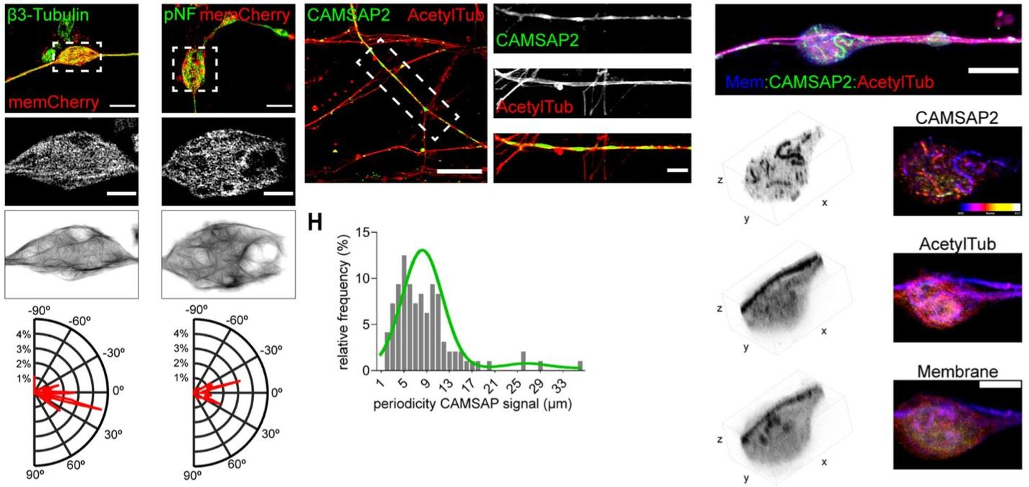
Can we go a little bit further ? Organization of cytoskeletal proteins in an in vitro model of Trauma Brain Injury
Unravel spatial organization of proteins and how it can change in specific conditions
Pozo Devoto et al., 2022
Figuring out details about proteins organization can help analyzing parameters such as orientation, periodicity of the protein in the cell, changes in conformation due to a pathological event

Slide 10
What are the main limitations of SIM?
SPEED
The acquisition rate is limited by the movements of the illumination patterns (depends on the grating rotation options of the machine);
SAMPLE QUALITY
Poor quality sample could lead to a wrong or no modulation of the grating pattern, requiring higher exposure, which can damage the sample;
RESOLUTION
It can only be doubled compared to the classical diffraction limit of point scanning microscopy

Slide 11
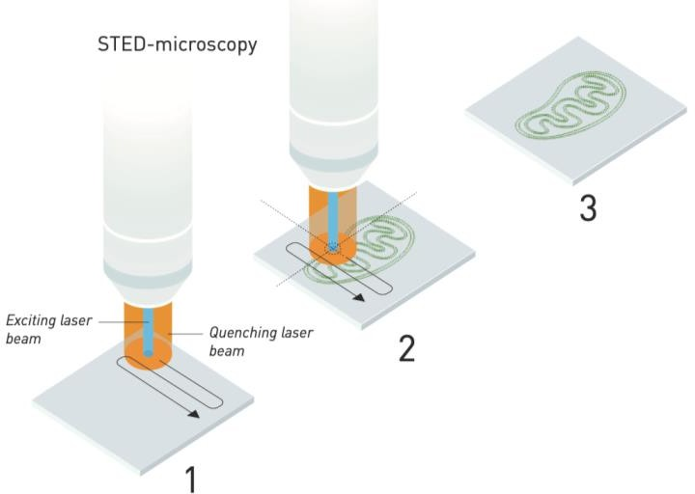
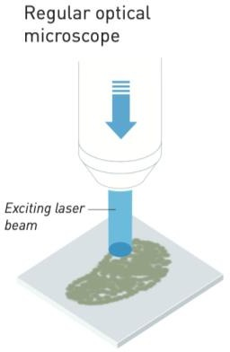
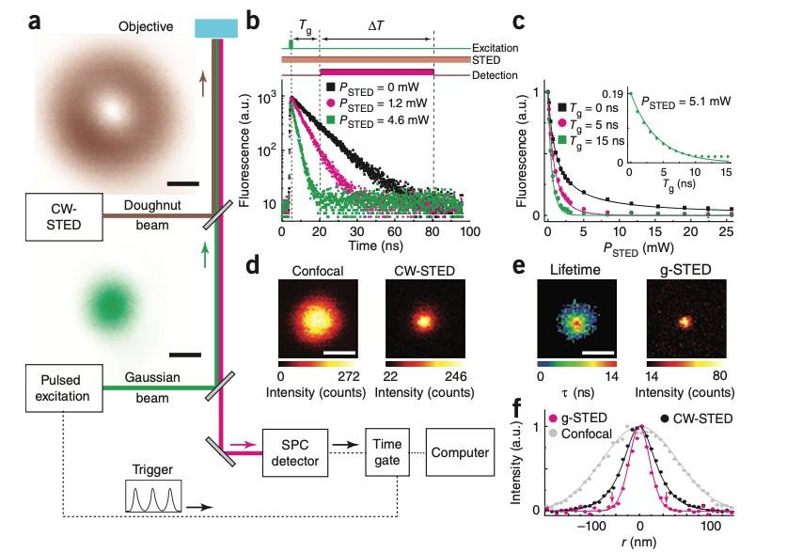
Stimulated Emission Depletion Microscopy (STED)
Confocal microscope;
The system needs an additional laser beam that quenches
”unnecessary” light;
Spatial resolution unlimited-bypass diffraction-limit;
Doesn’t require computational processing;
Vicidomini et al., 2011

Slide 12
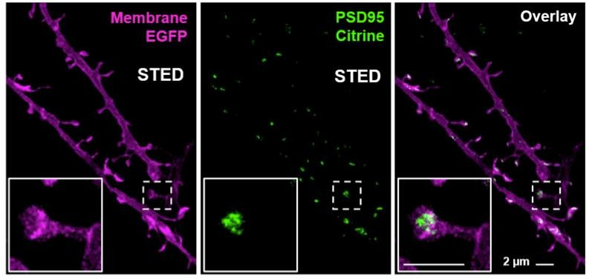
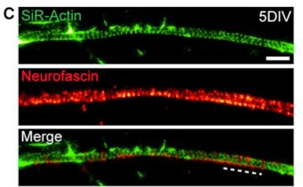
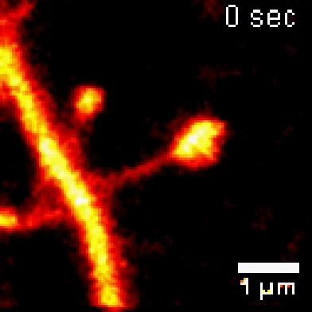
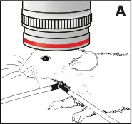
STED applications and achievements
Dual-color STED imaging for post-synaptic protein dynamic studies
Structural analysis;
Protein-protein interactions;
in vivo-imaging;
Actin rings periodicity at the dendrites
Wegner et al., 2020
In vivo imaging in a mouse brain of its synapses
D’Este et al., 2015
Berning et al., 2012

Slide 13
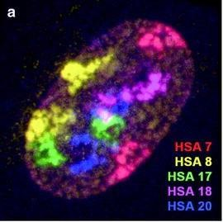
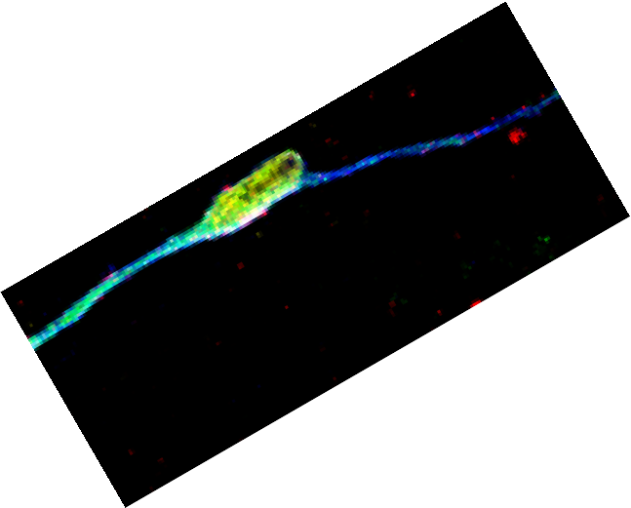
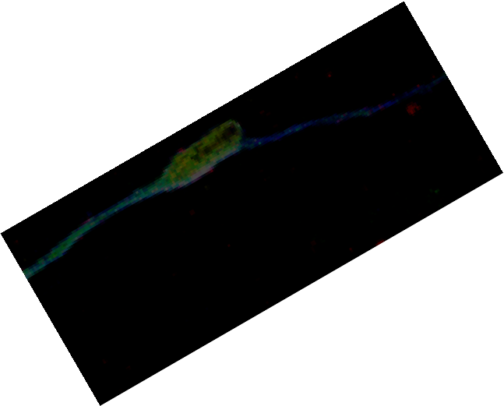
STED is a powerful but challenging super-resolution technique
Multicolor imaging can be done, but it can be difficult since for each excitation wavelength an associated depletion beam is needed;
Solovei and Cremer,2010
Sample preparation needs to be very accurate,
both in the choice of fluorophores and the
“density” of their staining;
Expensive technique, since requires a multilaser system;
High resolutions require massive laser intensities, which can conduct to photobleaching and phototoxicity;
photobleached

Slide 14
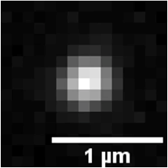
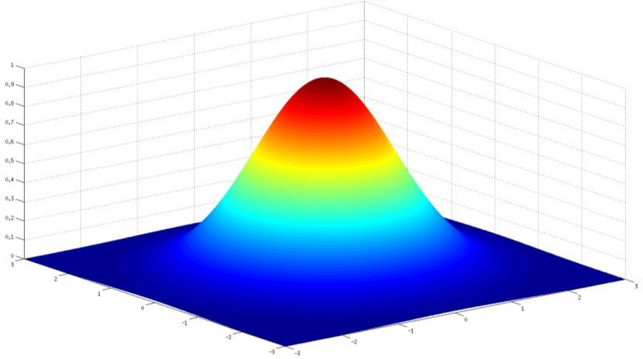
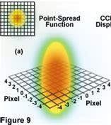
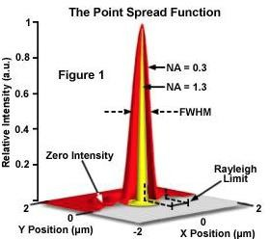
Where is the center?
Are we confident about the exact center of
this molecule?
Point Spread Function (PSF) Light waves converge and interfere at the focal point to produce a diffraction pattern of concentric rings
x
Gaussian fit to find the center
A single Alexa Fluor 647 dye
Some microscopy techniques can push beyond the boundaries of resolution limit to visualize for single molecule imaging

Slide 15
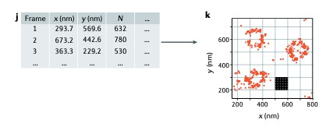
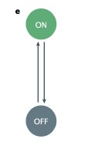
Single Molecule Localization Microscopy (SMLM)
Employs conventional wide-field excitation and achieves super-resolution by localizing individual molecules;
Can achieve spatial resolution of ca. 20-50 nm and sometimes even better (10x
more than conventional microscopy!);
SMLM methods are relatively easy to implement, but require a careful choice of fluorophores;
Principle(1):
Spatial coordinates of fluorescently labelled molecules can be determined with high precision if their PSFs do not overlap;
Principle(2):
Photoswitching of fluorescent molecules is applied via multiple acquisition over time of different molecules;

Slide 16
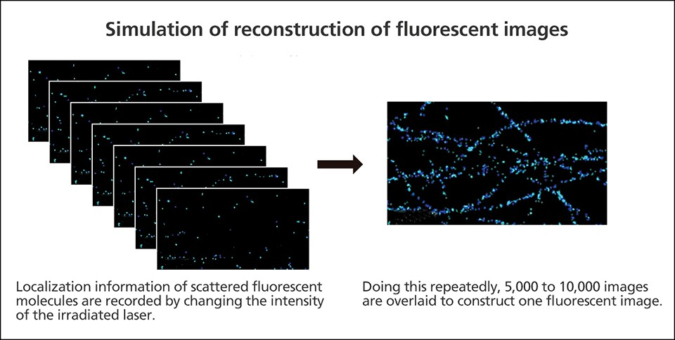
Many ways to acquire single molecules in our samples
STORM
Stochastic Optical Reconstruction Microscopy
PALM
Photoactivatable Localization Microscopy
PAINT
Points Accumulation for Imaging in Nanoscale Topography
The fluorophores used for all these techniques switch from a
“bright” state to a “dark” one
Sequential imaging of fluorophores subsets and consequent reconstruction of their positions via multiple frame acquisition (the “blinking” image);

Slide 17
Stochastic Optical Reconstruction Microscopy (STORM)
STORM
Conventional microscopy
Individual molecule activation
Lelek et al., 2021
Individual molecule detection (gating)
Localization of single molecules (coordinates)

Slide 18
Many fluorophores are available for different approaches
Fluorophores used in SMLM techniques fall into one of five different classes based on how they exchange their ON<>OFF status
Fluorescent dyes rather than fluorescent proteins have higher photon count therefore allowing shorter imaging times and higher localization precision
Fluorescent proteins are more suited for live-imaging applications (PALM), but premature bleaching or poor levels of expression in the specimen may limit the structural resolution
Lelek et al., 2021

Slide 19
STORM applications and milestones
Since its discovery in 2006 this microscopy technique has evolved continuously guaranteeing a revolutionary approach to study proteins and nucleic acids at nanoscale resolution

Slide 20
Unraveling nano-structures in cell nucleus
Tens to hundreds of nucleosomes along the chromatin fiber
Ricci et al., Cell 2015
STORM images of H2B in human fibroblasts
Thevathasan et al., Nat. Methods 2019
STORM imaging of single molecules for different nuclear pore proteins present at the nuclear level of Nup96 cells
RNApol II and Histone protein 2B interaction

Slide 21
Cytoskeletal proteins ultrastructure and synaptic receptor organization
Nanoscale organization of metabotropic glutamate receptors at presynaptic active zone
Xu et al., Science 2012
For the first time spatial organization of the cytoskeletal proteins of the axon was reconstructed thanks to STORM
Siddig et al., Science 2020

Slide 22
A fancy technique with different limitations…
1. Susceptibility to artefacts upon image reconstruction;
2. Difficulties in imaging thick samples: not suitable for tissue samples;
1. Low-throughput due by the small field of view required for single molecule localization and imaging;
Minimize with good software algorithms

Slide 23
Electron microscopy
First application 1931 when Ernst Ruska built the first electron microscope, for which he was awarded with the Nobel Prize in Physics in 1986;
“for his fundamental work in electron optics, and for the design of the first electron
microscope”

Slide 24
Basic concepts of Electron microscopy
The source allowing the images to be built is not a beam of light but of electrons, captured under vacuum condition usually on a phosphorescent screen;
Resolution and magnification capacities go beyond the classic diffraction limit, down to nm scale;
The main concept is based on the theory of Louis De Broglie (1924) that matter behaves like a wave exactly as light does;
the wavelengths of a beam of electrons is small such to don’t
have a remarkable impact on daily activities;
The smaller the wavelength the higher the resolution.

Slide 25
General “workflow” of an electron microscope
Electron gun generates the beam
2 sets of condenser lenses direct the electron
beam toward the specimen;
To move electrons down the column an accelerating voltage is applied (100-1000 kV)
The electron beam passes through the sample, which based on its density will differently scatter the electrons
The beam then passes through the objective lens, forming the intermediate magnified image
Finally, another set of lenses produces the further
magnified image

Slide 26
How are the images generated in electron microscopy?
EMs work using signals arising from the interaction of
an electron beam with the specimen
2 main EM techniques Transmission and Scanning Electron Microscopy (TEM and SEM respectively)
TEM (inner structures) SEM (outer structures)

Slide 27
TEM was the first non-optical technique to give a remarkable resolution improvement
Analogous to a compound microscope where a system of multiple lenses are placed one after the other
Powerful for visualizing many kind of small molecules:
Arrangement of proteins,
Lipids
Nucleic acids (DNA, RNA, ribosomes)
Contrast for visualization of different structures is achieved often by using
metal compounds
Osmium tetroxide (fixative, good lipid-binding)
Uranyl acetate (good for nucleic acid contrast)
Lead
Samples are dehydrated upon fixation and then stained;
Ultra-thin sections of 20 – 100 nm are then cut before imaging;
After the cut the thin layers are placed/embedded on a copper grid that
goes than to the microscope;
In the final image, the denser regions will reflect less and so they will be darker, while the less density will allow less absorption of electrons, thus generating a “brighter” image

Slide 28
TEM was the first non-optical technique to give a remarkable resolution improvement
centriole
Contrast for visualization of different structures is achieved often by using
metal compounds
microtubules
Osmium tetroxide (fixative, good lipid-binding)
Uranyl acetate (good for nucleic acid contrast)
Lead
Nucleus
Nucleolus
Lysosome
Samples are dehydrated upon fixation and then stained;
Golgi
Ultra-thin sections of 20 – 100 nm are then cut before imaging;
mitochondria
After the cut the thin layers are placed/embedded on a copper grid that
goes than to the microscope;
In the final image, the denser regions will reflect less and so they will be darker, while the less density will allow less absorption of electrons, thus generating a “brighter” image

Slide 29
Scanning Electron Microscopy (SEM)
a focused beam of high-energy electrons generates a variety of signals at the surface of solid specimens;
signals deriving from electron-sample interactions reveal
- external morphology
- chemical composition
- crystalline structure and orientation of materials;
magnification range >> 20-60000X
spatial resolution >> 50-100 nm
samples
accelerated electrons carry significant amount of kinetic
energy, then dissipated as a variety of signals:
secondary electrons (produce SEM images)
backscattered electrons
diffracted backscattered electrons (used to determine crystal structures and orientations of minerals)
dehydrated
solid
Coated with Ag, Au, Pt, others

Slide 30
Trauma brain injury model in vitro
Pozo Devoto et al., 2022
SEM images of ctrl and Injured axons
SEM image of full MF system
Quantification of swellings in SEM images before and post-injury
An example of SEM application
Workflow to establish swelling formation in human neurons, a mechanism occurring after a traumatic impact in the brain.
In this experiments the number of events (swellings) forming after injury were quantified by immediately fixing the cells and then scan images in an electron microscope

Slide 31
TEM and SEM: advantages and limitations
High magnification and
resolution
Material rarely distorted during specimen preparation, which is
not complicated
Allows the investigation of deep structures but also surface
interactions
PRO >>
Live samples cannot be
imaged
TEM samples must be cut in
ultra-thin slices
Samples need to be properly dried to favor the internal vacuum
conditions
Expensive to maintain (very sensitive to vibration and external
magnetic fields)
<< CONS

Slide 32
…. And more.. Scanning Probe Microscopy (1980s)
STM
The electrical current flowing between the cantilever tip and the sample
AFM
Electrostatic forces between the cantilever tip and the sample;
Mechanical properties of
cells/tissues
SPMs can measure deflections caused by many forces
mechanical contact
electrostatic
magnetic
Van der Waals
Images are colorless since they are measuring properties rather than reflection of light
Nanoscale surfaces and structures, including atoms;
Resolution sometimes <1nm;
A physical probe is used to scan back and
forth over the sample surface;
Probe tip mounted at the end of a cantilever;
The tip can be as sharp as an atom;
The user doesn’t see the surface directly, is
the tool that “feels” it;
A computer collects the data to generate an image;

Slide 33
Conclusions
Microscopy helped us to unravel the invisible;
Nowadays advanced microscopy techniques have a variety of applications in many fields, being extremely important for
biology and understanding of structure and interactions between proteins;
Super-resolution microscopy allows multiple color imaging by breaking the boundaries of the diffraction limit;
single molecule imaging allowed the visualization of cellular nanostructures never resolved before with light
microscopy;
Electron microscopy was the earliest technique able to reach resolutions that light microscopy had never reached;
TEM and SEM are still of large use for describing composition of structures and microorganisms;
SPM techniques achieved the ability to image a structure just based on the atomic composition and the forces involved in the interaction between a surface and a scanning probe;
The use of fluorophores for staining cell cultures and tissues both for basic research purposes or diagnostic ones
(histopathology) is in continuous evolution and the offer on the market improves very quickly;

Slide 34
Thank you for the attention!

