Slide 1
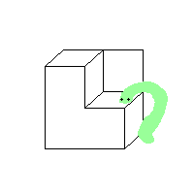
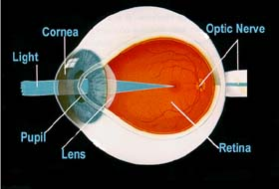
Lectures on Medical Biophysics
Biophysics of visual perception

Slide 2
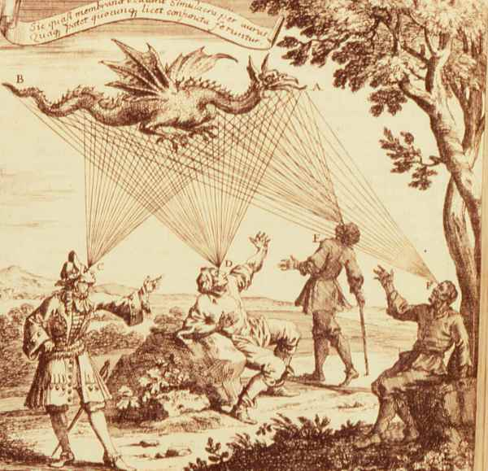
Lecture outline
Basic properties of light
Anatomy of eye
Optical properties of eye
Retina – biological detector of light
Colour vision

Slide 3
Basic properties of light
Visible electromagnetic radiation:
λ = 380 – 760 nm
shorter wavelength – Ultraviolet light (UV)
longer wavelength – Infrared light (IR)
Visible light – (VIS)
Medium in which the light propagates is called optical medium.
In homogeneous media, light propagates in straight lines perpendicular to wave fronts, this lines are called light rays.
Speed (velocity) of light (in vacuum)
c = 299 792 458 m·s⁻¹ approx. = 300 000 000 m·s⁻¹

Slide 4
Light (VIS) sources
Natural or Man–made (artificial)
Natural: The sun
Sun light is what drives life. It’s hard to imagine our world and life without it.
Man–made: light bulbs, fluorescent tubes, laser…

Slide 5
Polychromatic and Monochromatic Light, Coherence
Polychromatic or white light
consists of light of a variety of wavelengths.
Monochromatic light
consists of light of a single wavelength
According to phase character light can be
Coherent - Coherent light are light waves "in phase“ one another, i.e. they have the same phase in the same distance from the source. Light produced by lasers is coherent light.
Incoherent - Incoherent light are light waves that are not "in phase“ one another. Light from light bulbs or the sun is incoherent light.

Slide 6
Reflection and refraction of light
Reflection - Law of reflection: The angle of reflection α’ equals to the angle of incidence α. The ray reflected travels in the plane of incidence.
Refraction: When light passes from one medium into another, the beam changes direction at the boundary between the two media. This property of optical media is characterised by index of refraction
n = c/v [ dimensionless ]
n – index of refraction of respective medium
c – speed of light in vacuum
v – speed of light in the respective medium
Index of refraction of vacuum is 1.

Slide 7
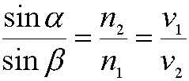
Snell‘s law (Law of refraction) α – angle of incidence (in medium 1) β – angle of refraction (in medium 2)
(Angles are measured away from the normal!) n₁, n₂ – indices of refraction v₁, v₂, – speed of light in respective media n is large: large optical density n is small: small optical density n₁ > n₂ – light refraction away the normal occurs n₁ < n₂ – light refraction toward the normal occurs
Reflection and refraction of light

Slide 8
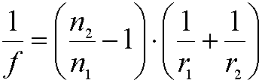
Lens–maker’s equation
f - focal distance (length) [m]
n₂ - index of refraction of the lens
n₁ - index of refraction of the medium
r₁, r₂ - radii of curvature of the lens

Slide 9
Common principles of optical imaging
Real image (can be projected): convergence of rays
Virtual image (cannot be projected): divergence of ray
Principal axis – optical axis of centred system of optical boundaries
Principal focus is a point where rays parallel to the principal axis
intersect after refraction by the lens or reflection by the curved mirror - front ( object ) focus and back (image) focus
Focal distance (length) f [m] is the distance of focus from the centre of the lens or the mirror
The radii of curvature are positive (negative) when the respective lens
or mirror surfaces are convex (concave).
Dioptric power (strength of the lens): reciprocal value of focal length
φ = D = S = 1/f [m⁻¹ = dpt = D (dioptre)]
Converging lenses: f and φ are positive
Diverging lenses: f and φ are negative

Slide 10
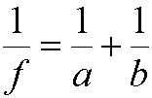
Lens equation
The rays parallel to the principal axis are refracted into the back focus (in converging lens), or so that they seem to be emitted from the front focus (in diverging lens). The direction of rays passing through the centre of the lens remains uninfluenced. Lens equation (equation of image, imaging equation):
a – object distance [m]
b – image distance [m]
Sign convention:
a is positive in front of the lens, negative behind the lens;
b is negative in front of the lens (the image is virtual), positive behind the lens (the image is real)

Slide 11
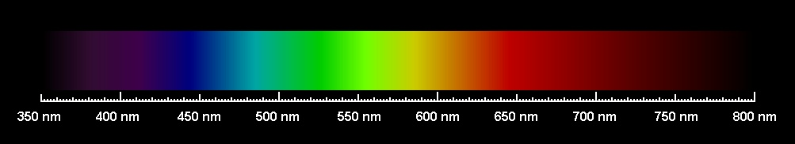
The human eye can detect light from about 380 nm (violet) to about 760 nm (red). Our visual system perceives this range of light wavelength as a smoothly varying rainbow of colours. We call this range „visible spectrum“. The following illustration shows approximately how it is experienced.
Visible spectrum

Slide 12
Anatomy of eye

Slide 13
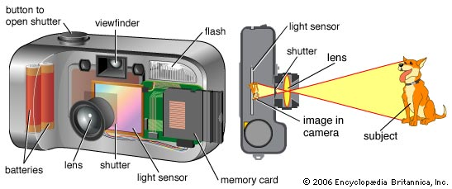
How Does The Human Eye Work?
The individual components of the eye work in a manner like a camera. Each part plays a vital role in providing clear vision.
The Digital Camera
The Human Eye
Notes:
How Does The Human Eye Work?
The individual components of the eye work in a manner similar to a camera. Each part plays
a vital role in providing clear vision. So think of the eye as a camera with the cornea, behaving
much like a lens cover. As the eye's main focusing element, the cornea takes widely diverging
rays of light and bends them through the pupil, the dark, round opening in the center of the
colored iris. The iris and pupil act like the aperture of a camera.
Next in line is the lens which acts like the lens in a camera, helping to focus light to the back
of the eye. Note that the lens is the part which becomes cloudy and is removed during cataract
surgery to be replaced by an artificial implant nowadays.
The Camera
The Human Eye
The very back of the eye is lined with a layer called the retina which acts very much like the
film of the camera. The retina is a membrane containing photoreceptor nerve cells that lines
the inside back wall of the eye. The photoreceptor nerve cells of the retina change the light
rays into electrical impulses and send them through the optic nerve to the brain where an
image is perceived. The center 10% of the retina is called the macula. This is responsible for
your sharp vision, your reading vision. The peripheral retina is responsible for the peripheral
vision. As with the camera, if the "film" is bad in the eye (i.e. the retina), no matter how good
the rest of the eye is, you will not get a good picture.
The human eye is remarkable. It accommodates to changing lighting conditions and focuses
light rays originating from various distances from the eye. When all of the components of the
eye function properly, light is converted to impulses and conveyed to the brain where an
image is perceived.
Glossary of Eye Terms:
Anterior Chamber
The cavity in the front part of the eye between the lens and cornea is called the Anterior
Chamber. It is filled with Aqueous, a water-like fluid. This fluid is produced by the ciliary
body and drains back into the blood circulation through channels in the chamber angle. It is
turned over every100 minutes.
Chamber Angle
Located at the junction of the cornea, iris, and sclera, the anterior chamber angle extends 360
degrees at the perimeter of the iris. Channels here allow aqueous fluid to drain back into the
blood circulation from the eye. May be obstructed in glaucoma.
Ciliary Body
A structure located behind the iris (rarely visible) which produces aqueous fluid that fills the
front part of the eye and thus maintains the eye pressure. It also allows focusing of the lens.
Conjunctiva
A thin lining over the sclera, or white part of the eye. This also lines the inside of the eyelids.
Cell in the conjunctiva produce mucous, which helps to lubricate the eye.
Cornea
The transparent, outer "window" and primary focusing element of the eye. The outer layer of
the cornea is known as epithelium. Its main job is to protect the eye. The epithelium is made
up of transparent cells that have the ability to regenerate quickly. The inner layer of the cornea
is also made up of transparent tissue, which allows light to pass.
Hyaloid Canal
A narrow channel that runs from the optic disc to the back surface of the lens. It serves an
embryologic function prior to birth but none afterwards.
Iris
Inside the anterior chamber is the iris. This is the part of the eye which is responsible for one's
eye color. It acts like the diaphragm of a camera, dilating and constricting the pupil to allow
more or less light into the eye.
Pupil
The dark opening in the center of the colored iris that controls how much light enters the eye.
The colored iris functions like the iris of a camera, opening and closing, to control the amount
of light entering through the pupil.
Lens
The part of the eye immediately behind the iris that performs delicate focusing of light rays
upon the retina. In persons under 40, the lens is soft and pliable, allowing for fine focusing
from a wide variety of distances. For individuals over 40, the lens begins to become less
pliable, making focusing upon objects near to the eye more difficult. This is known as
presbyopia.
Macula
The part of the retina which is most sensitive, and is responsible for the central (or reading)
vision. It is located near the optic nerve directly at the back of the eye (on the inside). This
area is also responsible for color vision.
Optic Disc
The position in the back of the eye where the nerve (along with an artery and vein) enters the
eye corresponds to the "blind spot" since there are no rods or cones in these location.
Normally, a person does not notice this blind spot since rapid movements of the eye and
processing in the brain compensate for this absent information. This is the area that the
ophthalmologist studies when evaluating a patient for glaucoma, a condition where the optic
nerve becomes damaged often due to high pressure within the eye. As it looks like a cup
when viewed with an ophthalmoscope, it is sometimes referred to as the Optic Cup.
Optic Nerve
The optic nerve is the structure which takes the information from the retina as electrical signals
and delivers it to the brain where this information is interpreted as a visual image. The optic
nerve consists of a bundle of about one million nerve fibers.
Retina
The membrane lining the back of the eye that contains photoreceptor cells. These
photoreceptor nerve cells react to the presence and intensity of light by sending an impulse to
the brain via the optic nerve. In the brain, the multitude of nerve impulses received from the
photoreceptor cells in the retina are assimilated into an image.
Sclera
The white, tough wall of the eye. Few diseases affect this layer. It is covered by the episclera
(a fibrous layer between the conjunctiva and sclera ) and conjunctiva, and eye muscles are
connected to this.
Vitreous
Next in our voyage through the eye is the vitreous. This is a jelly-like substance that fills the
body of the eye. It is normally clear. In early life, it is firmly attached to the retina behind it.
With age, the vitreous becomes more water-like and may detach from the retina. Often, little
clumps or strands of the jelly form and cast shadows which are perceived as "floaters". While
frequently benign, sometimes floaters can be a sign of a more serious condition such as a
retinal tear or detachment and should be investigated with a thorough ophthalmologic
examination.
How Does The Human Eye Work?
The individual components of the eye work in a manner similar to a camera. Each part plays
a vital role in providing clear vision. So think of the eye as a camera with the cornea, behaving
much like a lens cover. As the eye's main focusing element, the cornea takes widely diverging
rays of light and bends them through the pupil, the dark, round opening in the center of the
colored iris. The iris and pupil act like the aperture of a camera.
Next in line is the lens which acts like the lens in a camera, helping to focus light to the back
of the eye. Note that the lens is the part which becomes cloudy and is removed during cataract
surgery to be replaced by an artificial implant nowadays.
The Camera
The Human Eye
The very back of the eye is lined with a layer called the retina which acts very much like the
film of the camera. The retina is a membrane containing photoreceptor nerve cells that lines
the inside back wall of the eye. The photoreceptor nerve cells of the retina change the light
rays into electrical impulses and send them through the optic nerve to the brain where an
image is perceived. The center 10% of the retina is called the macula. This is responsible for
your sharp vision, your reading vision. The peripheral retina is responsible for the peripheral
vision. As with the camera, if the "film" is bad in the eye (i.e. the retina), no matter how good
the rest of the eye is, you will not get a good picture.
The human eye is remarkable. It accommodates to changing lighting conditions and focuses
light rays originating from various distances from the eye. When all of the components of the
eye function properly, light is converted to impulses and conveyed to the brain where an
image is perceived.
Glossary of Eye Terms:
Anterior Chamber
The cavity in the front part of the eye between the lens and cornea is called the Anterior
Chamber. It is filled with Aqueous, a water-like fluid. This fluid is produced by the ciliary
body and drains back into the blood circulation through channels in the chamber angle. It is
turned over every100 minutes.
Chamber Angle
Located at the junction of the cornea, iris, and sclera, the anterior chamber angle extends 360
degrees at the perimeter of the iris. Channels here allow aqueous fluid to drain back into the
blood circulation from the eye. May be obstructed in glaucoma.
Ciliary Body
A structure located behind the iris (rarely visible) which produces aqueous fluid that fills the
front part of the eye and thus maintains the eye pressure. It also allows focusing of the lens.
Conjunctiva
A thin lining over the sclera, or white part of the eye. This also lines the inside of the eyelids.
Cell in the conjunctiva produce mucous, which helps to lubricate the eye.
Cornea
The transparent, outer "window" and primary focusing element of the eye. The outer layer of
the cornea is known as epithelium. Its main job is to protect the eye. The epithelium is made
up of transparent cells that have the ability to regenerate quickly. The inner layer of the cornea
is also made up of transparent tissue, which allows light to pass.
Hyaloid Canal
A narrow channel that runs from the optic disc to the back surface of the lens. It serves an
embryologic function prior to birth but none afterwards.
Iris
Inside the anterior chamber is the iris. This is the part of the eye which is responsible for one's
eye color. It acts like the diaphragm of a camera, dilating and constricting the pupil to allow
more or less light into the eye.
Pupil
The dark opening in the center of the colored iris that controls how much light enters the eye.
The colored iris functions like the iris of a camera, opening and closing, to control the amount
of light entering through the pupil.
Lens
The part of the eye immediately behind the iris that performs delicate focusing of light rays
upon the retina. In persons under 40, the lens is soft and pliable, allowing for fine focusing
from a wide variety of distances. For individuals over 40, the lens begins to become less
pliable, making focusing upon objects near to the eye more difficult. This is known as
presbyopia.
Macula
The part of the retina which is most sensitive, and is responsible for the central (or reading)
vision. It is located near the optic nerve directly at the back of the eye (on the inside). This
area is also responsible for color vision.
Optic Disc
The position in the back of the eye where the nerve (along with an artery and vein) enters the
eye corresponds to the "blind spot" since there are no rods or cones in these location.
Normally, a person does not notice this blind spot since rapid movements of the eye and
processing in the brain compensate for this absent information. This is the area that the
ophthalmologist studies when evaluating a patient for glaucoma, a condition where the optic
nerve becomes damaged often due to high pressure within the eye. As it looks like a cup
when viewed with an ophthalmoscope, it is sometimes referred to as the Optic Cup.
Optic Nerve
The optic nerve is the structure which takes the information from the retina as electrical signals
and delivers it to the brain where this information is interpreted as a visual image. The optic
nerve consists of a bundle of about one million nerve fibers.
Retina
The membrane lining the back of the eye that contains photoreceptor cells. These
photoreceptor nerve cells react to the presence and intensity of light by sending an impulse to
the brain via the optic nerve. In the brain, the multitude of nerve impulses received from the
photoreceptor cells in the retina are assimilated into an image.
Sclera
The white, tough wall of the eye. Few diseases affect this layer. It is covered by the episclera
(a fibrous layer between the conjunctiva and sclera ) and conjunctiva, and eye muscles are
connected to this.
Vitreous
Next in our voyage through the eye is the vitreous. This is a jelly-like substance that fills the
body of the eye. It is normally clear. In early life, it is firmly attached to the retina behind it.
With age, the vitreous becomes more water-like and may detach from the retina. Often, little
clumps or strands of the jelly form and cast shadows which are perceived as "floaters". While
frequently benign, sometimes floaters can be a sign of a more serious condition such as a
retinal tear or detachment and should be investigated with a thorough ophthalmologic
examination.
How Does The Human Eye Work?
The individual components of the eye work in a manner similar to a camera. Each part plays
a vital role in providing clear vision. So think of the eye as a camera with the cornea, behaving
much like a lens cover. As the eye's main focusing element, the cornea takes widely diverging
rays of light and bends them through the pupil, the dark, round opening in the center of the
colored iris. The iris and pupil act like the aperture of a camera.
Next in line is the lens which acts like the lens in a camera, helping to focus light to the back
of the eye. Note that the lens is the part which becomes cloudy and is removed during cataract
surgery to be replaced by an artificial implant nowadays.
The Camera
The Human Eye
The very back of the eye is lined with a layer called the retina which acts very much like the
film of the camera. The retina is a membrane containing photoreceptor nerve cells that lines
the inside back wall of the eye. The photoreceptor nerve cells of the retina change the light
rays into electrical impulses and send them through the optic nerve to the brain where an
image is perceived. The center 10% of the retina is called the macula. This is responsible for
your sharp vision, your reading vision. The peripheral retina is responsible for the peripheral
vision. As with the camera, if the "film" is bad in the eye (i.e. the retina), no matter how good
the rest of the eye is, you will not get a good picture.
The human eye is remarkable. It accommodates to changing lighting conditions and focuses
light rays originating from various distances from the eye. When all of the components of the
eye function properly, light is converted to impulses and conveyed to the brain where an
image is perceived.
Glossary of Eye Terms:
Anterior Chamber
The cavity in the front part of the eye between the lens and cornea is called the Anterior
Chamber. It is filled with Aqueous, a water-like fluid. This fluid is produced by the ciliary
body and drains back into the blood circulation through channels in the chamber angle. It is
turned over every100 minutes.
Chamber Angle
Located at the junction of the cornea, iris, and sclera, the anterior chamber angle extends 360
degrees at the perimeter of the iris. Channels here allow aqueous fluid to drain back into the
blood circulation from the eye. May be obstructed in glaucoma.
Ciliary Body
A structure located behind the iris (rarely visible) which produces aqueous fluid that fills the
front part of the eye and thus maintains the eye pressure. It also allows focusing of the lens.
Conjunctiva
A thin lining over the sclera, or white part of the eye. This also lines the inside of the eyelids.
Cell in the conjunctiva produce mucous, which helps to lubricate the eye.
Cornea
The transparent, outer "window" and primary focusing element of the eye. The outer layer of
the cornea is known as epithelium. Its main job is to protect the eye. The epithelium is made
up of transparent cells that have the ability to regenerate quickly. The inner layer of the cornea
is also made up of transparent tissue, which allows light to pass.
Hyaloid Canal
A narrow channel that runs from the optic disc to the back surface of the lens. It serves an
embryologic function prior to birth but none afterwards.
Iris
Inside the anterior chamber is the iris. This is the part of the eye which is responsible for one's
eye color. It acts like the diaphragm of a camera, dilating and constricting the pupil to allow
more or less light into the eye.
Pupil
The dark opening in the center of the colored iris that controls how much light enters the eye.
The colored iris functions like the iris of a camera, opening and closing, to control the amount
of light entering through the pupil.
Lens
The part of the eye immediately behind the iris that performs delicate focusing of light rays
upon the retina. In persons under 40, the lens is soft and pliable, allowing for fine focusing
from a wide variety of distances. For individuals over 40, the lens begins to become less
pliable, making focusing upon objects near to the eye more difficult. This is known as
presbyopia.
Macula
The part of the retina which is most sensitive, and is responsible for the central (or reading)
vision. It is located near the optic nerve directly at the back of the eye (on the inside). This
area is also responsible for color vision.
Optic Disc
The position in the back of the eye where the nerve (along with an artery and vein) enters the
eye corresponds to the "blind spot" since there are no rods or cones in these location.
Normally, a person does not notice this blind spot since rapid movements of the eye and
processing in the brain compensate for this absent information. This is the area that the
ophthalmologist studies when evaluating a patient for glaucoma, a condition where the optic
nerve becomes damaged often due to high pressure within the eye. As it looks like a cup
when viewed with an ophthalmoscope, it is sometimes referred to as the Optic Cup.
Optic Nerve
The optic nerve is the structure which takes the information from the retina as electrical signals
and delivers it to the brain where this information is interpreted as a visual image. The optic
nerve consists of a bundle of about one million nerve fibers.
Retina
The membrane lining the back of the eye that contains photoreceptor cells. These
photoreceptor nerve cells react to the presence and intensity of light by sending an impulse to
the brain via the optic nerve. In the brain, the multitude of nerve impulses received from the
photoreceptor cells in the retina are assimilated into an image.
Sclera
The white, tough wall of the eye. Few diseases affect this layer. It is covered by the episclera
(a fibrous layer between the conjunctiva and sclera ) and conjunctiva, and eye muscles are
connected to this.
Vitreous
Next in our voyage through the eye is the vitreous. This is a jelly-like substance that fills the
body of the eye. It is normally clear. In early life, it is firmly attached to the retina behind it.
With age, the vitreous becomes more water-like and may detach from the retina. Often, little
clumps or strands of the jelly form and cast shadows which are perceived as "floaters". While
frequently benign, sometimes floaters can be a sign of a more serious condition such as a
retinal tear or detachment and should be investigated with a thorough ophthalmologic
examination.

Slide 14
Visual analyser consists of three parts:
Eye – the best investigated part from the biophysical point of view
Optic tracts – channel which consists of nervous cells, through this channel the information registered and processed by the eye are given to the cerebrum
Visual centre – the area of the cerebral cortex where is outwards picture perceived

Slide 15
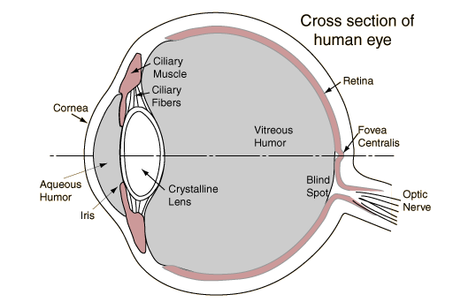
Anatomy of the eyeball

Slide 16
Anatomy of the eyeball
The tough, outermost layer of the eye is called the sclera. It maintains the shape of the eye.
The front about sixth of this layer is clear and is called the cornea. All light must first pass through the cornea when it enters the eye. Attached to the sclera are the six muscles that move the eye, called the extraocular muscles.
The chorioid (or uveal tract) is the second layer of the eye. It contains the blood vessels that supply blood to structures of the eye. The front part of the chorioid contains two structures:
The ciliary body - the ciliary body is a muscular area that is attached to the lens. It contracts and relaxes to control the curvature of the lens for focusing.

Slide 17
Anatomy of the eyeball
The iris - the iris is the coloured part of the eye. The colour of the iris is determined by the colour of the connective tissue and pigment cells. Less pigment makes the eyes blue; more pigment makes the eyes brown. The iris is an adjustable diaphragm around an opening called the pupil.
Inside the eyeball there are two fluid-filled sections separated by the lens. The larger, back section contains a clear, gel-like material called vitreous humour
The smaller, front section contains a clear, watery material called aqueous humour
The aqueous humour filled space is divided into two sections called the anterior chamber (in front of the iris) and the posterior chamber (behind the iris). The aqueous humour is produced in the ciliary body.

Slide 18
Anatomy of the eyeball
The iris has two muscles:
The m. dilator pupillae makes the iris smaller and therefore the pupil larger, allowing more light into the eye;
the m. sphincter pupillae makes the iris larger and the pupil smaller, allowing less light into the eye.
Pupil size can change from 2 millimetres to 8 millimetres.
This means that by changing the size of the pupil, the eye can change the amount of light that enters it by at least 16-times.

Slide 19
Anatomy of the eyeball
The transparent crystalline lens of the eye is located immediately behind the iris. It is a clear, bi-convex structure about 10 mm in diameter. The lens is kept in flattened state by tension of fibres of suspensory ligament. The lens changes shape because it is attached to muscles in the ciliary body, which act against the tension of ligament.
When this ciliary muscle is
  relaxed, its diameter increases, and the lens is flattened.
  contracted, its diameter is reduced, and the lens becomes more spherical (which is its natural state).
These changes enable the eye to adjust its focus between far objects and near objects.
The crystalline lens is composed of 4 layers, from the surface to the centre: capsule, subcapsular epithelium, cortex, nucleus

Slide 20
Intraocular pressure
(production versus drainage of aqueous humour - dynamic balance)
2.66 kPa (20 mmHg) ± 0.3 kPa
Changes greater than ± 0.3 kPa are pathological

Slide 21
Optical properties of eye

Slide 22
Gullstrand model
The eye is approximated as an centred optical system with ability of automatic focussing, however, this model does not consider certain differences in curvature of the front and back surface of cornea as well as the diferences of refraction indices of the core and periphery of the crystalline lens.

Slide 23
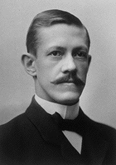
Gullstrand´s model of the eye – basic parameters
Allvar Gullstrand
1852 – 1930
Nobel Award – 1911
Swedish ophthalmologist
Refraction Index:
cornea................................ 1.376
aqueous humour............... 1.336
lens... ..................................1.413
vitreous humour.…………… 1.336
Dioptric power:
cornea ................................ 42.7 D
lens – inside eye................ 21.7 D
eye (whole)........................ 60.5 D
Radius of curvature:
cornea ...................................... 7.8 mm
lens – outer wall........ ............ 10.0 mm
lens – inner wall..................... -6.0 mm
Focus location:
(measured from top of the cornea):
front (object) focus.................... -14.99 mm
back (image) focus ................... 23.90 mm
retinae location.......................... 23.90 mm

Slide 24
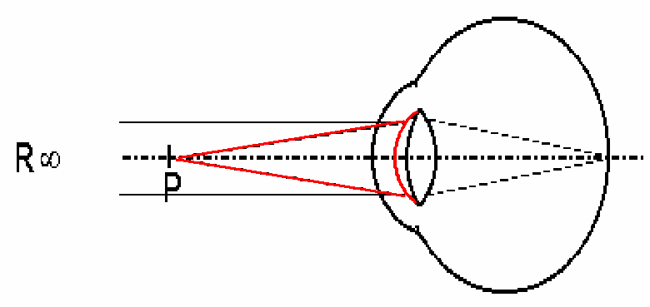
Accommodation
Accommodation is eye lens ability to change its dioptric power in dependence on distance of the observed object.
Accommodation – allowed by increasing curvature of outer lens wall (J.E.Purkyně, Czech physiologist of 19th century)
Far point - punctum remotum (R) - farthest point of distinct vision without accommodation.
Near point - punctum proximum (P) - nearest point of distinct vision with maximum accommodation.
The amplitude of accommodation is the difference of reciprocal values of the distances of the near a and far point, expressed in dioptres. In an emmetropic eye the reciprocal value equals to zero (1/∞ = 0), thus the amplitude of accommodation is given by the reciprocal value of the near point distance.

Slide 25
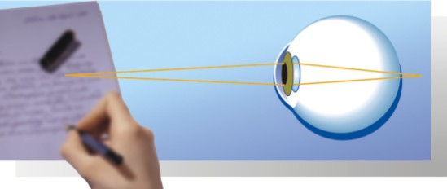
Presbyopia (“after 40” vision, old–age sight)
After age 40, and most noticeably after age 45, the human eye is affected by presbyopia, which results in greater difficulty maintaining a clear focus at a near distance with an eye which sees clearly at a far away distance. This is due to a lessening of flexibility of the crystalline lens, as well as to a weakening of the ciliary muscles which control the lens focusing, both attributable to the aging process.

Slide 26
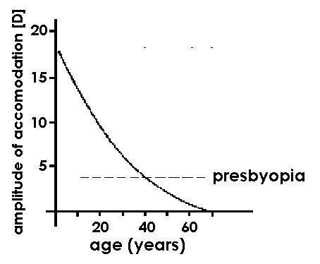
Decrement of accommodation ability in dependence on age

Slide 27
Retina – biological detector of the light
Retina - the light-sensing part of the eye.
It contains rod cells, responsible for vision in low light, and cone cells, responsible for colour vision and detail. When light contacts these two types of cells, a series of complex chemical reactions occurs. The light-activated rhodopsin creates electrical impulses in the optic nerve. Generally, the outer segment of rods are long and thin, whereas the outer segment of cones are more cone-shaped.
In the back of the eye, in the centre of the retina, is the macula lutea (yellow spot ). In the centre of the macula is an area called the fovea centralis. This area contains only cones and is responsible for seeing fine detail clearly.

Slide 28
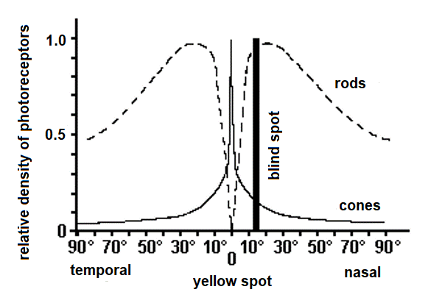
Blind spot
Density of cones decreases from the yellow spot to the periphery of retina. The rods have maximum density in a circle around the yellow spot (20º from this spot, the angle is measured from the back vertex of the lens). The nerve fibres transmitting the stimulation of photoreceptors converge to a place positioned nasally from the yellow spot. This place with no photoreceptors is called blind spot.

Slide 29
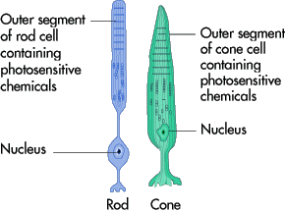
Rods and cones
The outer segment of a rod or a cone contains the photosensitive chemicals.
In rods, this chemical is called rhodopsin. In cones, these chemicals are called colour pigments.
The retina contains 100 million rods and 7 million cones.

Slide 30
Rhodopsin
When light comes in contact with the photosensitive chemical rhodopsin (also called visual purple) a photochemical reaction occurs. Rhodopsin is a complex of a protein called scot(opsin) and 11-cis-retinal - the latter is derived from vitamin A (⇒ lack of vitamin A causes vision problems). Rhodopsin decomposes when it is exposed to light because light causes a physical change in the 11-cis-retinal, changing it to all-trans retinal. This first reaction takes only a few trillionths of a second (10⁻¹⁸). The 11-cis-retinal is an angulated molecule, while all-trans retinal is a straight molecule. This makes the chemical unstable.
Rhodopsin breaks down into several intermediate compounds, but eventually (in less than a second) forms metarhodopsin II (activated rhodopsin). This chemical causes electrical impulses that are transmitted to the brain and interpreted as light. Here is a diagram of the chemical reaction we just discussed:

Slide 31
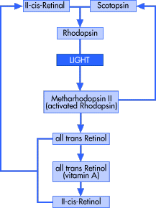
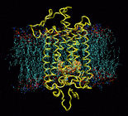
Biochemistry of rhodopsin:
Rhodopsin

Slide 32
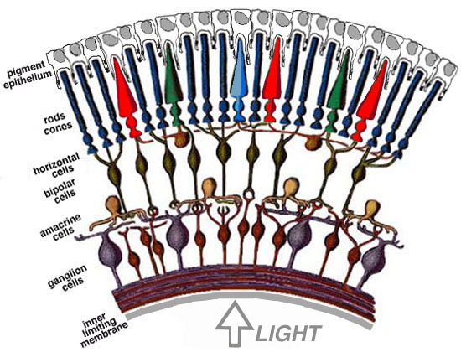
Structure of retina

Slide 33
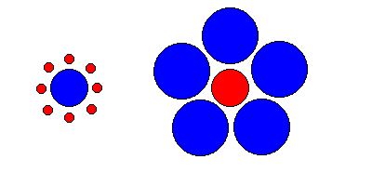

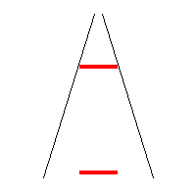
Optical illusions (to relax a little) indicating the role of visual cortex in processing of visual information

Slide 34
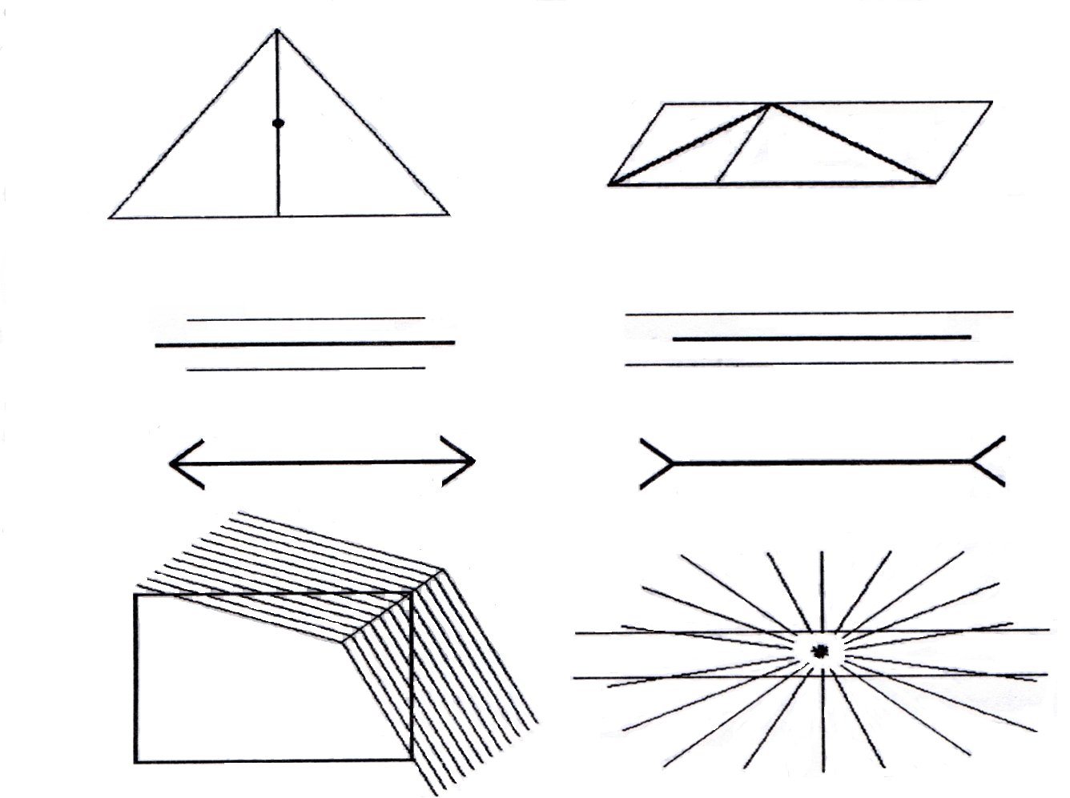
Optical illusions
indicating the role of visual part of brain cortex in processing of visual information

Slide 35
Electrical phenomena in retina
The electrical activity of retina is closely connected with photochemical reactions taking place in photoreceptors after illumination.
Early receptor potential
Late receptor potential
Electroretinography (ERG), recorded by means of two differential electrodes, measured voltage ranges from 100 to 400 μV

Slide 36
Colour vision

Slide 37
Colour Vision
The colour-responsive chemicals in the cones are called cone pigments and are very similar to the chemicals in the rods. The retinal portion of the chemical is the same, however the scotopsin is replaced with photopsins. Therefore, the colour-responsive pigments are made of retinal and photopsins. There are three kinds of colour-sensitive pigments:
  Red-sensitive pigment
  Green-sensitive pigment
  Blue-sensitive pigment
Each cone cell has one of these pigments so that it is sensitive to that colour. The human eye can sense almost any gradation of colour when red, green and blue are mixed (originally Young-Helmholtz trichromatic theory).

Slide 38
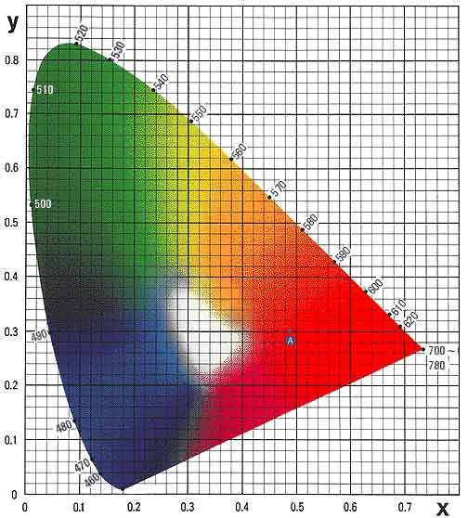
Colour Vision
x– red 650 nm,
y– green 530 nm
z – blue 460 nm
x + y + z = 1

Slide 39
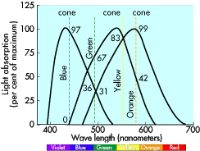
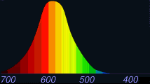
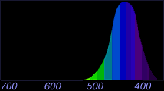
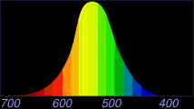
Colour Vision – spectral sensitivity
“Red-sensitive” or “L” cones
“Blue-sensitive” or “S” cones
“Green-sensitive” or “M” cones

Slide 40
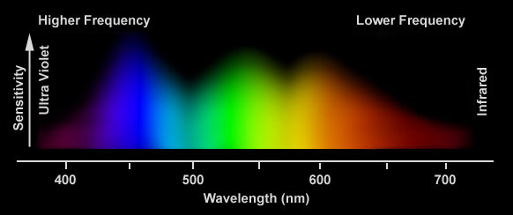
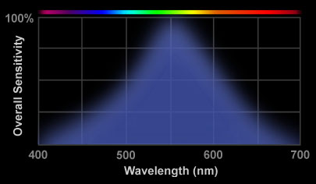
Wavelength Sensitivity
cones „summary“

Slide 41
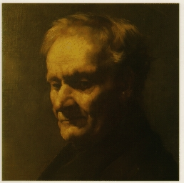
Colour Vision
PHOTOPIC VISION
normal vision in daylight; vision with sufficient illumination that the cones are active, and hue is perceived
Maximum at 555 nm, brightness over 100 cd·m⁻²
SCOTOPIC VISION
the ability to see in reduced illumination (as in moonlight)
Maximum at 507 nm
Purkinje effect (The tendency of the peak sensitivity of the human eye to shift toward the blue end of the spectrum at low illumination levels.)
Jan Evangelista Purkyně
1787 - 1869

Slide 42
Colour Vision
Trichromates - have normal colour vision
Monochromates - have only one cone colour sensing system
Dichromates:
protanopia (difficult distinguishing between blue/green and red/green) – „ red blindness “
deuteranopia (difficult distinguishing between red/purple and green/purple) – „ green blindness “
tritanopia (difficult distinguishing between yellow/green and blue/green) – „ blue blindness “

Slide 43
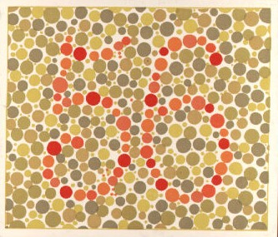
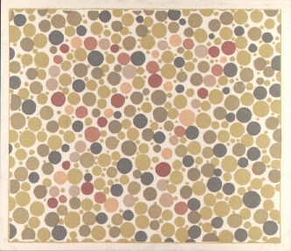
Investigation of colour vision pseudoisochromatic tables

Slide 44
Limits of vision
visual acuity: given by angle of 1min. of arc (tested by Snellen's charts )
sensitivity (intensity ) limit: 2 – 3 photons in several ms
frequency: 5 - 60 Hz depending on brightness
wavelength limit about: 380 – 760 nm
limit of stereoscopic vision: stereoscopic parallax difference smaller than 20 seconds of arc

Slide 45
Authors:
Vojtěch Mornstein, Lenka Forýtková
Content collaboration and language revision:
Ivo Hrazdira, Carmel J. Caruana
Last revision September 2024

