Slide 1
Examination methods in ophthalmology
Veronika Matušková

Slide 2
Outcome from learning
Student can describe basic examination methods in ophthalmology.
Oční lékařství (aVLOL7X1)

Slide 3
Basic examination methods Special examination methods
Examination of visual acuity (VA) = vision, far and near
Measurement of intraocular pressure
Examination of the anterior segment of the eye
Eye fundus examination
Gonioscopy
Perimetry
Ultrasound examination
Electrophysiological methods (ERG, VEP)
Optical coherence tomography (OCT)
Examination of color cell and contrast sensitivity
Corneal topography
Fluorescent angiography
Nerve fiber thickness measurement (HRT)
Oční lékařství (VLOL7X1)

Slide 4
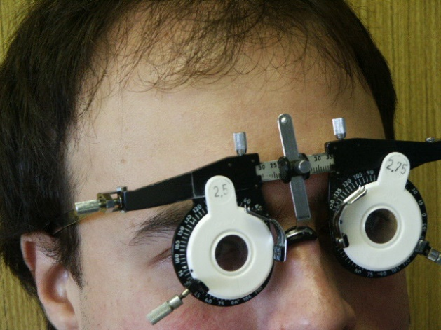
Examination of vision in the distance
We test uncorrected (natural) VA and the best corrected VA.
We examine monocularly (the fellow eye is covered by hand or opaque glass in the spectacle frame), from a specific distance of 4, 5 or 6 m.
The patient reads the characters on:
optotypes - Snellen optotypes, Landolt circles, Pflüger hooks, image optotypes
If patient does not read even the largest letter on the optotype, we test whether he counts the examiner's fingers on a black board, first from a distance of 4 m, then 3 m, 2 m, 1 m or 30 cm (fingers in front of the eye – counting fingres), we start from 4m and gradually we approach the patient.
If patient does not count fingers, we wave with hand in front of the eye (we examine the movement of the hand in front of the face – hand movement).
If patiens can not see hand movement, we darken the room and test whether he can see the light of a flashlight (we examine the light perception).
When the brightness is preserved, we find out whether the patient knows where the light is coming from - from above, from below, from the right, from the left site (we examine the projection
of light, which is correct - certa, or incorrect - incerta).
An eye without lightning is an blind eye (amaurotic).
The autorefractometer measures the optical power of the eye. Then we
Can determine the best corrected visual acuity (BCVA).
Spectacle frame
Oční lékařství (aVLOL7X1)

Slide 5

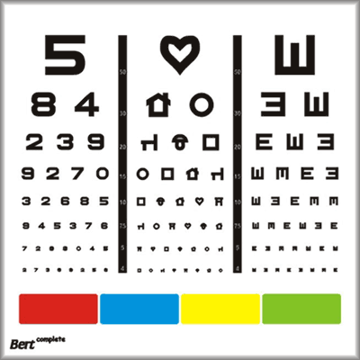
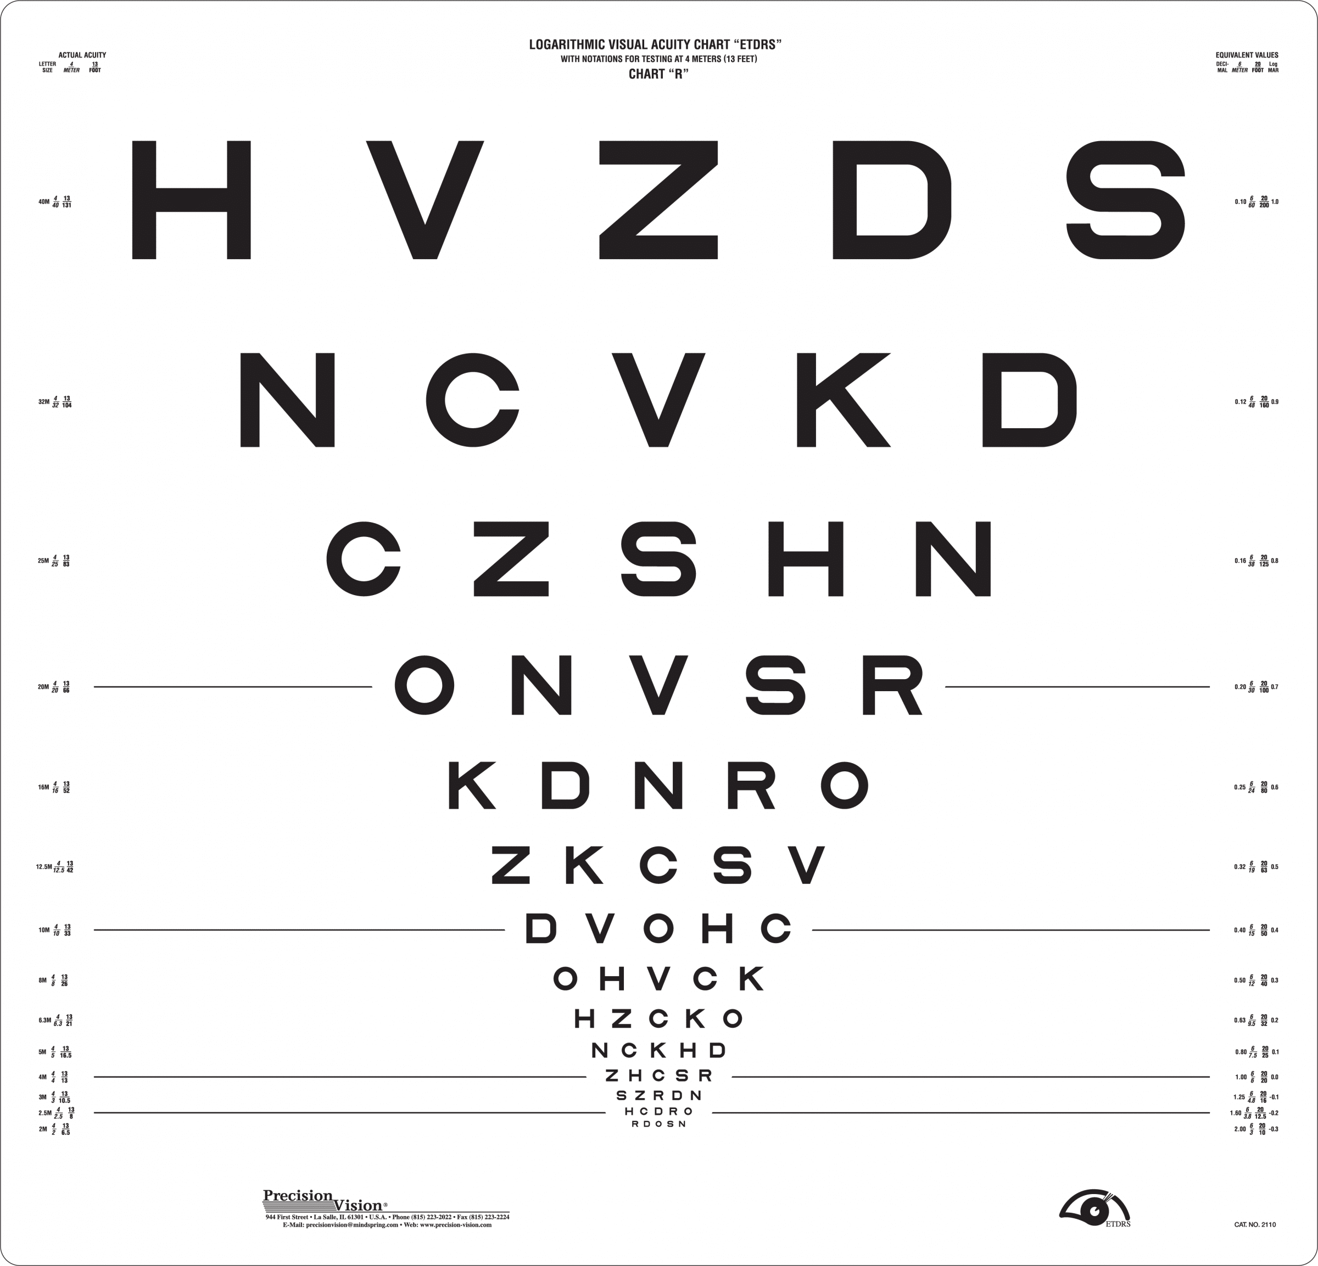
Near vision examination
Near vision depends on accommodation.
Accommodation - a process in which the dioptric force of the eye is changed by arching of the anterior surface of the lens. Gradual loss of accommodation due to age = presbyopia – it manifests itself in emetropes after the age of 40, in hypermetropes earlier.
We examine by using Jäger charts, from a distance of 30 cm, in good light, with correction (if necessary).
Each font size is assigned a number, the smallest letters - Jäger number 1.
Jäger tables
optotypes
ETDRS
Oční lékařství (aVLOL7X1)

Slide 6
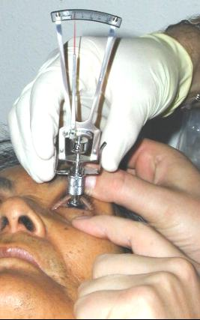
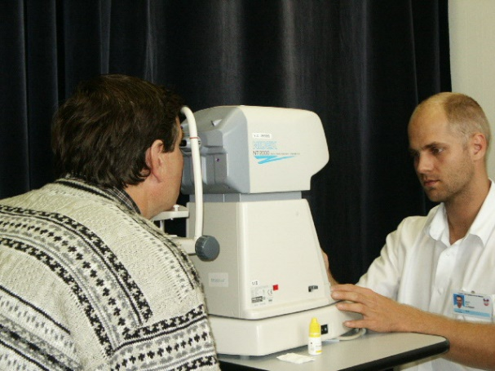
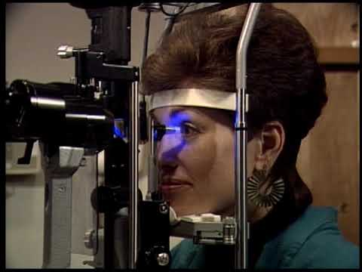
Measurement of intraocular pressure (IOP)
Normal IOP in adults: 10-21 mmHg.
Palpation over the lid - indicative, e.g. when examining of immobile patient in bed.
Tonometry measurement - IOP is indirectly derived from the amount of pressure needed to deform the central surface of the cornea, the deformation is achieved by flattening or impression.
Contact methods - anesthesia of the eye surface is required before measurement.
Schiötz impression tonometer
Goldmann's applanation tonometry - the gold standard for IOP measurements.
Contactless methods
Schiötz impression tonometer
Goldmann's applanation tonometry
pneumotonometer
Oční lékařství (aVLOL7X1)

Slide 7
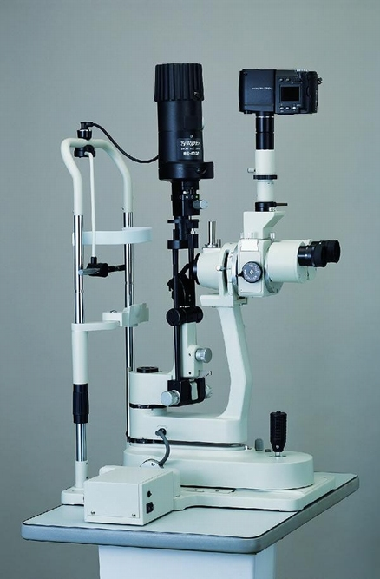
Examination of the anterior eye segment
Macroscopically by aspect
On a slit lamp (SL)
Binocular microscope, light source on a moving arm.
You can change the magnification 16-40x, the intensity and angle of illumination, the width of the slit of the light, you can use pre-color filters.
It is possible to examine the anterior segment up to the lens, resp. anterior vitreous.
The posterior segment can be examined with the help of SL using lenses with an optical power of 60-90 D.
Use the wheel to change the magnification of the image
Movable arm with light source
Patient's chin and forehead rest
Eyeglasses for doctors
We change the width of the light slit with the wheel
We use the joystick to move the SL in the vertical and horizontal, forwards and backwards (and thus sharpen structures at different depths of the eye)
We change the intensity of the light with the wheel, we do not dazzle the patient unnecessarily
The height of the table can be adjusted according to height of
the patient and the doctor
Oční lékařství (aVLOL7X1)

Slide 8
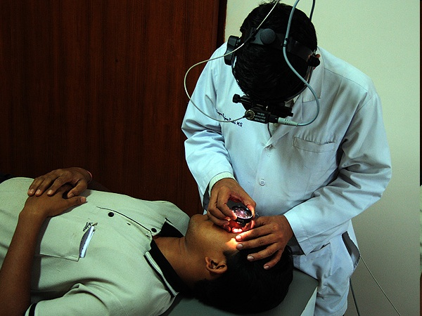
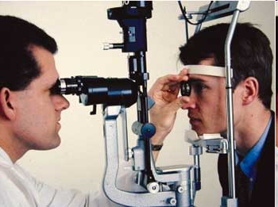
Examination of the posterior segment of the eye - ocular fundus
It is always necessary to induce artificial mydriasis (AM) using short-acting mydriasis (phenylephrine, tropicamide).
Direct ophthalmoscope - a handheld device with built-in lighting, the image is direct and enlarged, the disadvantage - monocular imaging of only a small part of the retina (we do not examine the periphery of the retina), today we examine it only exceptionally.
Indirect (indirect) ophthalmoscope - binocular ophthalmoscope with a light source on the doctor's head, use of a lens, the image is inverted and enlarged, we examine the retina to the periphery, the patient sits or lies, use perioperatively.
Examination of the ocular background on SL = biomicroscopy, use of a lens, the image is inverted and enlarged, we will examine retina to the periphery, today the most common method in the outpatient clinic.
Oční lékařství (aVLOL7X1)

Slide 9
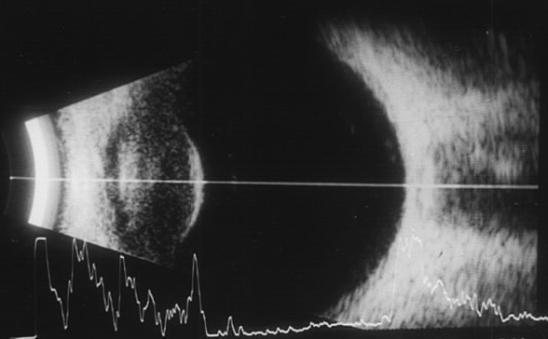
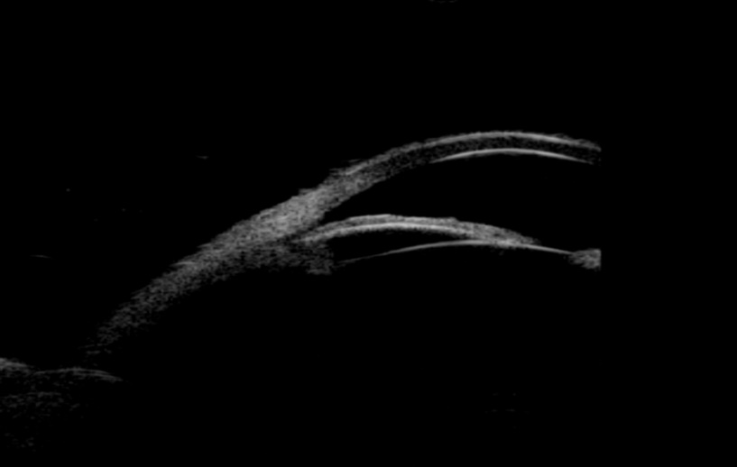
Ultrasound examination
cornea
lens
vitreous cavity
Ultrasound with a frequency of 8-10 MHz, reflection of ultrasound waves from
acoustic interfaces of the eye.
Display A (A-scan): linear (one-dimensional) display mode.
Display B (B-scan): a two-dimensional image.
Indication: to display the rear segment in non-transparent optical media.
Ultrasonic biomicroscopy (UBM): high frequency ultrasound, for
diagnosis of the anterior segment (ventricular angle, iris, ciliated
body), today it is replaced by the OCT method.
optic nerve
B-scan
A-scan
Oční lékařství (aVLOL7X1)

Slide 10
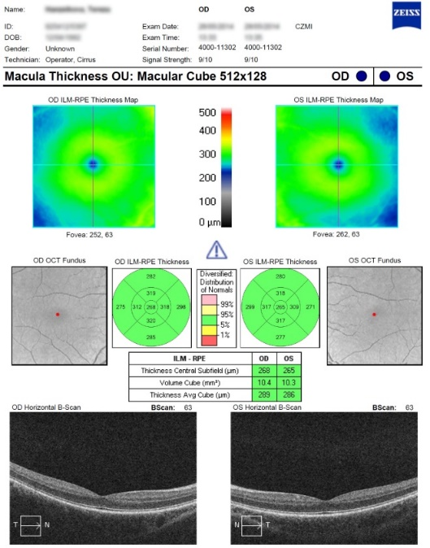
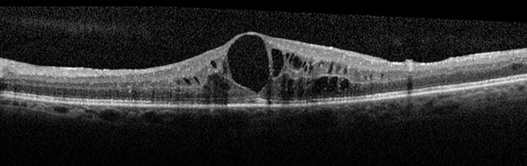
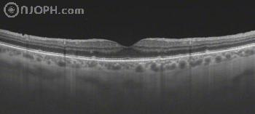
Optical coherence tomography (OCT)
One of the most important methods to examine retinal pathology.
Detailed cross-sectional view of the retina or optic nerve.
A beam of light of wavelength in the IR region, the beam is reflected from the tissues and the individual layers of tissue are displayed according to the degree of their optical reflectivity.
Macrocystic swelling of the retina
neuroretina
retinal pigment epithelium (RPE)
physiological foveolar depression (only photoreceptors, inner layers of the retina are pushed away)
choroid
sclera
Oční lékařství (aVLOL7X1)

Slide 11
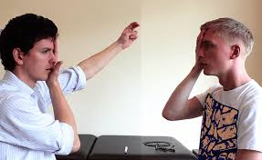
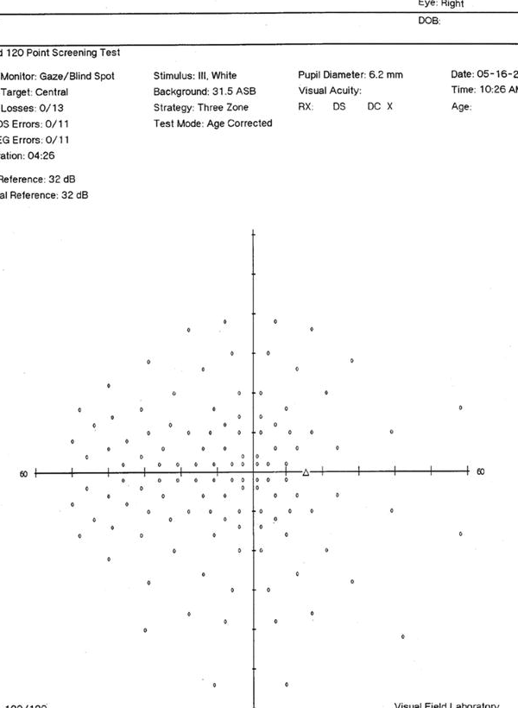
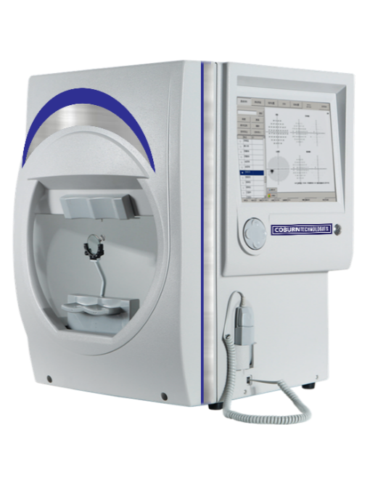
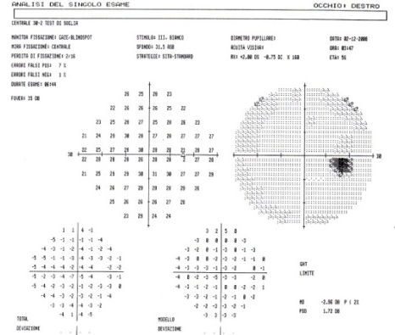
Visual field examination (VF)
Confrontation test - the doctor compares (confronts) the extent of his own VF (with the opposite eyes of the doctor and the patient being covered by the hand) with the patient‘s VF. Rough orientation examination.
Kinetic perimetry - the examiner moves a marker of a certain size and color from the periphery to the center. The link between the places in the diagram, where the patient stated that he can see the mark, is called an isopter. Today, limited use - with a significant decrease in VA, for less cooperating people.
Static perimetry - determines the threshold sensitivity of the retina to exposure in various places of VF. We are investigating part or all of the VF. We compare over time.
static perimetry - examination of the whole VF
conf. exam,
the distance between the patient and the doctor is 1 m
static perimetry - examination of central ZP (30 °)
30°
60°
static perimeter
stimuli of different brightness are offered in the hemisphere of the device
chin and forehead support
the patient presses the joystick as soon as he can see a flash of light
blind spot, located approx. 15 ° temporally from the center of VF
Oční lékařství (aVLOL7X1)

Slide 12
Take home message:
Or „What students often don‘ t know“ :
Three methods of examination of ocular fundus
Optical coherence tomography
Which visual acuity means blind eye ?
Oční lékařství (aVLOL7X1)

