Slide 1
Evidence-Based Medicine
Public Health I

Slide 2
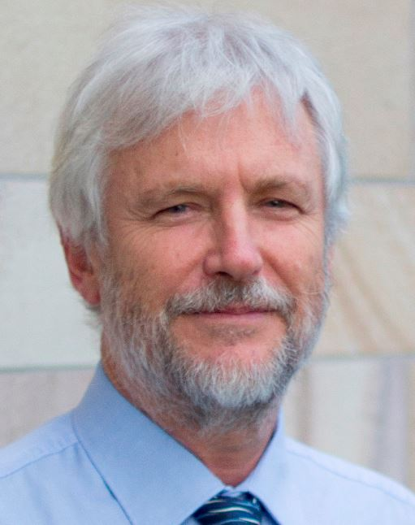
“Can a physician practice medicine without knowing EBM?”
“In medicine, we are continually making decisions, and if medicine is to be a science or a ‘‘learned’’ profession, we need to think critically about HOW and WHY we make those decisions.”
=
Prof. Paul Glasziou, MBBS, PhD
Why is evidence-based medicine important?

Slide 3
Evidence-based medicine (EBM) is the conscientious, explicit and judicious use of current best evidence in making decisions about the care of individual patients.
Evidence based medicine: what it is and what it isn't

Slide 4
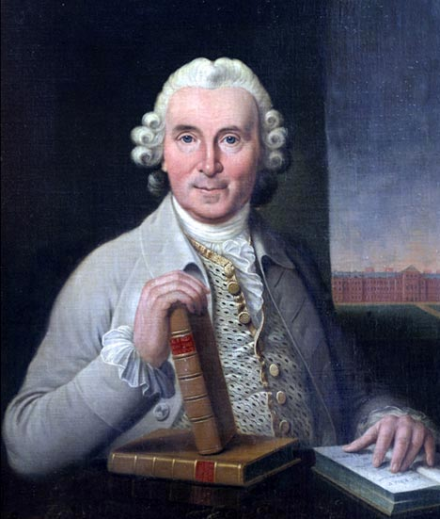
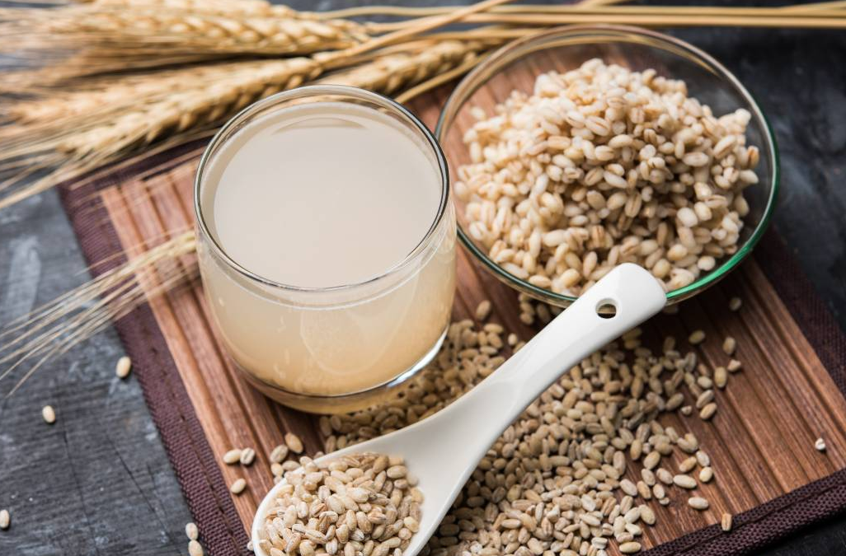
EBM Champions
Cider
n = 2
Elixir of vitriol
n = 2
James Lind (1716 – 1794)
Scottish naval surgeon.
Revered for conducting the first-ever clinical trial in history.
Concluded that scurvy can be cured by citrus fruits rich in Vitamin-C. How?
Vinegar
n = 2
Seawater
n = 2
Barley water
n = 2
Orange & Lemon
n = 2

Slide 5
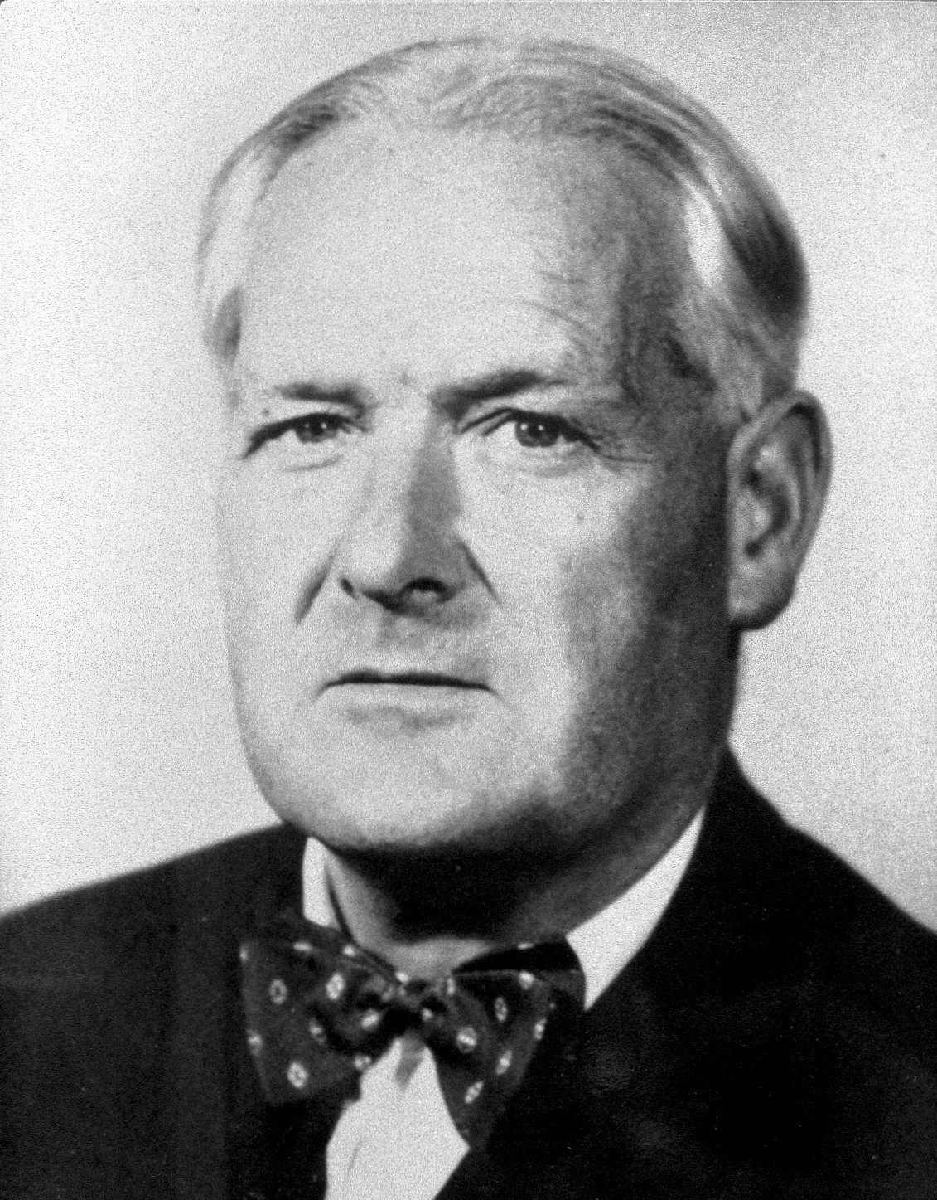
EBM Champions
Bradford Hill (1897 - 1991)
English epidemiologist and statistician.
Laid down the criteria of causal relationship between presumed cause (exposure) and an observed effect (outcome).
Hill’s criteria represent the cornerstone of causality in medicine till today. Define?

Slide 6
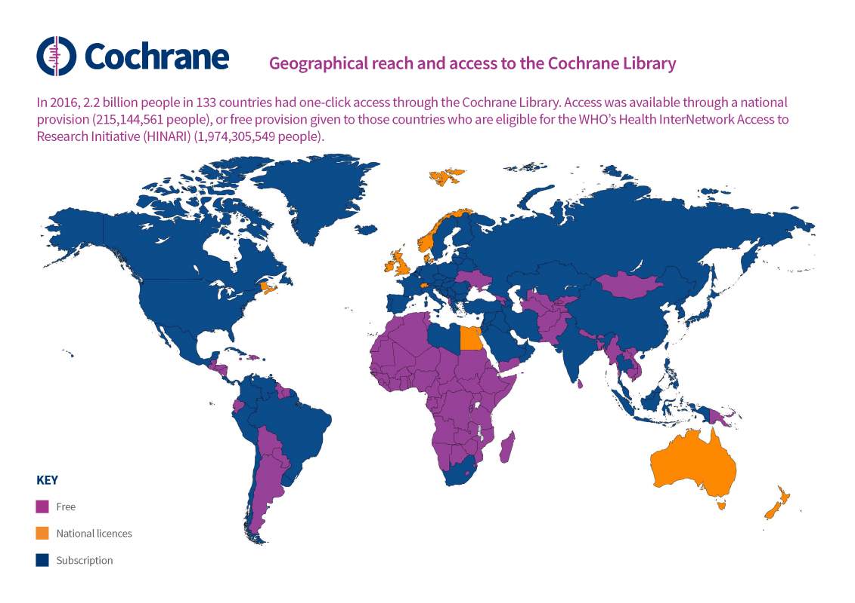
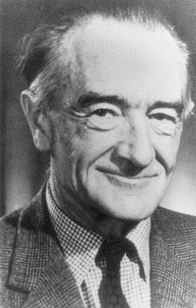
EBM Champions
Archie Cochrane (1909 - 1988)
Scottish physician and clinical epidemiologist.
Known for his advocacy for use of randomized control trials in guiding the clinical practice.
His seminal book “Effectiveness and Efficiency: Random Reflections on Health Services”.
His efforts led to the establishment of Cochrane Collaboration in 1993.

Slide 7
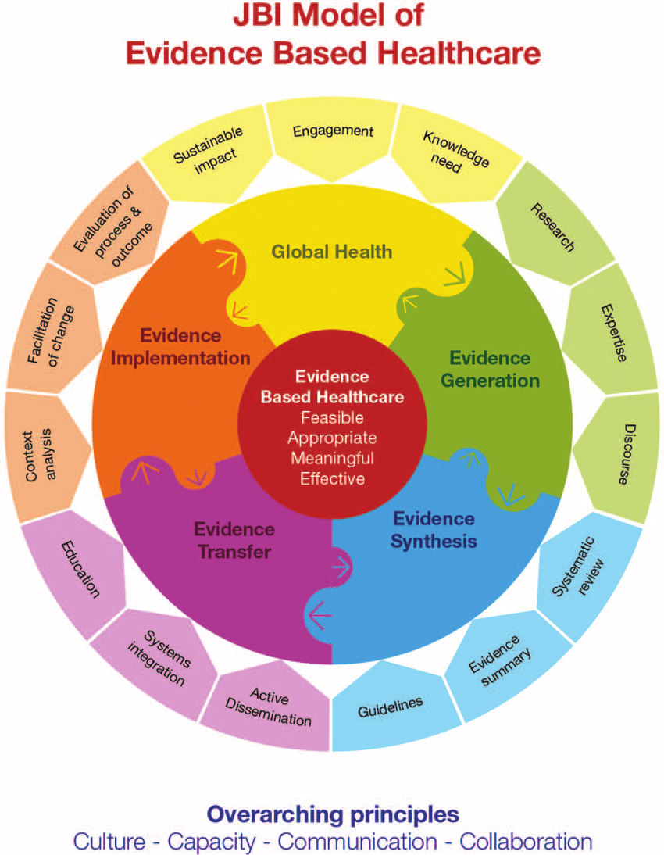
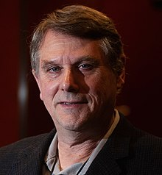
EBM Champions
Prof. Alan Pearson
Founder of Joanna Briggs Institute (JBI).
Prof. Gordon Guyatt
The most cited scholar in EBM.
Prof. Holger Schünemann
Founder of GRADE.

Slide 8
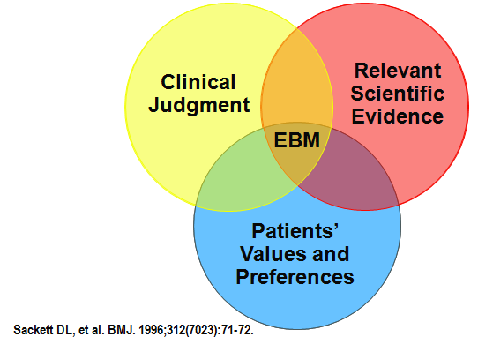
EBM Principles
EBM aims to integrate clinical experience and patient values with the best available scientific evidence.
EBM is not dogmatic cookbook medicine – it never implies that “one-size-fits-all”.
The EBM-oriented clinicians of tomorrow have three tasks:
to use evidence summaries in clinical practice;
to help develop and update selected systematic reviews or evidence-based guidelines in their area of expertise;
to enrol patients in studies of treatment, diagnosis and prognosis on which medical practice is based.

Slide 9
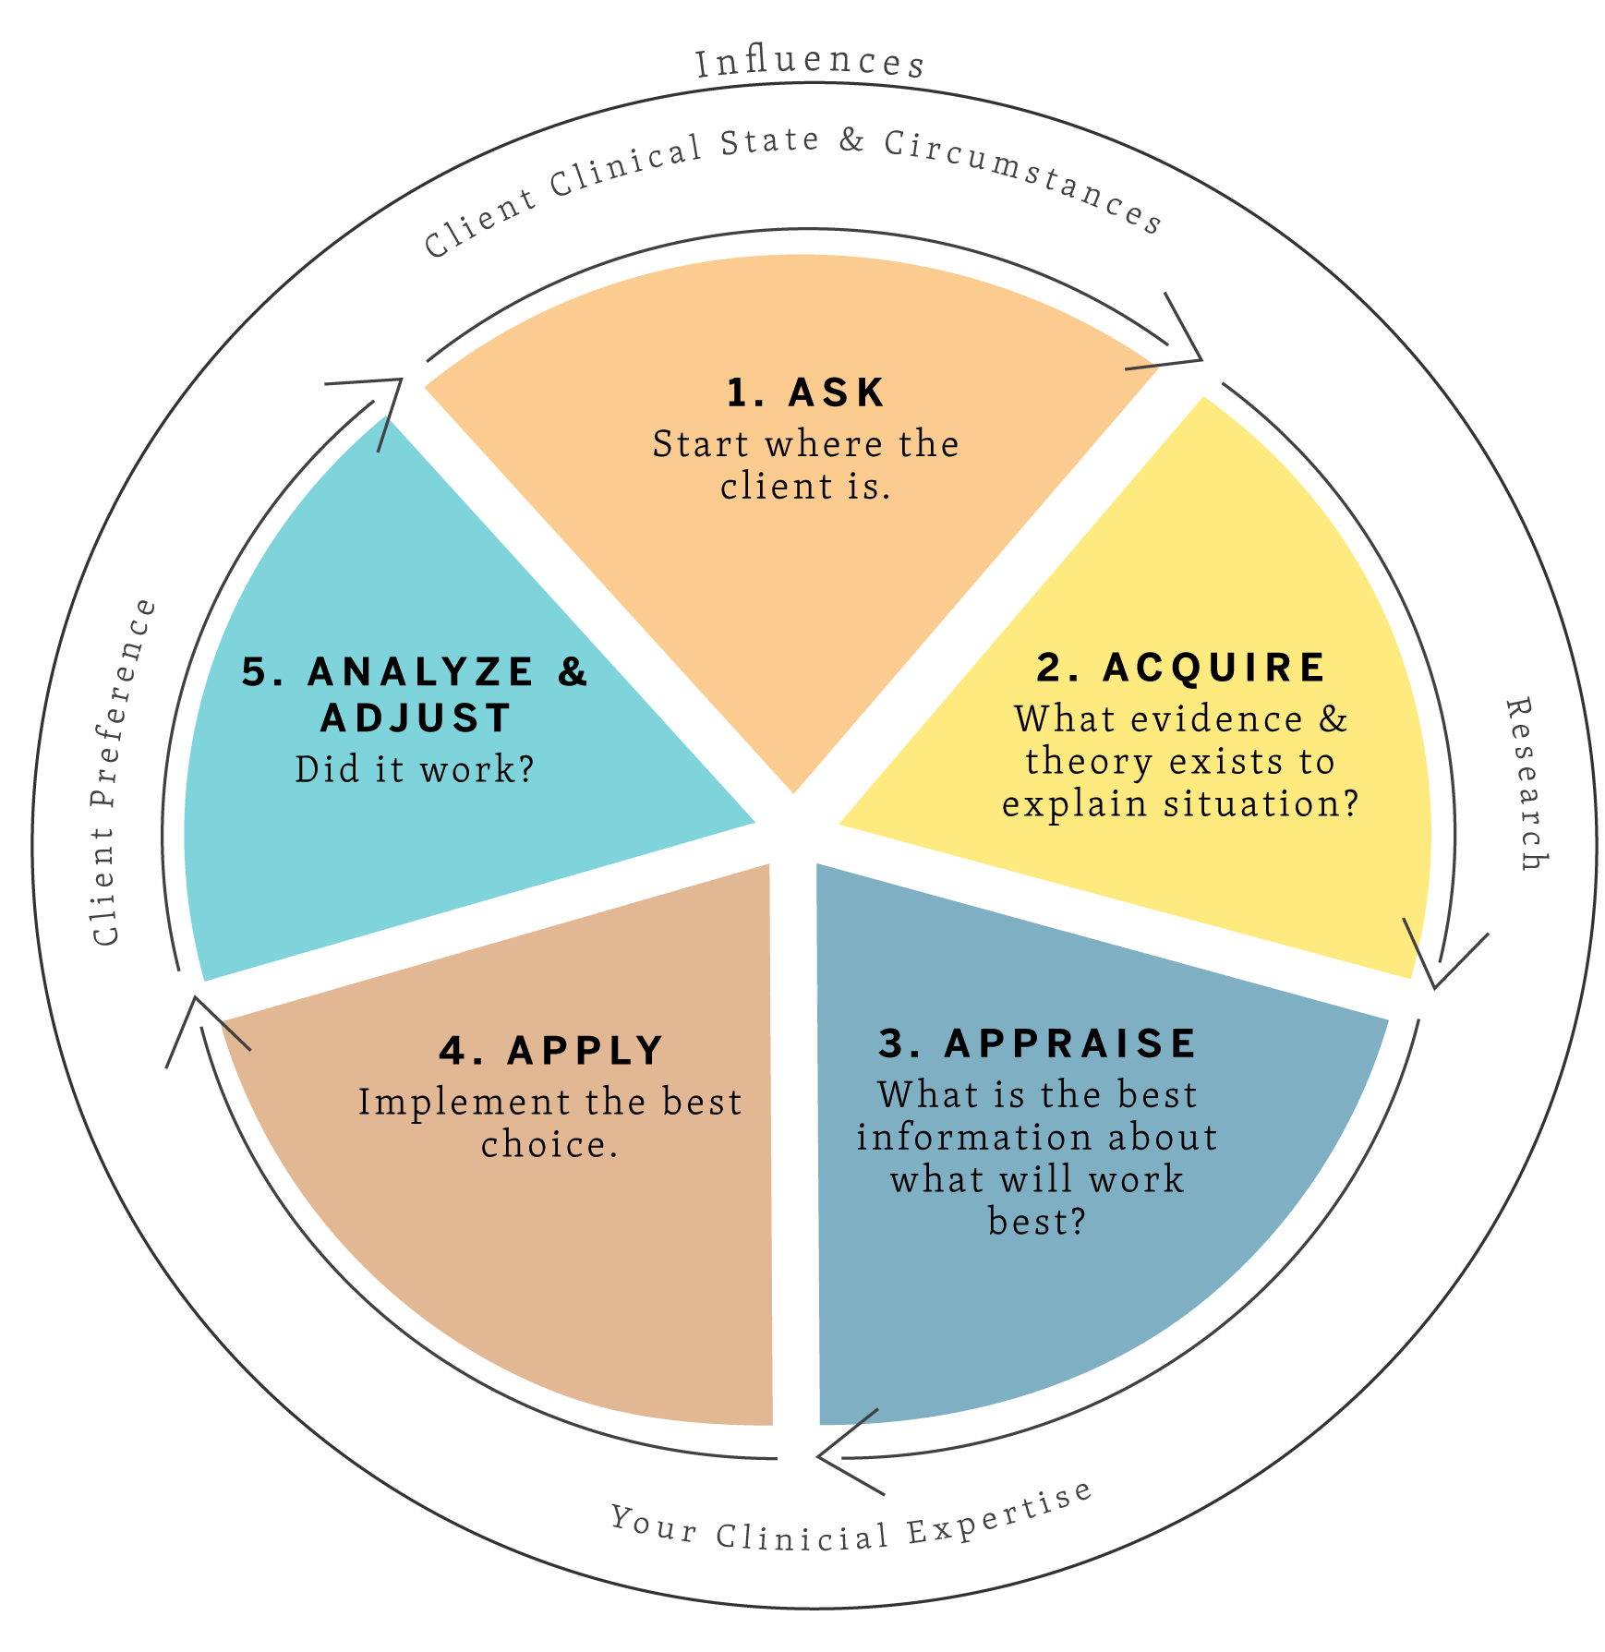
EBM Approach
The general steps (5 A) of EBM are as follows:
Ask: Generate Clinical Question
Acquire: Find Best Evidence
Appraise: Critical Appraisal
Apply: Apply the Evidence
Analyse: Evaluate

Slide 10
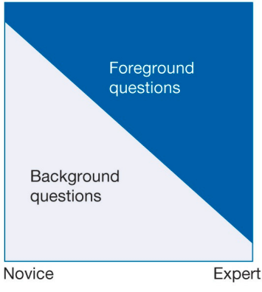
Generate Clinical Question
The initial step in the practice of EBM involves the meticulous formulation of clinical questions. This skill is indispensable for physicians committed to employing EBM.
Medical questions can be categorised into two primary types: 'background questions', commonly posed by medical students and those new to a subject, and 'foreground questions', which are more specific and arise during problem-solving or in-depth research.
It is crucial to dissect the clinical question into its essential elements, such as PICO framework (Patient, Intervention, Comparison, Outcome).
Background
Question
Foreground
Question
Clinical
Question

Slide 11
Generate Clinical Question
Background
Question
Foreground
Question
Clinical
Question
Background Question: What is hypertension and how is it managed in adults?
This type of question often provides foundational knowledge and is typical of those who are new to the subject matter. It is broad and usually seeks general information.
Foreground Question: What is the efficacy of thiazide diuretics compared to beta-blockers in lowering blood pressure in adults with hypertension?
Foreground questions are more specific and are usually asked when a clinician is seeking to make decisions about a specific patient's care. They often include comparisons between different interventions.
Clinical Question: Patient (Adults diagnosed with hypertension); Intervention (Thiazide diuretics); Comparison (Beta-blockers); Outcome (Reduction in systolic and diastolic blood pressure)
In adults diagnosed with hypertension, how effective are thiazide diuretics compared to beta-blockers in reducing systolic and diastolic blood pressure?

Slide 12
Clinical Questions
Types of
Effectiveness
Diagnostic Test Accuracy
Etiology & Risk Factor
Prevalence & Incidence
Qualitative
Population
Intervention
Comparison
Outcome
P I C O
P I R D
P E O
Co Co Pop
P I Co
Population
Index Test
Reference Test
Diagnosis
Population
Exposure
Outcome
Condition
Context
Population
Phenomena of Interest
Population
Context

Slide 13
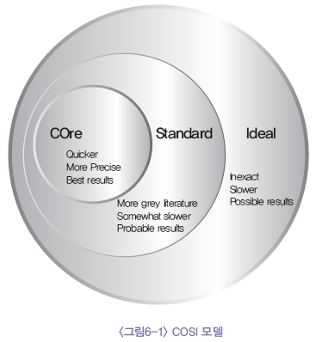
Find Best Evidence
What is good evidence?
Where to find it?
The conditions for the evidence acquired in EBM are that the evidence should be attainable, obtained externally from research, up-to-date, timely, of high quality, applicable to individual patients, and appropriately the best.
The U.S. NLM provides the scope for a literature survey, which is the COSI (Core, Standard, Ideal) model.

Slide 14
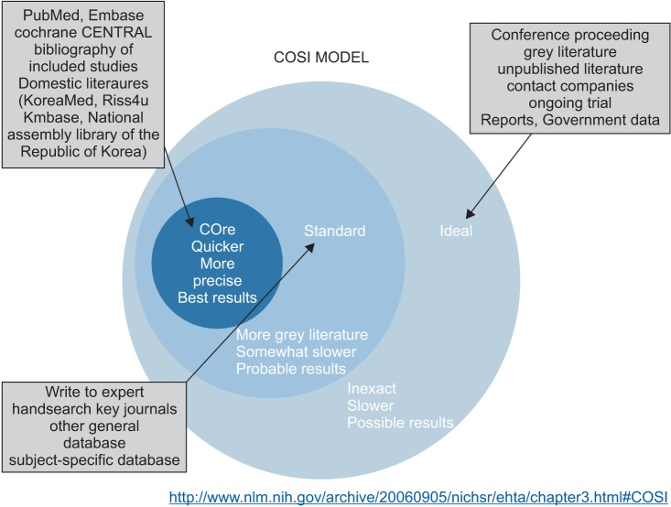
Find Best Evidence
The term "core" means the essence of a literature survey, which is the minimal database required to find the best results rapidly and simply. Therefore, the "core" database is what must be searched. The group of "core" databases includes MEDLINE, EMBASE, and CENTRAL.
The term "standard" represents the standard scope of a literature survey, includes a manual search of core journals and the search of databases that are not "core" (DARE, CINAHL, and PsycINFO).
The "ideal" part includes conference proceedings, grey literature, unpublished articles, and clinical trials currently in process.

Slide 15
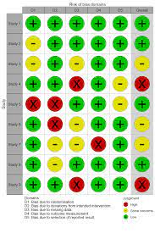
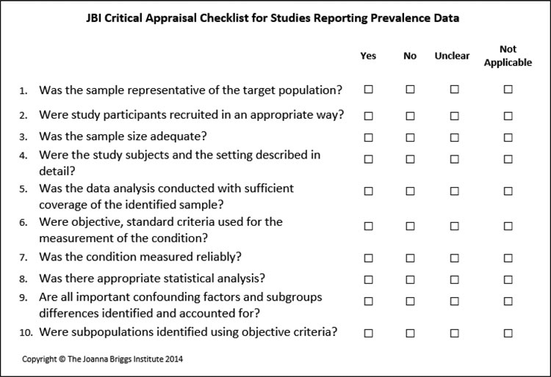
Critical Appraisal
Once the literature has been surveyed, appropriate literature should be selected and the quality and usefulness of the literature should be appraised.
Appraisal of the quality of literature enables decisions to be made regarding whether to accept the conclusions drawn.
Tools of appraisal are classified as scoring system and checklist system, e.g. RoB 2.0, ROBINS-I, JBI Checklists

Slide 16
Critical Appraisal
Once the literature has been surveyed, appropriate literature should be selected and the quality and usefulness of the literature should be appraised.
Appraisal of the quality of literature enables decisions to be made regarding whether to accept the conclusions drawn.
Tools of appraisal are classified as scoring system and checklist system, e.g. RoB 2.0, ROBINS-I, JBI Checklists

Slide 17
Apply the Evidence
Getting evidence into practice is not necessarily straightforward, with a simple estimate of the time it takes from evidence being created to its use in practice being 17 years.
How to bridge the gap between the evidence and the translation (or uptake) of research into clinical practice has been a point of ongoing debate over the years
The questions that we should ask before the decision to apply the results of the study are:
Are the participants in the study similar enough to my patient?
Is the treatment available and is health care system prepared to fund it?
What alternatives are available?
Do the potential side effects of the drug or procedure outweigh the benefits?
Are the outcomes appropriate to the patient? Does the treatment conflict with the patient’s values and expectations?

Slide 18
Evaluate
The final step of EBM is the evaluation.
During this process it is important to assess whether certain evidence, which is applied to the patient, caused changes to better and that to the extent that it is confirmed by research. If the data differ significantly, it would be necessary to investigate why some patients did not respond to the changes introduced in the expected way and what can be done to change it.

Slide 19
BREAK

Slide 20
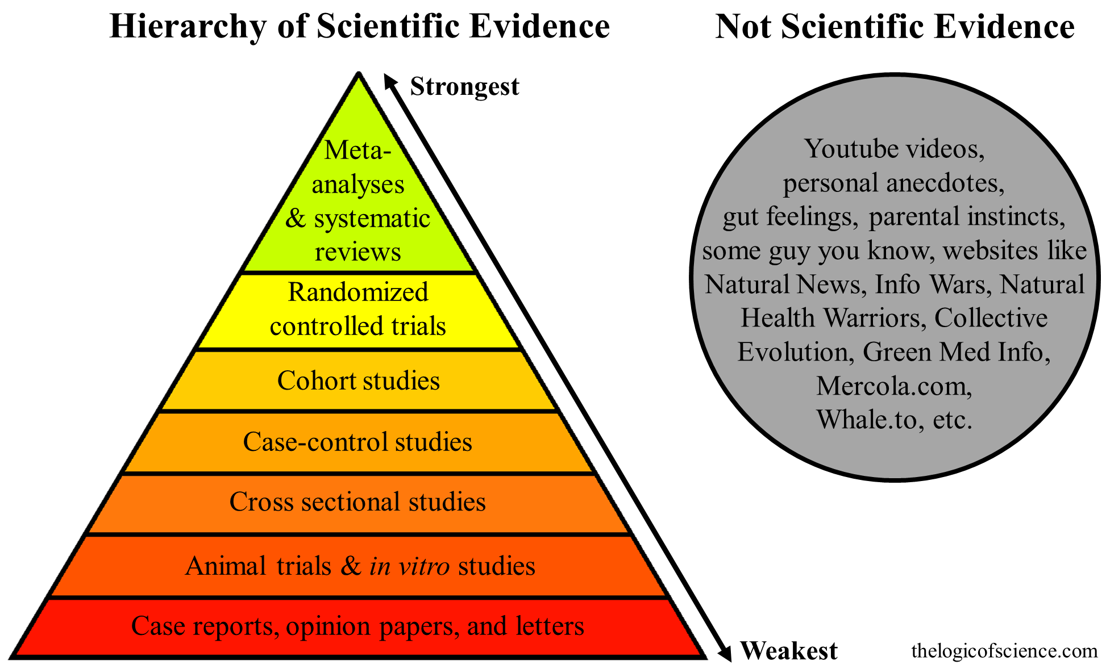
Systematic Review
Systematic reviews are rigorous reviews of the evidence bearing on specific clinical questions.
They are “systematic” because they summarize original research following a scientifically based plan that has been decided on in advance and made explicit at every step.

Slide 21
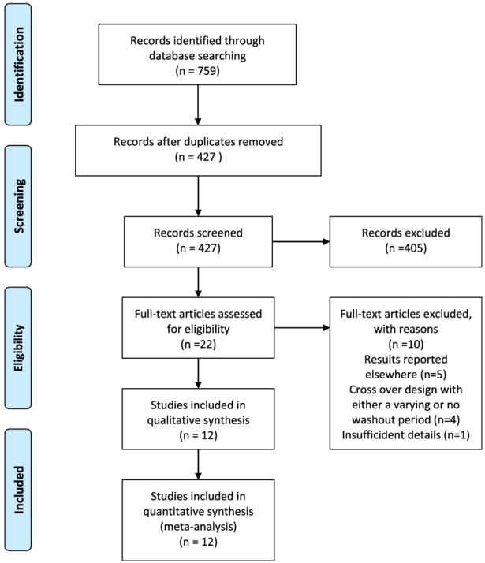
Systematic Review
A methodological protocol of the SR needs to be published in advance.
The workflow of SR is summarized using the Preferred Reporting Items for Systematic Reviews and Meta-Analyses (PRISMA) flow diagram.
The quality of the evidence obtained by SR is proportionate to the quality of the individual (primary) trials included.

Slide 22
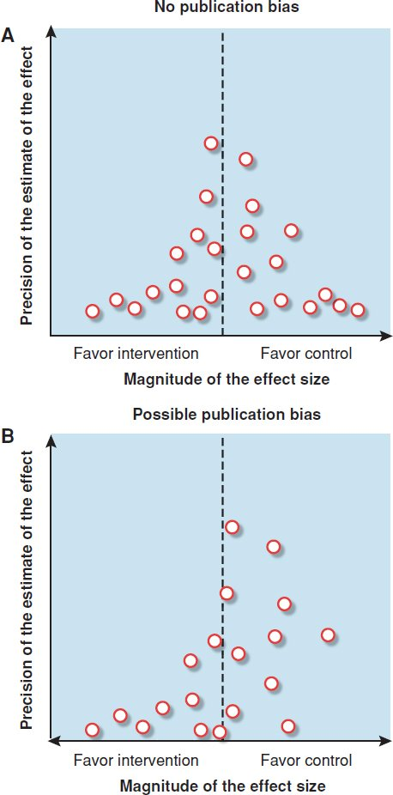
Systematic Review
Publication bias is the tendency of published studies to be systematically different from unpublished ones. In general, published studies are more likely to be “positive” (i.e., to find an effect), particularly for smaller studies.
Funnel plots are a graphical way of detecting bias in the selection of studies for systematic reviews. For each study, the effect size is plotted against some measure of the study’s size or precision, such as sample size, number of outcome events, or confidence interval

Slide 23
Evidence Synthesis
Qualitative Synthesis
Thematic analysis refers to the various processes of reading texts and refining the findings into key ‘themes’.
Meta-ethnography is a qualitative synthesis technique which involves: a) the mapping of key themes and concepts across studies (which may parallel a thematic analysis approach); b) the identification and resolution of any contradictions, and c) the building of a general interpretation based on the data.
Quantitative Synthesis
Meta-analysis is a quantitative, formal, epidemiological study design used to systematically assess the results of previous research to derive conclusions about that body of research.

Slide 24
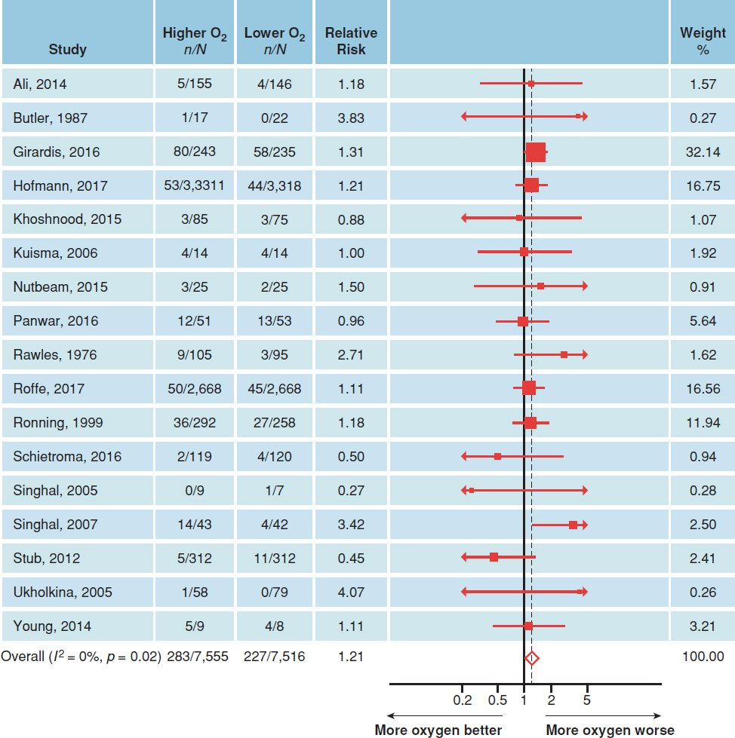
Meta Analysis
Meta Analysis is the quantitative synthesis of the critically appraised evidence.
Forest plots show the point estimate of effectiveness and confidence interval for each study in the review.

Slide 25
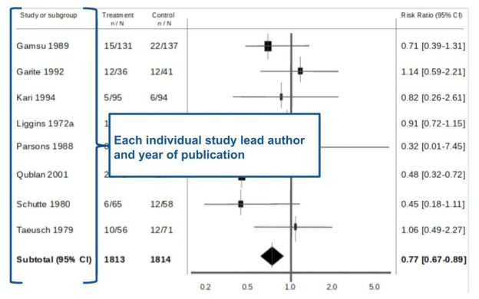
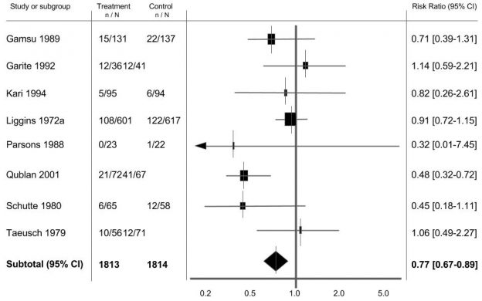
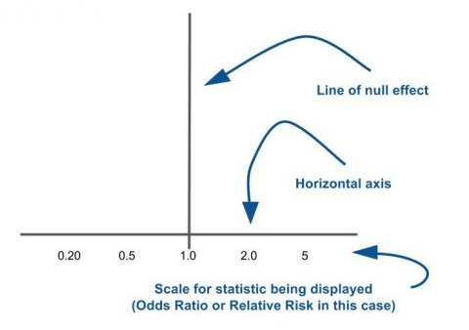
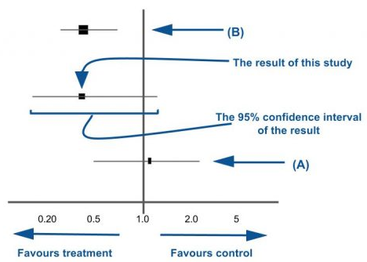
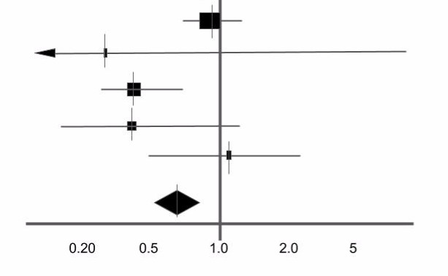
Meta Analysis
https://s4be.cochrane.org/blog/2016/07/11/tutorial-read-forest-plot
How to interpret forest plot?

Slide 26
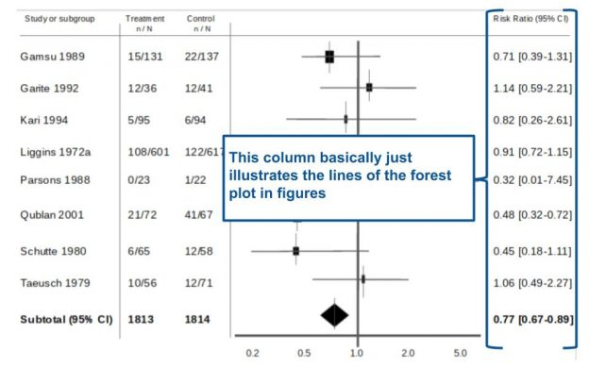
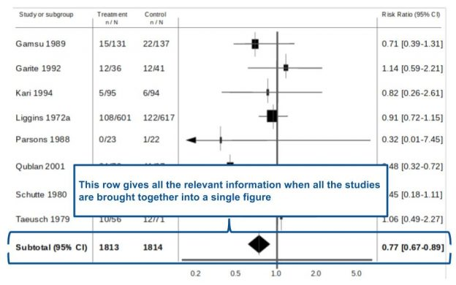
Meta Analysis
How to interpret forest plot?
https://s4be.cochrane.org/blog/2016/07/11/tutorial-read-forest-plot

Slide 27
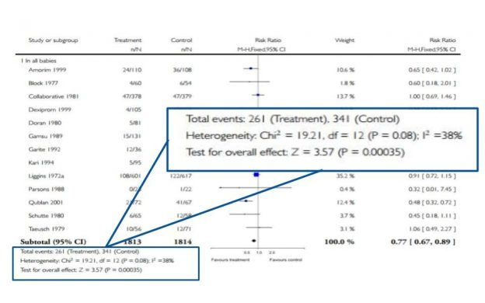
Meta Analysis
How to interpret forest plot?
https://s4be.cochrane.org/blog/2016/07/11/tutorial-read-forest-plot
Heterogenity

Slide 28
Useful Resources
Cochrane Library: https://www.cochranelibrary.com
Students 4 Best Evidence: https://s4be.cochrane.org
Centre for Evidence-Based Medicine (CEBM): https://www.cebm.ox.ac.uk
JAMAevidence: https://jamaevidence.mhmedical.com
JBI Evidence Synthesis: https://journals.lww.com/jbisrir
BMJ Evidence-Based Medicine: https://ebm.bmj.com

Slide 29
THANK YOU
abanoub.riad@med.muni.cz
Abanoub Riad (abanoub.riad@med.muni.cz)
Pavilion: A21 / Third Floor / Office: 315

