Slide 1
Respiratory system.

Slide 2
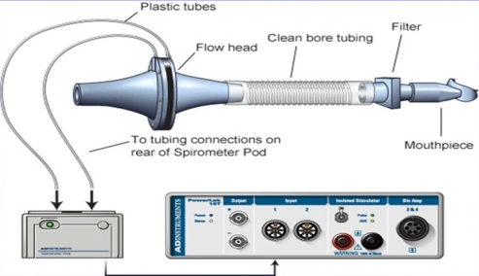
Lung ventilation, volumes, measurement
Principle: determination the air flow velocity from the measured pressure differences between the inner and outer spirometer membranes, the volumes being calculated (PowerLab spirometry)

Slide 3
Lung ventilation, volumes, measurement
V [l]
IRV (2,5 l)
Vt (0,5 l)
ERV (1,5 l)
RV (1,5 l)
Tidal volume (TV) – the volume of air that enters the lungs during each inspiration (or the volume that is exhaled during every expiration).
Inspiratory reserve volume (IRV) – the maximal amount of additional air that can be drawn into the lungs by determined effort after a normal inspiration at rest.
Expiratory reserve volume (ERV) – the additional amount of air that can be exhaled from the lungs by determined effort after a normal expiration.
Residual volume (RV) – the volume of air still remaining in the lungs after the most forcible expiration possible.

Slide 4
Lung ventilation, volumes, measurement
V [l]
IRV (2,5 l)
Vt (0,5 l)
ERV (1,5 l)
RV (1,5 l)
Lung capacity:
VC = VT + IRV + ERV
TLC = VC + RV
FRC = ERV + RV
IC = IRV + VT
EC = ERV + VT
Dynamic lung volumes:
VE
MMV

Slide 5
Lung ventilation, volumes, measurement
Dynamic lung volumes
V [l]
FVC – the maximum volume of air that can be exhaled after maximum inhale
FEV₁ – the volume of air exhaled with the greatest effort in 1 second after maximum inhale
FEV₁/FVC (%) – Tiffeneau index – around 0,8 (80 %)
FEV₁
FVC
RV
1 s
Time [s]

Slide 6
Lung ventilation, volumes, measurement
V [l]
V [l]
FVC > FVC
FEV₁
FEV₁
1 s
Time [s]
1 s
Time [s]
Obstructive lung disease
(FVC=N; FEV₁=↓)
tracheal stenosis
astma bronchiale
CHOPN
tumor
Restrictive lung disease
(FVC=↓; FEV₁=N)
Pulmonary etiology
pulmonary fibrosis
lung resection
pulmonary edema
pneumonia
Extrapulmonary etiology
ascites
kyphoscoliosis
burns
high diaphragm condition

Slide 7
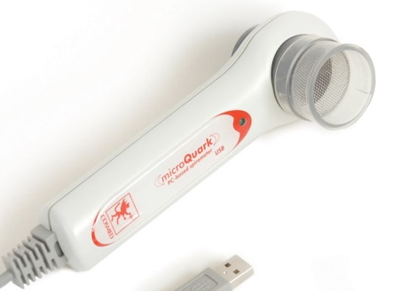
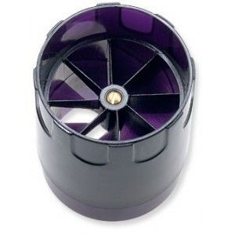
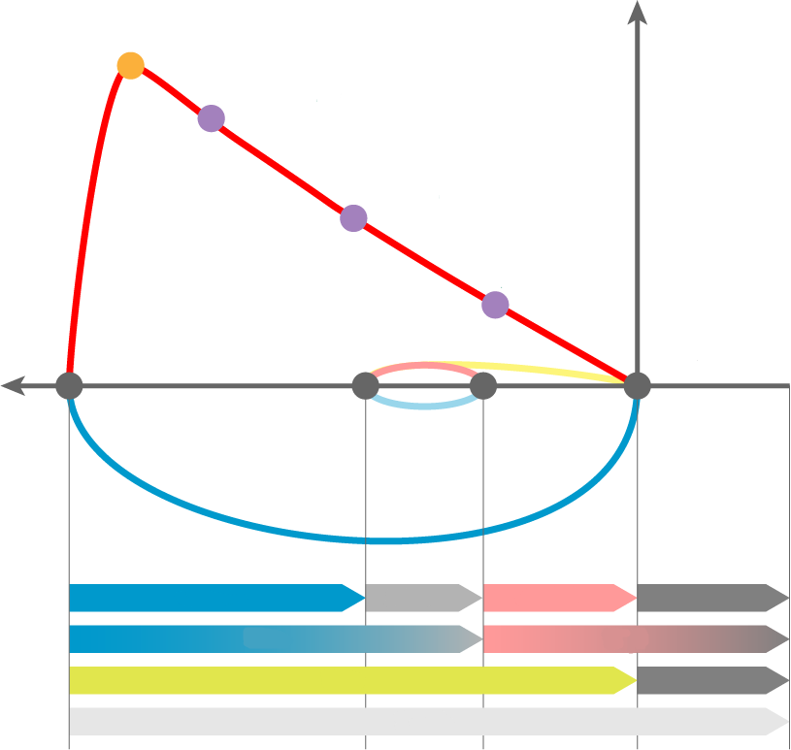
Maximal respiratory flow - volume curve (spirogram)
Principle: the measurement of the air flow velocity according to the speed of the turbine and the volumes are calculated (Cosmed).
PEF
PEF – peek expiratory flow; the highest speed of air flow at peak of exhale
MEF – maximum expiratory flow rates at different FVC levels, which is still to be exhaled (75 %, 50 % and 25 % of FVC)
MEF_{75%}
MEF_{50%}
MEF_{25%}
IRV
Vt
ERV
RV
IRC
FRC
VC
RV
TLC

Slide 8
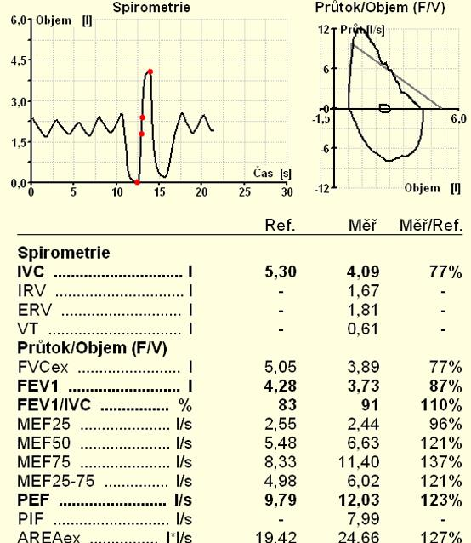

Slide 9
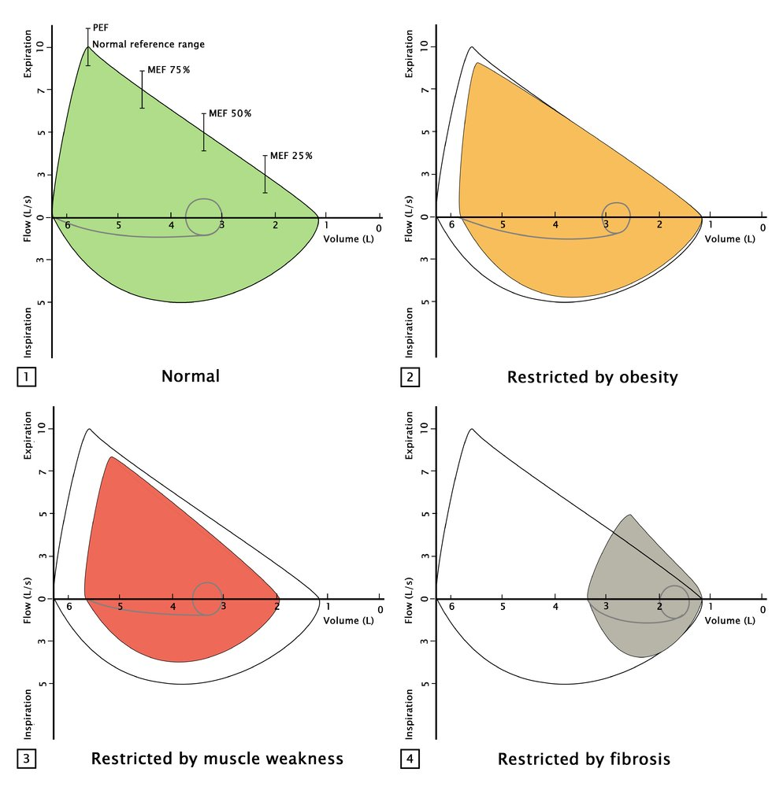
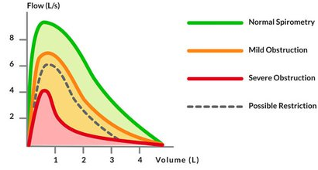
Maximal respiratory flow - volume curve (spirogram)

Slide 10
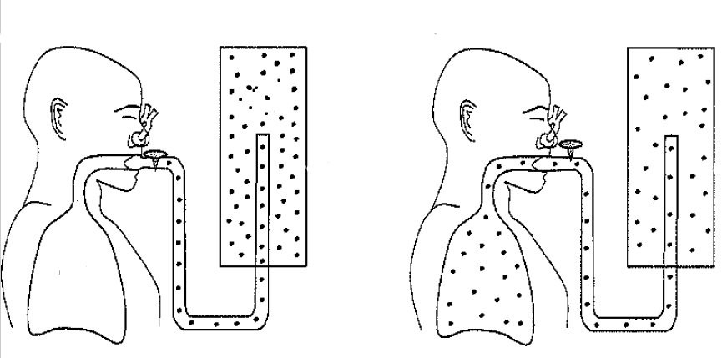
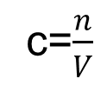
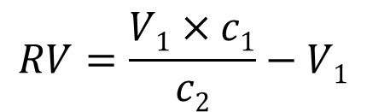
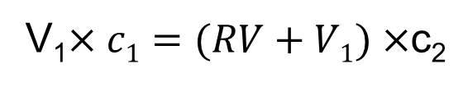
Lung ventilation, volumes, measurement
Helium dilution method – residual volume
V₁
c₁
c=$\frac{n}{V}$
V₂=RV+V₁
c₂
V₁$×c1=(RV+V1)×$c₂
$$RV=\frac{V1×c1}{c2}−V1$$

