Slide 1
Progress in the treatment of lung cancer
Monika Bratova, MD
Department of respiratory diseases and TB Faculty hospital Brno
Medical fakulty Masaryk university

Slide 2
Content
Epidemiology
Situation in the Czech Republic
Classification of lung cancer
Progress in the diagnosis of NSCLC
Progress in the treatment of SCLC
Paliative management – what is new?
Future development

Slide 3
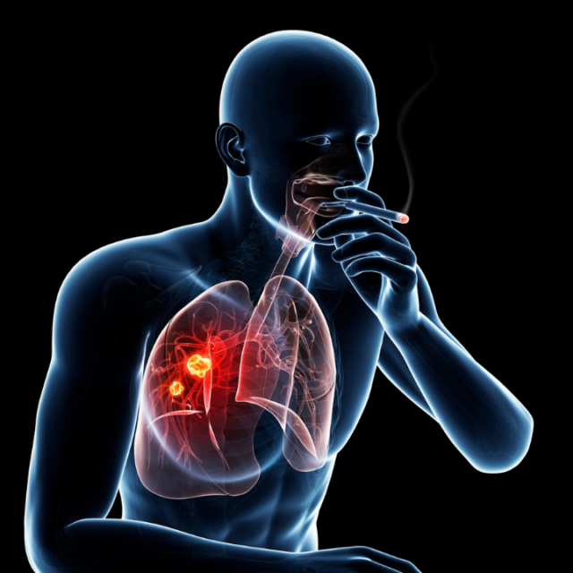
Epidemiology
The publication from 1912 counting all cases of lung cancer over the world found 374 cases x in 2020 WHO described 2 206 771 new cases over the world
It is the second most common malignancy and the first cause of death among all oncological diseases in the world (GLOBOCAN)
In the Czech Republic 6 459 new cases were detected in 2018 (ÚZIS)

Slide 4

Situation in the czech republic (ÚZIS 2018)
50% of patients are 63-75 years old
Male:Female = 1,9:1
The lowest incidence – South Moravian region, the highest – North-west of Czech
70% of cases are diagnosed in stage III a IV, 5-years survival is 17,8% x breast cancer 89,2%

Slide 5
Classification of lung cancer
According to the histology:
Adenocarcinoma
Squamous carcinoma
NSCLC NOS
Large cell carcinoma
Adenosquamous carcinoma
Sarcomatoid carcinoma
Mucoepidermoid carcinoma
Neuroendocrinne tumors

Slide 6
Classification of lung cancer
According to the biological features:
NSCLC – 85% of cases, slower growth, less sensitive to CHT and RT, lower risk of creating metastasis, TNM classification, molecular-genetic markers, more often in peripheral areas
SCLC – 15% of cases, quick growth and huge tendency to metastasis, sensitivity to CHT and RT, limited/extensive disease, central localisation

Slide 7
Classification of lung cancer
According to the clinical stage:
I-IIB – tumor max 5cm, max unilateral hilar lymfnodes
IIIA, B, C – any size of tumor with/without lymfnodes (hilar, mediastinal, supraclavicular)
IV – any size of tumor, solitar or multiple intra or extrathoracic metastasis, pericardial and pleural effusion, carcinomatoid lymfangoitis

Slide 8
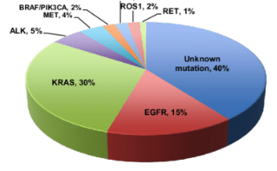
Classification of lung cancer
According to the molecular-genetic changes:
+ PD-L1 expression
(0-100%)

Slide 9
Progress in prevention
Screening of lung cancer – project MZČR – since January 2022
Inclusion criteria: smoking history, 20 pack-years, age 55-74 years
Indication of LD-CT scan
Radiological evaluation (positive/negative/nespecific finding), it leads to a control CT scan or examination at the pneumooncology

Slide 10
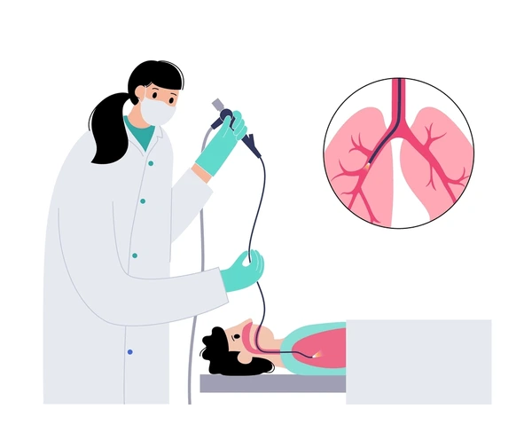
Progress in the diagnosis
An urgent need of a sufficient tissue sample for histology and molecular diagnosis
Bronchology – endobronchial cryobiopsy,
EBUS, rEBUS
Transthoracal biopsy (CT, UZ), mini-invasive
VATS, lobektomy is still a golden standard

Slide 11
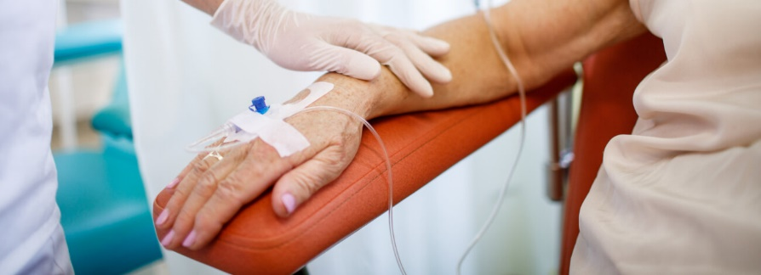
Progress in the treatment of NSCLC
A focus on the first line therapy with the highest efficacy
In NSCLC wild-type immunotherapy and its combinations is preffered (neoadjuvant, adjuvant, stage III/IV)
Phenomena of personalised treatment, Next Generation Sequencing
Radiotherapy and its special modifications (Proton therapy, Cyber knife)

Slide 12
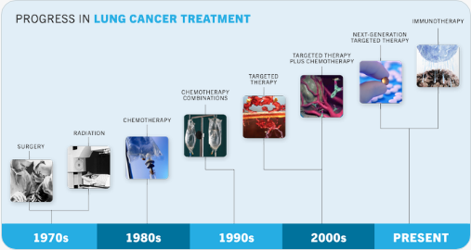

Slide 13
Standard chemotherapy
(platin based chemotherapy)
TKI‘s (x EGFR mutation)
- gefitinib, erlotinib, afatinib, osimertinib, amivantamab
ALK inhibitors
- crizotinib, alectinib, ceritinib, brigatinib, lorlatinib
ROS inhibitors
- crizotinib, entrektinib
NTRK inhibitors
- entrektinib
VEGFR inhibitors
- bevacizumab
Imunotherapy
- pembrolizumab, nivolumab, atezolizumab, durvalumab, cemiplimab
Chemo/
imunotherapy
- pembrolizumab + CHT, nivolumab+ipilimumab+ CHT
Other inhibitors (sotorasib – KRAS, pralsetinib - RET, dabrafenib - BRAF, tepotinib - MET)

Slide 14
Progress in the treatment of SCLC
Standard chemotherapy is still crutial
The new aprroach - combination with immunotherapy (durvalumab) for LD/ED stage
No genetic markers, still with bad prognosis

Slide 15

Paliative treatment – what is new?
Improved management of malignant pleural effusion (pleuroscopy, tunelized pleural catheter)
Insuficient venous systém (iv port, PICC, CICC catheters)
The treatment of bone metastasis (denosumab)
Wider background of mobile hospices and hospice departments

Slide 16

Future development
Centralisation of the oncological care
Shortening of the time to diagnosis
Pneumooncosurgical centers
„ NGS for everyone“
New agents and approach

Slide 17
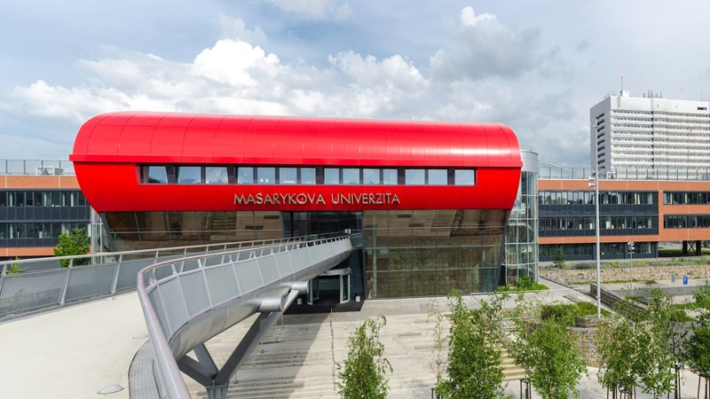
Thank you for your attention

