Slide 1
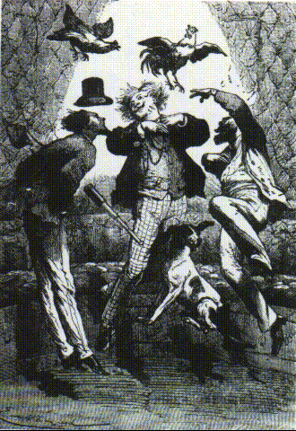

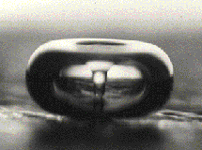
Lectures on Medical Biophysics
Safety aspects of air pressure and gravity changes, and ultrasound

Slide 2
Lecture outline
Hazards arising from too low or too high air pressure
Hazards from changed gravity, state of weightlessness and high accelerations
Hazards of ultrasound

Slide 3
Hazards of lowered air pressure
The atmospheric pressure decreases with altitude exponentially, its half value is reached at 5400 m (about 80% blood saturation by oxygen).
In a fast rise above 3000 m, altitude hypoxia (nausea and headache) appears in non-trained persons. Sped up shallow breathing is the first reaction ⇒ increase of alveolar partial pressure of oxygen and hence haemoglobin oxygen saturation. It is followed by liberation of erythrocytes from reserve spaces, increase of heart power and pulse frequency (tachycardia). Blood supply to the brain and heart increases above all.

Slide 4
Hazards of increased air pressure
The overpressure increases partial pressures of respiratory gases and their content in blood. When lowering ambient pressure to normal value, the excess respiratory gases diffuse out of the tissues into blood and alveolar air.
Problems arise in fast decompression. The superfluous oxygen is metabolised quickly, but the nitrogen remains in tissues and blood in the form of bubbles ⇒ the decompression or caisson sickness. (Caisson is a chamber without bottom used for underwater works. Increased pressure of air prevents its filling by water.) Joints, brain and heart muscle are affected ⇒ articular and muscular pain, headache, nausea and vomiting. N₂ bubbles cause gas embolism in lung veins, brain etc.. This disease is often encountered in divers.

Slide 5
Pressure chamber devices and dysbarism
Hypobaric chambers: Therapy of respiratory diseases – Pressure lowering by 20 - 40 kPa. Breathing volume and rate increases (also CO₂ release). Lungs are better supplied by blood – expectoration is facilitated, and persistent cough is inhibited.
Hyperbaric chambers are utilised not only for therapy of decompression or caisson sickness, but it is the only prevention of this sickness. After fast surfacing from depths, it is necessary to use therapeutic recompression in a hyperbaric chamber followed by a slow decompression. Oxygen therapy is also effective.
The overpressure used for other therapeutic purposes ranges from 26 - 54 kPa, sometimes more. Hyperbaric chambers are used in combination with oxygen therapy (breathing oxygen under pressure). This therapy is applied in some respiratory diseases, in poisoning by CO and cyanide, burns etc.

Slide 6
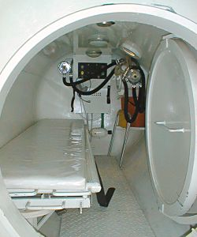
Hyperbaric chamber
http://www.stranypotapecske.cz/kontakty/pic/komora2.jpg

Slide 7
Dysbarism
Dysbarism refers to the problems caused by small pressure changes (up to 5 kPa) - mainly during air travel. The pain in the ears is a result of relative over-pressure or under-pressure in the middle ear, which stretches the ear drum. It often arises when the Eustachian tube is occluded. Repeated swallowing helps to equalise the pressures.

Slide 8
Hazards of High Accelerations
Humans are adapted to the normal vertical acceleration of gravity, g = 9.81 m·s⁻². In aerospace transport, an acceleration several times higher acts in the direction of the acting inertial force.
Positive acceleration – the force is directed from head to legs. Blood moves in the same direction ⇒ brain anaemia and accumulation of blood in lower extremities. Lowering of blood pressure in the brain causes loss of consciousness and the so called „white blindness“ (anaemia of retina). Critical value: about +5g.
Negative acceleration – the force is directed from legs to head. The blood accumulates in head, causes hyperaemia of retina – „red blindness“ - retinal and brain bleeding can appear. Critical value: about -3g.
Transversal acceleration – the force is directed perpendicular to the body axis. Critical value: about 18 g.
The effects of increased gravity may be reduced by appropriate body position, and by the so called anti-g suit.

Slide 9
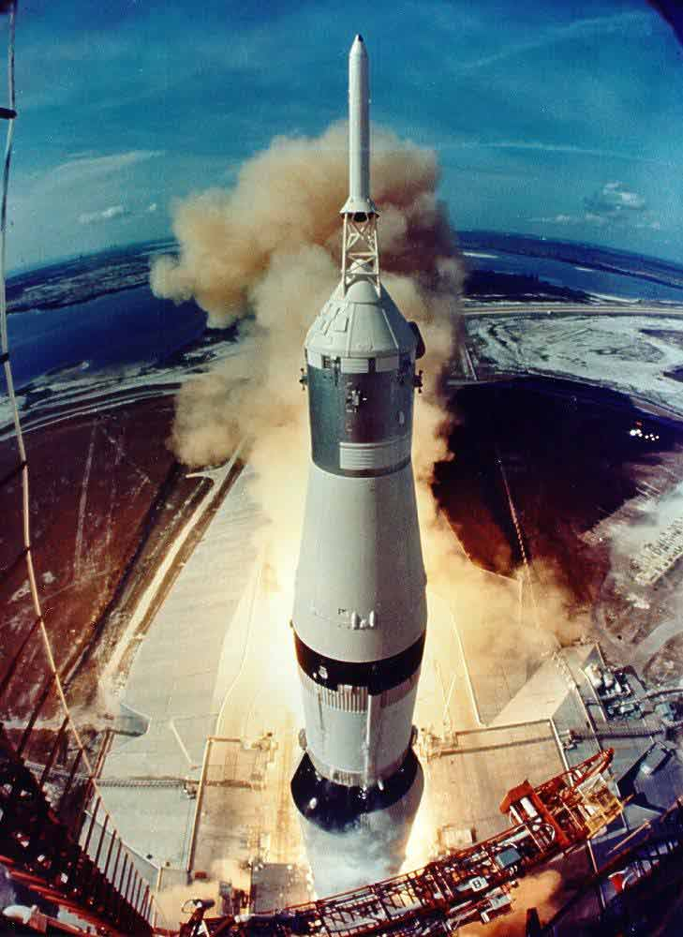
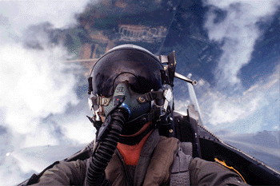
Effects of High Acceleration

Slide 10
State of weightlessness
In motion in Earth’s orbit, a state of weightlessness arises. It causes disorders in neuromuscular co-ordination owing to lack of stimuli coming from the extremities, as well as a distorted feeling of the body position due to malfunction of vestibular organ.
During a long stay in a state of weightlessness, muscular strength decreases, and bones are decalcified. The lowered load of locomotive organs can be substituted by exercises.
Jules Verne:
From the Earth to the Moon

Slide 11
Motion Sickness
Irregular acceleration and deceleration in moving vehicles causes motion sickness in sensitive persons. This disorder of the nervous system manifests itself by paleness, shallow and rapid breathing, nausea and vomiting.

Slide 12
Hazards of ultrasound
Passive and active ultrasound interactions
Active: thermal, cavitational and other effects
  Cavitational – see below
  Thermal – see the lecture on physical therapy
  other effects – thixotropy and emulsification, increased membrane permeability, accelerated diffusion – increasing rate of chemical reactions etc.

Slide 13
Biophysical aspects of ultrasound cavitation

Slide 14
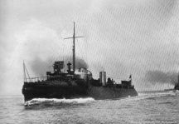
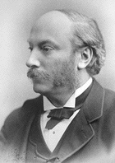
Historical observations of cavitation and the first attempt on mathematical processing of the problem
Sir John Isaac Thornycroft (1843 - 1928, British shipbuilder) and Sidney Barnaby observed cavitation effects of water turbulences on the propeller in 1895 (the destroyer HMS Daring)
Lord (John William Strutt) Rayleigh, 1842 – 1919, described first mathematically the radial oscillations of a bubble in a liquid – at British navy request.

Slide 15
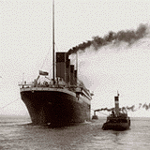
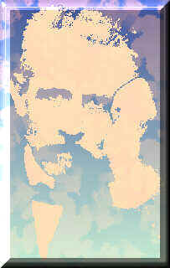

From Paul Langevin’s sonar to ultrasound therapy and diagnostics
After the sinking of Titanic (1912) and the submarine war, need of early warning arose.
Paul Langevin (1872 – 1946) together with Chilowski patented ultrasound echolocation system (1918).
The effective and controlled source of water-borne ultrasound appeared.
Wood a Loomis (1926, 1927) – chem. and biol. effects of US cavitation.
Sokolov (1937), Firestone (1942) - US defectoscopes
40‘ – beginnings of ultrasound therapy
50‘ – first applications of US in dentistry and diagnostics

Slide 16
What is cavitation?
Radial oscillations of gas-filled microbubbles
Two main kinds of cavitation:
  Transient (also collapse) - I_{US} above ~ 100 W/cm² (1 MW/m²)
  Resonance or pseudocavitation - I_{US} above ~ 0.2 W/cm² (2 kW/m²)
Cavitation thresholds: (different in general) - for mechanical effects, sonoluminescence, chemical effects. Blake threshold (onset of transient cavitation).

Slide 17
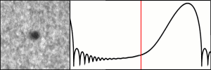
Oscillations of a cavitation bubble
The oscillation of cavitation bubbles is not harmonic (i.e., r = f(t) is not sinusoidal) - contrary to that of ultrasound waves in the surrounding liquid.
From: Reinhard Geisler (DPI), 1997 http://www.physik3.gwdg.de/~rgeisle/nld/blaf.html

Slide 18
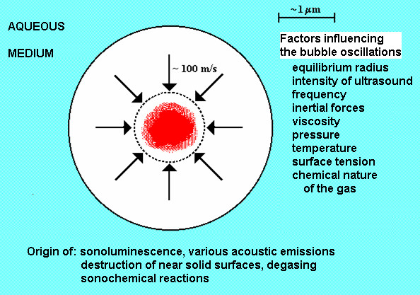
Oscillations of a microbubble

Slide 19
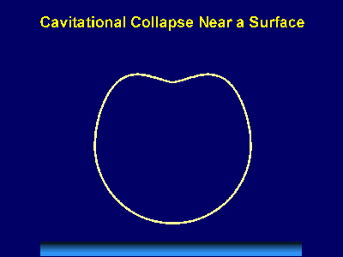
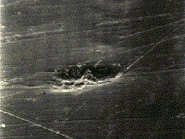
Behaviour of microbubbles at the solid/liquid interface
http://www.scs.uiuc.edu/~suslick/execsummsono.html: THE CHEMICAL AND PHYSICAL EFFECTS OF ULTRASOUND Kenneth S. Suslick
Crum L.A., Cavitation microjets as a contributory mechanism for renal calculi disintegration in ESWL, J. Urol. 140, 1988, p. 1587 - 1590
Micrograph of polished brass plate with cavitational damage.

Slide 20
How to study cavitation?
A theoretical problem: Cavitation is a phenomenon on the edges of the macroscopic and microscopic world – the cavitation bubble is too small and unstable for classical physical analysis, and too large for quantum physical analysis.
The mathematical models of bubble oscillations are very complicated and describe almost exclusively individual oscillating bubbles.
An experimental problem: How does cavitation act inside living organisms? How is the cavitation itself influenced by the biological medium? Is it possible to investigate cavitation in vivo?
Experimental studies deal mainly with ensembles of chaotically moving bubbles.

Slide 21
Methods for studying cavitation phenomena in biophysics
acoustic (measurement of acoustic emissions and changes in reflectivity)
optical (so-called schlieren method for imaging of acoustic field, high-speed photography, measurement of oscillations of an „anchored“ bubble by laser, measurement of sonoluminescence)
chemical (chemical dosimetry)
biological (haemolysis, histology – e.g. searching for bleeding into lung tissue in experimental animals)
evaluation of mechanical damage caused by cavitation, e.g. on metallic foils exposed to ultrasound field.
How can these methods be applied in vivo?

Slide 22
Sonochemistry of air saturated aqueous solutions
Sonolysis of water can be compared with radiolysis of water. Excitation of gas molecules arises inside cavitation bubbles. Examples of reactions:
In absence of oxygen in ultrasound treated water, the oxygen can appear because of following reactions:
H₂O₂ + •OH •HO₂ + H₂O
•HO₂ + •OH H₂O + O₂
In gaseous phase, there is increased probability of reactions leading to formation of free radiacals and oxygen peroxide:
H₂O (excit.) •H + •OH
•HO₂ + •HO₂ H₂O₂ + O₂
In the surrounding liquid, the excited molecules of water can enter reactions leading to the primary products of water sonolysis:
H₂O (excit.) + H₂O H₂ + H₂O₂

Slide 23
The other sonochemical processes
There are many compounds which can decrease the occurrence/intensity of ultrasound cavitation and hence the yield of sonochemical reactions.
These compounds penetrate into the cavitation bubble and prevent more or less its compression or collapse, for example - alcohols, ethers and aldehydes with high vapour pressure. The chemical effect of cavitation is also inhibited by some gases – e.g. CO₂, CO, H₂S, N₂O.

Slide 24
Chemical dosimetric methods
Fricke dosimeter is based on the oxidation of Fe²⁺ to Fe³⁺.
Iodide dosimetry: KI dissolved in distilled water. After ultrasound treatment, the concentration of liberated iodine is measured.
Cerium dosimeter is based on reduction of Ce⁴⁺ to Ce³⁺
Taplin dosimeter (two-component) - chloroform overlaid by water. HCL is formed, pH is measured.
Determination of H₂O₂ based on measurement of luminol luminescence.
Fluorescence of terephthalic acid after interaction with free radicals.
Liberation of chlorine from tetrachloromethane. Chlorine gives a colour compound with O-tolidine.

Slide 25
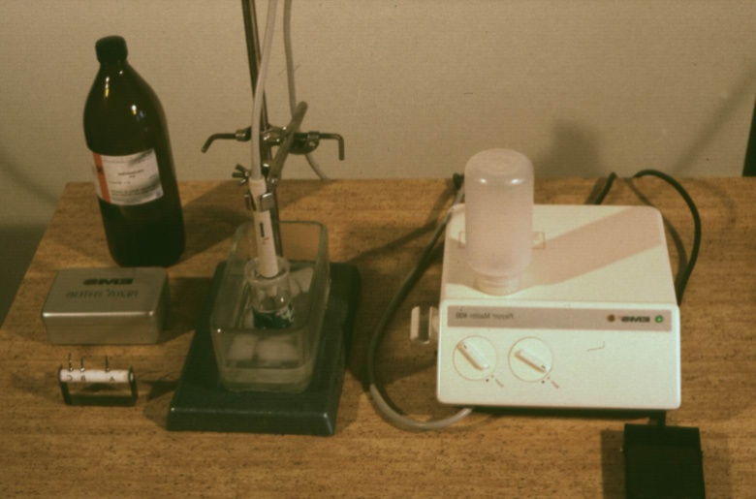
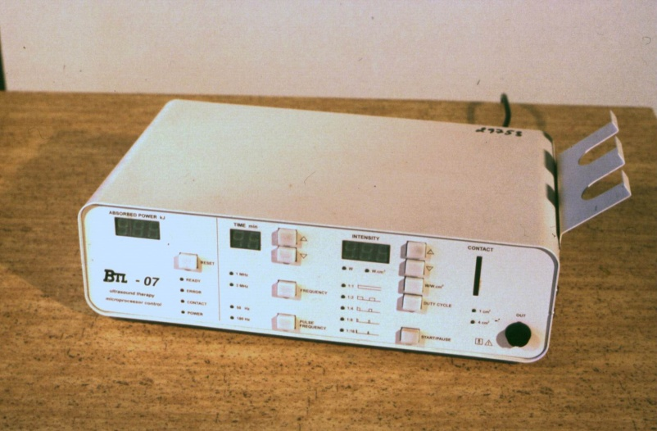
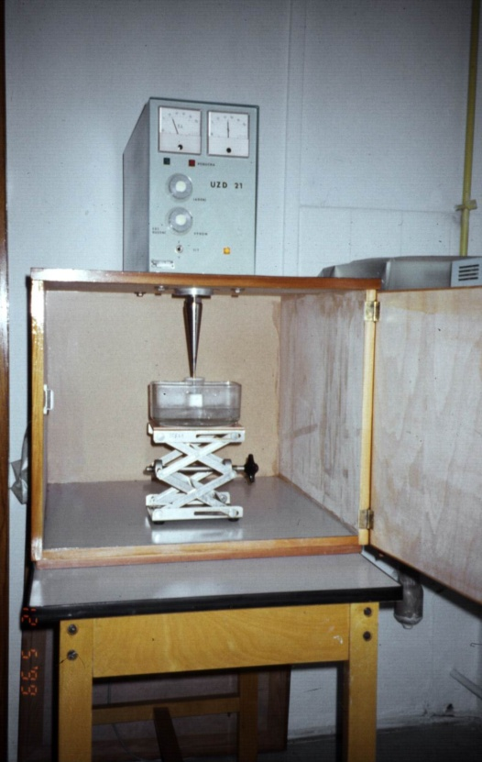
Sources of ultrasound used in following experiments
UZD – 21
(disintegrator)
Piezon Master 400
(dental device)
BTL – 07
(therapeutic device)

Slide 26
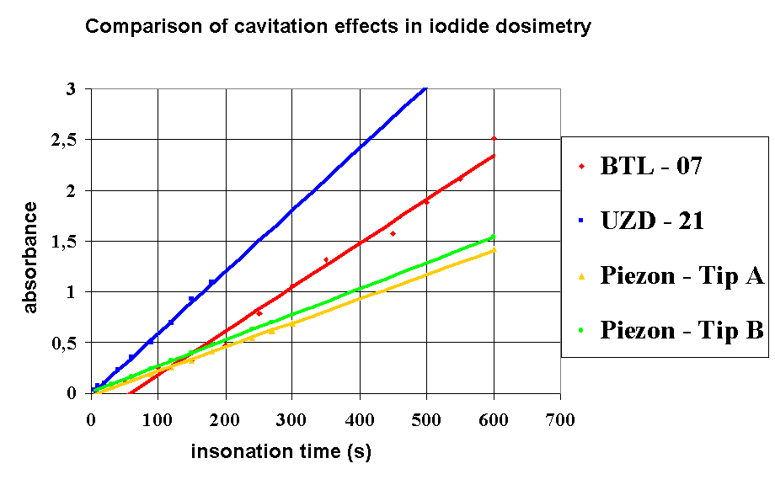
Iodide dosimetry of cavitation – absorbance measurement of treated KI solution at 350 nm

Slide 27

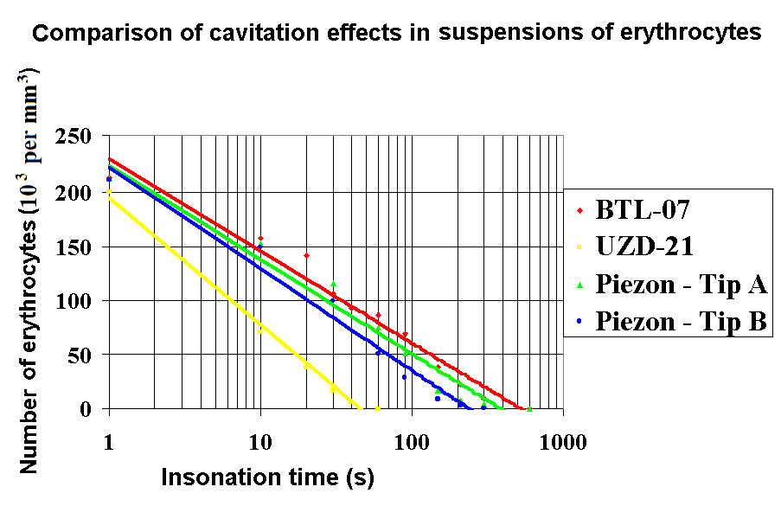
Haemolysis as a result of ultrasound cavitation

Slide 28
Cavitation – hazard or benefit in medicine
Direct hazard: in ultrasonography and Doppler diagnostics, with special regard to ultrasound contrast agents, which can nucleate the cavitation. Lung bleeding in experiment. Extracorporeal shock wave lithotripsy after application of US contrast agents.
Main acting mechanism:: surgical applications, angioplasty, facoemulsifiers, nebulisers, disintegrators, cleaning bathes
Subsidiary acting mechanism: application of shock waves, ultrasonic scalers in dentistry

Slide 29
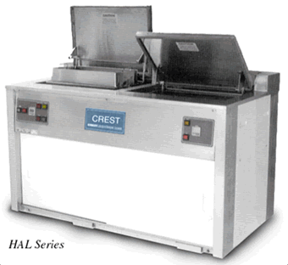
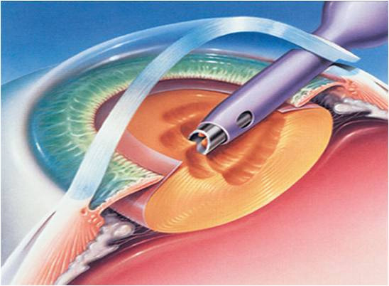
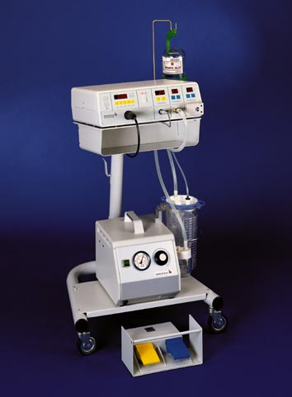
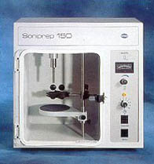
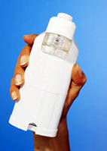
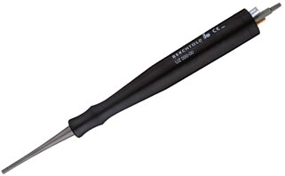
CUSA (surgery)
Cataract removal
Ultrasonic bath (cleaner)
disintegrator
nebuliser

Slide 30
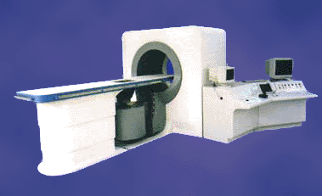
US cavitation in minimally invasive surgery – HIFU (High Intensity Focused Ultrasound)

Slide 31
Conclusions
Ultrasound cavitation is an important component of the biophysical effects of ultrasound.
It arises under conditions similar to those used in the therapeutic applications of ultrasound.
In the case of diagnostic ultrasound, it is perceived as a potential risk factor at high scanner outputs or under the presence of microbubble contrast agents

Slide 32
Author:
Vojtěch Mornstein
Content collaboration and language revision:
Carmel J. Caruana
Last revision September 2024

