Slide 1
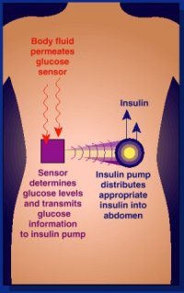
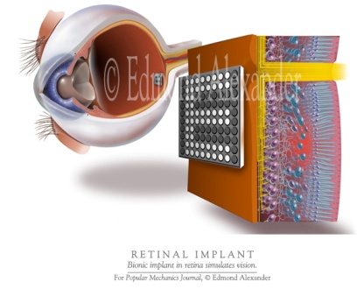
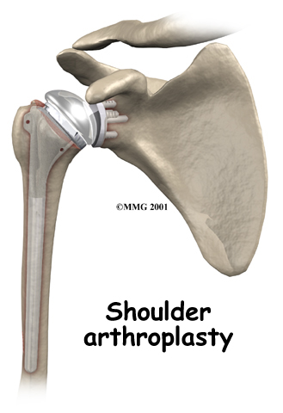
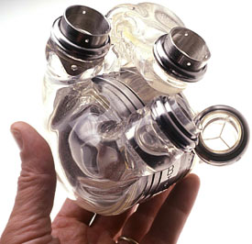
Lectures on Medical Biophysics
Devices for substitution and assist of body organs

Slide 2
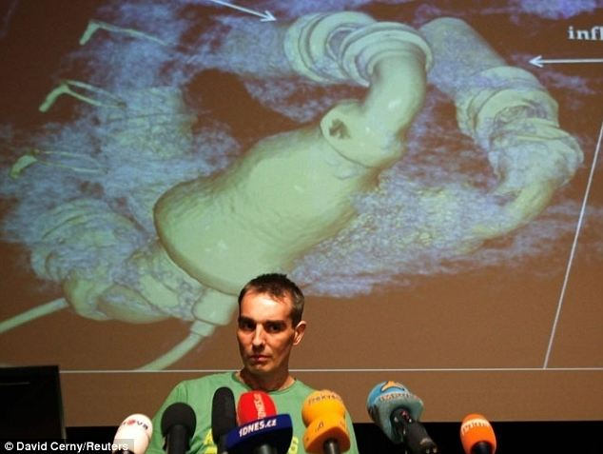
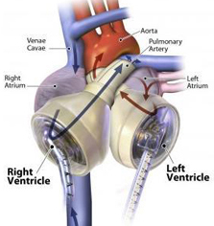
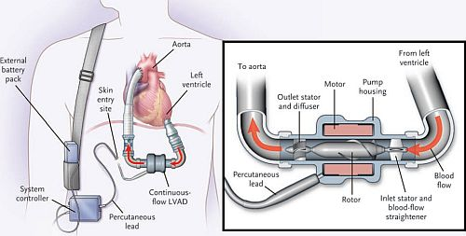
Support and replacement of heart
Man, who lived half a year with pair of rotation pumps Heartmate 2 without heart and pulse.
Two pumps with an external pneumatic drive

Slide 3
Cardiopulmonary bypass
During major heart or lungs surgery is often necessary to substitute function of these organs by an extracorporeal device. The lungs are substituted by oxygenator, which delivers oxygen to the body and removes carbon dioxide from it.
Two types of oxygenators: with direct contact of the gas with blood or based on diffusion of gases through a membrane between blood and gas.
In the bubble oxygenators, the oxygen bubbles ascend in a cylindrical vessel filled by blood. Blood uptakes oxygen and carbon dioxide is removed. Arising foam must be settled, then the blood passes through a filter and the „bubble trap“.
Membrane oxygenators are equipped by semipermeable membranes. Problem: certain denaturation of blood proteins and damage to the blood cells on the membranes limit their use to several hours. The membranes are layered or form capillaries. These oxygenators represent good approximation of lungs but it is necessary to disturb the blood layer on membranes by turbulences.

Slide 4
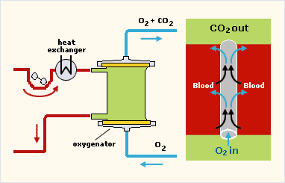
Cardiopulmonary bypass
Membrane
oxygenator
The common problem of all cardiopulmonary bypasses is the need of certain increase of circulating blood volume – it can be done by dilution.
Main parts of cardiopulmonary bypass: peristaltic pump, oxygenator, heat exchanger for heating or cooling blood and hence the patient’s body.

Slide 5
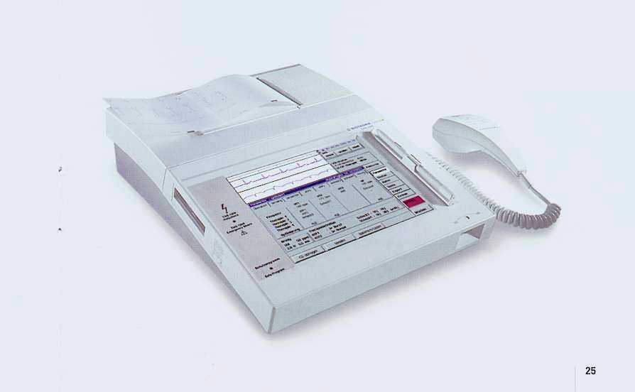
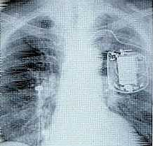
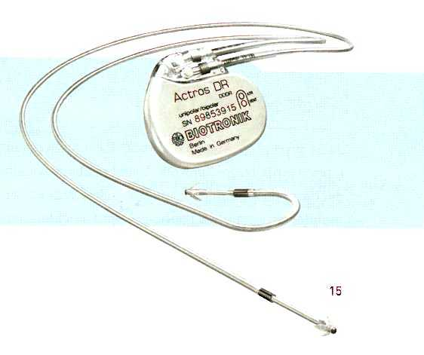
Pacemaker
programmer
Pacemakers are used in patients with severe arrhythmias and some other heart diseases. This active implantable device consists of electrodes and a central unit driven by durable batteries. They can be programmed from outside the body according the patient’s conditions. They replace the natural pacemaker – the sinoatrial node.

Slide 6
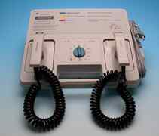
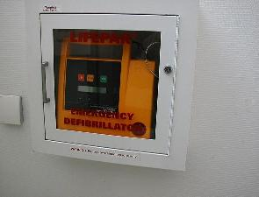
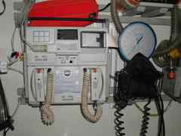
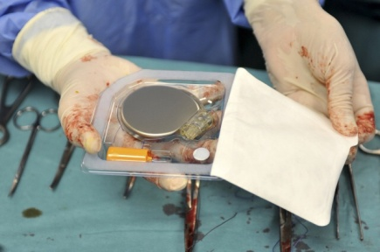
Defibrillators
Defibrillators are used in emergency medicine to renew spontaneous heart activity (in case of chamber fibrillation).
Implantable defibrillator/cardioverter

Slide 7
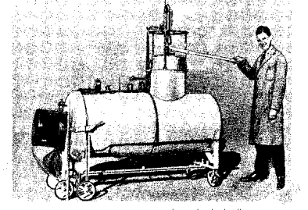
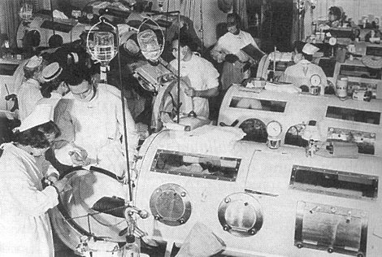
„Iron lungs“
(in the past)
Poliomyelitis (polio) treatment in 50´.
Later was the problem solved by the Salk vaccine.
www.blinn.edu/natscience/phillips/ironlung.html

Slide 8
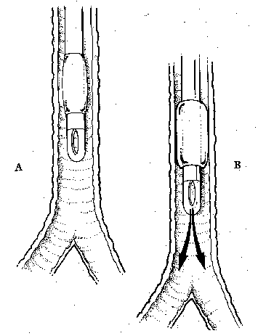
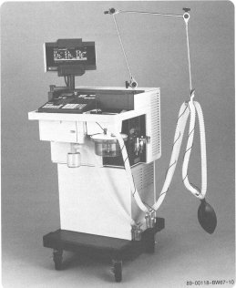
Mechanical ventilation of lungs
Ventilation is performed with air pressure or volume limit
Homework:
Look for ECMO!!!
http://www.mtsinai.org/pulmonary/books/physiology/chap10a.htm

Slide 9
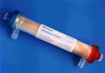
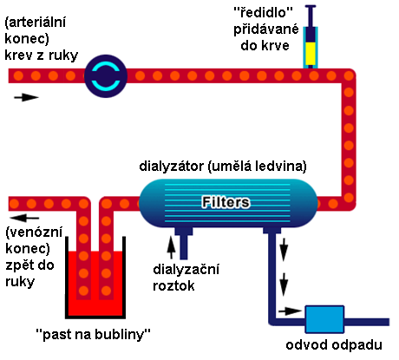
Artificial kidney - haemodialysis
Arterial end
(arm)
Diluent added to blood
Dialyser - artificial kidney
Superfluous volume of blood can be removed by underpressure in the dialysis solution
Venous end (arm)
Dialysis solution
“bubble trap”
Waste outlet
According to: www.renalpatients.co.uk/ haemodialysis.htm. www.rheomed.de/Bilder/ produkte/dialyser.jpg

Slide 10
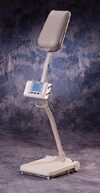
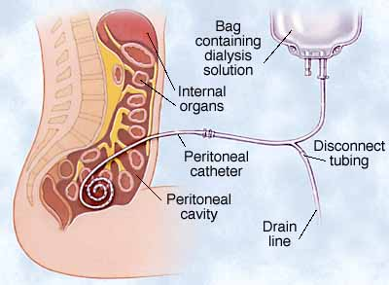
Peritoneal dialysis
Peritoneal dialysis can be done by the patient at home. A catheter is permanently inserted into the peritoneal cavity and serves for application as well as removal of dialysis solution. The procedure can be automated and performed during sleep.
www.devicelink.com/ expo/awards02/98winQ.html. www.healthyeatingliving.com/ Kidney_failure.htm.

Slide 11
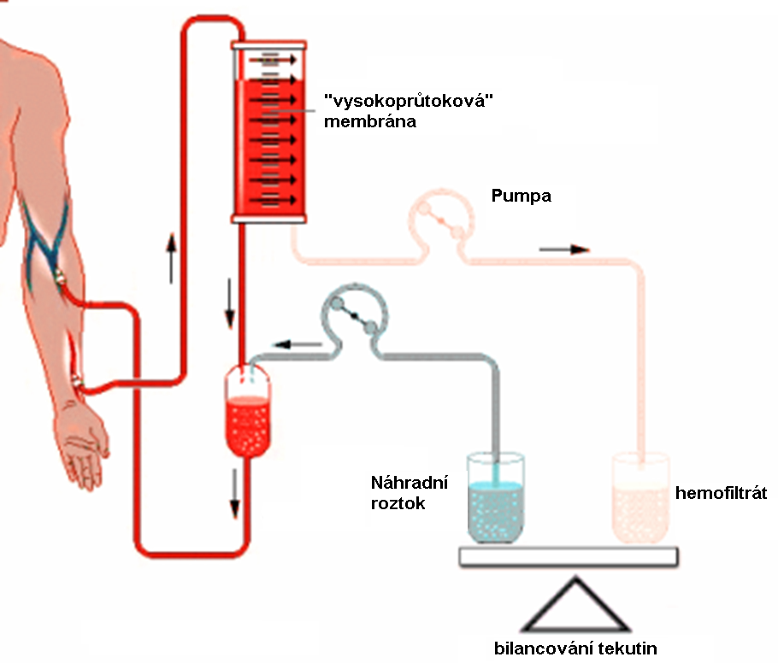
Haemofiltration
High-flow-rate membrane
Hemofiltration is an alternative of dialysis. It is very useful in some poisonings. Hemofiltrate with toxic substances is replaced by substitution solution added to blood in necessary amount.
pump
Substitution solution
haemo-filtrate
Balancing of fluids
According to: info-dialyse.de/.../ haemo_haemofiltration.php.

Slide 12
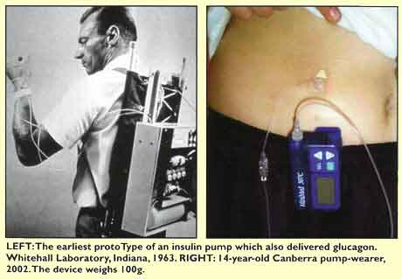
Artificial pancreas – insulin pump
http://www.diabetesaustralia.com.au/conquest/0204-insulin-pump-therapy.htm www.pnl.gov/ energyscience/06-01/ws.htm.

Slide 13
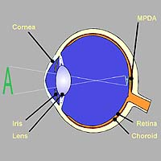
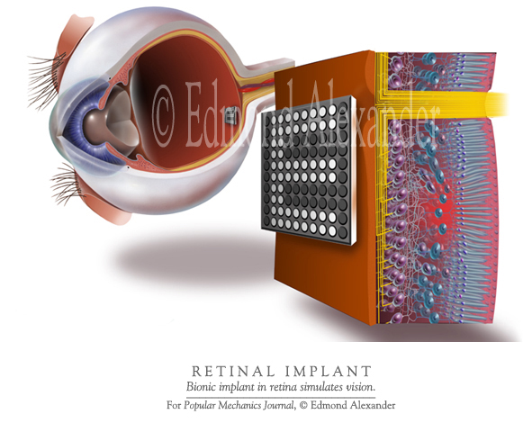
Retinal implant
MPDA – micro-photo-diode-array
Such devices are in clinical testing. They should enable basic spatial orientation.
www.nmi.de/deutsch/ showprj.php3?id=3&typ=1

Slide 14
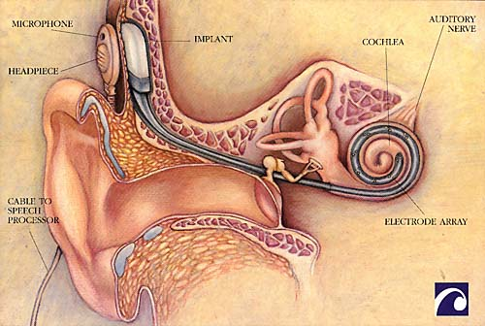
Cochlear implant
The electronic cochlear implants can partly replace the Corti's organ, mainly in children which have intact auditory nerve. It is an electrode system implanted into cochlea, which can stimulate the nerve by impulses generated in the so-called speech-processor.
http://www.accessexcellence.org/AB/BA/biochip3.html

Slide 15
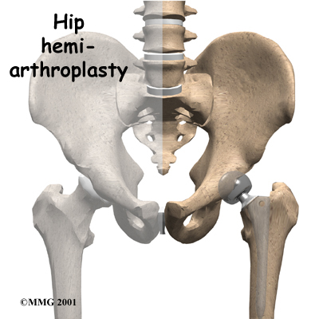
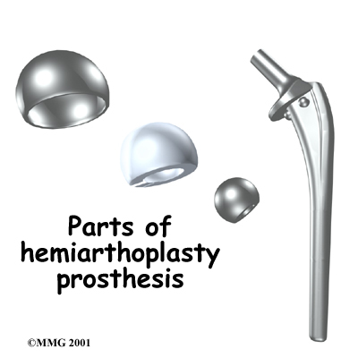
Hip joint substitution
Hip or other joint substitutions are made of combinations of plastics and ceramics or titanium and its alloys. Titanium surface is porous, which enables the bone to grow inside the implant surface - lowering need of bone cement.
http://www.orthogastonia.com/patient_ed/html_pages/hip/hip_hemiarthrooplasty.html

Slide 16
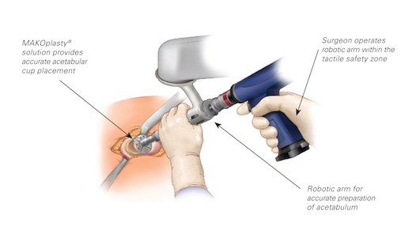
Acetabular cup (hip joint socket) placement
Robots in orthopaedic surgery. The endoprosthesis must be positioned (oriented) with great angular precision.

Slide 17
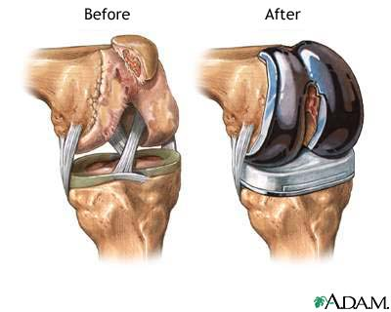
Knee joint substitution

Slide 18
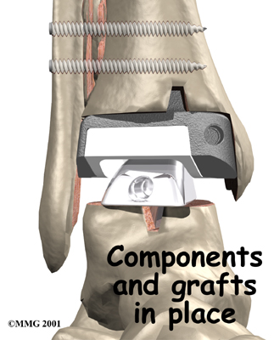
Ankle joint
http://www.orthogastonia.com/patient_ed/html_pages/ankle/ankle_arthroplasty.html

Slide 19
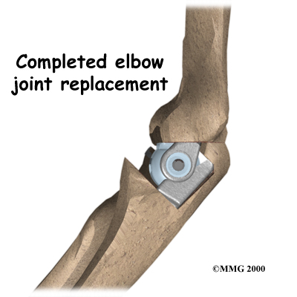
Elbow and shoulder joint substitution
http://www.orthogastonia.com/patient-ed.html

Slide 20
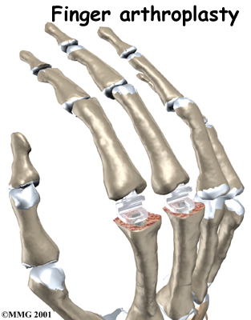
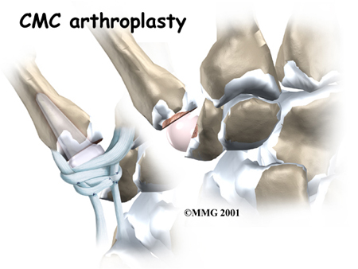
Joints of thumb and fingers
CMC = carpometacarpal
http://www.orthogastonia.com/patient_ed.html

Slide 21
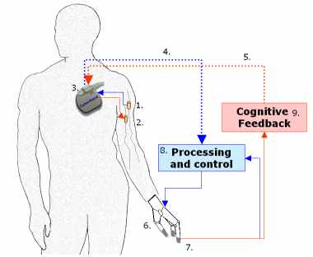
Bioprosthesis of hand – emerging reality
Electrode on efferent nerve;
Electrode on afferent nerve;
Implanted part for recording of nervous activity and nerve stimulation;
Efferent telemetric connection;
Afferent telemetric connection;
Bionic hand;
sensors;
Decoder of patient’s intentions and control of prosthesis;
Unit mediating the signals of sensors to the brain.
Subsystems 8-9 will be outside body but easy to carry.
http://www-arts.sssup.it/research/projects/CyberHand/default.htm

Slide 22
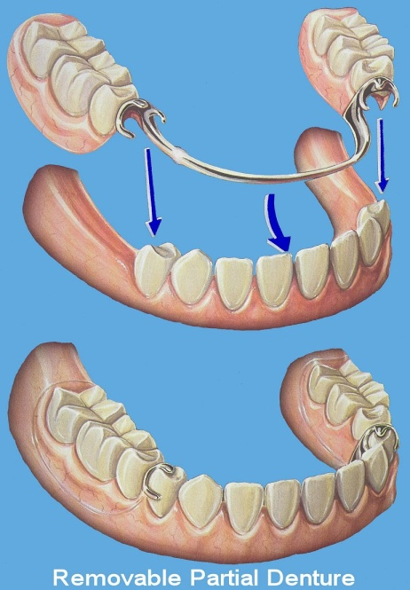
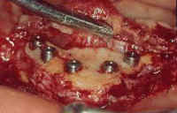
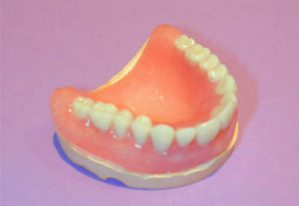
Dental prostheses
Preparation of the bed for total fixed dentition substitution
Partial prosthesis
Removable upper prosthesis

Slide 23
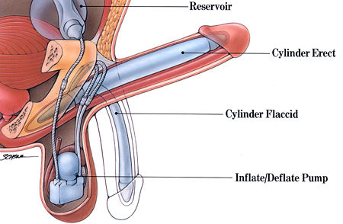
Penile endoprosthesis

Slide 24
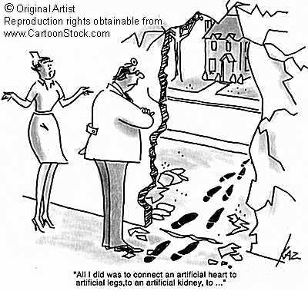
Author: Vojtěch Mornstein
Last revision September 2024
Content collaboration and language revision: Carmel J. Caruana

