Slide 1
Anticonvulsive drugs (antiepileptics)

Slide 2
Epilepsy
brain disorder characterized by an enduring predisposition to generate epileptic seizures and by the neurobiologic, cognitive, psychological, and social consequences of this condition
Seizures
  manifestation of abnormal hypersynchronous or hyperexcitable discharges of cortical neurons
  many causes, including a genetic predisposition for certain types of seizures, head trauma, stroke, brain tumors, alcohol or drug withdrawal, repeated episodes of metabolic insults, such as hypoglycemia
Prevalence 0,5–1 %

Slide 3
Factors lowering seizure threshold
Sleep deprivation
Alcohol withdrawal
Television flicker
Epileptogenic drugs
Systemic infection
Head trauma
Recreational drugs
Non-compliance
Menstruation
Dehydration
Barbiturate withdrawal
Benzodiazepine withdrawal
Hyperventilation
Flashing lights
Diet and missed meals
Stress
Intense exercise

Slide 4
Pharmacotherapy
The goal to achieve a seizure-free status without adverse effects
Monotherapy is desirable - avoids drug interactions
Many of the older anticonvulsant agents have hepatic enzyme–inducing properties
Main mechanism - to stabilize membrane of neuron and to decrease the excitability

Slide 5
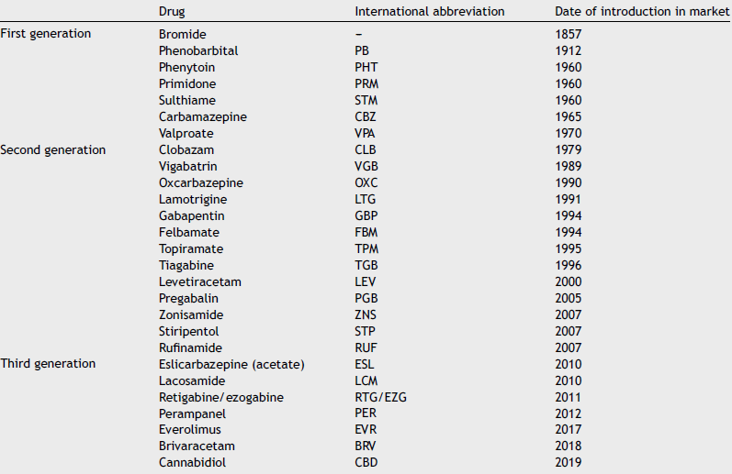
An Pediatr (Barc). 2019;91(6):415.e1---415.e10

Slide 6
Mechanisms of action
Classical
  Enhancement of GABA mainly via GABA-A rc
  Inhibition of sodium channel function
  Inhibition of calcium channel function
Mechanisms of newer drugs
  Inhibition of glutamate release
  Inhibition of GABA uptake
  AMPA receptor antagonism
  Synaptic vesicle protein SV2A
(multiple mechanisms)

Slide 7
GABA-ergic drugs
barbiturates (phenobarbital), BZD
vigabatrin – irreversible inhibition of GABA transaminase
tiagabine – inhibitor of GABA transporter (increases extracellular GABA)
stiripentol
  increases GABA effect similarly as barbiturates and inhibits lactate dehydrogenase, which may reduce metabolic energy prodcution requiered to mainain the seizure, used as adjunctive treatment in children
GABA-ergics may exacerbate absences

Slide 8
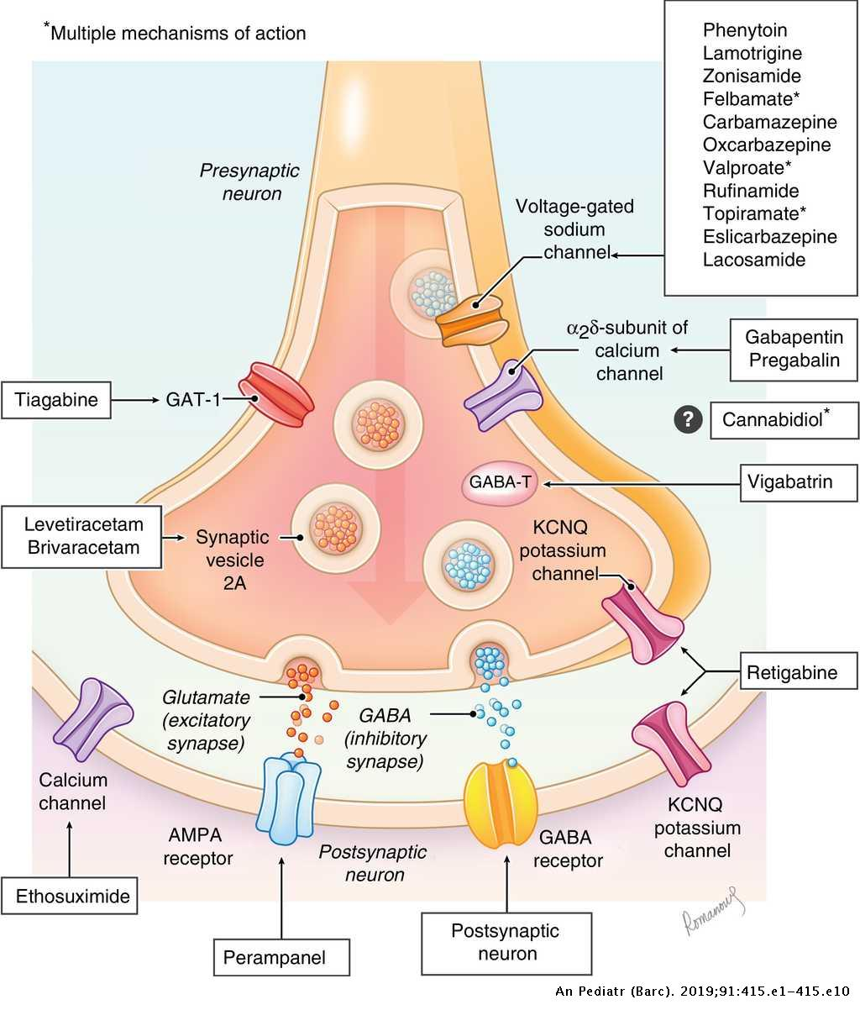
An Pediatr (Barc). 2019;91(6):415.e1---415.e10

Slide 9
Na⁺ channel inhibitors
carbamazepine
lamotrigine
phenytoin
lacosamide
Bind preferentially to inactivated channels and lower the number of functional channels able to generate action potential

Slide 10
An Pediatr (Barc). 2019;91(6):415.e1---415.e10

Slide 11
Ca²⁺ channel inhibitors
ethosuximide, valproate
  Act primarily on T type channels in the thalamus, which are responsible for absences
gabapentin, pregabalin
  GABA analogues, act primarily on P/Q type channels
  Lower trafficking of the channels to the membrane - reduce the calcium entry to the cell – reduce neurotransmitter release

Slide 12
An Pediatr (Barc). 2019;91(6):415.e1---415.e10

Slide 13
Other mechanisms
levetiracetam, brivaracetam
  Bind to SV2A protein and probably have also other mechanisms
perampanel, topiramate (multiple mechanisms)
  AMPA antagonism
rufinamide
  Inhibition of GABA reuptake
retigabine
  Opens KCNQ/Kv7 potassium channels

Slide 14
An Pediatr (Barc). 2019;91(6):415.e1---415.e10

Slide 15
Multiple mechanisms
valproate
  Inhibition of both sodium and calcium channels (T type), GABA transaminase
  All types of seizures
felbamate
  Inhibition of both sodium and calcium channels, GABA-A and NMDA rc
  Lennox-Gastaut sy
topiramate
  Inhibition of both sodium and calcium channels, GABA-A and AMPA rc
  Lennox-Gastaut sy
zonisamide
  Inhibition of both sodium and calcium channels, GABA-A rc
  Partial seizures

Slide 16
Cannabidiol
for adjuvant treatment of seizures associated with Lennox-Gastaut syndrome (LGS) or with Dravet’s syndrome (DS) in use together with clobazam in patients of the age 2 years and older
for adjuvant treatment of attacks associated with tuberous sclerosis complex (TSC) in patients of the age 2 years and older

Slide 17
Choice of anticonvulsant agent
https://pathways.nice.org.uk/pathways/epilepsy#path=view%3A/pathways/epilepsy/anti-epileptic-drugs-to-offer-based-on-presenting-epilepsy-seizure-types.xml&content=view-node%3Anodes-absence-seizures

Slide 18
All types of seizures
All but absence
  carbamazepine (oxcarbazepine, eslicarbazepine), phenytoin, phenobarbital (primidon)
All
  vigabatrin, lamotrigine, valproate

Slide 19
Treatment of specific types of seizures
Absence
  ethosuximide or valproate
  lamotrigine
Partial (focal) seizures
  carbamazepine or lamotrigine
  valproate, levetiracetam, clobazam, gabapentin, topiramate
Generalised tonic–clonic seizures
  valproate, carbamazepine or lamotrigine
  topiramate, levetiracetam
Myoclonic seizures
  valproate, topiramate, levetiracetam

Slide 20
Status epilepticus
Critical, life threatening condition, one seizure comes after another without recovery, lasts at least 30 min, fatal in 5-10% patients
  Shall be distinguished from a series of seizures with recovery inbetween
Causes – frontal lobe lesion (including stroke), head trauma, anticonvulsant discontinuation, alcohol withdrawal, metabolic disturbances, pregnancy
  Requires inpatient treatment – energetically demanding condition, hypoglycaemia, lung edema, hyperthermia, excitotoxicity, ...
lorazepam IV or midazolam IM or diazepam rectally

Slide 21
Epilepsy resistant to monotherapy
Consider combination therapy when:
  Treatment with two first line AEDs has failed
  The first well-tolerated drug substantially improves seizure control, but fails to produce seizure freedom at maximal dosage.
  The choice of drugs in combination should be matched to the patient’s seizure type(s) and should be limited to two or at most three AEDs.
gabapentin, lacosamide, lamotrigine, levetiracetam, pregabalin, topiramate, zonisamide (alphabetical order) may be considered as adjunctive therapy dependent on patient and seizure type.

Slide 22
DRUG RESISTENT EPILEPSY (DRE)
ILAE - DRE non-satisfactory compensation of attacks after trying of two well-tolerated, correctly chosen and dosed antiepileptic drugs (anti-seizure medication; ASM) in the form of monotherapy or combined treatment.¹
About 40 % of patients with epilepsy after treatment with two AE drugs do not achieve permanent and full control of attacks and therefore it belon to DRE defined by ILAE¹
ILAE, Mezinárodní liga proti epilepsii.
1. Kwan P, et al. Epilepsia 2010;51:1069–1077; 2. Chen Z, et al. JAMA Neurol 2018;75:279–286.

Slide 23
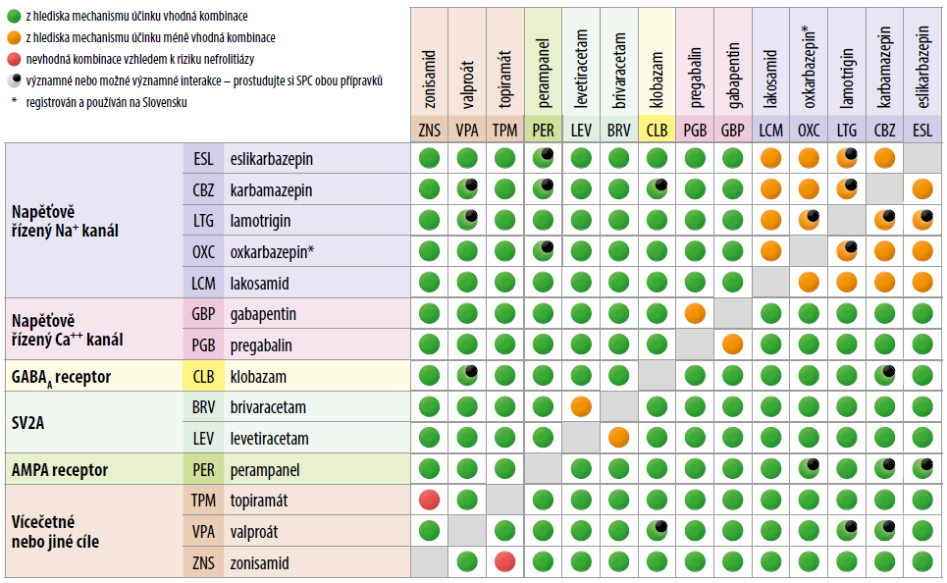
Combinations
● suitable combination (with respect to MoA)
● less suitable combination (with respect to
MoA)
● non-suitable combination (with respect to
risk of nephrolithiasis)
● significant or potentially significant
interactions (check SmPC)

Slide 24
Other uses on antiepileptic drugs
Bipolar disorder (valproate, carbamazepine, oxcarbazepine, lamotrigine, topiramate)
Prophylaxis of migraine (valproate, gabapentin, topiramate)
Anxiety disorders (gabapentin, pregabalin)
Neuropathic pain (gabapentin, pregabalin, carbamazepine, lamotrigine)

Slide 25
Drug-drug interactions
Drug-drug interactions are common among anticonvulsants as well as between anticonvulsants and other drugs
Mostly pharmacokinetic

Slide 26
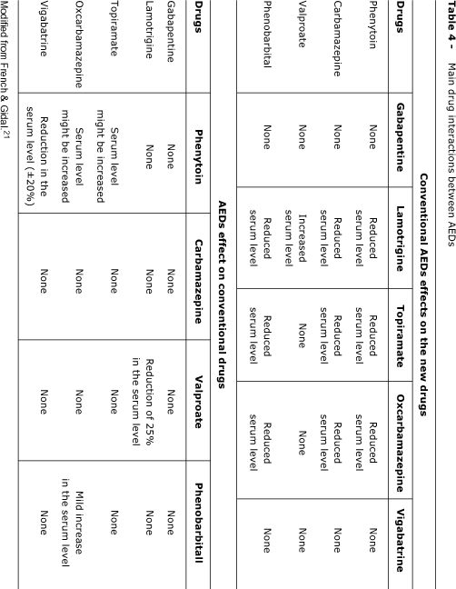
Interactions of anticonvulsant drugs

Slide 27
Anticonvulsants in specific populations
Neonates, children, elderly patients
Slowed hepatic metabolism
Decreased renal clearance
Decreased volumes of distribution
Women on contraceptive agents
Pregnant women - folic acid, at least 0.4mg/day, TDM, many drugs are teratogenic
Patients with hepatic or renal insufficiency
  Gabapentin, pregabalin, levetiracetam, and lacosamide excreted mostly renal clearance - their doses can be adjusted for renal insufficiency ; useful in patients with hepatic failure
  Lamotrigine metabolized by glucuronidation - also might be used in hepatic insufficiency.

Slide 28
Generic substitution
Changing the formulation or brand of AED is NOT recommended because different preparations may vary in bioavailability or have different pharmacokinetic profiles and, thus, increased potential for reduced effect or excessive side effects.

Slide 29
Exam questions
  gabapentin – GABA analogue, without affinity to GABA rcp., without effects on metabolism of GABA
    bonding to voltage gated Ca²⁺ channels
    used for therapy of partial attacks
    way of application: p.o.
    low interaction potential
    relatively safe, few AE
    other use: peripheral neuropathic pain (diabetic neuropathy, postherpetic neuralgia), preemptive analgesia

Slide 30
Exam questions
carbamazepine – inhibition of Na⁺ channels
  used for therapy of generalized attacks, mixed attacks, ineffective in absences
  way of administration: p.o. (both conventional tbl. and tbl. with prolonged effect)
  teratogenic!
  risk of severe skin toxicity (mainly in people of Chinese or Thai origin – pharmacogenetic background)
  high interaction potential (with inhibitors of CYP3A4 →↑↑ AE)
  other use: mania and prophylactic treatment of bipolar affective disorder, treatment of neuropathic pain and neuralgias (neuralgia of trigeminal nerve, diabetic neuropathy, treatment of abstinence syndrome in alcoholics

Slide 31
Exam questions
  valproate (valproic acid) – inhibition of sodium and calcium channels of T type, GABA transaminase
    suitable for therapy of many types of attacks (epilepsy in children, adolescents; affects both tonic-clonic seizures and absences), suitable for therapy of pharmaco-resistant epilepsy
    non-sedative
    way of administration: p.o. (with prolonged effect), injections
    high interaction potential
    high teratogenic!!!
    about 10% of patients – hair impairment, hepatotoxic
    other possible use: bipolar affective disorder, prophylaxis of migraine

