Slide 1


Introduction to Psychopharmacology
Department of Pharmacology FM MU

Slide 2

Lehmann classification of psychotropic substances
Affectivity | ↑ antidepressants, anxiolytics
 | ↓ dysforics/antimanics
Vigility | ↑ psychostimulants/nootropics
 | ↓ hypnotics/sedatives
Psychic integrity/integration | ↑ neuroleptics
 | ↓ halucinogens/psychodysleptics/delirogens
memory and cognitive functions | ↑ cognitive enhancers/ nootropics
 | ↓ anticholinergics, dementogens, neurotoxins, amnestics

Slide 3
schizophrenia
dementia
ADHD
anxietY
Psychic integration
antipsychotics
cognitive
enhancers
psychostimulants
anxiolytics
halucinogens
psychotomimetics
Memory and cognition
insomnia
Depression
epilepsY
nootropics
sedatives
anticonvulsants
antidepressants
hypnotics
antiepileptics
Bipolar disorder
mood stabilizers

Slide 4

Classification of psychotropic drugs
a new classification of psychotropic drugs is created based on the main mechanisms of effects
(neuroscience based nomenclature - NbN) - ECNP (European College of Neuropsychopharmacology)
Mobile phone app !
https://www.ecnp.eu/~/media/Files/ecnp/Projects%20and%20initiatives/Nomenclature/140214%20Nomenclature%20list.pdf

Slide 5
Antipsychotics
Drugs used predominantly in the therapy of psychoses but also other indications:
pharmacoresistant depression
psychotic depression
anxiety
Huntington's disease
Tourette's syndrome
anesthesia / neuroleptanalgesia
sleep disorders
nausea, vomitus
Notes:
http://casopis.vesmir.cz/clanek/schizofrenie

Slide 6
Schizophrenia
belong among psychoses with predominance of emotional disturbances, thinking, behavior, and personality disorder
the most striking symptoms are delusions and hallucinations
onset/Dg usually around 20th year of age
genetic predisposition - gender incidence - polygenic inheritance
affects about 1% of the population Dg. ICD 10: F20XX
Notes:
http://casopis.vesmir.cz/clanek/schizofrenie

Slide 7
Symptoms of schizophrenia
"Positive" symptoms - hallucinations, delusions, disintegration of thinking, speaking, catatonia, agitation, paranoia
"Negative" - ​​absent, blunted or incongruous emotional responses, apathy, social withdrawal, anhedonia, lethargy, sexual dysfunction, impaired attention

Slide 8
Substances capable of causing psychosis
levodopa (DA)
CNS stimulants (NA, DA, 5HT)
  cocaine
  amphetamines
  khat, kathinon, methkathinon, mezkalin
hallucinogens – LSD (5HT2c agonist)
cannabis
apomorphine (agonism D₂)
bupropion (NDRI)
phencyclidin, ketamine (NMDA antag.)
Notes:
http://casopis.vesmir.cz/clanek/schizofrenie

Slide 9
Dopamine hypothesis of schizophrenia
  Antipsychotics reduce DA-activity on synapses
  Drugs increasing DA in the limbic system trigger psychosis
  Drugs that reduce DA-activity in the limbic system (DA antagonists on postsynaptic D receptors) reduce psychotic symptomatology
  Affinity of older "classical" APs to D2 rcp. correlates with their clinical effect

Slide 10
Classification of antipsychotics
2nd. generation („atypical“)
less: EPS, tardive dyskinesias, prolactinemias,
malignant neuroleptic. syndrome)
MARTA (Multi-Acting Receptor Targeted Agents)
SDA (Serotonin-Dopamine Antagonist)
D2 / D3 antagonists
DSSS (Dopamine-Serotonin System Stabilizers)
1st. generation „typical“
Classical (basic, sedative): doses up to hundreds of milligrams
Incisive:
doses in mg to tens of milligrams
3rd. Generation ?
agonists of DA autoreceptors, partial agonists, glutamatergic, beta blockers?

Slide 11
Classical (typical) antipsychotics
affects positive, less negative symptoms, can aggravate cognition. dysfunction
mechanism of action: reduction of dopaminergic neurotransmission (blockade of postsynaptic D₂ receptors
AE Extrapyramidal syndrome
    Early (parkinsonoid, acute dyskinesia, akathisia)
    Late (tardive dyskinesia and dystonia, tardive akathisia)
    Neuroleptic malignant syndrome, hyperprolactinemia, anticholinergic, antihistamine, adrenolytic and others

Slide 12
Classical (typical) antipsychotics - basal
levomepromazine –D₂ antag. + another antag. (NA, 5HT, H, Ach) more pronounced sedation, less EPS, adjuvant with analgesics
antiemetic, antihistaminic, anti-adrenergic and anticholinergic effects
AE: Orthostatic collapse, QTc prolongation, torsades
chlorprotixen
5HT2, D1, D2, D3, H1, M and alpha 1 receptor antagonist
In low dose for insomnia (up to 50 mg)

Slide 13
Classical (typical) antipsychotics -basal
melperone
Low affinity D2 antagonism
5HT2A, alpha1 antagonist, without affinity for H1, M
low risk of dyskinesia + EPS
Confusion, anxiety restlessness, especially in the elderly and alcoholics (deliria) (low doses)
tiaprid
D2, D3 antagonism
lacks affinity for H1, α1, α2, 5HTR
I: Behavioral disorders, confusion, agitation, especially in the elderly and alcoholics (deliria) (low doses

Slide 14
Classical (typical) antipsychotics -incisive
fluphenazine
D2 antag., Highly effective (Dmax 40 mg)
AE: EPS, TD, priapism, galactorea
flupentixol - D2 antag, not so sedative, more EPS
AE: EPS - initiation of therapy, TD, insomnia, tachycardia, ↑ weight, dyslipidemia, rarely NMS
i.m.- noncompliance
haloperidol - D₂ antag. ,highly potent, better than phenothiazines, long T_{1/2,} less sedation, influencing BP
better tolerability (blood count, liver injury)
Notes:
Pokud pacienti na Haloperidol odpovídají při níizkých dávkách, tak na pozit. I negat. příznaky

Slide 15
Comparison of basal and incisive AP
Basal AP
- Low potency
(high doses – hundreds of
milligrams)
- Sedation to hypnosis
- D2 receptor blockade
- slower PK
- Frequent anticholinergic
and antihistaminic
adverse effects
- ↓ EPS
Incisive AP
- High potency (lower doses)
- Little sedation
- Block D2 receptor
- faster PK
- Causes ↑ EPS

Slide 16
Atypical antipsychotics
higher efficacy, better tolerability
affect positive and negative symptoms, cognition
D₂ receptor occupancy <80%, binding to multiple neurotransmitter systems
affect not only transport of dopamine but also other neuromediators (serotonin)
wide range between antipsychotic effects and EPS
selective extrastriatal (mesolimbic) blockade of dopamine D₁, D₂ receptors
risperidone, ziprasidone, olanzapine, quetiapine ...

Slide 17
Atypical antipsychotics
selective D₂/D₃ receptor antagonists sulpiride, amisulpride
selective serotonin and dopamine receptor antagonists (SDAs)
risperidone, ziprasidone, lurasidone, iloperidone, sertindole
multi-receptor antagonists (MARTA: D, 5-HT, α, H1, M)
clozapine, olanzapine, quetiapine and zotepine
DSSS (D2) stabilizer
aripiprazole, cariprazine

Slide 18
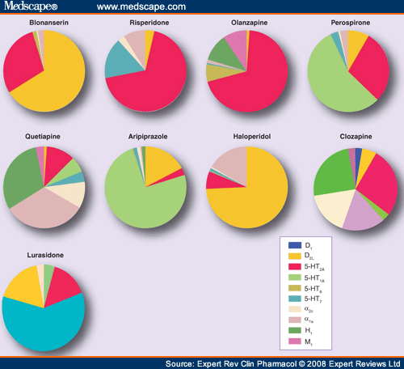
Relative receptor profile AP2G
Sumiyoshi, Expert Rev Clin Pharmacol. 2008;1:791-802 .

Slide 19
Atypical antipsychotics - MARTA
clozapine
antag. D₂ , antag. 5HT_{2A} (↑ release DA)
5HT_{1A}, 5HT_{2C}, (cognitive, affective symptoms)
minimal impact on the nigrostriatal system
Effect on alpha, 5HT2 rcp
Useful in: Pharmacoresistant psychoses - responds about 1/3
risk of suicidium, aggressive patients, EPS
AE: sedation, weight gain,
agranulocytosis - genetic test
Notes:
multi acting receptor targeted agents

Slide 20
Atypical antipsychotics - MARTA
olanzapine antag. D₂, antag. 5HT_{2A}
5HT_{2C} - improving cognitive symptoms
better efficiency
available depot injectable DDF
No/low risk of agranulocytosis
AE: sedation, weight gain, tachycardia, rarely TD

Slide 21
Atypical antipsychotics - SDA
risperidone
antag. D₂ , antag. 5HT2A (↑ release DA) , α1, 5HT7 (antidepresive action)
p.o. i.m. depot inj.
active metabolite 9-OH risperidon = Paliperidone
I: schizophrenia, mania, bipolar disorder, behavioral disorders in children, ADHD, resistant OCD
AE: weight gain, dyslipidemia, hyperprolactinemia
paliperidone
antag. D₂ , antag. 5HT2A, α1, less affinity 5HT7
p.o. and depot inj.

Slide 22
Atypical antipsychotics- SDA
lurasidone
  Risk of EPS: modest
  Relat. safe, well tolerated AP – (lacks AE: weight gain, metabolic AE, anticholinergic, sedtion, ortostatic hypotension, low risk of QTc prolongation)
cariprazine
    D2, D3, 5HT2B, 5HT1A partial agonist
    5HT2A, 5HT2C alpha1B antagonist

Slide 23
Atypical antipsychotics - DSS
aripiprazole – partial agonist D₂ + 5HT1A, antag. 5HT2A (localy increases DA –improves cognitive fctions, affectivity)
blocks 5HT2C, 5HT7 –antidepresive action
¨ lacks sedation, weight gain
p.o. + depot inj.
Other Indications: augmentation of antidepressants,

Slide 24
Adverse effects
Blockade of D₂ receptors in nigrostriatal pathway
EPS - early (acute)
- late (tardive)
Severity does not correlate with dose !
https://www.youtube.com/watch?v=FUr8ltXh1Pc&t=8s
Acute dystonia
involuntary contraction of individual muscles or muscle groups of prolonged duration, causing abnormal movements or positioning of different body parts.
occurs in up to 25-33% of all patients treated with typical AP
https://www.youtube.com/watch?v=2krwEbm5hBo

Slide 25
Adverse effects
Blockade of D₂ receptors in nigrostriatal pathway
EPS
Akathisia
- intense mental discomfort, compulsive movements restlessness
https://www.youtube.com/watch?v=W_iiy8ISvdY

Slide 26
Adverse effects
Blockade of D₂ receptors in nigrostriatal pathway
EPS
Parkinson's syndrome (PS)
combination of bradykinesia (movement retardation)
akinesia (inability to start movement)
hypokinesia (reduction of motion range)
stiffness/rigidity (increased muscle tone)
shaking
Typical APs : about 30-50%. https://www.youtube.com/watch?v=6HKMusvSfeI

Slide 27
Neuroleptic malignant syndrome
AP treatment in the previous 7 days (in depot inj. In previous 2-4 weeks)
Hypertermia > 38 st. C
Muscle rigidity
5symptoms of:
  Changes in mental state
  Tachycardia
  Hypertension or hypotension
  Tachypnoea or hypoxia
  Sweating or salivation
  Tremor
  Incontinence
  Increased creatine phosphokinase or myoglobinuria
  Leukocytosis
  Metabolic acidosis
Excluding other neuropsychiatric or somatic disease

Slide 28
Anxiolytic and hypnosedative drugs

Slide 29
Anxiety disorder
A chronic condition characterized by an excessive and persistent sense of apprehension, with physical symptoms such as sweating, palpitations, and feelings of stress
Anxiety disorders recognised clinically include the following:
generalised anxiety disorder (GAD)
obsessive–compulsive disorder (OCD)
post-traumatic stress disorder (PTSD)
social anxiety disorder, phobias etc.

Slide 30
Anxiolytics
First line: non-benzodiazepine (SSRI + others, see the AD materials)
Second line: benzodiazepines (BZ, adjuvant therapy)
drugs mostly acting like CNS depressants (not always sedative)
affecting receptors in limbic system, hypothalamus, cerebellum and corpus striatum

Slide 31
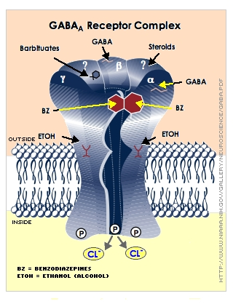
Mechanism of action (BZD)
specific (via receptors)
- selectively binding to the benzodiazepine binding site of GABA_{A} subunit (coupled with Cl⁻ channel)
- increase affinity of binding site for GABA (positive allosteric modulation)
- increase in frequency of opening of Cl⁻ channel
- hyperpolarization of neuron membrane
inhibition of signal transduction
Inhibition of neural activity is leading to anxiolytic effect
in higher doses to sedation and sleep
overdose can be lethal (specially if combined with ethanol)

Slide 32
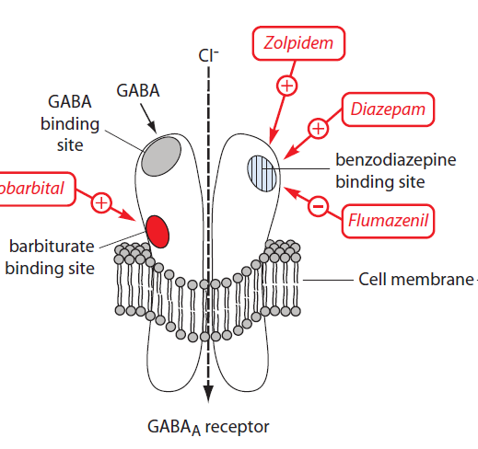
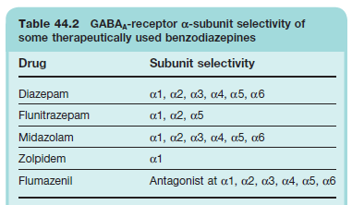
GABA_{A} subunit | effect
α₁ | sedative, anterograde amnesia, partially anticonvulsive; addictive
α₂ | anxiolytic, myorelaxant
α₃ α₅ | contributing to myorelaxant effects
α₁ α₅ | modulating temporal and spatial memory

Slide 33
Indications
adjuvant therapy in psychiatry (for transient period)
acute intervention of panic attack
treatment of acute alcohol withdrawal
diagnostic/therapeutic procedures (gastroscopy, colonoscopy)
commonly used together with an SSRI to provide symptomatic relief for the first few weeks before the effects of the SSRI kick in
phobias (strong fears of specific things or situation (snakes, flying)
psychosomatic disorders
post-traumatic stress disorder (anxiety triggered by insistent recall of past stressful experiences
OCD

Slide 34
Effects of benzodiazepines
1) hypnosedative
midazolam
2) anxiolytic
alprazolam, bromazepam, oxazepam
3) anticonvulsant
diazepam, clonazepam
4) myorelaxant
clonazepam
5) amnestic (anterograde amnesia)
most of benzodiazepines, historically typical for flunitrazepam

Slide 35
Pharmacokinetics of benzodiazepines
ABSORPTION:
  well absorbed if given orally , C_{max} reached in about 1 h
  intramuscular injection – absorption time is mostly unpredictable
  possible IV and per rectum application (used for pediatric febrile seizures)
BINDING: strongly bound to plasma proteins
DISTRIBUTION: large V_{d}: accumulation in body fat (high lipid solubility)
METABOLISM: hydroxylation
conjugation with glucuronic acid
short-, medium- and long-acting BZ
the role of N-desmethyldiazepam

Slide 36
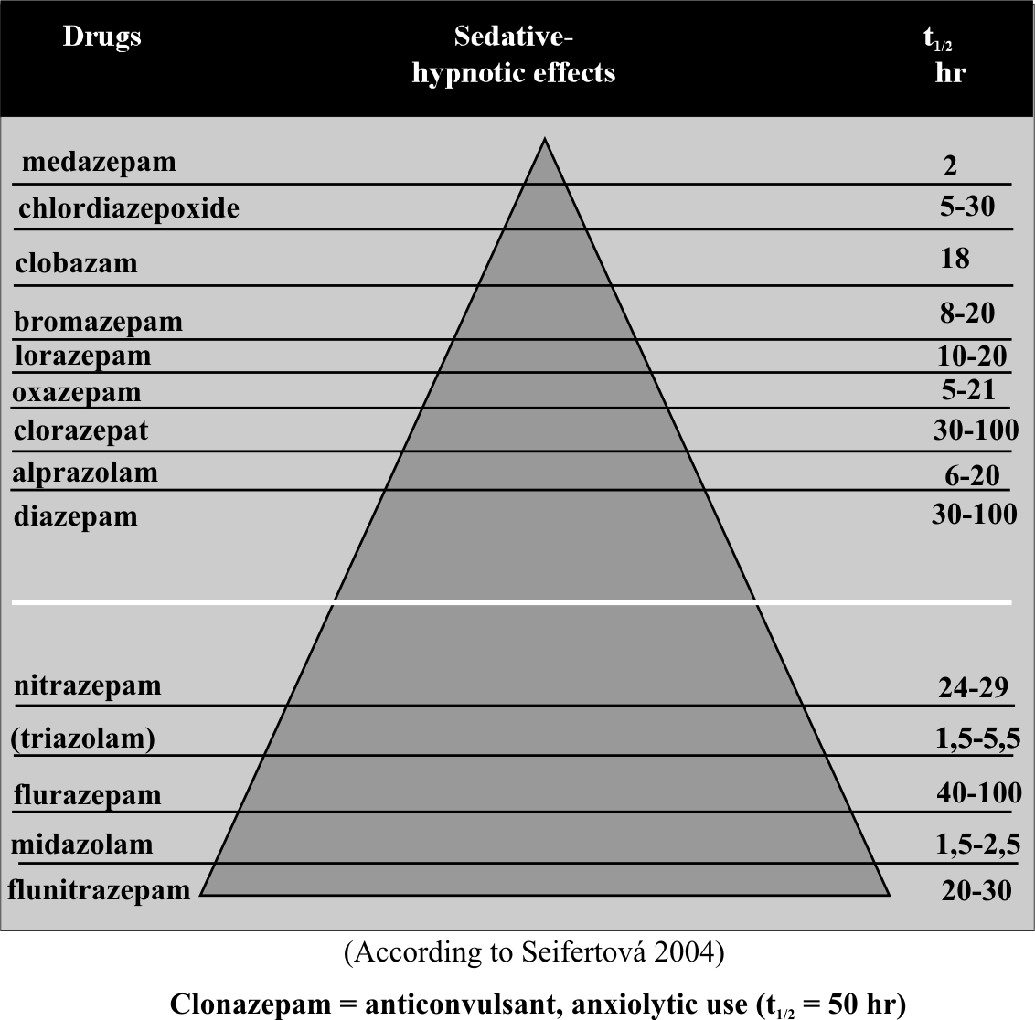

Slide 37
Specific antagonist of benzodiazepine receptors
flumazenil
Use: in benzodiazepine overdose, antagonising the central sedative effects of benzodiazepines in anaesthesiology
the onset of action is rapid and usually effects are seen within one to three minutes
its action lasts for only about 1 hour, so drowsiness tends to return - repeat doses of flumazenil may be required to prevent recurrent symptoms of overdosage once the initial dose of flumazenil wears off
can cause acute withdrawal syndrome in benzodiazepine dependent patient

Slide 38
Unwanted effects
drowsiness, confusion, amnesia, impaired coordination
paradoxical reactions (aggression, violence; see Beers list)
dependence (in human subjects and patients, stopping BZ treatment after weeks and months causes an increase in symptoms of anxiety, together with tremor and dizziness)
cognitive deficits (memory loss, slower psychomotor deficits)
breath center depression
muscle relaxation
tolerance (gradual escalation of dose needed to produce the required effect and occurs with all BZs. Appears to represent a change at the receptor level)
“rebound“ phenomenon
may cause „floppy baby syndrome“ or neonatal abstinence syndrome when used during third trimester of gravidity (tremor, tachypnea, convulsions)

Slide 39
Beers list
guidelines for healthcare professionals to help improve the safety of prescribing medications for older adults
Notes:
https://www.dcri.org/beers-criteria-medication-list/
http://www.medscape.com/viewarticle/846136#vp_2

Slide 40
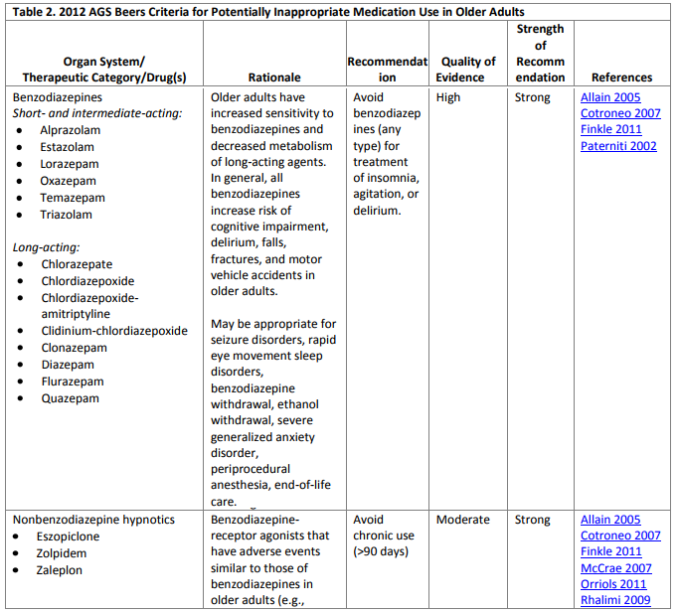

Slide 41
Contraindications
pregnancy and lactation
myasthenia gravis
ethylism, co-medication with other hypnotics
respiratory insufficiency, sleep apnoe
any other comorbid addiction
patients using benzodiazepines should not donate blood or drive vehicles

Slide 42
Benzodiazepine withdrawal syndrome
the cluster of symptoms that emerge when patient undergoes abrupt discontinuation of use
more frequent with: short-acting benzodiazepines (alprazolam), higher doses, serious concurrent psychopathology
more expressed in women and patients abusing alcohol
25-50 % patients are capable of consecutive discontinuation of BZ use during 6-21 months. First half of dose is discontinued easier then the other half, therefore rapid discontinuation of first half is recommended, followed by 10-20 % reduction during 3-5 days
„plateau“ stage is recommended during discontinuation, when the dose is not reduced
usually the morning dose is reduced in the first place, then the afternoon’s one a the evening dose is the last reduced
long-acting benzodiazepines cause delayed withdrawal syndrome (2-4 weeks later)

Slide 43
Non-benzodiazepine drugs with anxiolytic effect
SSRI: sertraline, fluvoxamine, fluoxetine (see AD materials)
other AD: mirtazapine, trazodone, amitriptyline, dosulepin, venlafaxine
antiepileptics: gabapentin, pregabalin (generalised anxiety disorder), tiagabine, valproic acid
antipsychotics: quetiapine, olanzapine

Slide 44
Non-benzodiazepine drugs with anxiolytic effect
partial agonist at 5-HT1A receptors: buspirone - used to treat generalised anxiety disorders and as adjuvant therapy in depression, less effective in controlling panic attacks or severe anxiety states
H1 antihistamins: hydroxyzine
guaifenesin (+ myorelaxant+expectorant action)
beta-blockers: metipranolol, metoprolol
medicinal herbs: Valerian, Hop, Saffron, Passionflower, St. Johns Wort, Rhodiola, Lavender

Slide 45
Hypnosedatives
Sedation
can be defined as a suppression of responsiveness to a constant
level of stimulation, with decreased spontaneous activity and
ideation.
A hypnotic drug should produce drowsiness and encourage the onset and maintenance of a state of „sleep“ that as far as possible resembles the natural state of sleep.
Hypnotic effects involve more pronounced depression of the CNS than sedation, and this can be achieved with most sedative drugs simply by increasing the dose.

Slide 46
INDICATION
HYPNOTICS: are used for treating sleep disturbances and disorders
– insomnia
SEDATIVES – in anxiety, ammeliorrate hyperactivity, aggressivity
No clear cut-off between HYPNOTICS and SEDATIVES „HYPNOSEDATIVES“

Slide 47
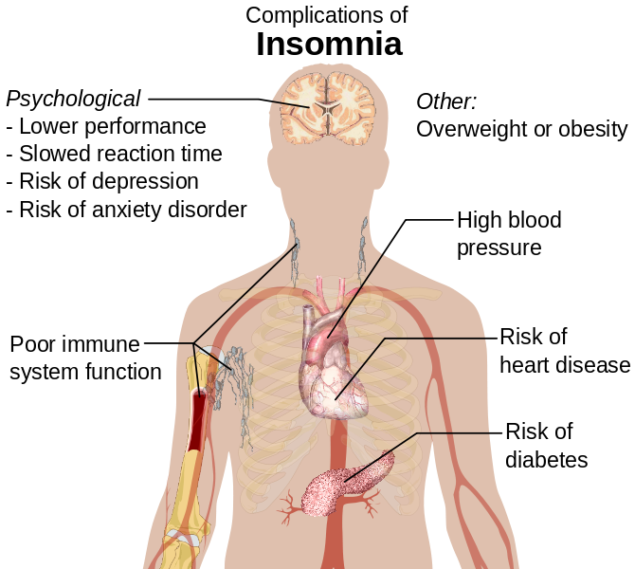
Notes:
https://commons.wikimedia.org/wiki/File:Complications_of_insomnia.svg

Slide 48
Insomnia:
temporary = less than week
short term= less than month
chronic = more than month (according to International Classification of Sleep Disorders 3 months with a frequency of 3 times a week)

Slide 49
Indications
Sleep disorders in case of:
no causative treatment available
causative treatment still not effective
short term treatment
severe sleep disorder (debilitating for patient, causing sick leave)
Recommended just for short courses of treatment of insomnia- from few days to 2 weeks (max. of 4 weeks in a row)

Slide 50
„Ideal“ hypnotic drug
to mimick physiological structure of sleep cycles
broad ther. range
optimal halflife of elimination
rapidly absorbed after p.o. admin.
terap. levels in blood 5-7 h, no active metabolites
no ADE , interactions
no risk of addiction

Slide 51
First generation hypnotics
clomethiazole
acts as a positive allosteric modulator at the barbiturate/picrotoxin site of the GABAA receptor
Indications: insomnia in geriatric patients, acute alcohol withdrawal syndrome, delirium tremens
Contraindicated in case of sleep apnoe and chronic respiratory insufficiency
barbiturates
obsolete, death from respiratory and cardiovascular depression if given in large dose – flumazenil not effective
mainly used in anaesthesia (thiopental) and as a treatment of epilepsy (phenobarbital)

Slide 52
Second generation hypnotics
Benzodiazepines
midazolam – also for premedication in anaesthesiology
diazepam
cinolazepam
clobazam
medazepam
unwanted effect: dependence, drowsiness, disturbed sleep cycle

Slide 53
Third generation hypnotics
Selective agonists at benzodiazepine site containing α₁ subunit
- selective hypnotic effect, lacking moyrelaxant, anxiolytic and anticonvulsive effect
- non-benzodiazepine structure
can cause dependence, not causing morning „hangover“, causing confusion, hallucinations, somnambulism and delusions in sensitive and geriatric patients
zopiclone
zolpidem
zaleplon

Slide 54
Antidepressive drugs in treating insomnia
trazodone
agomelatine
mirtazapine – see AD materials

Slide 55
New trends in hypnosedatives
Drugs influencing circadian rhytms
melatonin
just weak hypnotic
universal signal molecule which gives estimate about light/dark cycle to the brain
is synthetised in epiphysis, retina, GIT
sleep do not affect synthesis, peak levels between 11PM and 3AM

Slide 56
New trends in hypnosedatives
Dual orexin receptor antagonist
suvorexant
produces similar reinforcing effects to those of zolpidem and thus may have a similar abuse liability
unwanted effects: sleep terror, drowsiness
contraindicated in pregnancy

Slide 57
Risks associated with using hypnotics
dependence, cognitive disorders
higher mortality (respiratory center depression caused by overdose)
higher infection rate (weak respiratory infections, pneumonia)
higher risk of cancer
depression and suicide
higher risk of dementia, fractures and injuries
Notes:
84% higher of Alzheimer disease for those who took the drug for 6 months or longer

Slide 58
Other drugs with hypnosedative effect
antipsychotics: quetiapine
chlorprothixen, levomepromazine
H1 antihistamins (1. generation): hydroxyzine, promethazine, moxastine, bisulepine
medicinal herbs

Slide 59
Medicinal herbs as hypnosedatives
Melissa off. (Lemon balm)
Valeriana off. (Valerian)
Humulus lupulus (Hop)
Passiflora incarnata (maypop, purple Passionflower)
Hypericum perforatum (St. Johns Wort)

Slide 60
Antidepressants

Slide 61
Depression
loss of interest, happiness and motivation
loss of self-confidence, remorses, feeling of guilt
suicidal tendencies (in 2/3 patients)
loss of energy and tiredness
attention deficit, indecision
agitation (if anxiety is present)
sleep disorder (characteristic is early wake-up)
change in apettite
decrease of libido
the most common affective disorder
pesimistic mood with feelings of dejection, low self-worth or guilt for at least two weeks
different grades of severity
world-wide one of the most common causes of premature death
emotional and biological symptoms

Slide 62
Monoamine theory of depression
depression = monoamine deficit in particular parts of the brain
mania = hyperactivity of monoamines in the CNS
clinical evidence – substances decreasing monoamine activity = mood aggravation
the specific roles of 5-HT and NA are not clear
antidepressants directly or indirectly increase the monoamine activity

Slide 63
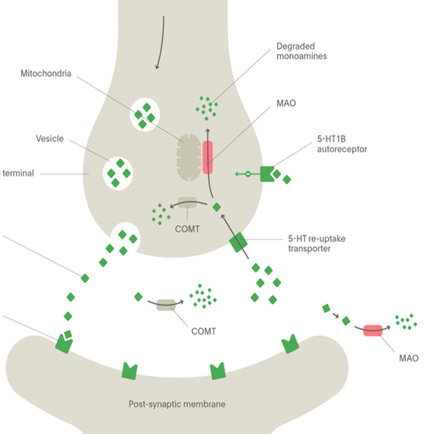
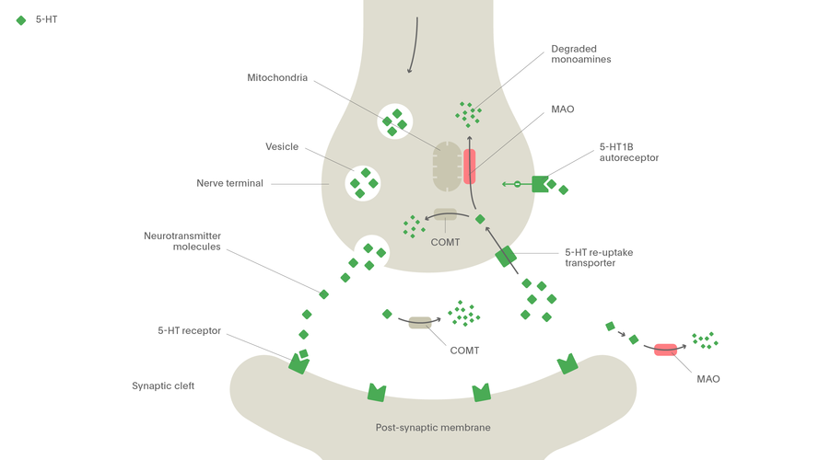
Mechanismus účinku antidepresiv
iMAO
MAO
SMS
MAO
5HT - AUTORECEPTOR
TCA
α2- AUTORECEPTOR
SNRI
NARI
Noradrenaline
Serotonin
NET
SERT
SSRI
SARI
MAO
5-HT1A
MAO
α1
β3
5-HT2A
5-HT2C
NASSA

Slide 64
Mode of action of antidepressants
most AD increase 5-HT, NA or D activity
General modes of action of antidepressants:
MAO inhibition (selective MAO A/ nonselective)
reuptake inhibition (SERT, NAT)
desensitisation/antagonism of presynpatic
autoreceptors (5-HT_{1D}, α₂)
agonism of postsynaptic receptors 5-HT_{1A}
antagonism of postsynaptic receptors 5-HT_{2A}
increase of
5-HT and/or NA
increased BDNF
activity

Slide 65
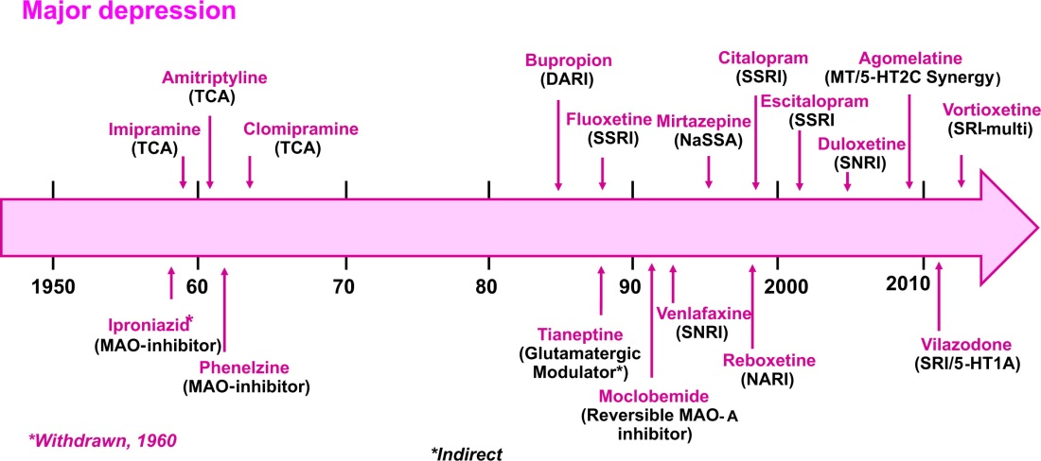
History of antidepressants
MILLAN, Mark J., et al. Learning from the past and looking to the future: Emerging perspectives for improving the treatment of psychiatric disorders.European Neuropsychopharmacology, 2015, 25.5: 599-656.

Slide 66
Efficacy of antidepressants
in general partial response or remission in 60-70% of patients
„only 30 %“ in the first line of antidepressant treatment
significant interindividual differences in treatment response
the efficacy of distinct groups of AD is equipotential
= criteria of AD selection
1. depression side symptoms (agitation, anxiety, insomnia)
2. decrease of adverse reactions risk

Slide 67
SSRI – selective serotonin reuptake inhibitors
inhibit also NAT, but more selective for SERT
PK and PD differences between single agents = one SSRI can be replaced by other in case of therapy failure
drugs of choice in most patients
great safety profile – but not tolerability
↑ risk of suicide in tennagers
risk of drug-drug interactions (iCYP 2D6 and 3A4 inhibitors)
I: depression, anxiety, OCD, PTSD, migraine, pain

Slide 68
SSRI
AE
GIT irritation
↑ bleeding, sex. dysfunction, anhedonia
Serotonin syndrome
induced by hyperactivity of serotonine in the CNS
high risk in combinations of serotonergic drugs (AD, triptans, analgesics)
Antidepressant discontinuation syndrome - FINISH

Slide 69
SSRI
fluoxetine
5-HT_{2A}antagonist, CYP2D6 strong inhibitor
sertraline
- the strongest SERT inhibitor
- weak DAT inhibitor, anxiolytic activity
paroxetine
- weak antimuscarinic effect = sedative; CYP2D6 strong inhibitor
citalopram
- the lowest risk of drug-drug interactions

Slide 70
SSRI - escitalopram
MofA: SERT selective inhibition
Indications: depression, anxiety
Administration: per os
PK: good absorption from GIT, low protein binding, complete biotransformation in liver (CYP2C19), active metabolites, dominantly excreted into urine
AE: prolongation of QT, serotonine syndrome
DDI: iMAO ↑risk of serotonine syndrome, CYP inhibitors
KI: till 18 years, gravidity, lactation

Slide 71
SNRI – serotonin and noradrenaline reuptake inhibitors
MofA – nonselective blockade of 5-HT and NA reuptake
„activating“ drugs
AE: stimulation of adrenergic receptors = insomnia, sex. impairment, ↓ apetite, hypertension
increased risk of suicide, discontinuation sydrome
venlafaxine + desvenlafaxine
duloxetine – also for neuropathic pain, hepatotoxic

Slide 72
NDRI – noradrenaline and dopamine reuptake inhibitors
bupropion
little effect on 5-HT
in comparison to other DAT and NAT inhibitors does not cause euphoria
in the treatment of smoking cessation
AE
risk of seizures, aggravation/development of psychotic signs

Slide 73
NARI – noradrenaline reuptake inhibitor
reboxetine
MofA – blockade of NAT: SERT = 20:1
M, H1 and α₁ antagonist
AE
stimulation of adrenergic receptros = insomnia, restlessness, anxiety
constipation, sex. dysfunction
atomoxetine –ADHD therapy

Slide 74
SARI – serotonine antagonist and reuptake inhibitor
trazodone
MofA
SERT inhibition
5-HT_{1A} agonism
5-HT_{2A} and _{2C} antagonis
H₁ and α₁antagonismus
AE: hypotension, sleepiness
CYP2D6 substrate, 3A4 inhibitor

Slide 75
mirtazapine
NASSA – noradrenergic and specific serotonergic antidepressants
MofA: block of presynaptic α₂ + postsynaptic 5-HT2A, 5-HT2C and 5-HT3
stimulation of 5-HT1
block of H1 and weak antagonism of α1
Administration: per os
PK: F from GIT app. 50%, protein binding, substrate of CYP3A4, CYP2D6 and CYP1A2, complete metabolization, some metabolites are active
AE: serotonine syndrome, sedation, ↑ weight
Interactions: serotonergic drugs, including St. John‘s wort, CYP inducers/inhibitors
KI: till 18 years, combination with iMAO
drug discontinuation– slow dose decrease
suitable in depression with insomnia, low risk of sex. disorders

Slide 76
SMS – serotonin modulator and stimulator
vortioxetine
MofA: inhibice SERT
5-HT_{1A}agonism
5-HT_{1D}, 5-HT₃ antagonism
AE: pruritus, nausea, live dreams
risk of serotonin syndrome
CYP2D6 substrate

Slide 77
MASSA-melatonine agonist and serotonin selective antagonist
MofA: MT₁ and MT₂ agonist
5- HT_{2C} antagonist
increased melatonin release and resynchronizes circadian rhythm
CYP1A2 substrate
risk of hepatotoxicity = monitoring of transaminases
in single dose when going to bed

Slide 78
TCA
MofA: 5-HT, NA and D reuptake inhibition
+ 5-HT2A antagonism and 5-HT1A agonism
+ antagonism of H₁, M, α₁ and 5-HT_{2C} => AE
serotonergic adrenergic
clomipramine imipramine, desipramine amitriptyline, nortriptyline

Slide 79
TCA
AE:
antiM – confusion, cognitive deficit, peripheral effects
antiH₁ – sedation, weight gain
antiα₁ – ortostatic hypotension
anti 5HT_{2C} - weight gain
proarrhythmogenic
significant acute toxicity
initial dose usualy titrated

Slide 80
TCA
liver metabolism - CYP2D6 and 3A4
plasma protein binding
long t_{1/2} = risk of drug accummulation
„older“ drugs, still in use
I: resistant depression
co-analgesics

Slide 81
iMAO
ireversible inhibitors today obsolete
reversible selective iMAO A – moclobemide
the strongest effect on 5-HT > NA > D
„cheese reaction“
positive effect on cognition
inhibitor of CYP2D6, 2C19 and 1A2
AE: hypotension, CNS stimulation, weight gain

Slide 82
Side effects of antidepressant therapy
Nonselective serotonergic activity (SSRI, iMAO, TCA, SNRI)
+ anxiolytic and antidepressant activity
- sex. impairment, emotional flatness, serotonin syndrome
Nonselective noradrenergic activity (TCA, NARI)
+ „activation“ of patient, antidepressant activity
- tremor, tachycardia, hypertension

Slide 83
Side effects of antidepressant therapy
antihistaminergic activity = sedation, weight gain
α₁lytic activity= ortostatic hypotension and risk of falls
antimuscarinic activity = cognitive deficit and peripheral effects
QT interval prolongation

Slide 84
activating x sedative AD
fluoxetine
nortriptyline
venlafaxine
paroxetine, fluvoxamine, citalopram
dosulepin, maprotiline
trazodone
mirtazapine
agomelatine

Slide 85
Augmentation of antidepressant terapy
Antipsychotics
separately or in combination with antidepressants
in depression with psychotic symptoms, and in prophylaxis
atypical antipsychotics
Anxiolytics
in the begining of therapy of depression with significant anxiety component to decrease the risk of suicide
Phytopharmacology

