Slide 1
III. Erythrocyte sedimentation rate
IV. Estimation of osmotic resistence of red blood cells
Physiology I – practice
Autumn, weeks 4-6
2015 © Michal Hendrych, Tibor Stračina

Slide 2
Erythrocyte sedimentation rate

Slide 3
Sedimentation of erythrocytes (RBCs)
It is a physical process of settling (sedimentation) of RBCs in non-flowing non-coagulating blood.
The estimation of erythrocyte sedimentation rate (ESR)
  Non-specific laboratory method, low sensitivity
  Speed of the erythrocyte sedimentation in the column of anti-coagulated blood in a glass tube
The value of ESR is inversely related to the suspension stability of blood

Slide 4
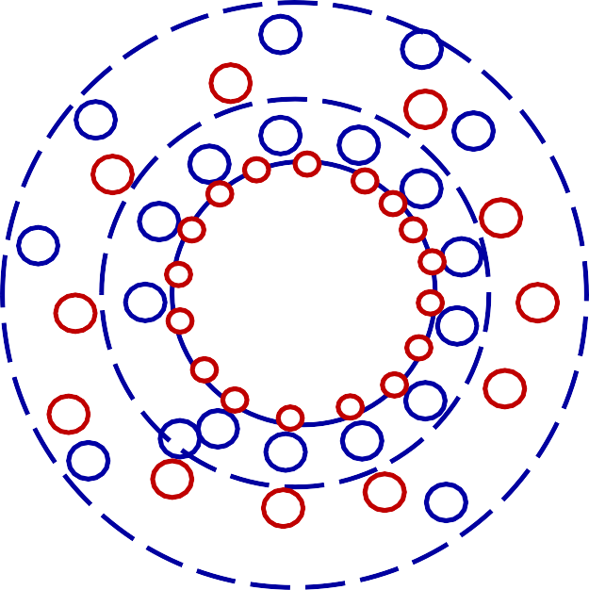

Suspension stability of blood
Helmholtz electrical double-layer
  There is a negative charge on the membrane of red blood cells caused mainly by sialic acid residues of membrane proteins
  Positively charged ions (primarily Na⁺) are held in proximity to the membrane by electrostatic forces - they form the 1st layer of ions
  Negatively charged ions are attracted to the positively charged layer, which makes up the majority of the 2nd ion layer
  Due to their "electric envelope", the RBCs repel each other, which ensures that the non-flowing non-coagulating blood remains as a suspension of blood elements in the plasma for a certain time = suspension stability
RBC - -
-
+

Slide 5
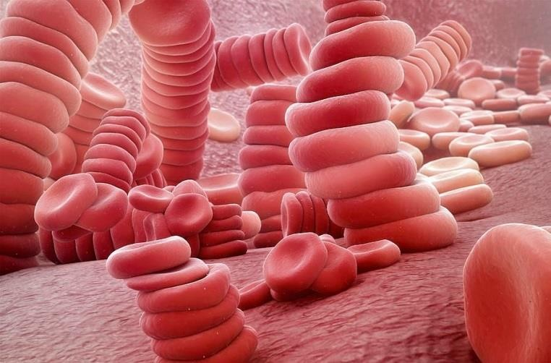
Mechanism of erythrocytes sedimentation
Gravity – under its influence, erythrocytes in non-flowing non-clotting blood gradually settle down (sediment).
Factors impairing the Helmholtz electrical double-layer cause aggregation of RBCs into cylindrical aggregates (rouleaux) with higher volume and relatively smaller surface (compared to the corresponding volume of separate RBCs)
  Aggregates fall down (sedimentate) faster than separate RBCs = value of ESR is higher
  Disruption of the electrical double layer will thus cause an increase in the sedimentation rate

Slide 6
Basic factors affecting ESR
ESR depends on RBCs characteristics and plasma composition
Plasmatic proteins
  Albumin is charged negatively – it helps the suspension stability of blood
  Immunoglobulins and fibrinogen – possess negative and positive charges which cause impairment of Helmholtz electric double-layer
  Fatty foods should not be eaten before blood taking for sedimentation testing
  Sedimentation is also affected by RBC’s shape (spherocytosis, sickle cell anemia)
Effect on ESR | ↑ value | ↓ value
Erythrocytes
Number of RBCs | decelerates | accelerates
Size of RBCs | accelerates | decelerates
Plasma
Albumin | decelerates | accelerates
Imunoglobulins | accelerates | decelerates
Fibrinogen | accelerates | decelerates
Lipids | accelerates | decelerates

Slide 7
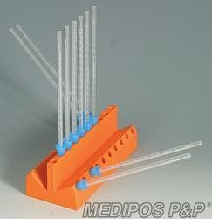
Methods of ESR estimation
Fahraeus-Westergren (FW) – direct method
  A glass tube in vertical position
  Measured after 1 hour (2 hours)
Wintrobe
  100 mm long, thin glass tube in oblique position (45°)
  Measured after 15 minutes
  Less sensitive than the FW

Slide 8
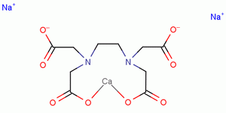
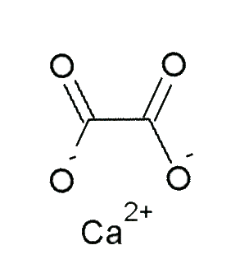
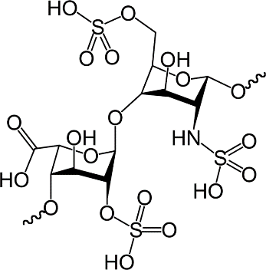
Anti-coagulated blood
A blood sample with the coagulating system blocked
Possible anticoagulant agents
  Chelation of Ca2+ ions which are essential for coagulation (chelation anticoagulants)
    Sodium citrate
    EDTA (ethylenediaminetetraacetic acid)
    Sodium oxalate
Activation of antithrombin III – heparin and its low molecular weight derivatives (LMWHs)
  Antithrombin III inactivates thrombin and some other coagulation factors, heparin enhances the effect of antithrombin III

Slide 9
Physiological values of ESR (FW)
Men: 2-8 mm/h
Women: 7-12 mm/h
Newborns: 2 mm/h
Infants: 4-8 mm/h
Intersexual differences in adults are caused by different RBC count and by differences in concentration of plasmatic proteins (women have fewer RBCs and more fibrinogen)
  Sedimentation accelerates with age

Slide 10
Changes in ESR (FW)
Increased ESR (FW)
  Pregnancy, menstruation
  Macrocythemia
  Inflammation
  Infection
  Necrosis (myocardial infarction, injury)
  Cancer
  Relative/absolute loss of albumin (e.g. renal disorders)
  Hyperlipidemia
Decreased ESR (FW)
  Irregular RBC shape - spherocytosis
  Polycythemia vera
  Leukocytosis
  Dysproteinemia – hypofibrinogenemia, hypogammaglobulinemia
  Dehydration

Slide 11
Types of blood in physiology practice
Full human blood
  RBCs in plasma (normal hematocrit) – sedimentation rate should be normal
Human RBCs + physiological solution
  Sedimentation will be slow – there are no plasma proteins
Full horse blood
  Large RBCs, more plasma proteins - rapid sedimentation
Horse RBCs + physiological solution
  Horse RBCs in saline solution sediment more slowly than in full horse blood
Only theoretically:
(Beef blood - A higher number of smaller RBCs - very slow sedimentation)
(Anemic blood - RBCs in plasma (low hematocrit) – sedimentation should be faster)

Slide 12
Osmotic resistence of red blood cells

Slide 13
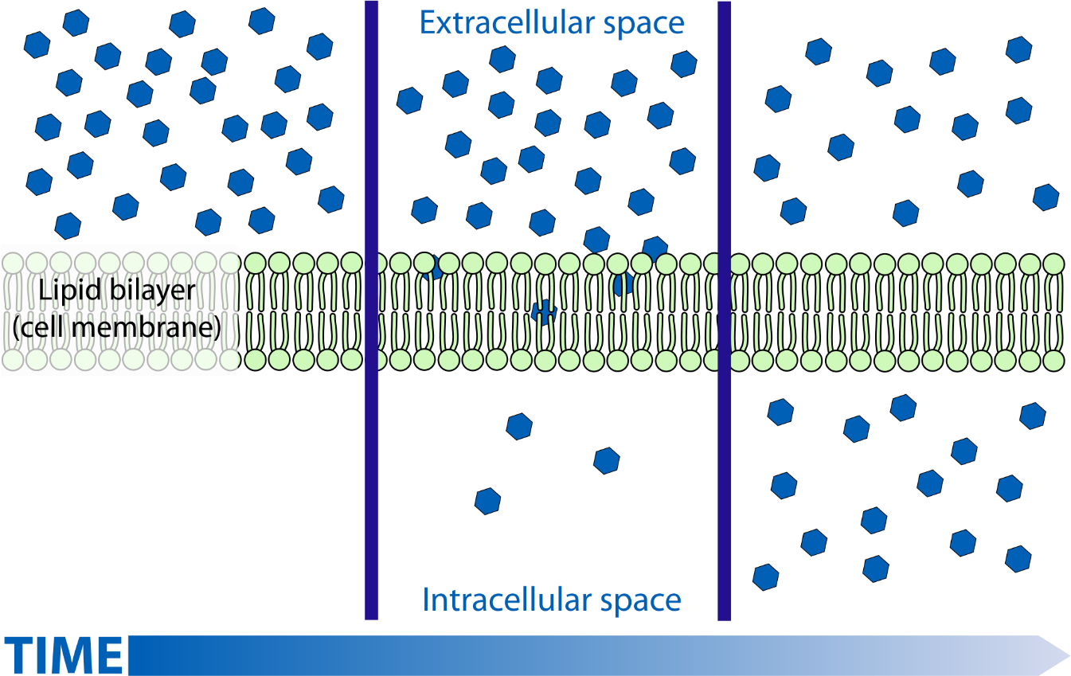
Diffusion
Movement of molecules or atoms from a region of high concentration to a region of low concentration

Slide 14
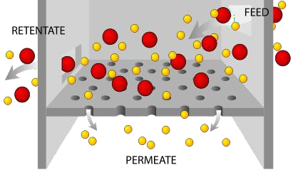
Filtration
Separation of fluids from the „solid“ parts through the membrane powered by the pressure gradient

Slide 15
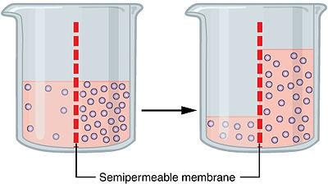
Osmosis
A flow of solvent (water) through
a semipermeable membrane according to
an osmotic gradient
Osmotic pressure – pressure necessary to stop the osmosis
Osmolarity – concentration of osmotic active particles in 1 litre of solution
Osmolality – concentration of osmotic active particles per 1 kg of solvent
Osmolality of plasma = 2*[Na⁺] + [glc] + [urea] =
= 275-295 mmol/kgH₂O

Slide 16
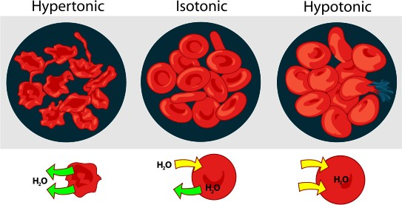
Tonicity
The osmolality of a solution compared to the osmolality of intracellular fluid
  Hypotonic solutions – the solution had lower osmolality than intracellular fluid → water flows into the cells
  Isotonic solutions – same osmolality of solution and intracellular fluid – 0.9% NaCl = physiological solution (saline)
  Hypertonic solutions – the solution has a higher osmolality than the intracellular fluid -> water leaves the cells.

Slide 17
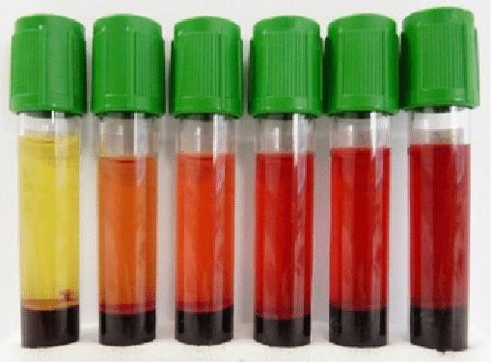
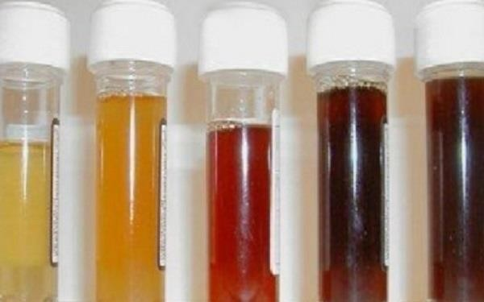
Hemolysis
Blood with sediment and various levels of hemolysis
Break-up of RBC due to disintegration of its membrane – hemoglobin and intracellular fluid are spilt into the solution (plasma)
  Hemolysed blood – plasma is pink in colour thanks to hemoglobin
  Old fragile RBCs are captured and processed in the red pulp of the spleen
  After hemolysis in the circulation, hemoglobin is bound to haptoglobin, which prevents filtration of hemoglobin by the kidneys
  In excessive intravascular hemolysis, there is not enough haptoglobin, and hemoglobin is filtered by the kidneys and lost in the urine (hemoglobinuria), together with iron (iron loss). It can lead to tubule blockage and kidney damage (hemoglobinuric nephrosis)
Urine with various levels of hemoglobinuria

Slide 18
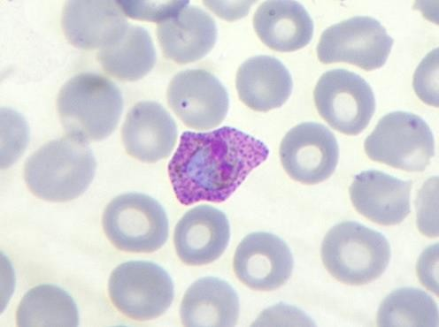
Types of hemolysis
Physical
  Mechanical damage to the membrane, shaking, ultrasound, extreme temperature changes, UV radiation
Osmotic
  RBC in a hypotonic solution absorbs water and bursts
Chemical
  A chemical reaction of lipids in the membrane with a chemical substance – strong acids and bases, fat solvents, surfactants (detergents)
Toxic
  Bacterial toxins, poisons (plant, snake, insect, spider,...), parasites (Plasmodium spp. - malaria)
Immunological
  Transfusion of incompatible blood – immune system hemolyzes erythrocytes (via complement)
Malaria
(Plasmodium spp.)

Slide 19
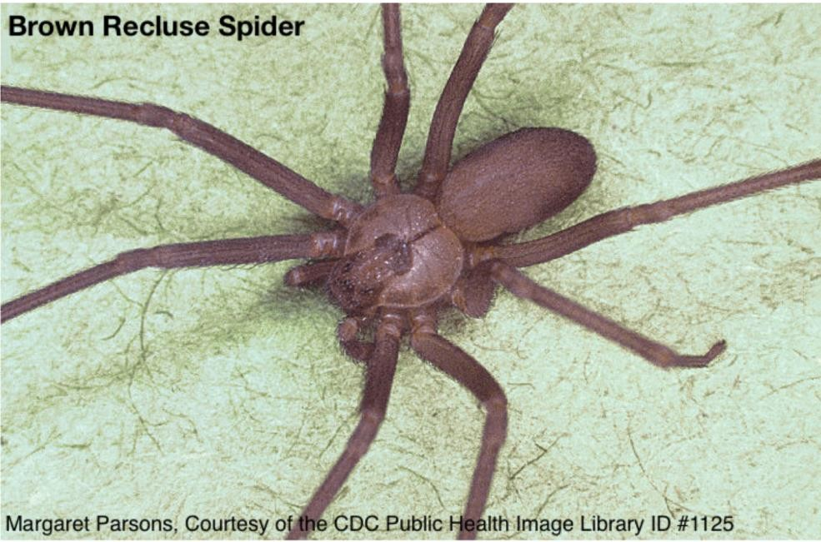
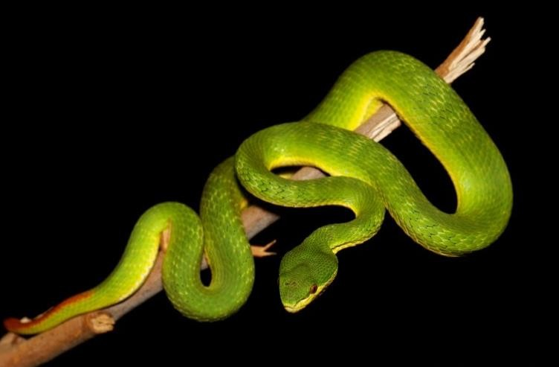
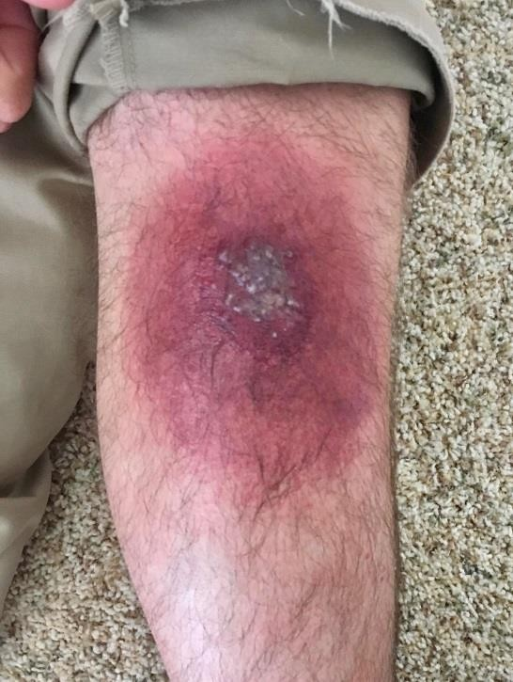
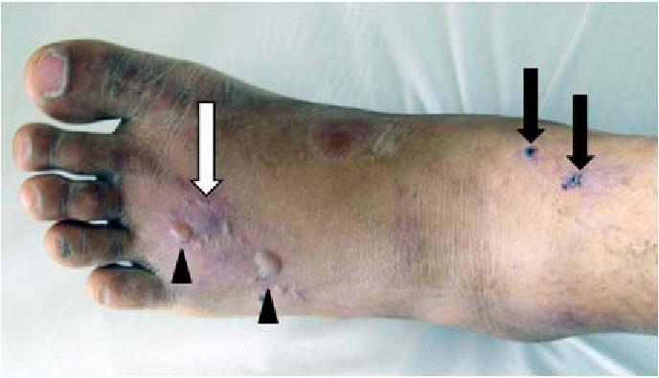
Hemolytic poisons
Brown recluse (Loxosceles reclusa) is native to America, and very rarely appears in Europe, at least for now
White-lipped tree viper (Cryptelytrops albolabris)
Vipers and rattlesnakes also have hemolytic poisons. Czech viper (adder) has a combination of hemolytic and neurotoxic poison. It is dangerous for weakened individuals, mainly due to an allergic reaction.
Chill, almost all Czech spiders are poisonous, but only some can bite through human skin.
Examples: Moravian steppe, Moravian weaver, poison ivy, rarely poison weaver (black widow). But apart from the black widow, they are rare, outdoor, shy spiders. The bite usually causes a local allergic reaction that disappears within two days

Slide 20
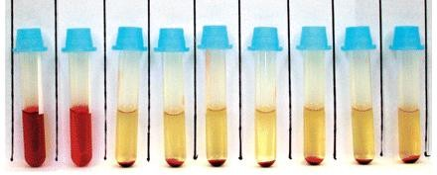
Osmotic resistance of RBCs
Estimation of RBCs resistance in hypotonic solutions
  A specific method used in the differential diagnosis of hemolytic anemia
Minimal osmotic resistance (0.40-0.44%)
  Concentration of hypotonic NaCl solution in which first RBCs are hemolysed – there is a pink coloured plasma above the sediment, the least resistant RBCs hemolyze
Maximal osmotic resistance (0.30-0.33%)
  Lowest concentration of hypotonic NaCl solution in which the small fraction of RBCs are still not hemolyzed – the last tube containing the sedimented RBCs, the most resistant ones
Osmotic resistance range
  The difference between minimal and maximal osmotic resistance

Slide 21




Osmotic resistance of RBCs – in practice
Solution gradient from weakly hypotonic to strongly hypotonic
  Each tube: 10 mL NaCl solution + 2 drops of blood
Hemolysis of all RBCs, the solution is transparent and pink
Hemoglobin from first hemolysed RBCs changes the solution’s colour to pink
A sediment of last remaining RBCs
Transparent yellow solution
Non-transparent
RBCs sediment
Saline solution
0.63 0.60 0.57 0.54 0.51 0.48
0.45 0.42 0.39
Minimal osmotic resistance
0.36 0.33
Maximal osmotic resistance
0.30 0.9
%NaCl

Slide 22
Pathological values of osmotic resistance
Higher values of minimal osmotic resistance
  Congenital hemolytic anemia
Lower values of maximal osmotic resistance
  Polycythemia vera
  Thalassemia
  Sickle cell disease
  Sideropenia
  Status after splenectomy

Slide 23
Isotonic hemolysis
In vitro conditions
Isotonic glucose solution: RBCs intake and metabolize glucose, the solution becomes hypotonic and osmotic hemolysis occurs
Isotonic urea solution: urea freely passes through the membrane into the RBCs (it diffuses along its concentration gradient) and the surrounding solution becomes hypotonic

