Slide 1

Entonox
MDDr. Michaela Bartošová, Ph.D

Slide 2
What is entonox?
Mixture: 50% N₂O (nitrous oxide) and 50% O₂ (oxygen)
N₂O was used for the first time 200 years ago
1880 – pain relief during the birth – administered without oxygen – asphyxia
50 years 20. century – mixture 50% N₂O with 50% O₂
The part of general anesthesia, pain relief
Administered by anesthesiologists, non - anestesiologists, after training also intermediate medical staff
Extremly mild influence on CNS and cardiovascular system
Individual effect, influenced by sugestion
Serious side effects are minimal

Slide 3
Benefits
Easy and safe application
It could be administered by non-anesthesiologists and intermediate medical staff (obstetrics, gastroenterology, dentistry)
Minimal occurrence of side effects
Rapid onset of sedation and analgesia
Fast psychomotor recovery

Slide 4
History
1772 - Josef Pristley discovered N₂O
1778-1829 – Humprey Davy discovered effect of N₂O – laughing gas, Lachgas, rajský plyn – used for entertainment purposes
1815 – 1848 – Horace Wells – dentist, he discovered analgesic effect
20. century – analgesic for oral surgery
  Weak effect on pain relief, high risk of hypoxia, imperfect technical equipment
  Anxiolytic and sedative effects are more important than weak analgesic effects
80 % N₂O and 20% O₂ today 50% N₂O with 50% O₂

Slide 5
Pharmacodynamics of N₂O in CNS
Minimal effect on EEG and bispectral index (form of EEG monitoring of sedation depth and anesthesia)
Increased blood flow to the brain and slightly increased blood volume in the brain
Neurological manifestations of chronic exposure only in its frequent recreational usage in the past (numbness, decreased activity of tendon reflexes, feelings of electric shocks in the body, cognitive dysfunction, swelling of mitochondria of neurons and apoptosis)
NMDA receptor antagonist
At concentrations of 10 and 20%, it affects psychomotoric functions

Slide 6
Pharmacodynamics N₂O in CNS
Amnestic effect– information are different, anterograde amnesia, mediated by the interaction of N₂O with NMDA receptors
Analgesic effect - effect on opioid receptors, its stimulation releases endogenous opioid peptides - endorphins and enkephalins.
  It corresponds to 15 mg of morphium, max. threshold in 10 minute
  Rapid development of tolerance
  Significant reduction of sensitivity after application of local anesthetic
Anesthetic effect - used to accelerate the induction of other inhalation anesthetics

Slide 7
Pharmacodynamics of N₂O
The tolerance to nitrous oxide could be created
  The tolerance develops between 10 minutes and 2 hours
  Significant differences in acute tolerance - various neurotransmitters are involved in the transmission of information
  The decrease in the density of opioid receptors in individual brain regions is also important
Respiratory system - increase in respiratory frequency, slight reduction in tidal volume, pCO₂ unchanged
Cardiovascular system - slight increase in heart rate, heart rate and peripheral resistance - slight sympathomimetic effect, release of catecholamines »increase in blood pressure, heart rate, increased incidence of cardiac arrhythmias
Gastrointestinal system - in 50% nausea, vomiting
Kidneys, liver - does not influence their metabolic activity, can be used in patients with severe diseases of these organs

Slide 8
Pharmacokinetics
Inhalation from lungs to bloodstream and further to CNS
Slightly soluble in blood, rapid equalization of alveolar concentration in the lungs with blood = rapid onset of action, fast disappearance
The transport in blood is free, not bound to hemoglobin, it is not metabolized, excreted by the lungs
Rapid diffusion into closed body cavities and it could lead to their expansion (intestinal loops, processus mastoideus, pneumothorax)
Oxygen in the lungs is diluted during elimination - temporary hypoxia, there is no risk of hypoxia with a 50:50 mixture

Slide 9
Clinical manifestation of inhalation
Feeling of intoxication, vertigo, paresthesia in the upper and lower limbs, in the oral cavity, feeling of warm in the body, feeling of euphoria, analgesia begins
Blood pressure, heart rate and respiratory rate is rising
Peripheral vasodilation
Flush - redness on the face
Decrease in muscle tone, changes in perception, hyperacusis
Laugh or crying

Slide 10
Indication
Surgical procedures (joint reposition, insertion and removal of drains, abscess incision, fracture reposition, treatment of wounds and contusions)
Gynecology and obstetrics - minor gynecological procedures and the first phase of childbirth
Urology
Dentistry
Gastroenterology - endoscopic procedures
Dermatology
Hematology
Treatment of pressure ulcers
Podiatrics
Psychiatry and psychology
Radiology
Neurology
Sick patients in the terminal phase

Slide 11
Contraindications
Pneumothorax, pneumopericardium, severe emphysema, air embolism, COPD
Acute myocardial infarction
After intracutaneous gas injections
Dilatation of the digestive tract - ileus
Heart failure, cardiac dysfunction
Increased intracranial pressure
With reduced consciousness and lack of cooperation
Untreated vitamin B12 or folic acid deficiency
In case of facial injuries disables the usage of an breathable valve
Ear surgery (tympanoplasty)
Intraocular gas injections or perforating eye injuries
Damage to the blood-brain barrier
First trimester of pregnancy - interference with the metabolic pathway of vit B = disruption of DNA synthesis
Children under 3 years

Slide 12
Side effects
Short-term headache
Vertigo
Nausea, vomiting
Inhibition of methionine synthetase interferes with the metabolism of folic acid and methionine
Prolonged administration leads to vitamin B12 and folic acid deficiency - erythropoiesis disorders with the development of macrocytic anemia, leuko- and thrombo-cytopenia to agranulocytosis
Neurotoxic complications - acute funicular myelosis

Slide 13
Inhalation in childhood
In children in 3-4 years, cooperation is necessary
Younger child needs higher concentration N₂O to reach desired effect
The fear leads to flat breathing and decreased tidal volumes, suggestion and calming of atmosphere is necessary.
Sometimes it is necessary to interrupt analgosedation and choose another form of analgesia
Combinations with various drugs can also be performed under the supervision of an anesthesiologist:
  Surface anesthesia
  Combination with paracetamol rectally, orally and intravenously
  Tramadol - orally
  Nalbuphine - intravenously
  Midazolam - orally, rectally or intravenously

Slide 14
Entonox in dentistry – adult patient
Anxiolytic and narcotic (euphoric) effect is applied, pain reduction with LA application
Inhalation is accompanied by soothing speech, inducing a feeling of confidence
N₂O makes the patient accessible to suggestion
Instructions:
  Inhalation before treatment
  Application of LA
  Inhalation before dental treatment
Inhalation is also possible with a nasal mask - lower efficiency
Not suitable for patients with odontophobia

Slide 15
Entonox in dentistry – child as a patient
Cooperation is necessary
Consider combination with midazolam per os, per rectum, or nasally (supervision by anestesiologist is necessary)
Amnesia after inhalation is very frequent
Defensives reflexes are preserved, the child still defends himself after inhalation, but the patient does not usually remember the procedure.
In children younger than 3 years is the effect of N₂O insufficient, general anaesthesia is necessary

Slide 16
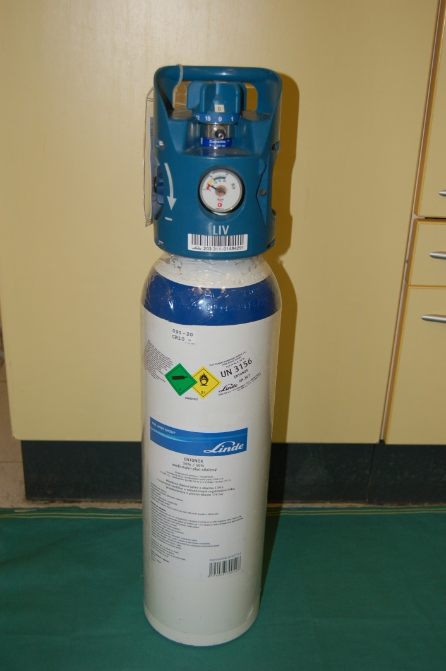
Practical design of inhalation sedation
Mixture 50% N₂O with 50% O₂
It is delivered in gas bottles (5 a 10 l) with LIV valve (Linde integrated valve)
The upper part of the bottle is marked with a white and blue stripes – mark for a mixture of oxygen and nitrous oxide
White cylinder body - designation for medical gas
Average number of procedures (lasting about 10 minutes) 20-40

Slide 17
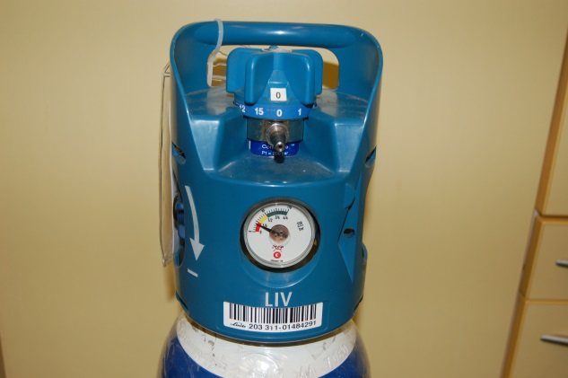
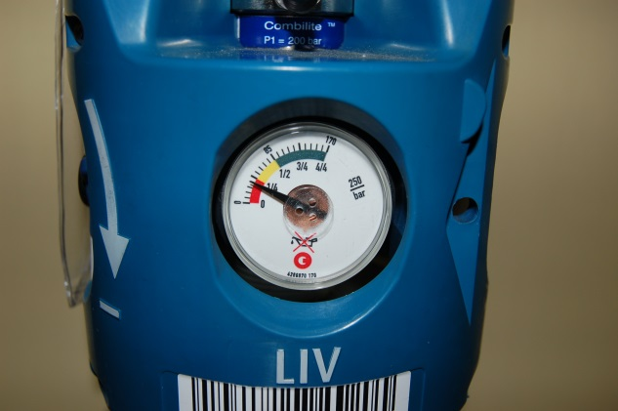
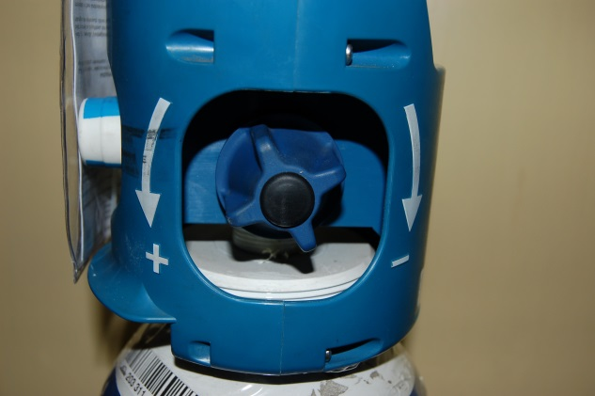
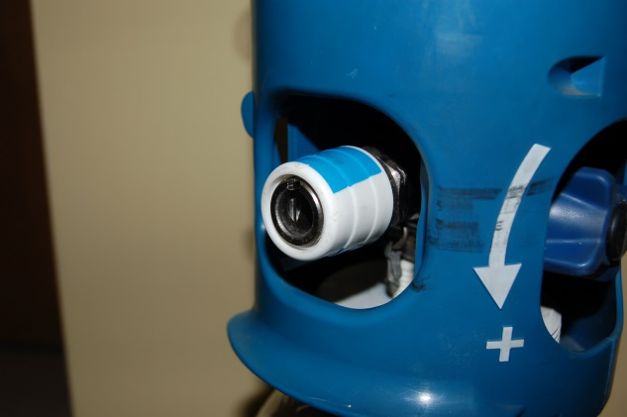
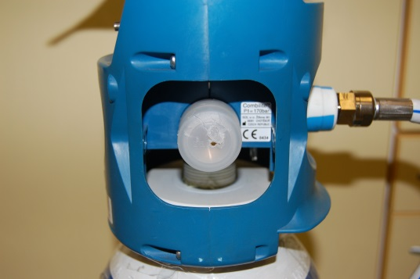
Gas bottle Entonox
Continuous flow controller with output
Active manometer - gas quantity indicator
Shut-off valve
Handrail
Quick coupling with blanking plug
Technological input for bottle filling

Slide 18
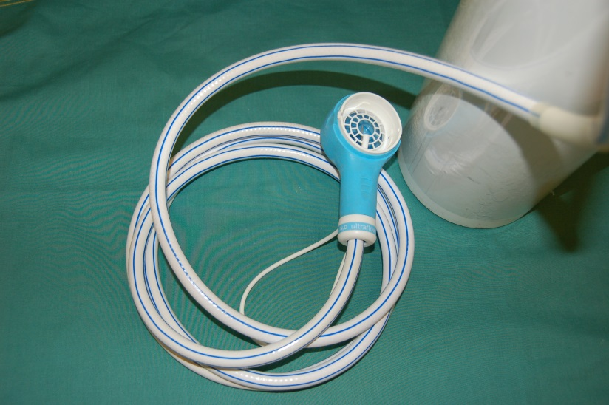
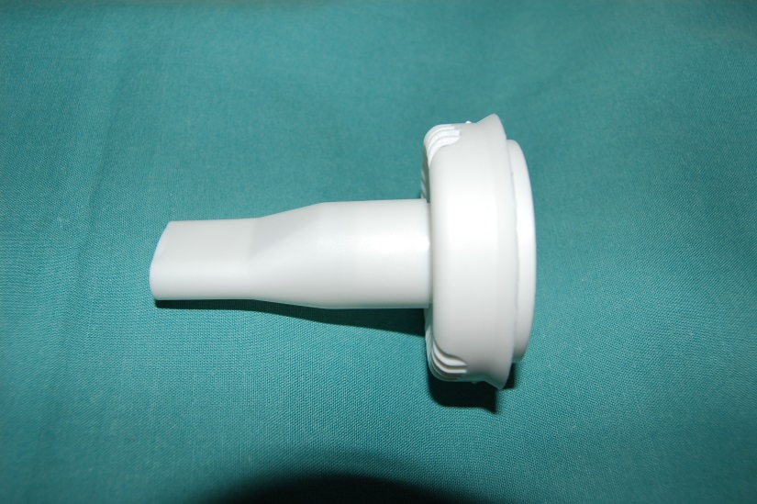
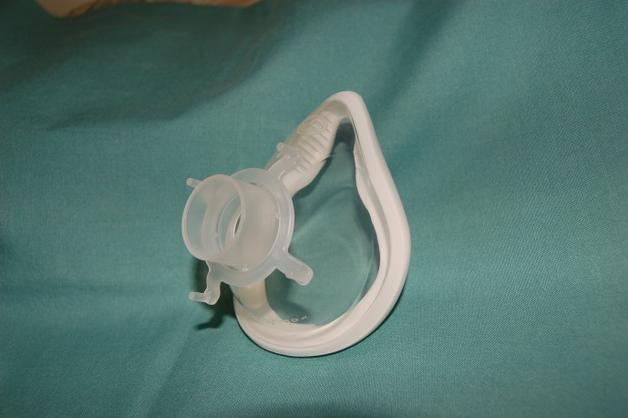
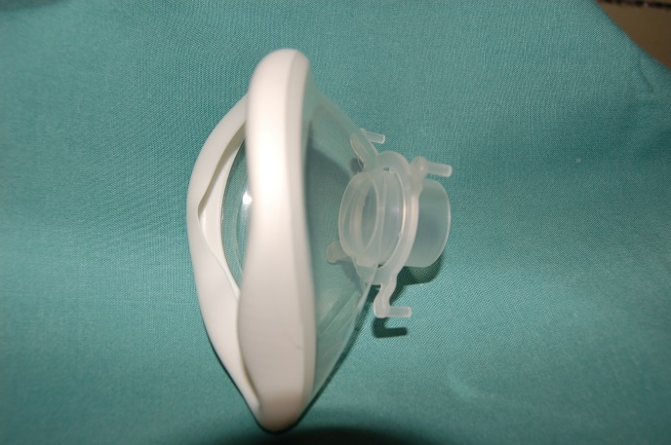
Breathing valve Carnét
Valve body with test button and loop
Hose for connection to the bottle
Inhalation attachment / mask

Slide 19

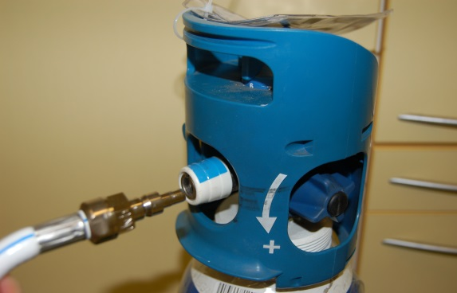

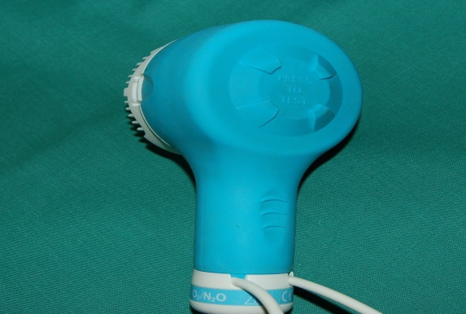
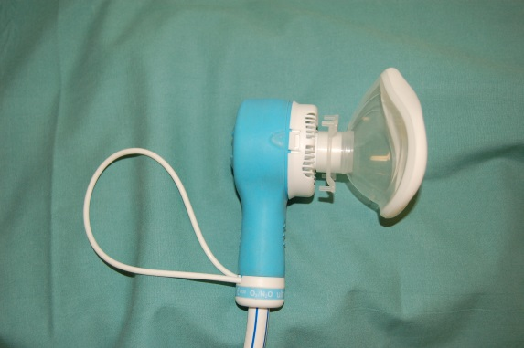
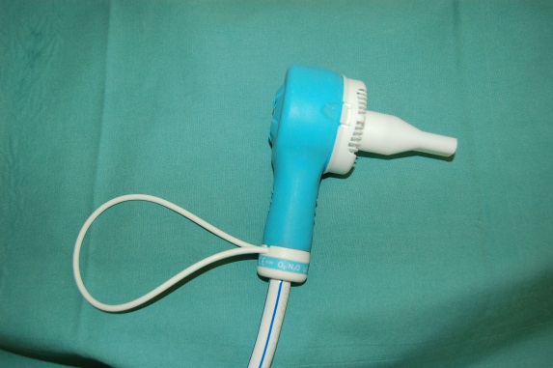

Instructions before the application
1. to control the amount of gas on active manometr, continuous flow controller is closed
2. to connect quickcoupler, of breathing valve Carnét
3. to open closing valve in the direction of mark
4. to check the flow of gas by the botton Press
5. The filter and mouthpiece or mask is put on breathing valve.

Slide 20
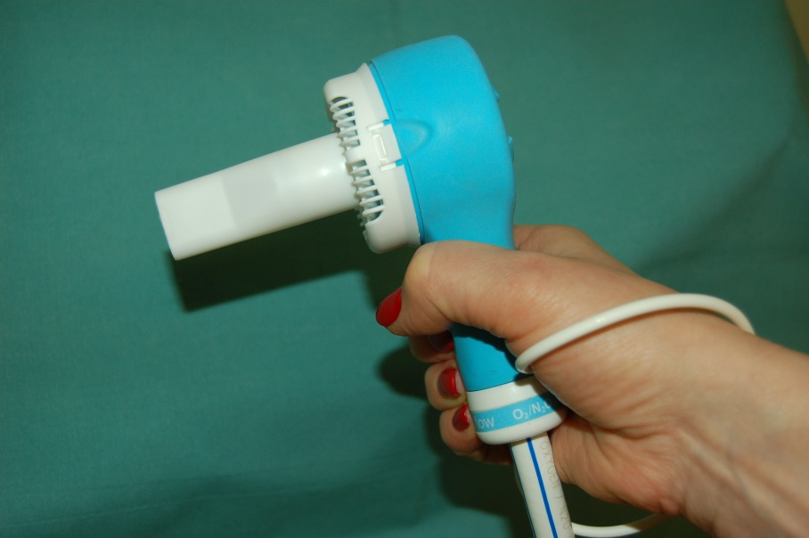
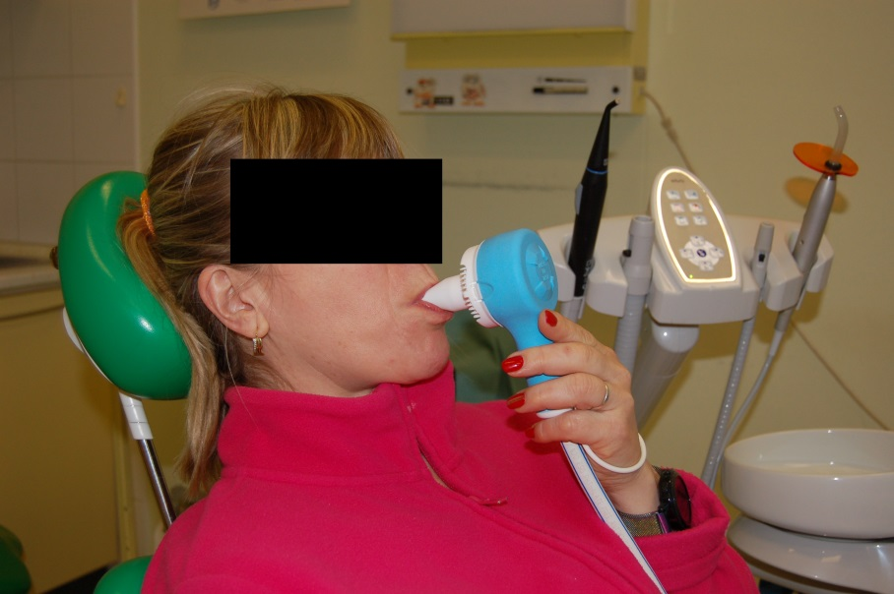
Application
We put a white strap on the patient's hand and insert the inspiratory valve with the filter and mouthpiece into the patient's hand
The patient wraps the mouthpiece with his mouth and inhales - deep breaths only through the mouth and exhalations through the nose and mouth
With the inhalation mask you can inhale through the nose even through the mouth
Inhale for at least 1 minute, max for effect after 2-3 minutes

Slide 21
After the application
Close the valve in the directon of the arrow
Drain the rest of gas from carnét
Disconnect the valve in place of quickcoupler
Remove filter with mouthpiece or mask
Desinfect Carnét
Patient is waiting in the waiting room for 30 minutes till the effect of gas will fade.

Slide 22
Bottle storage
At a temperature higher than -5ºC
Out of reach of flammable material
In well-ventilated rooms
Do not expose to strong heat
Move to a safe place if there is a risk of fire
The bottle must be clean, free of oil or grease
Stored in areas reserved for the storage of medical gases
Secure the bottle from falls and punches
Store and move with closed valves

Slide 23
Conclusion
Contact patient-doctor is necessary – calm speech, suggestion
Eliminate negative perceptions – loud speech, manipulation with instruments, we can not hurry, we are quiet
Patient reacts to your question, he/she is able to cooperate with the staff
Patient is recoverd within a few minute, adult are able to drive a car after 30 minutes
Severe side effects are missing

Slide 24
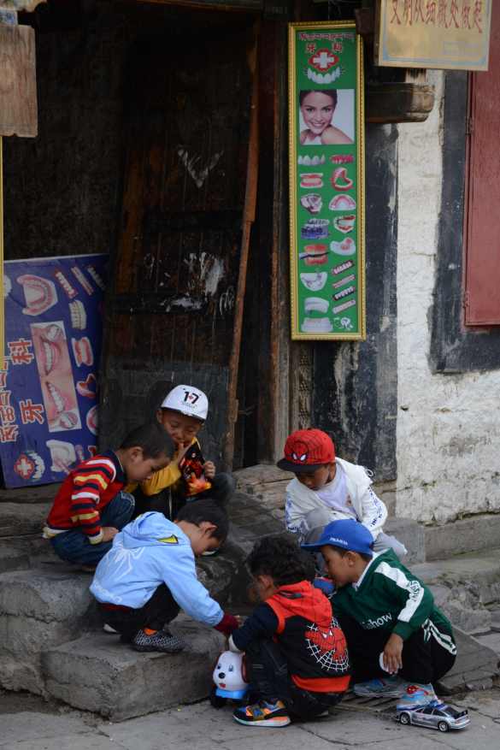
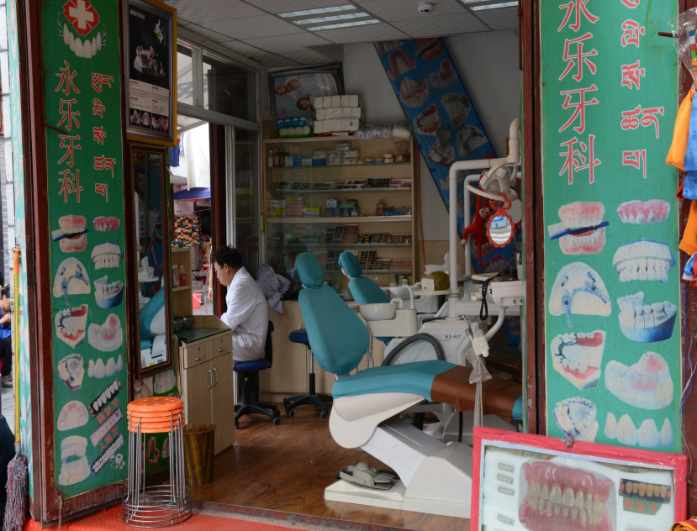
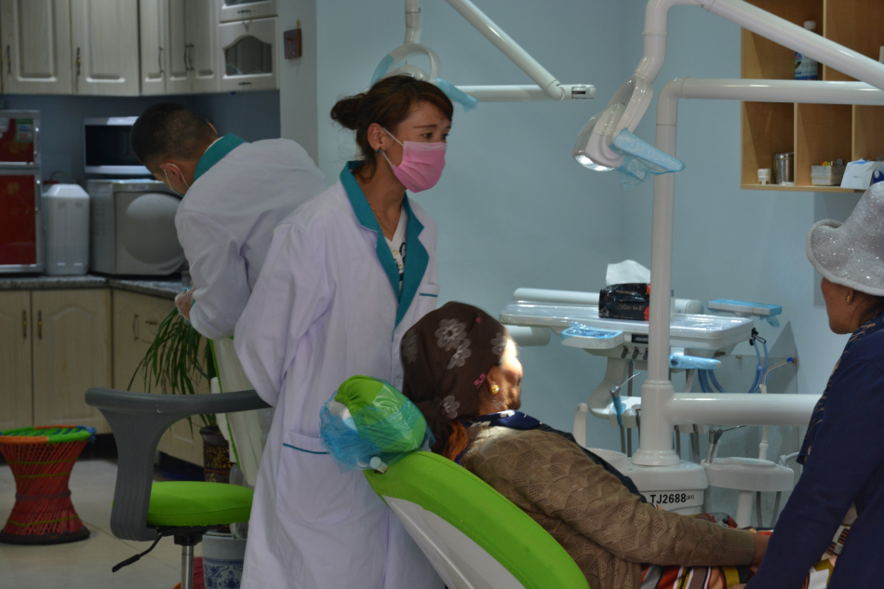
Thank you for your attention

