Slide 1
Respiratory system
&
Lung diseases

Slide 2
Points
Ventilation
Diffusion
Perfusion

Slide 3
Breathing
Lung ventilation can be considered in two parts:
the mechanical process of inspiration and expiration
the control of respiration to a level appropriate for the metabolic needs.

Slide 4
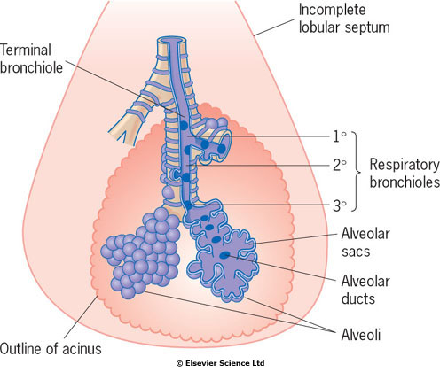

Slide 5
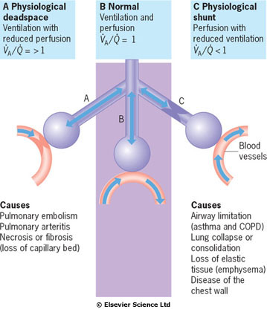

Slide 6
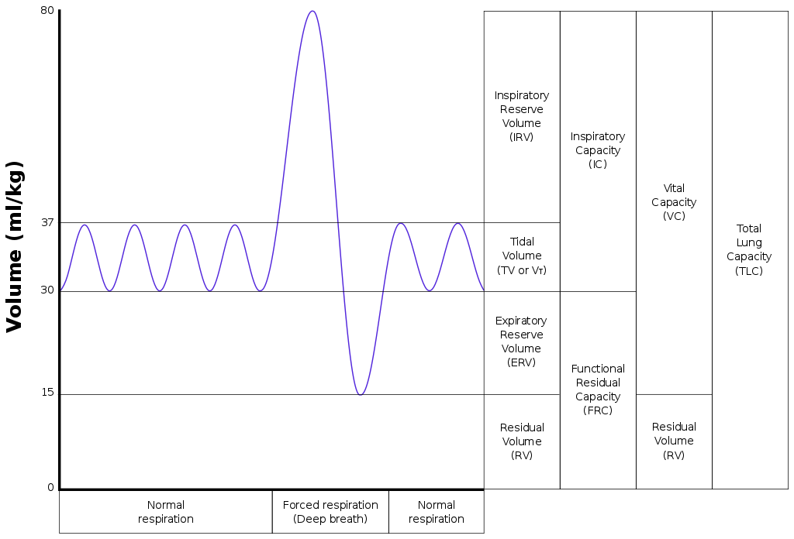

Slide 7
Lung Volume Patterns
Obstructive Disease: Characterized by hyperinflation and gas trapping (increased TLC and RV/TLC)
  asthma, chronic COPD (bronchitis, emphysema)
Restrictive Disease: Characterized by generalized reduction in lung volume (decreased TLC, RV and FRC)
  interstitial lung diseases (pulmonary fibrosis, sarcoidosis), pneumothorax, lung resection

Slide 8
Obstructive pulmonary diseases
They are characterized by airway obstruction that is worse with expiration.
Either more force (i.e., use of accessory muscles of expiration) is required to expire a given volume of air or emptying of the lungs is slowed or both.
The unifying symptom of obstructive disease is dyspnea, the unifying sign is wheezing.
The most common obstructive diseases are asthma, chronic bronchitis and emphysema.
Because many individuals have both bronchitis and emphysema, they are often called COPD

Slide 9
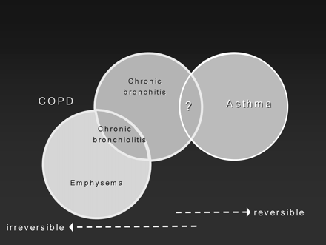
Spectrum of Obstructive Lung Disease Syndromes
Chronic
Bronchitis
Asthma
Emphysema

Slide 10
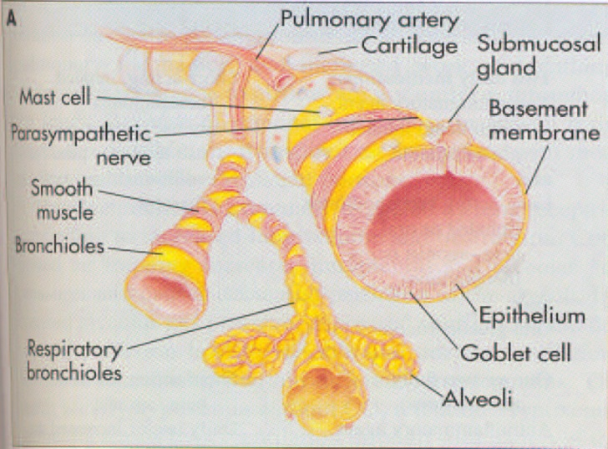
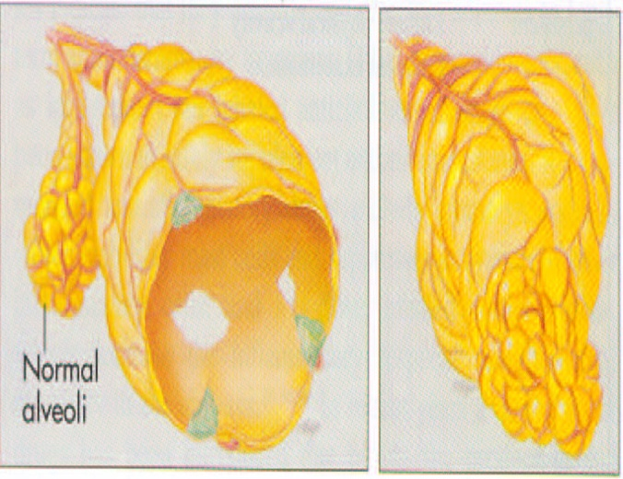
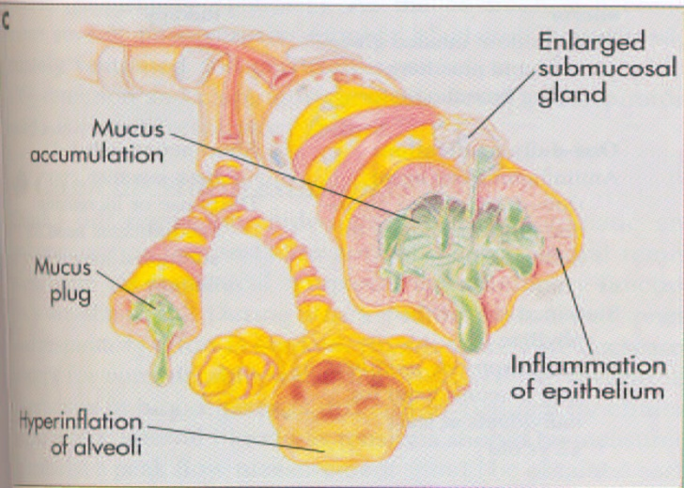
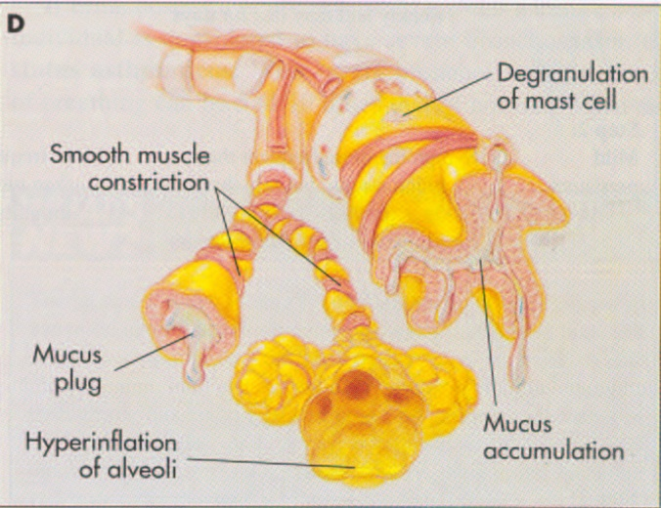
Airway obstruction caused by emphysema, chronic bronchitis, and asthma
Normal lung
Emphysema
Bronchitis
Asthma

Slide 11
Asthma bronchiale
Asthma is a chronic inflammatory disorder of the airways in which many cells and cellular elements play a role.
The chronic inflammation causes an associated increase in airway hyperresponsiveness that leads to recurrent episodes of wheezing, breathlessness, chest tightness, and coughing, particularly at night or in the early morning.
These episodes are usually associated with widespread but variable airway obstruction that is often reversible either spontaneously or with treatment.

Slide 12
Asthma Pathogenesis
Airway Irritants
Gender
Exercise
Rhino-
sinusitis
Ozone
Airway Hyper-
reactivity
Chronic Airway
Inflammation
M. pneumoniae
C. pneumoniae
IgE
Viruses
GERD
Cold air

Slide 13
Types of asthma
Allergic asthma
Non-allergic asthma
IgE-mediated
asthma
IgE non-mediated
asthma

Slide 14
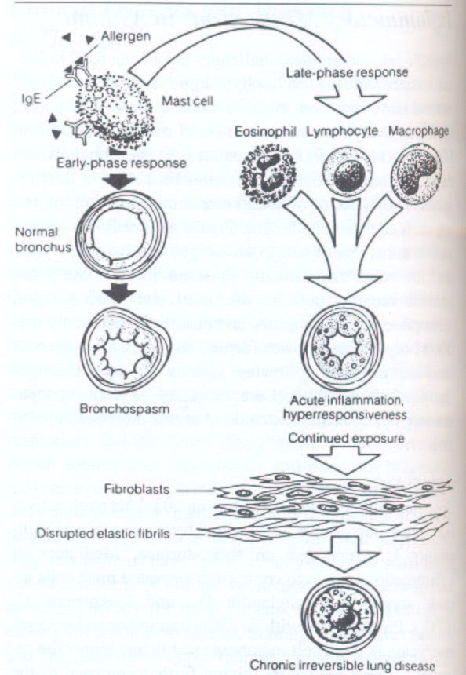
Allergic asthma
Asthma response
Early phase
Late phase

Slide 15
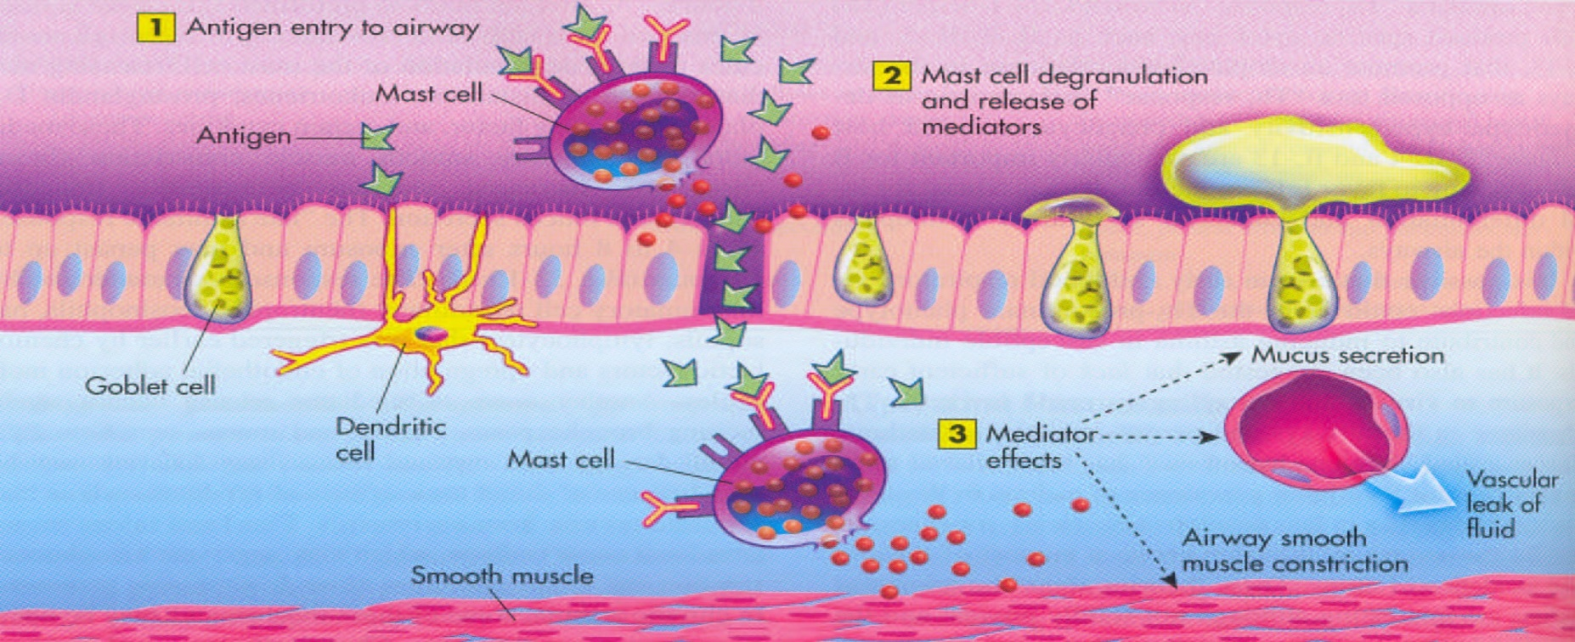
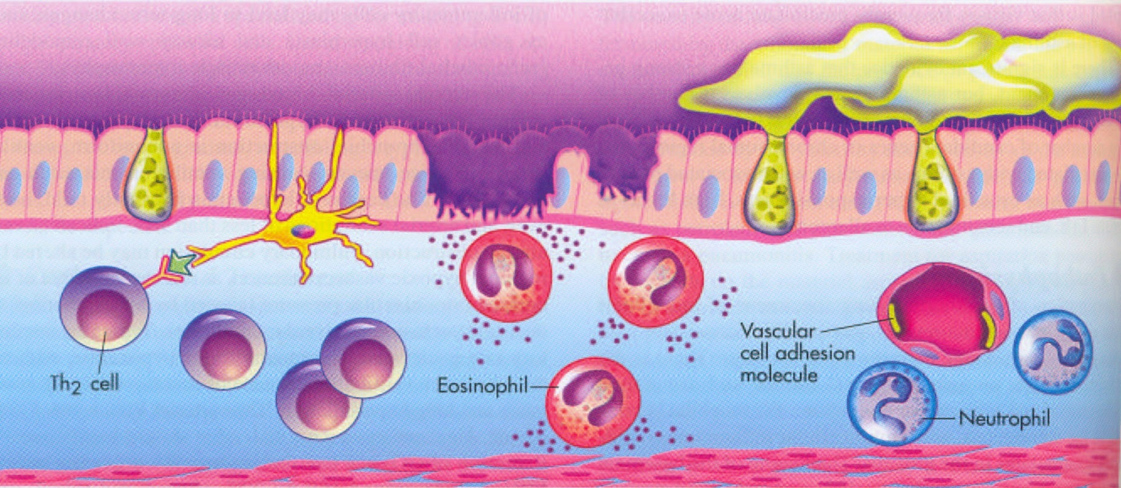

Slide 16
Asthma classification based on severity
Mild intermitent
Mild persistent
Moderate persistent
Severe persistent

Slide 17
Determining Asthma Severity

Slide 18
Asthma – clinical manifestations
During full remision
  Individuals are asymptomatic and pulmonary function tests are normal.
During partial remision
There are no clinical symptoms but pulmonary function
tests are abnormal
During attacks
  Individuals are dyspneic and respiratory effort is marked
  Breath sounds are ecreased except for considerable wheezing, dyspnea, non-productive coughing, tachycardia and tachypnea occur

Slide 19
Asthma - pulmonary function
Spirometry shows decreases in expiratory flow rate, forced expiratory volume (FEV), and forced vital capacity (FVC)
FRC and total lung capacity (TLC) are increased.
Blood gas analysis shows hypoxemia with early respiratory alkalosis or late respiratory acidosis.

Slide 20
Treatment
Goals:
To reverse of acute attacks
To control recurrent attacks
To reduce bronchial inflammation and the associated hyperreactivity
+ elimination of allergens (if it is possible)
Drugs:
Allergen´s immunotherapy
Bronchodilator (Beta agonists, Anticholinergic agents, Theophylline)
Immunosuppressant (corticosteroids)
Others (Leukotriene modifiers, antihistamine, e.g.)

Slide 21
Chronic obstructive pulmonary disease (COPD)
COPD is defined as pathologic lung changes consistent with emphysema or chronic bronchitis.
It is syndrome characterized by abnormal tests of expiratory airflow that do not change markedly over time, and without a reversible response to pharmacological agents.
5-20% adult population
Most frequently in men
The fifth leading cause of death

Slide 22
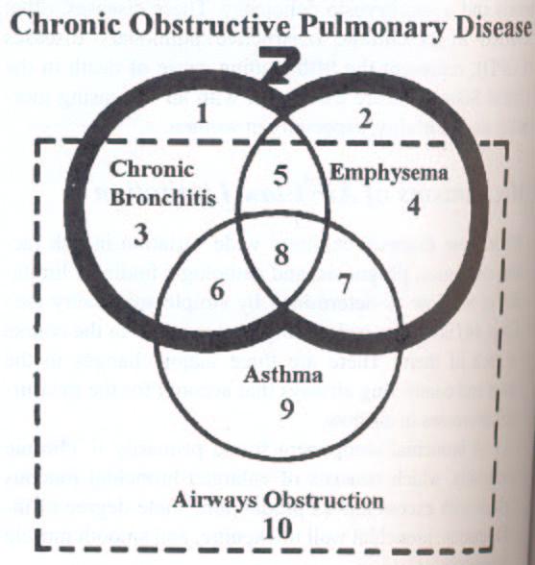
The complex, heterogenous overlapping of the three primary diagnoses include under diseases of air flow limitation is present on the next picture:

Slide 23
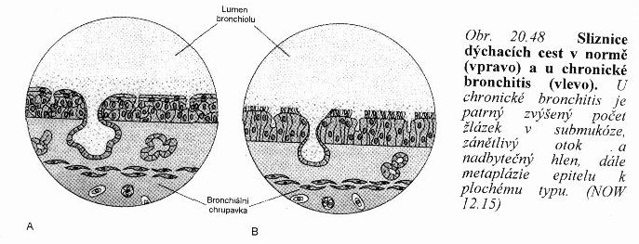
1. Chronic bronchitis
Chronic bronchitis is defined as hypersecretion of mucus and chronic productive cough that continues for at least 3 months of years for at least 2 consecutive years.
Incidence is increased in smokers (up to twentyfold) and even more so in workers exposed to air pollution.
It is a major health problem for the elderly population. Repeated infections are common.

Slide 24
Chronic bronchitis - etiology
It is primarily caused by cigarette smoke, both active and passive smoking have been implicated
Other risk factors:
- profesional exposition
- air pollution
- repeated infections of airways
- genetics

Slide 25
Chronic bronchitis - morphology
Inspired irritants not only increase mucus production but also increase the size and number of mucous glands and goblet cells in airway epithelium
The mucus produced is thicker and more tenacious than normal. This sticky mucus coating makes it much more likely that bacteria, such as H. influenze and S. pneumoniae, will become embedded in the airway secretions, there they reproduce rapidly.
Ciliary function is impaired, reducing mucus clearance further. The lung´s defense mechanisms are tehrefore compromised, increasing susceptibility to pulmonary infection and injury.
The bronchial walls become inflamed and thickened from edema and accumulation of inflammatory cells.

Slide 26
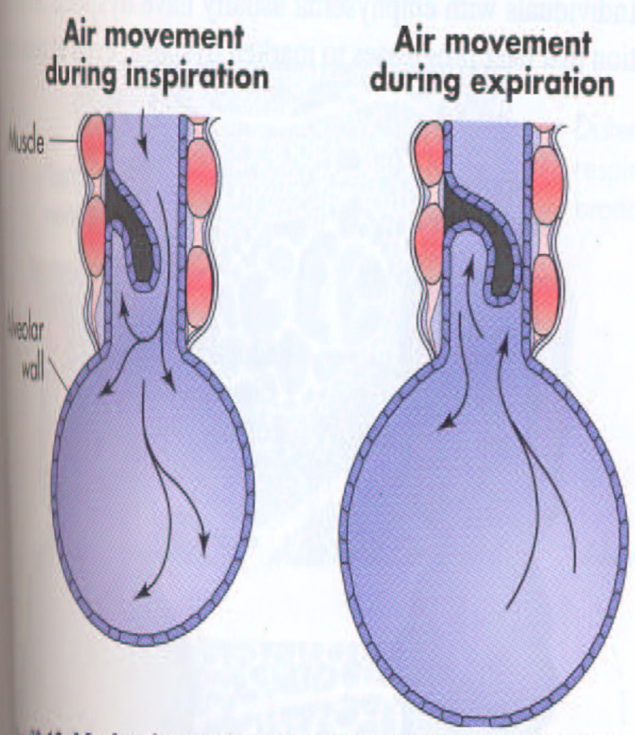
Initially chronic bronchitis affects only the larger bronchi, but eventually all airways are involved.
The thick mucus and hypertrophied bronchial smooth muscle obstruct the airways and lead to closure, particularly during expiration, when the airways are narrowed.
The airways collapse early in expiration, trapping gas in the distal portions of the lung.
Obstruction eventually leads to ventilation-perfusion mismatch, hypoventilation (increased PaCO2) and hypoxemia.

Slide 27
Chronic bronchitis – clinical manifestations
Individuals usually have a productive cough („smoker´s cough“) and evidence of airway obstruction is shown by spirometry
Bronchitis patients are often described as „blue bloaters“ due to their tendency to exhibit both hypoxemia and right heart failure with peripheral edema in spite of only moderate obstructive changes on pulmonary functional tests.
Acute episodes (e.g. after infection) result in marked hypoxemia that leads to polycytemia and cyanosis (blueness) associated with an increase in pulmonary artery pressure, impairing right ventricular function, and significant jugular venous distension and ankle edema (bloated)

Slide 28
Chronic bronchitis – evaluation and treatment
Diagnosis is made on the basis of physical examination, chest radiograph, pulmonary function tests and blood gas analyses.
The best „treatment“ is prevention, because pathological changes are not reversible.
If the individuals stops smoking, disease progression can be halted
Therapy: - bronchodilators
- expectorans
- chest physical therapy
- steroids
- antibiotics

Slide 29
Chronic bronchitis: low-flow oxygen therapy
It is administered with care to individuals with severe hypoxemia and CO2 retention
Because of teh chronic elevation of PaCO2, the central chemoreceptors no longer act as the primary stimulus for breathing.
This role is taken over by the peripheral chemoreceptors, which are sensitive to changes in PaO2.
Peripheral chemoreceptors do not stimulate breathing if the PaO2 is much more than 60 mmHg.
Therefore, if oxygen therapy causes PaO2 to exceed 60 mmHg, the stimulus to breathe is lost, PaCO2 increases, and apnea results.
If inadequate oxygenation cannot be achieved without resulting in respiratory depression, the individual must be mechanically ventilated)

Slide 30
2. Emphysema
  It is abnormal permanent enlargement of gas-exchange airways (acini) accompanied by destruction of alveolar walls and without obvious fibrosis.
  In emphysema, obstruction results from changes in lung tissues, rather than mucus production and inflammation, as in chronic bronchitis.
  The major mechanism of airflow limitation is loss of elastic recoil.

Slide 31
Types of emphysema
Three distinctive types of alveolar destruction have been described, according to the portion of the acinus first involved with disease:
1) Centrilobular (centriacinar):
- septal destruction occurs in the respiratory bronchioles and alveolar ducts, usually in the upper lobes of the lung. The alveolar sac (alveoli distal to the respiratory bronchiole) remains intact. It tends to occur in smokers with chronic bronchitis.
2) Panacinar (panlobular):
- It involves the entire acinus with damage more randomly distributed and involving the lower lobes of the lung. It tends to occur in patients with α1-antitrypsin deficiency.
3) Distal acinar (subpleural):
- It is typically seen in a young adult with a history of a
spontaneous pneumothorax.

Slide 32
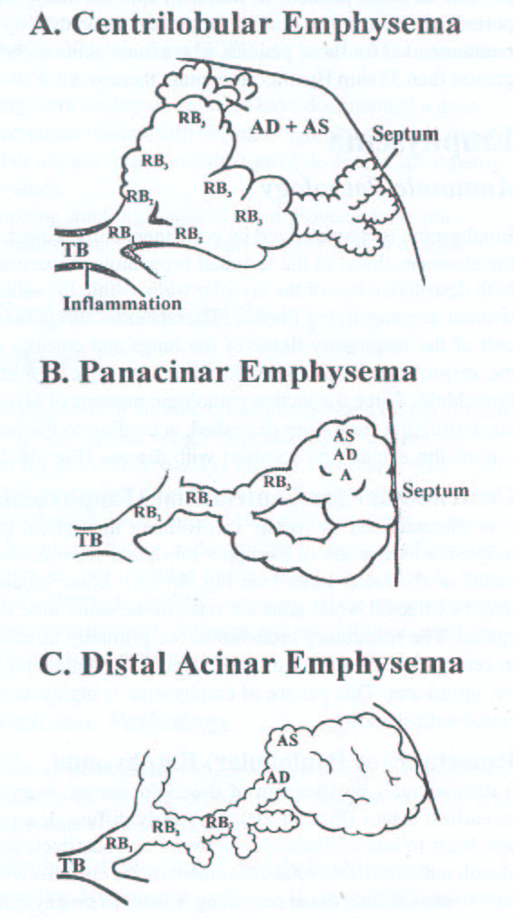

Slide 33
Types of emphysema
Primary emphysema:
- it is commonly linked to an inherited deficiency of the enzyme α1-antitrypsin that is a major component of α1-globulin, a plasma protein.
- Normally it inhibits the action of many proteolytic
enzymes.
- Individuals with deficiency of this enzyme (AR) have an increased likelihood of developing emphysema because proteolysis in lung tissues is not inhibited.
Secondary emphysema:
- It is also caused by an inability of the body to inhibit proteolytic enzymes in the lung. It results from an insult to the lungs from inhaled toxins, such as cigarette smoke and air pollution.

Slide 34
Pathophysiology of emphysema
Emphysema begins with destruction of alveolar septa
It is postulated that inhaled oxidants, such as those in cigarette smoke and air pollution, tip the normal balance of elastases (proteolytic enzymes) and antielastases (such as α1-antitrypsin) such that elastin is destroyed at an increased rate
Expiration becomes difficult because loss of elastic recoil reduces the volume of air that can be expired passively.
Hyperinflation of alveoli causes large air spaces (bullae) and air spaces adjacent to pleura (blebs) to develop.
The combination of increased RV in the alveoli and diminished caliber of the bronchioles causes part of each inspiration to be trapped in the acinus.

Slide 35
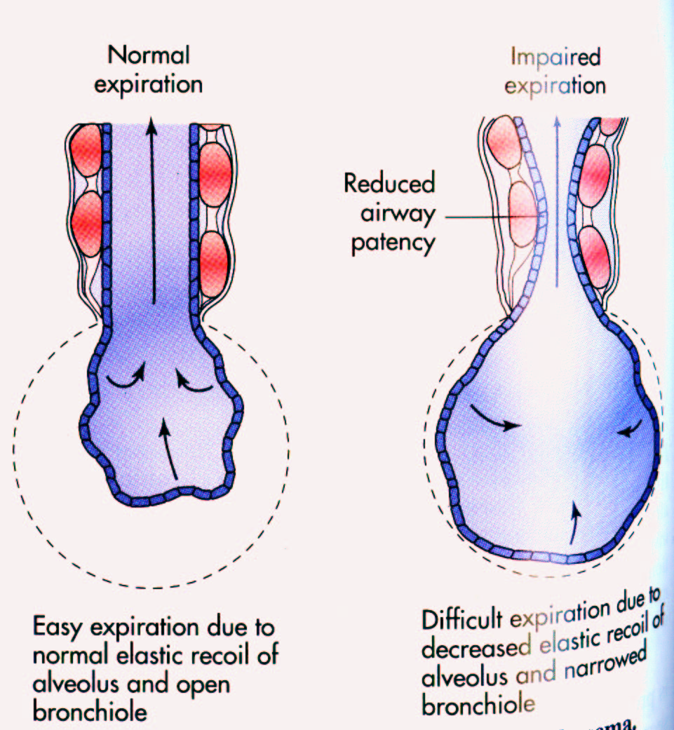
Mechanisms of air trapping in emphysema
Damaged or destroyed alveolar walls no longer support and hold open the airways, and alveoli lose their property of passive elastic recoil.
Both of the se factors contribute to collapse during expiration.

Slide 36
Emphysema – clinical manifestations
Patients with emphysema are able to maintain a higher alveolar minute ventilation than those with chronic bronchitis. Thus they tend to have a higher PaO2 and lower PaCO2 and have classically been referred to as „pink puffers“
Physical examination often reveals a thin, tachypneic patient using accessory muscles and pursed lips to facilitate respiration. The thorax is barrel-shaped due to hyperinflation.
There is little cough and very little sputum production (in „pure“ emphysema)

Slide 37
Emphysema – evaluation
Pulmonary function tests:
- indicate obstruction to gas flow during expiration
- airway collapse and air trapping lead to a decrease in FVC and FEV1 and an increase in FRC, RV, and TLC.
- diffusing capacity is decreased because destruction of the alveolocapillary membrane
Arterial blood gas measurements are usually normal until latge in the disease

Slide 38
Emphysema – approach to therapy
Smoking cessation is the most important intervention
Inhaled anticholinergic agets
β2-adrenergic agonists
Steroids
Low-flow oxygen therapy in selected individuals
Lung transplant can be considered

Slide 39
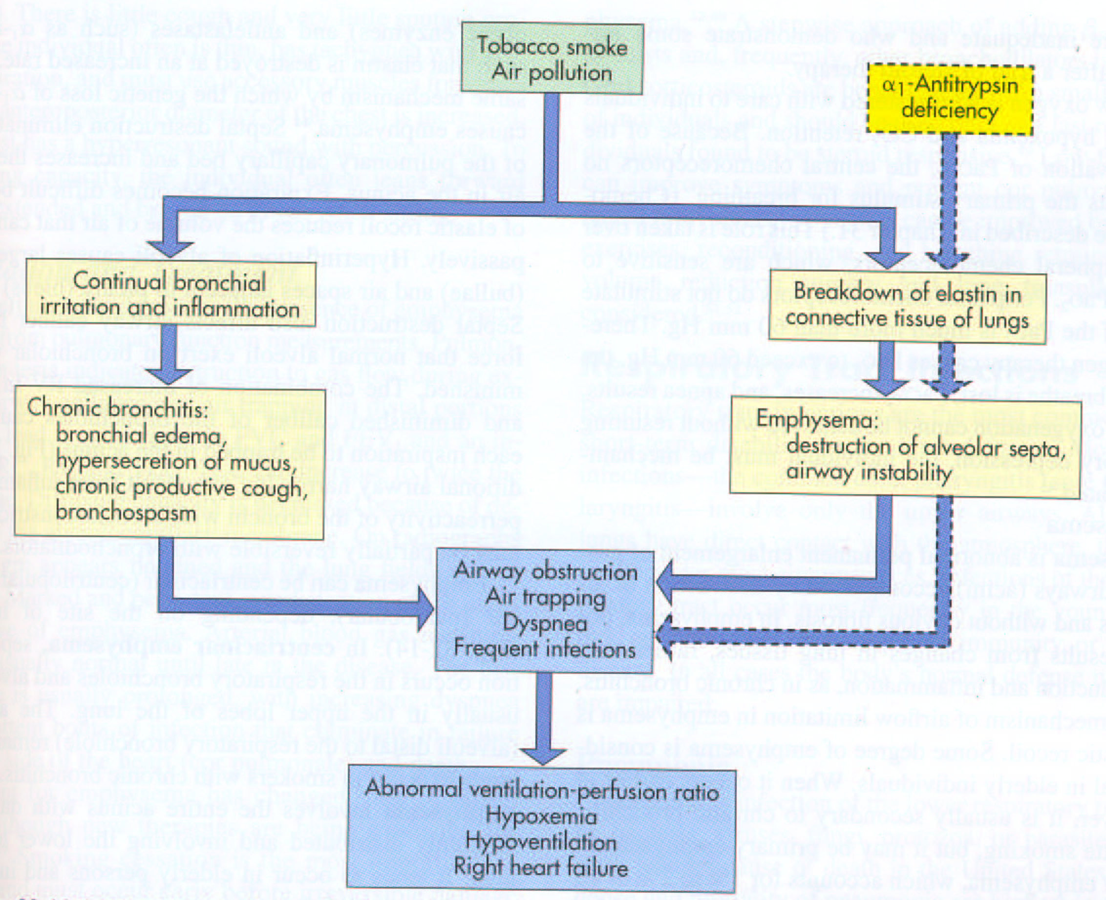

Slide 40
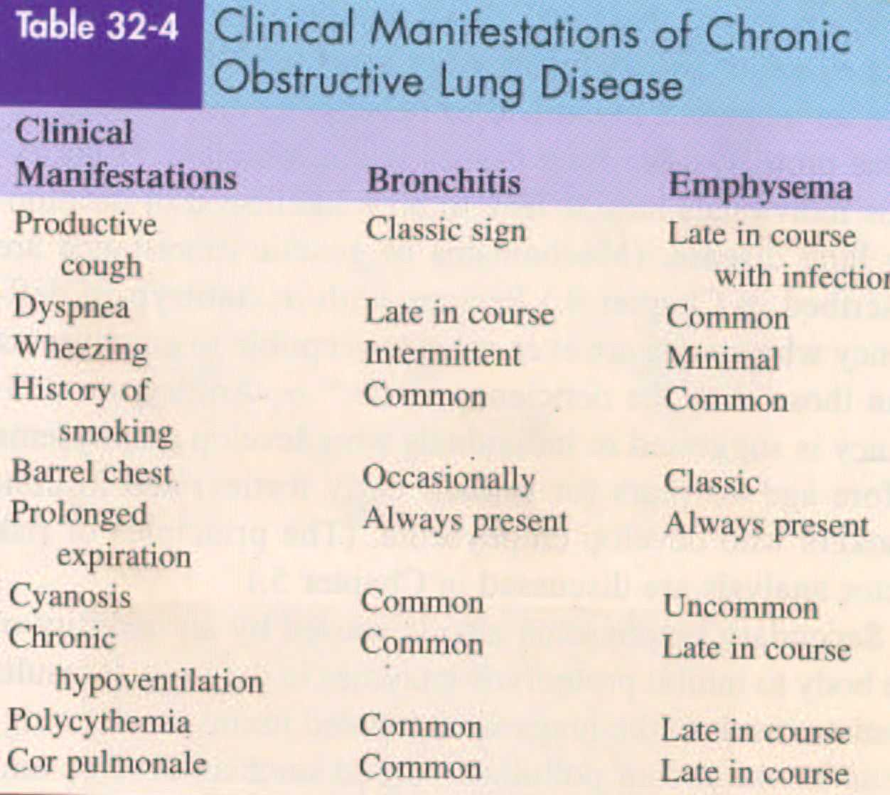

Slide 41
Cyansis
Reduced hemoglobin higher than 50 g/l
Hemoglobin
    Normal – 120-160 g/l (F), 130-180 g/l (M)
    Anemia – less than 110 g/l,
    Severe anemia – less than 79 g/l

Slide 42
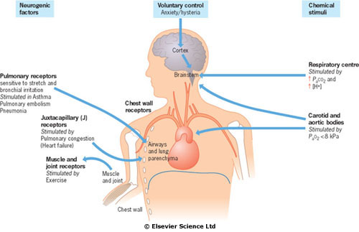

Slide 43
Hypoxic drive
Traditional theory, obsolete
Global respiratory insufficieny (hypoxemia + hypercapnia) disables stimulation based on pCO₂
Respiration stimulated by hypoxemia
Administration of oxygen may cause depression of the respiratory center (leading to critical hypercapnia)

Slide 44
Ventilation-perfusion mismatch
Current theory
Low pO₂ causes pulmonary vasoconstriction
  (redistribution of perfusion to a ventilated area)
Administration of oxygen will reverse pulmonary vasoconstriction,
however, a poorly ventilated alveolus does not ventilate CO₂
Oxygen also leads to a shift of the dissociation curve to the right (release of CO₂ from hemoglobin – Haldane effect), which is not ventilated, increasing pCO₂
Oxygen administration is safe if oxygenation is titrated to reach 88%-92% saturation

Slide 45
Interstitial lung diseases
There are a large number of diseases that affect the interstitium of the lung
⇓
it is connective tissue present between the alveolar epithelium and capillary endothelium
Some of these diseases have known etiology, e.g. occupational diseases
Others are diseases of unknown etiology
- most frequent of these are idiopatic pulmonary fibrosis
(diffuse interstitial fibrosis), pulmonary fibrosis associated with collagen-vascular diseases, and sarcoidosis.

Slide 46
Nozological units
Idiopatic pulmonary fibrosis
Diseases unknown etiology, non-specific fibrotic change in lung. The diagnosis is to some extent one of exclusion.
Sarcoidosis
One of the most common. It is multi-systém granulomatous disease that involves lung, lymph nodes, salivary glands, and liver. Specific type is called erythema nodosum
Occupational intersticial diseases
Exposure to occupational and environmental inhalants for a long time can lead to develop lung disease. Workers in industries with heavy exposure to silica dust, asbestos particles, and welding fumes are generally aware of the risk of their occupation.

Slide 47
Occupational diseases
Diseases
Cause
Azbestosis
Azbestos particlesl
Aspergilosis
Mould -
Berryliosis
Berrylium´s compouds
Lung of breeder of birds
Birds´ antigens
Pneumoconiosis
Coal
Farmer´s lung
Grain´s mould
Silicosis
Silica dust
Welder´s lung
Welding fumes

Slide 48
Clinical manifestations
Subjective symptoms
dyspnoe
cough
Objective signs
tachypnoe
crackles
clubbing
cyanosis
cor pulmonale
Laboratory findings
Decrease PaO₂
normal PaCO₂
ECG- cor pulmonale
Spirometry - restrictive pattern ( VC, normal ratio FEV1/FVC)
Decrease diffusion capacity of the lung for carbon monooxide

Slide 49
Therapy
It depends on etiology (if it is known)
Stopping the occupational exposure
Antibiotics
Diseases of unknown etiology (sarcoidosis, idiop. pulmonary fibrosis) corticosteroids
Oxygen therapy

Slide 50
Spirometry

Slide 52
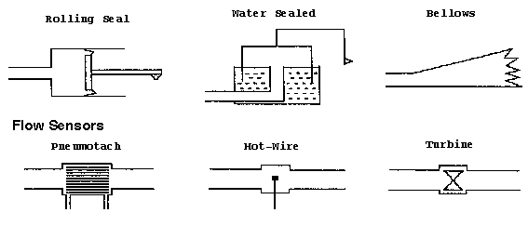
Types of spirometers

Slide 53
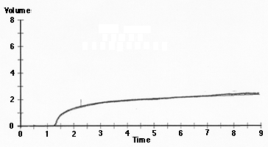
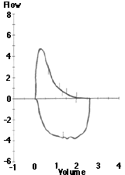
Graphs
Expiration
FEV1
Inspiration
Volume-time
Flow-volume

Slide 54
Lung Volume Patterns
Obstructive Disease: Characterized by hyperinflation and gas trapping (increased TLC and RV/TLC)
Restrictive Disease: Characterized by generalized reduction in lung volume (decreased TLC, RV and FRC)

Slide 55
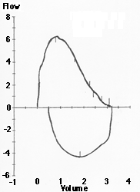
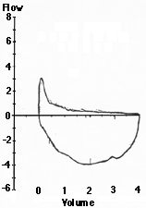
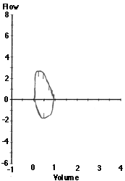
Flow-volume graphs
Normal
Obstructive
Restrictive

Slide 56
