Slide 1
Nuclear medicine I.
KRNM FN Brno

Slide 2
Nuclear medicine – uses radiopharmaceuticals for:
Diagnostics
Therapy
Scintigraphy
PET
Beta- and alfa emiters
  ¹³¹I – thyroid carcinoma, hyperthyreosis
  ¹⁷⁷Lu – metastatic prostate cancer, NETs
  ⁹⁰Y – synovectomy
  ²²³Ra (alfa) – prostate cancer bone mts
Gama emiters
  ^{99m}Tc, ¹²³I, ^{81m}Kr, ¹¹¹In
  Detects 1 photon
  Planar scintigraphy (sumation) or SPECT (tomographic)
  Static x dynamic
  Possible hybrid imaging SPECT/CT
Beta+ emiters
  ¹⁸F, ⁶⁸Ga, ¹¹C
  Detects 2 photons
  Tomographic method
  Always hybrid imaging PET/CT or PET/MRI

Slide 3
Nuclear medicine
Medical specialty using radiopharmaceuticals for diagnostic and therapeutic purposes
Diagnostics - imaging the distribution of the tracer in the body
  Scintigraphy (planar, tomographic=SPECT) and PET
  Static or dynamic examinations
The tracer uptake is related to biochemical process and function within tissue/organ/body – scintigraphies are referred to as functional imaging techniques, not showing anatomic details
Therapeutic methods – targeted radiotherapy based on the distribution of a carrier bound to a suitable radionuclide (beta⁻, alfa emitter) – ¹³¹I, ²²³Ra, ¹⁷⁷Lu, Sr, Sm, Re, ⁹⁰Y, Er

Slide 4
Bone scintigraphy
One of the most commonly used method
Principle: When tracer is injected intravenously, is taken up by adsorbtion onto the surface of bone, distribution in the skeleton is based on differencies in regional perfusion (vascularity) and bone turnover as well as other factors – non specific!!!
High sensitivity, small specifity (clinical context, patient´s history, SPECT, SPECT/CT)
RP: technetium-labeled bisphosphonates (^{99m}Tc-MDP), analogs of some components of the mineral portion of bone
  (alternatively - 18F-NaF for PET imaging )
Imaging technique: wholebody planar image in anterior and posterior view 2-4h after RP administration, SPECT or SPECT/CT , 3-phase protocol

Slide 5
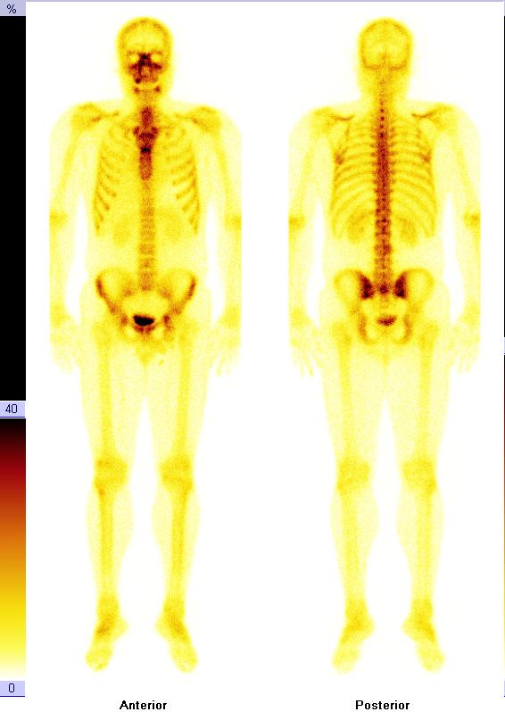
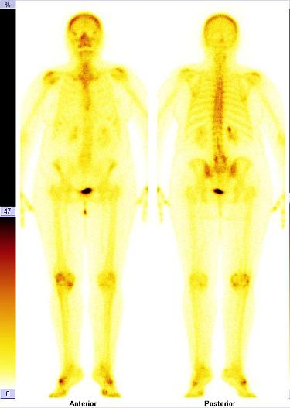
Bone scan

Slide 6
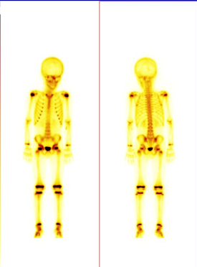
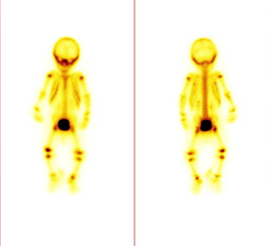
Bone scan

Slide 7
Bone scintigraphy
Indications:
Metastatic bone disease, primary bone tumors
Osteomyelitis (mostly periferal bones)
Evaluation of prosthetic joints for loosening and infection
Skeletal trauma, stress fructures
Metabolic bone disease : Morbus Paget, hyperparathyroidism
Evaluation of bone pain in patients with normal radiographs, evaluation of the significance of an incidental bone finding on radiographs, determination of biopsy site

Slide 8
Bone scintigraphy
High sensitivity - predominantly osteoblastic sites show increased activity (hot spots), whereas mainly osteoclastic or lytic lesions can be difficult to detect (cold lesions) – tumors that are predominantly lytic have lower sensitivity
Highest sensitivity for prostate cancer, high sensitivity for breast and lung cancer, low sensitivity for multiple myeloma, thyroid cancer, renal carcinoma…..
Bone scan vs FDG PET
  Higher sensitivity of scintigraphy in osteoplatic metastases
  Higher sensitivity of PET in osteolytic lesions

Slide 9
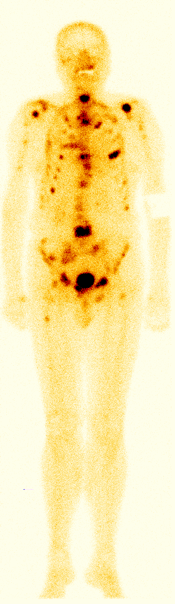
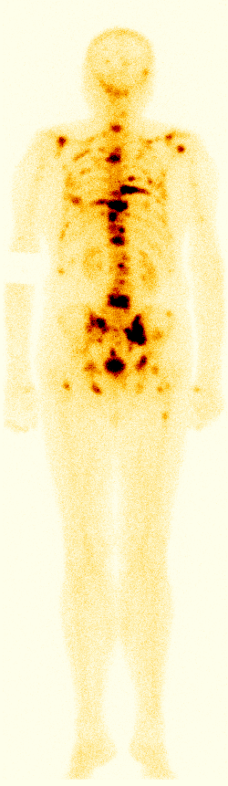
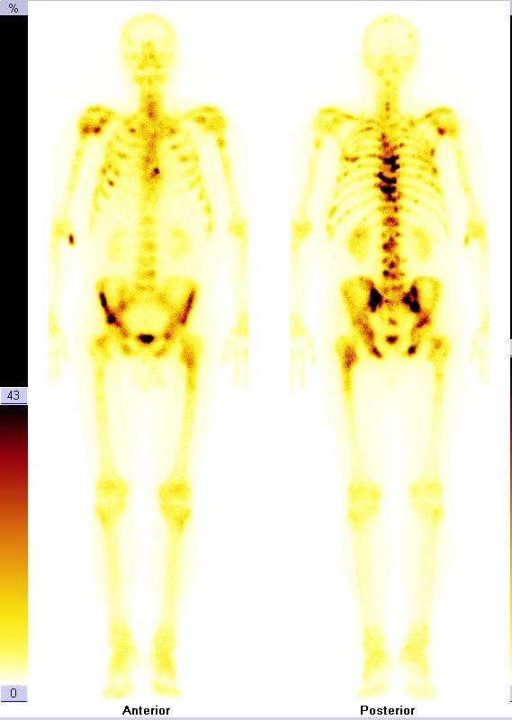
Bone scan
Metastatic breast cancer
Metastatic prostate cancer

Slide 10
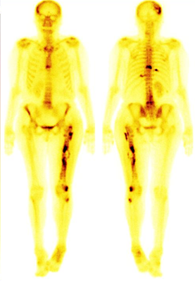
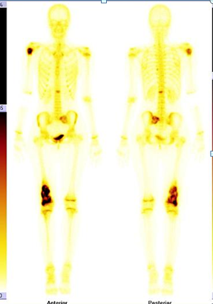
Bone scan
RCC
Osteosarcoma

Slide 11
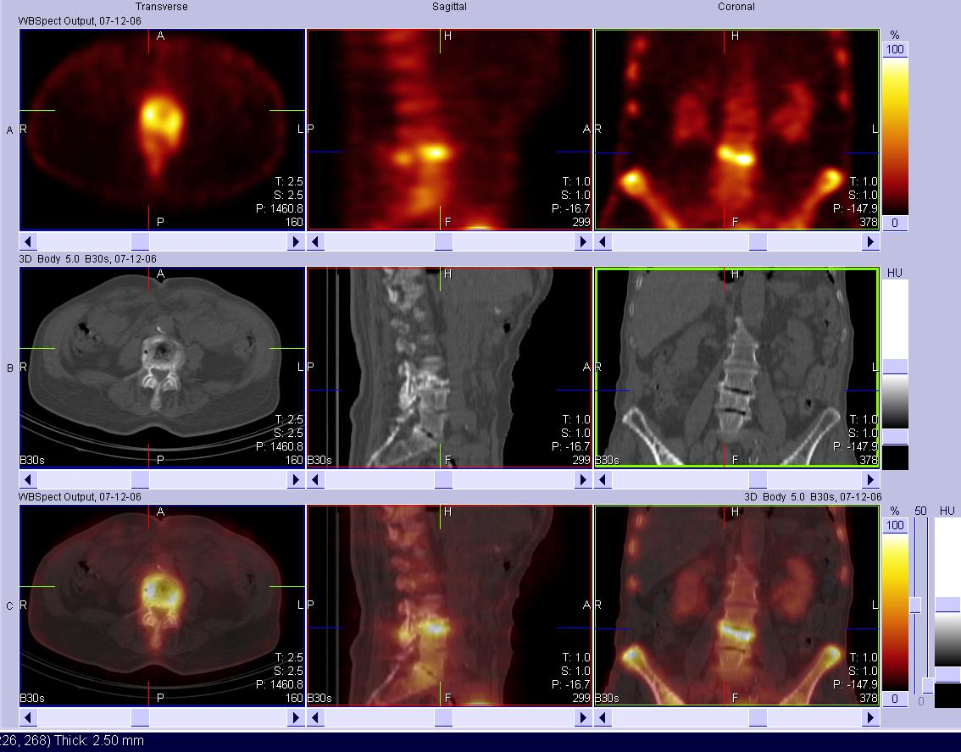
Bone scan – SPECT/CT

Slide 12
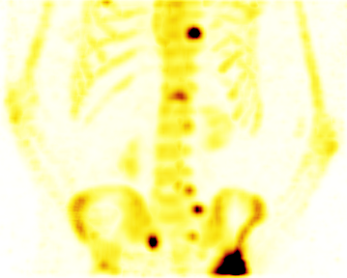
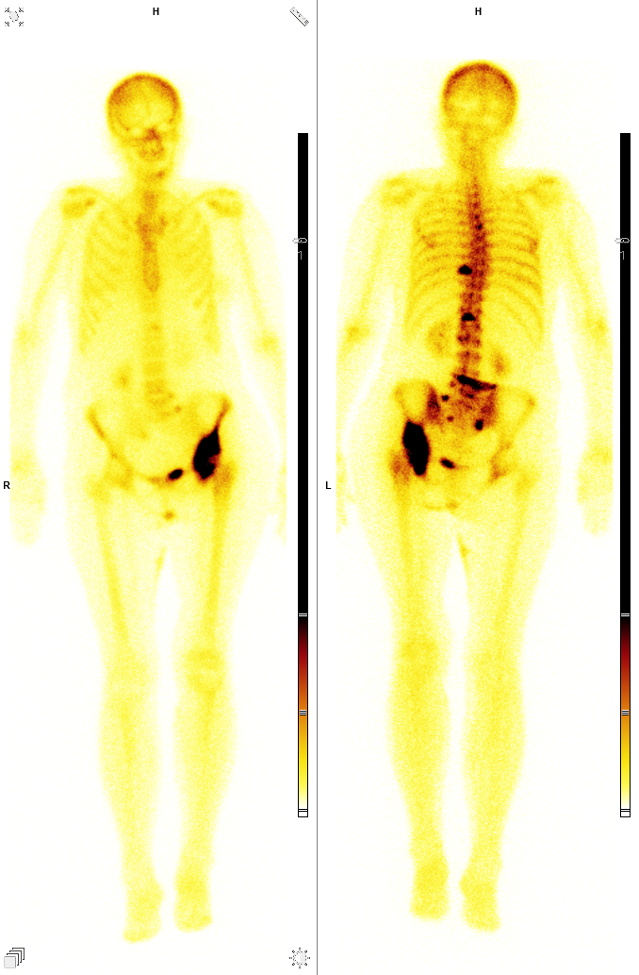
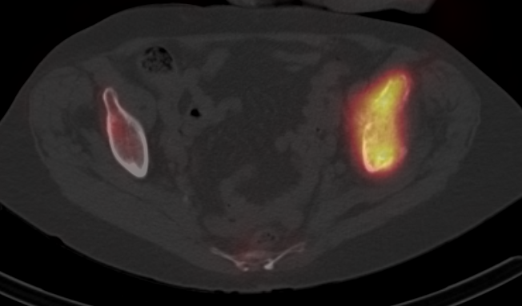
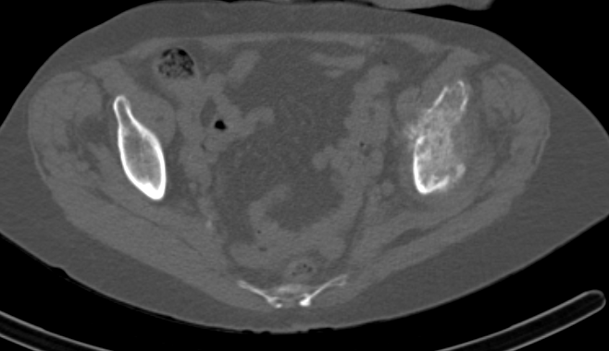
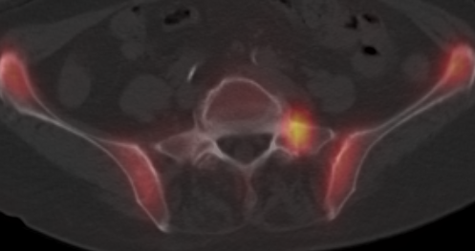
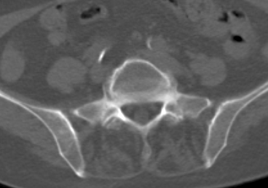
Bone scan– SPECT/CT
Lung cancer

Slide 13
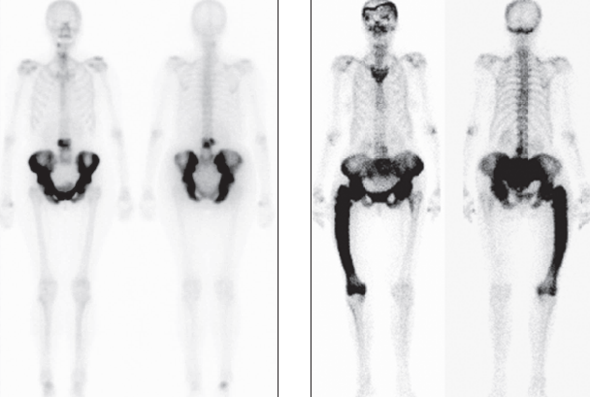
Paget disease
The pelvis is the most commonly involved site, followed by the spine, skull, femur…

Slide 14
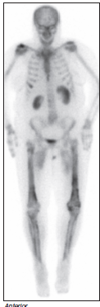
Track sign
Hypertrophic osteoarthropathy
Increased uptake in the cortices of the femora and tibiae
Commonly seen in patients with bronchogenic carcinoma, can be seen in other pulmonary conditions

Slide 15
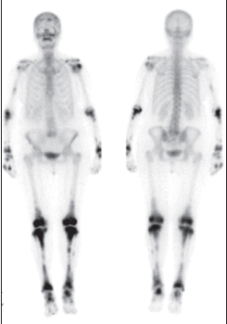
Bone scan : Erdheim –Chester disease
Non Langerhans-cell histiocytosis (rare disease)
Bone leasions are typically symmetrical, sclerotic and involve long bones (with prominent uptake on scan)

Slide 16
Infection imaging methods
3-phase bone scintigraphy – bones only!
Radiolabeled leukocytes
Radiolabeled antigranulocyte monoclonal antibodies
18F-FDG PET
Galium imaging (67 galium citrate) – has very limited role today

Slide 17
3-phase bone scintigraphy
Indication: differentiation between eosteomyelitis and cellulitis (especially in periferal skeleton), evaluation of joint replacement complications (aseptic loosening or infection)
Imaging protocol:
I. Flow phase: dynamic 2- to 5-second images of the area of interest for 60 seconds after bolus injection
II. Blood pool and soft tissue phase = immediate static images for time (usually 5 minutes), followed dynamic phase
III. Skeletal phase : Delayed images at 2-4 hours after injection
SPECT/CT increasis specifity
Withouth underlying bone pathology negative study result exludes osteomyelitis with high degree of certainty
With underlying bone pathology (recent trauma, tumor..) is still sensitivity very high, but specificity only 30-50%

Slide 18
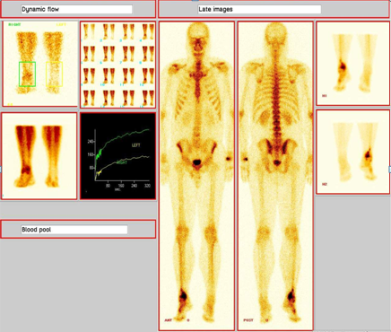
3-phase bone scintigraphy

Slide 19
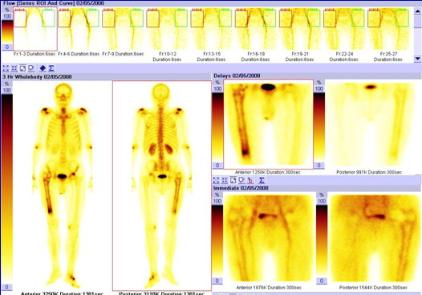
3-phase bone scintigraphy

Slide 20
Radiolabeled leukocytes
Leukocyte imaging using in vitro labeling with 111Indium or 99mTc is the nuclear medicine gold standard for diagnosing most infection
Principle: leukocytes are attracted to the site of inflammation – acitive migration, uptake is not specific for infection, may occur in any inflammatory process that incites the leukocytes response
Leukocytes are isolated from about 60ml anticoagulated blood, labelled in vitro, effectiveness depends on viability, thus is essential to avoid damage to the cells
(If not possible to label enough leukocytes, examination with radiolabeled antigranulocyte monoclonal antibodies is possible, needs HAMA test, imaging protocol is same)
Imaging protocol: wholebody image in anterior and posterior view at 4 and 24 hours after injection + SPECT/CT , early imaging of the abdomen at 1- 2 hours after injection is obtain in case of inflammatory bowel disease
Indication: acute pyogenic infection, fever of the unknown origo, osteomyelitis, prosthetic joint infection, vascular grafts infection…
! MR is the method of the choice once there is a suspicion for spine osteomyelitis and no other underlying bone patology

Slide 21
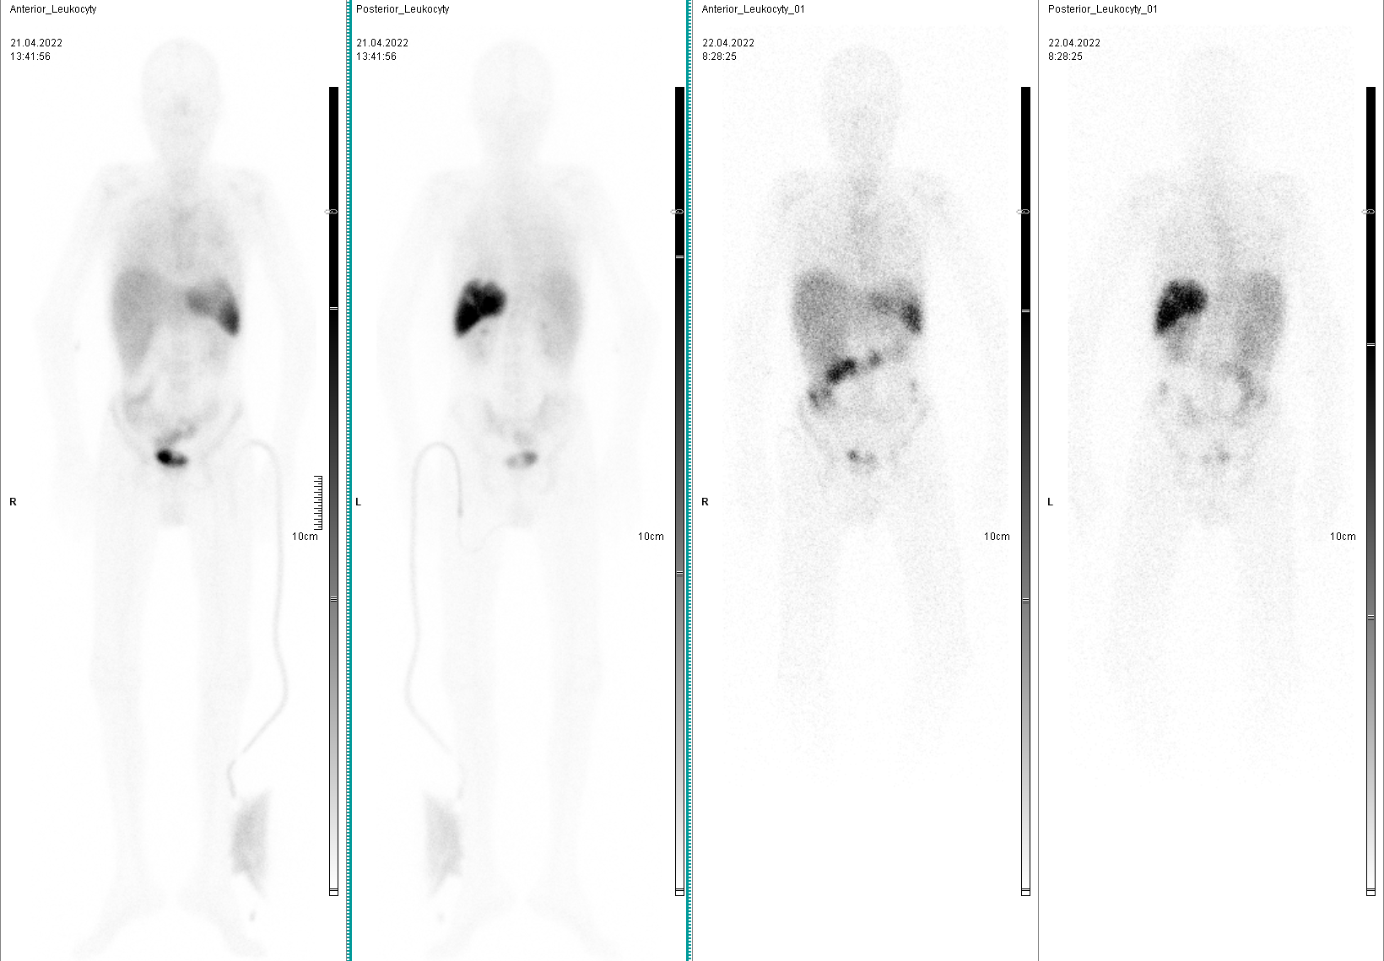
Radiolabeled leukocytes
Ant 4h
Post 4h
Ant 24h
Post 24h

Slide 22
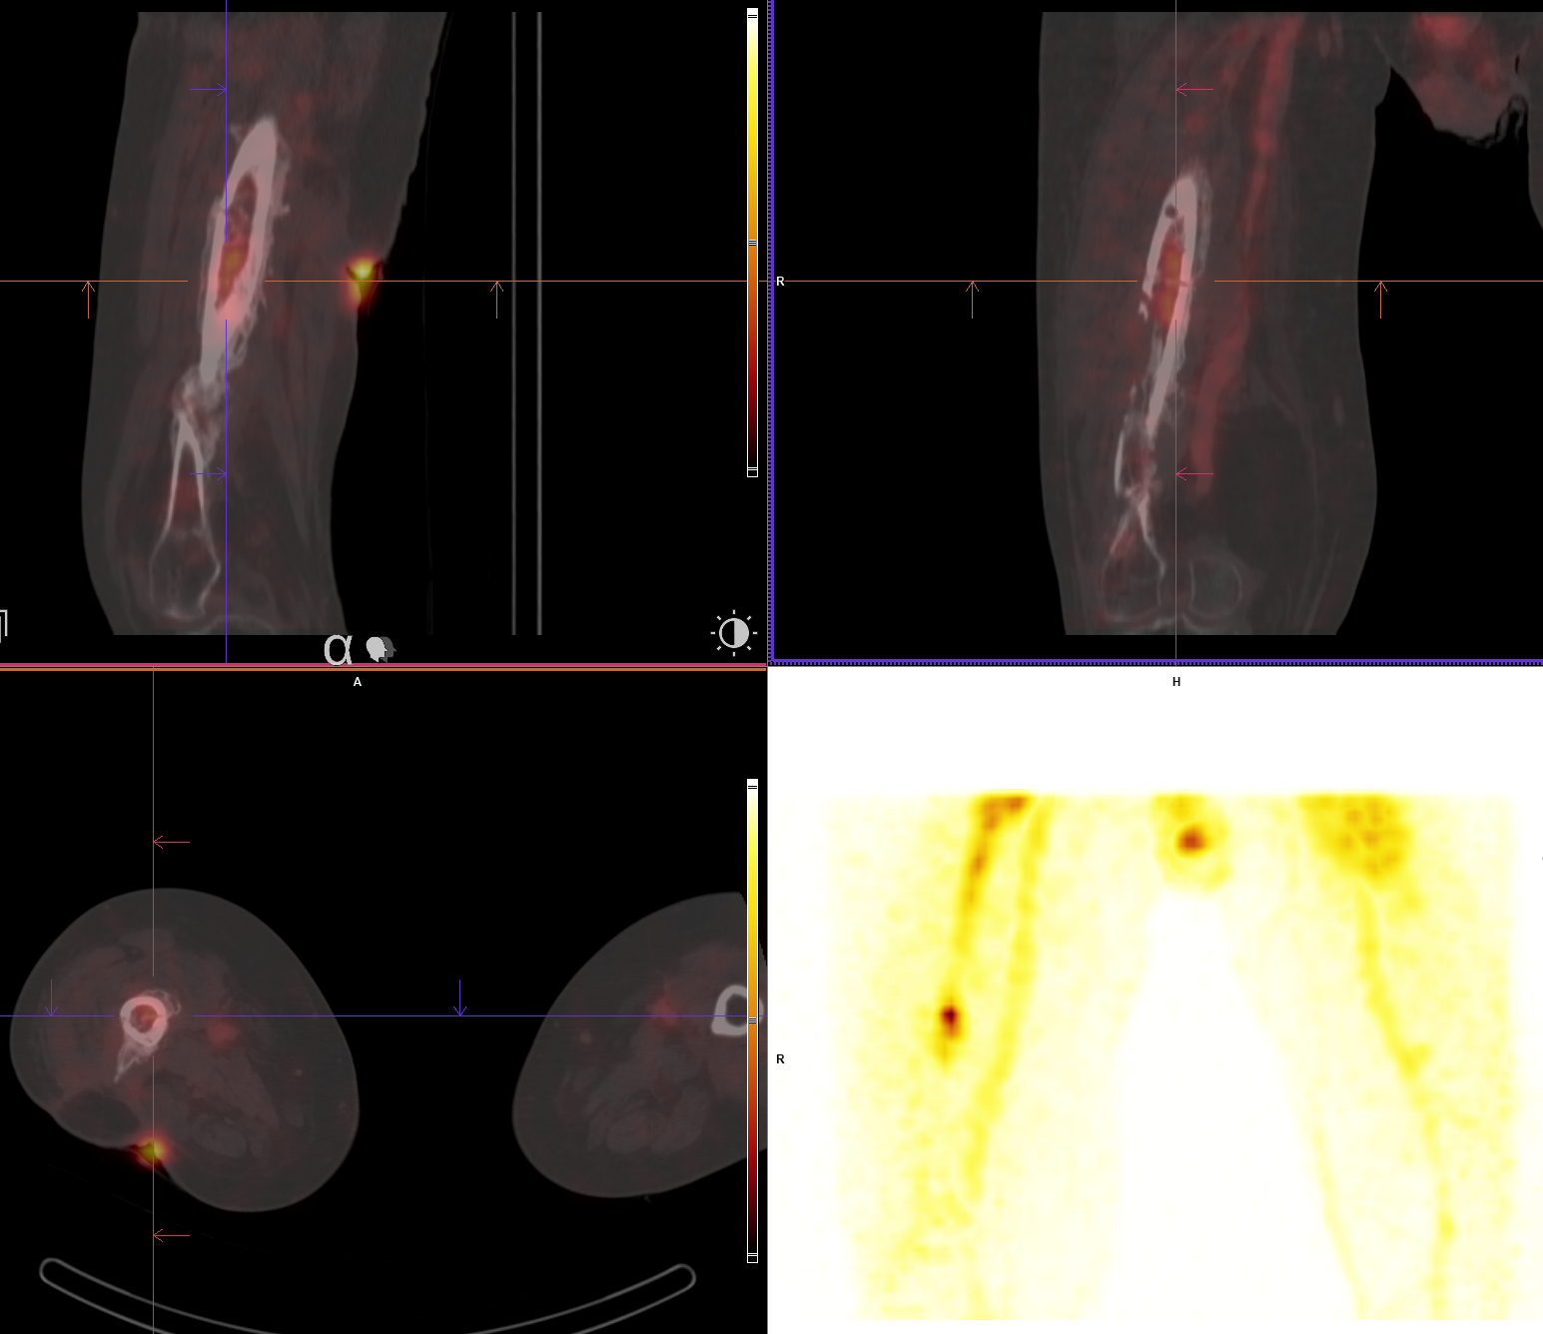
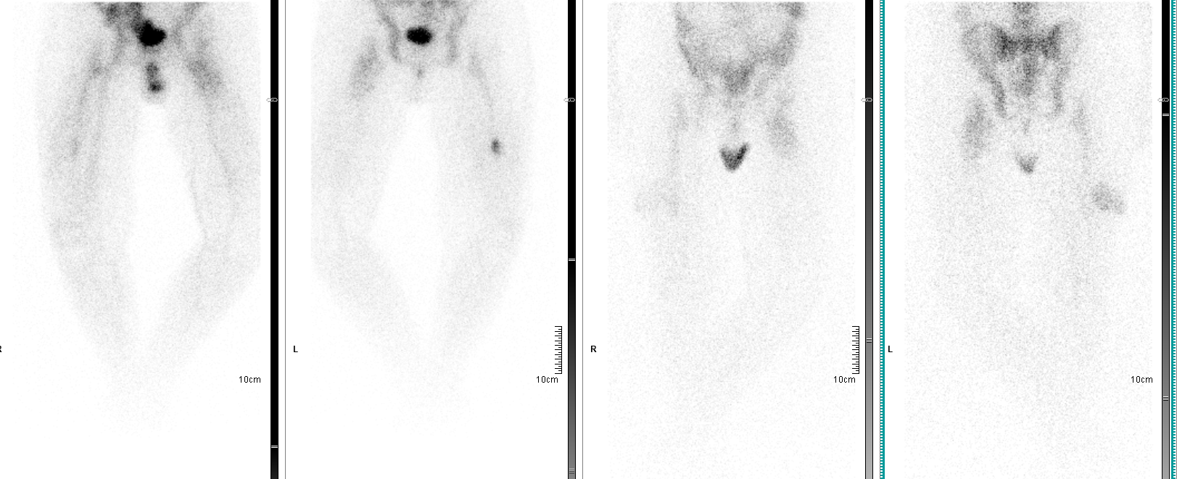
Radiolabeled leukocytes
Post removal of OS, infection in soft tissues without osteomyelitis

Slide 23
Respiratory system – nuclear imaging methods
Perfusion study : 99mTc-MAA macroaggregated albumin- displays regional lung perfusion
Ventilation study: radiolabeled aerosols (^{99m}Tc-DTPA), radioactive gases (^{81m}Krypton) - display regional lung ventilation
18F-FDG PET/CT, PET/MR : lung carcinoma, infection

Slide 24
Perfusion a ventilation scintigraphy
Indication: assess the probability of pulmonary embolism, assess regional lung perfusion before lung surgery (semiquantitative evaluation)
Imaging: traditionally perfusion+ventilation (V/Q scan) - V/Q Mismatch
SPECT/low-doseCT perfusion only
  Ventilation in uclear cases only
Many centers performed both the perfusion and ventilation studies, clinical experience show that perfusion study by performing SPECT/CT is fully sufficient (depends on clinical context, technical equipment…)
R-L shunt may be demostrated at images (activity is seen in the brain, kidneys)
Notes:
‘Q’ comes from “quantité“, the French word for quantity or amount. French scientists like Darcy and Poiseuille derived equations involving rate of flow represented by the variable ‘Q’

Slide 25
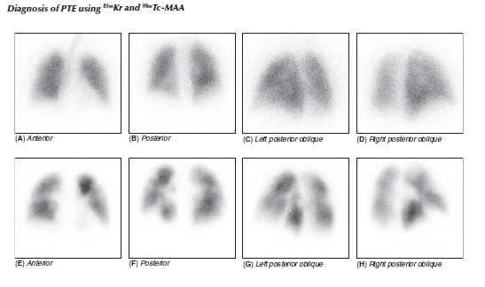
Perfusion ventilation study

Slide 26
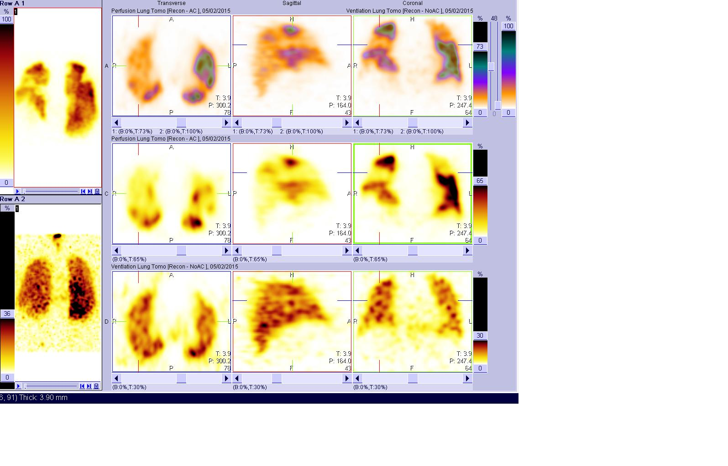
Perfusion ventilation study SPECT

Slide 27
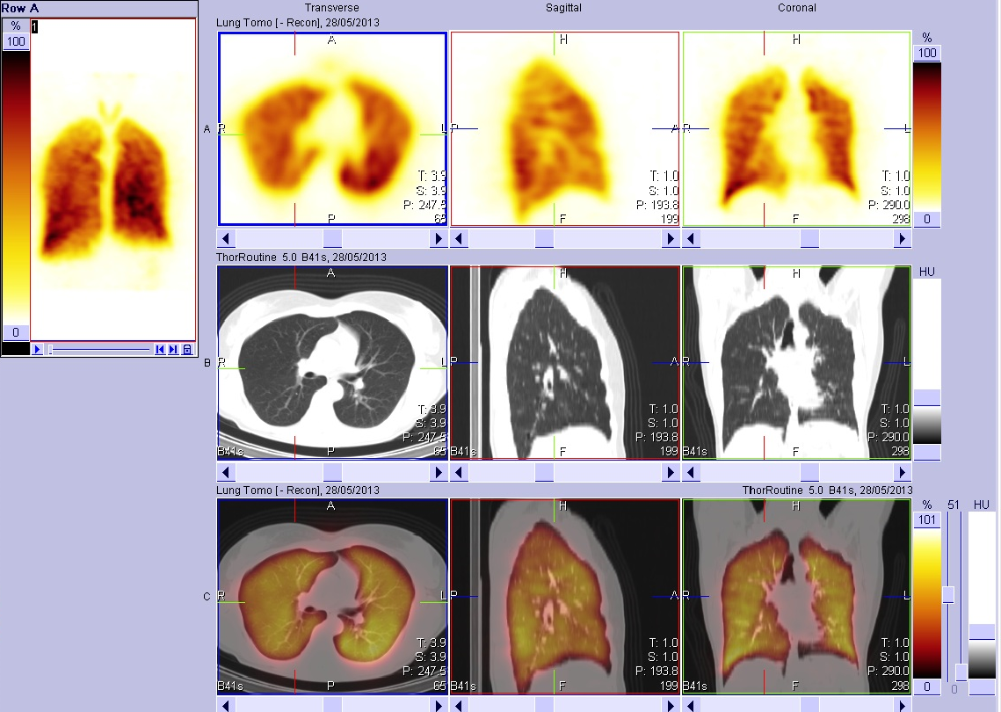
Lung perfusion study, SPECT/CT

Slide 28
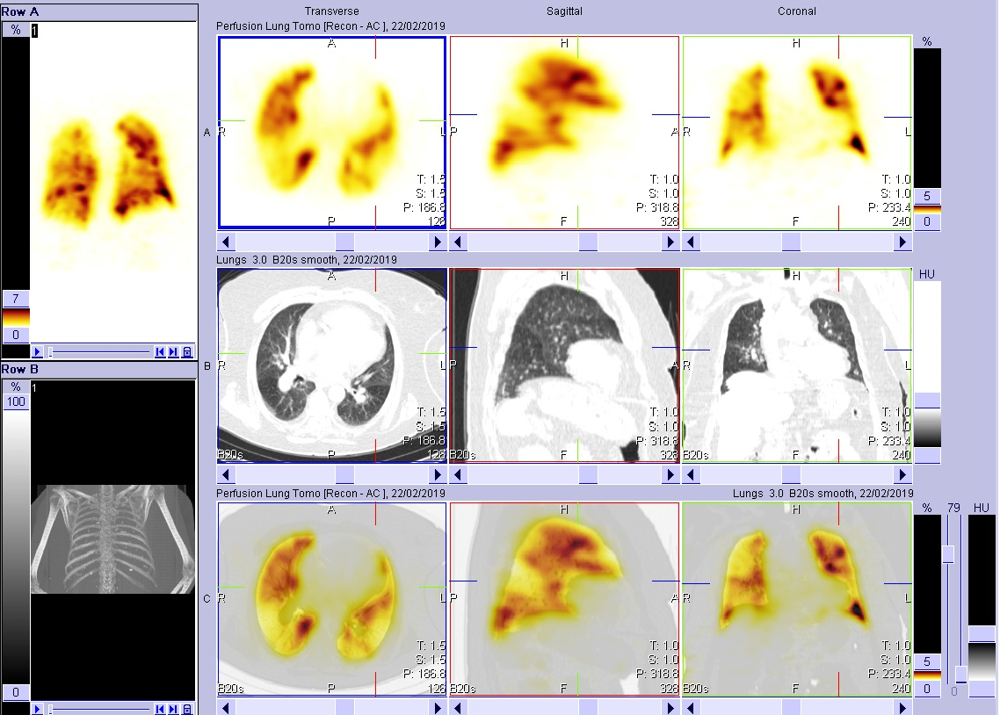
Lung perfusion study, SPECT/CT

Slide 29
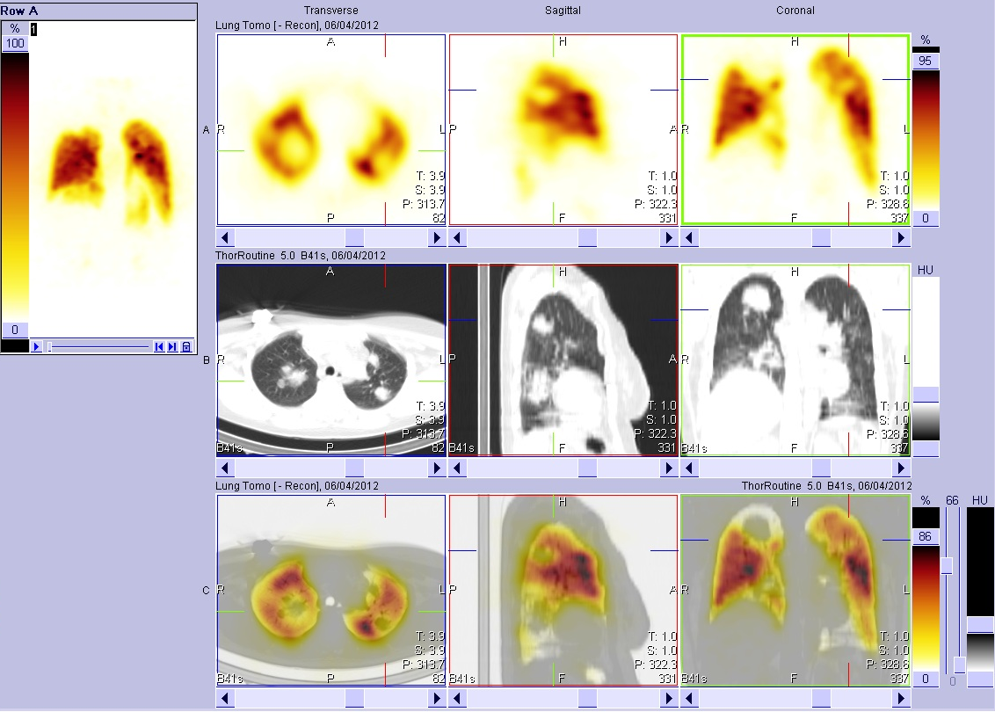
Lung perfusion study, SPECT/CT

Slide 30
Thyroid imaging
RP: ^{99m}TcO₄ (technetium pertechnetate), ¹²³I, ¹³¹I
Planar images, SPECT, SPECT/CT

Slide 31
Thyroid scintigraphy - indication
Hyperthyroidism : autonomous/toxic adenoma, Graves disease, subacute thyreoiditis, compensatory low level TSH due to another disease
Thyroid nodules : to determine their functional status
Detection of the ectopic thyroid tissue, evaluation of the retrosternal tissue mass (retrosternal goiter, lingual thyroid, struma ovarii)
Thyroid cancer (¹²³I, ¹³¹I) staging

Slide 32
Therapy I 131
Hospitalization required
Malignant - patients with differentiated thyroid cancer:
Elimination of residues and micrometastases after TTE
Therapy of metastases found on follow up dg. scan with I131
Benign:
Autonomous adenoma
Relapse of autoimmune hyperthyroidism (Graves-Basedow) without endocrine orbitopathy

Slide 33
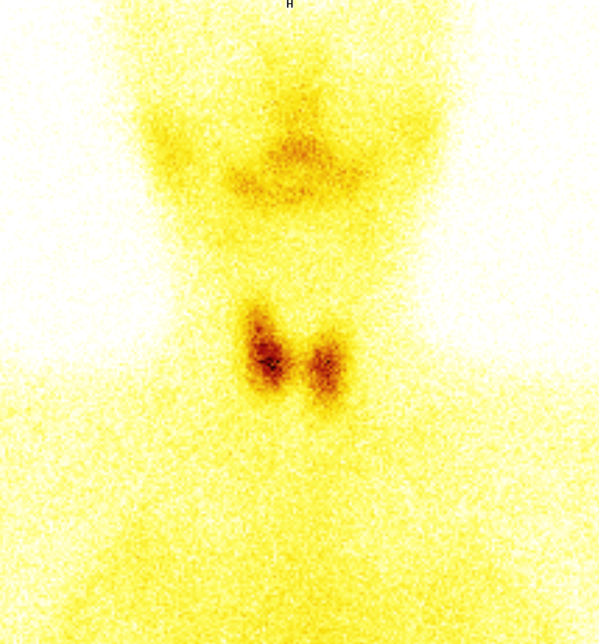
Thyroid scintigraphy – normal finding

Slide 34
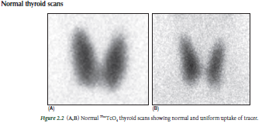
Thyroid scintigraphy – normal finding

Slide 35
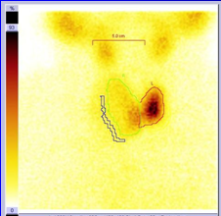
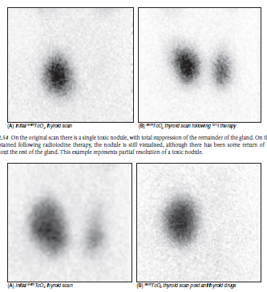
Thyroid study
Cold nodule
Toxic adenoma

Slide 36
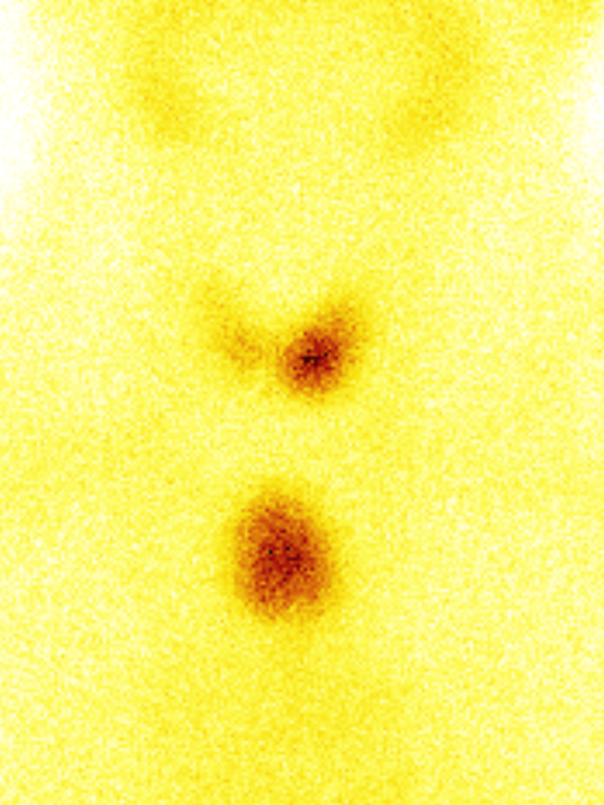
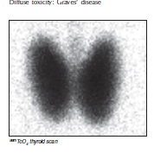
Thyroid scintigraphy
Ectopic thyroid - substernal
Graves-Basedow disease

Slide 37
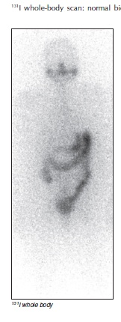
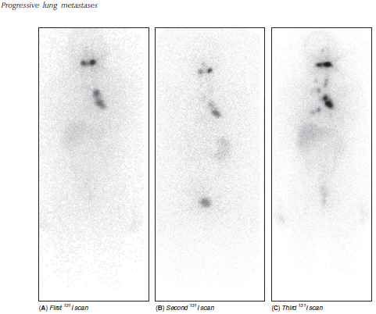
Iodine 131
131I –normal finding
131I-dissemination

Slide 38
Parathyroid scintigraphy
Indication: preoperative localization of hyperfunctioning parathyroid glands making possible minimally invasive surgery
RP: ^{99m}Tc-MIBI – unspecific uptake in paratahyroid and thyroid gland
Protocol:
Two-phase scan (^{99m}Tc-MIBI), initial images 10 min after injection, second set of images at 2 hours, there is more rapid washout fromt the thyroid, so delayed images show hyperfunctioning parathyroid gland)
Subtraction methodology (compares ^{99m}Tc-pertechnate study and ^{99m}Tc-MIBI study by digital subtraction)
Planar images, but SPECT, SPECT/CT with better accuracy, localization of the parathyroid gland
If unclear/negative result – posibility of ¹⁸F-choline PET

Slide 39
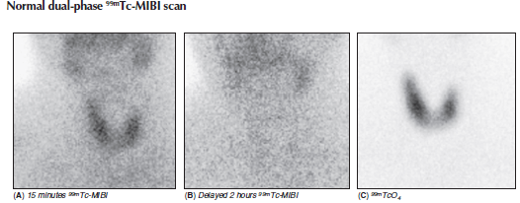
MIBI normal finding

Slide 40
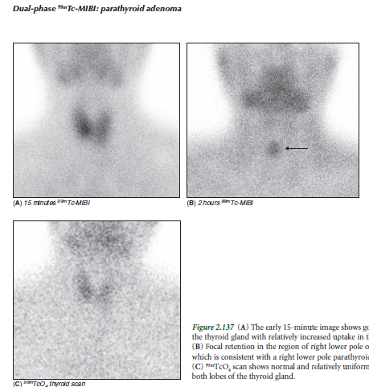
MIBI - adenoma

Slide 41
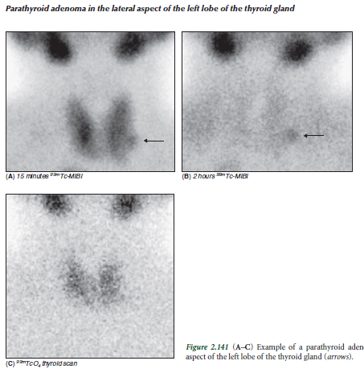
MIBI adenoma

Slide 42
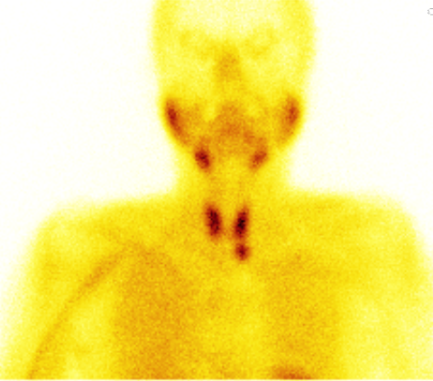
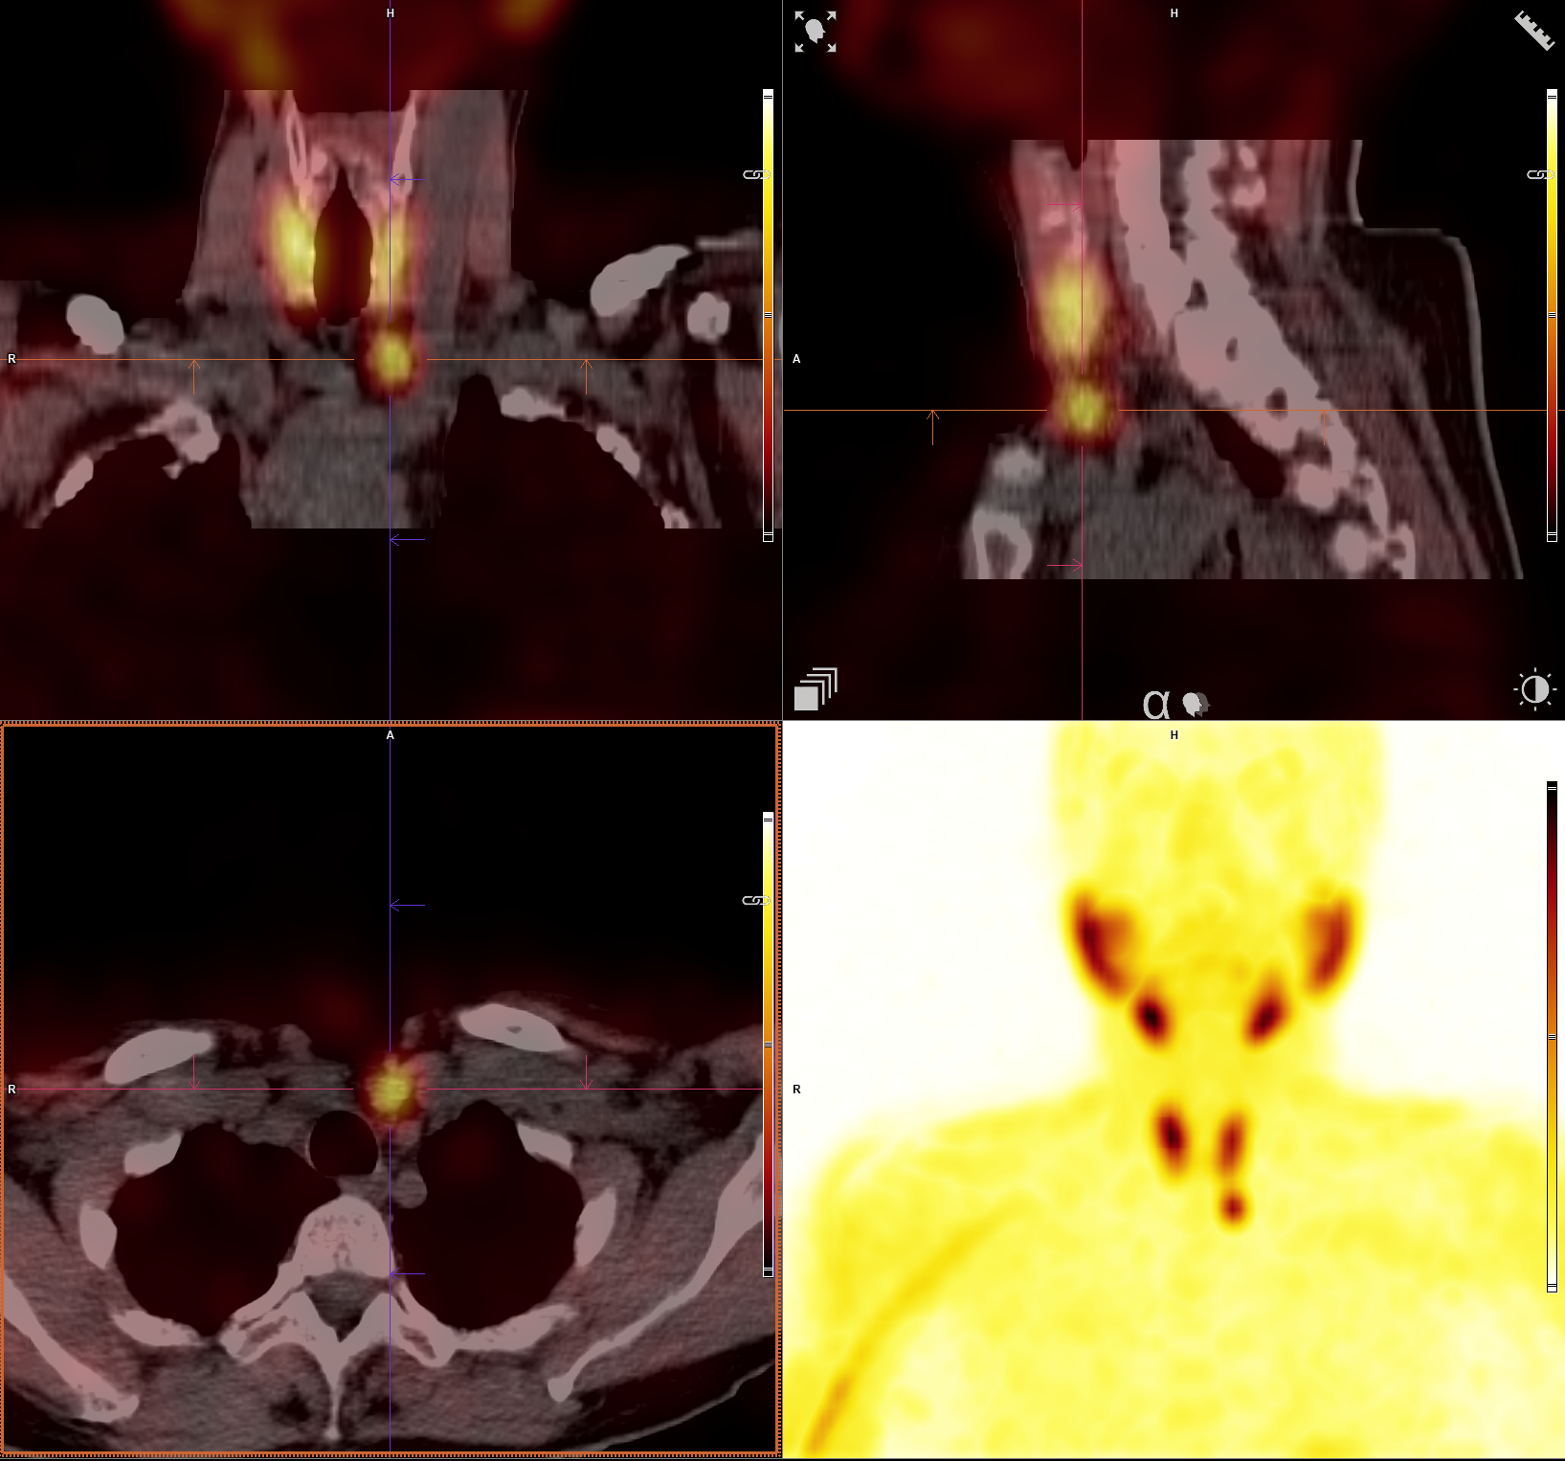
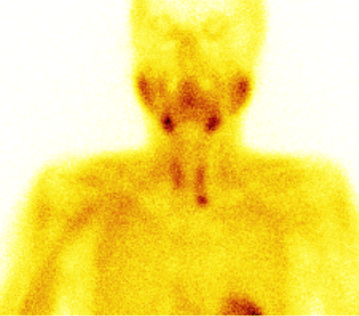
MIBI adenoma
Ant 5min
Ant 2h

Slide 43
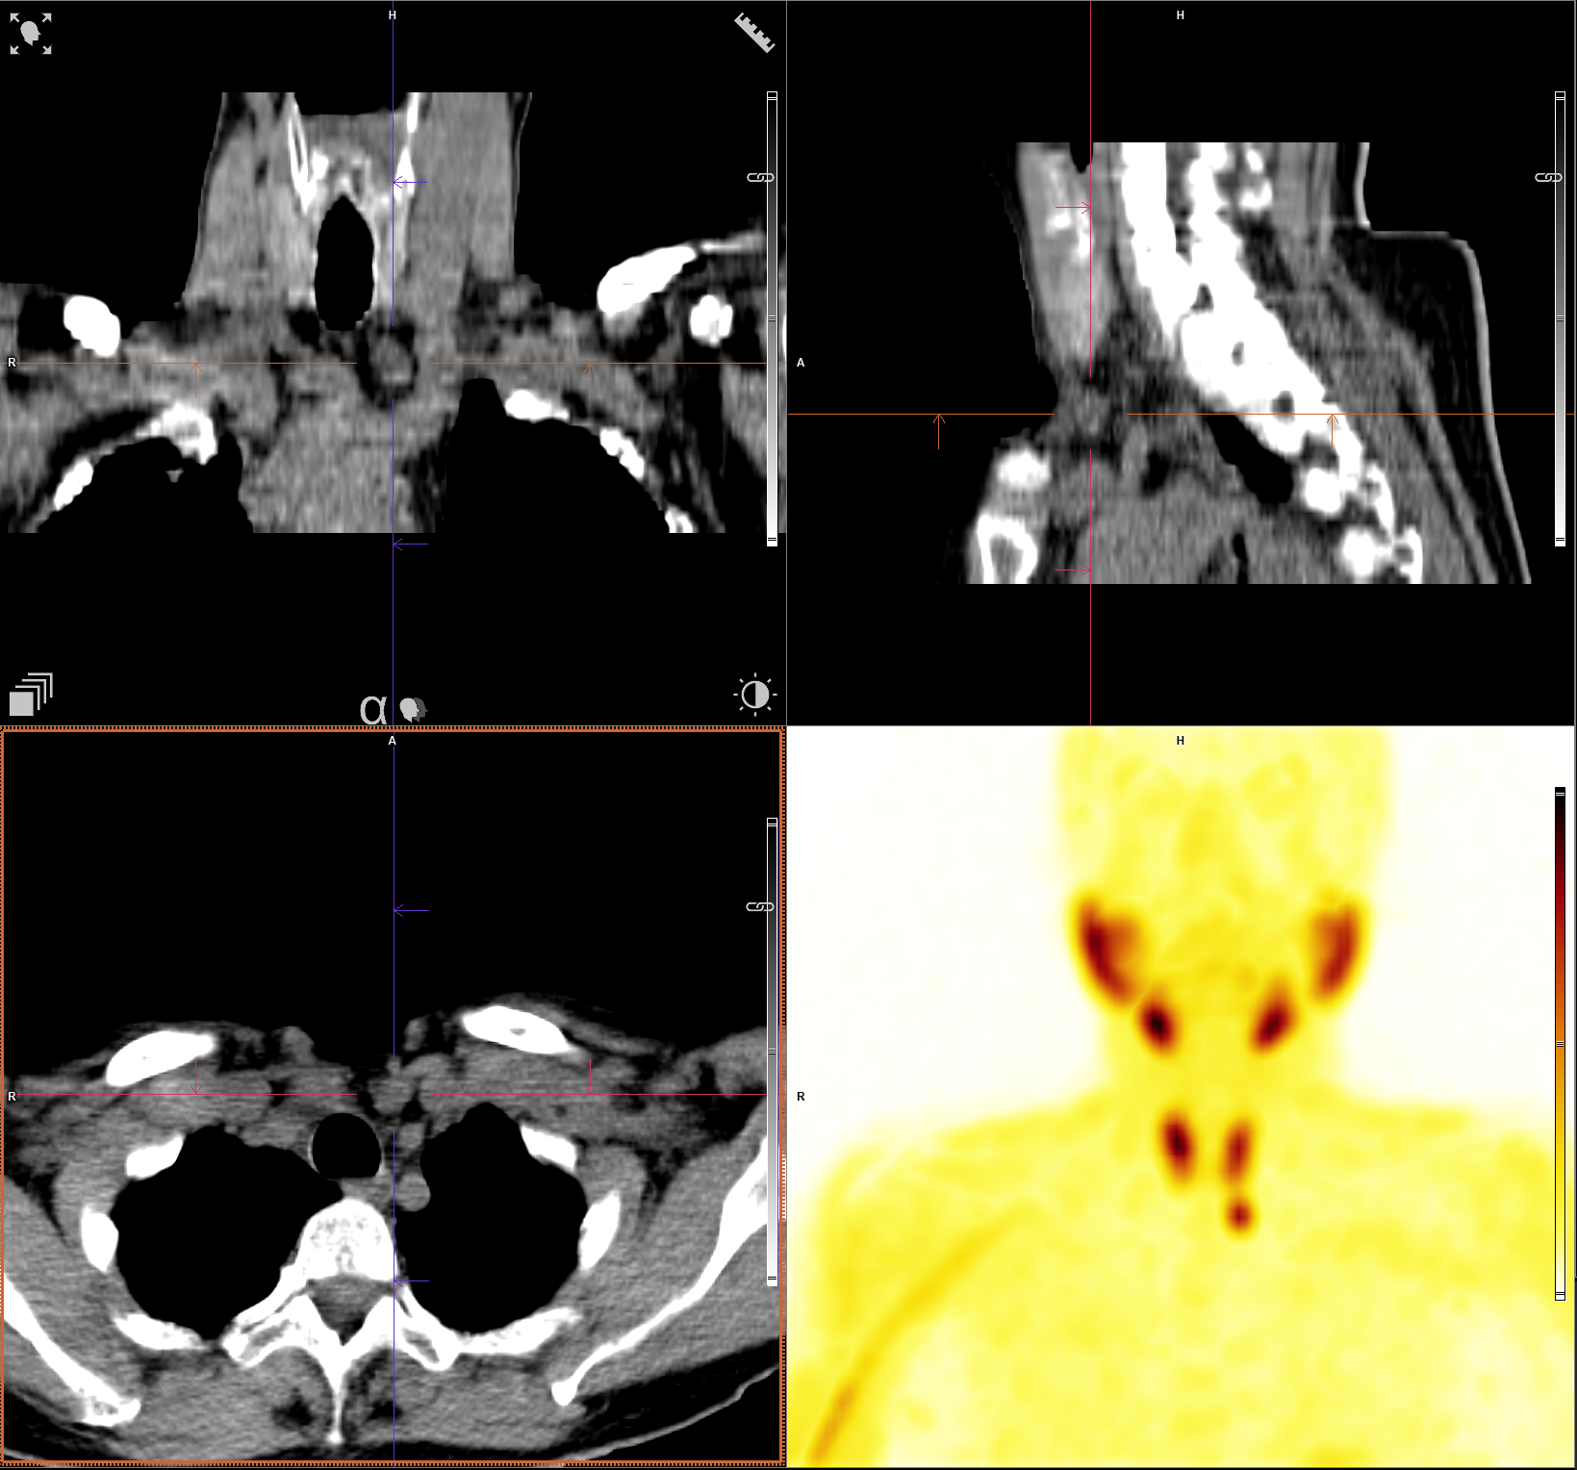
MIBI adenoma
Ant 5min
Ant 2h

Slide 44
Central nervous system
Brain perfusion imaging
Epileptogenous focus, Brain death, evaluation of cerebrovascular reserve,, dementia (AD, vascular,…)
Neuroreceptor imaging - DaTscan
Parkinson disease and syndromes, essential tremor, Dementia with Lewy Bodies
(Cerebrospinal fluid imaging)
Evaluation of suspected CSF leaks, investigation of suspected communicating hydrocephalus (normal-pressure hydrocephalus), verification of CSF shunt patency
PET : Amyloid imaging, 18F- FDG, 18-F-FLT….

Slide 45
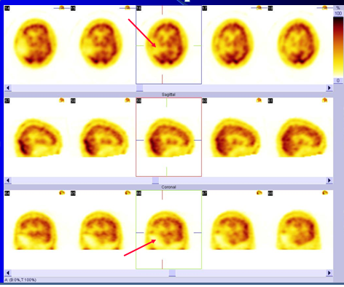
Brain perfusion
RP: ^{99m}Tc-HMPAO – lipophilic, crosses blood–brain barrier, enter neurons, becomes hydrophilic and is trapped

Slide 46
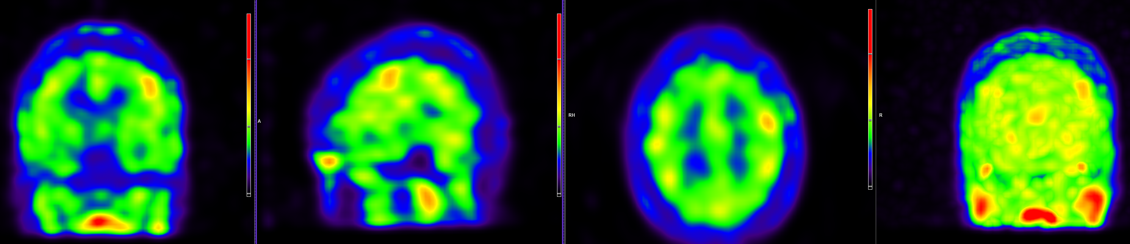
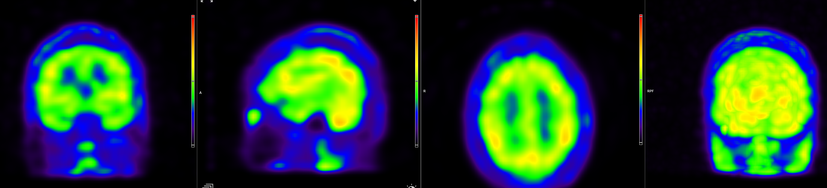
Brain perfusion – epilepsy
Ictal
Interictal
Notes:
farmakorezist. fokální epilepsie z levé pericentárlní oblasti, dle MR výrazná gyrifikace vlevo frontálně

Slide 47
Brain death
Imaging methods for diagnosing brain death: Brain perfusion study, angiography, CT angiography, transcranial Doppler ultrasound
Criteria for brain death (brain perfusion study): No intracerebral arterial, capillary or venous blood flow/tracer activity on the dynamic study, no visualisation of the sagittal sinus on immediate post-injected images (99mTc-HMPAO, 99mTc-ECD)
Protocol: dynamic study, immediate post-injected images better in multiple projections, SPECT
Advantages: No iodine contrast (possible nephrotoxic effect), simple intravenous injection, preferable in patients with lossy head injury or craniectomy (arteriography can be falsely negative)

Slide 48
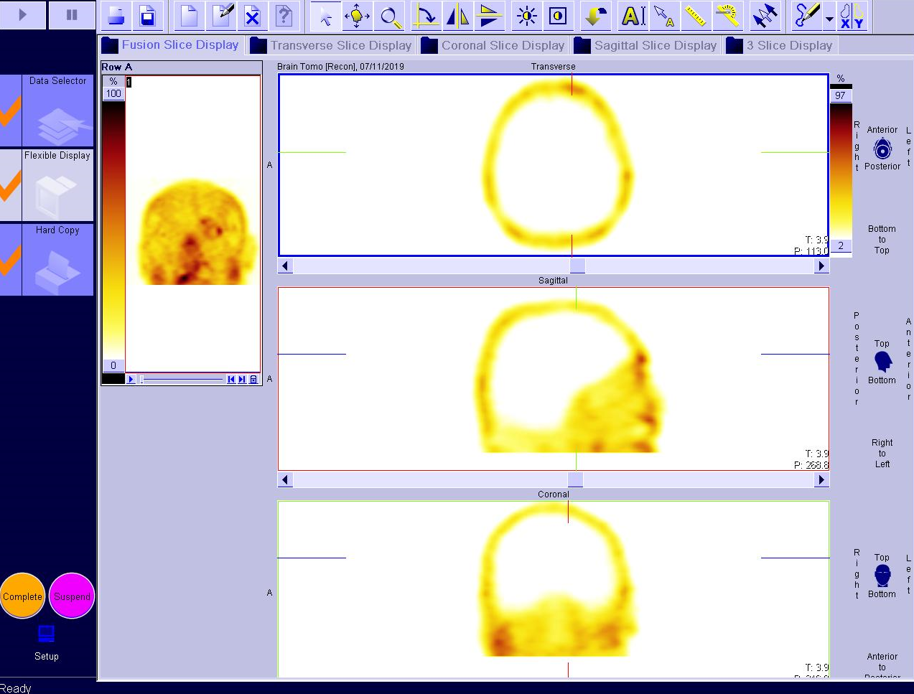
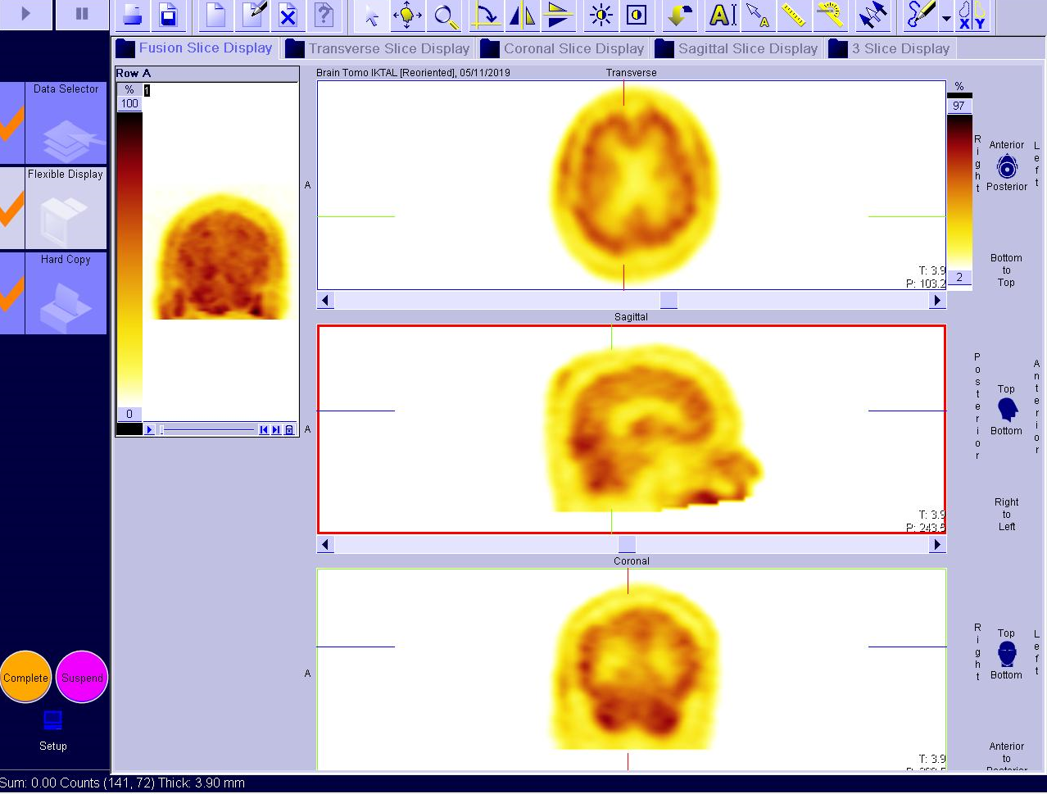
Brain death
Positive
Negative

Slide 49
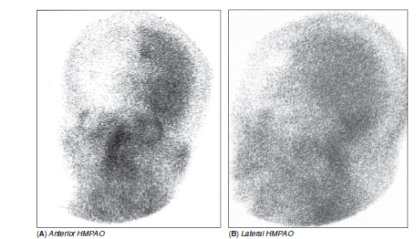

Brain death – 99mTc-HMPAO study
Uptake is seen in the left hemisphere – negative study for the brain death
Total absence of cerebral uptake – brain death confirmed

Slide 50
Datscan – 123Ioflupan
Idiopatic Parkinson disease – degeneration of nigrostriatal pathways, impairment of afferent pathway from substantia nigra to BG = presynaptic impairment
Parkinson's disease plus diseases (MSA, PSP...) - directly affected striatum, affected pre- and postsynaptically
Essential tremor, parkinsonism secondary to medication = no dopamine synapse disorder
¹²³I-Ioflupan : distribution of presynaptic dopamine transporters, cocaine analogue, thyroid blockade preparation
Indications: differentiation of Parkinson's disease and Parkinson plus diseases from essential tremor, dg. dementia with Lewy bodies

Slide 51


Slide 52


Datscan
Normal
Positive – Parkinson disease

Slide 53

99mTc-MIBI (sestamibi)
Nonspecific tumor binding agent, it is concentrated in mitochodria of the viable cells as a result of the passive difusion
Use:
cardiology (cardiac perfusion studies – dg. ICD)
endocrinology (localisation of hyperparathyroid gland)
oncology – follow up of patients with differentiated thyroid cancer as an alternative to ¹³¹I
- earlier in pts. with multiple myeloma, breast ca, soft tissue sarcomas
- accumulation also in other types of malignancies.

Slide 54


MIBI scan
Notes:
Normal finding: uptake in salivary glands, thyroid, myocardium, liver, colon , bladder, kidneys, small, intestinum , spleen, muscles

Slide 55

Scintimammography
- Adjunct procedure to mammography, ultrasound, MRI

Slide 56
123I-MIBG – adrenal medullary scintigraphy
Metajodobenzylguanidin = guanethidin analogue (similar to norepinephrin) that accumulates in adrenergic and neuroblastic tumors
Protocol: Wholebody planar scan + SPECT/CT at 4 and 24 hours after injection, patient preparation before study! (thyroid blockade)
Indication : diagnosis, staging, management of adrenergic neuroectodermal tumors ( pheochromocytomas, extraadrenal paragangliomas, neuroblastomas), before planned 131I-MIBG therapy of medullary thyroid cancer
Pheochromocytoma/paraganglioma – catecholamine-secreting tumors (hypertension, arrytmias), 10%bilateral pheochr., 10% extraadrenal paragangliomas, 10% malignant, found from the bladder up to the base of the skull
Neuroblastoma – embryonal malignancy of the sympathetic nervous system, typically in children younger than 4years of age, 70% originate in retroperitoneal area, 131I-MIBG for therapy after the failure of previous conventional therapies

Slide 57

123I-MIBG scan – normal finding
Prominent uptake in salivary glands, heart, liver
Colon and blader clearance
Mild uptake in nasal mucosa

Slide 58




¹²³I-MIBG

Slide 59

Pheochromocytoma on 123I-MIBG scan
The increased uptake corresponds to a enlarged left adrenal mass with central necrosis on CT

Slide 60
Imaging of somatostatin receptors
        Imaging of the distribution of somatostatin receptors, which are highly expressed in neuroendocrine tumors (especially pulmonary and gastro-enteropancreatic NETs)
        ¹¹¹In-Pentetreotid (Octreoscan) - synthetic somatostatin analogue with high affinity to SSTR2, SSTR5
Protocol : wholebody scan + SPECT/CT at 4h, 24h (sometimes 48h) after injection
Newer alternative:
Tektrotyd = ^{99m}Tc-EDDA/HYNIC-TOC – at 1h and 4h
- better image quality than Octreoscan (energy of ^{99m}Tc), 1-day exam, lower radiaton dose, lower price
Indication: evaluating neuroendocrine tumors, especially carcinoid , gastroenteropanctreatic tumors, small cell lung cancer, meningioma, variable affinity for medullary thyroid cancer, insulinoma
Limitation : false positive uptake in bening inflammmatory granulomatous disease (sarcoidosis, TBC, IBD...), in tumors expressing lack of appropriate receptor subtype
PET alternatives:
68Ga-DOTA-TOC - best sensitivity and image quality, lower availability (⁶⁸Ga), higher price
18F-FDG PET useful in poorly differentiated neuroendocrine tumors
Therapy: ¹⁷⁷Lu-DOTA-TATE – beta- radiation therapy in patients with progressing GEP NETs

Slide 61

Octreoscan – normal finding
Prominent uptake in spleen, liver
Kidneys clearance

Slide 62

Tektrotyde – NET in ileum + lymph nodes

Slide 63

Tektrotyd vs Octreoscan

Slide 64

Carcinoid - octreoscan

Slide 65


Lymfoscintigraphy of limbs
RF: ^{99m}Tc-nanocoloid, subcutaneus
Indication: lymphedema

Slide 66
Lymphoscintigraphy – SLN detection
Small amount of radioactive active colloidal tracer is injected into the skin in proximity to tumor leasion to determine the SLU receiveing drainage and thus possibly metastasizing tumor cells
SLN (sentinel lymph node) = the first lymph node (nodes) which is first on a direct lymphatic drainage pathway from a primary tumor site, and as such is the most likely the location of metastasis
Identification and histopathological examination of the SLU (after surgical removal) allow us to predict a regional metastatic potential of that given tumor and thus to choose optimal therapy
99mTc-nannocolloid
Indication : malignant melanoma, breast cancer, cancer of the tonque, neck, head, vulva
Contraindication: already known metastatic disease indicated fo systemic therapy, suspected altered lymphatic drainage due to the previous surgery procedure

Slide 67



Breast cancer – detection of SLN

Slide 68

SLU imaging – patient with melanoma
Tracer was injected around the leasion on the lower back and drained to 2 lymph nodes. They were marked superficially over the skin

