Slide 1
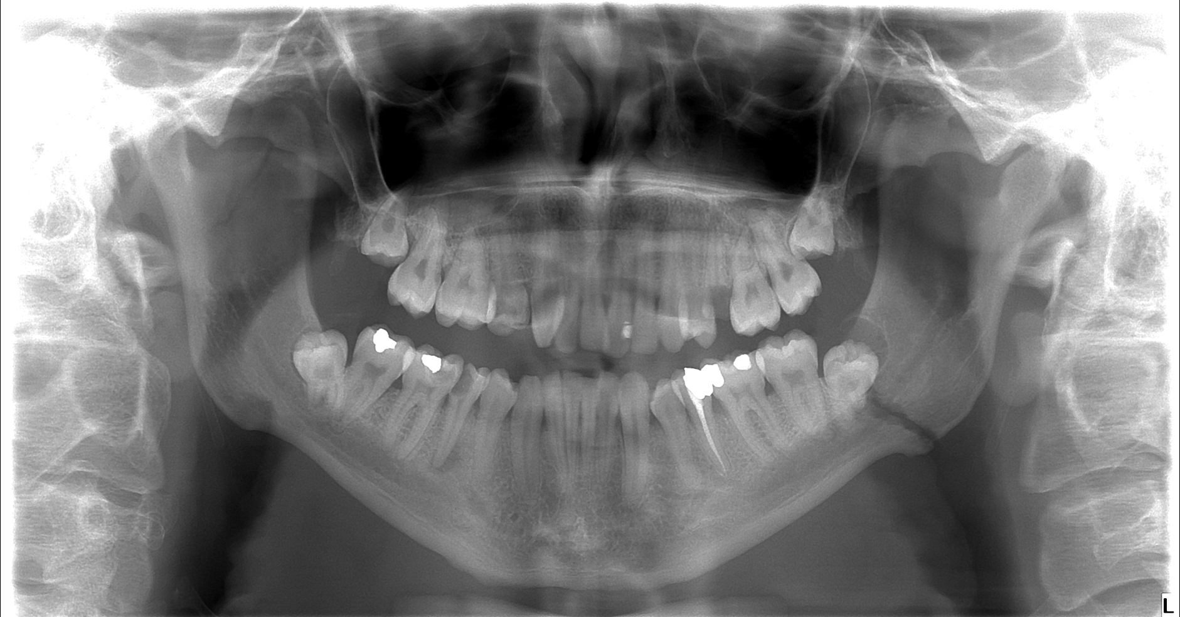
male 96* - attacked and hit in the face

Slide 2
fct. mandibulae duplex - proc. articularis l.dx. et anguli mandibulae l.sin., trough -8.

Slide 3
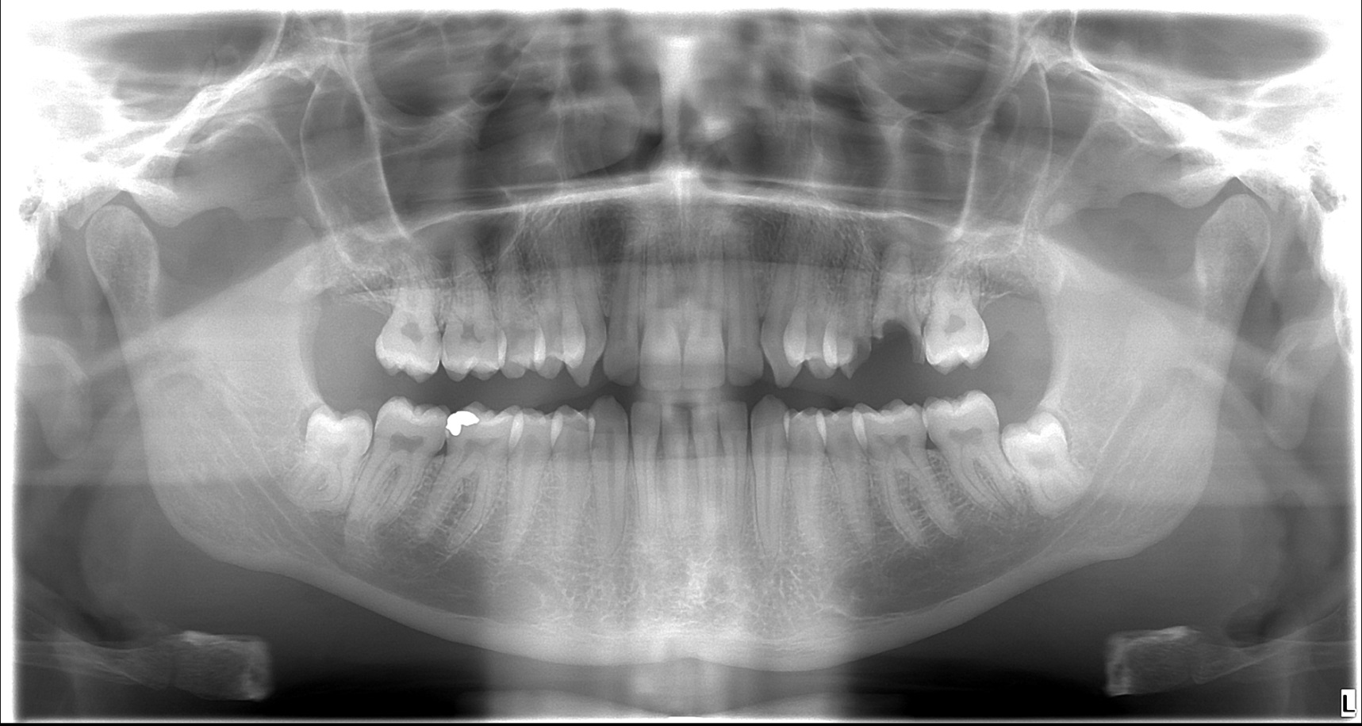
Male 93*

Slide 4
+6 radix relicta (tooth root that is broken after extraction and left in situ, eventually root of destroyed tooth)
Partially retinated 8--8

Slide 5
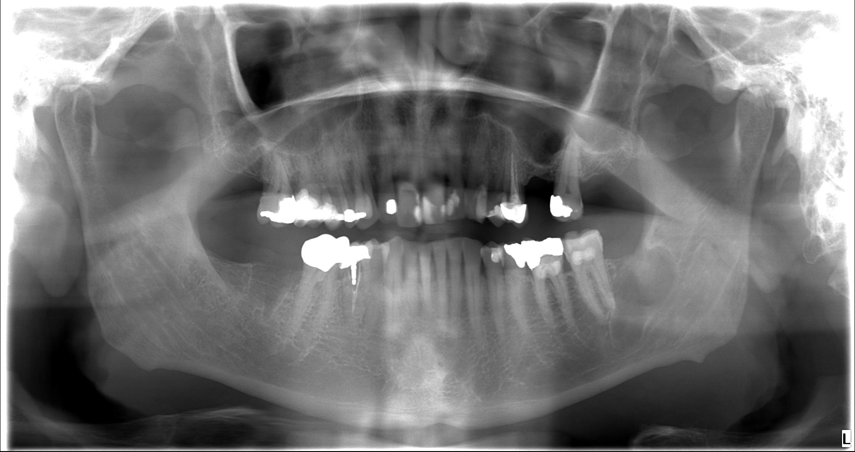
Male 62* Yesterday in the morning he ate a hotdog, there was a crunch in the left part of lower yaw and pain.Since then he can not freely open his mouth.

Slide 6
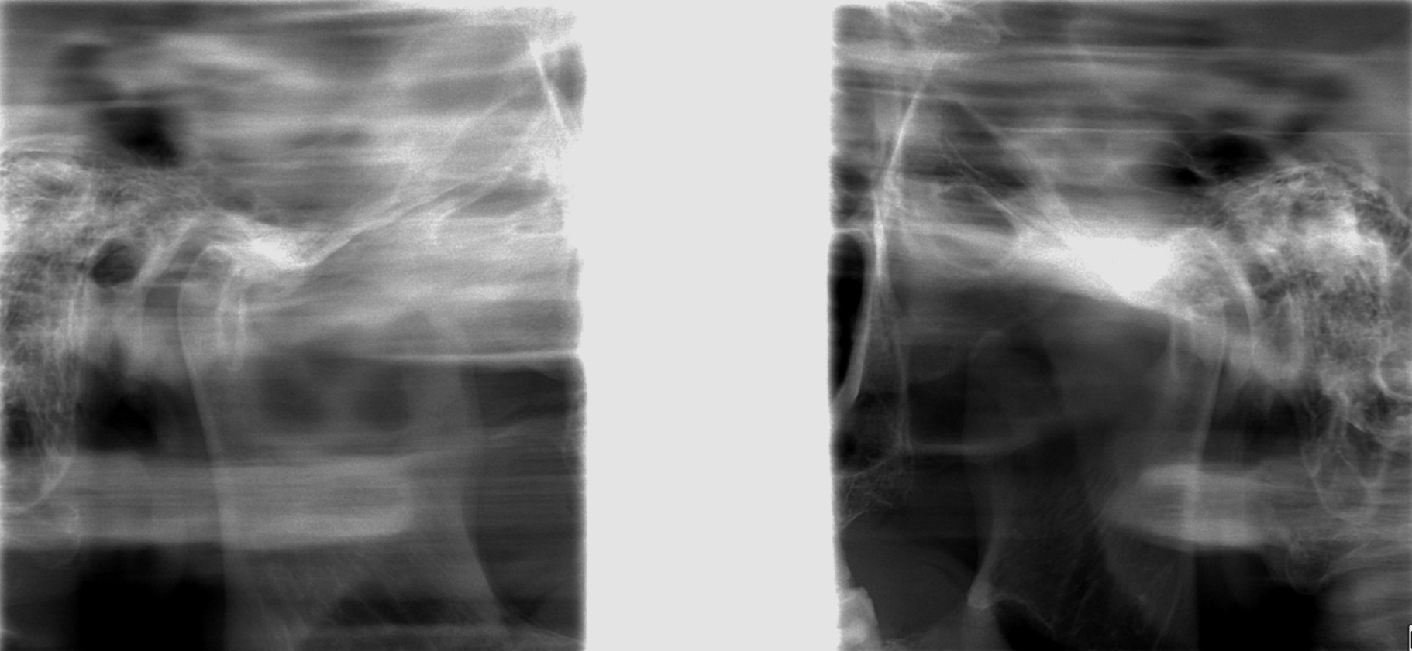
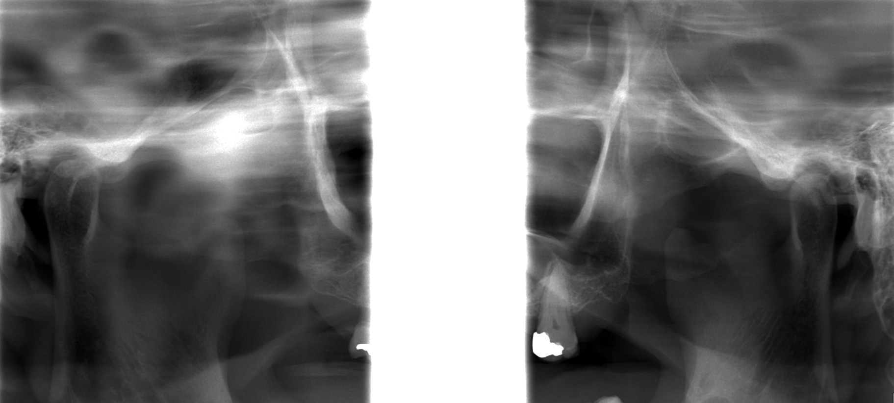

Slide 7
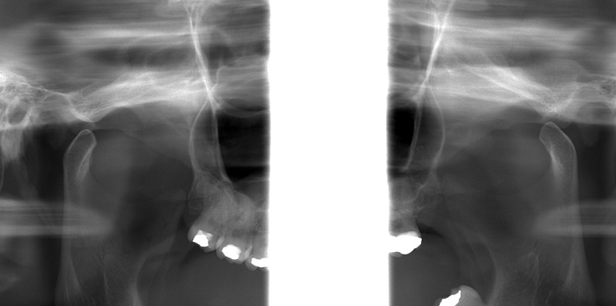
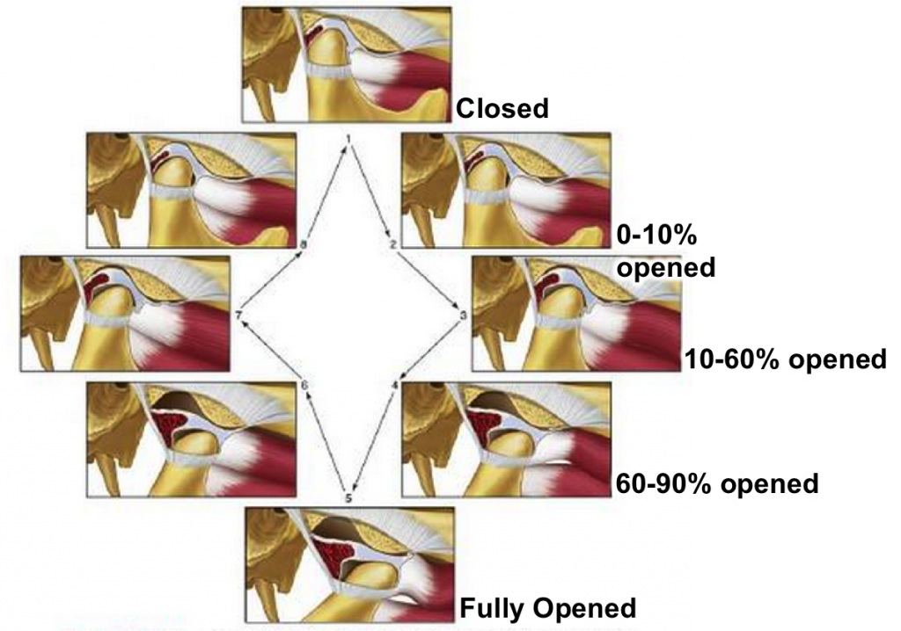

Slide 8
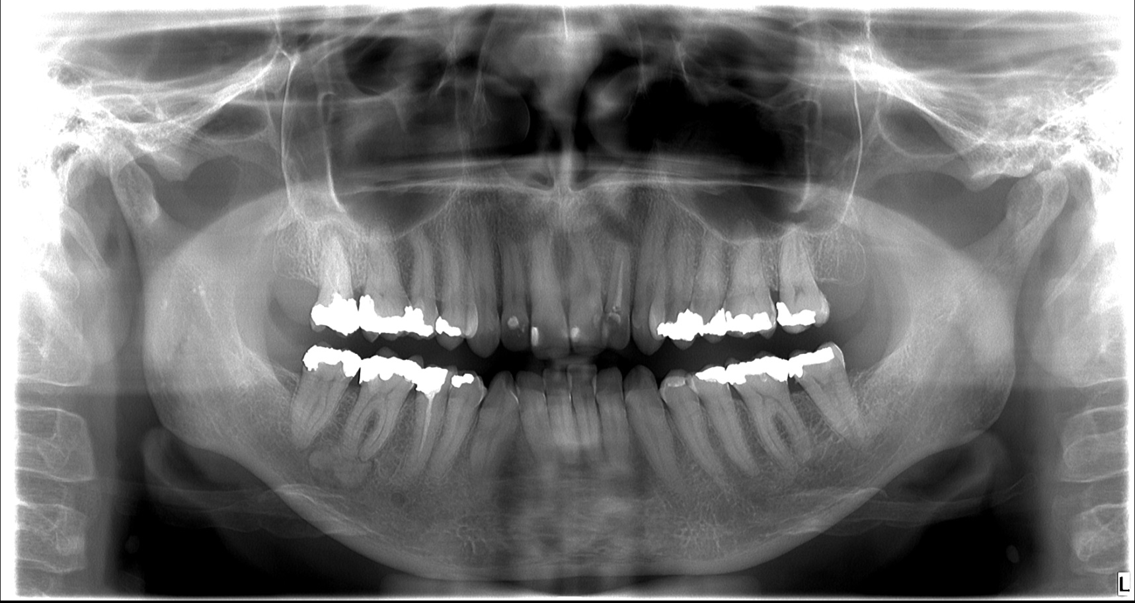
female 71*

Slide 9
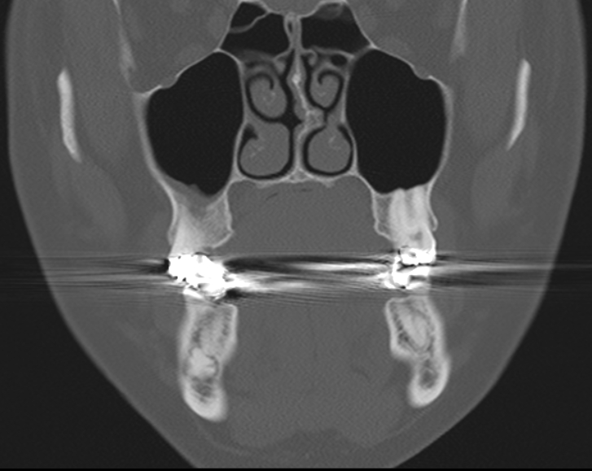
Odontom
benign tumor containing all tooth components
we distinguish composite and complex odontom
Composite odontom
especially the frontal section of both jaws
consists of several teeth of different sizes
2. decenium
manifested by gaps and pruning disorder
Complex odontom
irregular tangle of dental tissues
angle of lower jaw, tuber
Odontoma is one of the most common lesions of the lower jaw and the most common odontogenic tumor of lower jaw.
Xray/CT characteristics:
Composite odontom
we can distinguish the developmental
stage of teeth
developed teeth have an enamel cap
Complex odontom
irregular shading bounded by brightening

Slide 10
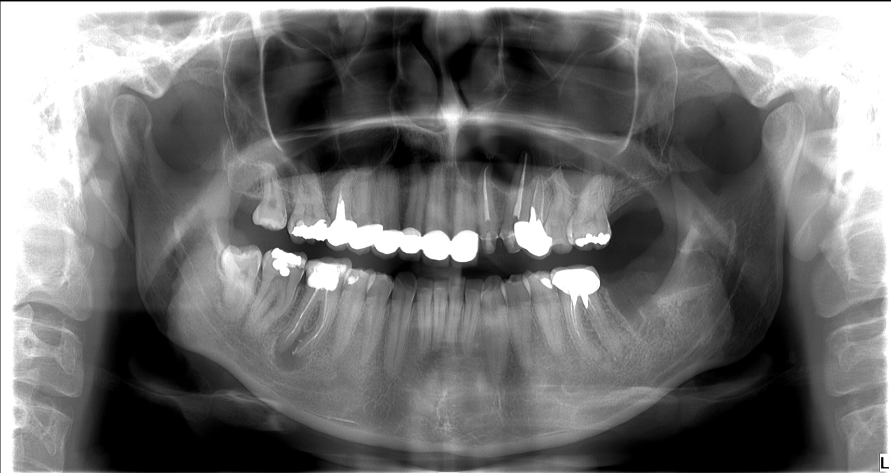
female 91*
Clinically: arching of hard palate, fluctuation, size 2x1cm. No pain

Slide 11
female 91*
OPG extensive cystic brightening in area +12345 extending into the maxilla, with compression of the left nasal pass way.
Radicullar cyst – inflamatory
forms about 75% of all odontogenic cysts.
It is formed apically or laterally, from granuloma or chronic dentoalveolar abscess. Condition is presence of an avital tooth. The content of the cyst is a clear, serous liquid with small cholesterol masses produced by the epithelium and multiplied by transudation from the surroundings.

Slide 12
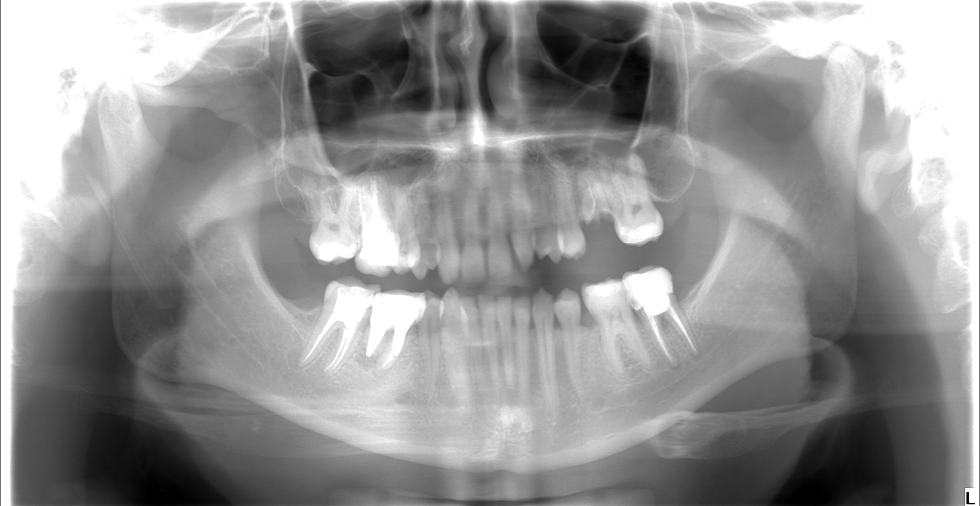
91* male -3 days swelling in oral vestibule at bottom right

Slide 13
6- external radix resorption, periapical lucency
Radix relicta +5
Small periapical lucency 7- -7

Slide 14
male 76*
from Saturday to Sunday attacked in ebrieta by unknown attackers with a kick to the lower jaw area on the left.

Slide 15
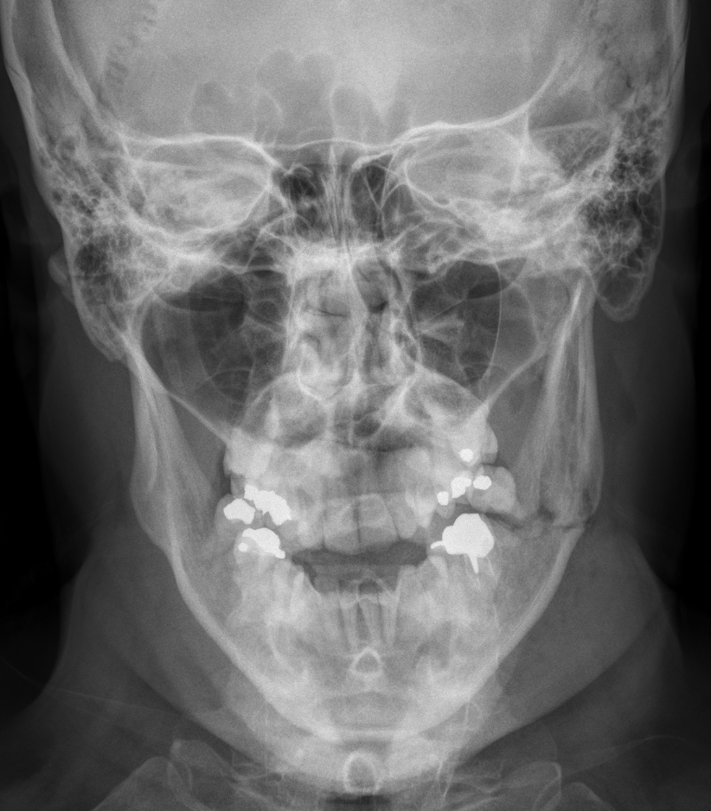
1.day ENT specialist- X ray of skull

Slide 16
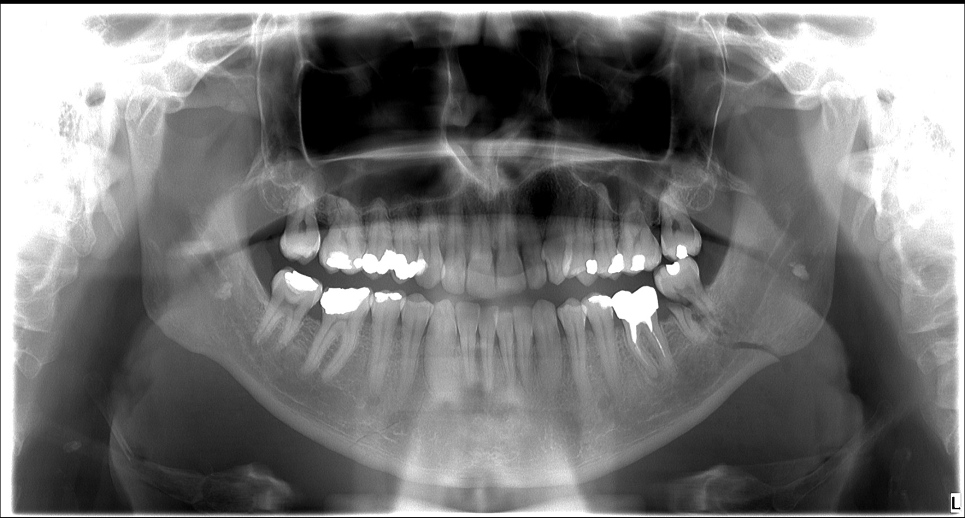
2.Day OPG in our Hospital on Dental clinic

Slide 17
Mandibular angle fracture on the left side, fracture line passing trough -7
Oblique infraction of mandibular body on right side regio 3-.

Slide 18
Male 60*
since december the pain of the left half of the mandible
the teeth in the lower left quadrant were extracted by the dentist
but the trouble has not gone away

Slide 19
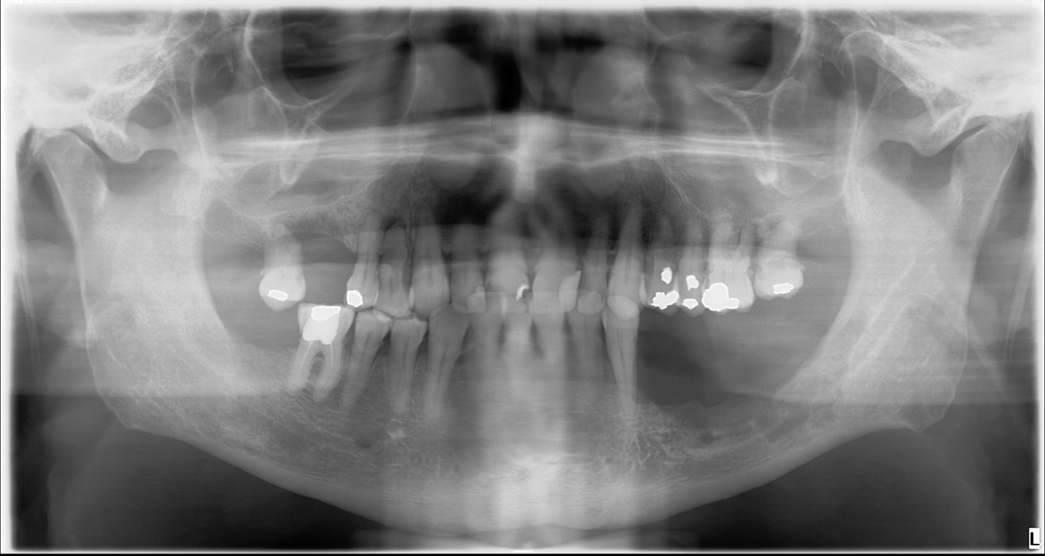
1/2019

Slide 20
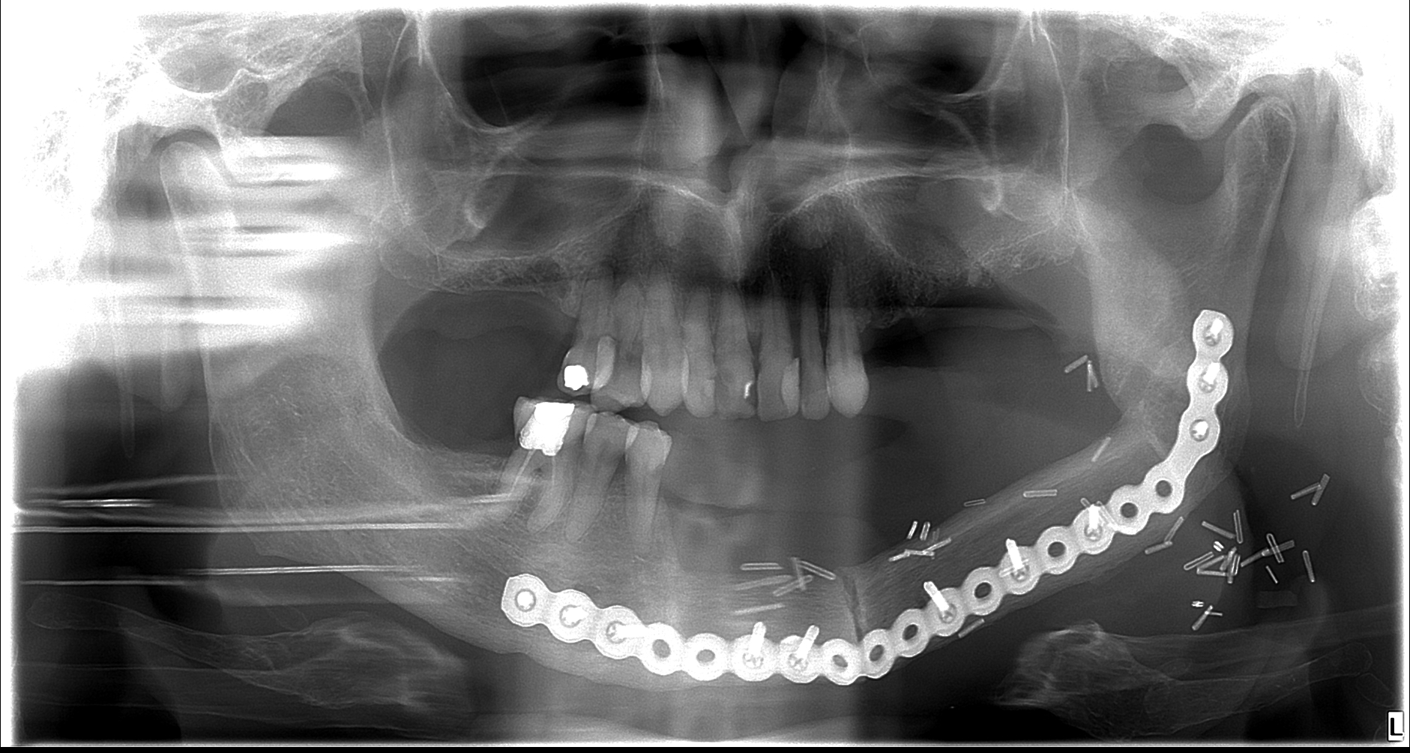
Histology: spinocellular carcinoma
10/19 was made resection of left part of mandibulla with reconstruction with bone graft.

Slide 21
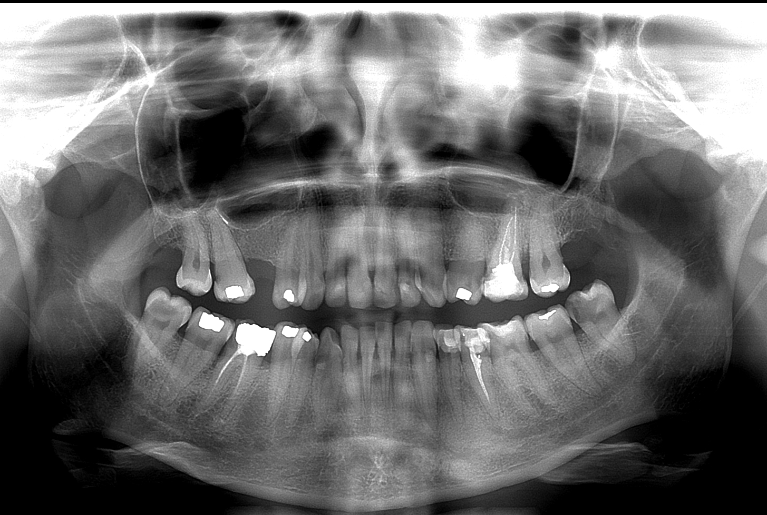
female 85*
to exclude the focus of the infection before initiating biological therapy for MS

Slide 22
-8 caries destruction, 6+ caries

Slide 23
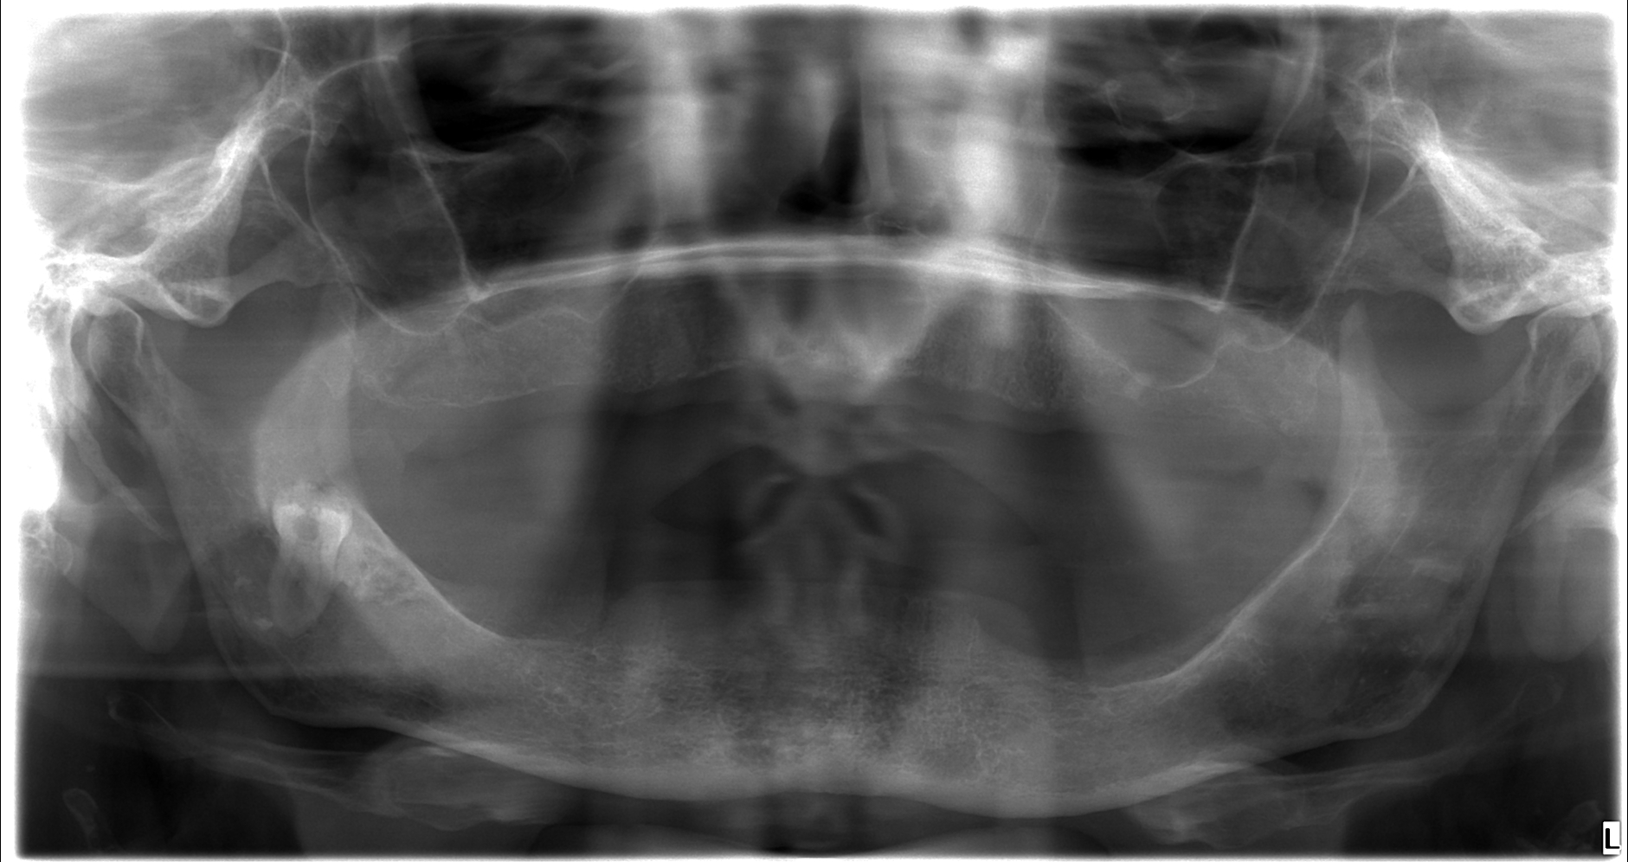
female 45* - She complains of pain in the frontal section under total dental replacement.

Slide 24
Maxillar cyst regio 1++1 size 15x15mm, according to CBCT arising from canalis nasopalatinus
Histology: Benign cyst, finding admits cyst of nasopalatin duct
cyst of nasopalatin duct is the most common non -ontogenous cyst of the upper jaw. It is based on the epithelial residues of the nasopalatinus duct.

Slide 25
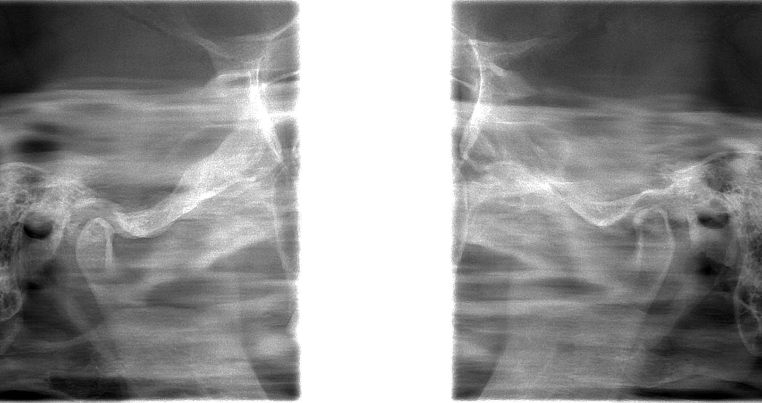
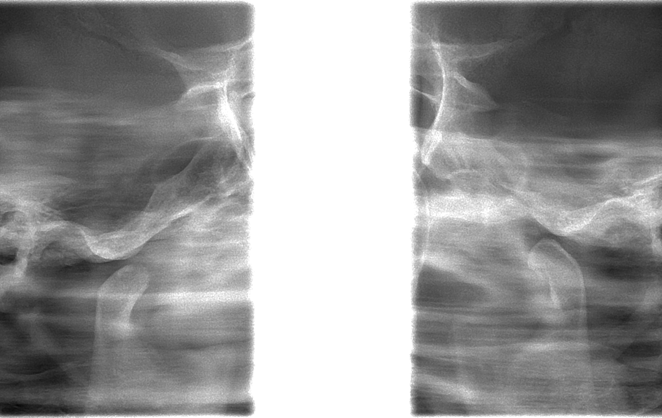
female 82* - Longer time crunching when opening the mouth on both sides. Last six months more intensively. She has no pain.
.

Slide 26
OPG-ATM: Without degeneration, hypermobility on both sides

Slide 27
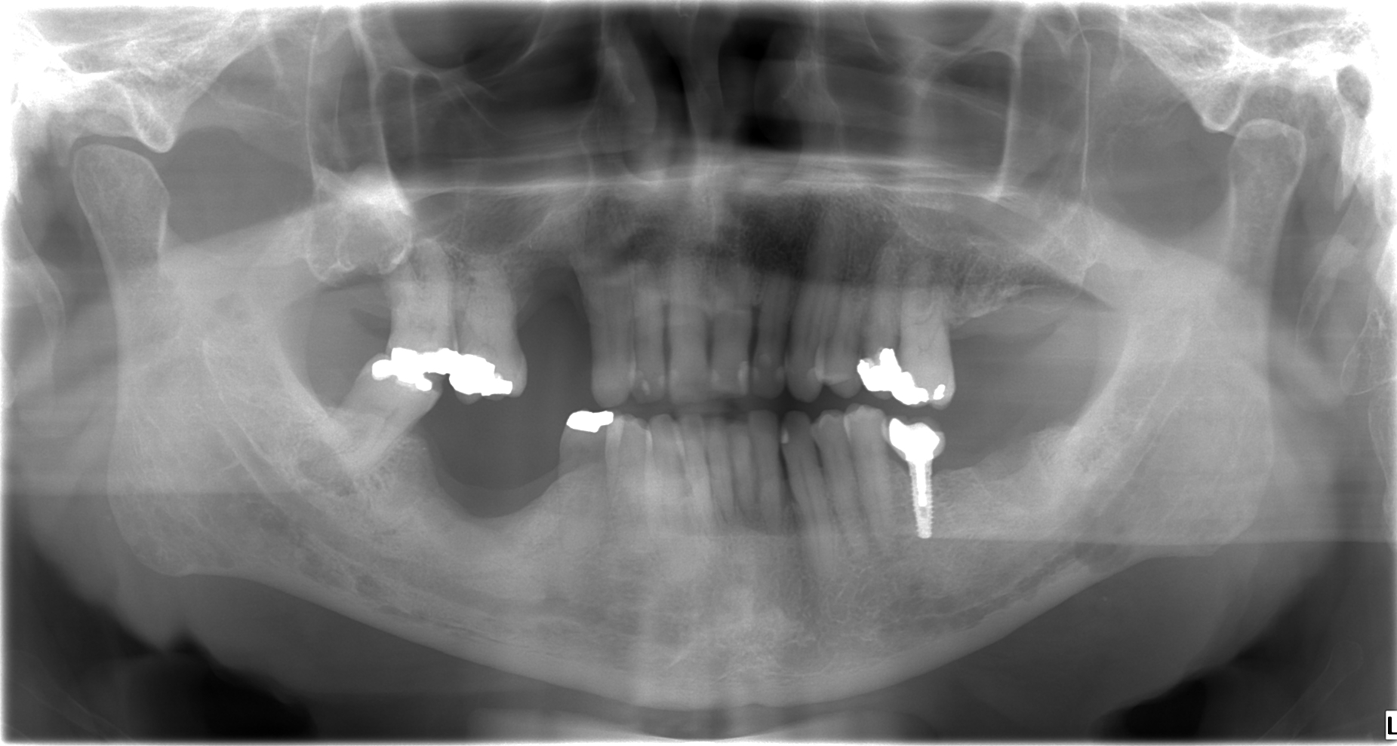
male 43* - back pain, in the oral cavity without pain - check after tooth extraction

Slide 28
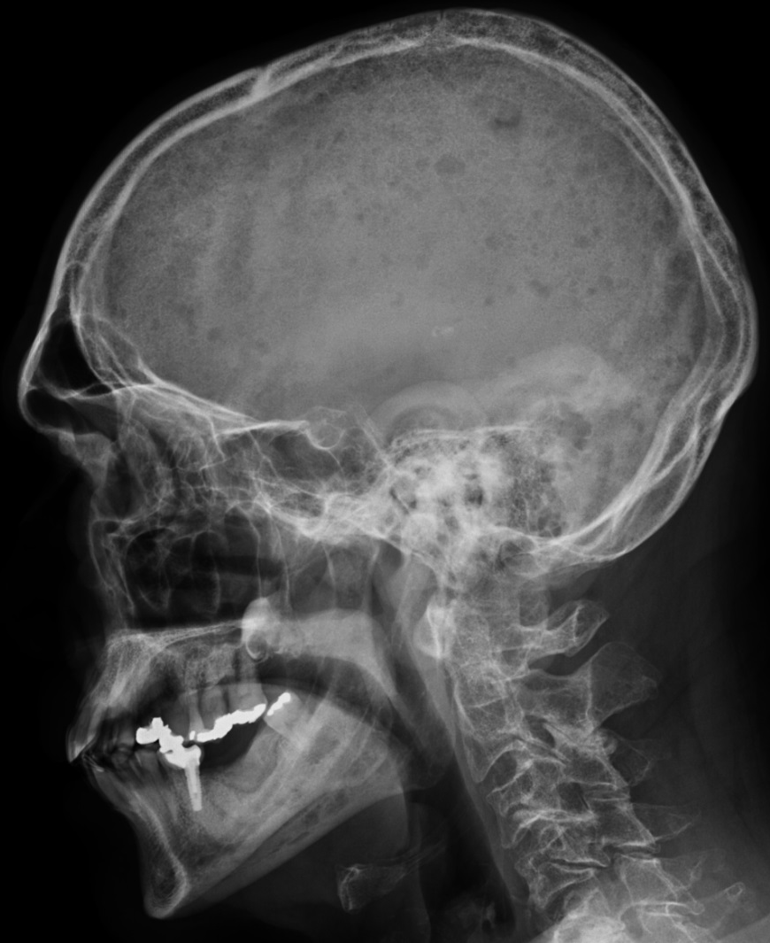
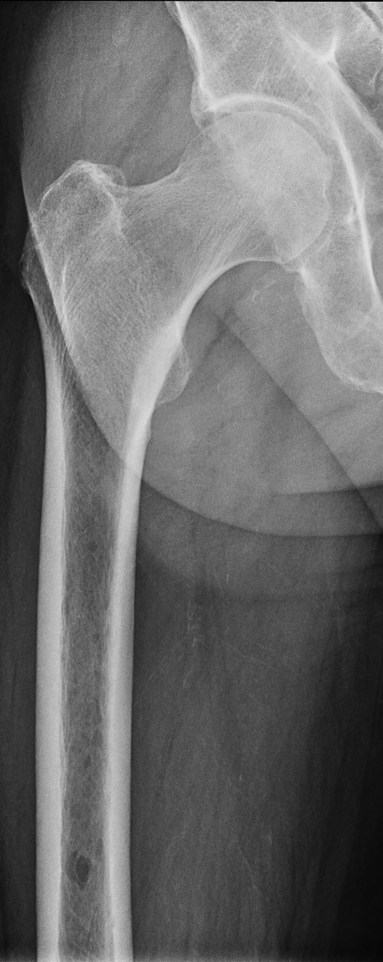
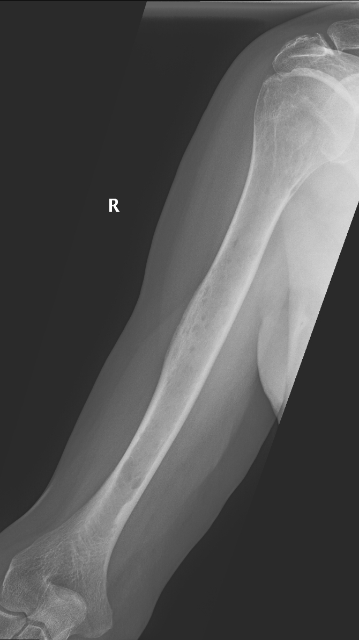

Slide 29
female 61
in june this year she woke up with limited mouth opening
Gradual normalization of the mouth opening condition
pain persists, at night waking up from sleep

Slide 30
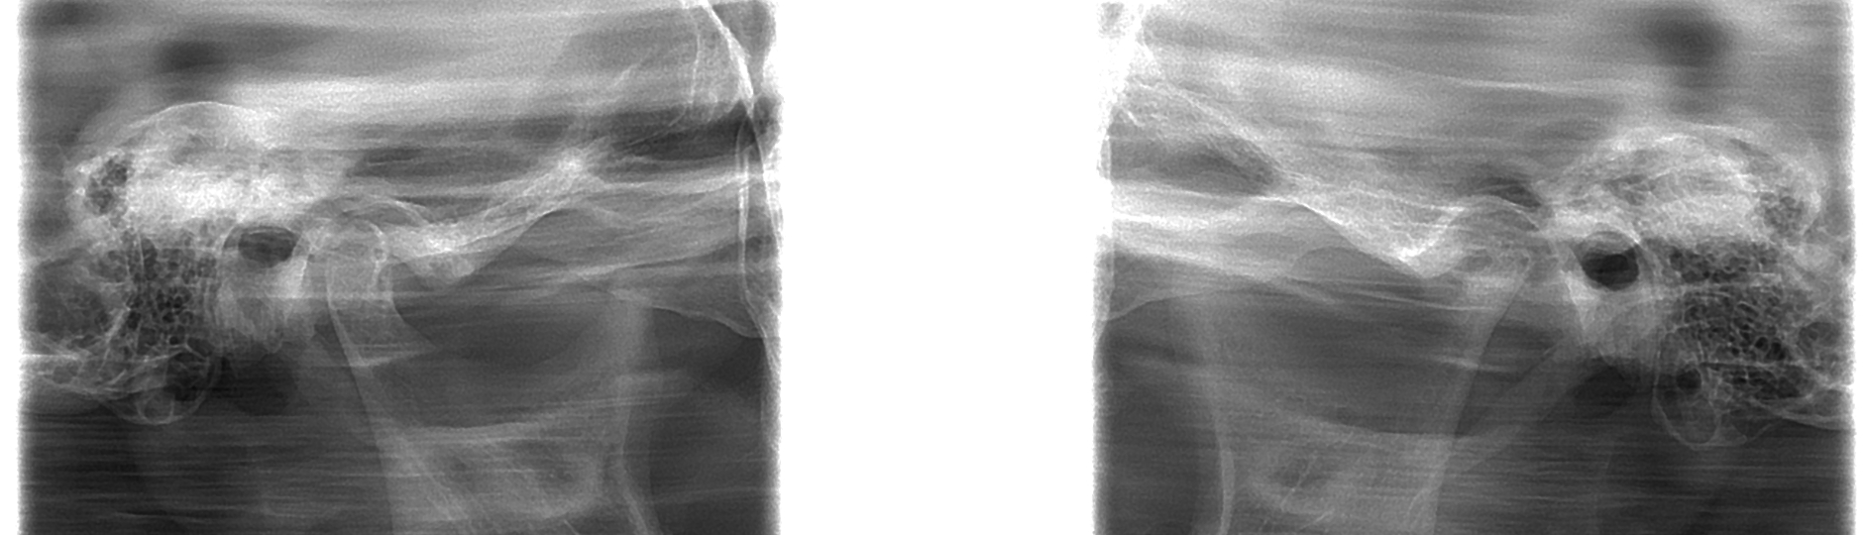
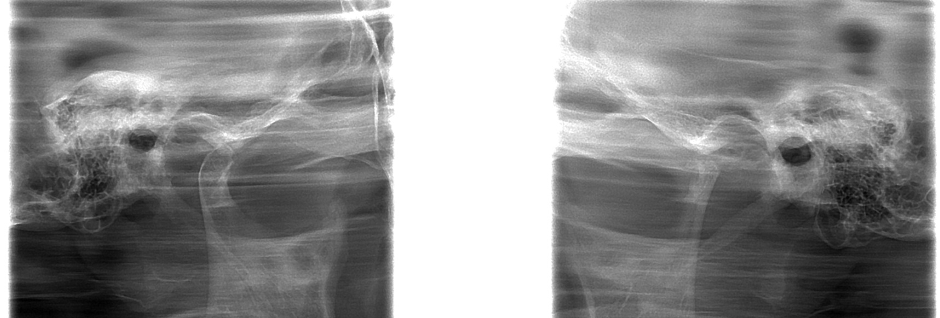

Slide 31
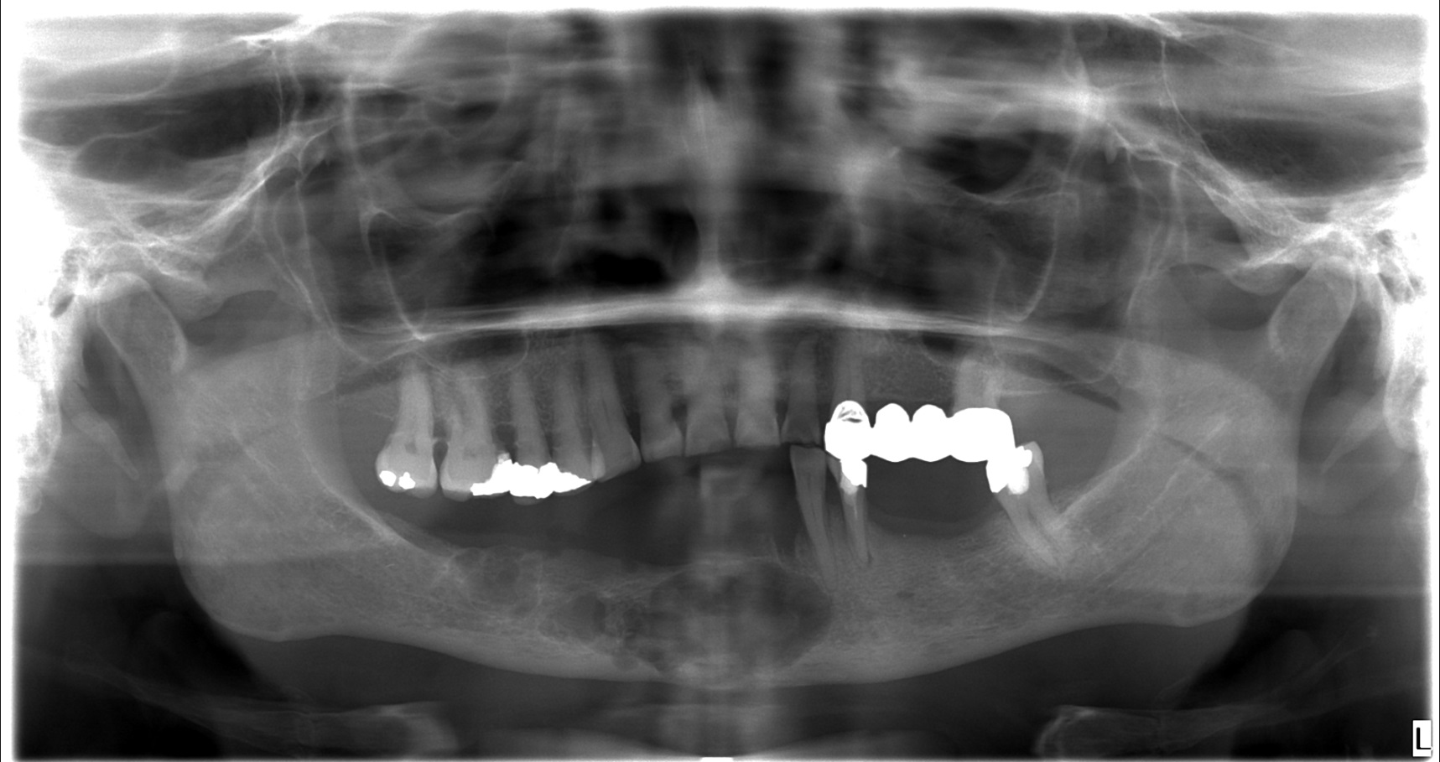
female 40* - pain of lower jaw

Slide 32
Histology: Ameloblastoma
is a rare, benign tumor of odontogenic epithelium
m/w 1:1
in a region of caudal molars (80%)
long-term relaps = radical resection
variable histological image – many of variants
RTG
  multilocular
  multicystic
  bubble transparency with septum around
  compacta thin out
slow growth, painless
oedema, facial asymetry

Slide 33
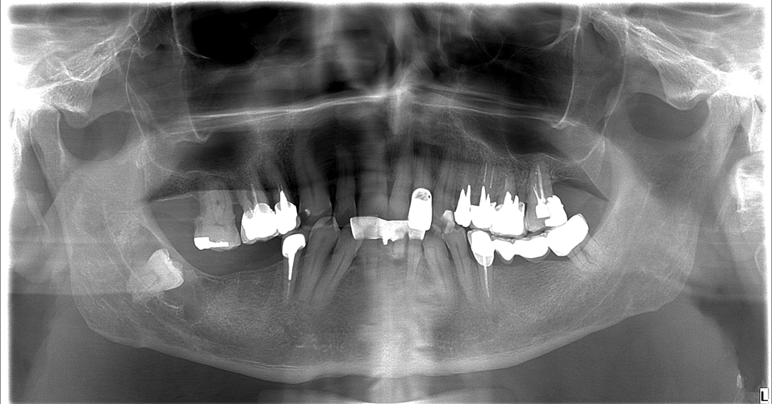
Male 38* - without problems, OPG in prevention

Slide 34
Folicular cyst
They arise spontaneously in the crown area from a supernumerary or regular tooth due to irritation
They fit on the cemento - enamel border and surround the entire crown

Slide 35
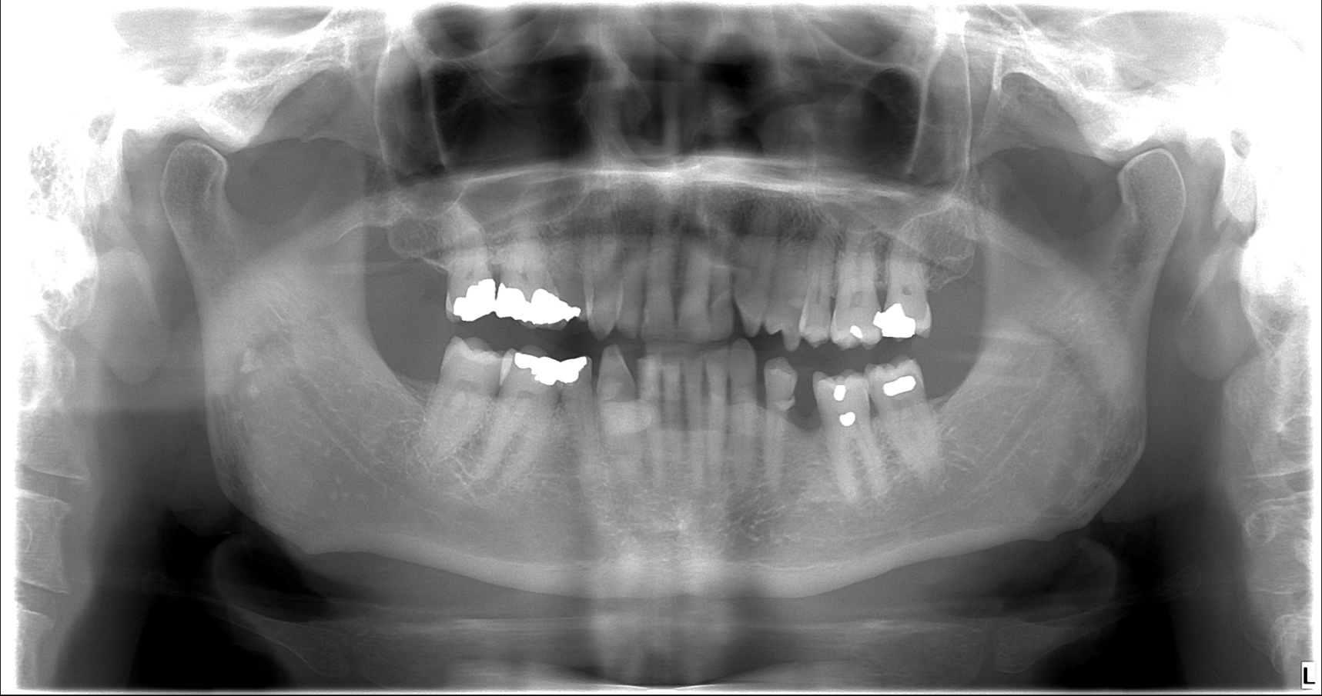
Male 58* – without problems, OPG within prevention

Slide 36
Flebolits or sialolithiasis behind the lower yaw angle

Slide 37
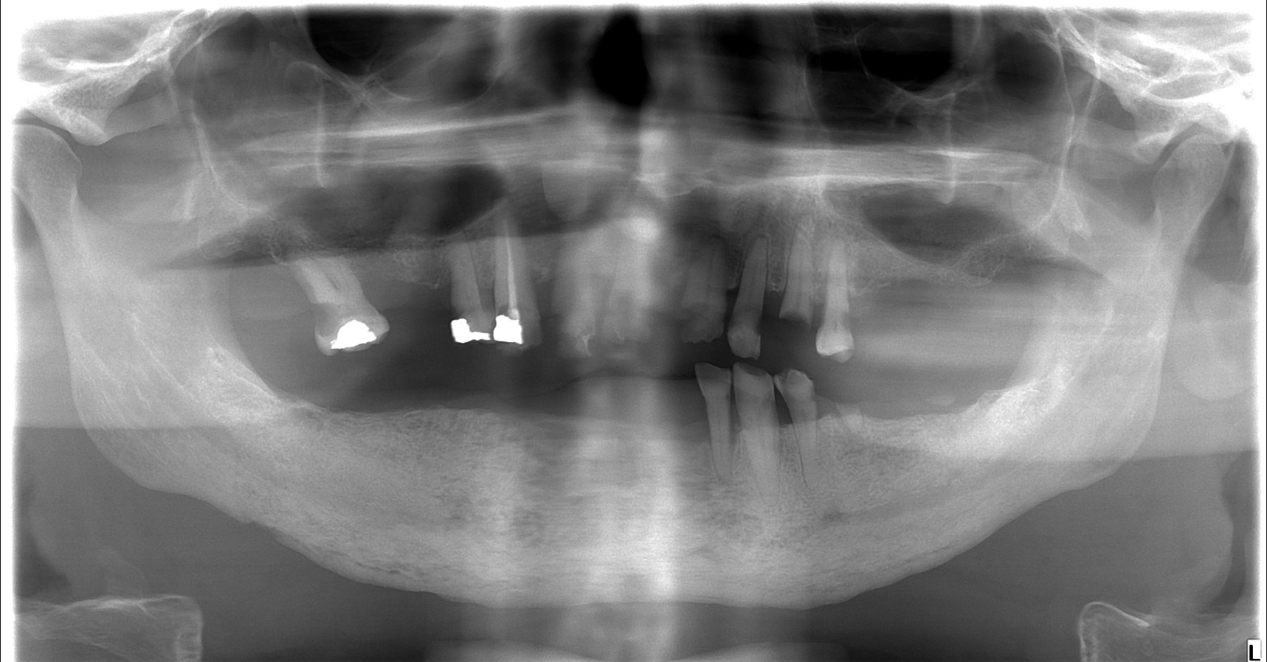
male 67*
Sent to dentist for edema of right side of lower jaw to incision. The swelling lasts about 4 days. About 9 months ago there was tooth extraction. Further treated by a dentist for pain, however, pain did not stop after extraction.

Slide 38
residual teeth in III. quadrant of lower yaw and in the upper jaw - caries
Osteolysis and sclerotic changes of lower yaw.
Osteomyelitis with absces

Slide 39
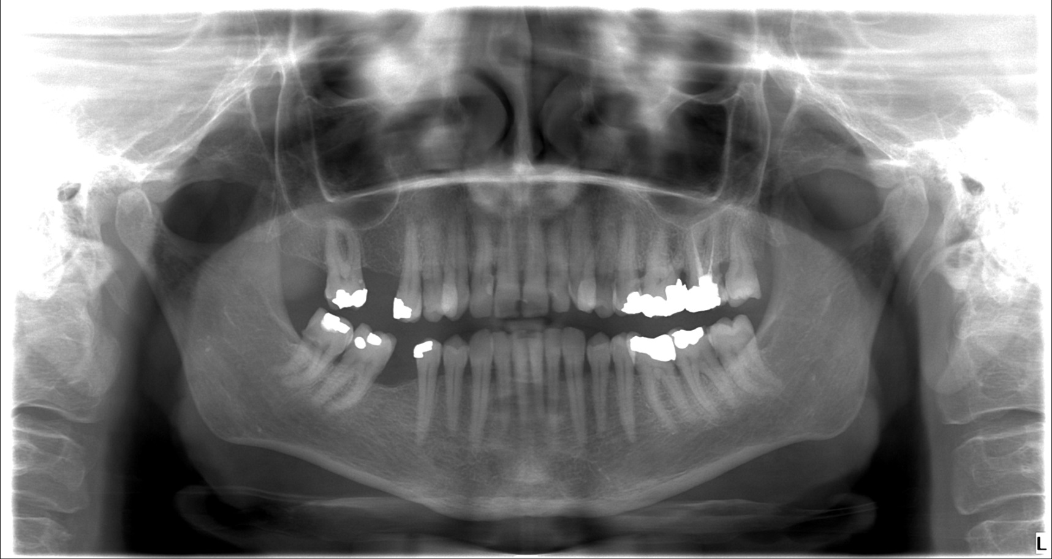
female 67* – fall from the bike

Slide 40
No trauma

Slide 41
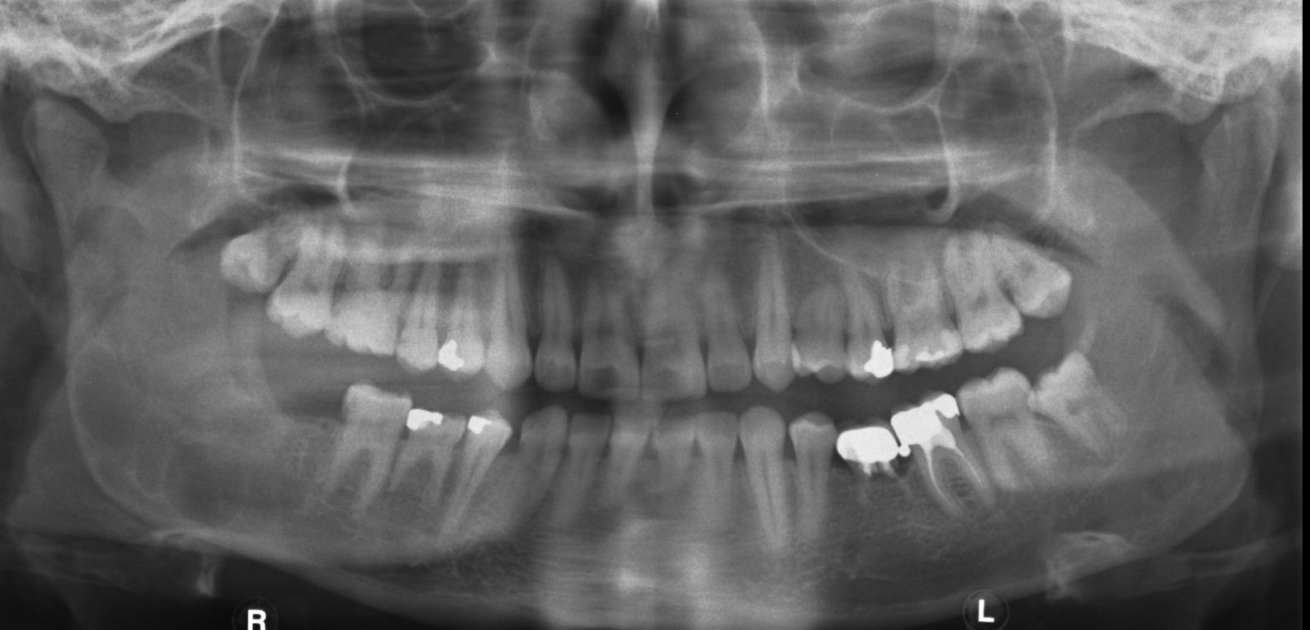
Male 89* – OPG within prevention

Slide 42
Histology: Keratocyst
Keratocyst is a benign but locally aggressive developmental cystic neoplasm. It most often affects the posterior mandible

Slide 43
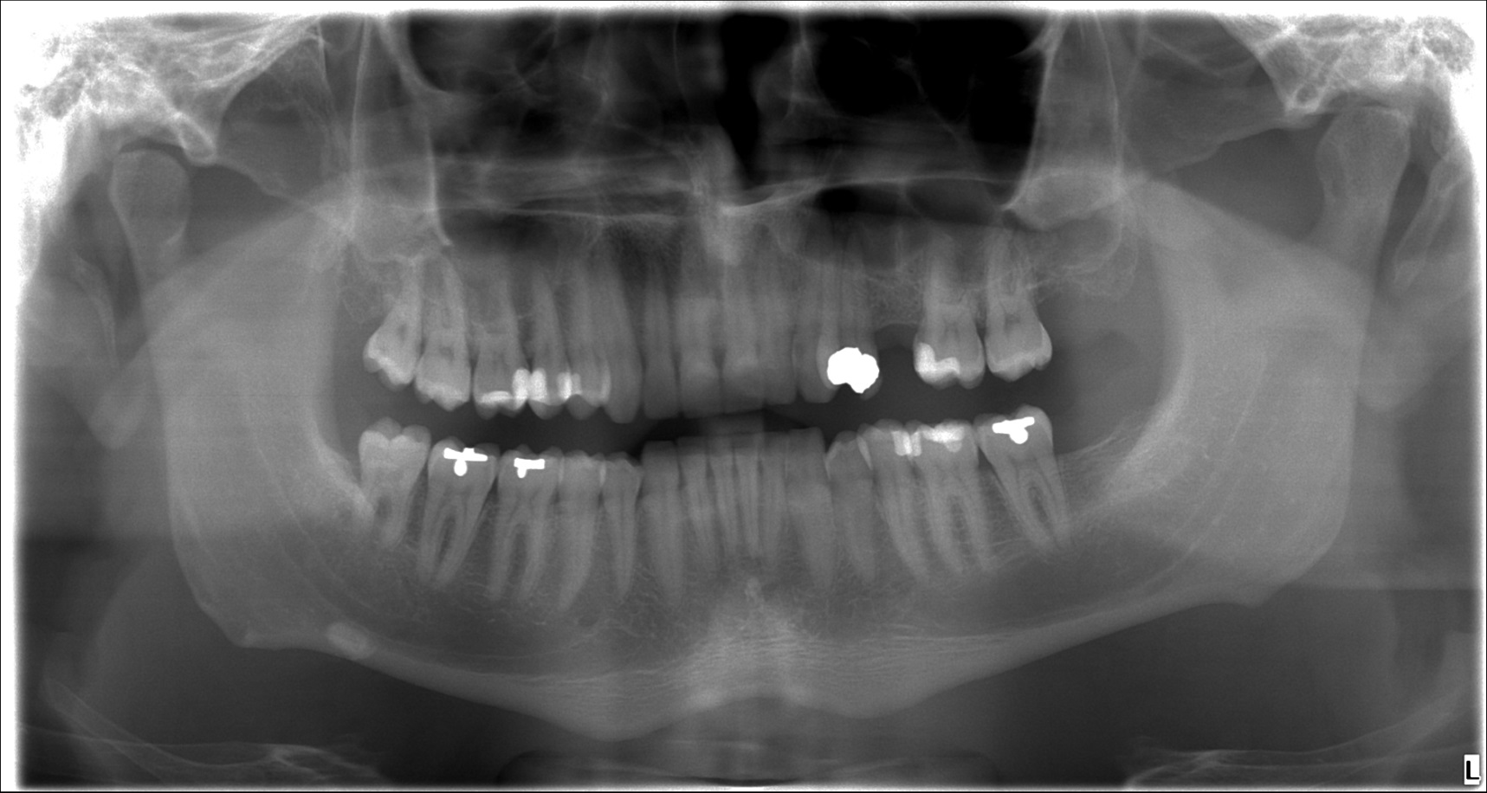
Male 90*

Slide 44
Sialolithiasis in Wartin duct.
Sialoadenitis purulenta

Slide 45
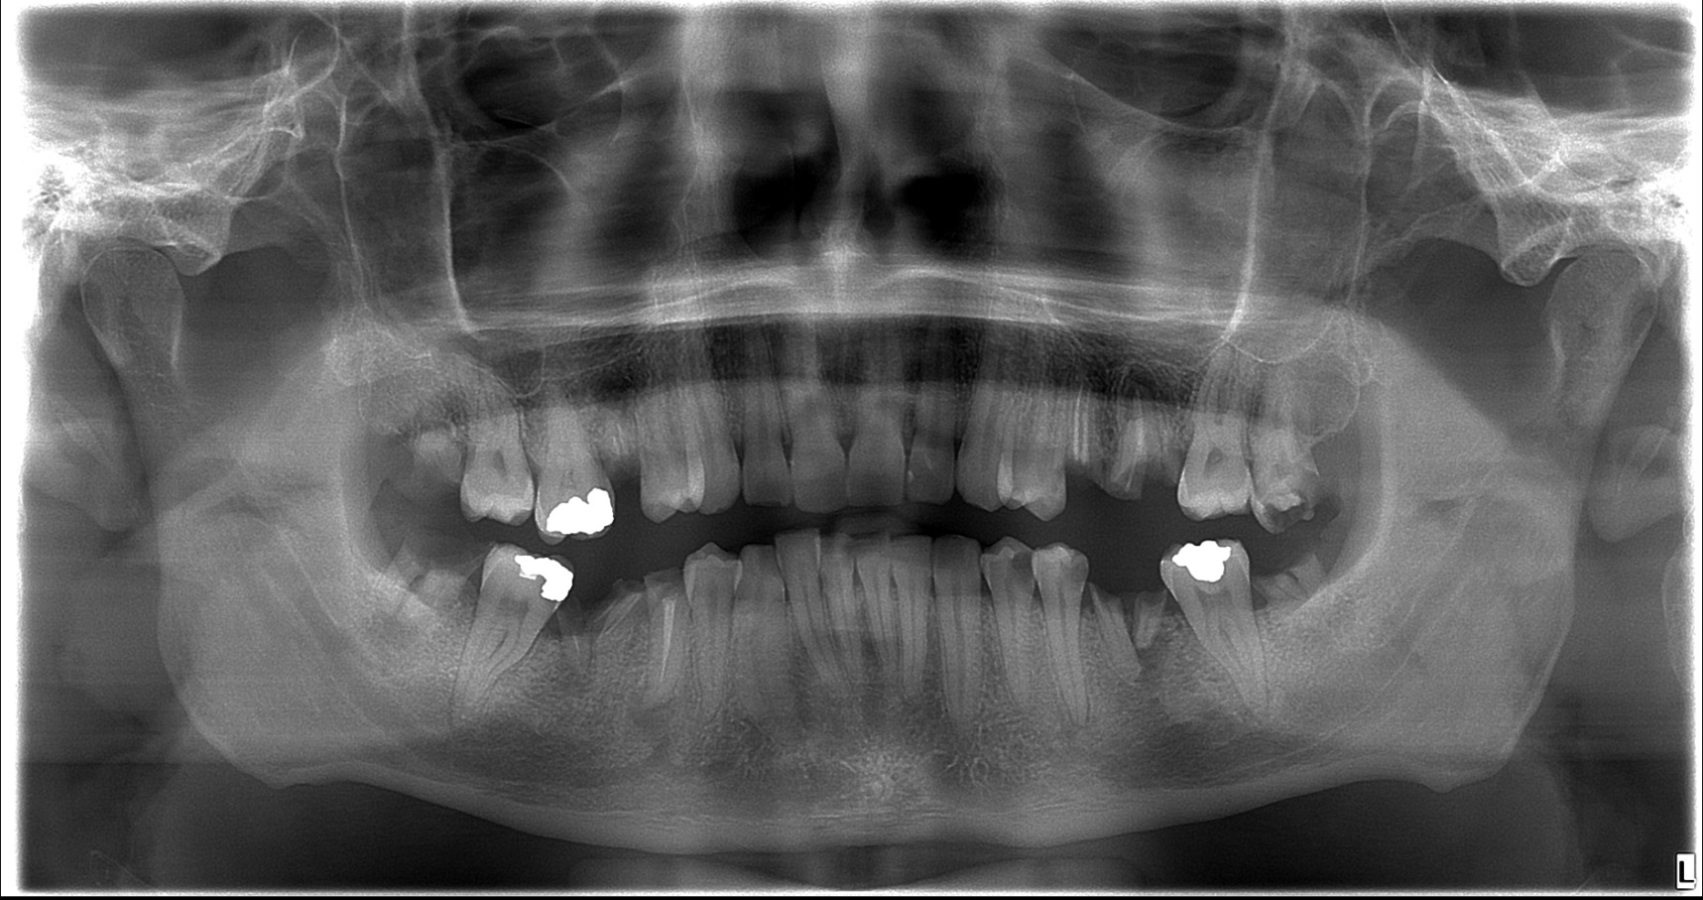
Male 87* – headache

Slide 46
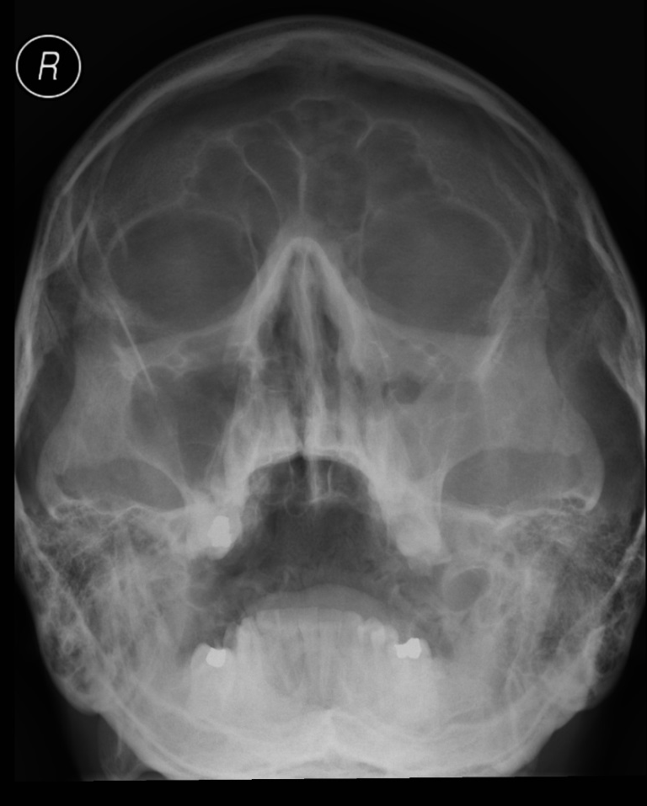
Sinusitis maxillaris, numerous focuses in the oral cavity

Slide 47
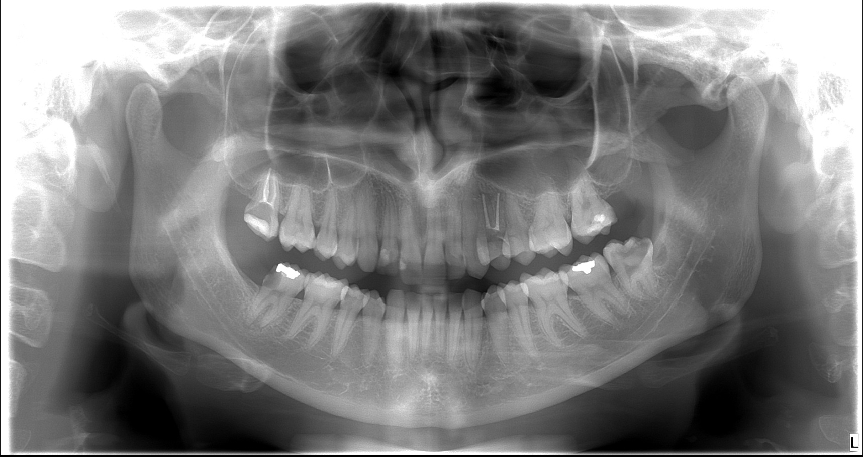
Female 94* – pain in lower right area

Slide 48
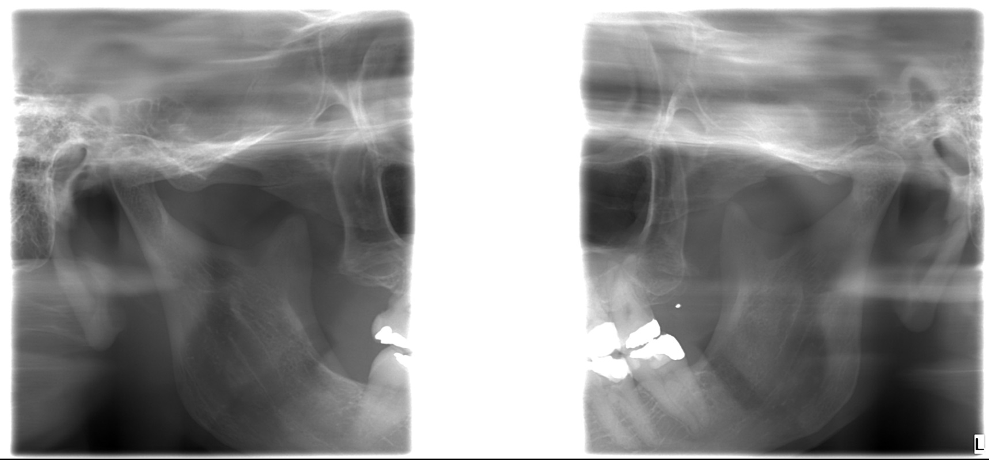
Pain of ATM - female 70*

Slide 49
