Slide 1
Reformatory education

Slide 2
Reform education - history
At the beginning of 20th century – period of educational movement full of suggestions, ideas, tendencies, inspirational thoughts and practical experience
New education – change of European school and its way of work
1921 – International League for New Education

Slide 3
Main features of reformatory education
Pedocentrism (child-centered pedagogy): education is completely conformed to interests and needs of a child
Respect of the individualization principle – supposes methodological work with using various material according to various children and their learning styles, needs, interests...
Project method – integration of subjects into organized units; projects corresponding to real life situations
Independence and activity principle

Slide 4
Reformatory education in Europe and the USA
International League for New Education: publication of journals; international meetings; acceptation of several principles and aims:
Education should try to keep and encourage children‘s spiritual energy, respect children‘s individuality
Universal education should be an opportunity for realization children‘s natural interests in aesthetical, intellectual and social activities
Competiton should be replaced with cooperation
The human being should be aware of its dignity thanks to education

Slide 5
Common features of famous educators (Comenius, Rousseau, Pestalozzi, Tolstoy):
The aim of education is harmony of body, intellect, emotions, will and acts
Education should be important for individual and social life
School should be a part of sociality
Pupils responsible for their education
Social education (education of children of different ages)
Teaching using illustrations, demonstration...

Slide 6
Ellen Key (Swedish; 1849 – 1926)
Supports freedom, emancipation and rights of women
Children should grow up in family environment

Slide 7
John Dewey (American; 1859-1952)
An educational philosopher, psychologist and writer was a leading voice for progressive education
Believed that classrooms were too rigid and inflexible, did not adapt to needs, interests, and abilities of individual students
Believed schools should place a greater emphasis on the development of problem solving and critical thinking skills
Promoted the link between learning and experience
Due to his influence schools today:
Collaborative learning on projects and discussing topics
Role of teacher as guiding learning
Real life activity that linked new information to previous experiences

Slide 8
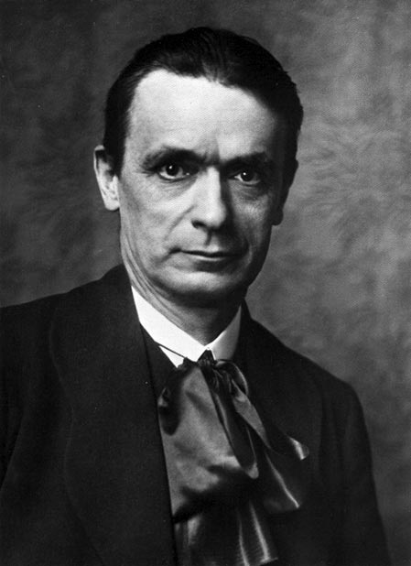
Rudolf Steiner (German; 1861-1925)
The base of his pedagogical conception is anthroposophy
School represented as free, universal, supporting individual talent and creativity of children

Slide 9
Maria Montessori (Italian; 1870-1952)
Italy’s first female doctor, tried to find ways to help children who had difficulty learning
Believed that young children are capable of great discovery and motivated to explore the world.
Sensory experiences should come before learning to read and write
Developed the Montessori method
Considers all of a child’s needs, not just intellectual
Classrooms are stimulating environments
Many opportunities for large and fine-motor development and sensory exploration, along with language, science, art, geography, and math
Children direct their own learning with teachers as partners
Teachers encourage children to judge their own progress and choose own interests

Slide 10
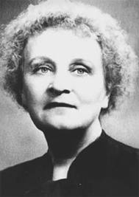
Helen Parkhurst (American; 1887-1959)
Dalton conception
Independence, freedom, cooperation

Slide 11
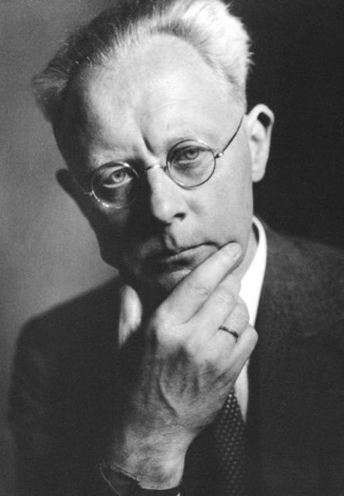
Peter Petersen (German; 1884-1952)
Jena plan
School live in their own community
Children should cooperate, old children help the younger ones

Slide 12
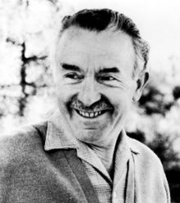
Célestin Freinet (French; 1896 – 1966)
Founder of modern working school
Connection of school with life, physical and psychical work, pedagogical cooperation of pupils and teacher and teachers between each other

