Slide 1
EXPLORING INSECTS LEARNING OUTSIDE THE CLASSROOM
Nataša Dolenc Orbanić, Ph.D.
Petra Furlan
University of Primorska,
Faculty of Education. Koper, Slovenia

Slide 2
LEARNING OUTSIDE THE CLASSROOM
An outdoor classroom is any outdoor space used for student exploration, inquiry and learning.

Slide 3
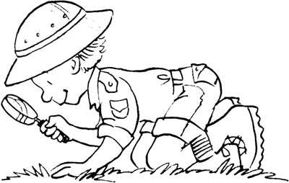
Where?
parks,
seashore,
woods,
meadows,
school grounds,
science museums,
zoos, …

Slide 4
Why?
increase motivation,
enhance learning,
personal development,
well being.

Slide 5
How?
5E Model of Instruction:
Engagement
Exploration
Explanation
Elaboration
Evaluation

Slide 6
Engagement
The purpose of the ENGAGE stage is to pique student interest and get them personally involved in the lesson, while pre-assessing prior understanding.
Anticipate activities and focus students' thinking on the learning outcomes of current activities. Students should become mentally engaged in the concept, process or skill to be learned.
During the ENGAGE stage, students make connections between past and present learning experiences.

Slide 7
Engagement – What do you know about insects?
Write a list of insects you have already known.
What do you think, how many different species of insects exist?
What do you think, which are common features of insects?
Where can we find insects?
Which are the body parts of insects?
How do insects developed?
What is the role of insects in the nature?
What do you want to know about insects?

Slide 8
Exploration
The purpose of the EXPLORE stage is to get students involved in the topic; providing them with a chance to build their own understanding.
They identify and develop concepts, processes, and skills.
During this phase, students actively explore their environment or manipulate materials.

Slide 9
Exploring insects
Find the common features of animals which you have in front of you and discribe them. Discuss with your group collegues.

Slide 10
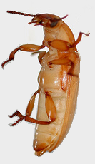
Exploring insects – body parts of grain beetle

Slide 11
Exploring insects – metamorphosis of grain beetle

Slide 12
Exploring insects – body parts of stick insect

Slide 13
Exploring insects – metamorphosis of stick insect

Slide 14
Explanation
This phase helps students explain the concepts they have been exploring.
They have opportunities to verbalize their conceptual understanding or to demonstrate new skills or behaviors.
This phase also provides opportunities for teachers to introduce formal terms, definitions, and explanations for concepts, processes, skills, or behaviors.

Slide 15
Elaboration
This phase extends students' conceptual understanding and allows them to practice skills and behaviors.
Through new experiences, the learners develop deeper and broader understanding of major concepts, obtain more information about areas of interest, and refine their skills.

Slide 16
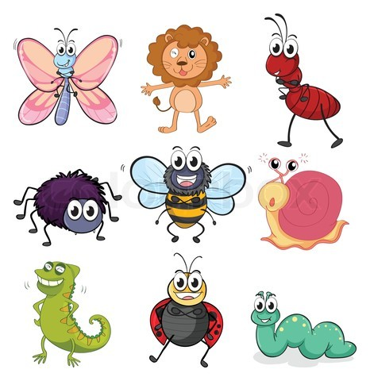
Elaboration – Are they insects or not?

Slide 17
Safety at work
Wear a long-sleeved shirt and long pants with boots.
Avoid contact with insect nests, swarming insects, and ant mounds.
Closely look for insects or insect activity before placing hands on objects.
Use insect repellants containing compounds such as DEET (repels insects) on exposed skin and permethrin (kills many insects on contact) on clothing only.

Slide 18
Safety at work
If your students experience an insect bite or sting, wash the wound with soap and water, apply an antiseptic, and cover the wound with a band aid or clean dressing. Carefully remove stingers from skin by using tweezers and then clean and dress sting wounds.
Inform your students that they never scratch an insect bite or sting.
Promptly seek professional medical attention if you suspect that someone are experiencing severe venom allergic reaction symptoms.
It is necessary to know in advance if your students are allergic to insect bites or stings, so you can respond appropriately if they are bitten or stung.

Slide 19
Evaluation
The purpose for the EVALUATION stage is for both students and teachers to determine how much learning and understanding has taken place.
This phase encourages learners to assess their understanding and abilities.
Teachers evaluate students' understanding of key concepts and skill development.

Slide 20
Evaluation
What was the most interesting thing you learned about insects?

Slide 21
Thank you for your attention

