Slide 1
Puritanism
The haunting fear that someone, somewhere, may be happy (H. L. Mencken)
Puritanism, in whatever expression, is a poisonous germ. On the surface everything may look strong and vigorous; yet the poison works its way persistently, until the entire fabric is doomed. (Emma Goldman)

Slide 2
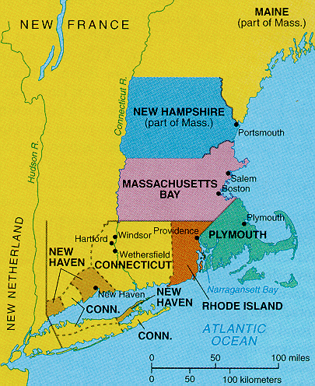

Slide 4
Characteristics of Puritanism
reaction against Catholic and Anglican theology
salvation (spása) by: grace, not faith (Luther) or works (Catholic)
Predestination (předurčení), not free will (svobodná vůle)
original sin (prvotní hřích)
the “elect” (vyvolený)

Slide 5
Mayflower

Slide 6
John Winthrop: “city upon a hill”

Slide 7
Seal of Plymouth Plantation

Slide 8
New England Primer

Slide 9
New England Primer alphabet

Slide 11
Increase and multiply

Slide 12
Thomas Smith, Self Portrait (1680)

Slide 13
John Freake, c1671

Slide 14
Elizabeth Freake and baby Mary

Slide 15
Detail from the Van Bergen overmantel Attributed to John Heaten (active 1730-1750) Leeds, New York, 1730-1745 Oil on wood New York State Historical Association

Slide 16
Lydia Hart, Boston 1744

Slide 17
Connecticut, c1660

Slide 18
Massachusetts, 1634

Slide 19
Tombstone art

Slide 22
Salem witch trials

Slide 23
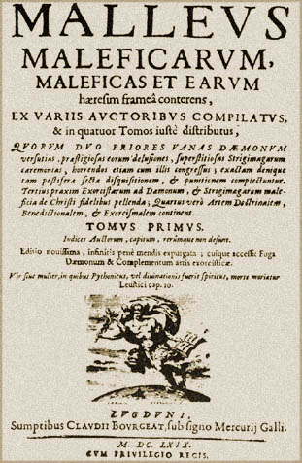

Slide 24
From Cotton Mather’s book on witch hunting, 1692

Slide 26
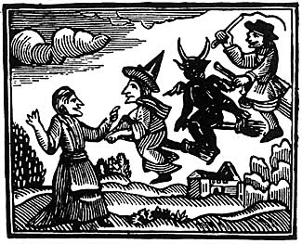

Slide 27
The June 10, 1692 hanging of Bridget Bishop

